Slide 1


Customer Value
Proposition

Slide 2
AGENDA
Why Solar?
Who is Windmar?
How does it work?
How does your system work?
Maintenance & Warranties
Frequently Asked Questions
Next Steps

Slide 3

WHY SOLAR?

Slide 4



REASONS TO BELIEVE IN SOLAR
Lock in:
Fixed prices
Lower price for your future utility bills
Protect yourself against rising energy costs.
Transition to:
Renewable energy
Long-term solution
A source with no more harmful emissions
Capitalize on:
Government incentives of 30% tax credit
100% property tax exemption
Utility Prices
Clean Energy
Benefits

Slide 5



TRENDS POWERING OUR INDUSTRY
New Construction
Solar mandatory in some Florida counties
Lennar communities including solar panels
Solar Surge
5k+ Families per month transitioning to solar in Florida
Cost of Living
Rising utility costs
Inflation
Cost of oil
Self-Sufficiency
Climate change
Reliability (i.e., Tesla battery)
EVs

Slide 6
POSITIVE OUTCOME ON ELECTRIC BILL
Replace your fluctuating and rising electric bill with a low-cost payment.

Slide 7
KILL THE BILL

Slide 8
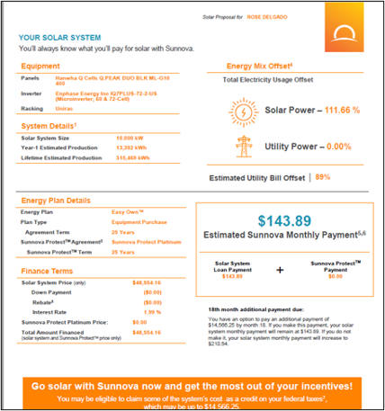
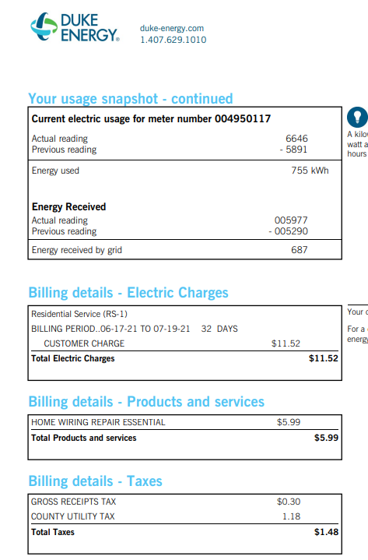
No Tiered Pricing
No crazy fees
No crazy taxes
KILL THE BILL

Slide 9
WHO IS WINDMAR?

Slide 10
WINDMAR TIMELINE
Founded for Large Projects
Established operations in Florida
2015
Future
Launched Residential Division
Expanding into other
US States
2002
2017

Slide 11
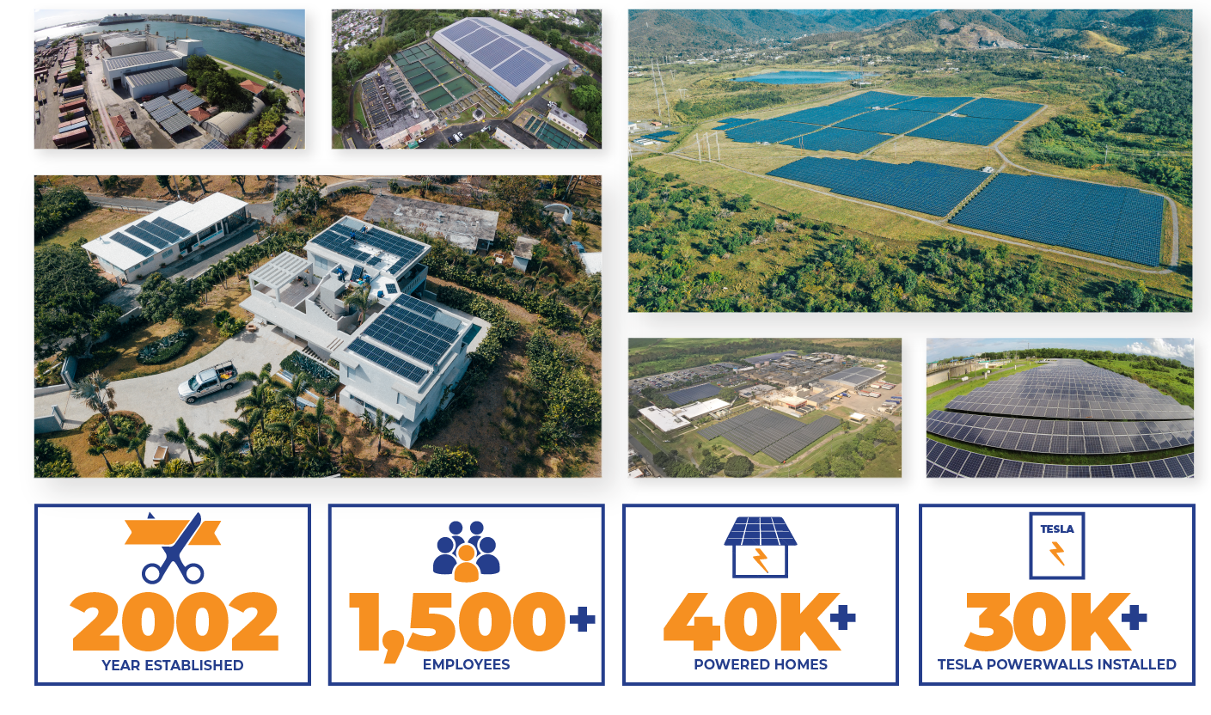
  Largest Renewable Energy Company in Puerto Rico
  Top 5 Solar Contractors in Florida

Slide 12



WHAT DO WE OFFER?
Provide a stable and clean alternative to your home & become self-sufficient.
Set a fixed fee for your utility bill. Have a seat at the negotiating table for electric costs.
A long-term solution to your energy needs, including 25-year warranties.
PROTECTION
LOW COST
SOLUTION

Slide 13
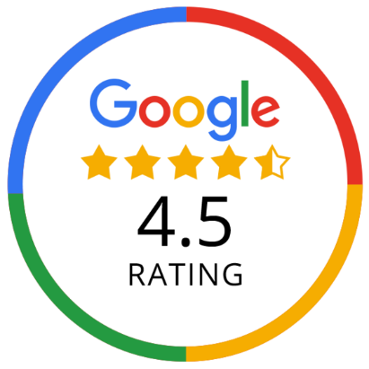
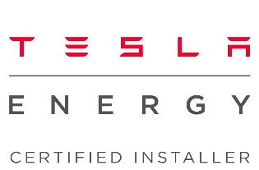
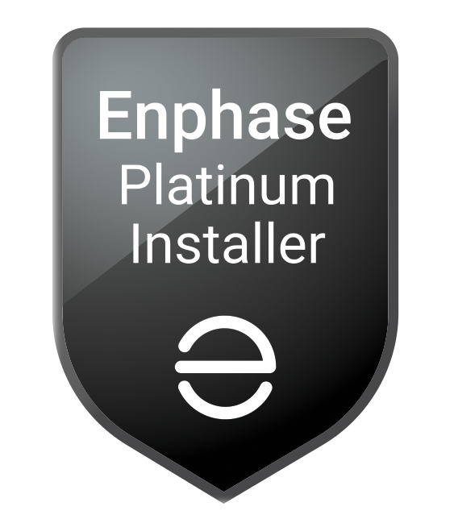
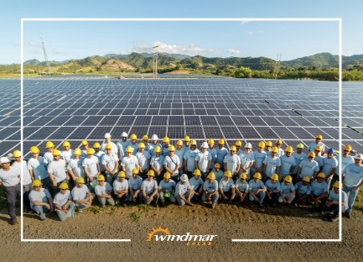






WHAT SETS US APART?
Customer Service
Warranties & Services
State & Federal Certifications
Exclusive Financing
Notes:
We set you up for SUCCESS!!!

Slide 14
HOW DOES IT WORK?

Slide 15
REQUIREMENTS TO GET STARTED
Qualify
Bill Change Understanding
Tax Benefits
What you & Windmar need to take care of

Slide 16
QUALIFY TO OBTAIN A SYSTEM
01
Homeowner
02
Roof space and condition
03
Monthly electric bill of $100+
04
Credit score of 650+
05
Savings or checking acct.
06
Valid email address

Slide 17

MULTIPLE BENEFITS
Savings on monthly payments.
Controlled, steady, reliable payments
Comfort & ease, Windmar handles everything
Savings on monthly payments
Does NOT compromise your payment
Does NOT create a lien on your property
You don't have to manage financing

Slide 18
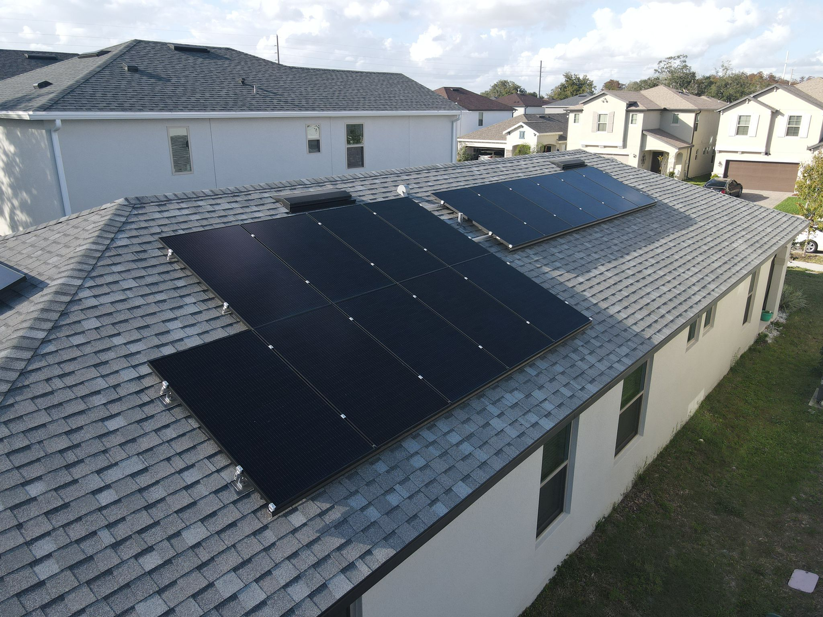

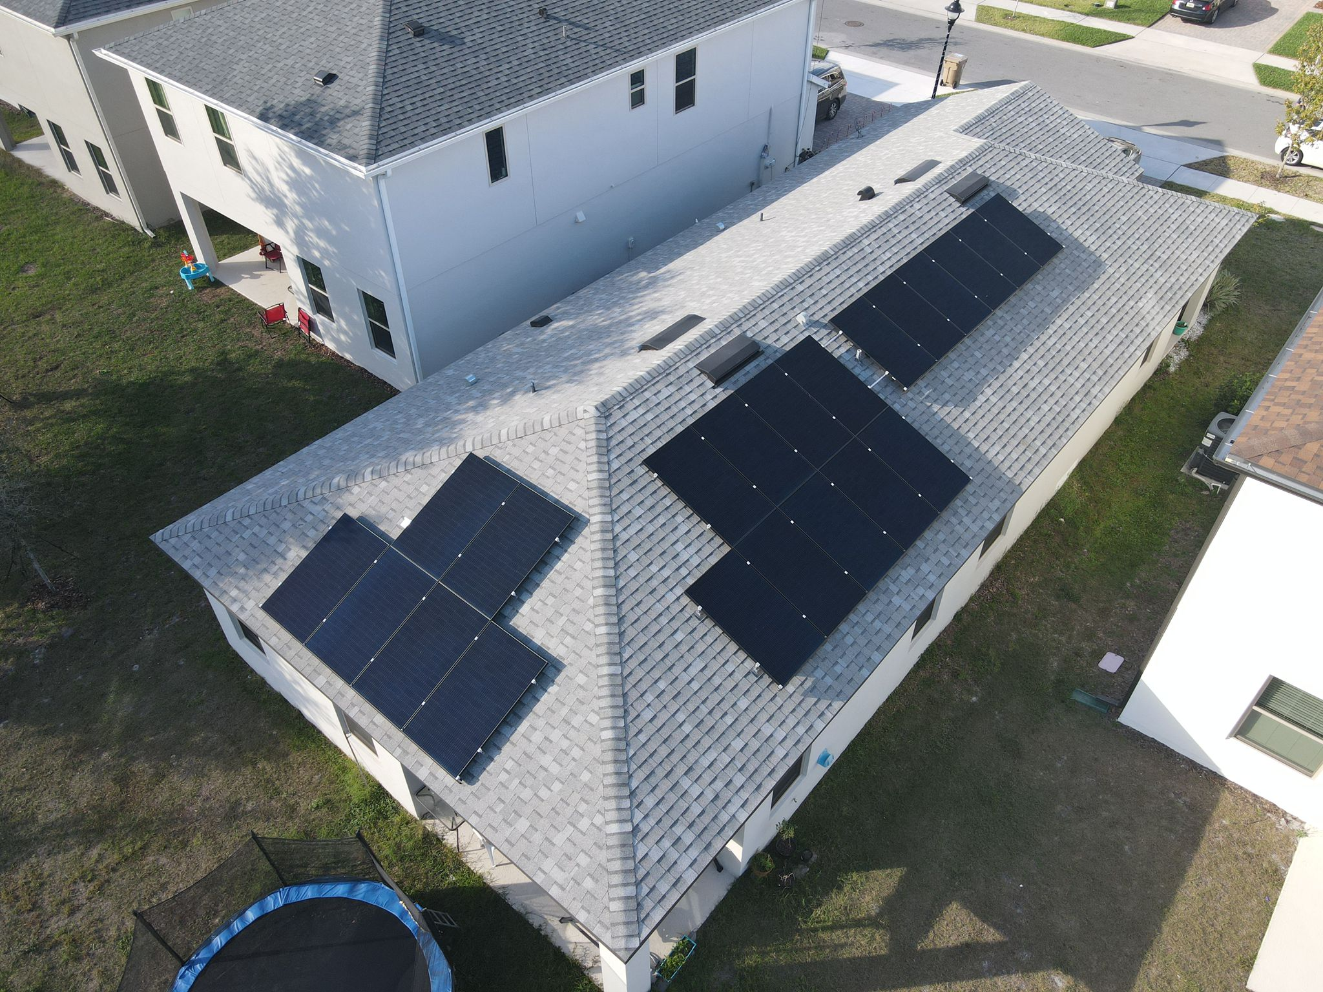
OUR RESPONSIBILITY
The entire installation
Permitting
Equipment Maintainance
System Monitoring
Liability and Eqipment Insurance
Notes:
Windmar Solar will take care of your install from start to finish, from the engineering plan, permitting, and install

Slide 19

TAX CREDIT
makes all of the investment
You DO NOT need to take out a loan
The system cost is not shown on your credit
The savings from the tax credit recieved by Sunnova is passed to you in the form of a cheaper kWh rate

Slide 20

INCREASE THE VALUE OF YOUR HOME
Transfer the system and its benefits to the new owner
Transfer the system to your new residence*
Pay the system cost in full & sell the house with the value of the system included
Notes:
You may choose from these options.

Slide 21

NET METERING BENEFITS
Generate electricity
Export excess power to the grid
Receive credits on utility bill
This allows utility customers to generate their own electricity cleanly and efficiently.
Moreover, it allows you to export that power to the grid and reduce your electric bills.
Notes:
Net metering is an electric billing tool that uses the electric grid to “store” excess energy produced by your solar panel system. Under net metering, the energy produced by your solar panels that you don't use is credited back to you.
Net metering is a billing arrangement that allows residential and commercial customers who generate their own electricity from renewable energy sources to receive credits on their utility bills for any excess electricity they export back to the grid.

Slide 22
HOW DOES YOUR SYSTEM WORK?

Slide 23
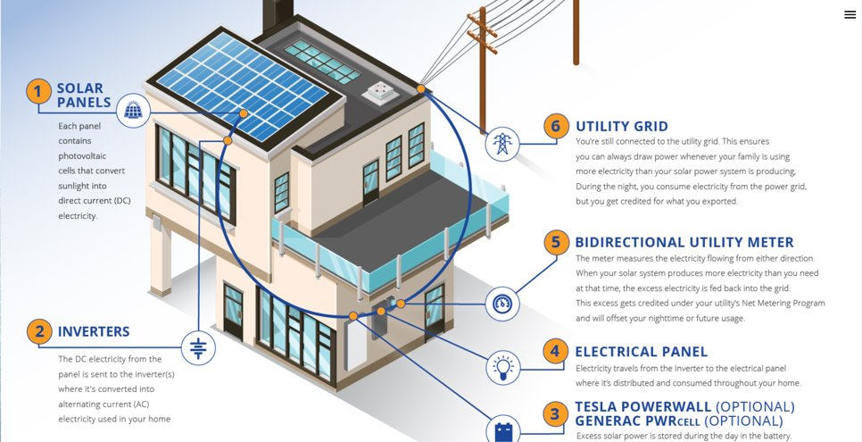
HOW DOES A SOLAR SYSTEM WORK?

Slide 24

OUR BATTERIES
Tesla Powerwall 2.0
13.5kWh storage capacity
NMC battery type
10 yr standard manufacturer warranty
25yr additional Warranty through Sunnova

Slide 25
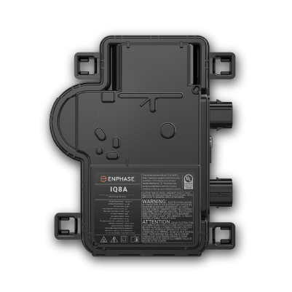

OUR INVERTERS
Enphase IQ7A
Capable of inverting 295-465w
Connects with Enphase Enlighten monitoring app
25 yr Warranty
Produces in AC current
Notes:
We use the most efficent type of inversion system available on the market.
This converts DC to AC power

Slide 26
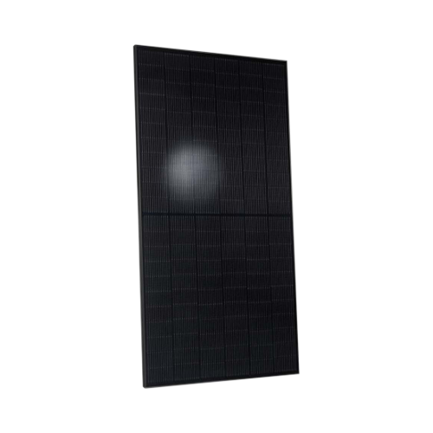

OUR PANELS
Highest performance Tier 1 panel
QCELL 400w
Monocrystalline
132 Split Cell
25 yr warranty
30+ yr Lifespan
Produces
in DC current

Slide 27
MAINTENANCE & WARRANTIES

Slide 28
MAINTENANCE
Replacement of parts or solar panels
Equipment replacement or repair
Monitoring 24/7
The system includes preventive maintenance & equipment insurance

Slide 29

WARRANTY
Every Year of the contract agreement
10 year roof penetration warranty included
25 years of parts on all equipment
Exclusions
Unauthorized Repairs
Non-Compliance

Slide 30
FREQUENTLY ASKED QUESTIONS

Slide 31

WHAT HAPPENS IF I CONSUME MORE POWER THAN EXPECTED?
If you use more than estimated, you will be charged the utilities kWh rate
Sunnova can increase your system size if needed (2nd contract)
Average

Slide 32
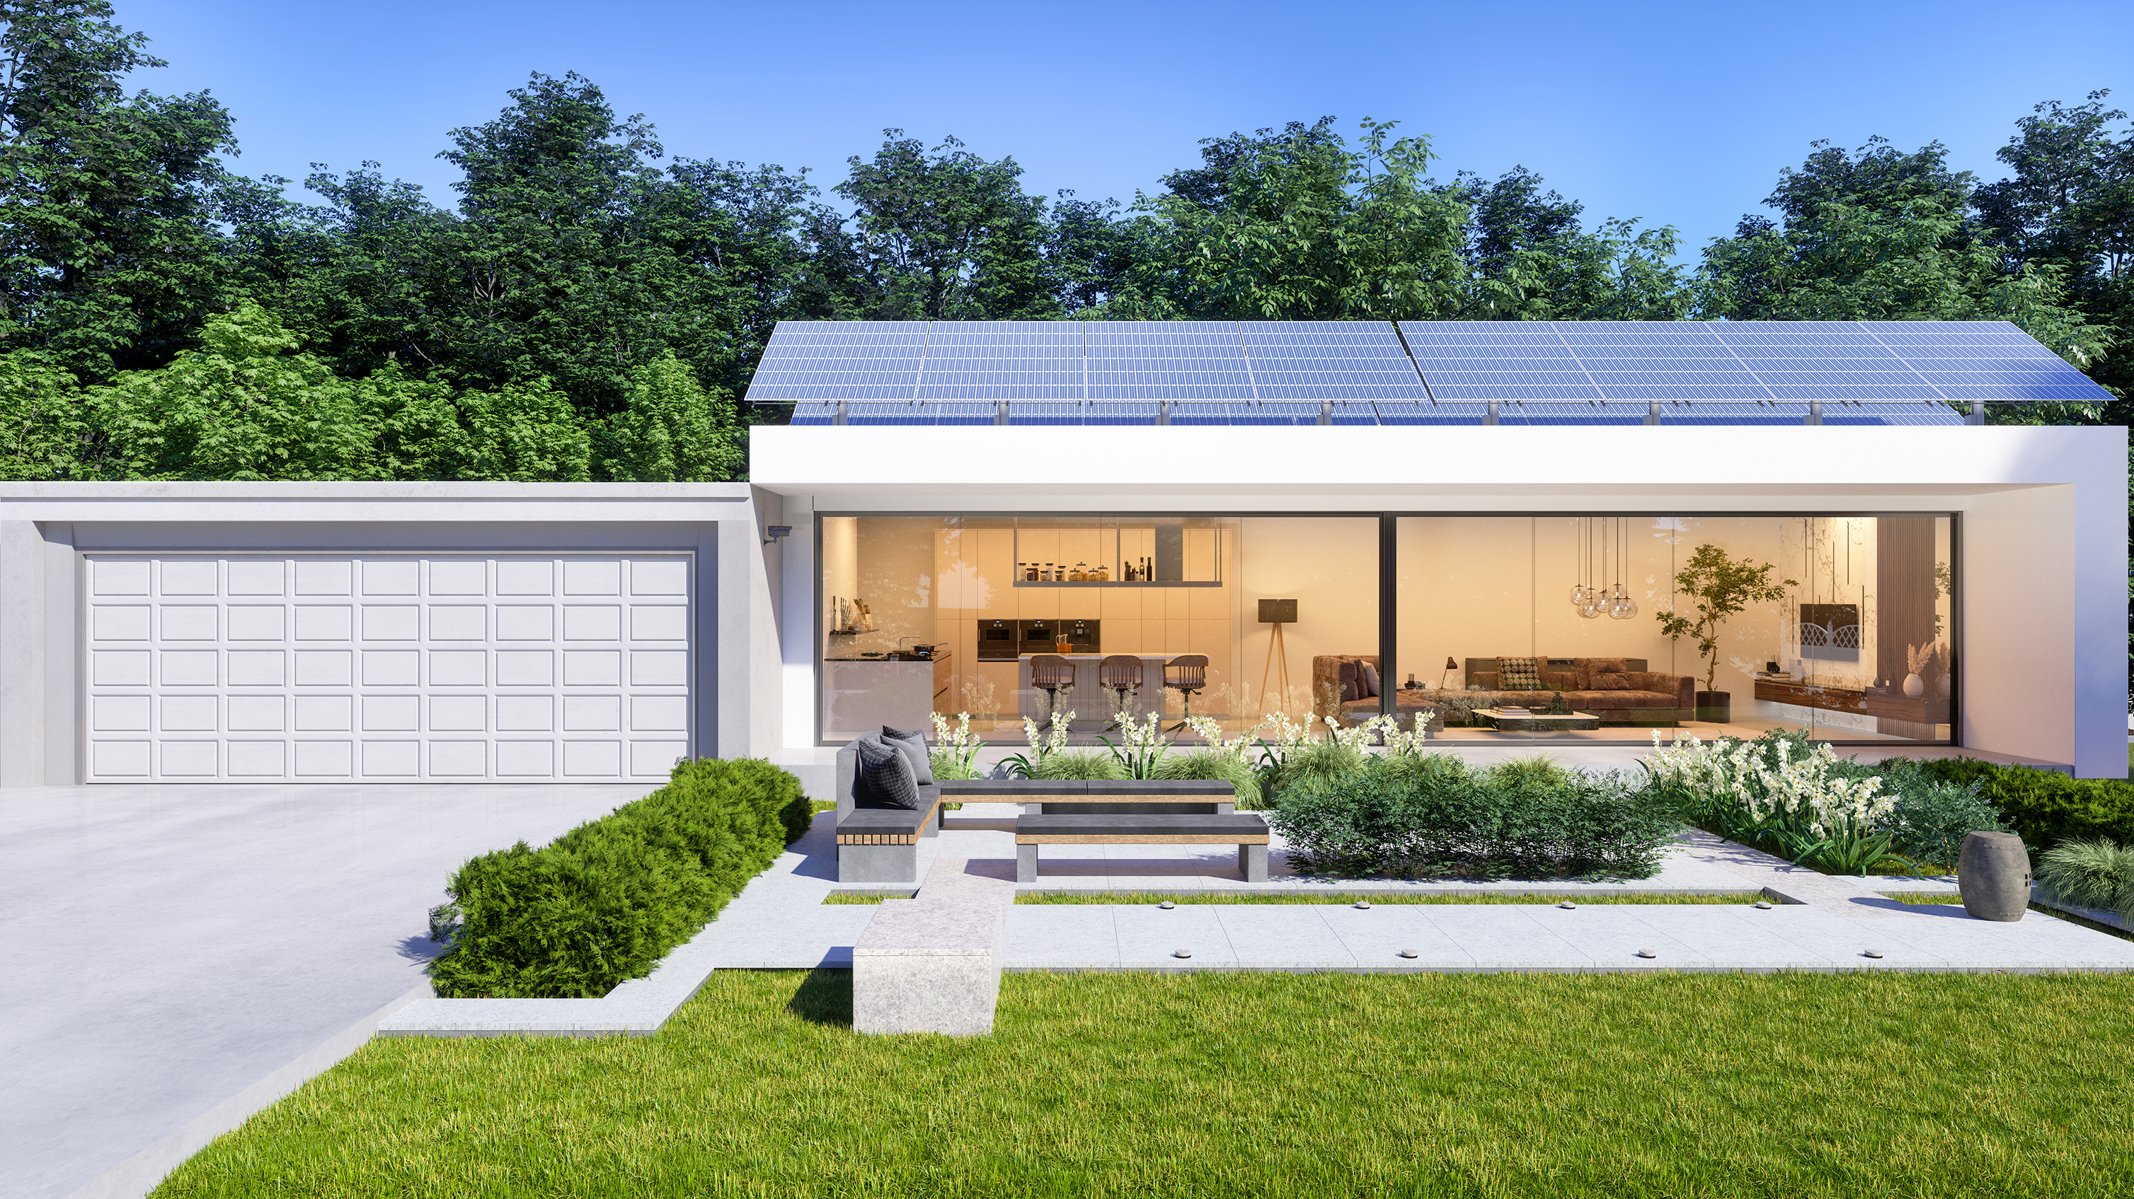
WHAT IF I WANT TO BUY THE SYSTEM?
You may purchase the system after 5 years
No penalties
Cost at market price

Slide 33


SECURITY OF THE AGREEMENT
We will complete a 25 year service agreement where all these commitments are laid out clearly and precisely.
Security of a fixed price!

Slide 34
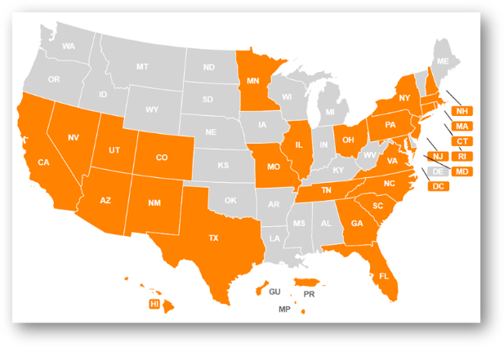
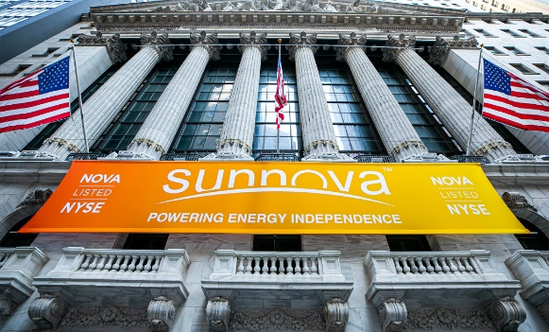

SECURITY OF SUNNOVA
245,00+ systems installed in the US
Publically traded on the NYSC
Solar Energy Service Provider

Slide 35

CAN I EXTEND THE AGREEMENT?
YES
For a period of 5 years
For a second period of 5 years
You can keep the system if you’d like to

Slide 36
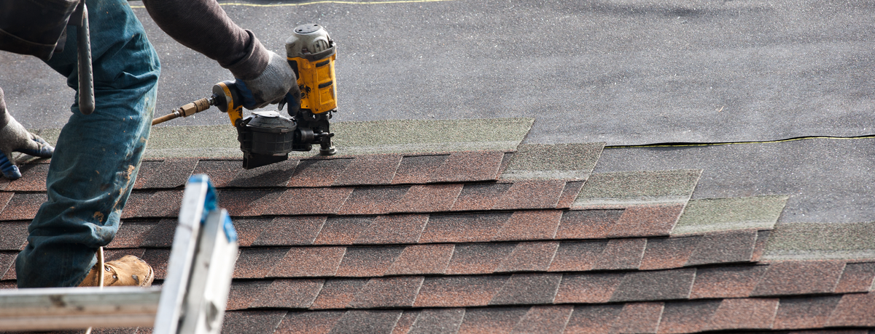
CAN I WORK ON MY ROOF?
You will need to request the panels to be removed temporarily, in which case you would incur in additional costs.

Slide 37
NEXT STEPS

Slide 38


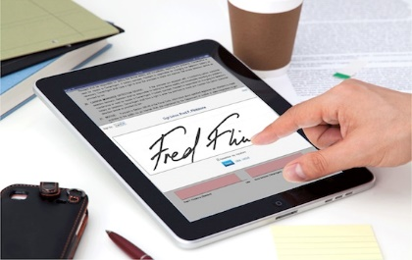

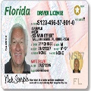
NEXT STEPS
Answer any other questions
Qualify you through Catalyst
Present the Purchase Agreeement
Photo ID and Electric Bill

Slide 39
NEXT STEPS
Arrange site visit
Engineering Design
Permits
Installation
Permission to operate from the utility provider
Notes:
Coordinate site visit.
Engineering Team will design your system.
Permits request
We will install the system on your roof. A city inspector will validate system.
The utility company will replace the meter and turn on the system
Install time is estimated for 45 to 90 days*

