Slide 1
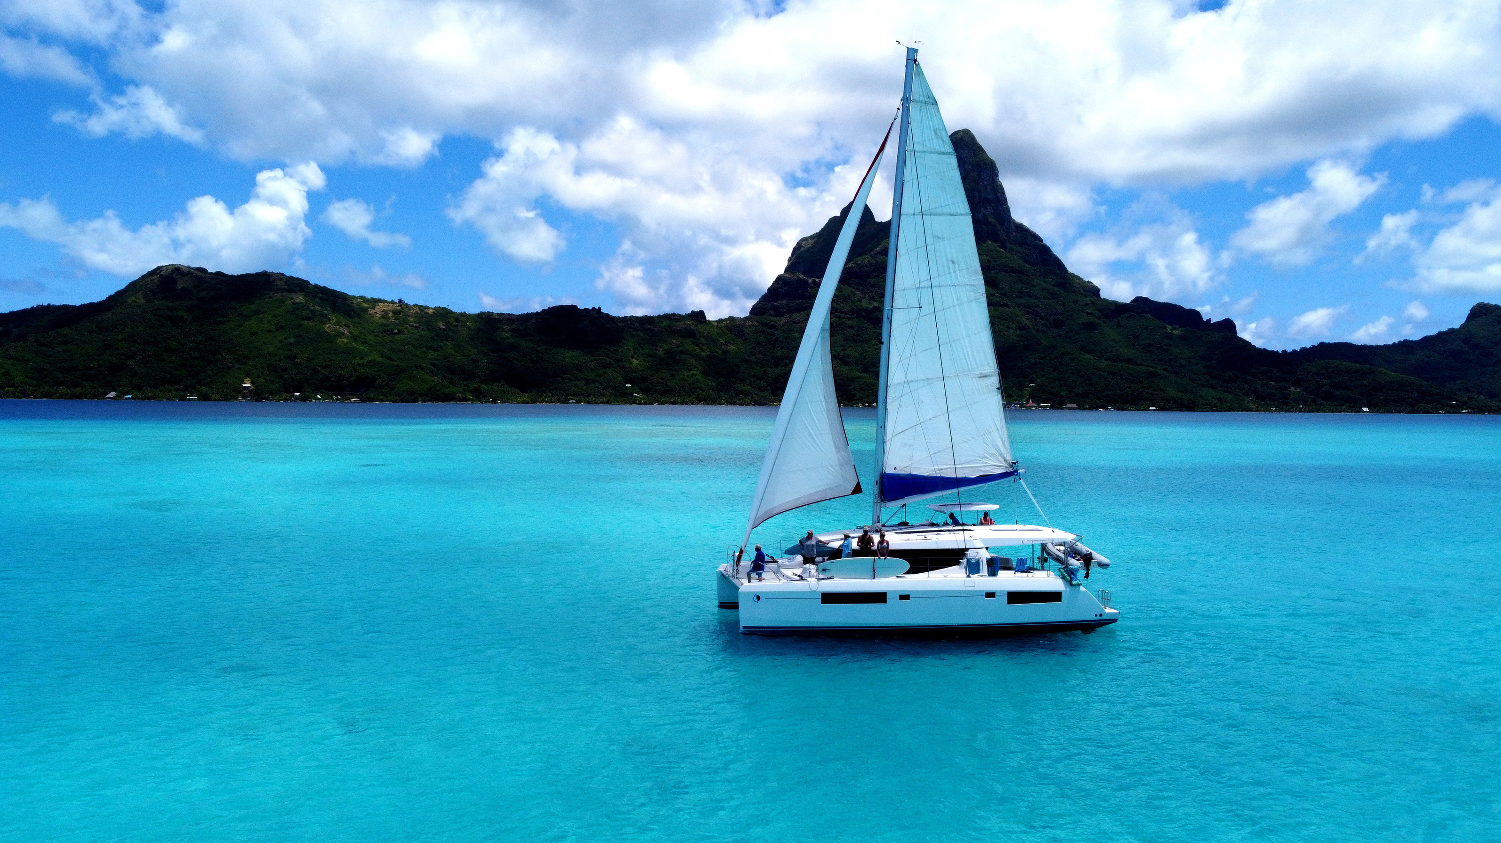


PRESENTED BY
SHARE THE SAIL
TAHITI, FRENCH POLYNESIA
APRIL 25TH - MAY 2ND

Slide 2
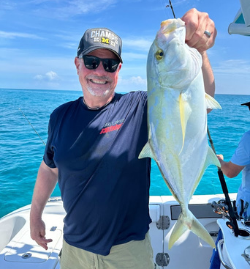
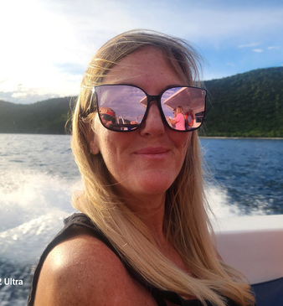
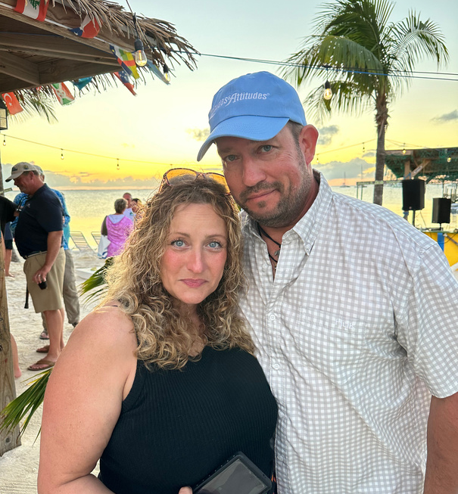
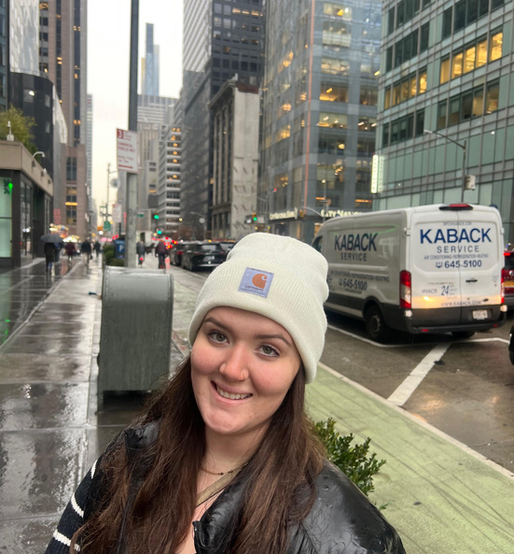
OUR CREW MEMBERS
+
Erik
+
Melanie
+
David & Karen
+
Zoe
Project Manager
Marketing
Party Organizers
Customer Service
BORCELLE

Slide 3
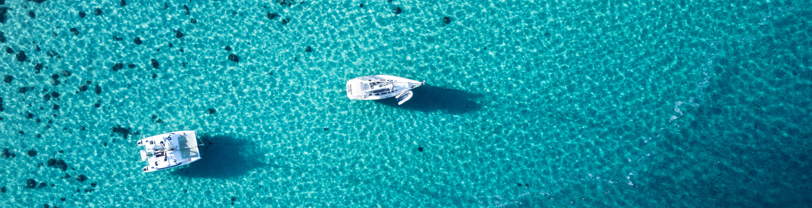
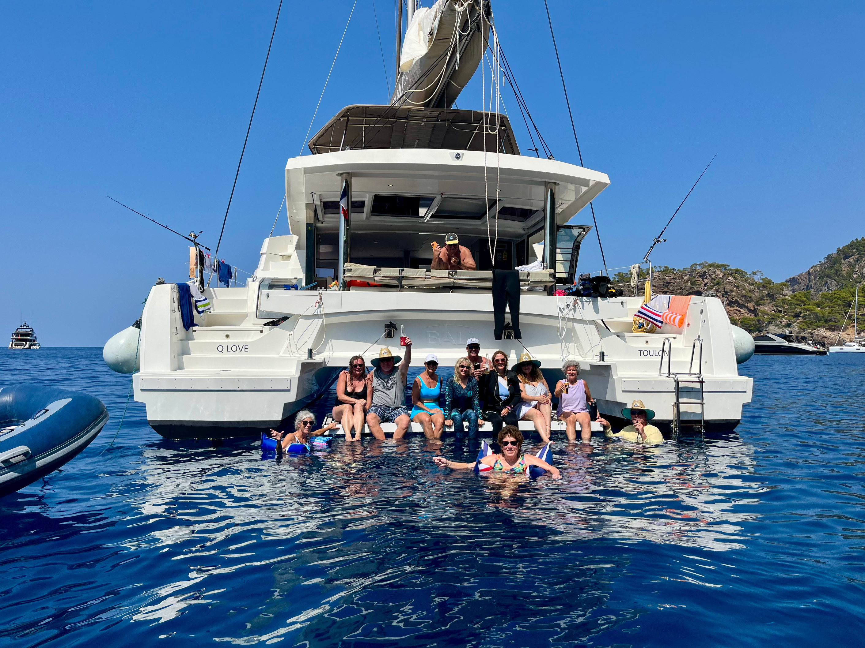
Share the Sail is a hosted sailing experience by Latitudes & Attitudes Magazine that brings like-minded adventurers together to explore bucket-list destinations by boat. Each trip is fully organized, captained, and designed to make you feel like part of a floating community—no sailing experience required. From provisioning to planning, we handle the details so you can relax and enjoy the ride. Whether you're traveling solo, as a couple, or with friends, you’ll leave with new skills, unforgettable memories, and lifelong connections.
About Us

Slide 4

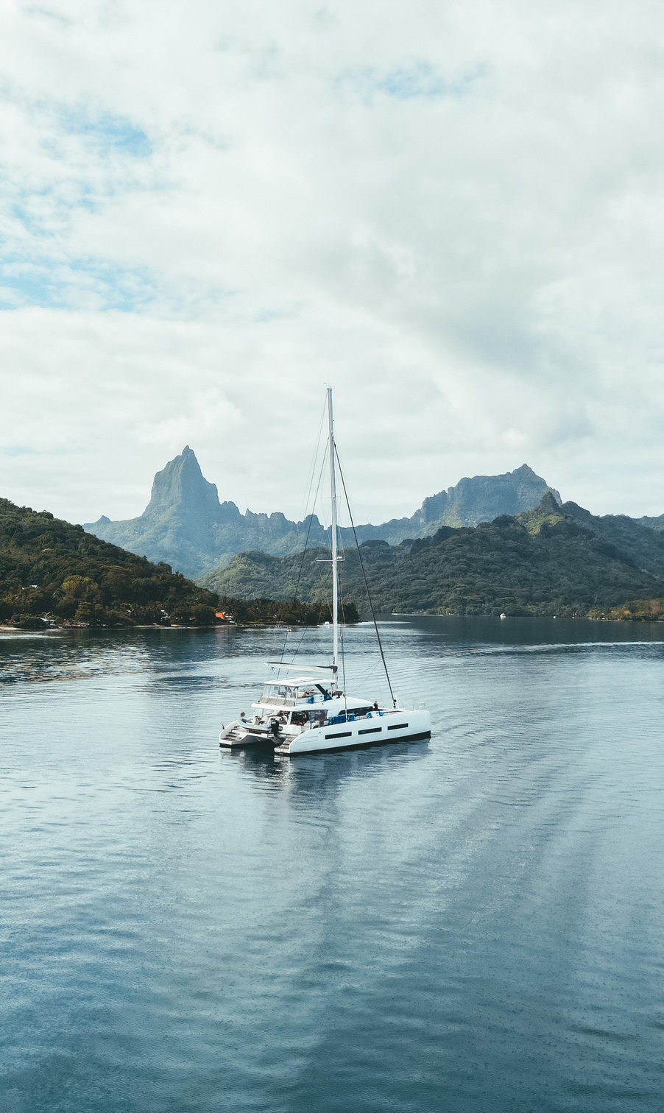
why tahiti?
Stunning Natural Beauty
Tahiti and the islands of French Polynesia are famous for their turquoise lagoons, dramatic volcanic peaks, and pristine coral reefs. Sailing here means every anchorage looks like a postcard.
Ideal Sailing Conditions
  Steady trade winds provide reliable sailing without extreme conditions.
  Short passages between islands make it easy to hop from one paradise to another.
  Protected lagoons offer calm, crystal-clear anchorages perfect for swimming, snorkeling, and paddleboarding.
Thriving Coral & Marine Life
French Polynesia’s waters are teeming with life — tropical fish, manta rays, sea turtles, and dolphins. The coral reefs are among the healthiest in the Pacific, offering some of the best snorkeling and diving in the world.
2.

Slide 5

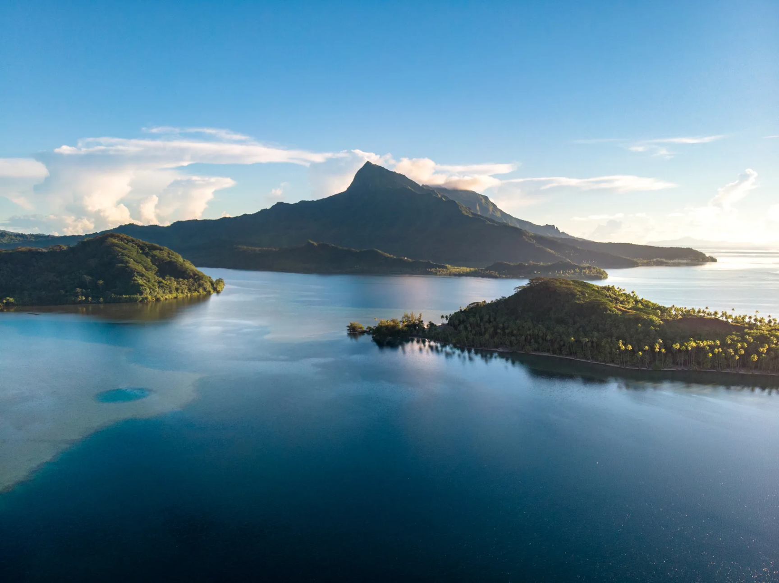
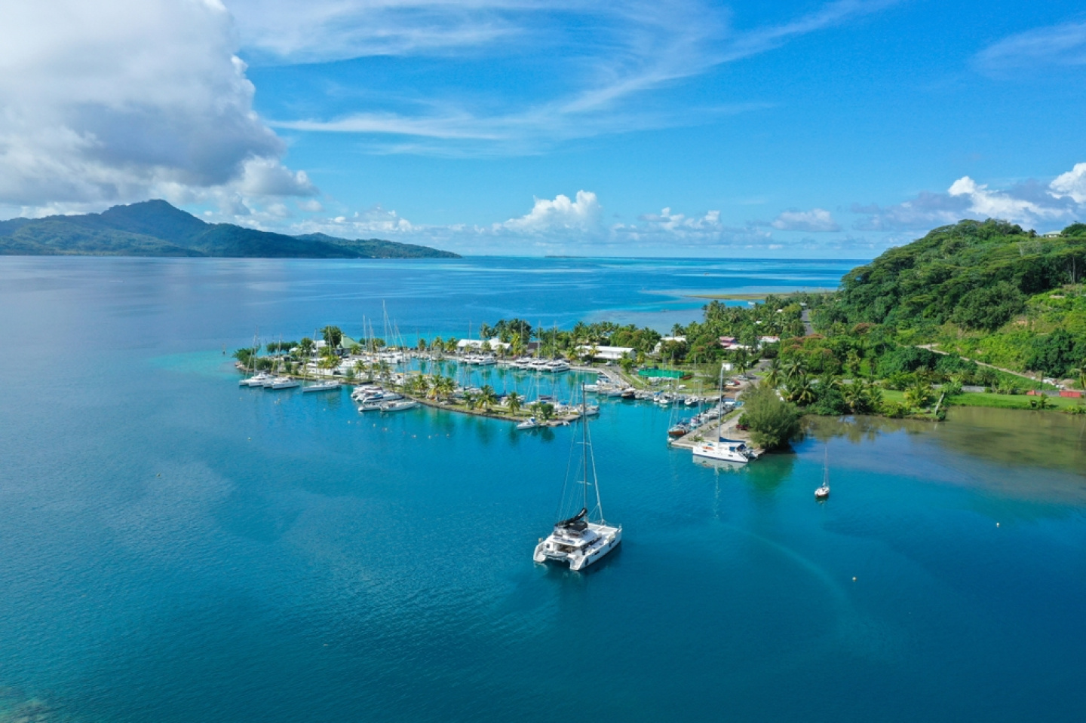
Pre-trip information
Fly from the U.S. to Papeete
Fa'a'ā International Airport (PPT)
Pronounced: PAH-pay-EHT-ee
  Direct flights available from:
    Los Angeles (LAX)
    San Francisco (SFO)
Take a Connecting Flight to Raiatea
  Book with Air Tahiti or Air Moana
  Raiatea’s airport code: RFP
Arrival Timing Tips
  Arriving early in the day? You can connect to Raiatea the same day
  Arriving later? Plan to overnight in Papeete
Hotel Options
  Many options in Papeete (great for layovers)
  Fewer options in Raiatea — book early if you plan to stay before or after the trip

Slide 6
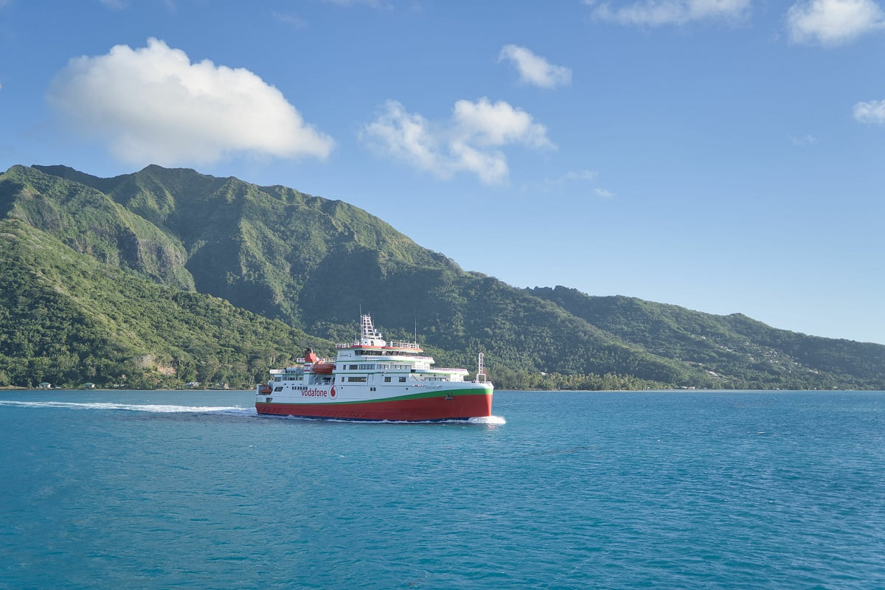
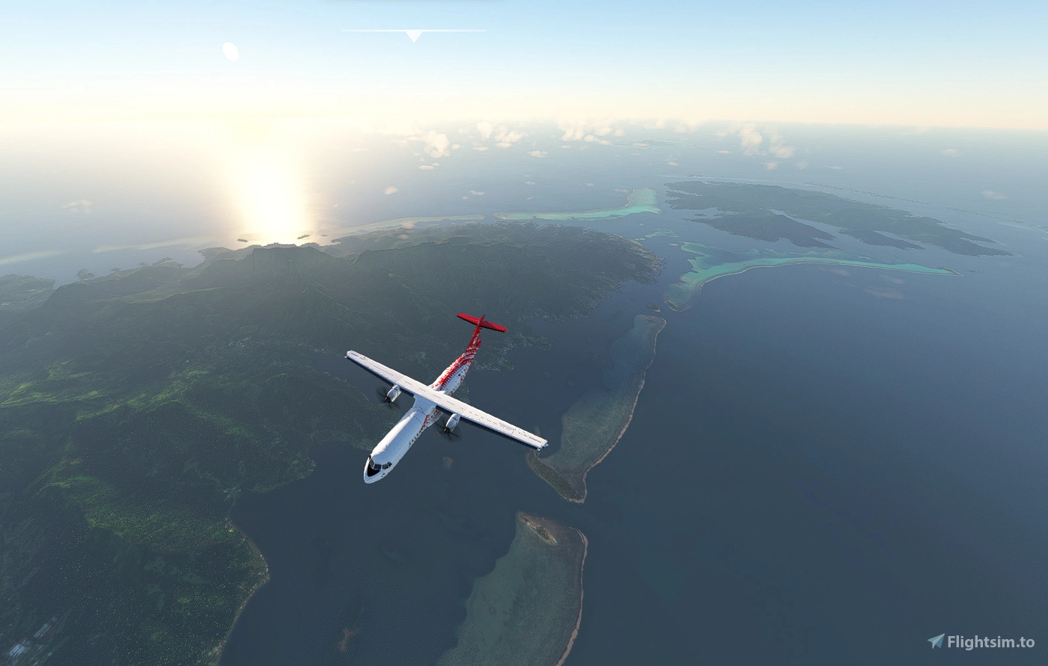
How to get to Raiatea
By Plane
Air Tahiti or Air Moana
  ~50-minute flight
  Approximately $350 round trip
  5–6 flights per day from Papeete (PPT) to Raiatea (RFP)
Fastest and most common option
By Ferry
  Travel via Tahiti → Huahine → Raiatea
    Tahiti to Huahine: ~3 hours
    Huahine to Raiatea: ~1 hour
  Total time: 4.5 hours
  Cost: ~$175 round trip
  Ferry days: Monday, Thursday, Saturday only
Note: Ferries are less frequent and take longer—best for those extending their stay.

Slide 7
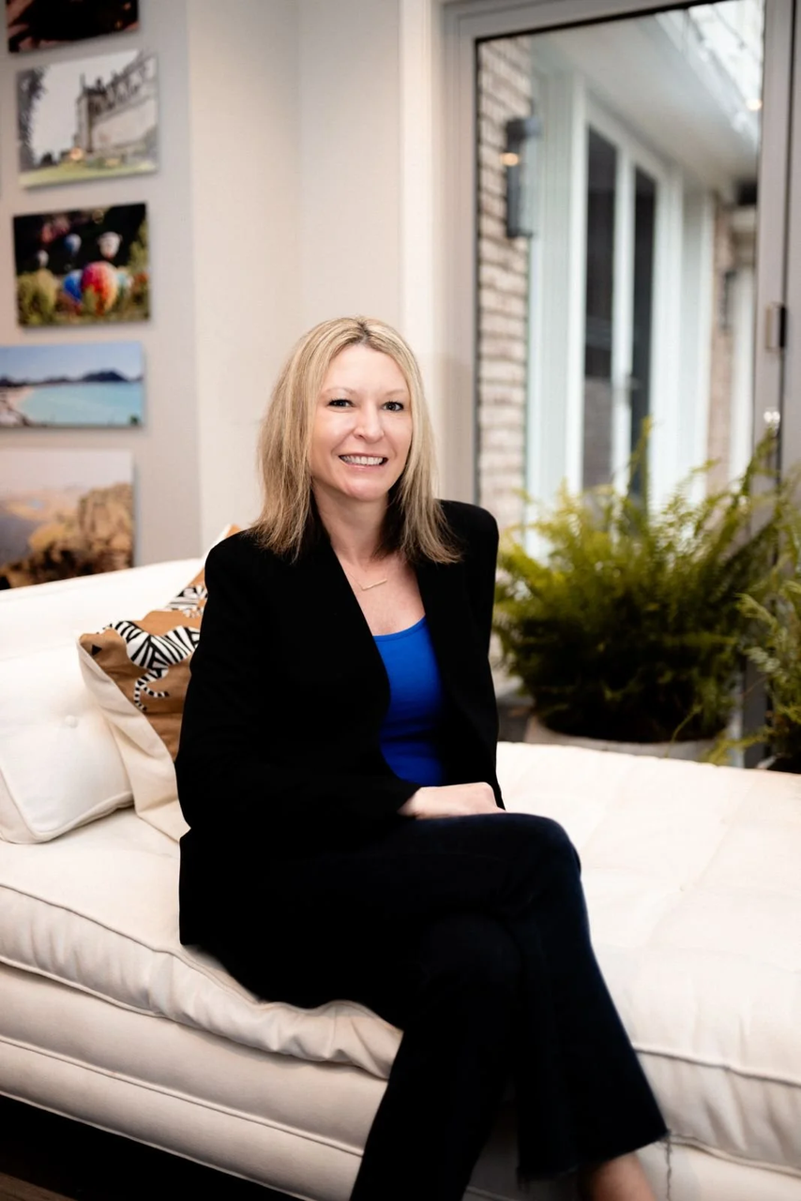
Travel Agent
Anne Studer with VLX Travel
  anne@vlxtravel.com
  216-496-9991
Can Assist With
  Flights
  Pre or Post trip hotels
  Travel Insurance

Slide 8
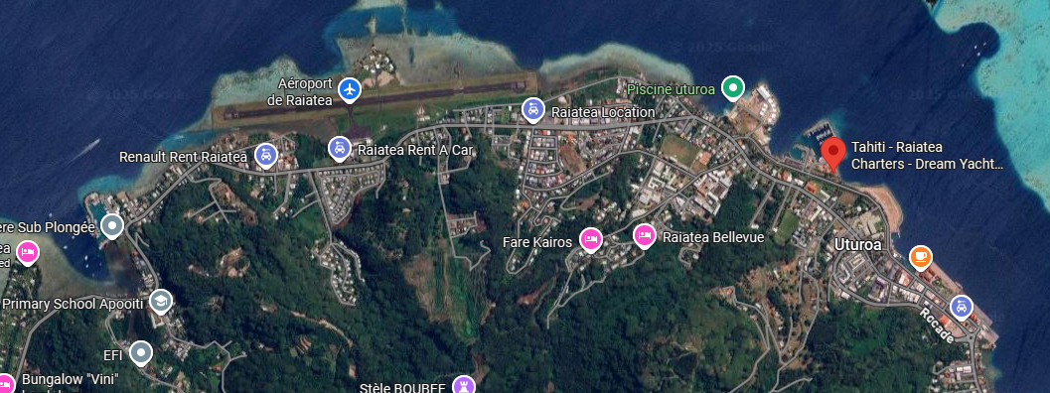
Raiatea
  Base is just a 10-minute taxi ride from the airport
  Several grocery stores are within walking distance of the marina
Once you land at Raiatea Airport, it's a quick and easy transfer to the Dream Yacht Charter base. Stock up on snacks, drinks, and last-minute items before setting sail—everything you need is close by in the town of Uturoa.

Slide 9
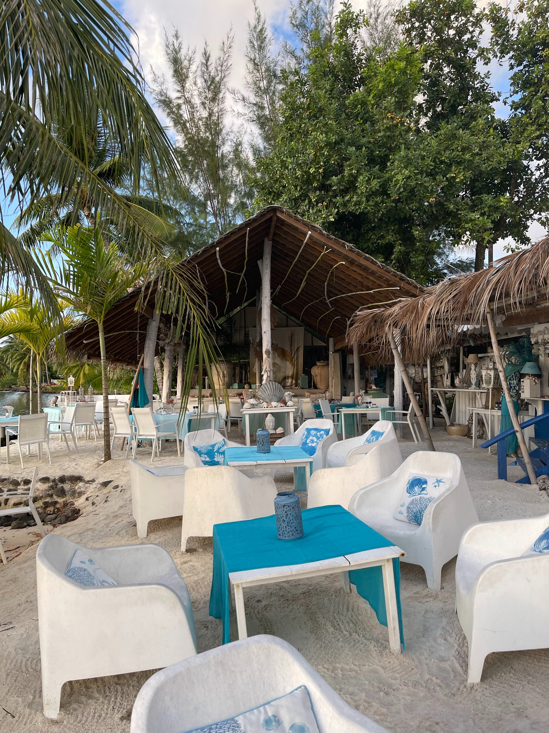
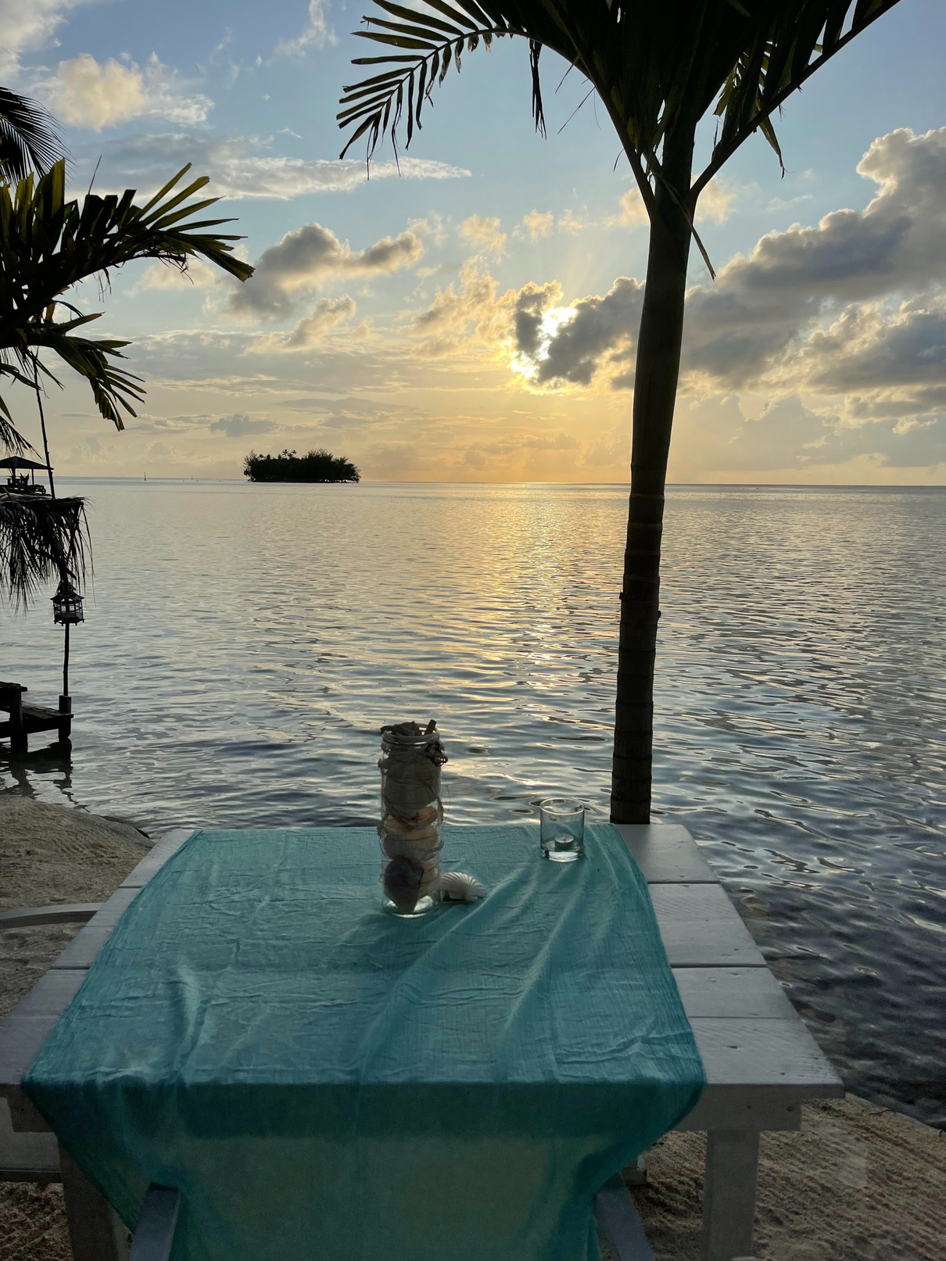
Friday Night -
Fish & Blue Restaurant
  Welcome Happy Hour
  8 Minutes from the Raiatea Airport
  10 Minutes from Dream Yacht Base
  We will be making a group dinner reservation for that night - please let us know if you want to be included.

Slide 10
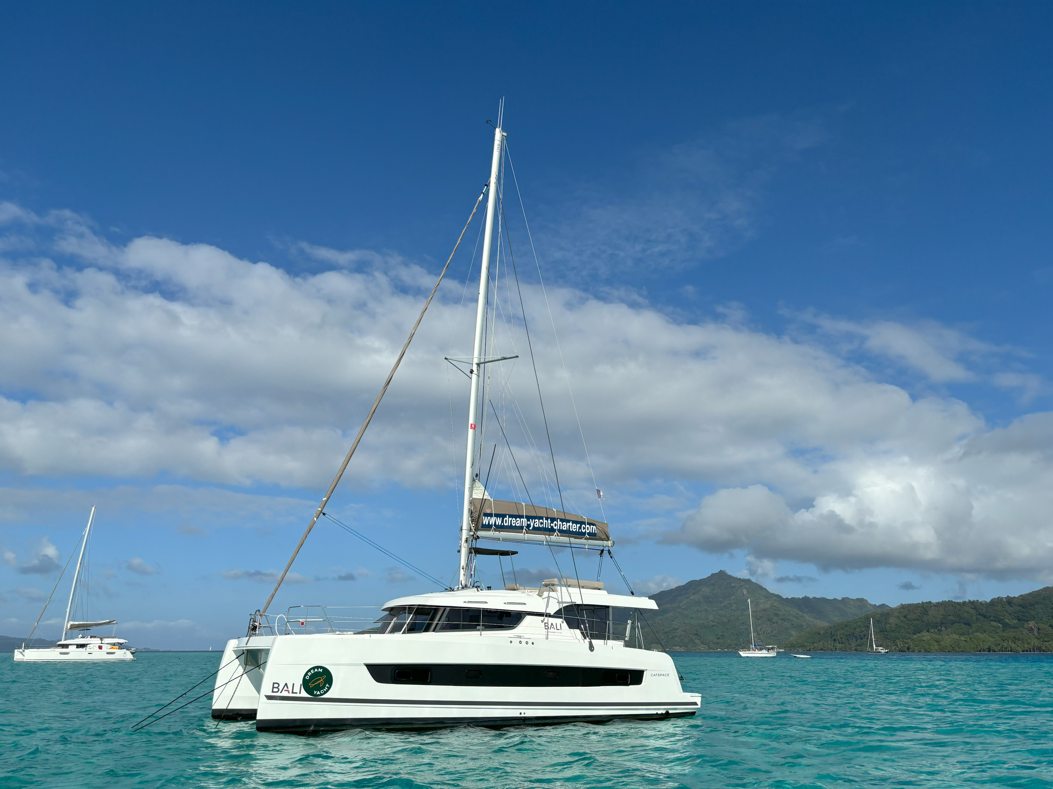
Saturday –
Check-In & Prep Day
  2:00 PM:
    Arrival & Check-In at Base (Raiatea)
  Boats:
    42'–45' Catamarans with A/C, private cabins & en-suite heads
  To-Do:
    Pick up any last-minute provisions (alcohol is much cheaper in Raiatea than in Bora Bora)
    Your boat will already be stocked with basic provisions for breakfasts, lunches & snacks
  Use this time to meet your crew, settle in, and get ready to cast off for an unforgettable week of island hopping.

Slide 11
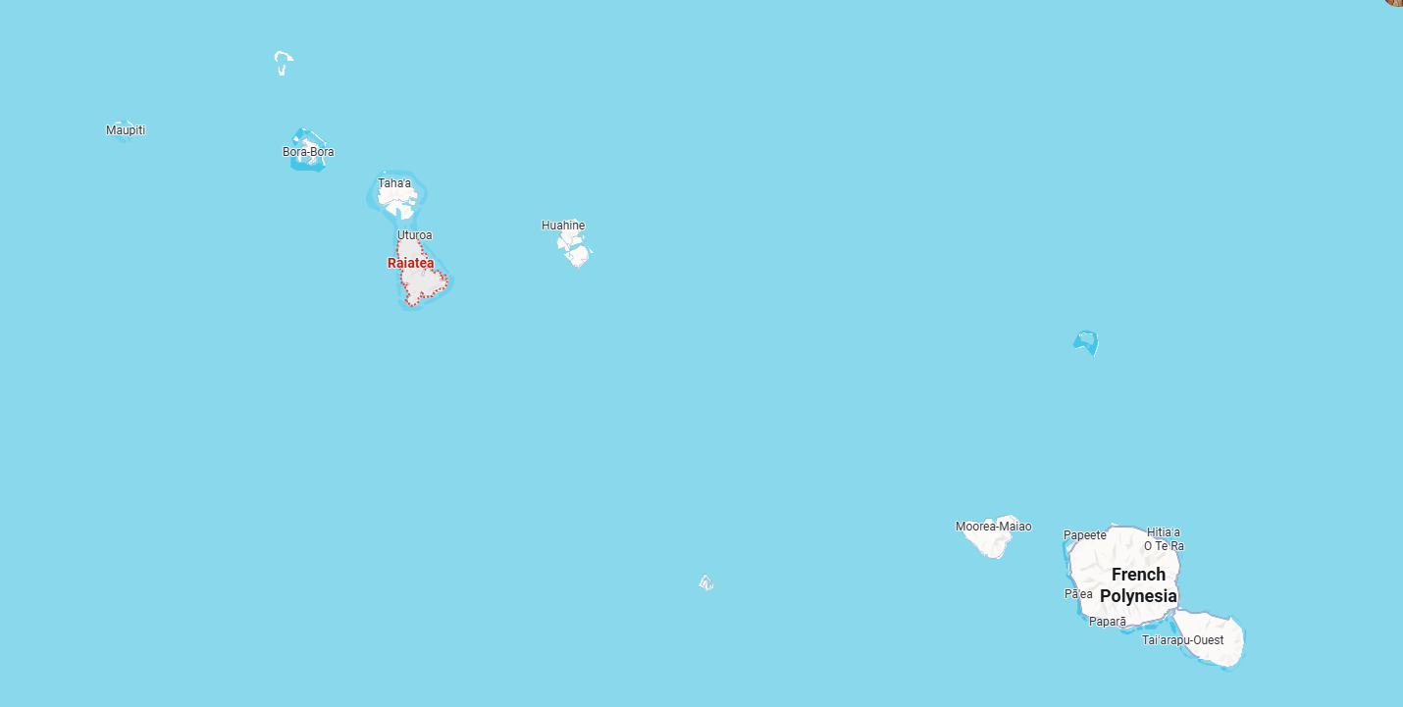

Slide 12
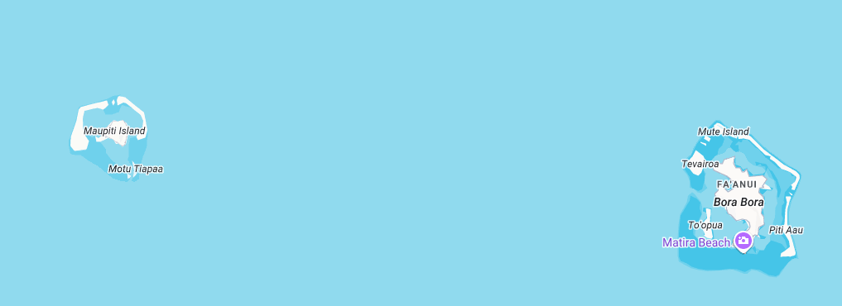
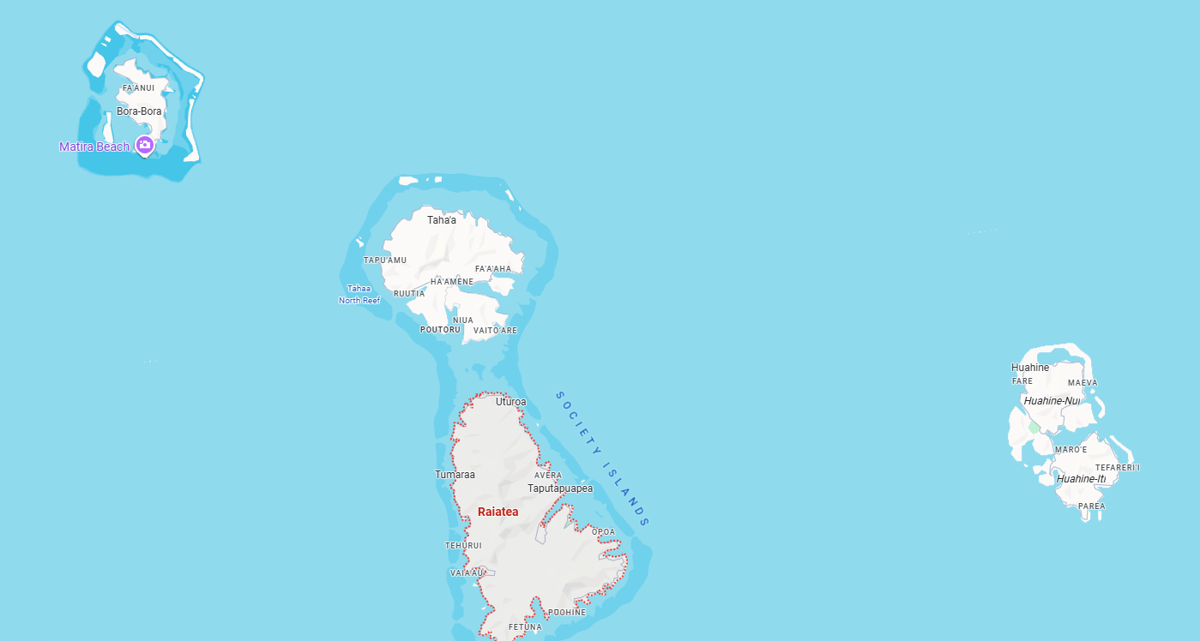

Slide 13
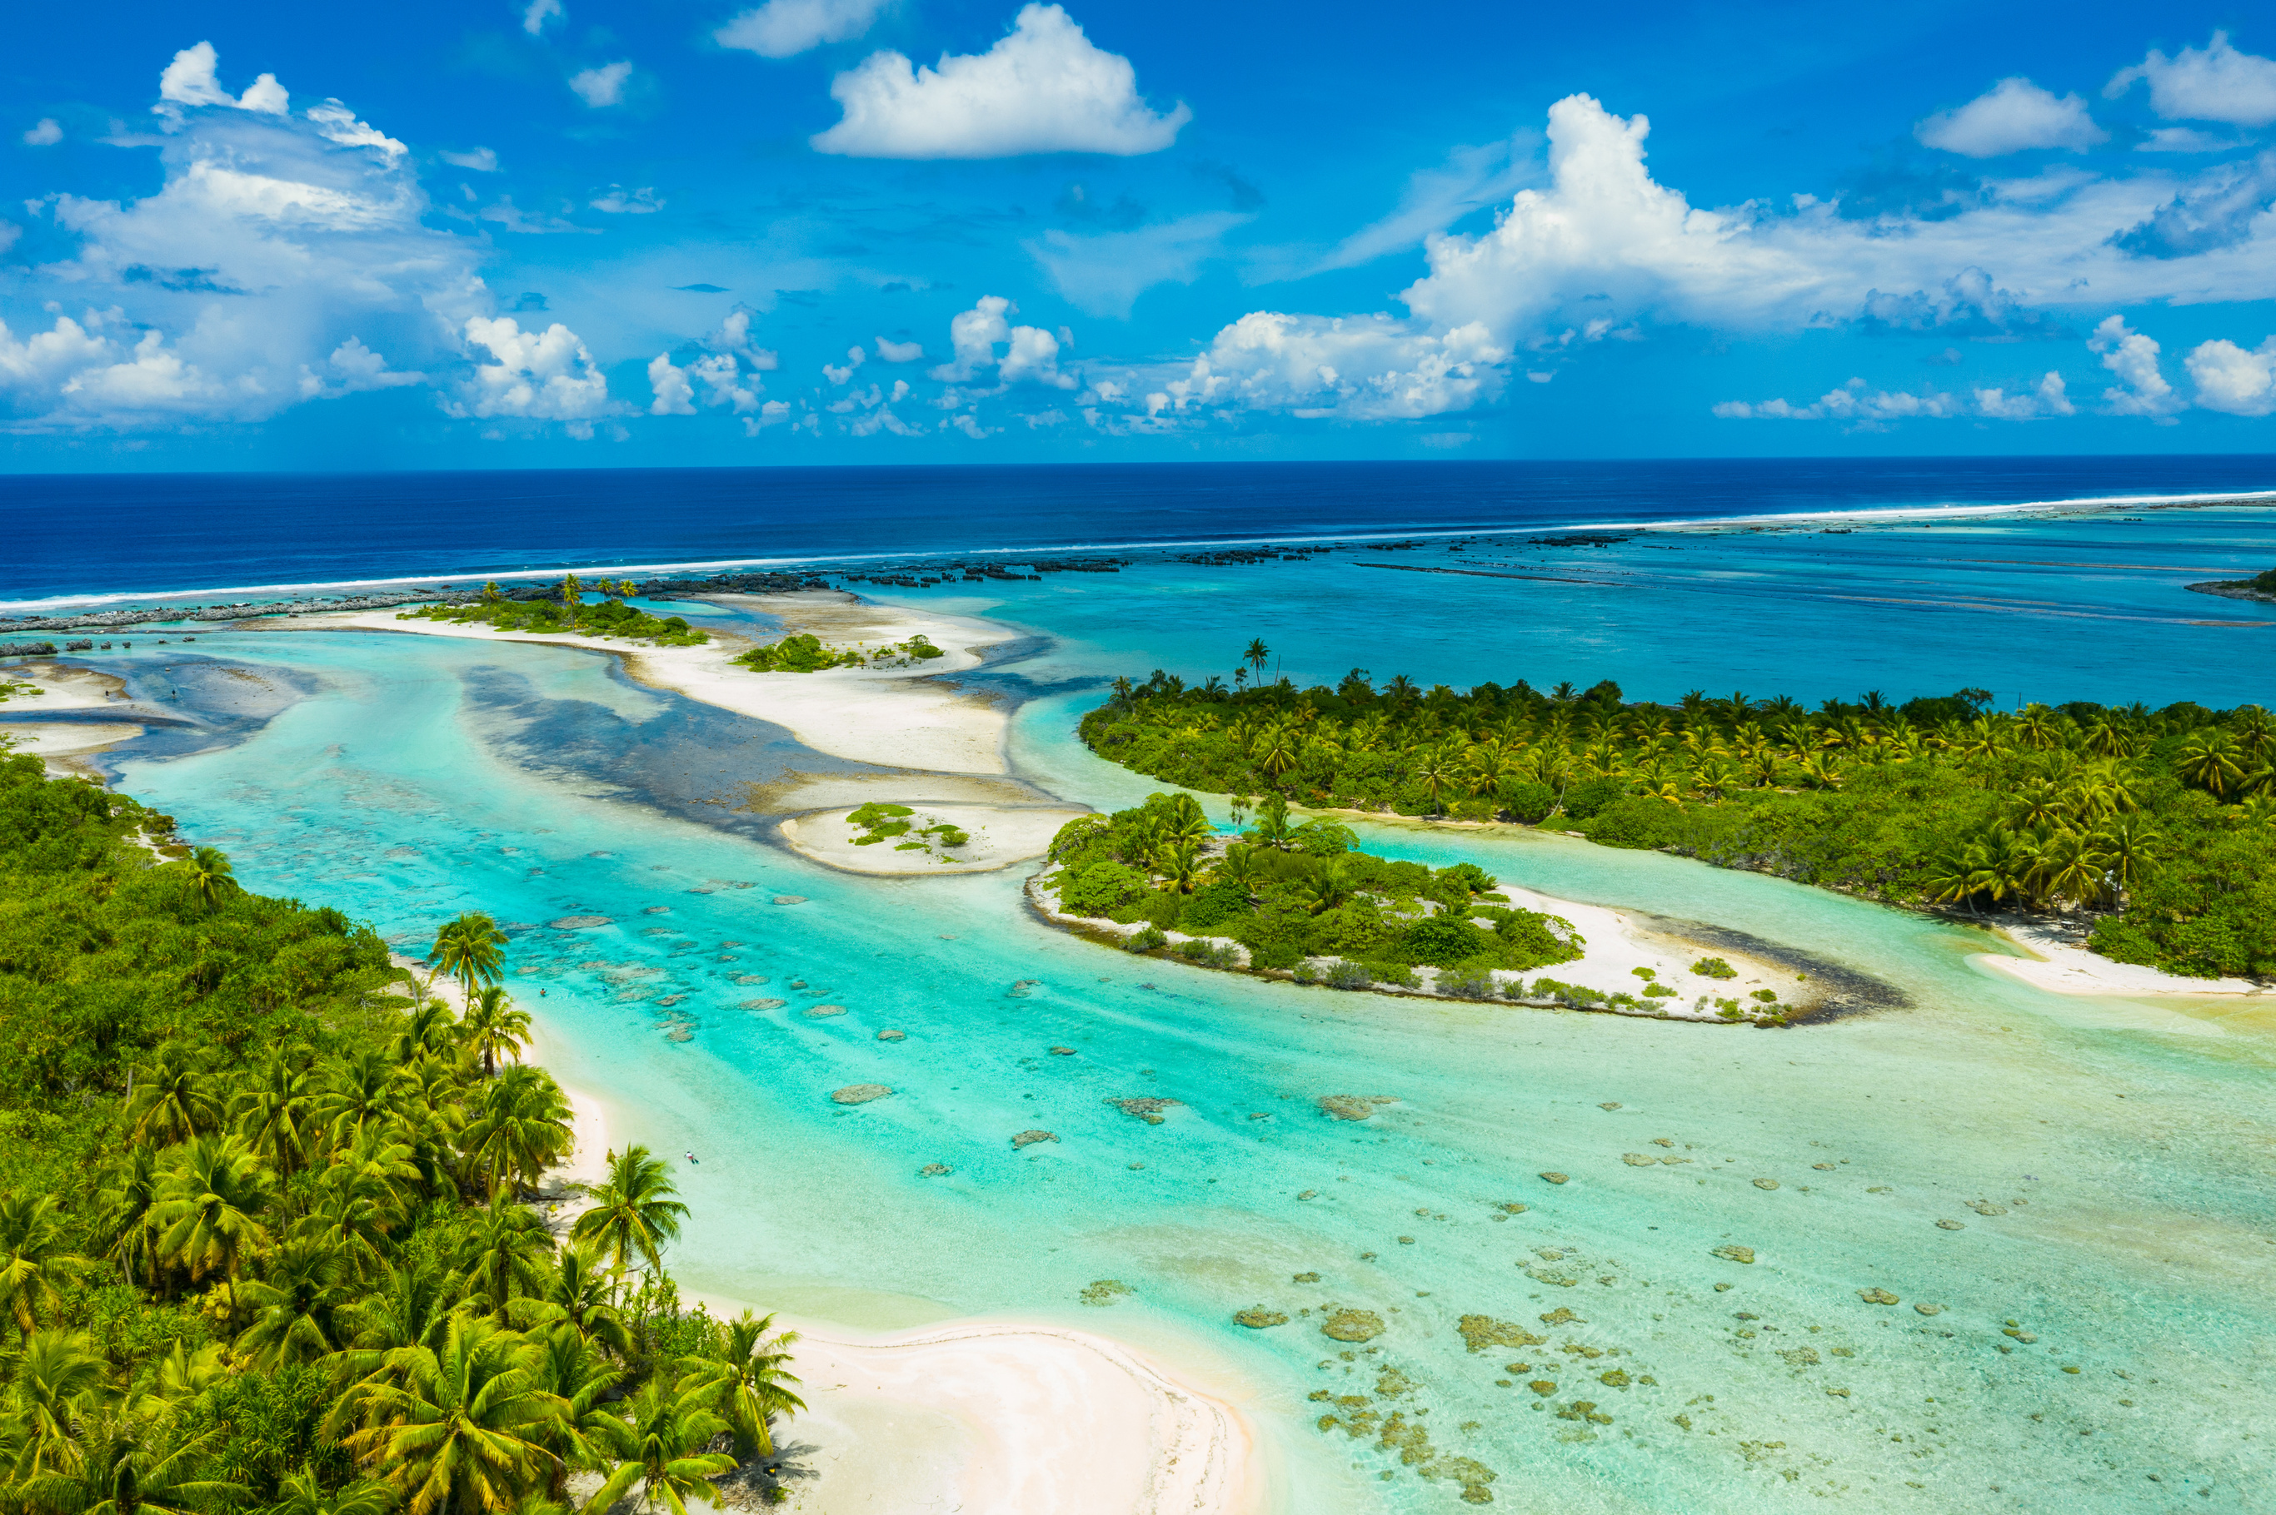
taha’a

Slide 14
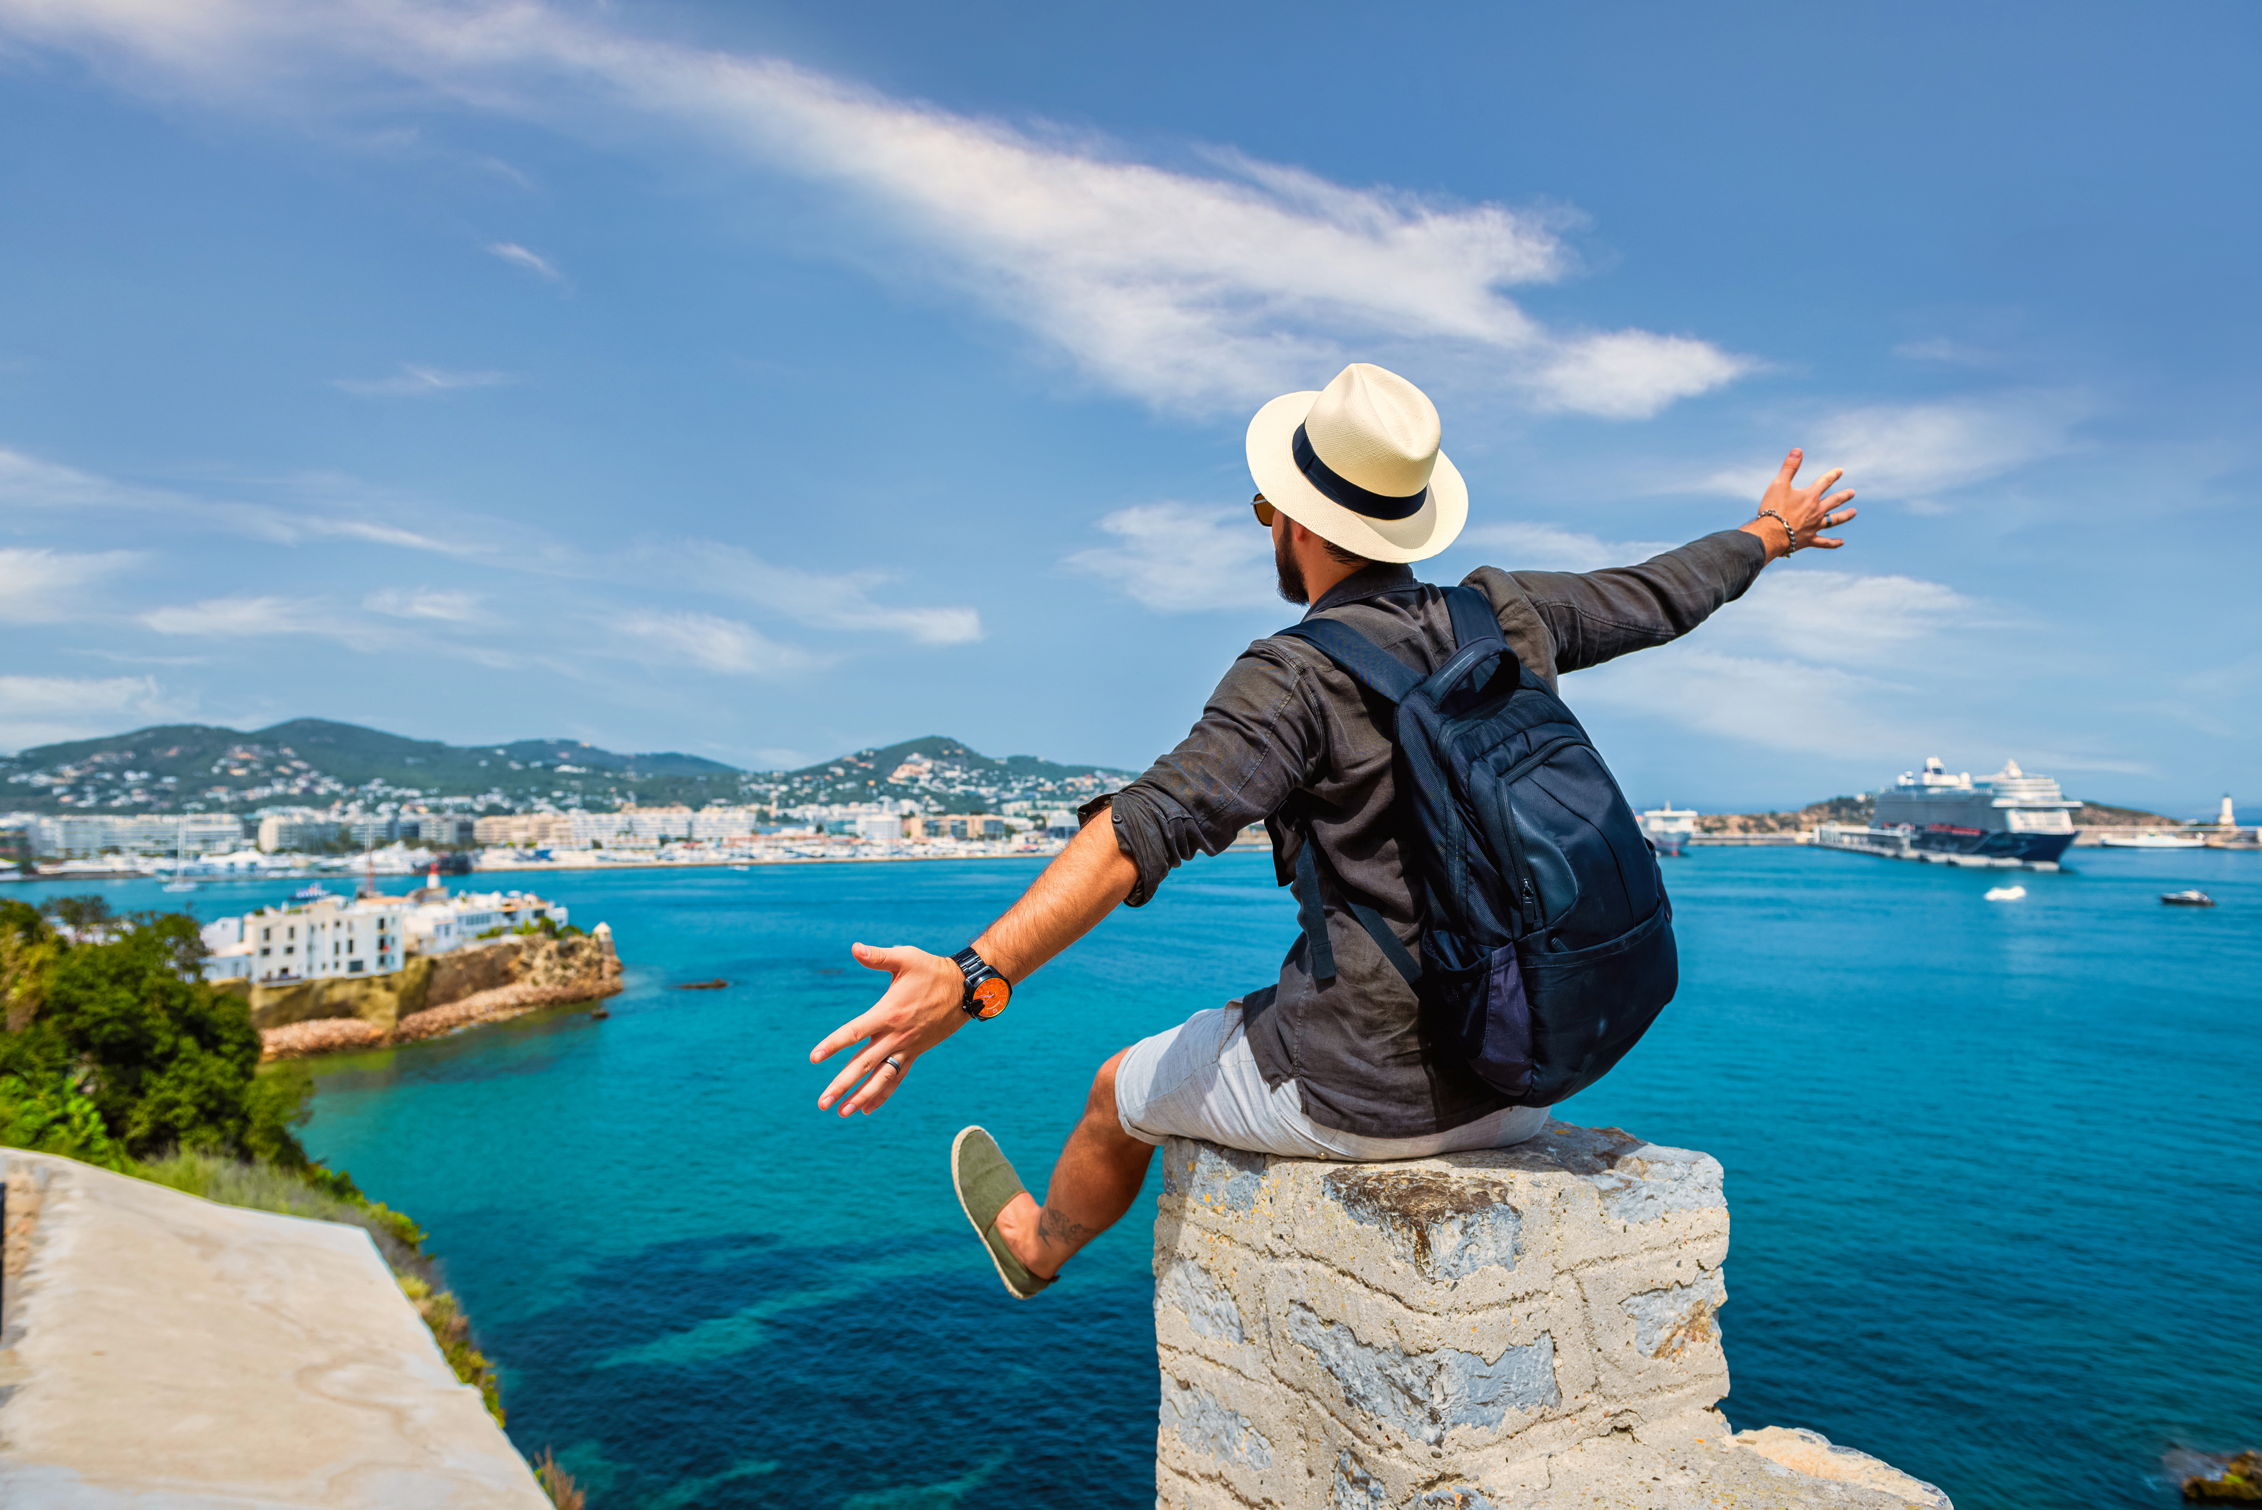
Sail to Apu Bay, Taha’a
01
saturday, april 25th, 2026
Check-in & Departure
  Arrive at base in Raiatea for check-in and safety briefing
  Provision boats and meet your crew
  Afternoon departure with a scenic sail to Taha’a
Activity: Champon Black Pearl Farm
  Learn how Tahitian black pearls are cultivated
  Optional snorkeling around coral gardens
Dinner Option: Ficus Restaurant (Taha’a)
  15-course beachfront dinner experience
  Traditional fire dance performance
  Family-friendly, relaxed atmosphere
  May be scheduled for tonight or the final evening
Vibe
  Easy sailing
  Lagoon exploring
  First taste of island culture
Distance: ~15 nautical miles
Departure: Marina Uturoa, Raiatea
Anchorage: Apu Bay, Taha’a

Slide 15
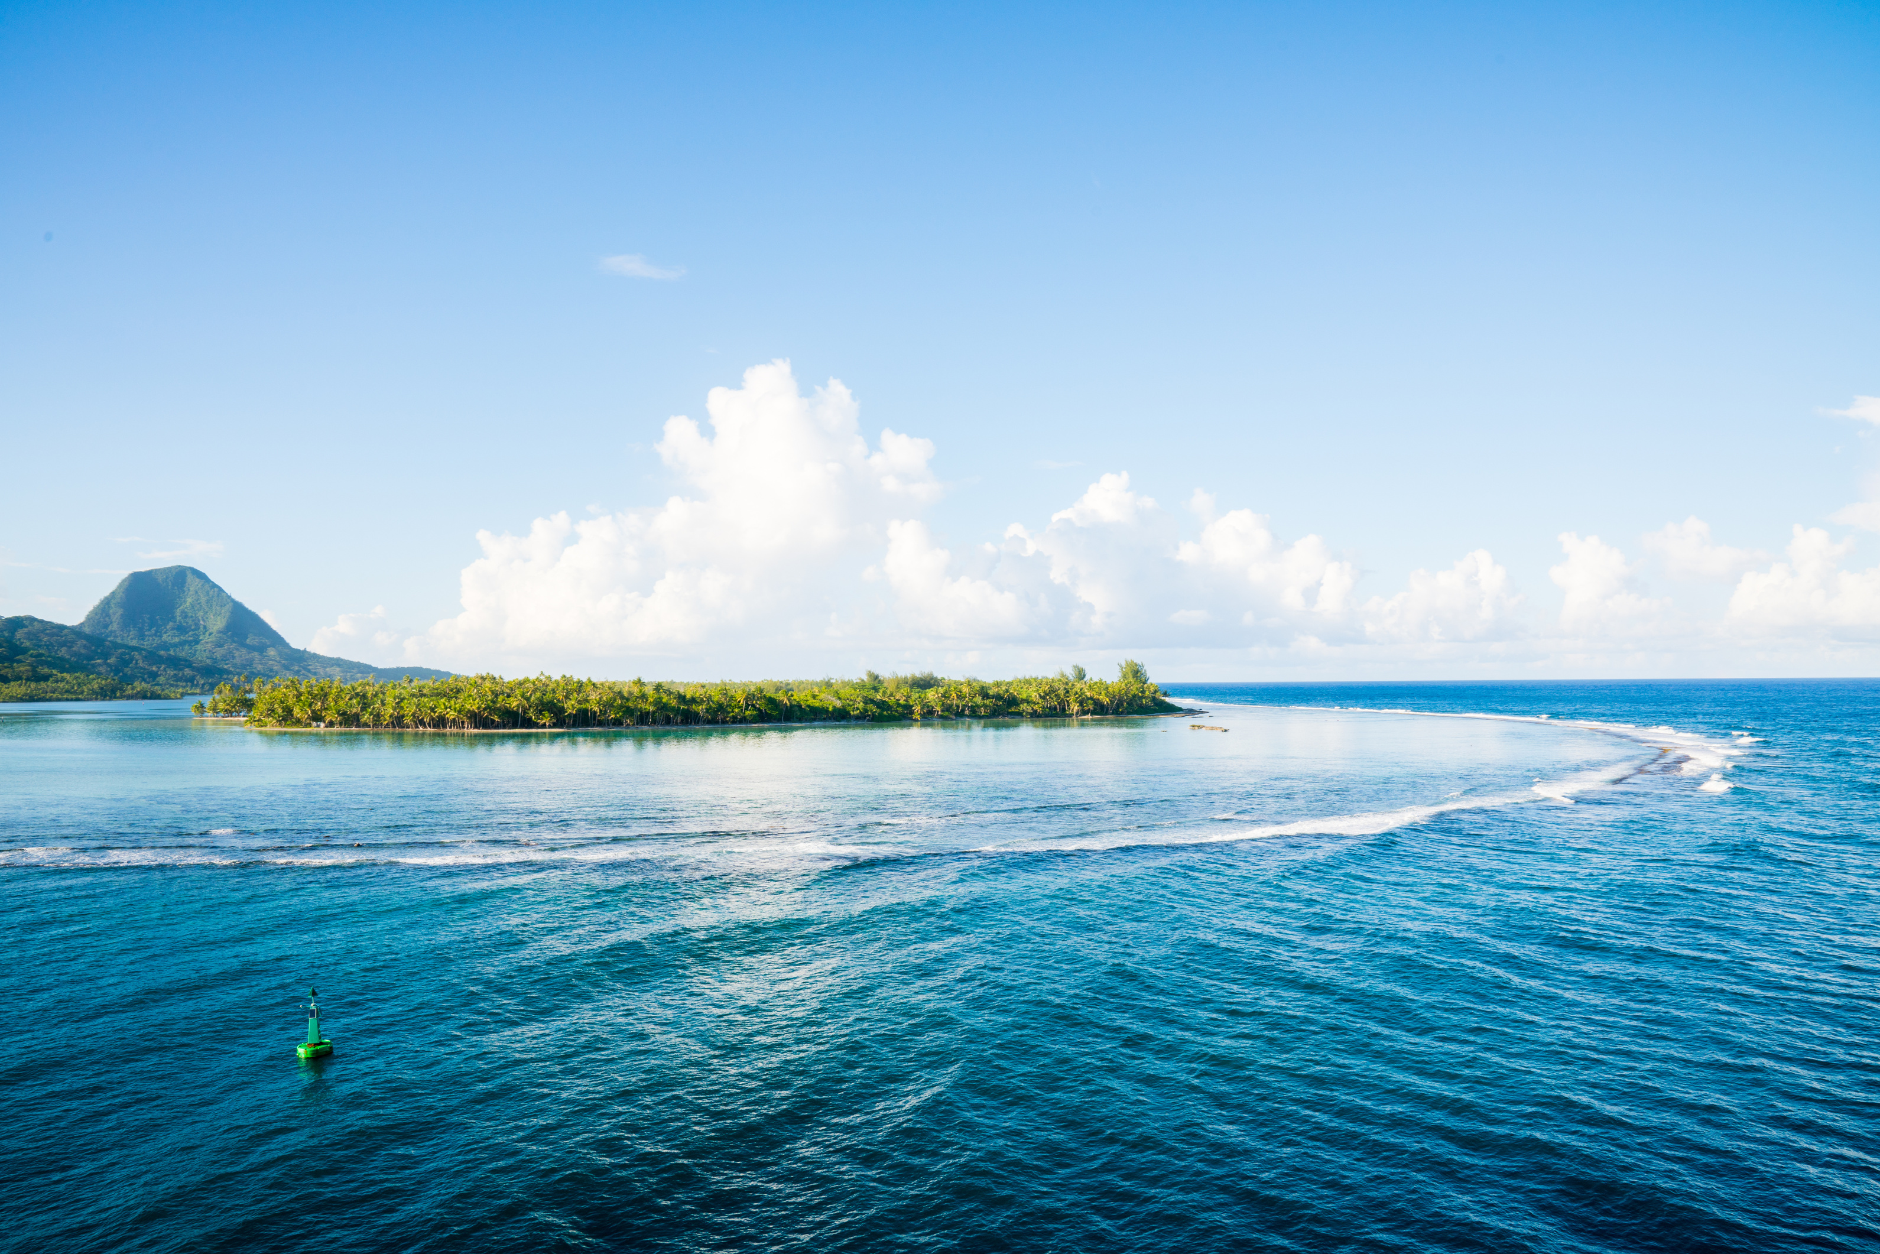
huahine
  Rent an E-Bike and go explore the island
  Dinner at the Huahine Yacht Club or Chez Tara
  We are also trying to secure a private Motu picnic in the water.

Slide 16
02
SUNDAY, april 26th, 2026
EXPLORE TAHAA OR SAIL TO HUAHINE
Option #1: Apu Bay to Huahine
  Open water sail ~22 nautical miles
  Anchor in Fare, Huahine’s main village
  Explore shops, grab lunch, or relax onshore
  Excellent snorkeling around the reef
Option #2: Apu Bay to Motu Tehutu (Taha’a)
  Lagoon sail ~10 nautical miles
  Anchor near Motu Tehutu — calm, scenic spot
  Enjoy snorkeling and paddleboarding
  Great for an easier day on the water
Meal Stop: Motu Tuahi (Taha’a)
  Stop for lunch or early dinner
  Remote motu with epic views of Bora Bora
  Fresh seafood, grilled island-style
Vibe
  Choose your pace: adventure sail or laid-back loop
  Culture, cuisine, and colorful coral reefs
  Sunset anchorage with great star views

Slide 17
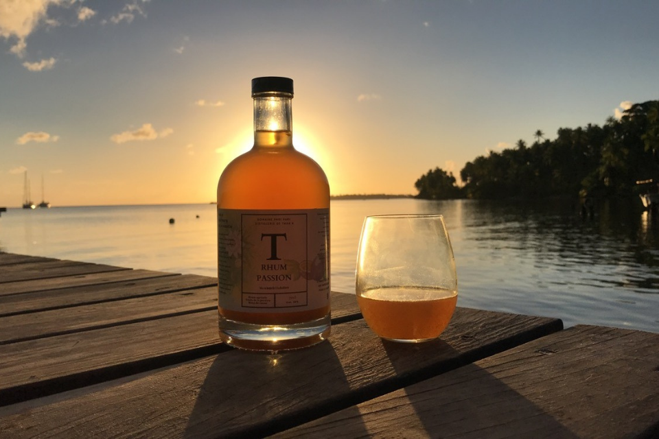
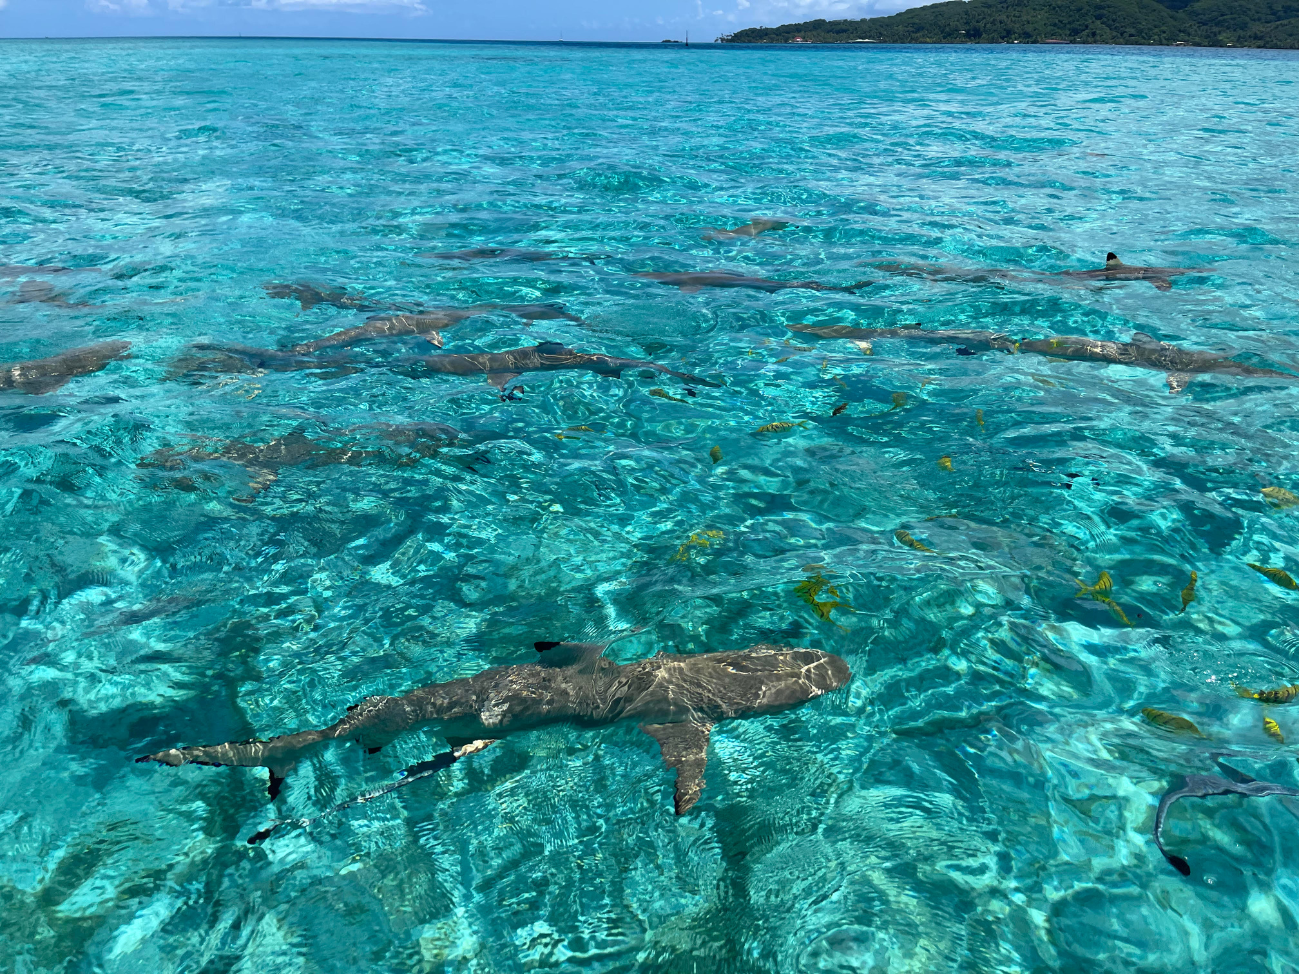
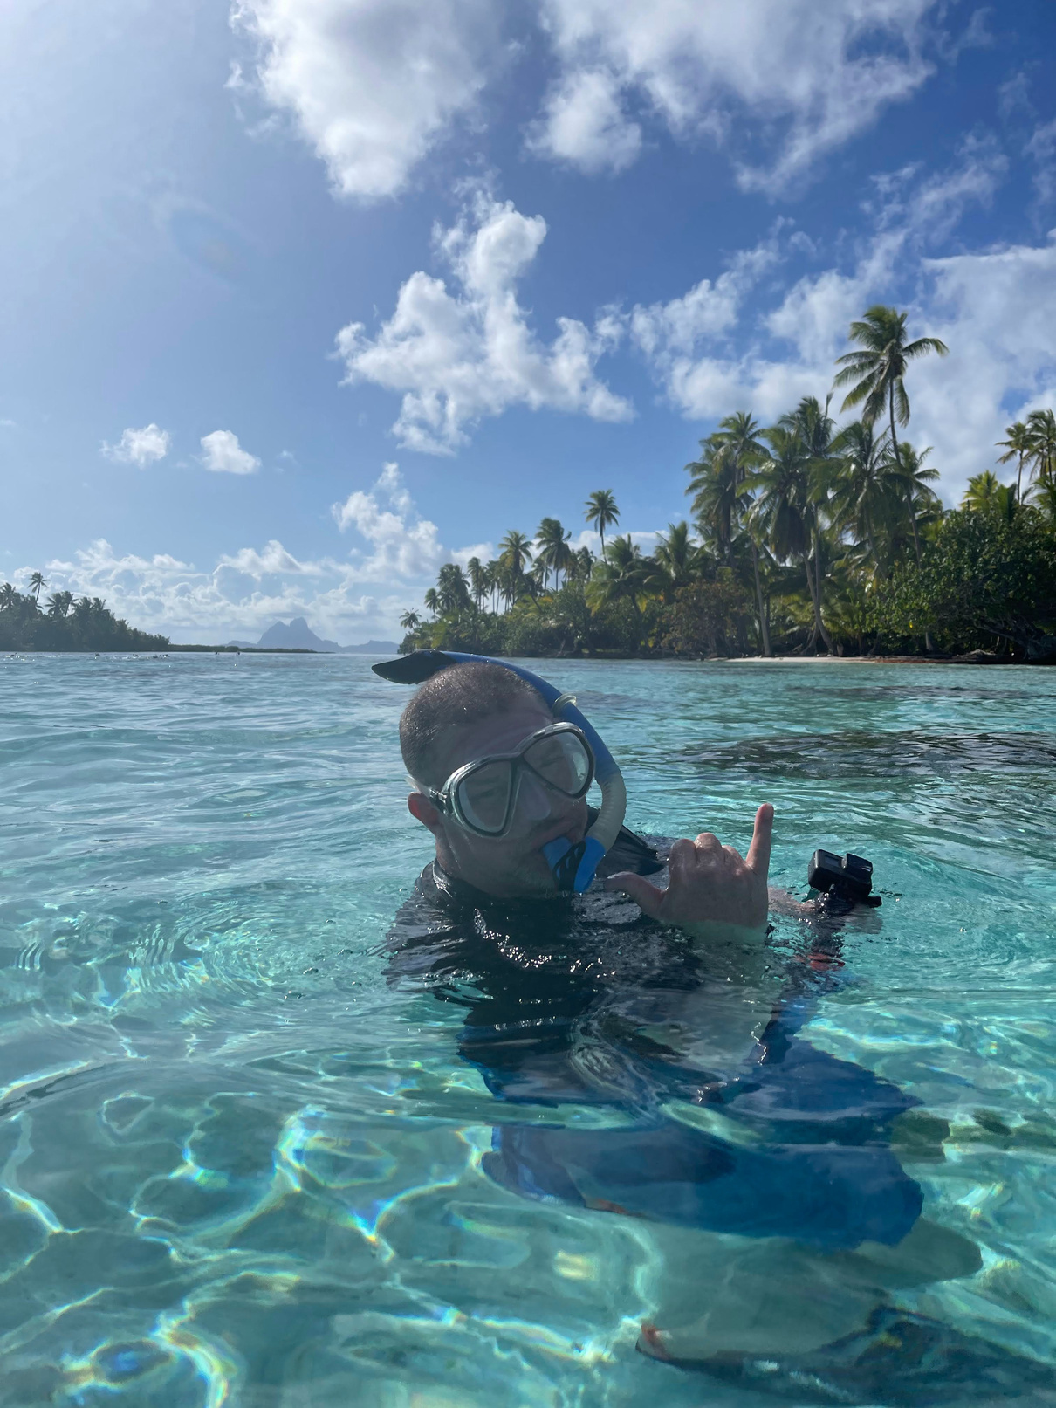
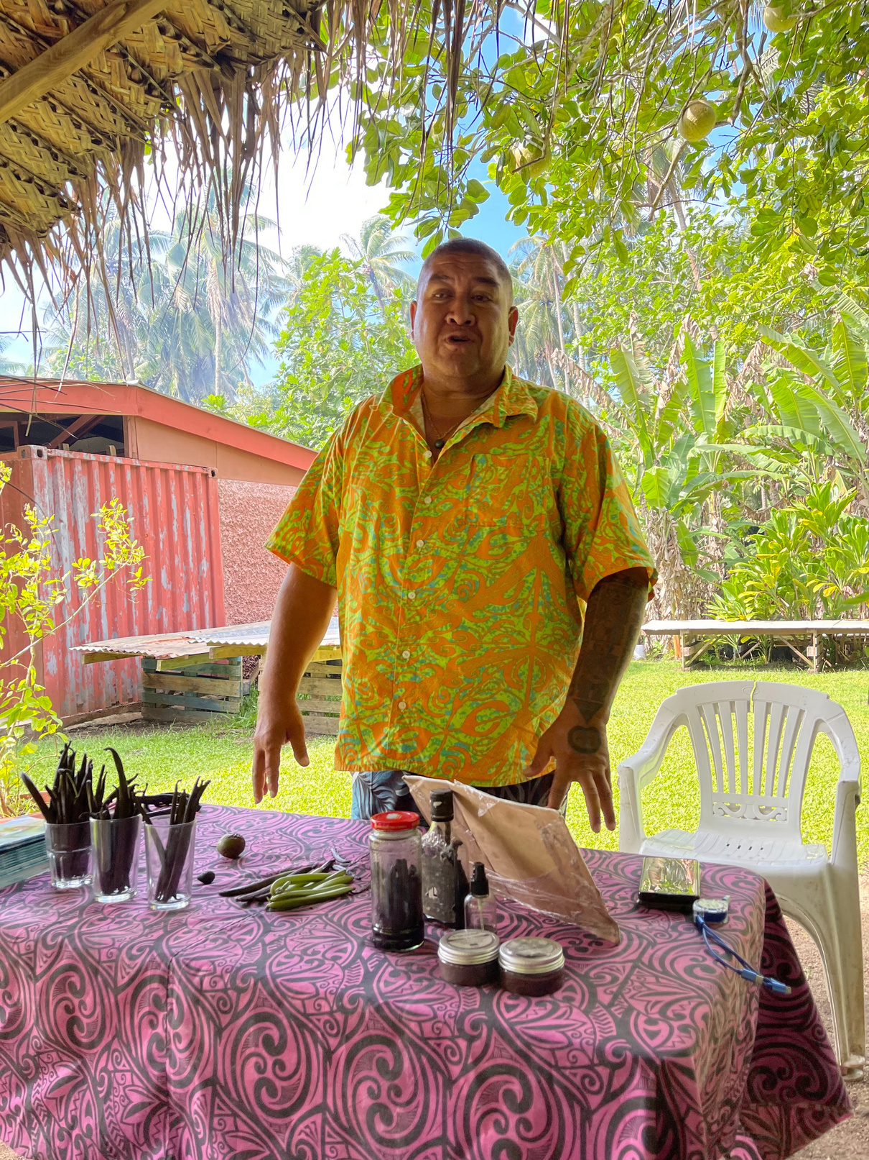
East Side of Tah’a
West Side of Taha’a
Explore the serene coral gardens of Taha’a’s east side with a guided snorkeling experience in crystal-clear waters. Afterward, stop by the Pari Pari Rum Distillery for a quick tasting and enjoy a cocktail on their floating barge. As the sun dips lower, enjoy a relaxing dinner at Le Taha’a, a luxury resort with stunning views and island-inspired cuisine.
Start your morning with a visit to La Vallée de la Vanille, where Noah welcomes you into his home and guides you through his vanilla farm aboard an open-air truck. After this immersive cultural stop, cool off with a swim alongside reef sharks in the vibrant turquoise lagoon—an unforgettable experience that perfectly blends adventure with local flavor.

Slide 18
03
MONDAY, april 27th, 2026
PASSAGE TO BORA BORA OR TAHAA’S CORAL GARDENS
Option #1: Sail from East Taha’a to Bora Bora
  ~23 nautical miles of open ocean sailing
  Scenic approach to Bora Bora’s iconic peaks
  Anchor near Motu To’opua for calm lagoon views
  Swim, snorkel, or lounge beachside
Option #2: Sail from Huahine to Coral Gardens, Taha’a
  ~22 nautical miles downwind passage
  Anchor near Taurere Bay for epic snorkeling
  Drift snorkel through coral channels full of life
  Sea turtles, rays, clownfish, and more!
Dinner Ideas
  Onboard BBQ with your crew
  Beach picnic if anchored near motus
  Optional dinner ashore depending on anchorage
Vibe
  Big sail day or underwater paradise
  Choose your adventure based on the weather
  Both routes offer incredible photo ops

Slide 19
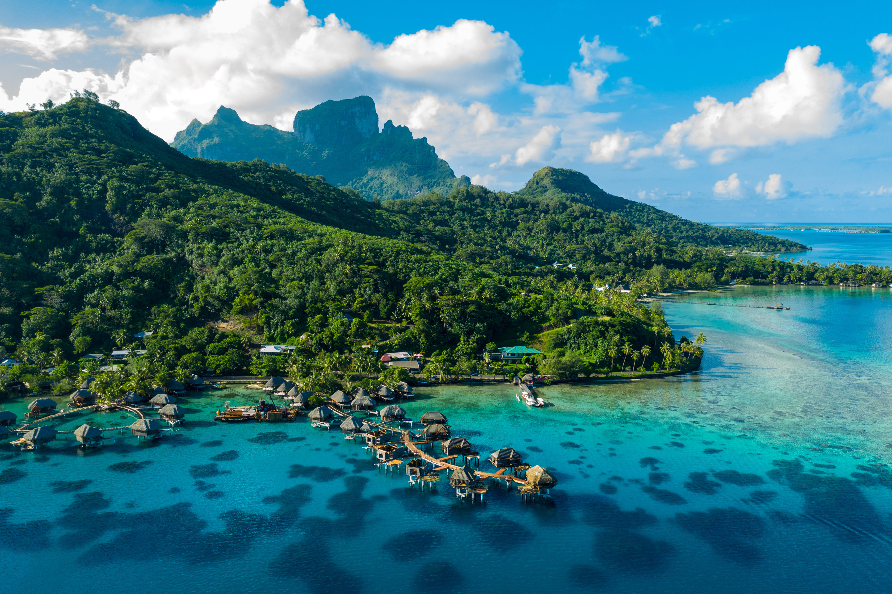
BORA BORA
We plan on spending two days in Bora Bora - Different anchorages each night

Slide 20
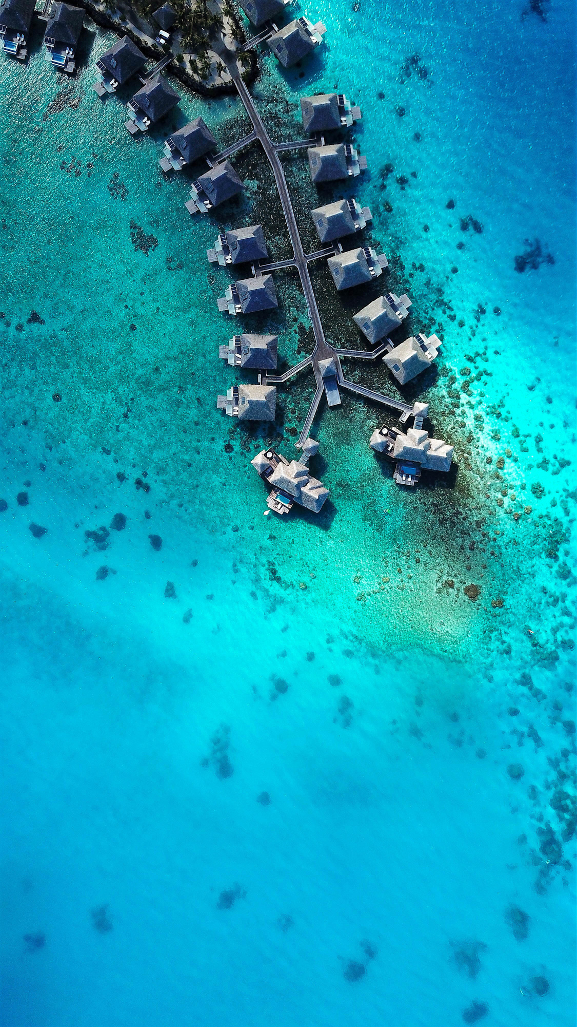
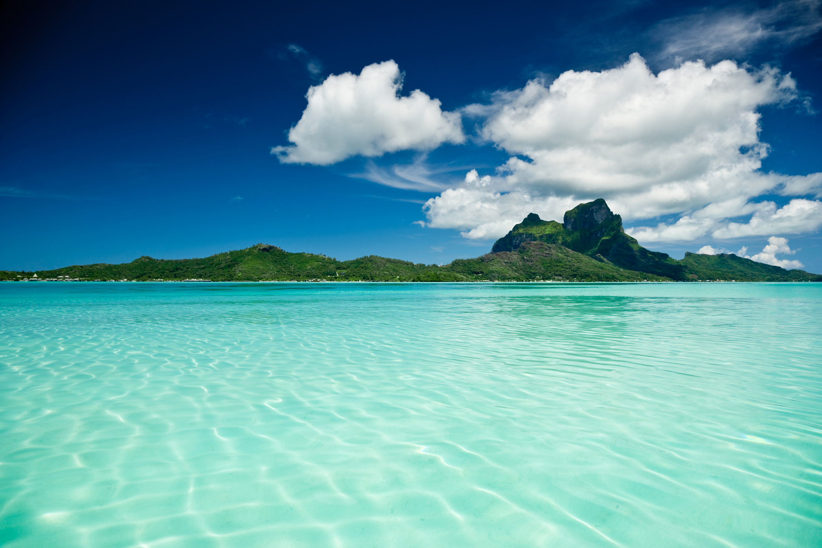
The Swimming Pool
  Crystal-clear, shallow turquoise waters
  Perfect for floating, paddle boarding & sunset lounging
Local Artist Studio and Shops
  Beachfront gallery with vibrant Polynesian art
  Great spot for souvenirs and supporting local shop owners
In-the-Water Happy Hour
  Paddle boards become floating bars
  Bring your drink and join the crew in the lagoon
Arii Motu Grill – Private Dinner Option
  Intimate beachfront dinner
  Local flavors, fresh fish, and unbeatable views

Slide 21
04-05
tue, april 28th -wed, april 29th, 2026
BORA BORA LAGOON DAYs
Morning Activities
  Wake up anchored in Bora Bora's turquoise lagoon
  Option to move anchorage closer to Matira Beach or Motu Piti A’au
  Enjoy breakfast on deck with views of Mount Otemanu
Adventure Options
  Swim with reef sharks and stingrays (local tour operators available)
  Drift snorkel through coral gardens
  Kayak or paddleboard in the calm, shallow waters
  Relax on motu beaches with soft white sand
Lunch & Chill
  Onboard lunch with your crew
  Optional dinghy trip to Bloody Mary’s for iconic Bora Bora bites
Dinner Options
  Dinner onboard or beach picnic
  Dinghy ashore for dinner at Matira’s local restaurants
Vibe
  A full day in paradise
  Snorkel, swim, soak it all in
  The postcard day everyone dreams of

Slide 22
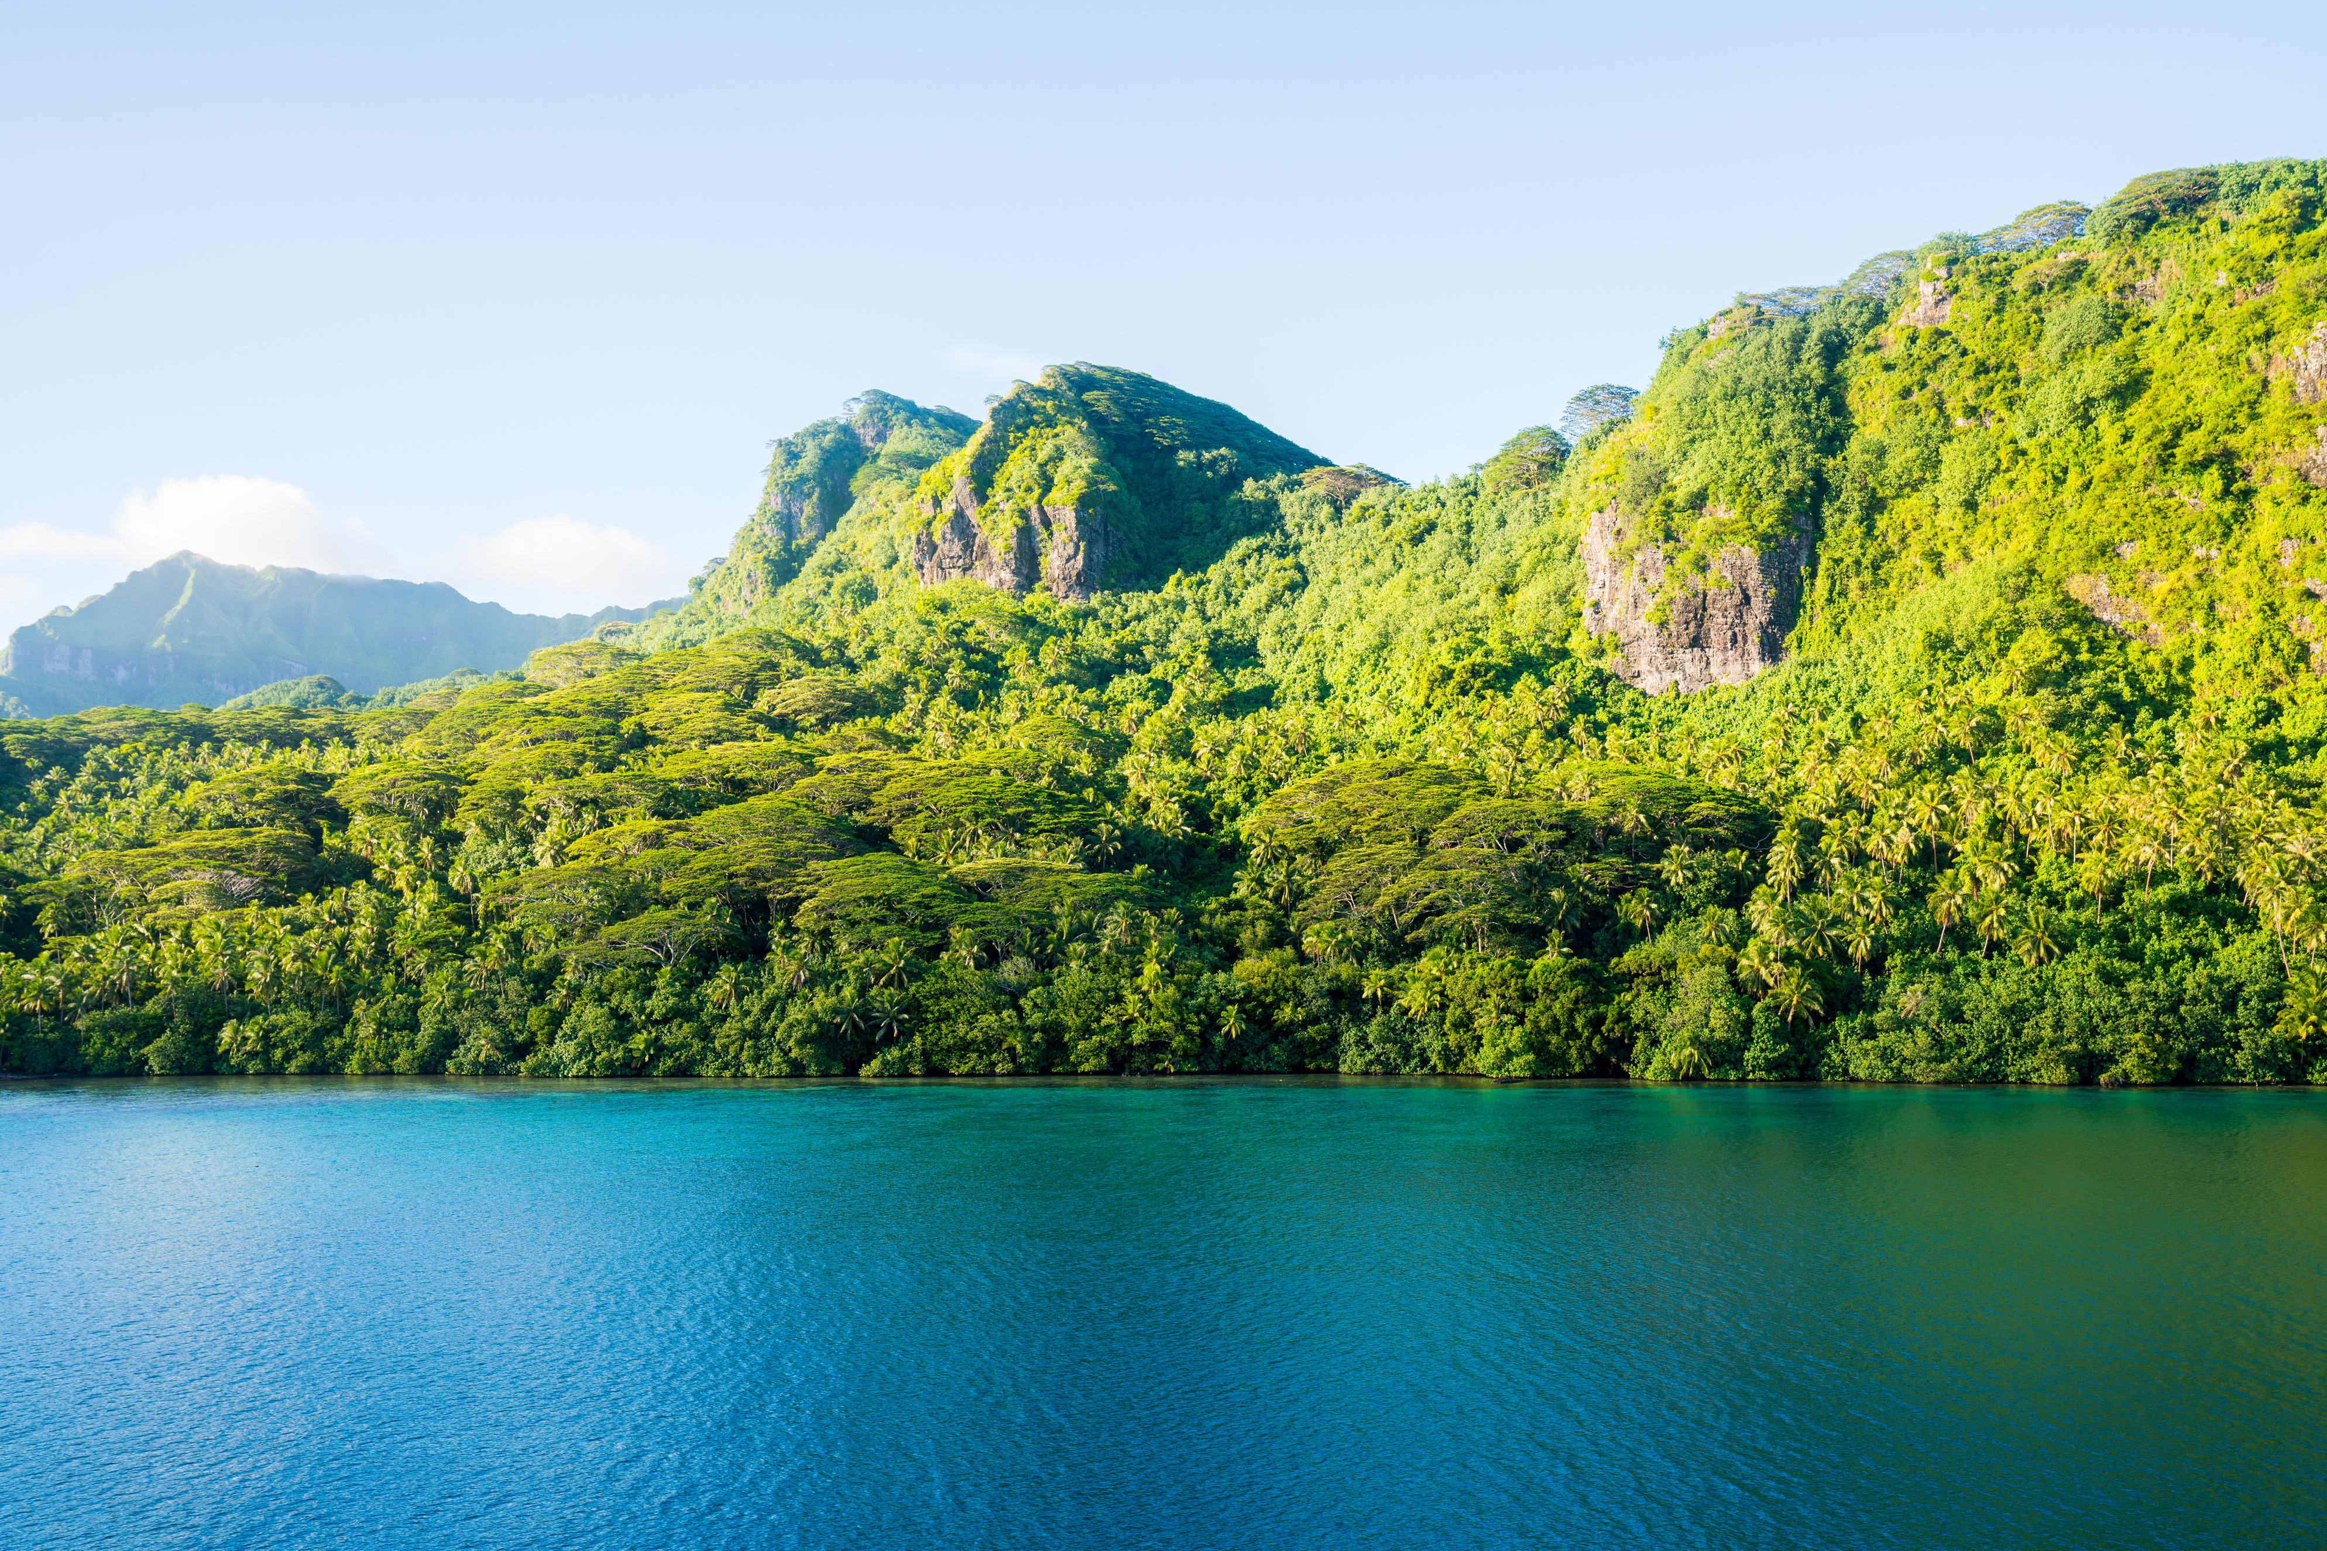
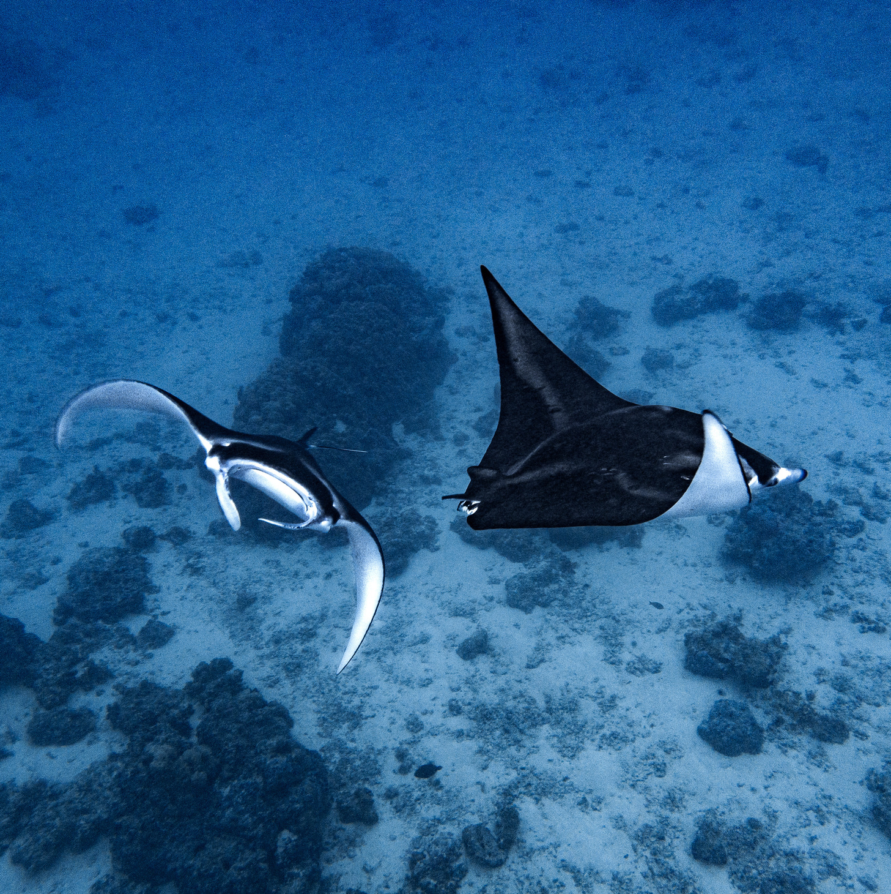
huahine
vs
MAUPITI

Slide 23
06
thursday, april 30th, 2026
SAIL TO HUAHINE 1/2
Morning Departure
  Early morning sail from Bora Bora to Huahine
  Approx. 25–30 nautical miles depending on anchorage
  Open ocean passage: scenic, smooth, and exciting with a steady breeze
Sailing Highlights
  Chance to spot dolphins or flying fish
  Great opportunity to relax, read, or help the captain at the helm
  Arrive to the lush, untouched island of Huahine
Anchor & Explore
  Anchor in Fare Village or Avea Bay depending on conditions
  Go ashore to explore local markets and grab a fresh coconut
  Optional: Bike rentals, snorkeling, or just unwind on the beach
Dinner Options
  Casual dining ashore in Fare
  Try fresh-caught fish and traditional Polynesian dishes
Vibe
  Big sail day
  Authentic Polynesian village vibes
  Lush, jungly, and wild — Huahine is a hidden gem

Slide 24
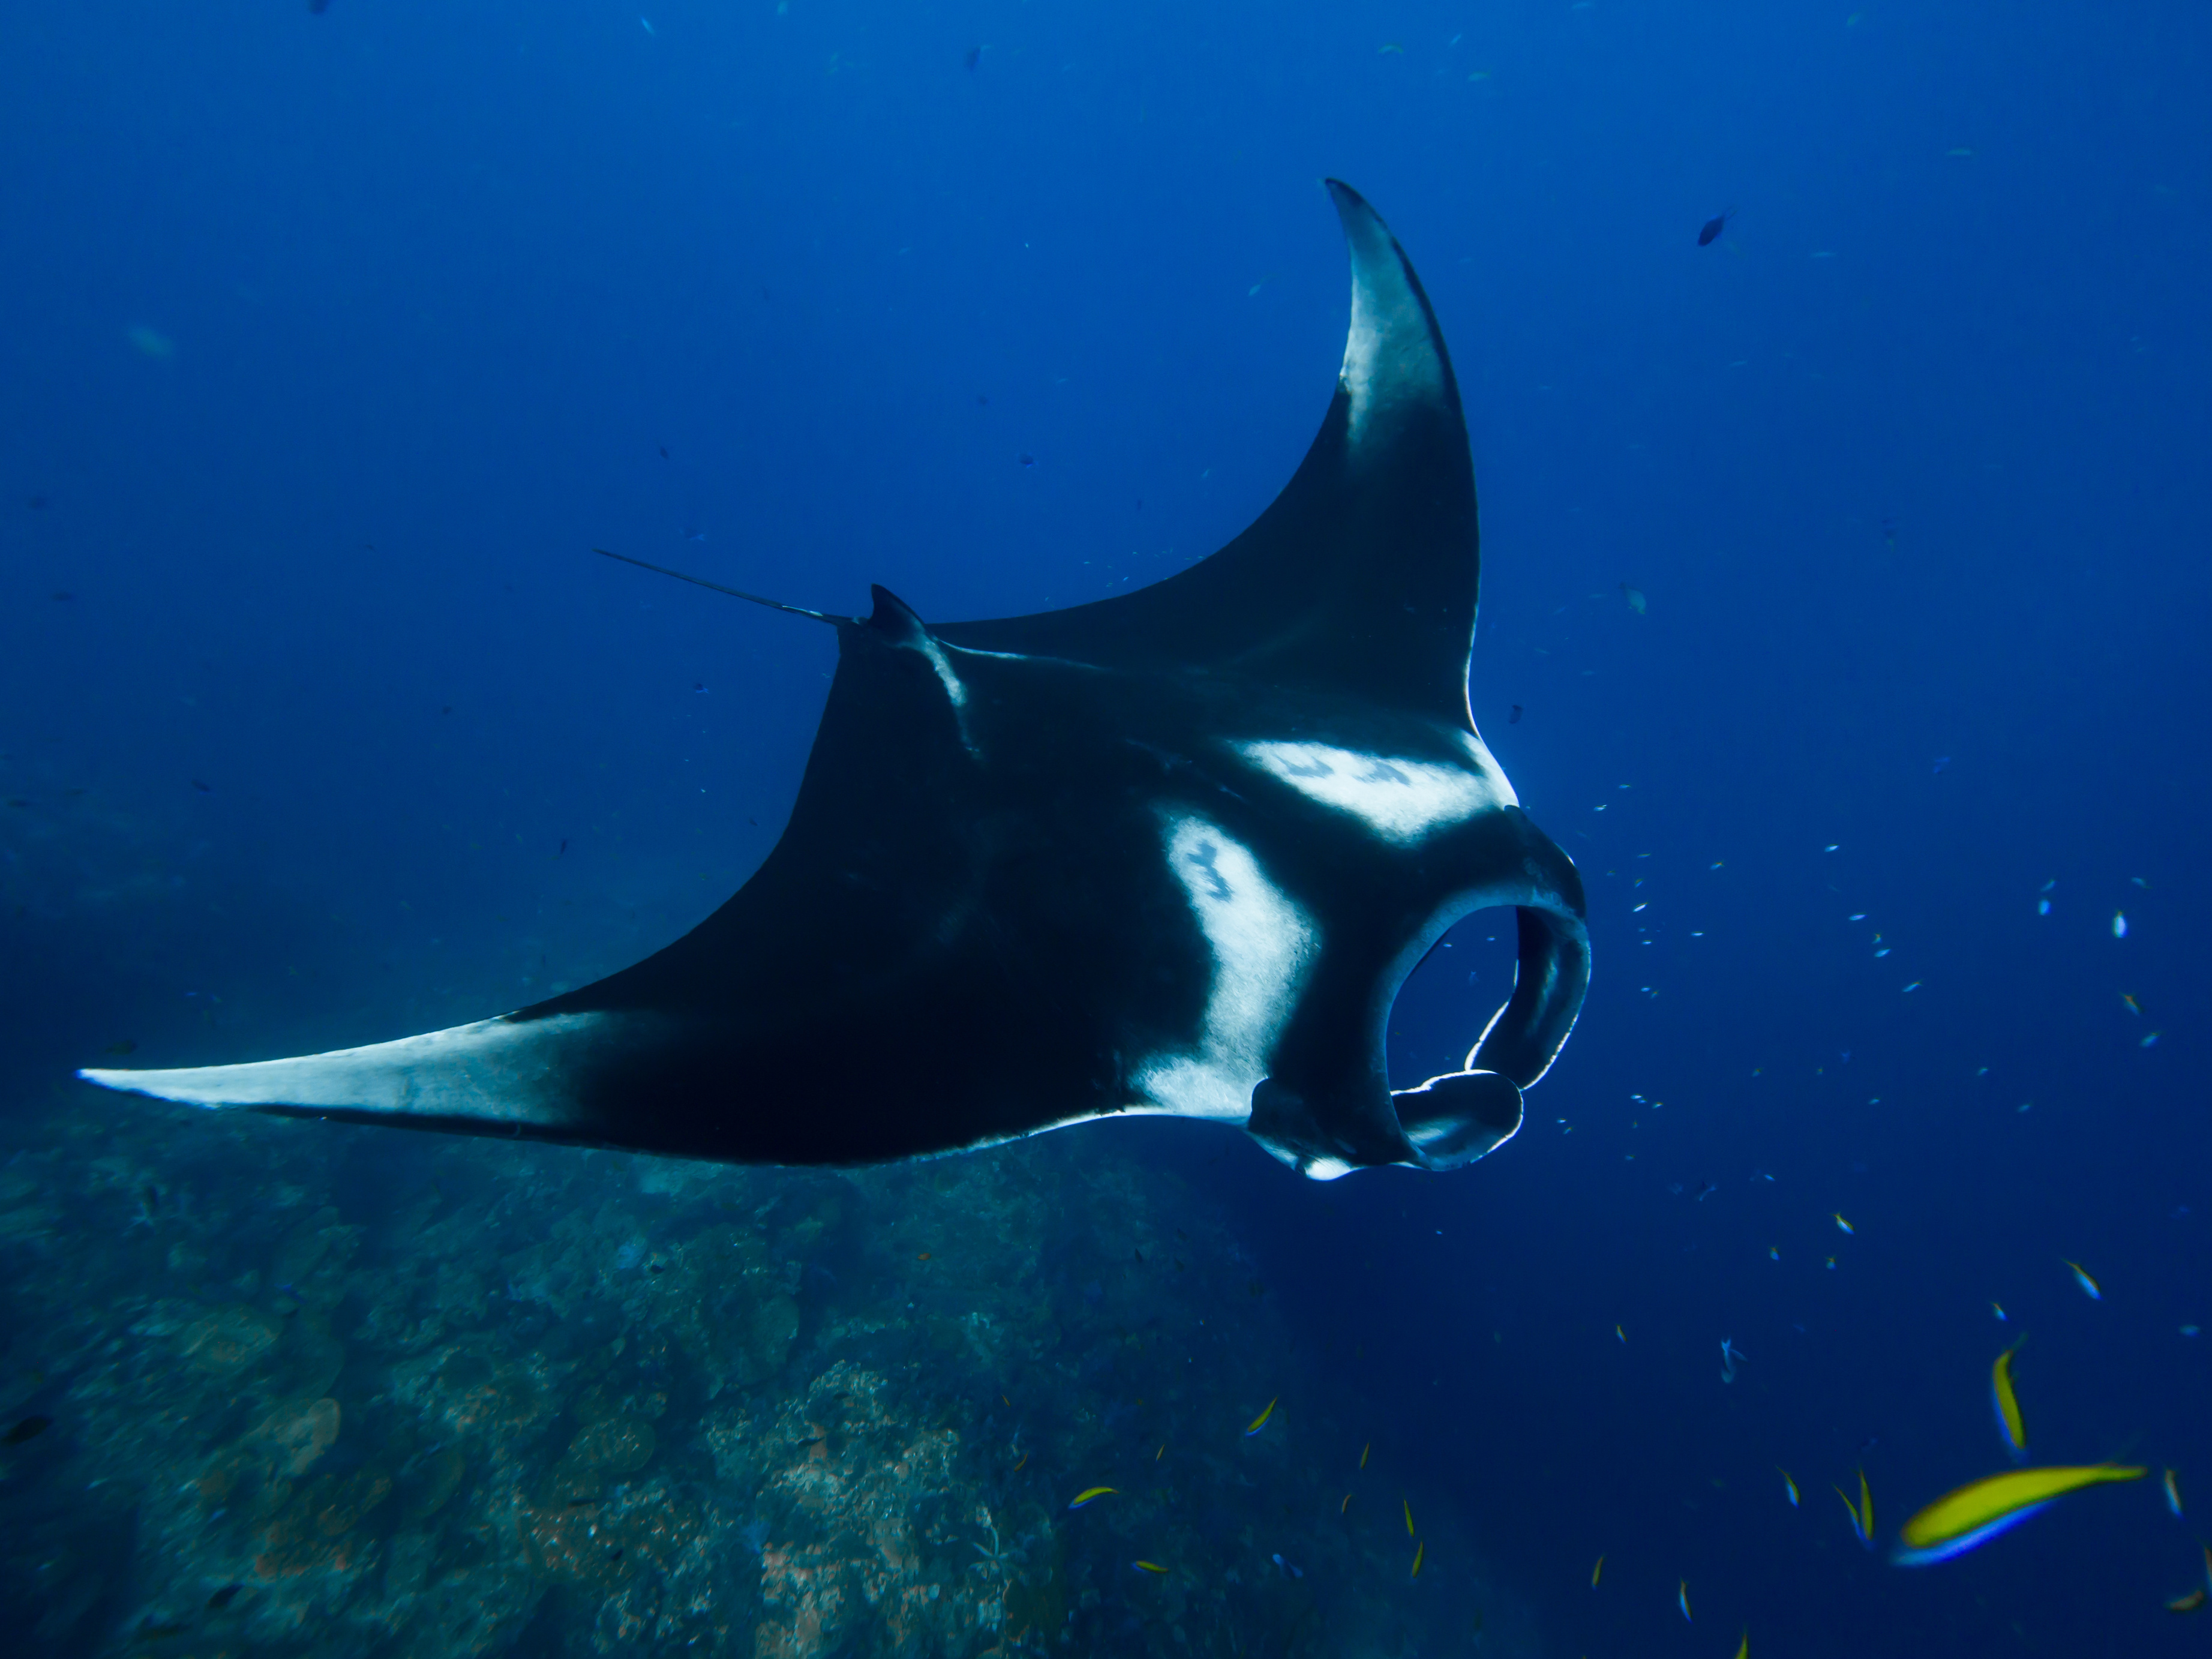
06
thursday, april 30th, 2026
OPTIONAL SAIL TO MAUPITI 2/2
Weather-Dependent Adventure
  This offshore sail from Bora Bora to Maupiti is highly weather-dependent
  If conditions are favorable, we’ll make the 28 NM sail west to one of French Polynesia’s most untouched gems
  If not, we’ll head back toward Taha’a for more inner-island exploring
Maupiti Highlights
  Anchor inside one of the narrowest lagoon passes in Polynesia (requires calm seas)
  Explore stunning, secluded beaches
  Snorkel with manta rays in crystal-clear water
  Quiet island life with minimal tourism—this is the real deal
Vibe
  Off-the-beaten-path magic
  Remote and rewarding
  A favorite among seasoned cruisers

Slide 25
07
thursday, may 1st , 2026
SAIL TO TAHA’A
Route Options (Weather Dependent)
  Sail from Bora Bora or Maupiti to Taha’a
  Anchor along the East Coast or near Motu Tehutu on the North Side
  Scenic ~25–30 NM return with views of the Leeward Islands chain
Group Lunch at Motu Tuahi (Taha’a)
  Private beachfront lunch for Share the Sail crew
  Relax under palms with your toes in the sand
  Enjoy authentic local flavors and island hospitality
Vibe
  Unwind after a week of adventure
  Gather with new friends to recap the journey
  Prime time for last group photos and connection

Slide 26
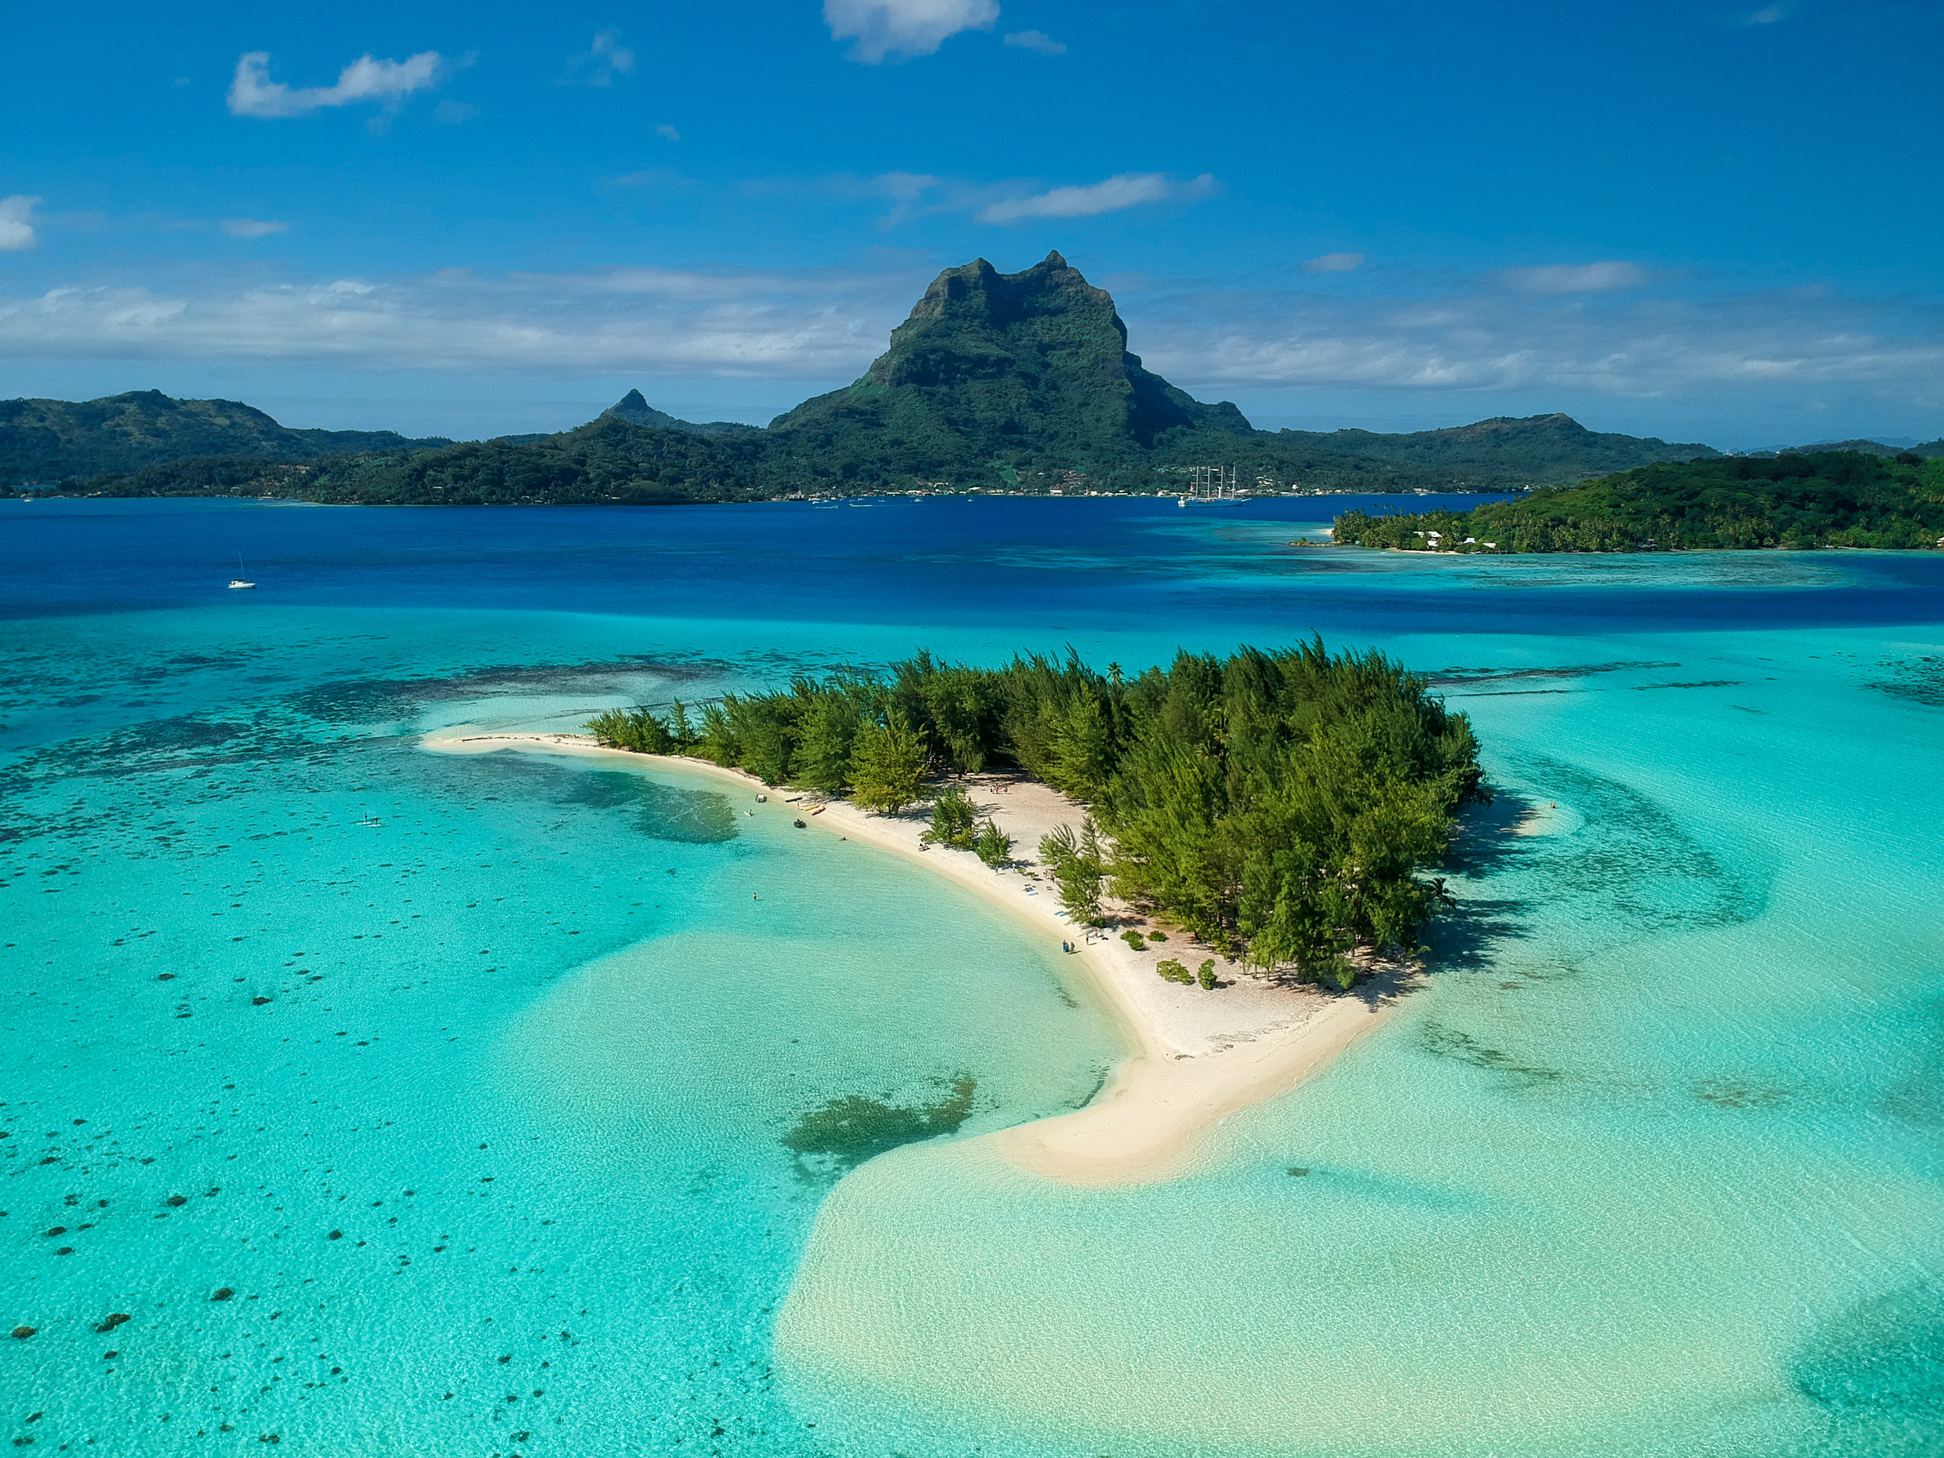
what is a motu?
Motus are small coral sand islets that form along the reef of an island. Over time, sand naturally collects in protected spots—like behind a reef or near a pass—and gradually builds up. As vegetation takes hold, these sandy patches evolve into beautiful white-sand islands, perfect for exploring or relaxing in paradise.

Slide 27
08
thursday, may 2nd , 2026
RETURN TO BASE
Check-Out & Return
  Arrive back at the marina by 10:00 AM
  Fuel up at the dock before disembarking
  Complete check-out and gather belongings
Final Goodbyes
  Say farewell to your captain and crew
  Snap last-minute photos
  Exchange contacts with your new cruising friends
Vibe
  Easy sail and smooth wrap-up
  Bittersweet goodbye to the islands
  Already dreaming of the next Share the Sail adventure

Slide 28
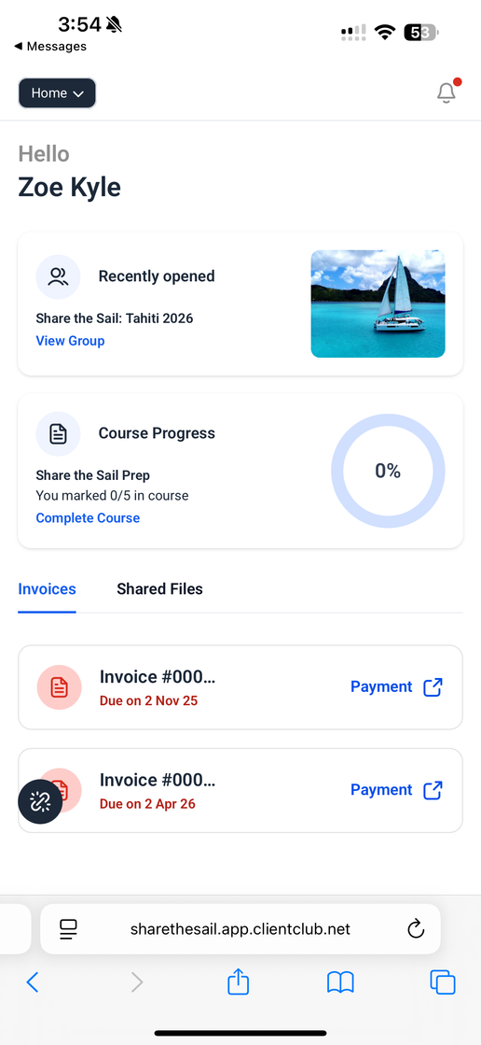
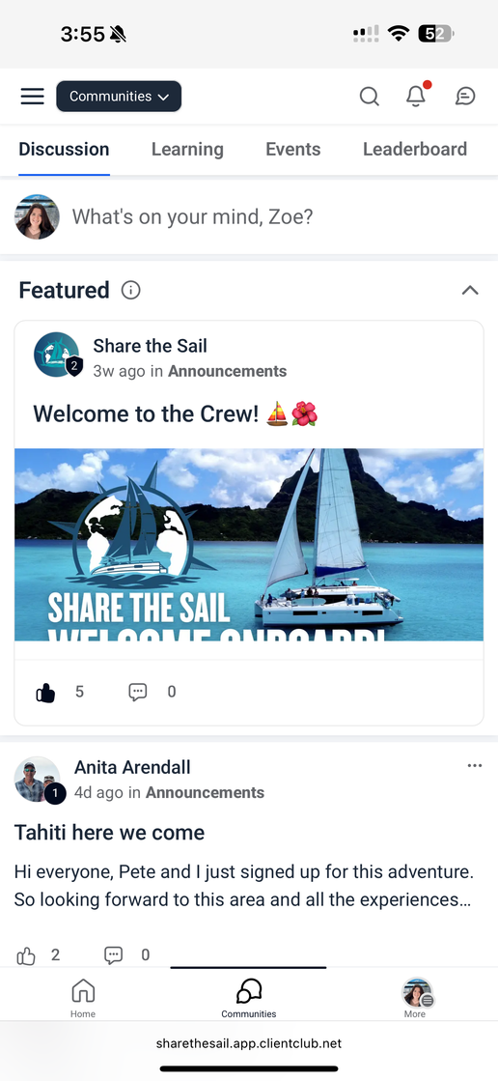
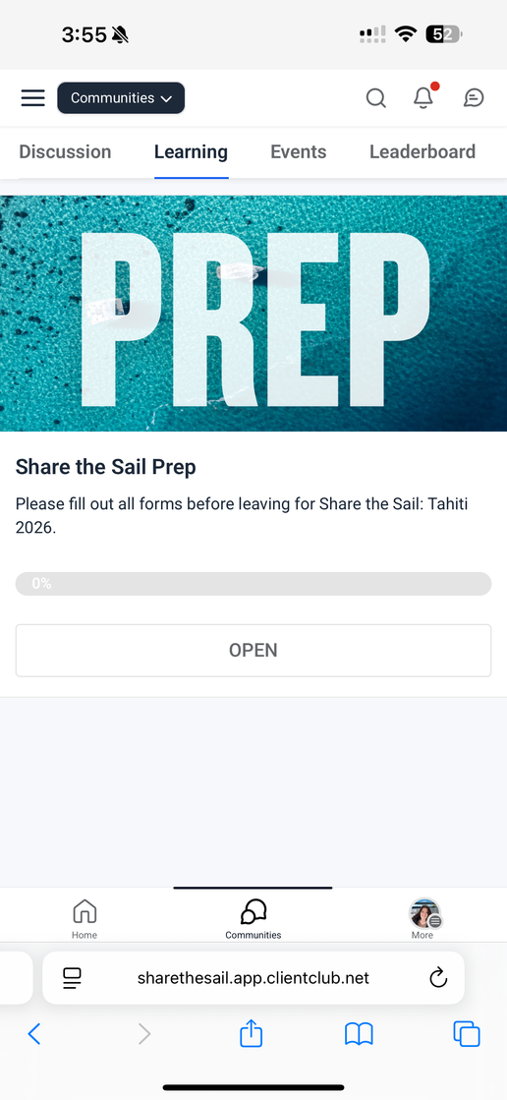

Portal and Preferences
Make payments
Fill out your required forms
Build your provisioning list
Post and make friends with your future crew
Find trip announcements and details

Slide 29
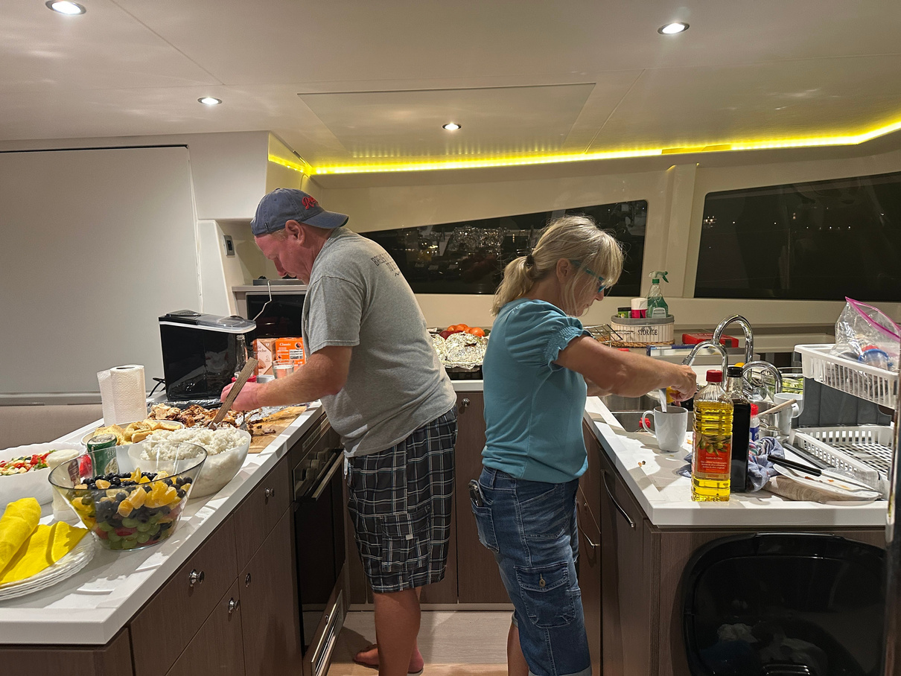
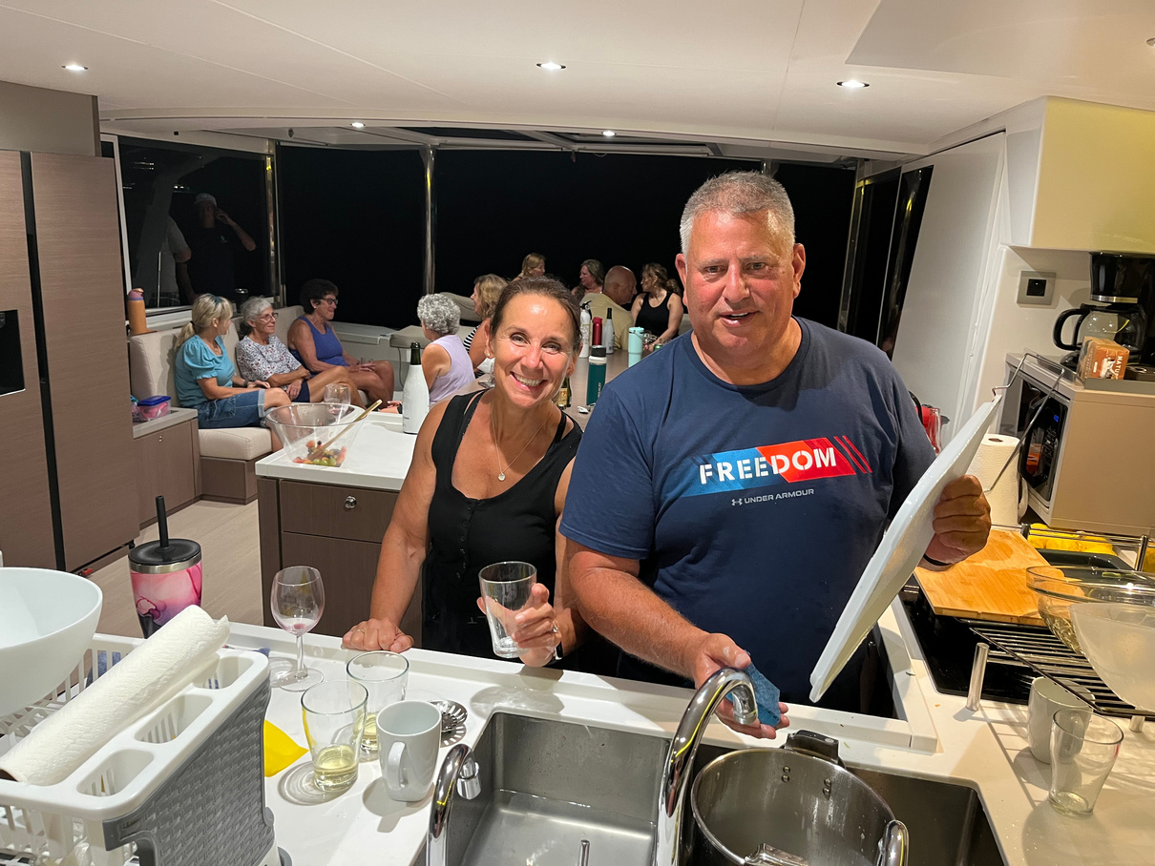
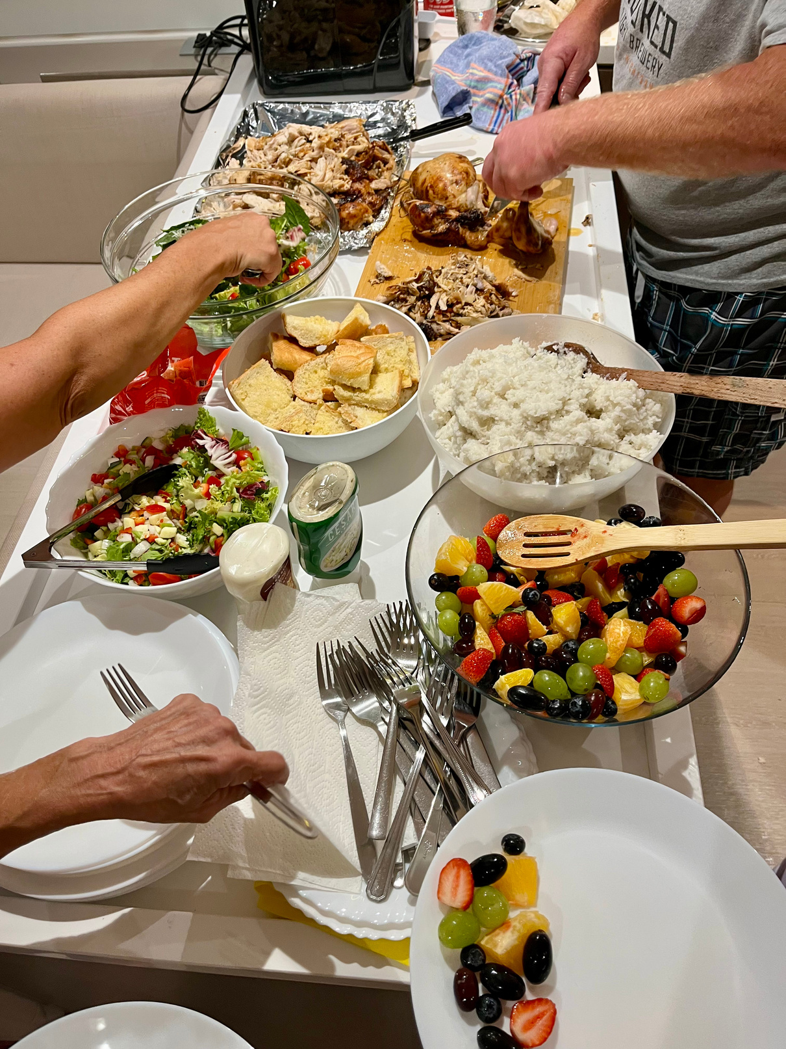
Provisioning information
  Your boat will be fully stocked with everything you need for breakfasts, lunches, snacks, and bottled water throughout the week.
  Dinners will be on your own — giving you the chance to explore local restaurants or enjoy beachside meals with your crew.
  Alcohol, soda, and specialty drinks are not included, so feel free to bring your favorites or pick some up locally once you arrive.

Slide 30
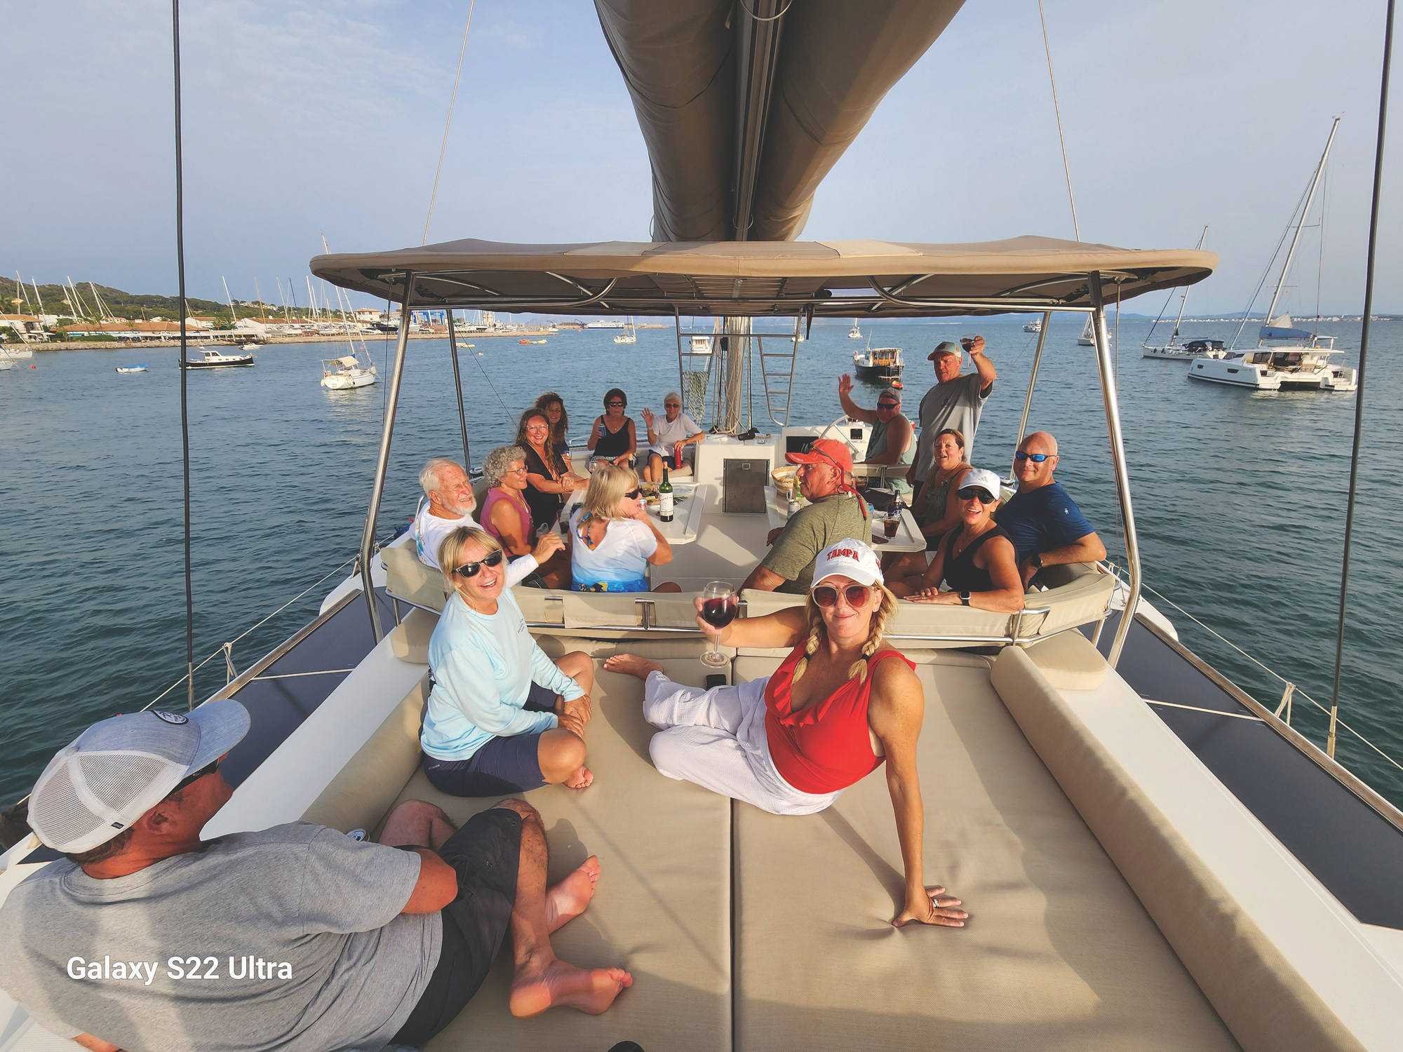
Boat Assignments
  Boat assignments will be finalized closer to the trip based on group dynamics, preferences, and availability.
  We do our best to match you with like-minded cruisers to ensure a fun and comfortable onboard experience. Each catamaran will have a professional captain and up to four double-occupancy cabins.
  Once assignments are made, you’ll receive details about your specific boat, your captain, and your fellow crewmates!

Slide 31
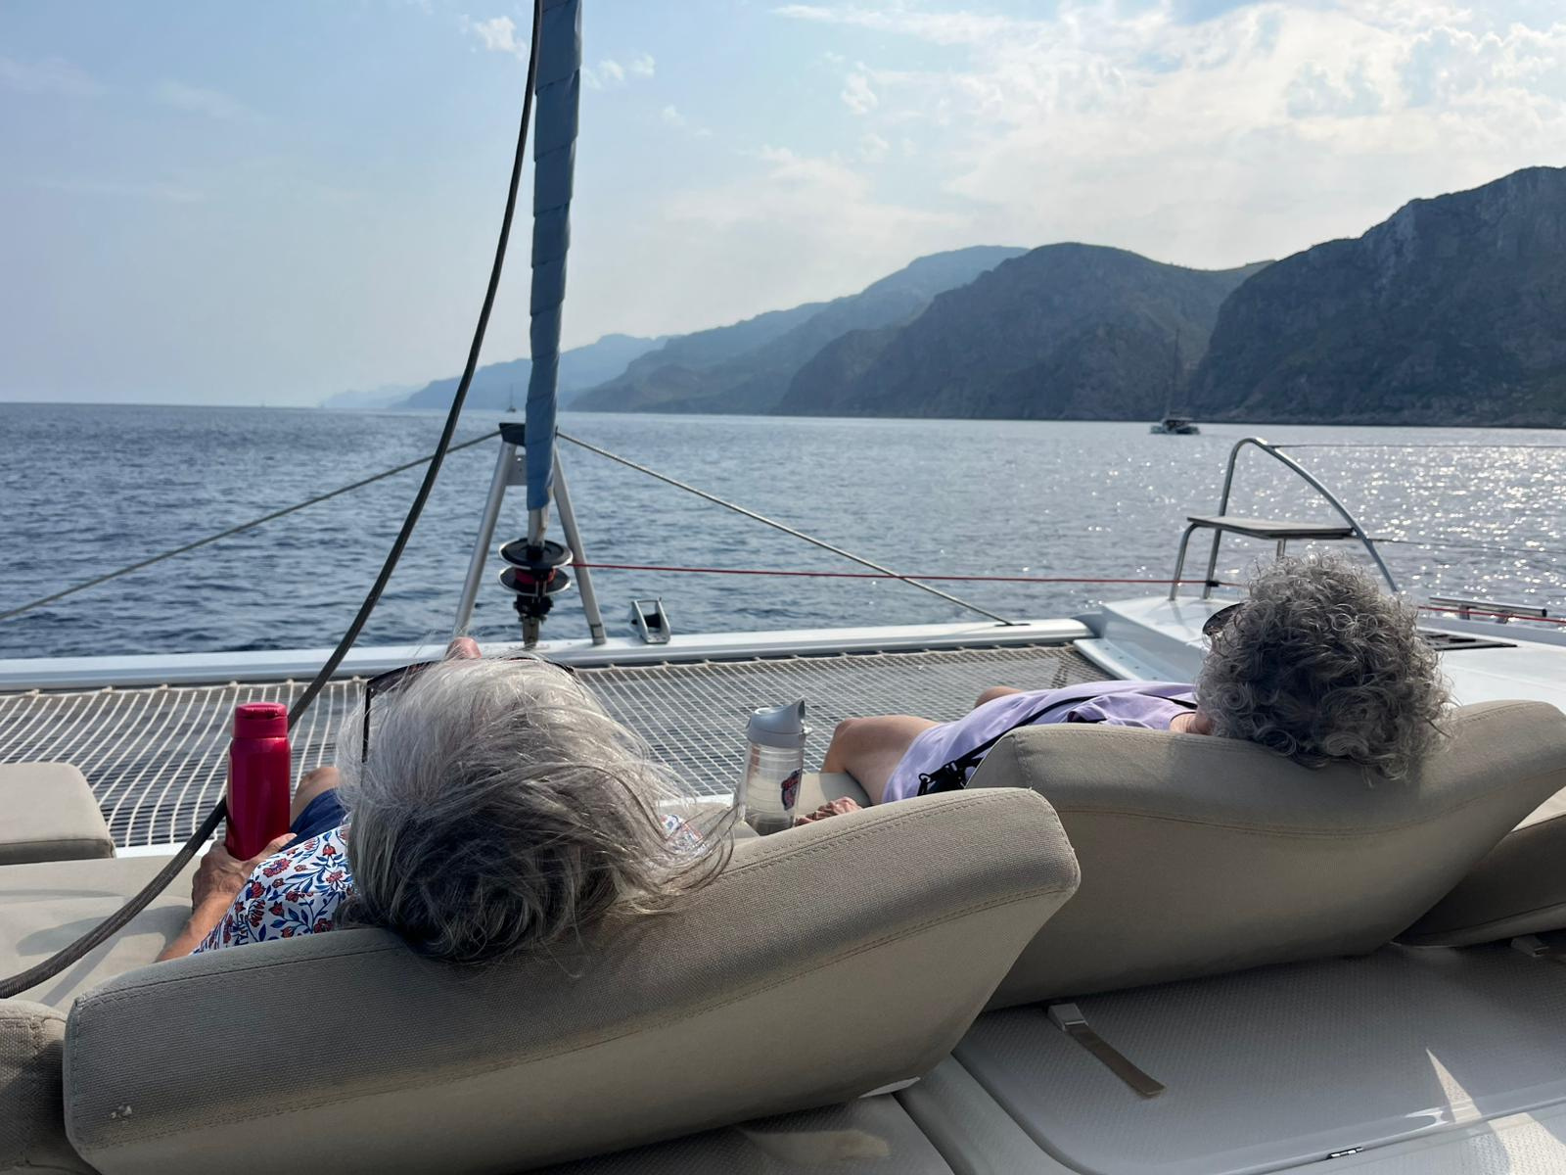
FAQ
  Will I have Wifi?
  What happens in an emergency?
  Do we have to stay with the group?
  Electricity on the boat?
  Is there a chef on the boat?
You can find more FAQs on our website!

Slide 32
Questions?

Slide 33
Slide 12 – Reserve Your Spot
Recap: Limited cabins, unforgettable adventure
Contact info / booking link
Call to action: “Join us in paradise – Tahiti 2026 awaits!”
Visual: Sunset sail with bold “Reserve Today” banner

