Slide 1
Adult Learner Survey: Transitioning to Remote/Virtual/Online Learning during the U.S. COVID-19 Pandemic June, 2020
David J. Rosen
djrosen123@gmail.com

Slide 2
1,064 Participants from June 7 to June 30
From 43 states, the top 11 participating states were, in order:
Kentucky, Connecticut,
New York, Oklahoma,
Massachusetts, Ohio,
Pennsylvania, Illinois,
California, Rhode Island, and
Florida

Slide 3
This was not, however, a representative sample of adult basic skills learners
Those who responded were able to get to the online survey, and nearly all were comfortable enough with digital technology to complete it.
This was a “convenience sample” not a random sample, so it was not a scientific survey.
However, I monitored the results every few days during the three weeks and they did not change much even as new states joined the survey so they are probably fairly representative of students who can get online.
We need more surveys of adult learners, ideally ones that have representative samples.

Slide 4
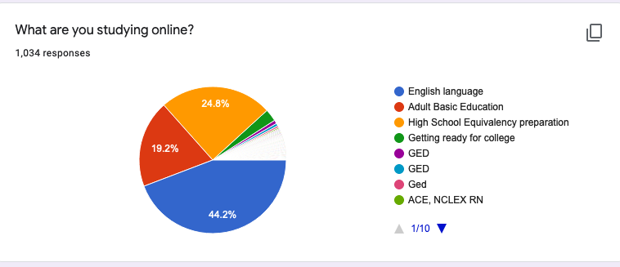
Representing a wide range of kinds of learners:

Slide 5
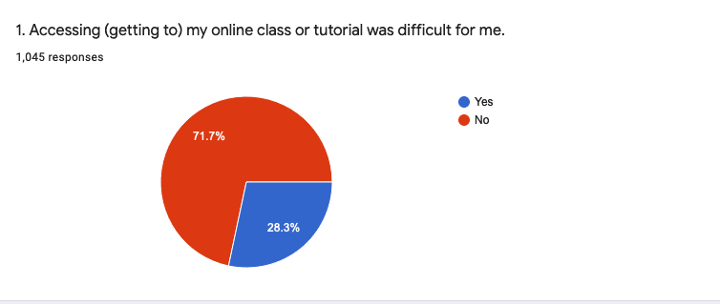
Difficulty accessing online class or tutorial

Slide 6
Why Difficult? Top reasons:
I didn’t have a computer at home (24%)
I had trouble using my smartphone to access (get to) my class or tutorial (20%)
I didn’t know how to find my online class (or tutorial) (14%)
I didn’t have Internet access at home (12 %)

Slide 7
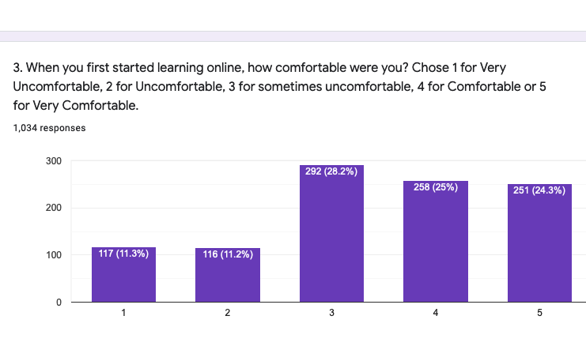
Comfort in the beginning

Slide 8
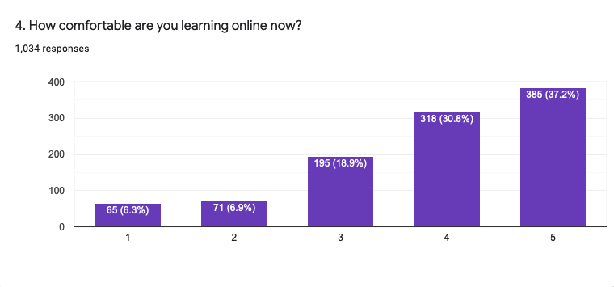
Comfort now…(when answered survey in June)

Slide 9
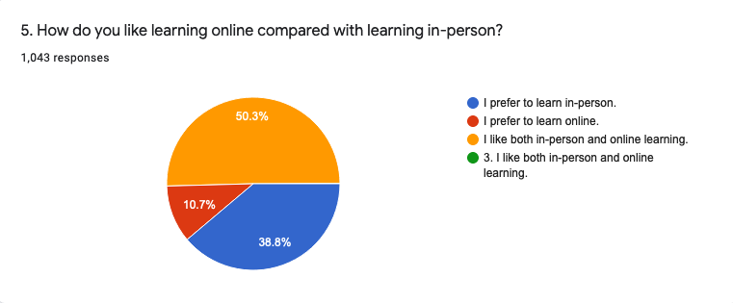
In-person vs. Distance vs. Blended/hybrid

Slide 10
What students learned to use:
6. During online learning, I learned to use (check all that apply):
Videoconference software (such as Zoom, GoToMeeting, etc.) (55%)
A computer for learning (46%)
A smartphone for learning (42%)
Google Classroom (32%)
An online course for learning (24%)
An app for learning (such as WhatsApp, Learning Upgrade, Cell-Ed) (19%)
An electronic tablet for learning (14%)
A chromebook for learning (13%)

Slide 11
My online class or tutorial could be improved if…. (check all that apply)
7. I think my online class (or tutorial) could be better if .... (check all that apply):
My school or program could lend students free computers, tablets or chromebooks (35%)
I had free or low-cost Internet (33%)
I was taught how to do online learning (31%)
It were available on a different day or time (22%)
Our teacher knew more about using online technology (16%)

