Slide 1


MORTGAGE PROTECTION
PROTECT YOUR MOST IMPORTANT ASSET: YOUR HOME
YOUR NAME
National Producer Number: YOUR PRODUCER #

Slide 2

INSERT PHOTO OF
YOUR DRIVER’S LICENSE
INSERT PHOTO OF
YOUR STATE LICENSE
INSERT PHOTO OF
YOUR BUSINESS CARD
State License and Photo I.D.

Slide 3

WHAT I DO
Life
Mortgage Protection
Term, Universal and Whole
Final/Burial Expenses
Accidental
Health
Dental
Disability
Medicare Supplemental
Long Term Care
Critical Illness
Asset Strategies
Annuities
Indexed Universal Life
College Tuition

Slide 4
WHY I DO THIS
INSERT PHOTO OF
YOUR “WHY”
(Your Family, Your Dogs, Your Church, etc.)

Slide 5

WHAT WE WILL DO
Go Through The Health Information
Review Financial Need
Options Available
Help Apply With The Carrier

Slide 6

HEIGHT AND WEIGHT?
TOBACCO/NON-TOBACCO?
DIABETES?
(DIAGNOSIS DATE, MEDS, INSULIN, COMPLICATIONS)
CANCER?
(DIAGNOSIS DATE, MEDS, LAST TAKEN)
HIGH BLOOD PRESSURE?
(HOW MANY MEDS, HOSPITALIZED)
HEART ISSUES?
(BLOOD THINNERS, STENT, A-FIB, HEART ATTACK)
LUNG ISSUES?
(COPD, CHRONIC ASTHMA, MEDS)
STROKE?
(DIAGNOSIS DATE AND MEDS)
SLEEP APNEA?
(FOR SNORING, ON OXYGEN)
WHAT HEALTH QUESTIONS?

Slide 7
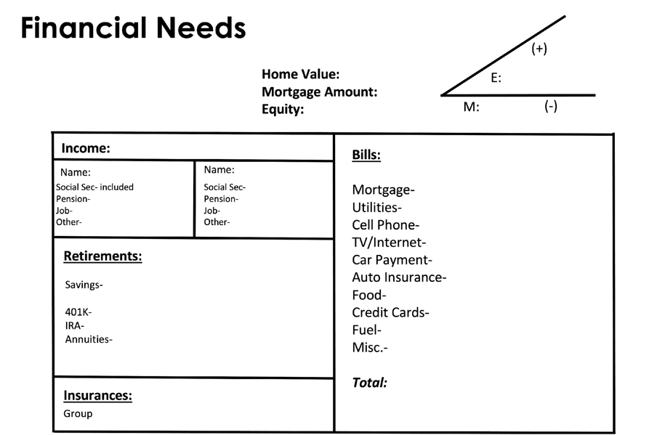

Slide 8
30 yr. =
15 yr. =
WHAT OPTIONS?:
CLIENT
NAME
CLIENT
NAME
OPTION #1 Full Mortgage $300,000
30 yr. =
15 yr. =
30 yr. =
15 yr. =
30 yr. =
15 yr. =
30 yr. =
15 yr. =
OPTION #2 Half Mortgage $150,000
6 mos =
9 mos =
12 mos=
30 yr. =
15 yr. =
OPTION #3 Equity Protection

Slide 9
WHAT OPTIONS AVAILABLE::
CLIENT
NAME
CLIENT
NAME
OPTION #1 Full Mortgage $300,000
30 yr. = 130
15 yr. = 95
30 yr. = 230
15 yr. = 130
30 yr. = 85
15 yr. = 52
30 yr. = 92
15 yr. = 63
OPTION #2 Half Mortgage $150,000
6 mos = 65
9 mo = 82
12 mos= 98
6 mos = 72
9 mos = 94
12 mos= 102
OPTION #3 Equity Protection

