Slide 1


Slide 2


First Continental Life & Accident Insurance Company is a Select Insurance Carrier founded in 1997 based out of Sugar Land, TX.
Since its inception, FCL Dental has become a leader in providing access to affordable quality dental benefits.
The provider choices are vast as we utilize the DenteMax Plus network, a 50-state network.
There are over 770,000 access points in the Dentemax Plus network.
Find a provider by visiting https://fcldental.dentemaxportal.com/
Select Find a Dentist. Select Dentemax Plus.

Slide 3
$1,500
MEMBER $44.01
MEMBER + SPOUSE $78.26
MEMBER + CHILD(REN) $87.22
FAMILY $125.37
$3,000
MEMBER $49.55
MEMBER + SPOUSE $87.88
MEMBER + CHILD(REN) $97.51
FAMILY $136.00
$5,000
MEMBER $56.50
MEMBER + SPOUSE $99.16
MEMBER + CHILD(REN) $112.00
FAMILY $160.73
BASIC 80%
No waiting period
Simple restorative services (fillings)
Simple extractions
Palliative treatment for dental pain, local anesthesia
Sealants for children ages 6-15 (one per tooth)
Periapical X-rays
Full mouth or panorex X-rays (one per 36 months)
PREVENTIVE 100%
No waiting period
Routine Exams (one per 6 months)
Prophylaxis (cleanings-one per 6 months)
Emergency exams for dental pain (minor procedures)
Fluoride treatments for dependent children under age19 (one per 12 months)
Bitewing X-rays (once per 6 months)
MAJOR 50%
12 month waiting period
Major restorative services (crowns and inlays)
Prosthetics (bridges, dentures)
Space Maintainers
General anesthesia (for services dentally necessary)
Endodontics/root canal therapy
Periodontics
Implants
WAITING PERIOD FOR MAJOR SERVICES CAN BE WAIVED WITH PROOF OF PRIOR COVERAGE

Slide 4
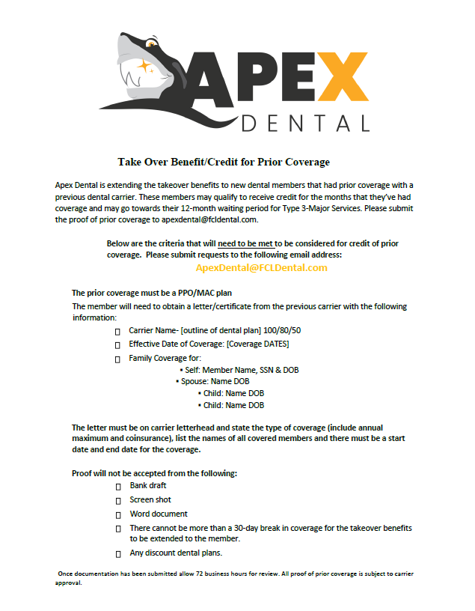

Slide 5

Maximum Allowable Charge (MAC) Plan
Out Of Network Comparison
In Network
Contracted Provider:
The discounted fee is : $70.00
Your plan pays:
(80% Basic x $70 discounted fee) $56.00
Your out-of-pocket cost $14.00
Out of Network
Non-Contracted Provider covered at the in-network fee schedule (MAC)
Dentist usual fee is: $110.00
Your plan pays:
(80% Basic x $50 in network fee) $40.00
Your out-of-pocket cost: $70.00
For Presentation Purpose Only

Slide 6
Keys to Dental Plans
The goal of your dental plan is reducing your out-of-pocket cost.
Simply comparing rates is NOT the most educated way to purchase a plan.
All plans can be different even when there is the same yearly maximum.
Co-Insurance and waiting periods along with covered services are the most important.
Our plan is the most comprehensive, and one of the larger if not the largest network at the most reasonable rate.
GO IN NETWORK!!!

Slide 7
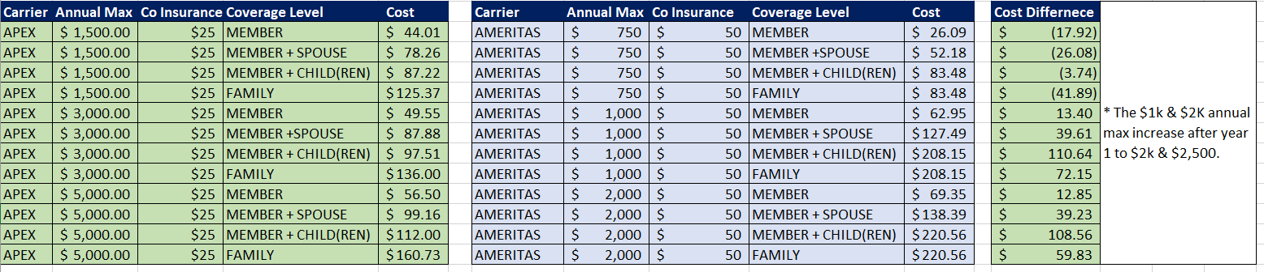
Price Comparison

Slide 8
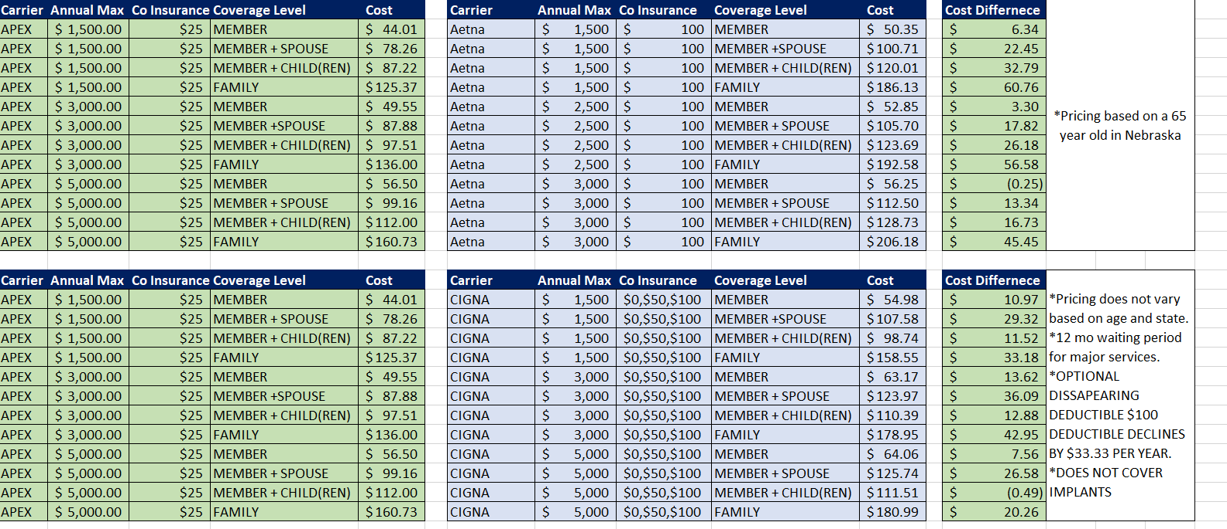
Price Comparison

Slide 9
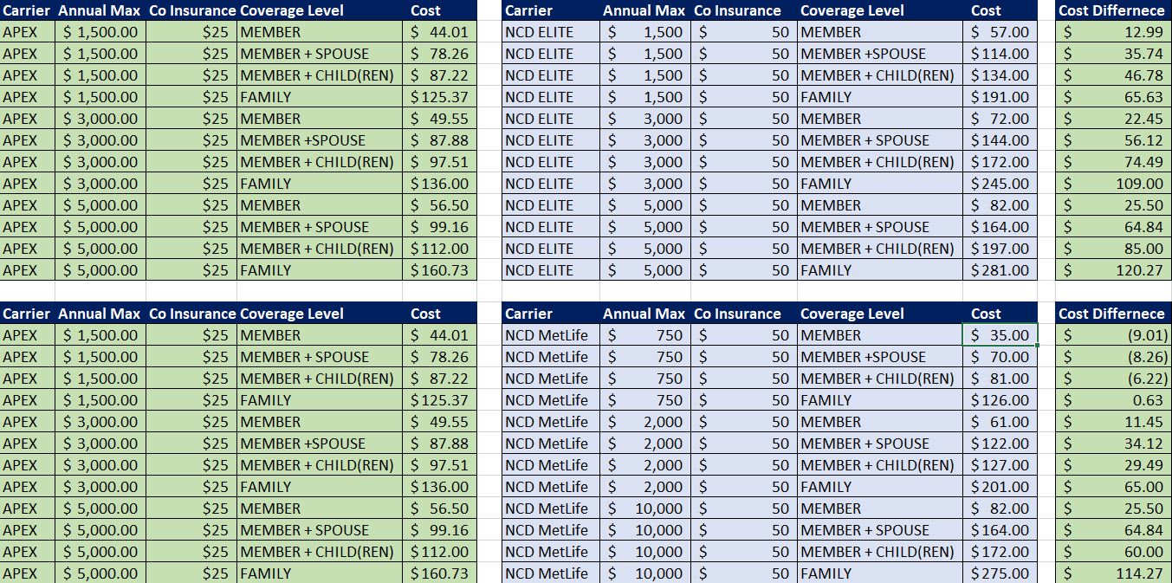
Price Comparison

Slide 10


Slide 11

An Arizona License is required to sell Apex Dental.
The association (ABH) is domiciled in Arizona and is built on a group chassis, which requires anyone selling our dental product to be licensed in the state the association is domiciled in.

Slide 12
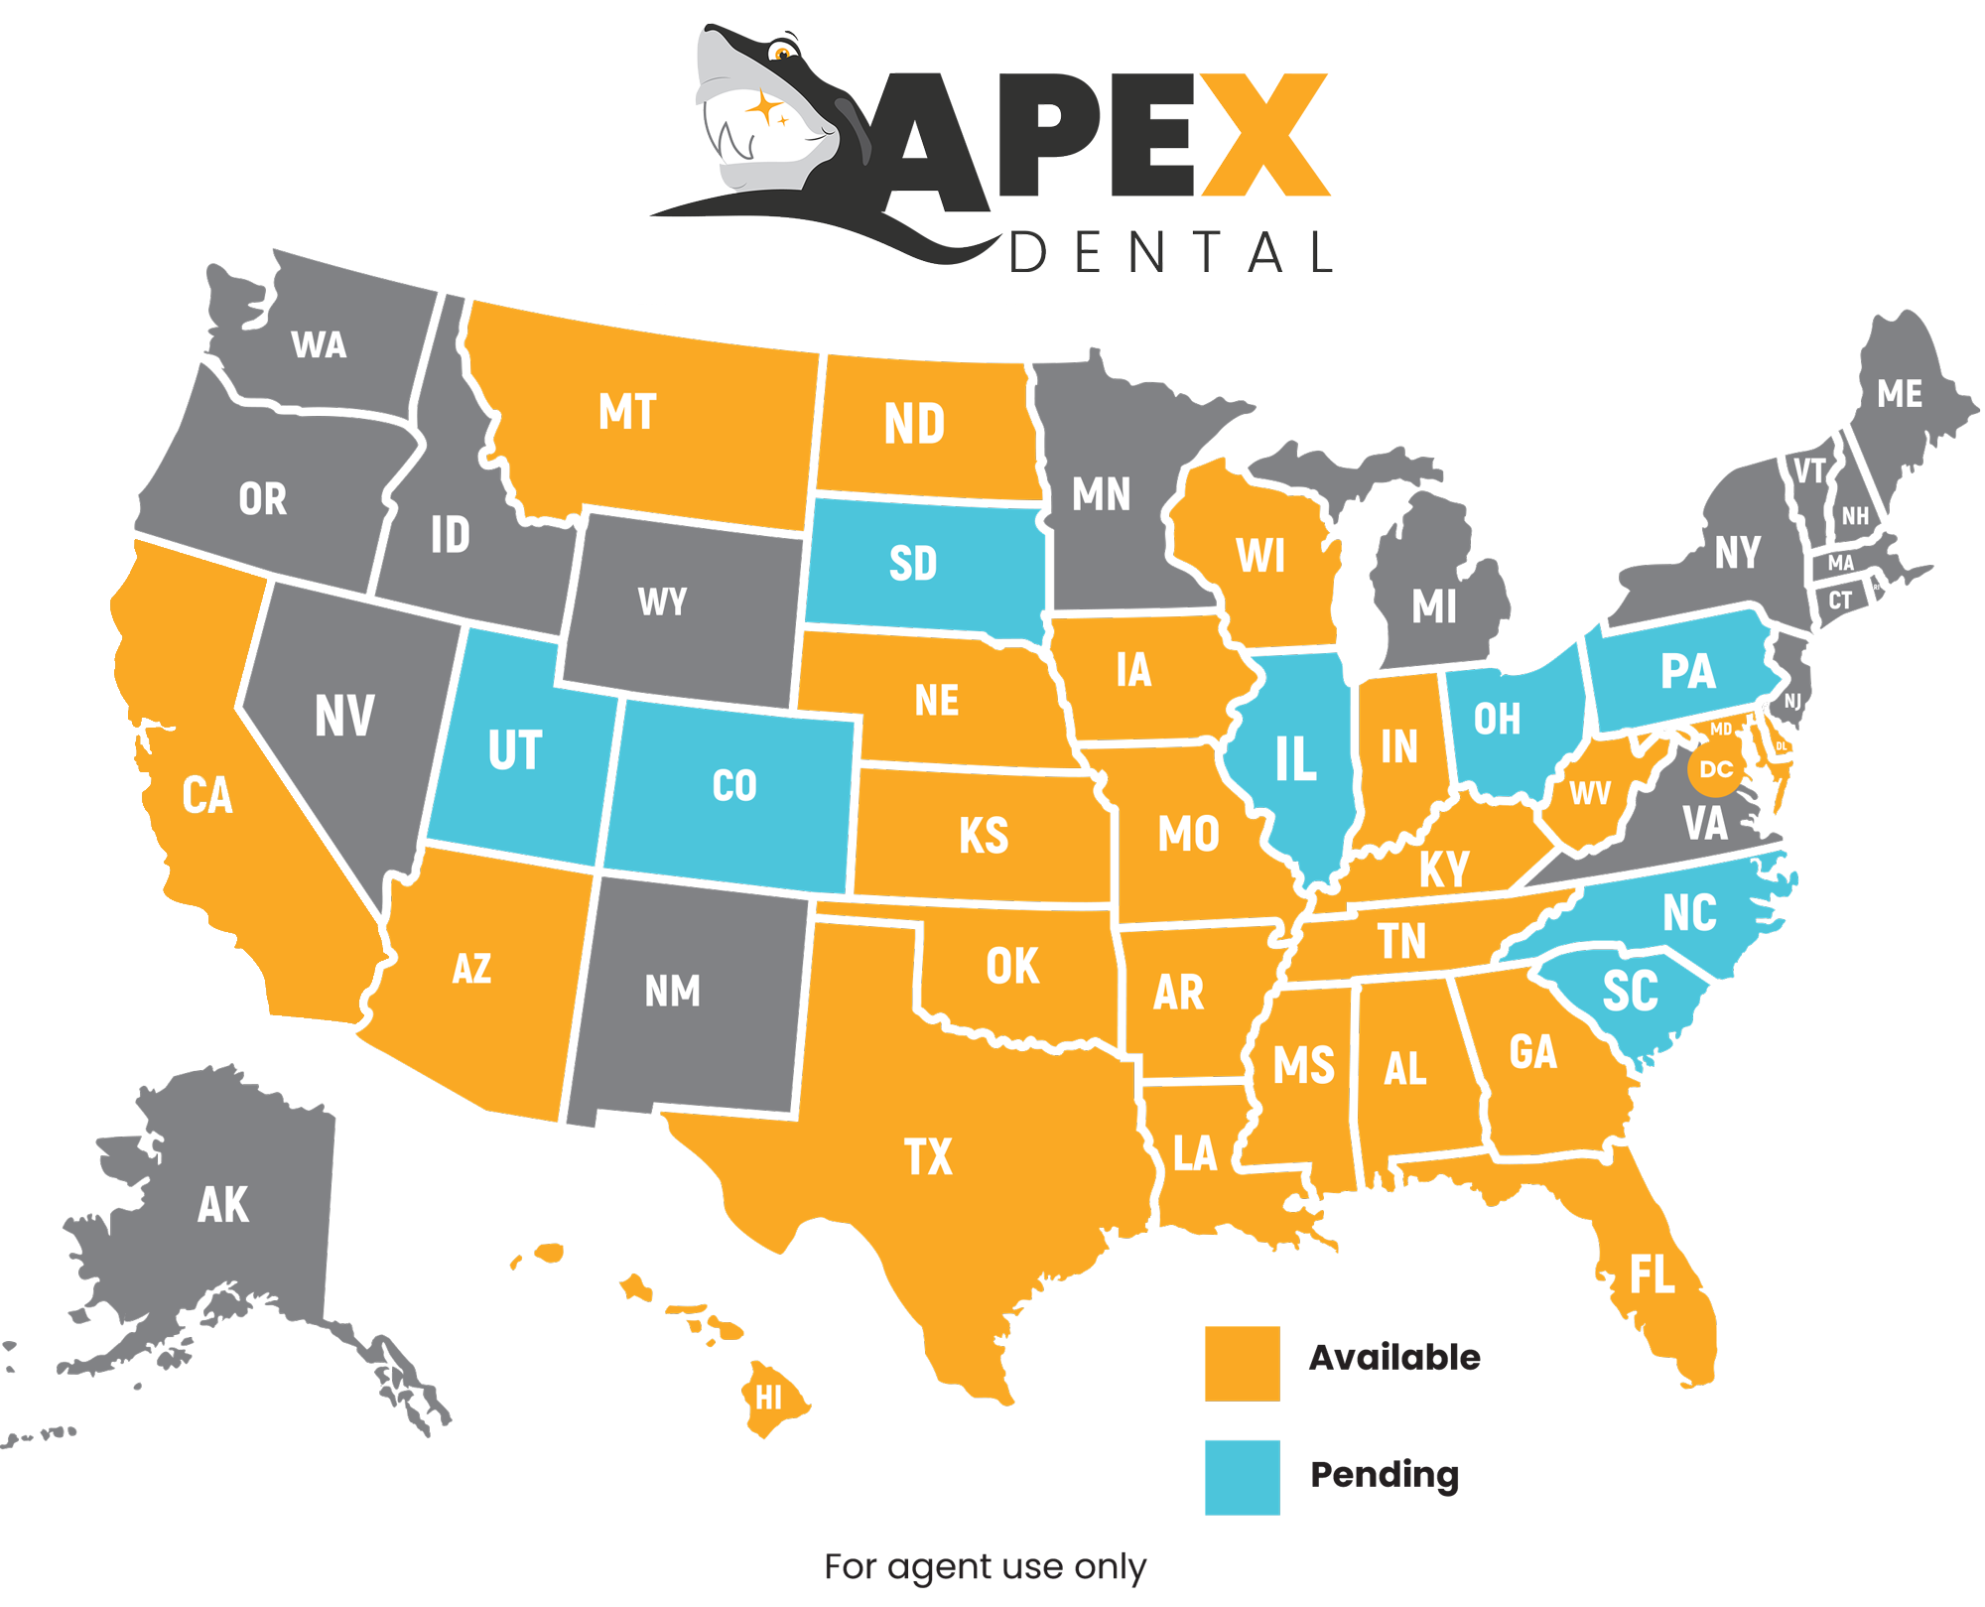

Slide 13

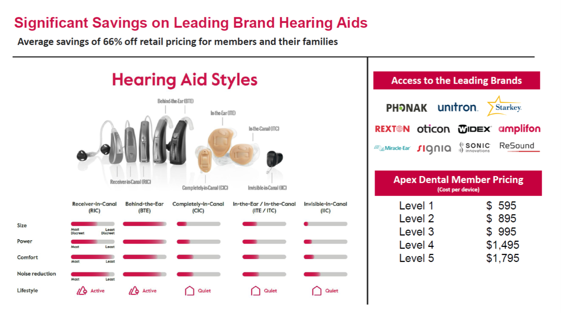

Slide 14

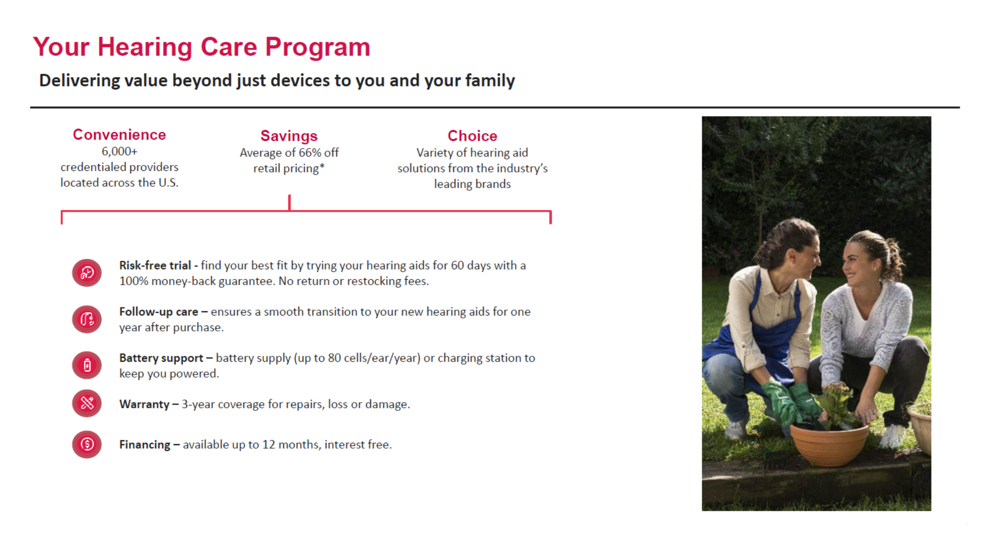

Slide 15
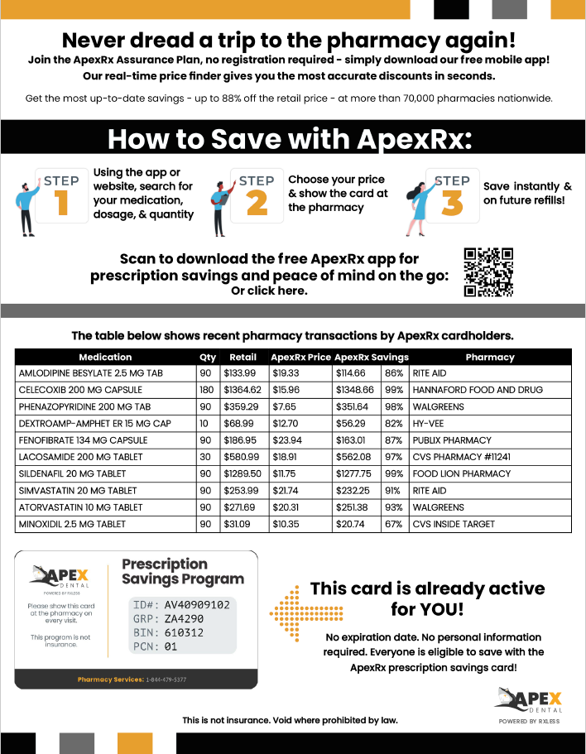

Slide 16
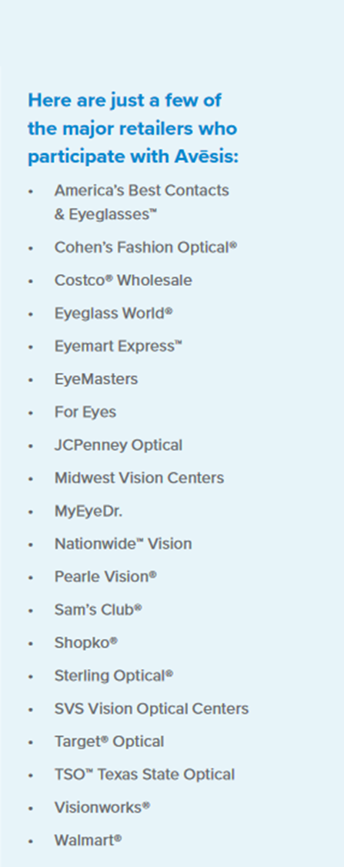

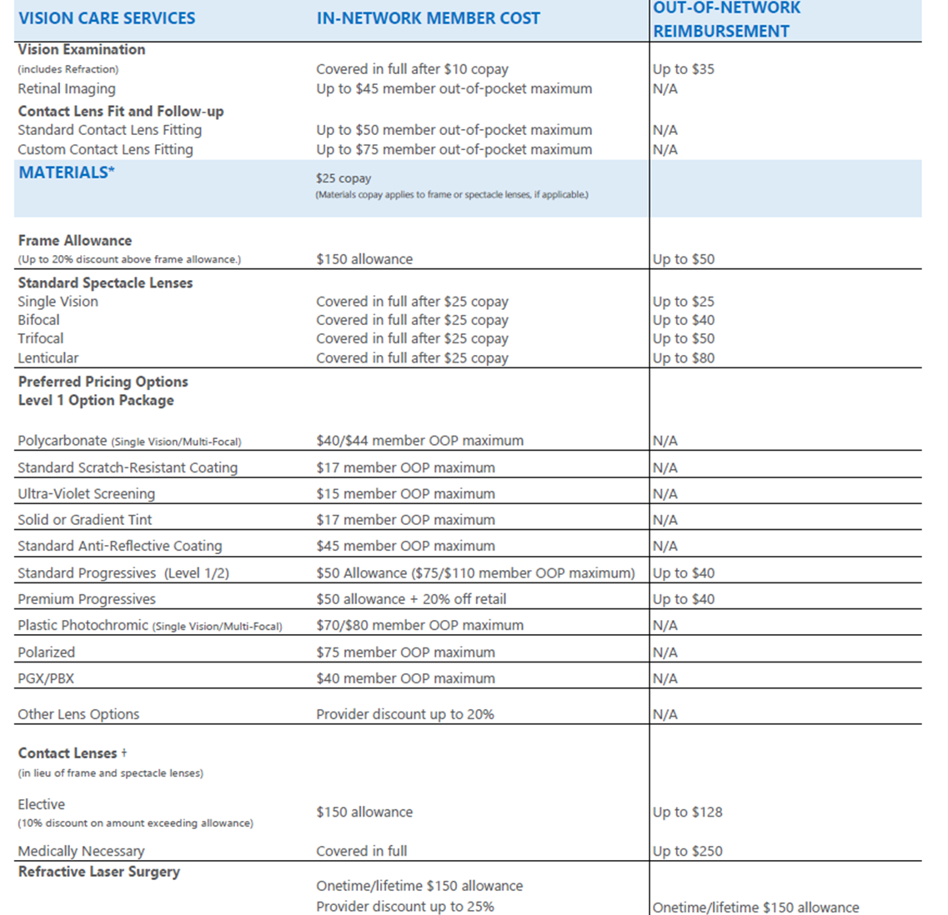

Slide 17

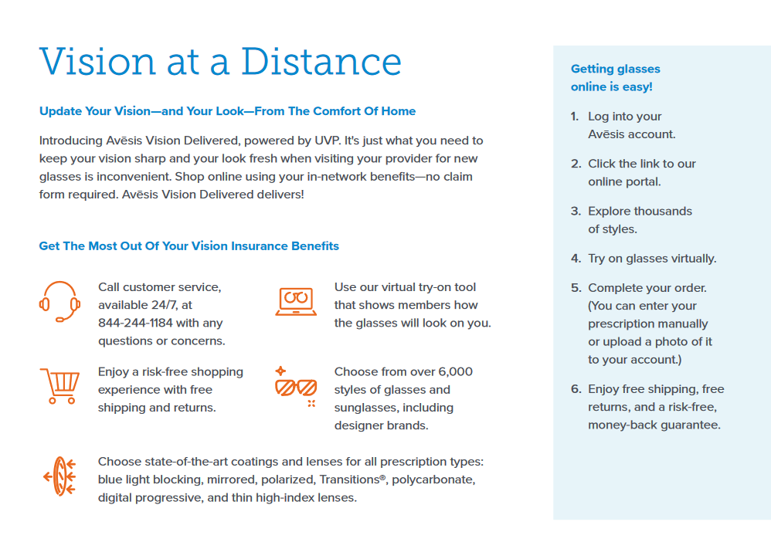

Slide 18
Level | Price
Member | $11.46
Member + Spouse | $20.25
Member + Child | $21.93
Family | $27.76

Slide 19
Apex Dental Important Contacts
Michael Brocato
Director of National Sales
O: 281-276-1019
C: 281-924-1214
Lexi Mireles
Account Manager
lmireles@fcldental.com
O: 281-276-1060
Customer Service
1.346.460.5451
ID Cards, where to find a dentist, etc.
FCL Dental Customer Service
1.877.493.6282
Claims Only

