Slide 1

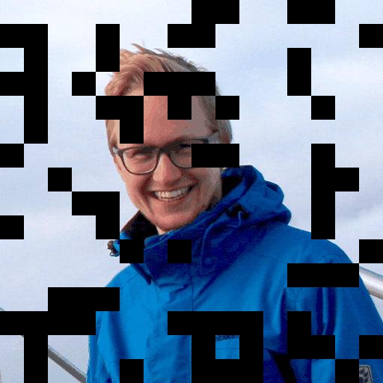
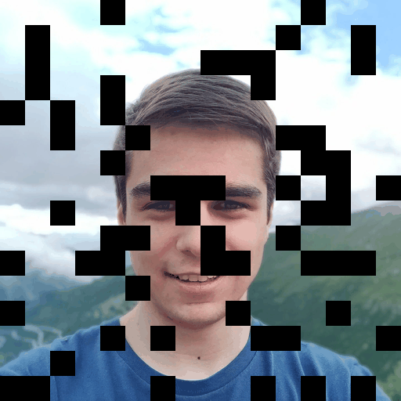
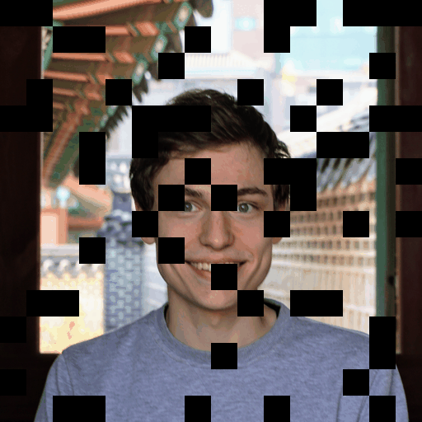
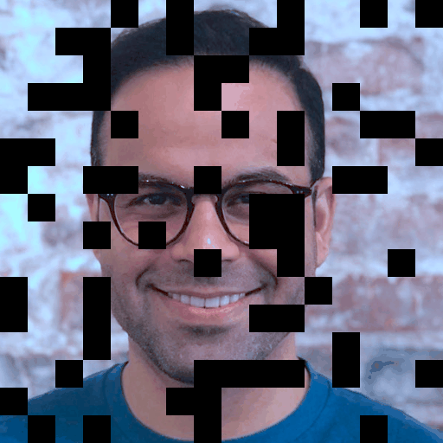
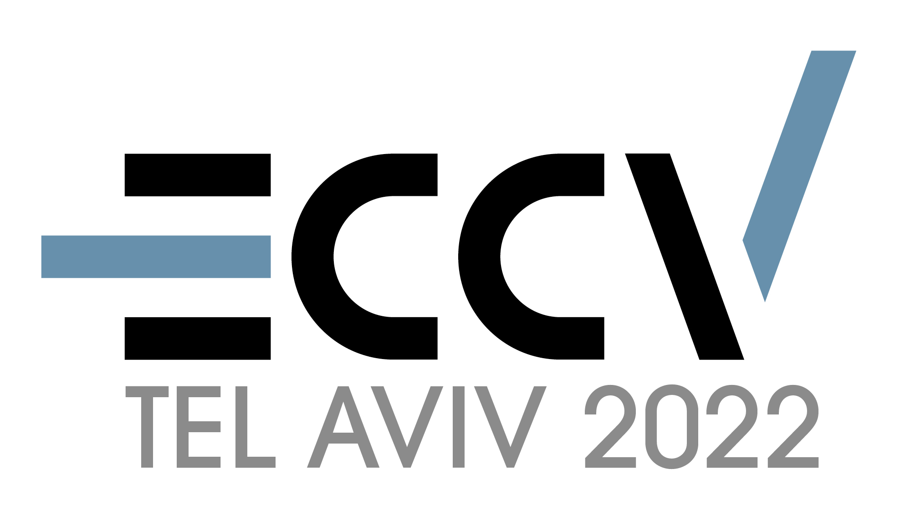
MultiMAE:
Multi-modal Multi-task
Masked Autoencoders
multimae.epfl.ch
Roman Bachmann*, David Mizrahi*, Andrei Atanov, Amir Zamir
*Equal contribution

Slide 2

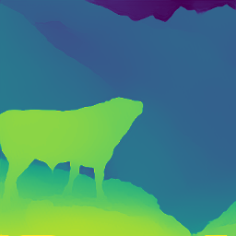


We can process multiple modalities
ECCV 2022
“A fine Simmental bull, its tawny coat blotched with white, overlooks the valley from the heights of its pastureland…”
(“Moo” 🐮)
MultiMAE
[Taureau dans les Alpes, Eugène Burnand, 1884]
Multi-modality a key aspect of biological intelligence. [The development of embodied cognition: six lessons from babies. Smith & Gasser, 2005] [Sensory Modality Segregation. VR de Sa, 2003]

Slide 3
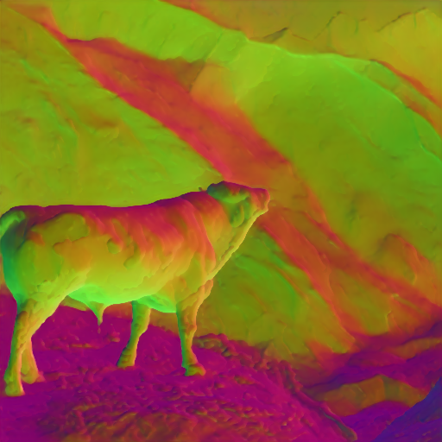
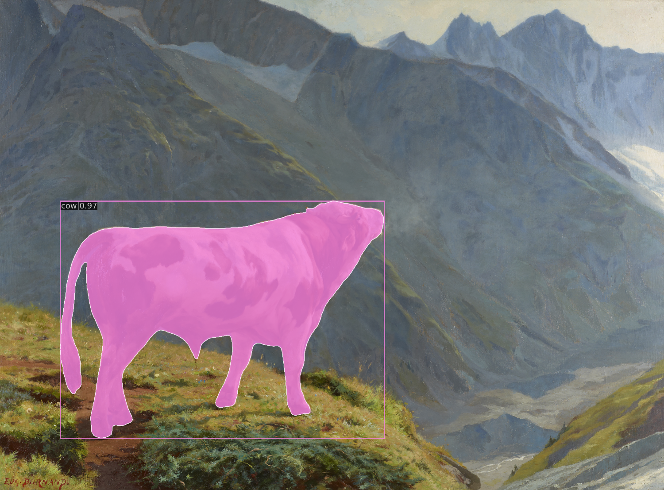
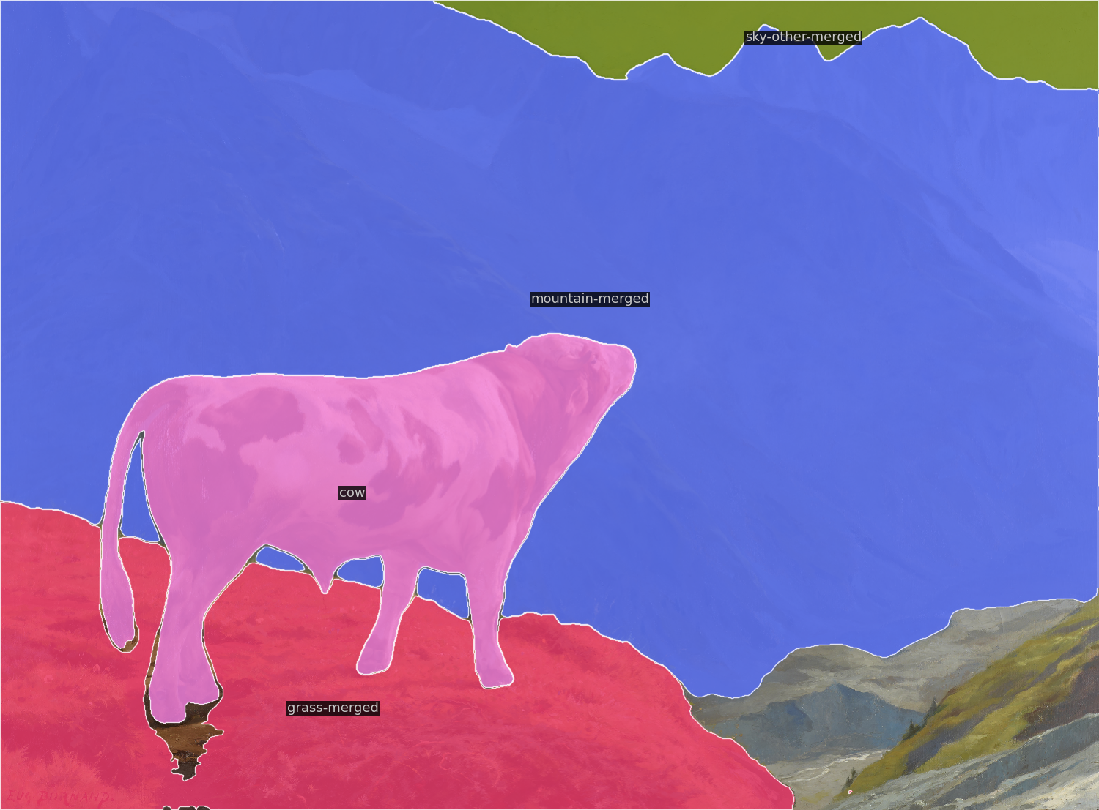
We can perform many tasks
“A fine Simmental bull, its tawny coat blotched with white, overlooks the valley from the heights of its pastureland…”
Surface normals
Depth
ECCV 2022
Object detection
Segmentation
MultiMAE
caption: a cow in the mountains looking up
Q: What is the bull looking at?
A: mountains

Slide 4
Our models should be multi-modal & multi-task
ECCV 2022
Multi-modal & multi-task model
Modality 1
Task 1
Modality 2
Task 2
MultiMAE
Modality 3
Task 3

Slide 5
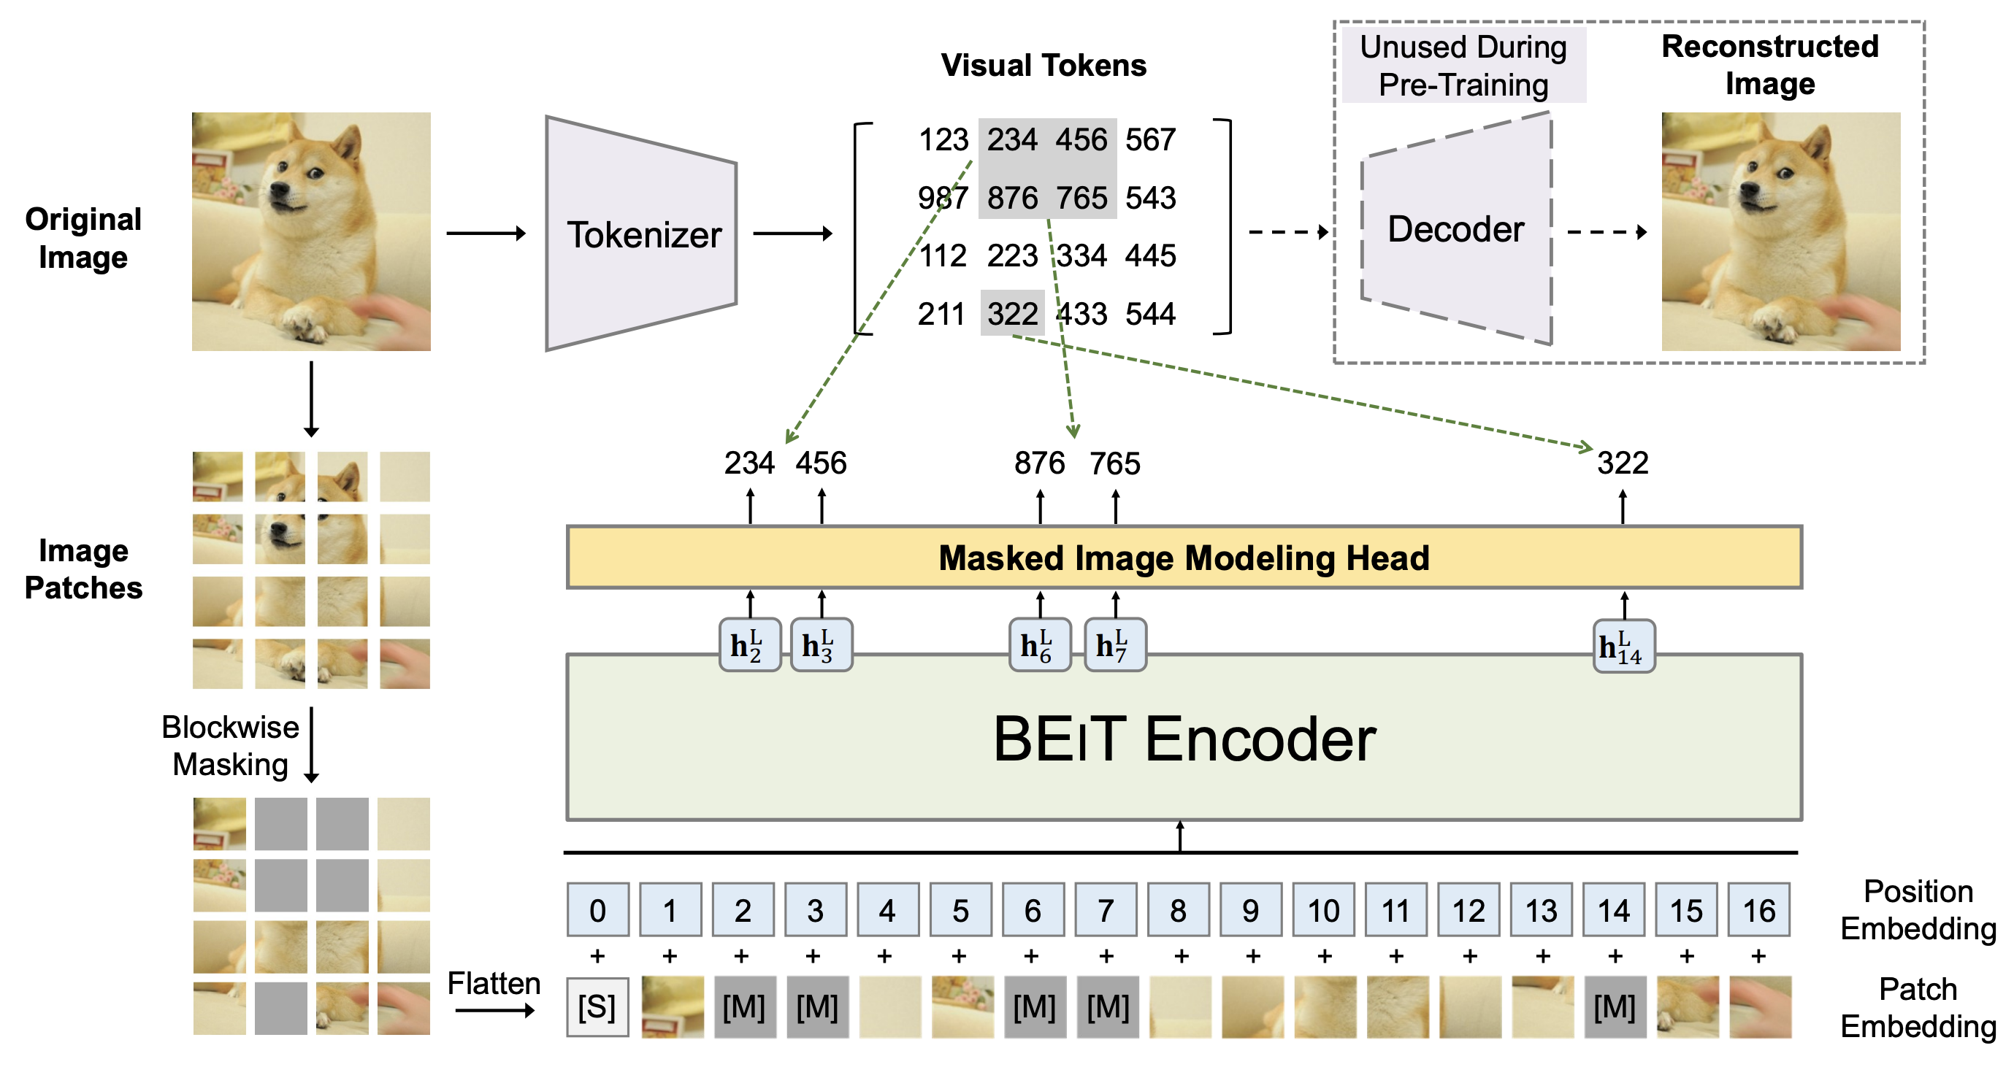
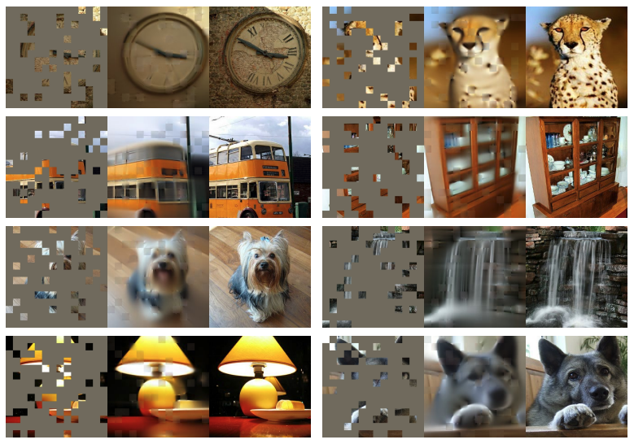
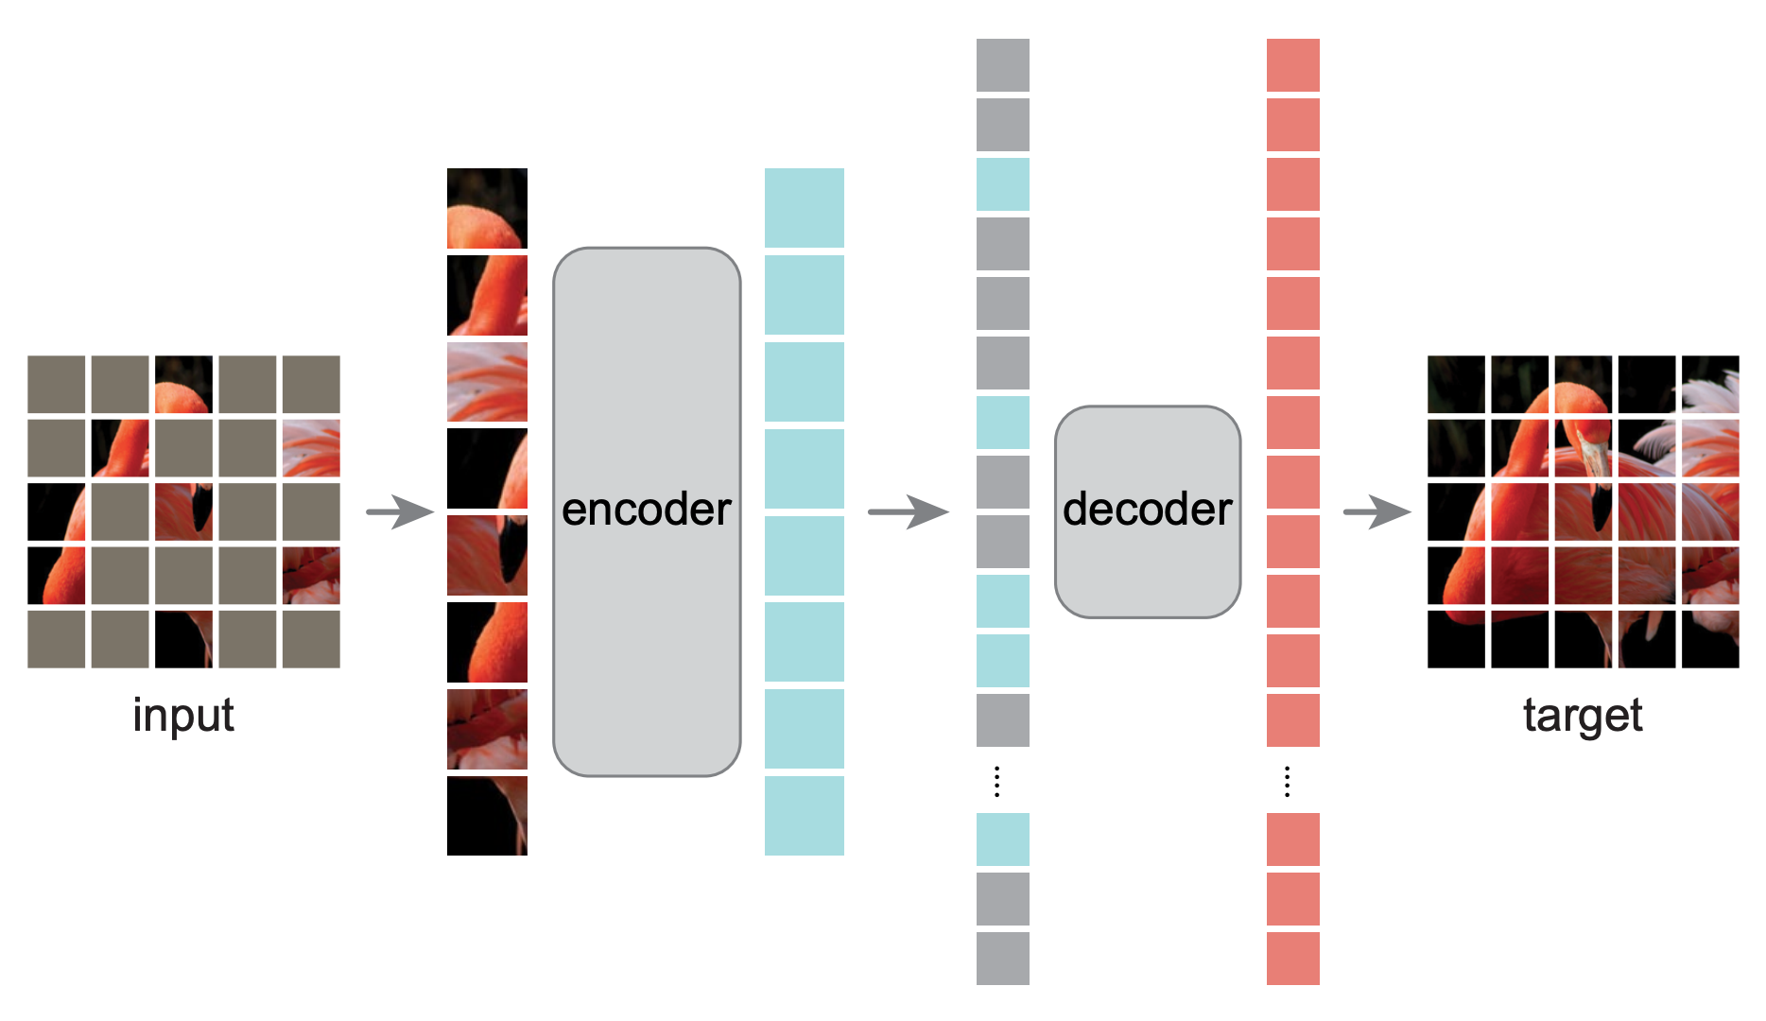
Masked autoencoding is a powerful pre-training objective
BEiT
Bao et al.
ICLR 2022
ECCV 2022
MultiMAE
MAE
He et al.
CVPR 2022

Slide 6
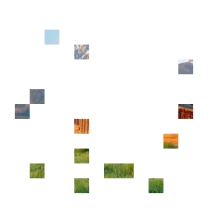

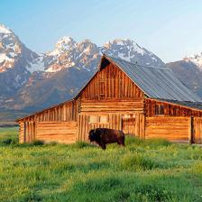

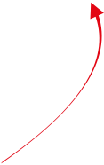

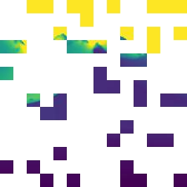
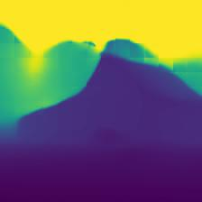
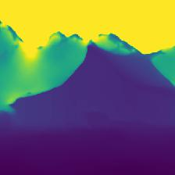


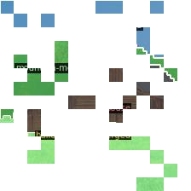
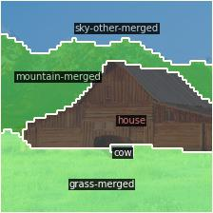
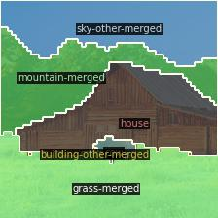

Learn cross-modal predictive coding through masking
Selected input patches
Predictions
Non-masked reference
Masked autoencoding useful beyond RGB-only “in-painting”
Cross-modal predictive coding:
Learn to predict any patch of any modality from any other
To complete masked regions, information from multiple modalities needs to be effectively combined
RGB
ECCV 2022
Depth
MultiMAE
Semantic

Slide 7
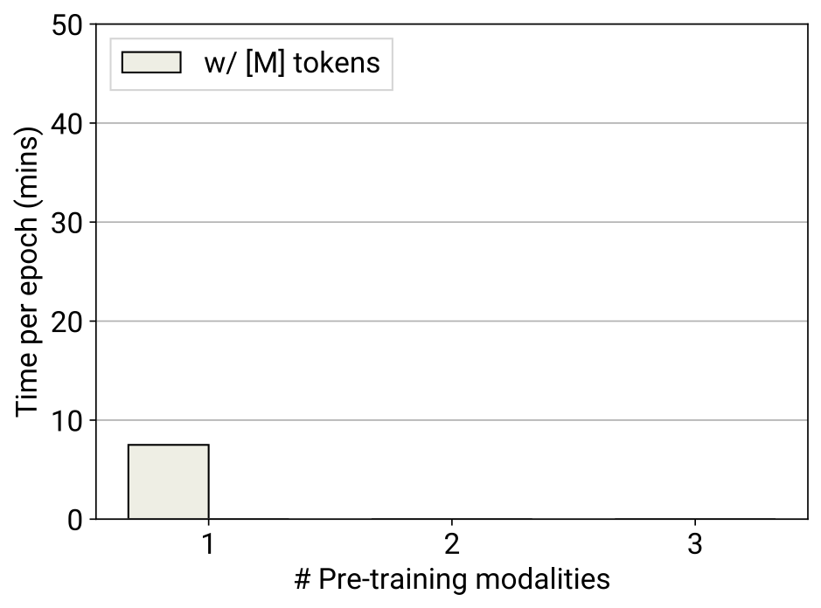
Naïvely encoding multiple modalities is intractable
Using mask tokens ( ) to read-out predictions gets expensive…
ECCV 2022
Transformer encoder
MultiMAE
RGB

Slide 8
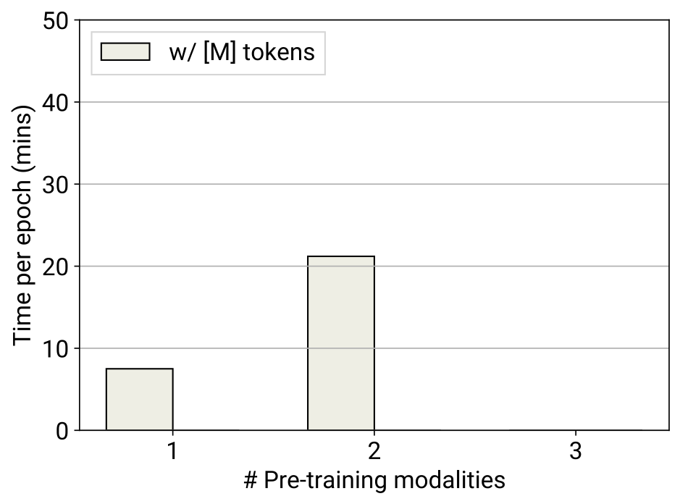
Naïvely encoding multiple modalities is intractable
Using mask tokens ( ) to read-out predictions gets expensive…
… especially when encoding more modalities.
ECCV 2022
RGB
Transformer encoder
MultiMAE
Depth

Slide 9
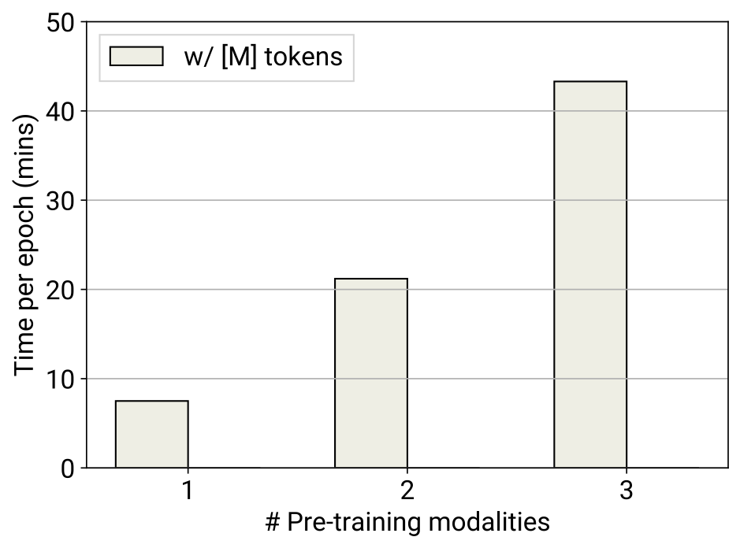
Naïvely encoding multiple modalities is intractable
Using mask tokens ( ) to read-out predictions gets expensive…
… especially when encoding more modalities.
RGB
ECCV 2022
Transformer encoder
MultiMAE
Depth
Semantic

Slide 10
MultiMAE enables efficient multi-modal training
ECCV 2022
Solution: Drop mask tokens in encoder and read out predictions with shallow decoders, as in MAE [He et al. CVPR 2022]
RGB
Transformer encoder
MultiMAE
Depth
Semantic

Slide 11
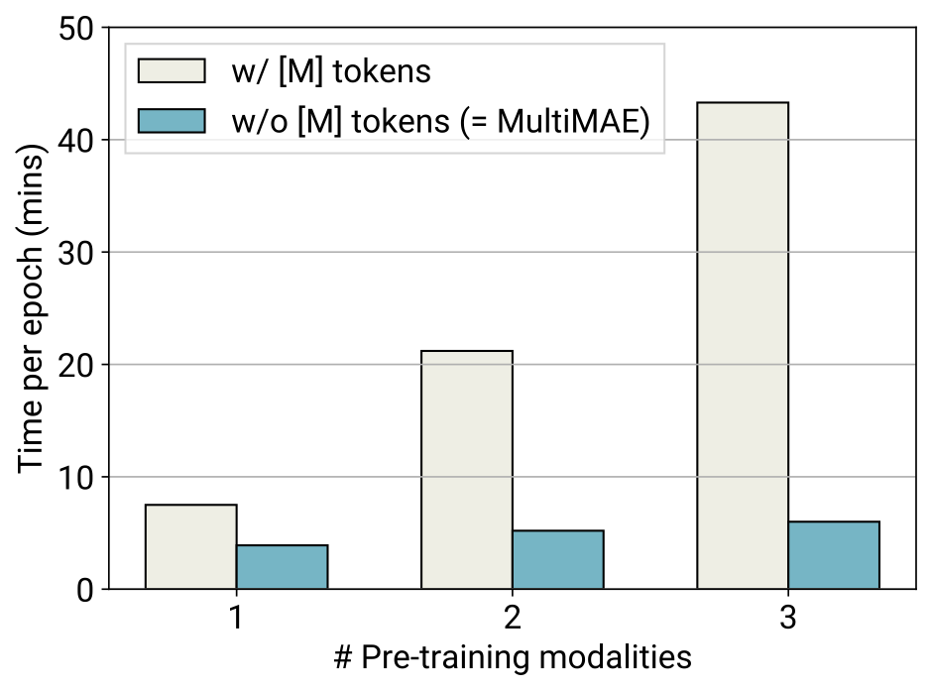
MultiMAE enables efficient multi-modal training
ECCV 2022
Solution: Drop mask tokens in encoder and read out predictions with shallow decoders, as in MAE [He et al. CVPR 2022]
Decoder
RGB
Transformer encoder
Depth
MultiMAE
Decoder
7x speedup !
Semantic
Decoder

Slide 12
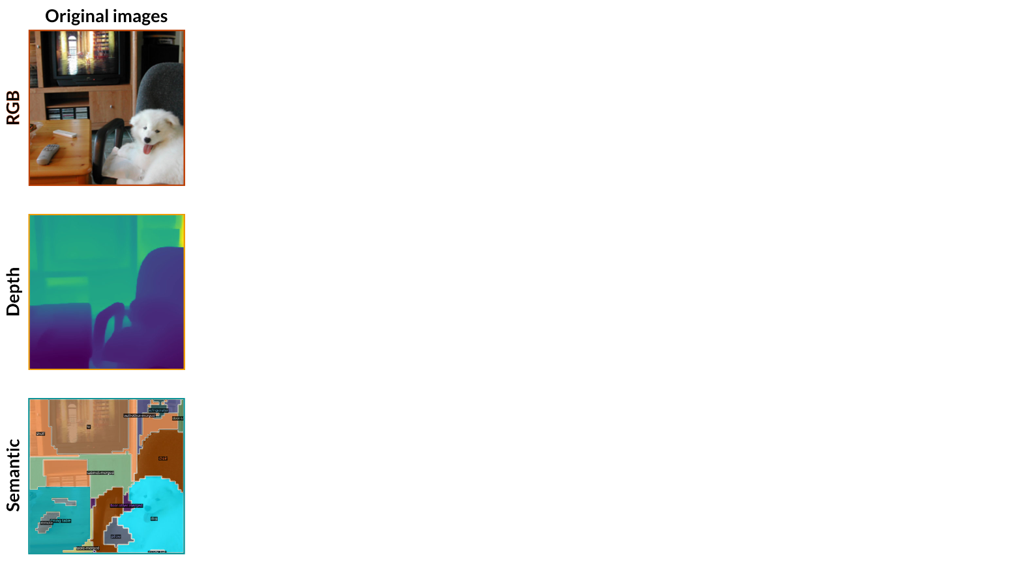
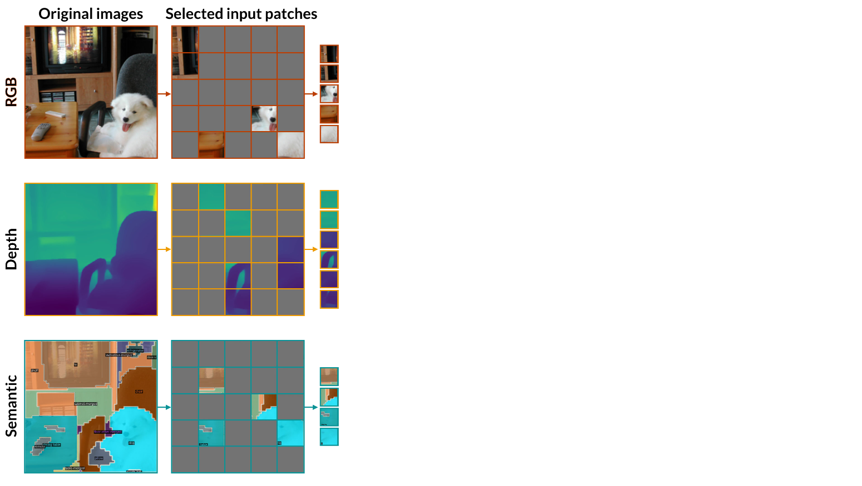
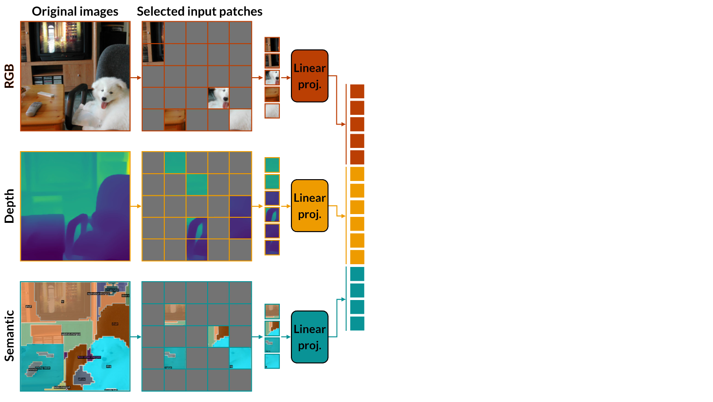
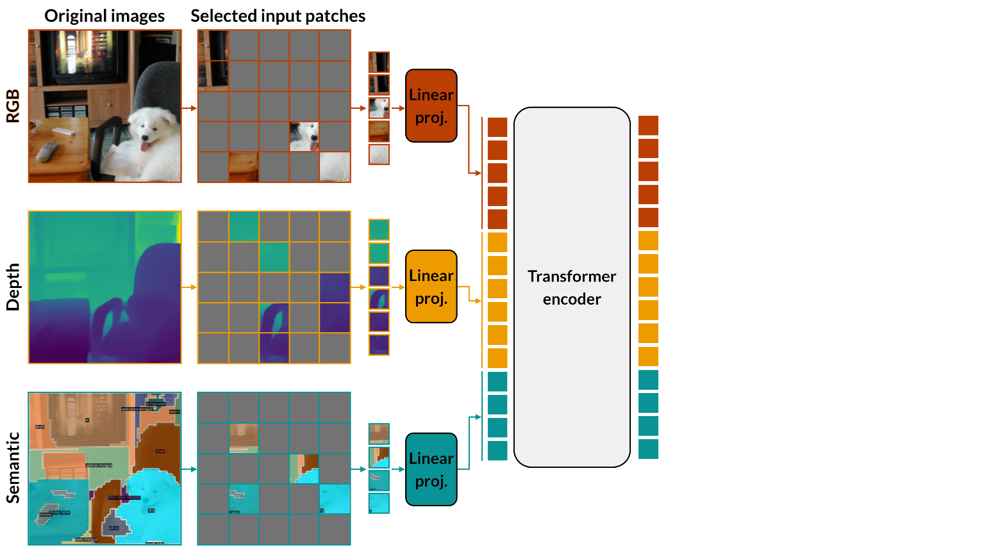
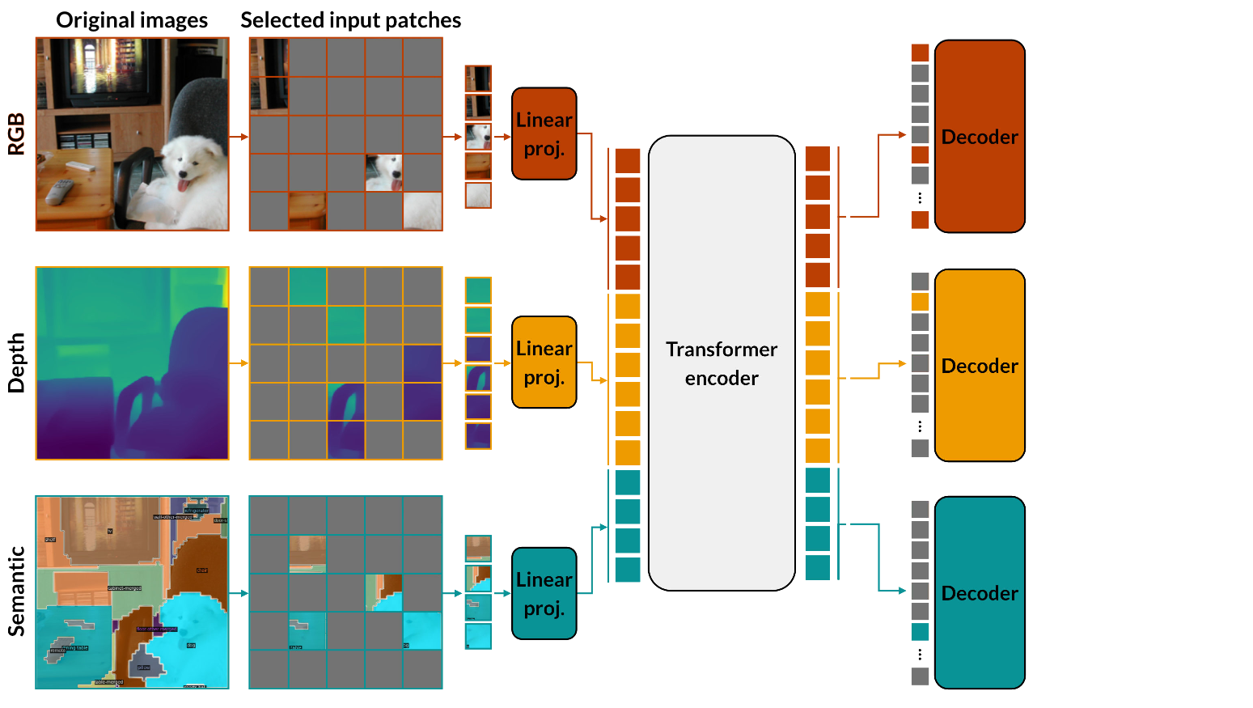
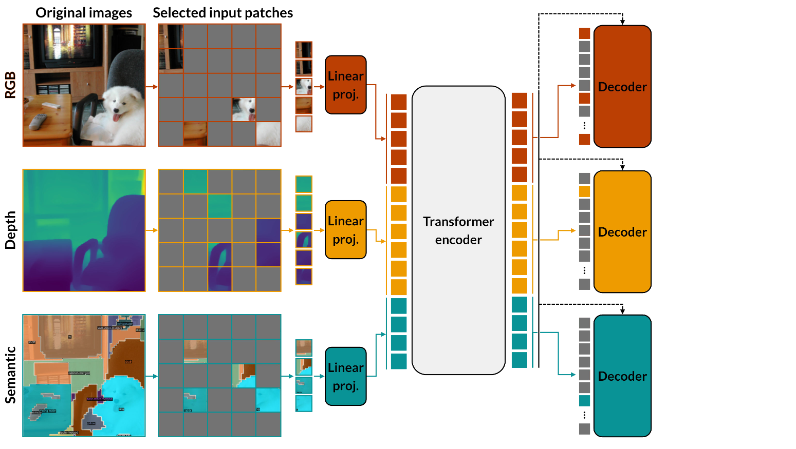
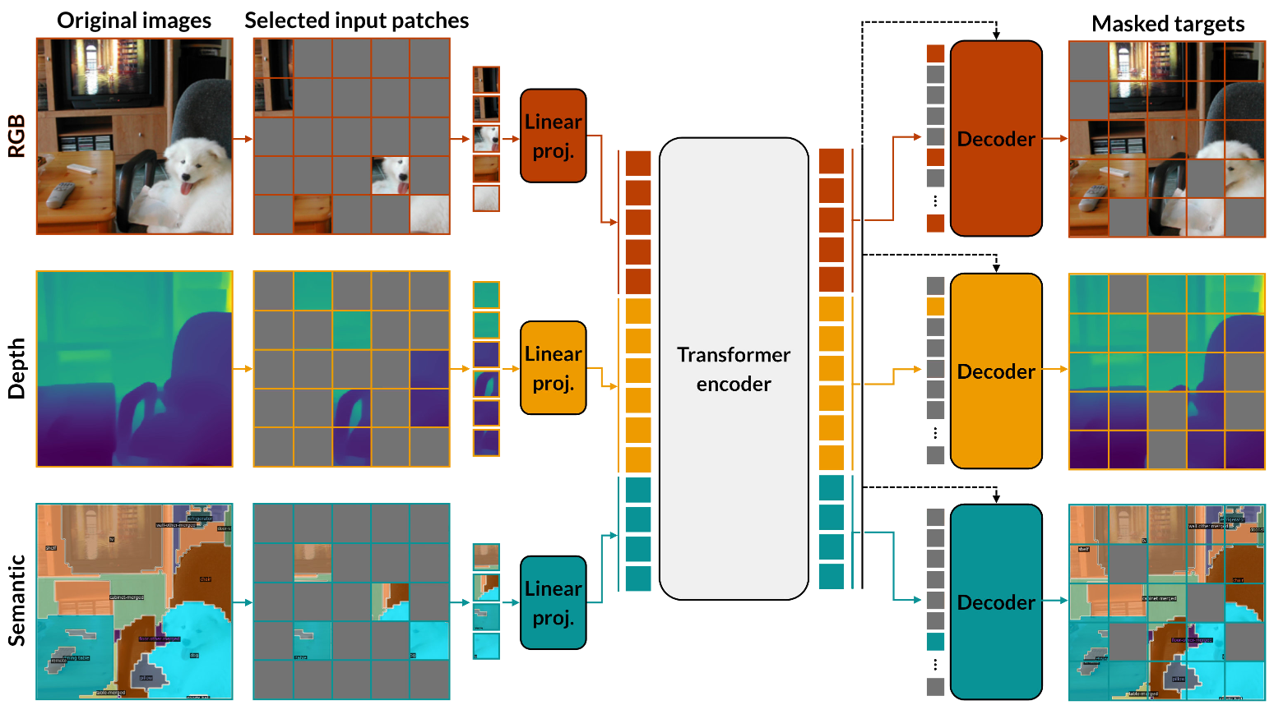
MultiMAE architecture & objective
ECCV 2022
MultiMAE

Slide 13
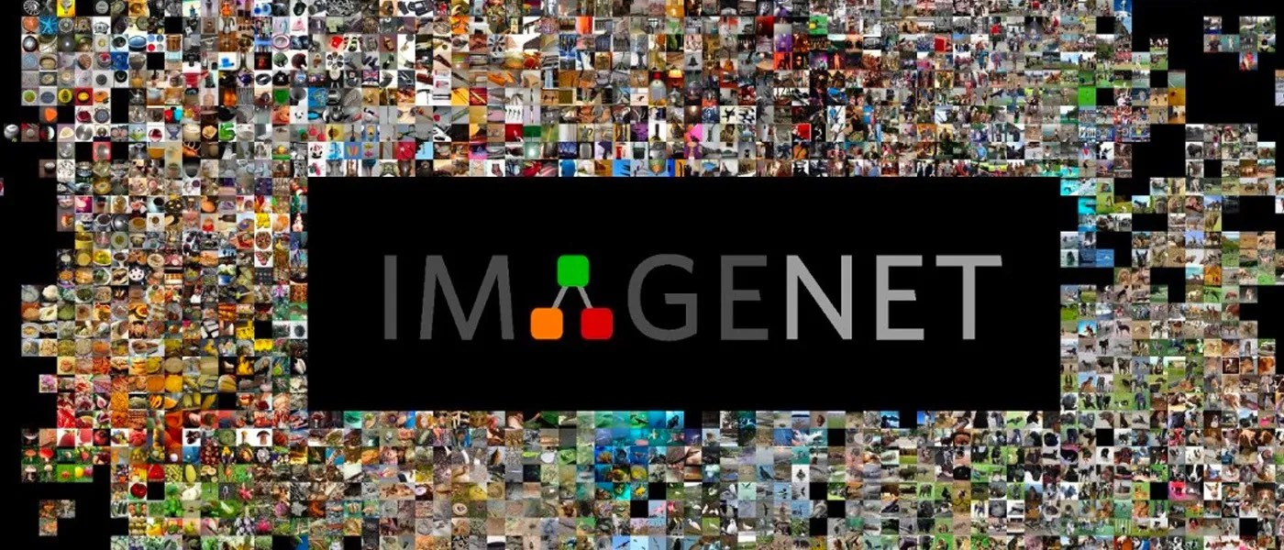
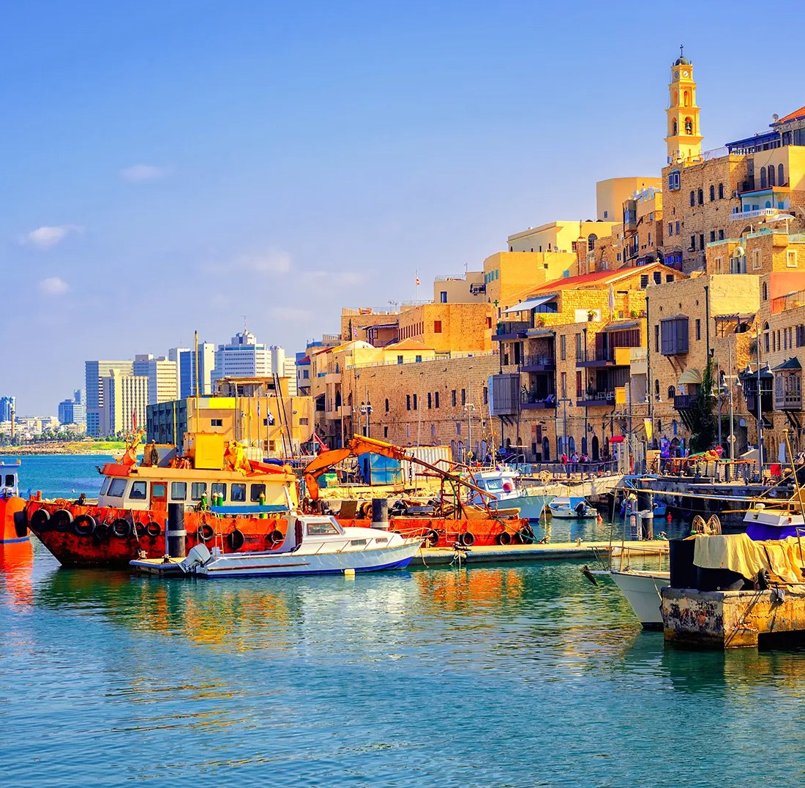
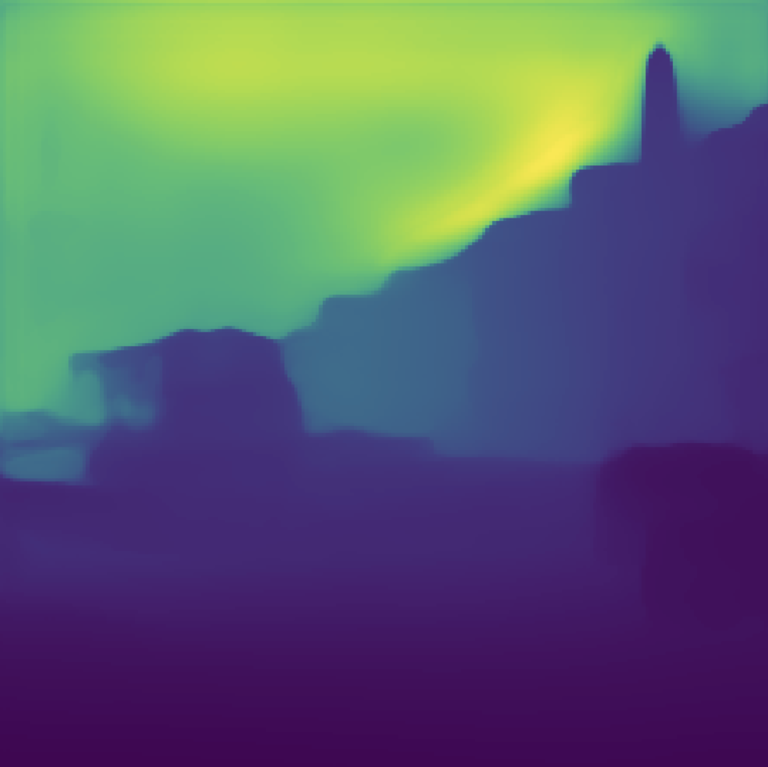
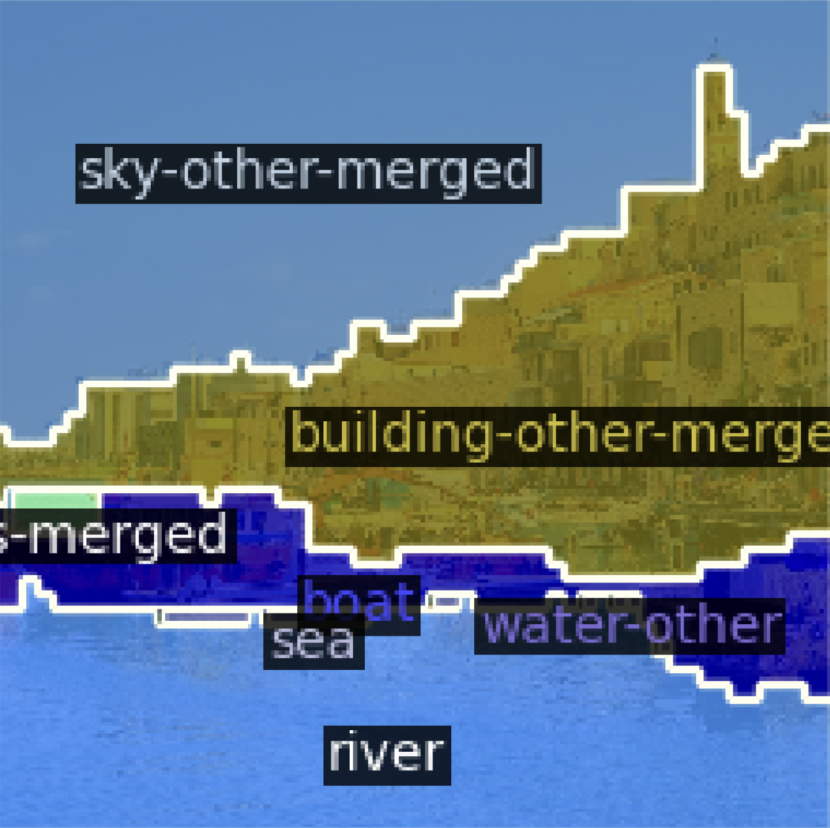
Pseudo labeling a large multi-task dataset
ECCV 2022
MultiMAE
COCO segmentation
[Cheng et al. CVPR 2022]
Omnidata depth
[Eftekhar et al. ICCV 2021]

Slide 14
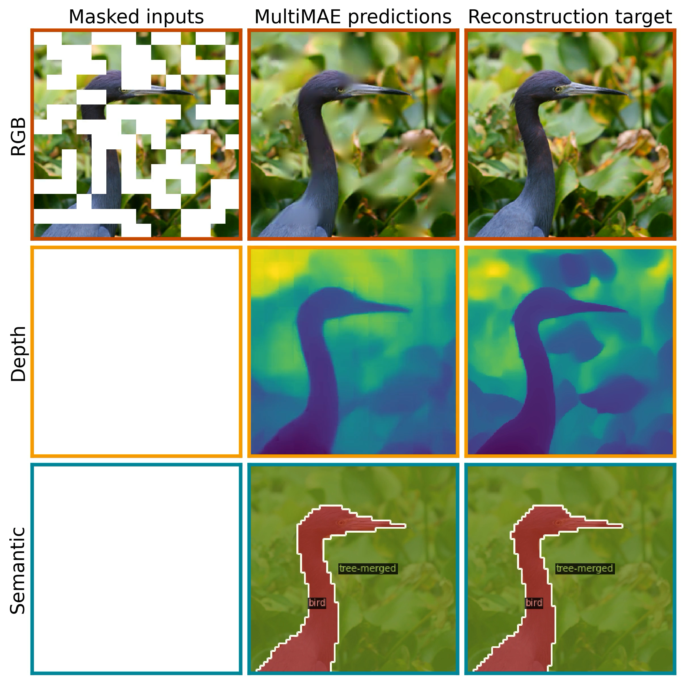
Any-to-any cross-modal predictive coding learns shared representations
ECCV 2022
MultiMAE

Slide 15
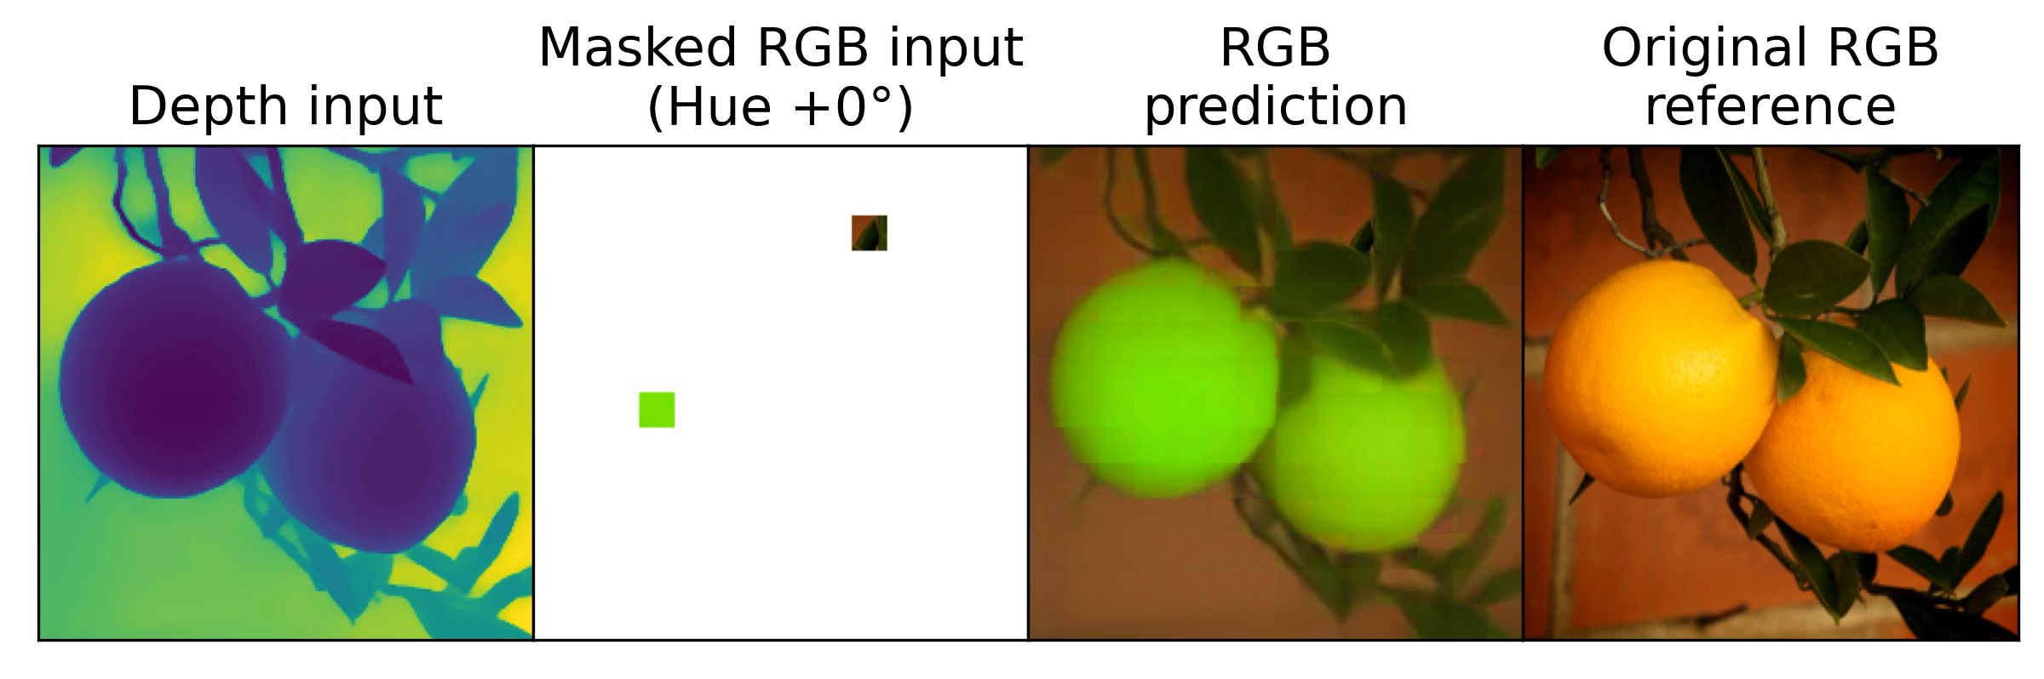
Probing cross-modal predictive coding through patch manipulation
ECCV 2022
MultiMAE

Slide 16
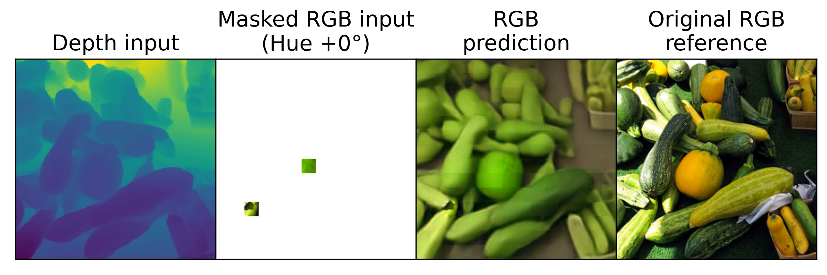
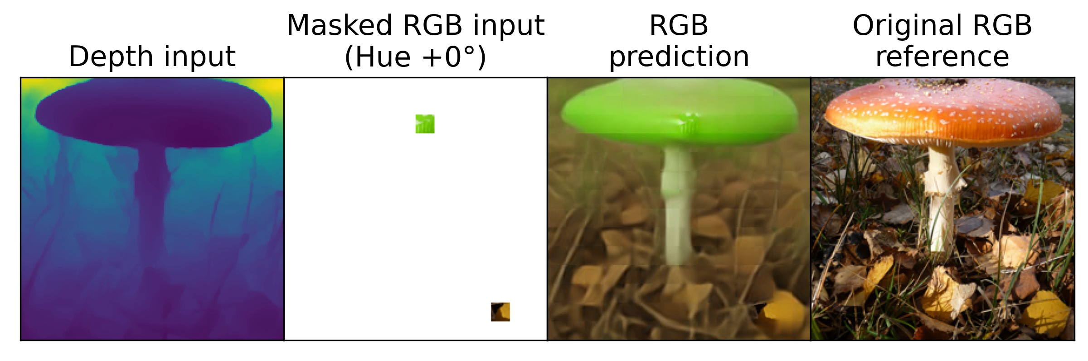
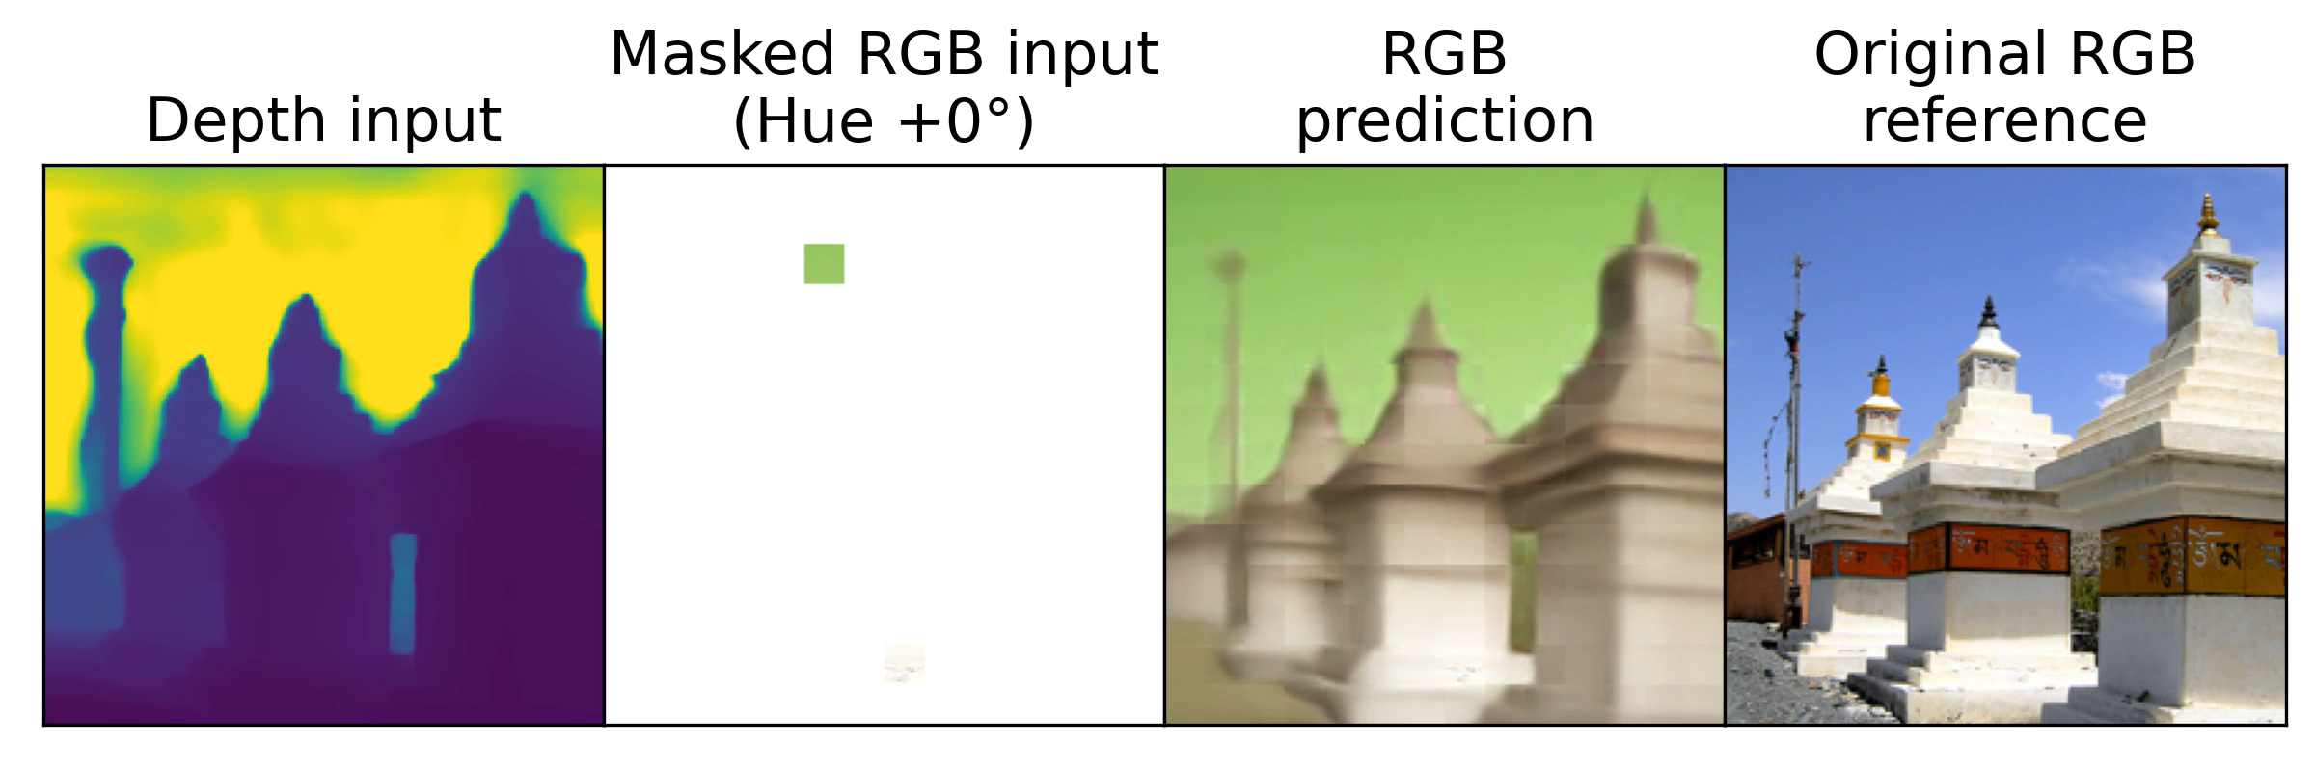
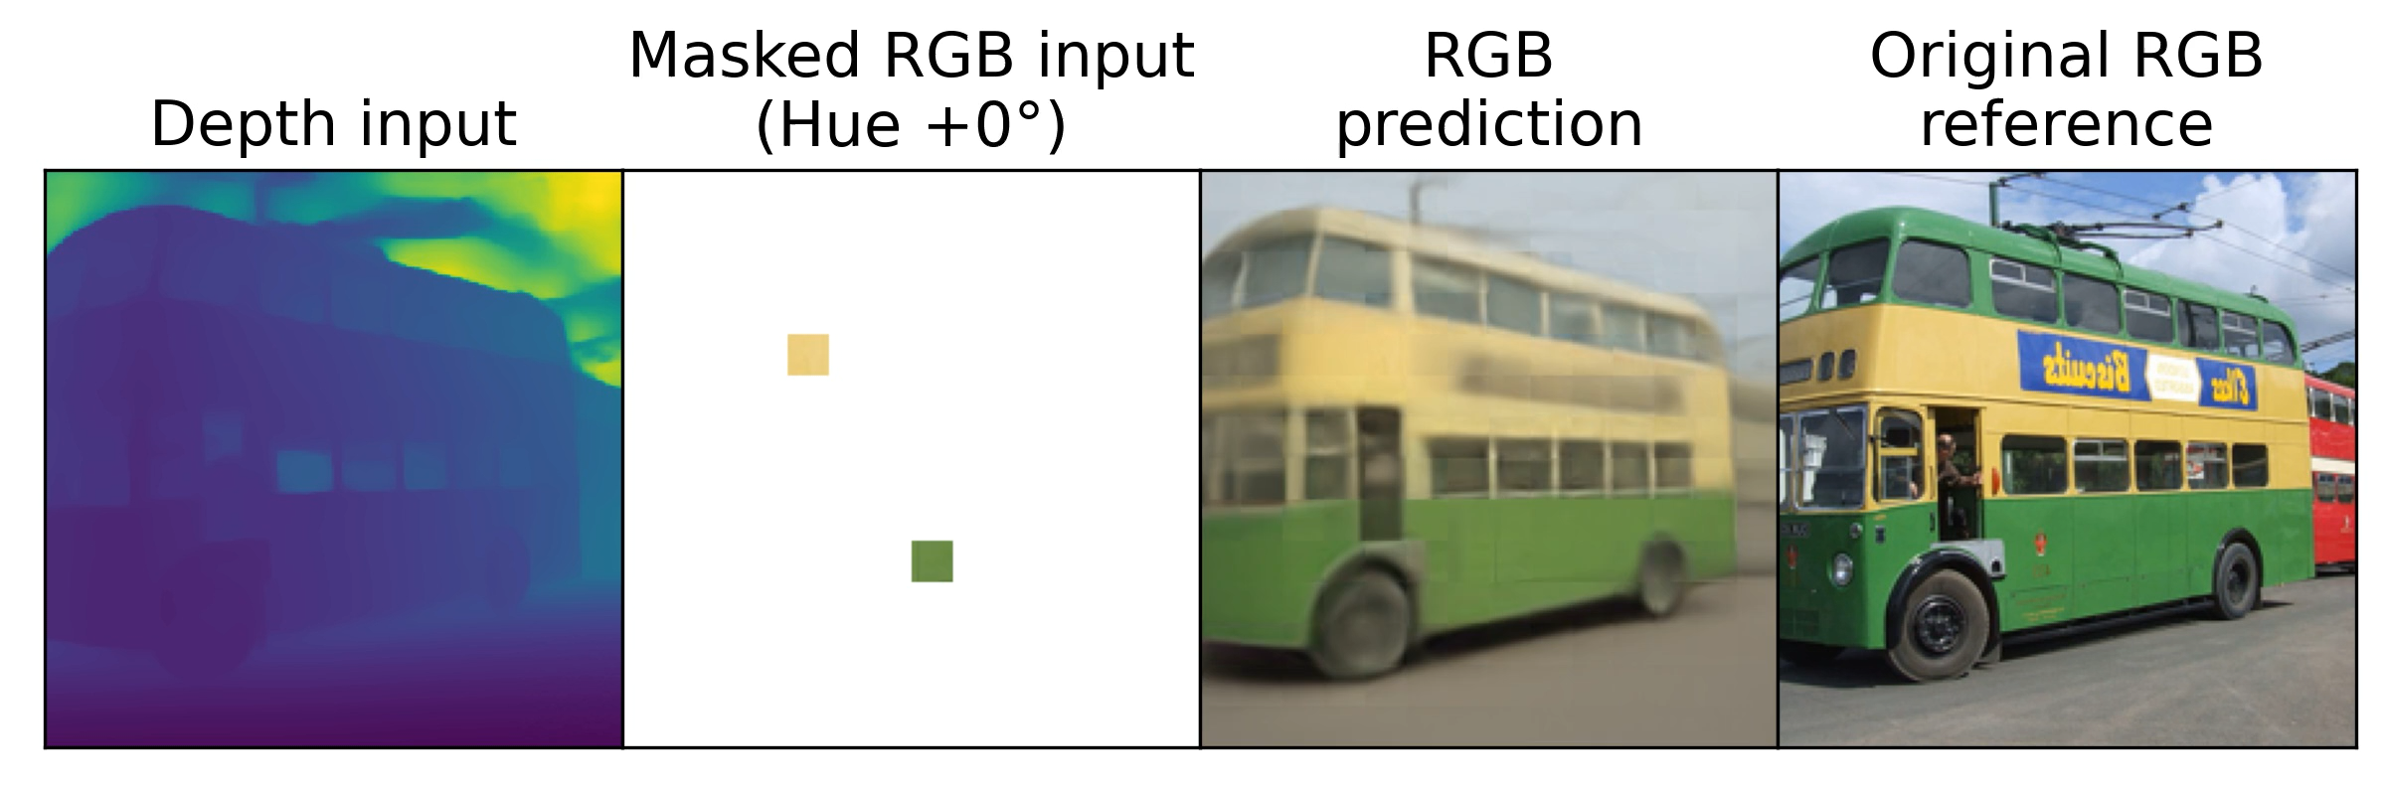
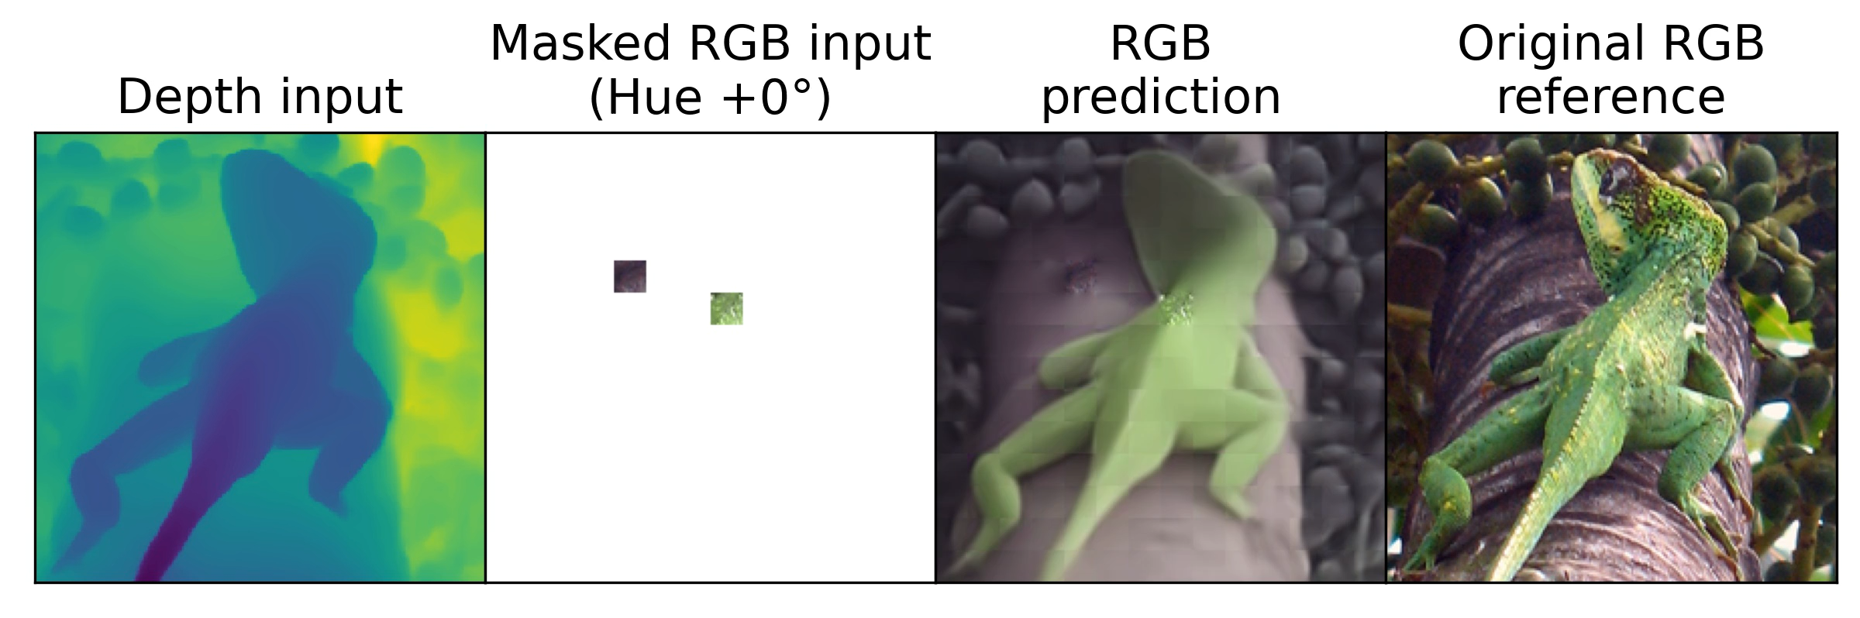
Probing cross-modal predictive coding through patch manipulation
ECCV 2022
MultiMAE

Slide 17
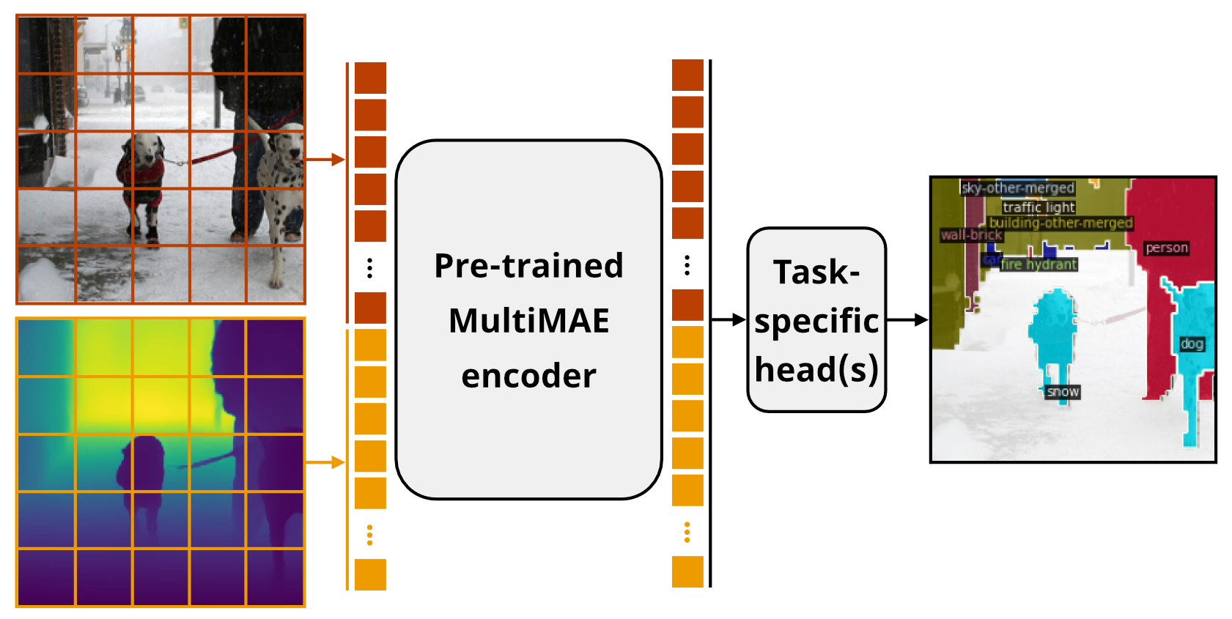
Transfer from MultiMAE
ECCV 2022
Flexibly transfer from any combination of pre-training modalities
MultiMAE

Slide 18
Transfer from MultiMAE
ECCV 2022
Flexibly transfer from any combination of pre-training modalities
MultiMAE

Slide 19
Transfer from RGB-only
ECCV 2022
Can be used as RGB-only ViT, competitive to MAE
Method | Arch. | Classification (Top 1 acc. ↑) | Semantic Segmentation (mIoU ↑) |  |  | Depth (δ1 ↑)
 |  | ImageNet-1K | ADE20K | Hypersim | NYUv2 | NYUv2
Supervised (DeiT) | ViT-B | 81.8 | 45.8 | 33.9 | 50.1 | 80.7
MAE | ViT-B | 83.3 | 46.2 | 36.5 | 50.8 | 85.1
MultiMAE | ViT-B | 83.3 | 46.2 | 37.0 | 52.0 | 85.4
MultiMAE

Slide 20
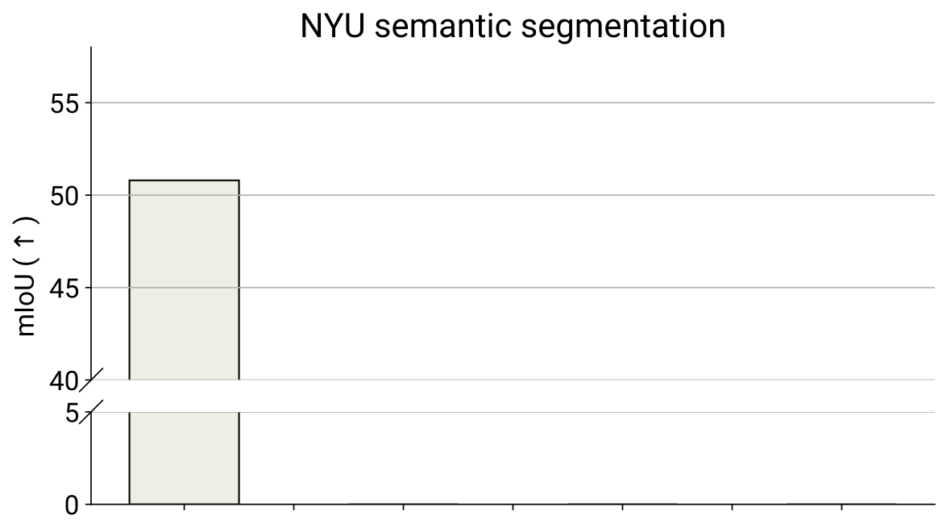
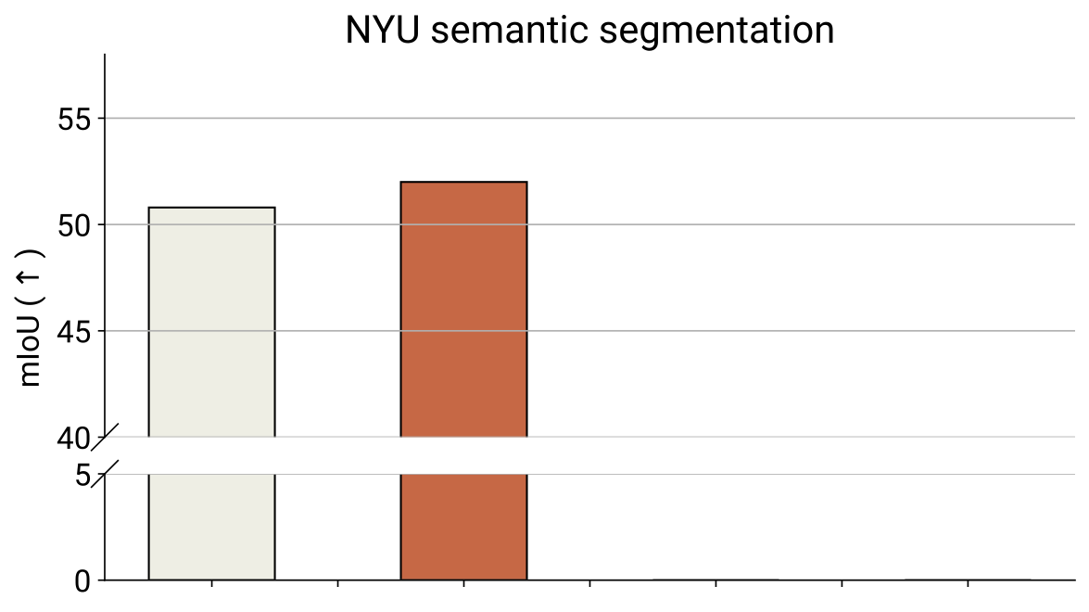
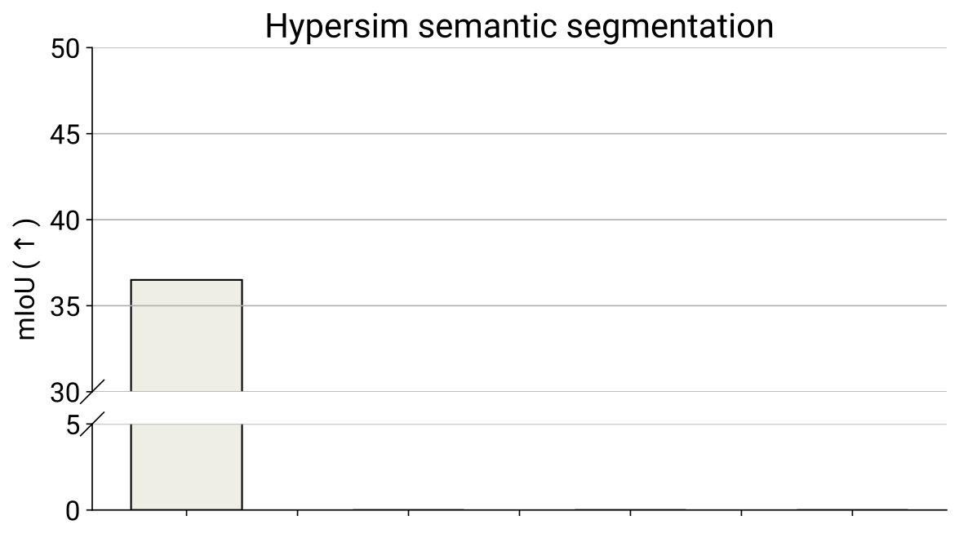
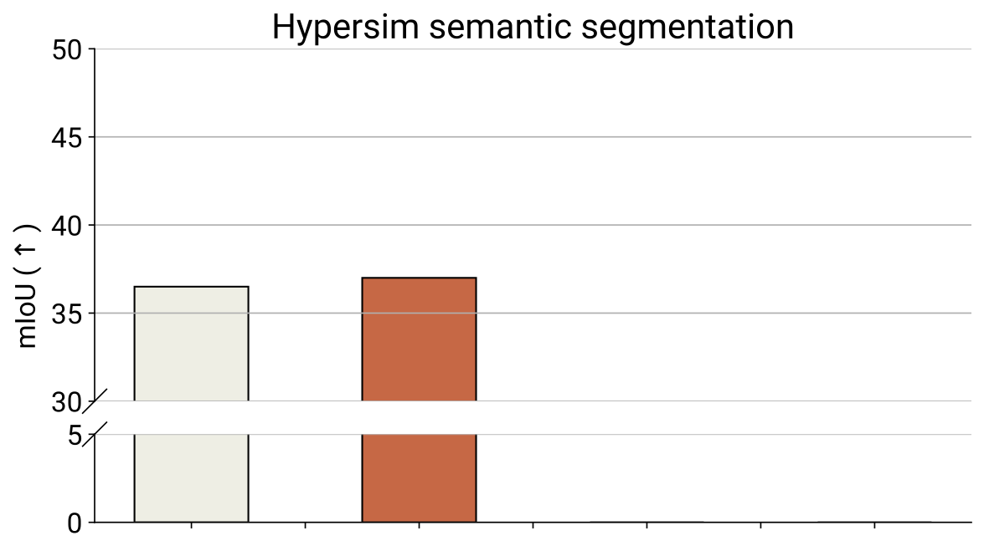
Transfer from RGB and depth
ECCV 2022
Supports any subset of the modalities used during pre-training
MultiMAE
MAE (RGB)
RGB
MAE (RGB)
RGB
MultiMAE
MultiMAE

Slide 21
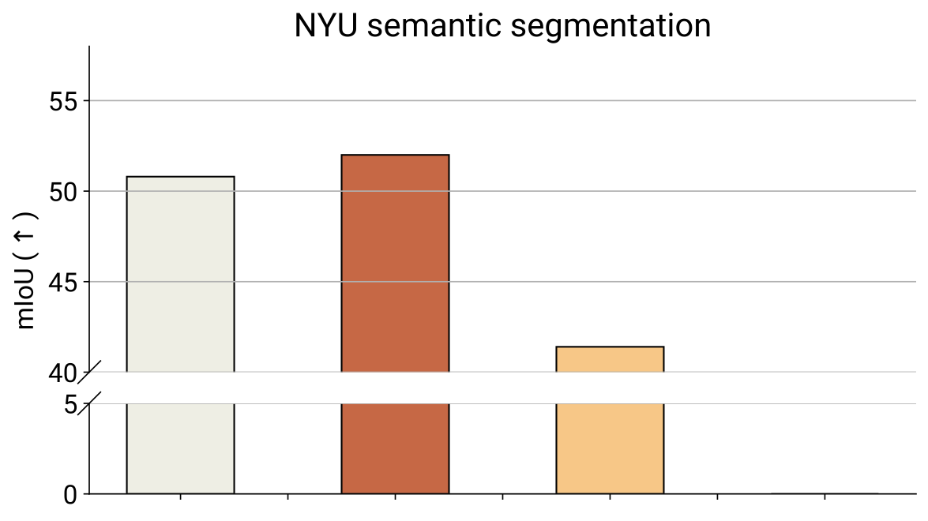
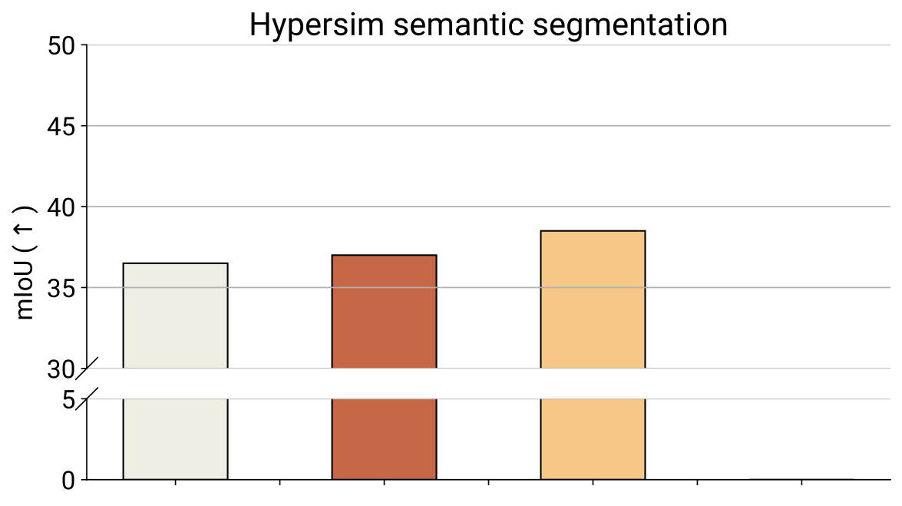
Transfer from RGB and depth
ECCV 2022
Supports any subset of the modalities used during pre-training
MultiMAE
MAE (RGB)
RGB
Depth
MAE (RGB)
RGB
Depth
MultiMAE
MultiMAE

Slide 22


Transfer from RGB and depth
ECCV 2022
Supports any subset of the modalities used during pre-training
MultiMAE
MAE (RGB)
RGB
Depth
RGB + depth
MAE (RGB)
RGB
Depth
RGB + depth
MultiMAE
MultiMAE

Slide 23



Transfer from RGB + depth & semantic pseudo labels
ECCV 2022
Can optionally use pseudo labels as inputs
RGB
RGB + pD
RGB + pS
RGB + pD + pS
RGB
RGB + pD
RGB + pS
RGB + pD + pS
MultiMAE
RGB
RGB + pD
RGB + pS
RGB + pD + pS

Slide 24






MultiMAE:
Multi-modal Multi-task Masked Autoencoders
Roman Bachmann*, David Mizrahi*, Andrei Atanov, Amir Zamir
Simple & effective multi-modal pre-training
Entirely trained using pseudo labels
Relies on masking to learn strong cross-modal predictive coding abilities
Retains the benefits of MAE for RGB-only transfer
Notable performance gains for multi-modal transfer
multimae.epfl.ch

