Slide 1

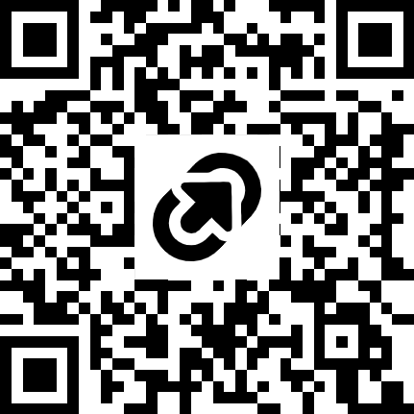
#401
Enhancing Data & Process Visualization in PowerPoint
Michael West
Senior Learning Solutions Developer
Colonial Life & Accident w Columbia, SC
mwest@coloniallife.com
LinkedIn: michaelwestjr
Exercise File: https://tinyurl.com/EnhancedDataDevLearn2025
Notes:
Good morning, everyone, and welcome! My name is Michael West. I’m one of two senior learning solutions developers for agent enablement at Colonial Life in Columbia, SC. [Prompt the QR code, link]
Like almost everyone in here I am an accidental instructional designer. You just don’t see too many of us who are like, “Oh yeah…I totally planned this.” It’s “I was going to go to law school, but then my cousin’s band needed a flyer, I bought Pagemaker, here I am.” Now, as instructional designers, we use a number of tools to ply our trade. So you’re probably wondering, “PowerPoint? Really?” I get it. Just yesterday morning in this very same room I learned precisely just absolutely ignorant I am whenB it comes to AI. It’s astounding. And yesterday afternoon, just next door, I learned how to use Javascript coding in Storyline.
So PowerPoint? Seriously? Why PowerPoint? Well, let’s do a quick pulse check: How many of you use PowerPoint on a regular basis? Now, for how many of you is PowerPoint your primary resource or tool?
So we’re here to discuss visualizing data in PowerPoint. Let’s take a look at a couple of slides…

Slide 2
INDUSTRY OVERVIEW
COMPETITION
45 companies in the market
22 companies with more than $50M revenue in 2024
13 companies with more than $100M revenue in 2024
Only one standalone company
All others are offshoots of larger companies
Notes:
This a modified version of a slide used at a sales conference recently, discussing the competition and where we stand.

Slide 3
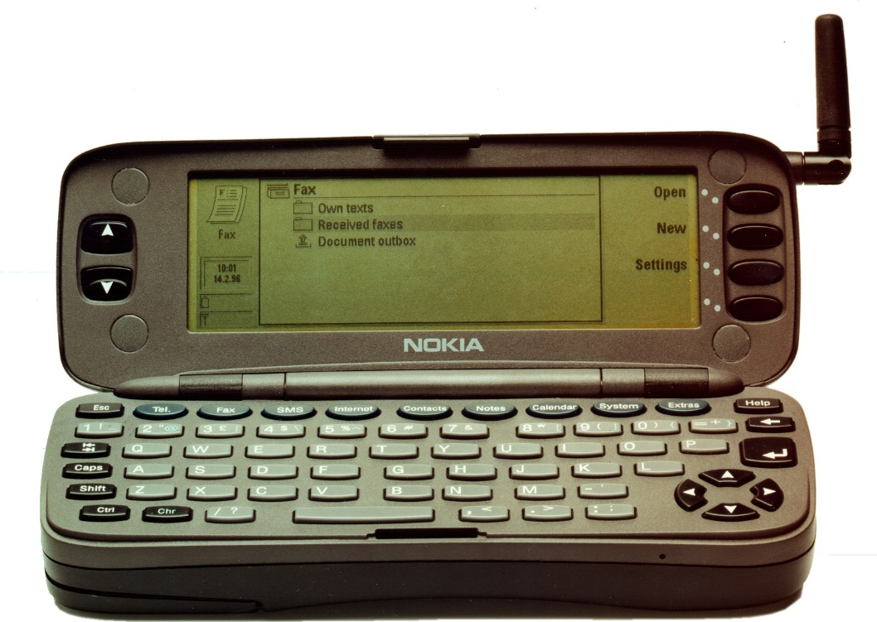
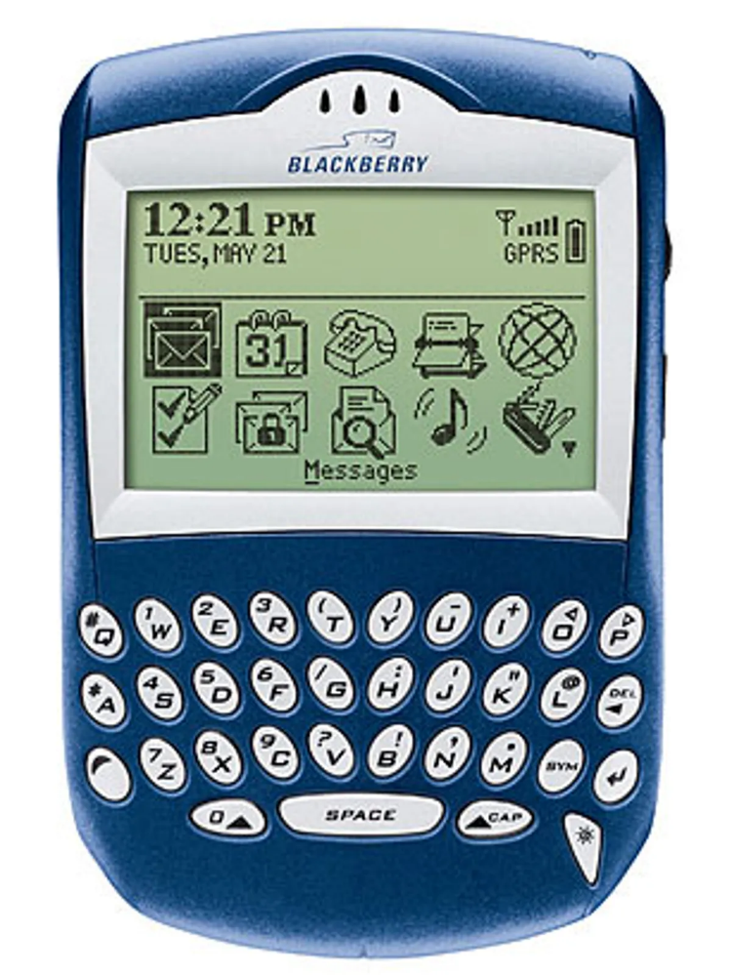
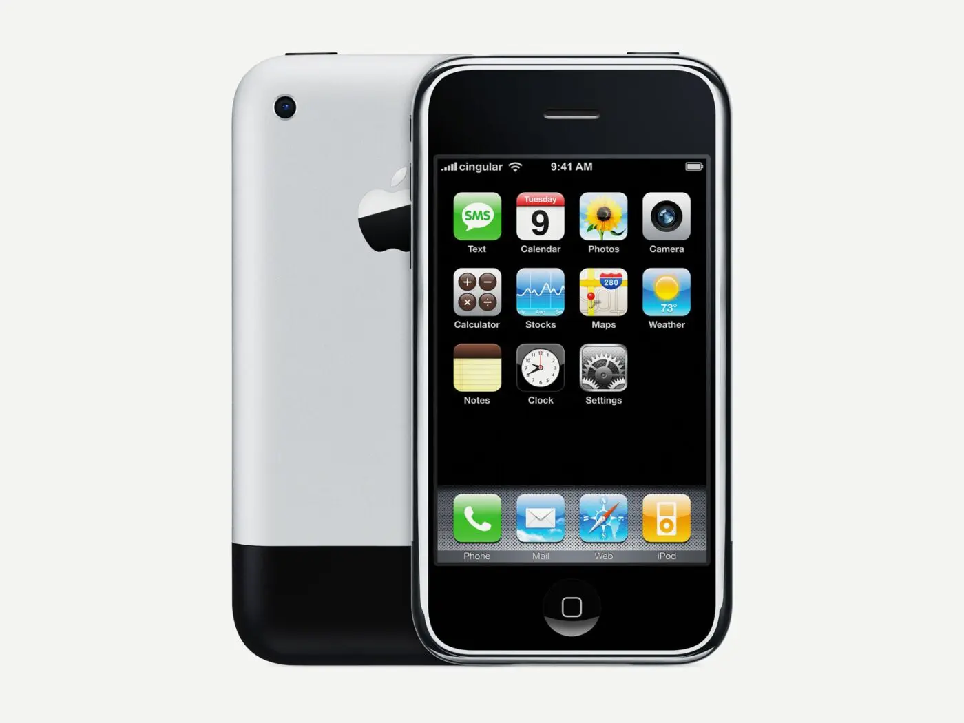
Evolution of the smartphone
1996: Nokia 9000 Communicator
2002: Blackberry
2007: iPhone released
Notes:
And this is a bulleted outline of the evolution of the Smartphone. Nothing seriously wrong with either of these slides. They’re harmless enough. Something that a senior level staff member could talk to, right.
But are they impactful? Not especially.
But what do we know about visualizing information like this?

Slide 4





Visualization and Cognitive Load
Reduce unnecessary mental effort
Processed faster than words
Diagrams show structure better
Stick longer, decay less
Notes:
So what do we know about images and cognitive load?
1. Reduce necessary mental effort
2. Images are processed faster than words
3. Diagrams and timelines show structure and process better
4. Images stick longer and decay less
Corporate or business settings typically aren’t safe spaces for transitions or animations. If you don’t use them properly, they come across as unprofessional, childish almost. And most senior level presenters, the ones I work with at least, I’ve found that, in many cases, they simply aren’t aware of what you can do with these. Never mind the fact that most of them aren’t familiar with adult learning theory. So if we can visualize that information it’s a big win for both our presenters and instructional designers everywhere
So…here’s how this will work. I have 4 separate scenarios. I don’t think we’ll have time to unpack all 4. So, what I’d like to do is first show you each of the 4 visualizations. Once we go through them all, we’ll vote. You’ll select which of these 4 we’ll unpack. If we have time we’ll do a few others.
Now, If your favorite visualization gets treated like Andy Richter on this week’s Dancing with the Stars, do not fret. The exercise file has step-by-step instructions for building each of these scenarios. The only one that doesn’t is the industry data visualization, and that’s because there’s really nothing special about how that was built.
Does that sound fair?

Slide 5

#401
Enhancing Data & Process Visualization in PowerPoint
SCHEDULE/PROCESS BUILDER

Slide 6
 | MONDAY | TUESDAY | WEDNESDAY | THURSDAY | FRIDAY
8:00 AM
8:30 AM
9:00 AM
9:30 AM
10:00 AM
10:30 AM
11:00 AM
11:30 AM
12:00 PM | Lunch | Lunch | Lunch | Lunch | Lunch
12:30 PM
1:00 PM
1:30 PM
2:00 PM
2:30 PM
3:00 PM
3:30 PM
4:00 PM
4:30 PM
5:00 PM
5:30 PM
6:00 PM
Review Weekly Plan
In-field presentations
Prepare for Interviews
In-field presentations
Organize Follow-Ups
Candidate Sourcing
Prospecting Follow-Ups
Weekly Monday Kickoff
First Interviews
Qualifying Calls
SAMPLE WEEKLY CALENDAR
Existing Account Work
Broker Follow-Ups
Broker Follow-Ups
Prospecting Phone-a-thon
New Prospecting Calls
New Prospecting Calls
New Field Touchpoints
New Field Touchpoints
Second Interviews
Send 2nd Interview Confirmations
Prospecting Phone-a-thon
In-field presentations
In-field presentations
In-field presentations
One-on-one meetings with your agents
Broker Follow-Ups
Broker Follow-Ups
Broker Follow-Ups
Recruiting Phone-a-thon
New Prospecting Calls
New Prospecting Calls
New Prospecting Calls
New Field Touchpoints
New Field Touchpoints
New Field Touchpoints
Broker Follow-Ups
Source Candidates for Recruiting Phone-a-thon
New Agent Debrief
New Agent Debrief
Send Interview Confirmations
Send Reminders: 1st Interviews
CRM: Enter Activity & Follow-Ups
Candidate Sourcing
Claim Leads for Monday’s Prospecting
CRM: Enter Activity & Follow-Ups
CRM: Enter Activity & Follow-Ups
Send Reminders: 2nd Interviews
Prepare for Weekly Monday Kickoffs
CRM: Enter Activity & Follow-Ups
Notes:
This is the calendar we provide to our field managers. It introduces a prescribed approach to the various activities they’ll be expected to perform on any given week.
When we refreshed our manager training a few years ago, we created a focus group of veteran managers to help us redesign it. One of the more basic pieces of feedback we received from the managers was that the calendar was helpful, but that it didn’t really capture the amount and variety of activity that’s involved. They wanted to make sure that we gave new managers a new starting point, a new reference point for what they need to be able to do whIle simultaneously providing a sample weekly plan.

Slide 7
WHAT WEEKLY MANAGERIAL TASKS DRIVE BUSINESS GROWTH?
Weekly Monday Kickoff
Send Reminders: 2nd Interviews
Qualifying Calls
Prepare for Interviews
Prospecting Follow-Ups
Source Candidates for Recruiting Phone-a-thon
In-field presentations
Conduct Interviews
Send Interview Confirmations
Review Weekly Plan
Send 2nd Interview Confirmations
New Agent Debrief
Existing Account Work
Prospecting Phone-a-thon
Recruiting Phone-a-thon
New Prospecting Calls
Prepare for Weekly Monday Kickoff
Broker Follow-Ups
Organize Follow-Ups
Plan and schedule your weekly coaching activity
One-on-one meetings with your agents
Candidate Sourcing
CRM: Enter Activity & Follow-Ups
New Field Touchpoints
Claim Leads for Monday’s Prospecting
Send Reminders: 1st Interviews
Notes:
We asked, “Okay. Where do we start?”
Well, new managers obviously need to know what’s involved in being a manager. And wouldn’t it be helpful if we categorize each of those tasks? Finally, we have a prescribed weekly plan for new managers to follow. Can we outline that sample weekly plan?
[Explain]
So we started with this: Which tasks must successful managers complete in order to grow their businesses?
[CLICK] – Tasks animate in.
[Ask]
It’s a little overwhelming, isn’t it? All of those tasks and responsibilities just seem to be all over the place, don’t they?
But what if…[go to next slide]

Slide 8
WHAT WEEKLY MANAGERIAL TASKS DRIVE BUSINESS GROWTH?
SALES ACTIVITIES
RECRUITING ACTIVITIES
COACHING ACTIVITIES
ADMINISTRATIVE ACTIVITIES
New Field Touchpoints
Prepare for Interviews
New Field Touchpoints
New Agent Debrief
New Agent Debrief
Prepare for Weekly Monday Kickoff
Candidate Sourcing
Prospecting Follow-Ups
Candidate Sourcing
One-on-one meetings with your agents
Review Weekly Plan
Qualifying Calls
Source Candidates for Recruiting Phone-a-thon
Plan and schedule your weekly coaching activity
Organize Follow-Ups
New Prospecting Calls
New Prospecting Calls
New Prospecting Calls
New Prospecting Calls
New Prospecting Calls
Recruiting Phone-a-thon
Weekly Monday Kickoff
CRM: Enter Activity & Follow-Ups
CRM: Enter Activity & Follow-Ups
CRM: Enter Activity & Follow-Ups
CRM: Enter Activity & Follow-Ups
In-field presentations
In-field presentations
In-field presentations
In-field presentations
In-field presentations
Send Interview Confirmations
Claim Leads for Monday’s Prospecting
Send Reminders: 1st Interviews
Existing Account Work
Send 2nd Interview Confirmations
Prospecting Phone-a-thon
Prospecting Phone-a-thon
Send Reminders: 2nd Interviews
Broker Follow-Ups
Broker Follow-Ups
Broker Follow-Ups
Broker Follow-Ups
Broker Follow-Ups
Broker Follow-Ups
Conduct Interviews
Conduct Interviews
Conduct Interviews
Notes:
Approx. time on slide: 10 sec.
[FACILITATOR NOTE] – On slide entrance, tasks from previous slide moprh amd transition to their respective categories.
[Explain]
…we provided you a systematic, structured approach to handling these activities? What if that system helped you organize and plan your activities based on the way other successful districts and territories plan out their weeks?
It becomes a lot less daunting, doesn’t it?

Slide 9
 | MONDAY | TUESDAY | WEDNESDAY | THURSDAY | FRIDAY
8:00 AM
8:30 AM
9:00 AM
9:30 AM
10:00 AM
10:30 AM
11:00 AM
11:30 AM
12:00 PM | Lunch | Lunch | Lunch | Lunch | Lunch
12:30 PM
1:00 PM
1:30 PM
2:00 PM
2:30 PM
3:00 PM
3:30 PM
4:00 PM
4:30 PM
5:00 PM
5:30 PM
6:00 PM
Review Weekly Plan
In-field presentations
Prepare for Interviews
In-field presentations
Organize Follow-Ups
Candidate Sourcing
Prospecting Follow-Ups
Weekly Monday Kickoff
Conduct Interviews
Qualifying Calls
SAMPLE WEEKLY CALENDAR
Prospecting Phone-a-thon
Broker Follow-Ups
Broker Follow-Ups
Existing Account Work
New Prospecting Calls
New Prospecting Calls
New Field Touchpoints
New Field Touchpoints
Conduct Interviews
Send 2nd Interview Confirmations
Sales Activities
Recruiting Activities
Coaching Activities
Prospecting Phone-a-thon
In-field presentations
In-field presentations
In-field presentations
One-on-one meetings with your agents
Administrative Activities
Broker Follow-Ups
Broker Follow-Ups
Broker Follow-Ups
New Prospecting Calls
New Prospecting Calls
New Prospecting Calls
Recruiting Phone-a-thon
New Field Touchpoints
New Field Touchpoints
New Field Touchpoints
Source Candidates for Recruiting Phone-a-thon
New Agent Debrief
New Agent Debrief
Send Interview Confirmations
Send Reminders: 1st Interviews
CRM: Enter Activity & Follow-Ups
Candidate Sourcing
Claim Leads for Monday’s Prospecting
CRM: Enter Activity & Follow-Ups
CRM: Enter Activity & Follow-Ups
Plan and schedule your weekly coaching activity
Send Reminders: 2nd Interviews
Prepare for Weekly Monday Kickoff
CRM: Enter Activity & Follow-Ups
Notes:
[FACILITATOR NOTE] – On slide entrance, tasks morph and move into place on the blank schedule.

Slide 10
#401
Enhancing Data & Process Visualization in PowerPoint
INDUSTRY DATA

Slide 11
INDUSTRY OVERVIEW
BEFORE
COMPETITION
45 companies in the market
22 companies with more than $50M revenue in 2024
13 companies with more than $100M revenue in 2024
Only one standalone company
All others are offshoots of larger companies

Slide 12



INDUSTRY OVERVIEW: COMPETITION
45
COMPANIES
23
$50M SALES
12
$100M SALES
Notes:
This is actually the least complicated.

Slide 13
#401
Enhancing Data & Process Visualization in PowerPoint
TIMELINES
Notes:
Corporate or business settings typically aren’t safe spaces for transitions or animations. If you don’t use them properly, they come across as unprofessional, childish almost.
However, in working with many senior level presenters, I’ve found that, in many cases, they simply aren’t aware of what you can do with these. If you think about the typical business presentations, especially if you’ve ever been to annual sales meeting, they’re more often than not linear, heavy on the bullet points. And that’s okay. But I’ve been able to sell – pardon the pun – many of our senior level leaders that we can present this same data in a visually dynamic way, allowing them to truly drive home the story behind the data.

Slide 14
Evolution of the smartphone
BEFORE
1996: Nokia 9000 Communicator
2002: Blackberry
2007: iPhone released

Slide 15
Evolution of the smartphone
BEFORE
Nokia 9000 Communicator
iPhone released
2002
1996
2007
Blackberry

Slide 16
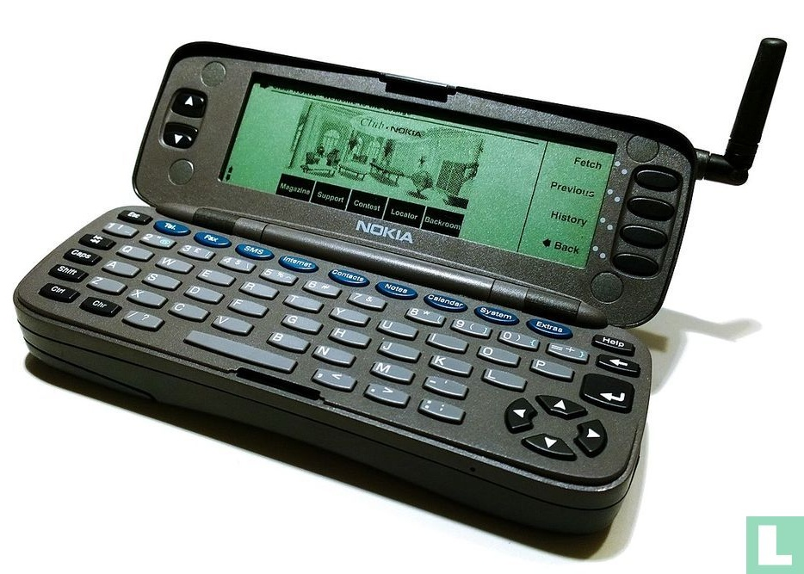
AFTER
Evolution of the smartphone
1996
NOKIA 9000 COMMUNICATOR

Slide 17
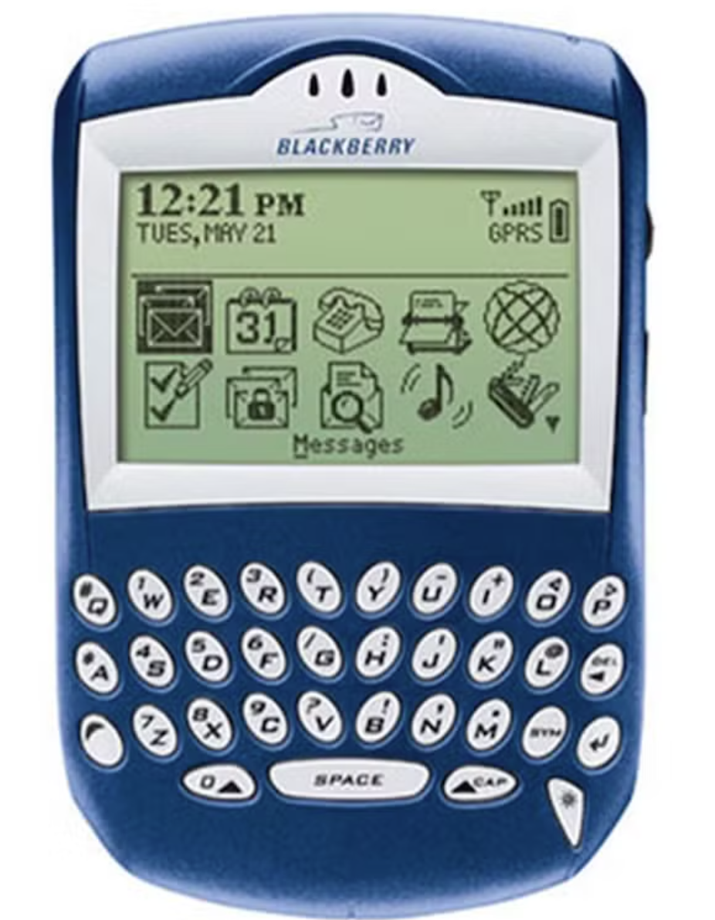
AFTER
Evolution of the smartphone
2002
BLACKBERRY

Slide 18
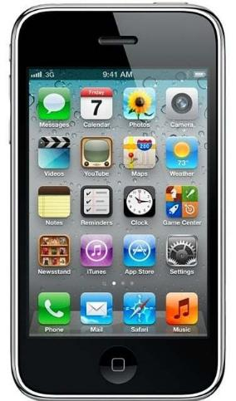
AFTER
Evolution of the smartphone
2007
iPHONE

Slide 19
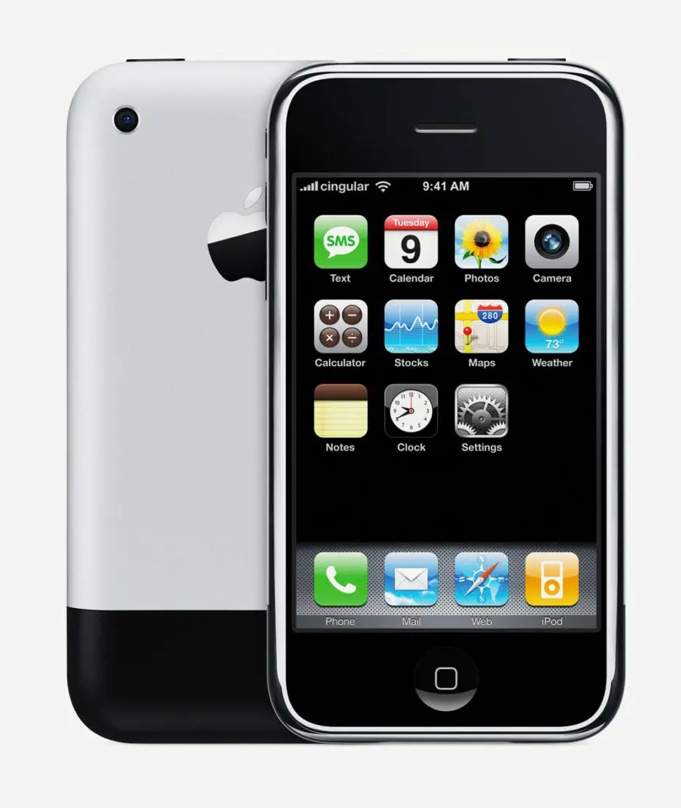


EVOLUTION OF THE SMARTPHONE
9
8
7
6
5
4
3
2
1
0
iPhone
9
8
7
6
5
4
3
2
1
0
Blackberry
0
9
8
7
6
5
4
3
2
1
0
0
9
8
7
6
5
4
3
2
1
0
demo
2007
2002
1996
Nokia 9000 Communicator

Slide 20
EVOLUTION OF THE SMARTPHONE
9
8
7
6
5
4
3
2
1
0
9
8
7
6
5
4
3
2
1
0
iPhone
demo
2007
2002
1996
0
9
8
7
6
5
4
3
2
1
0
0
9
8
7
6
5
4
3
2
1
0
Blackberry
Nokia 9000 Communicator

Slide 21
EVOLUTION OF THE SMARTPHONE
9
8
7
6
5
4
3
2
1
0
9
8
7
6
5
4
3
2
1
0
demo
2007
2002
1996
0
9
8
7
6
5
4
3
2
1
0
0
9
8
7
6
5
4
3
2
1
0
iPhone
Blackberry
Nokia 9000 Communicator

