Slide 1
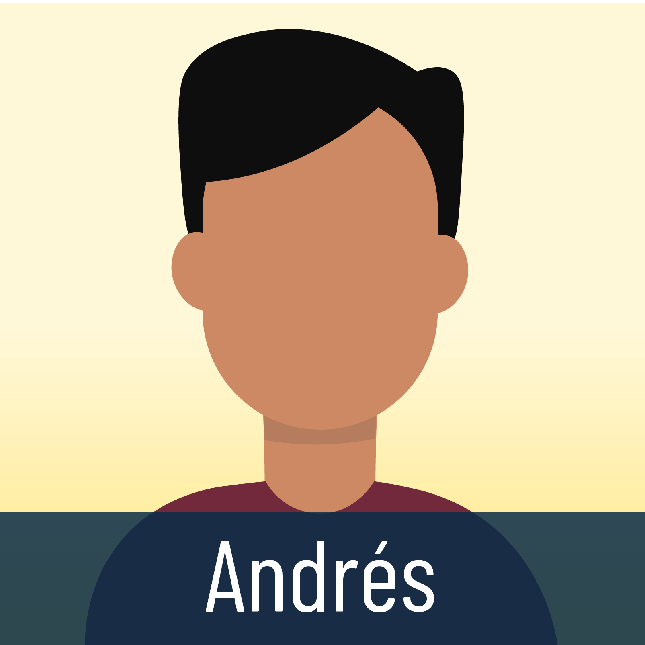

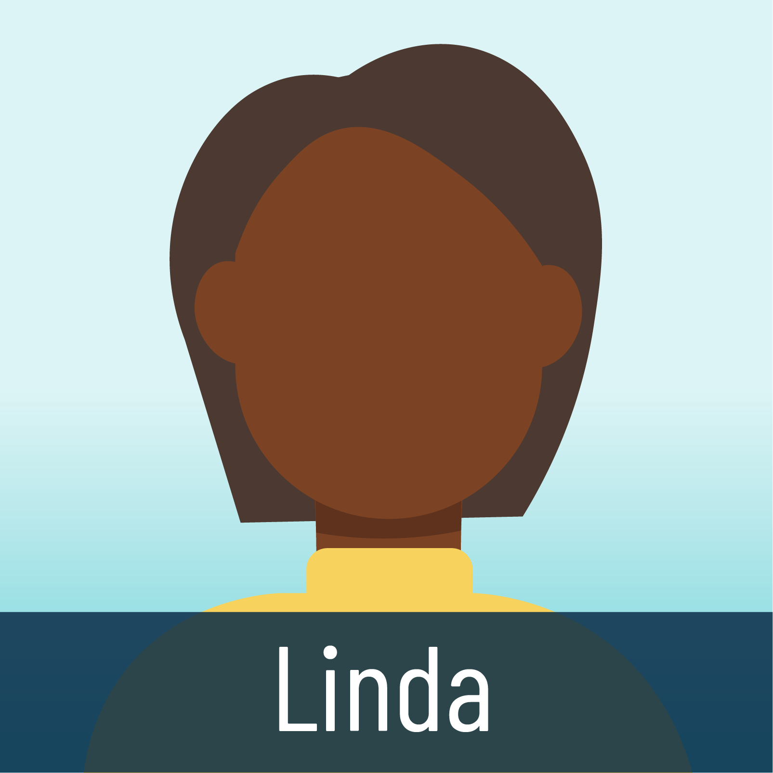
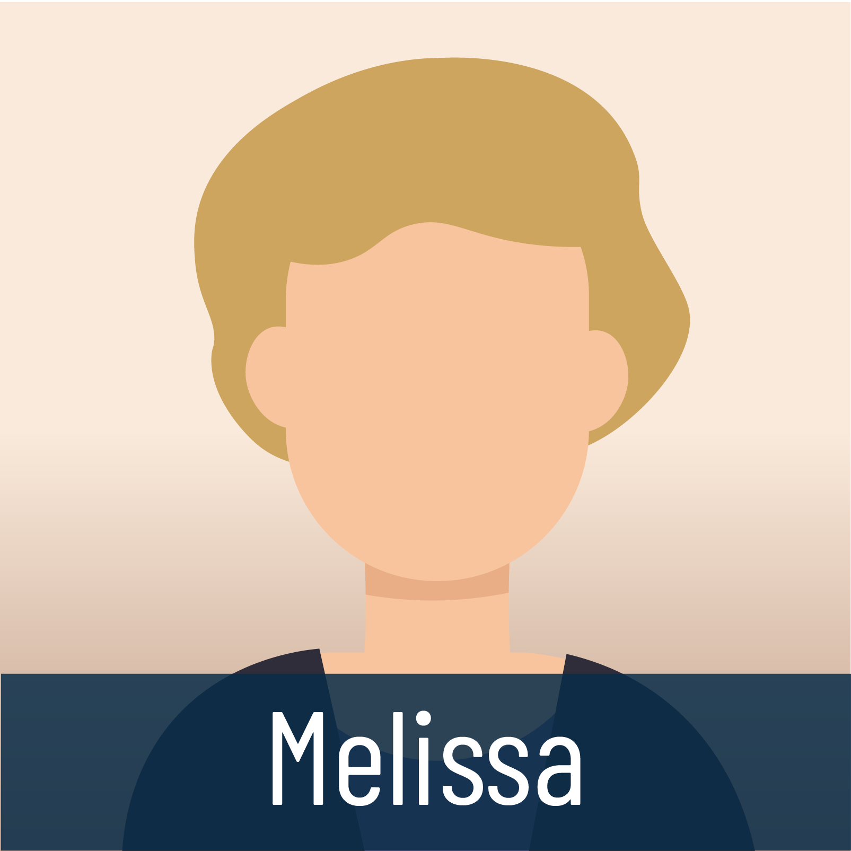
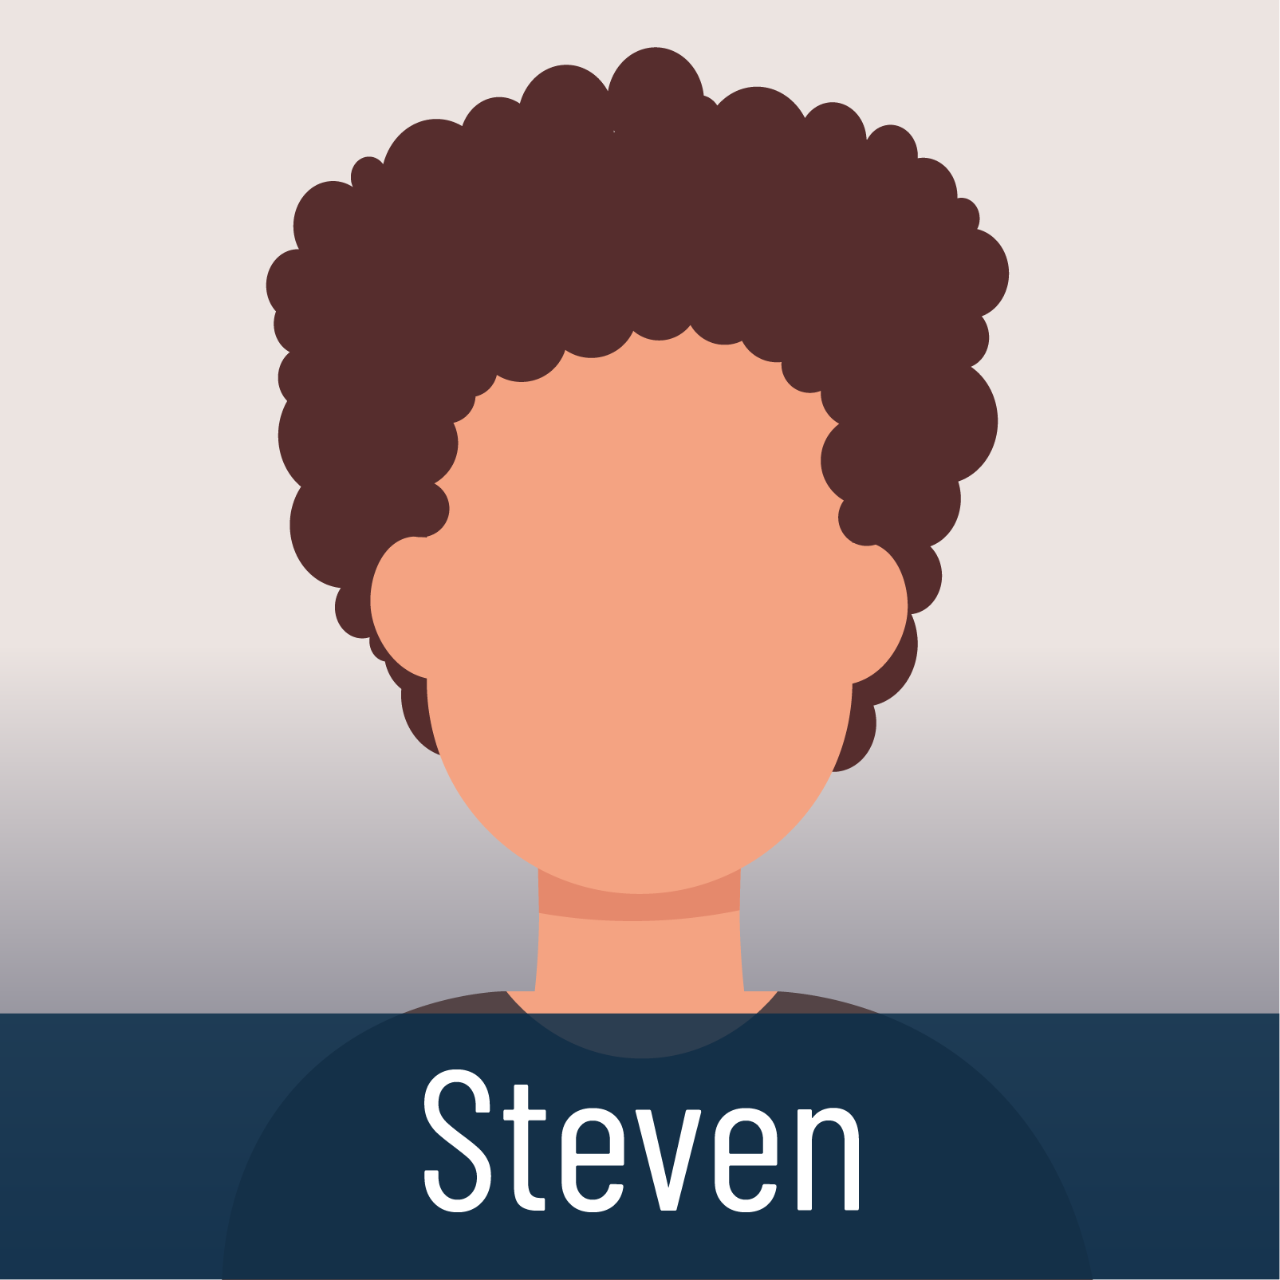
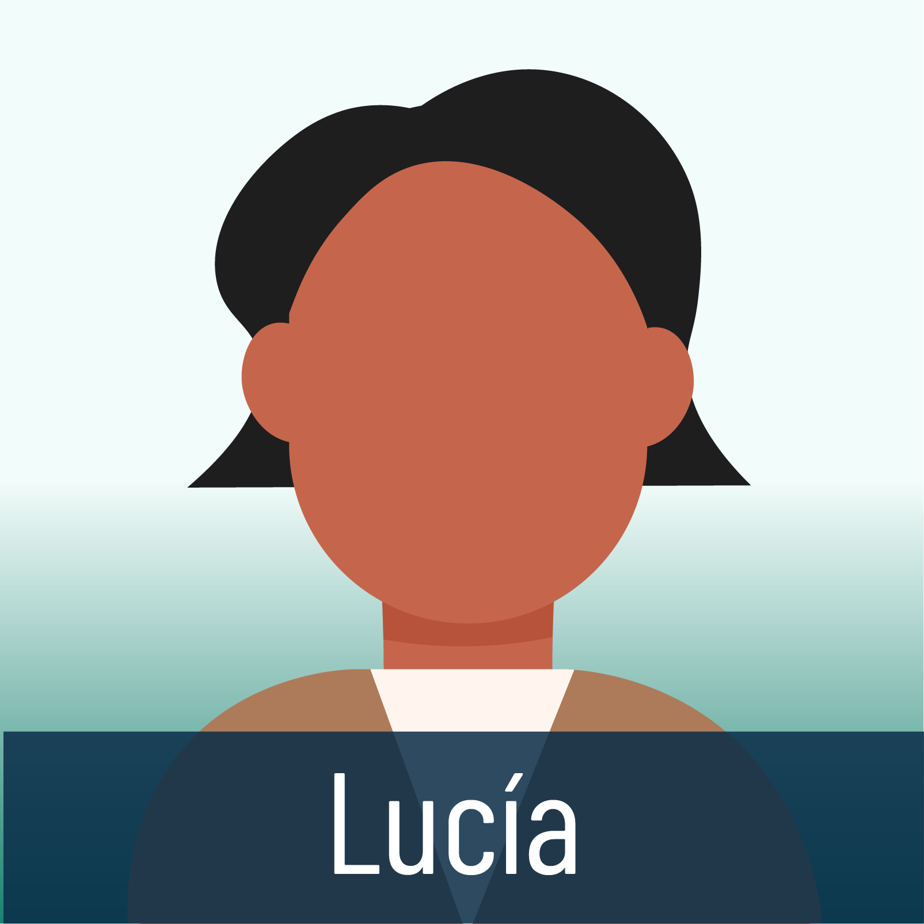
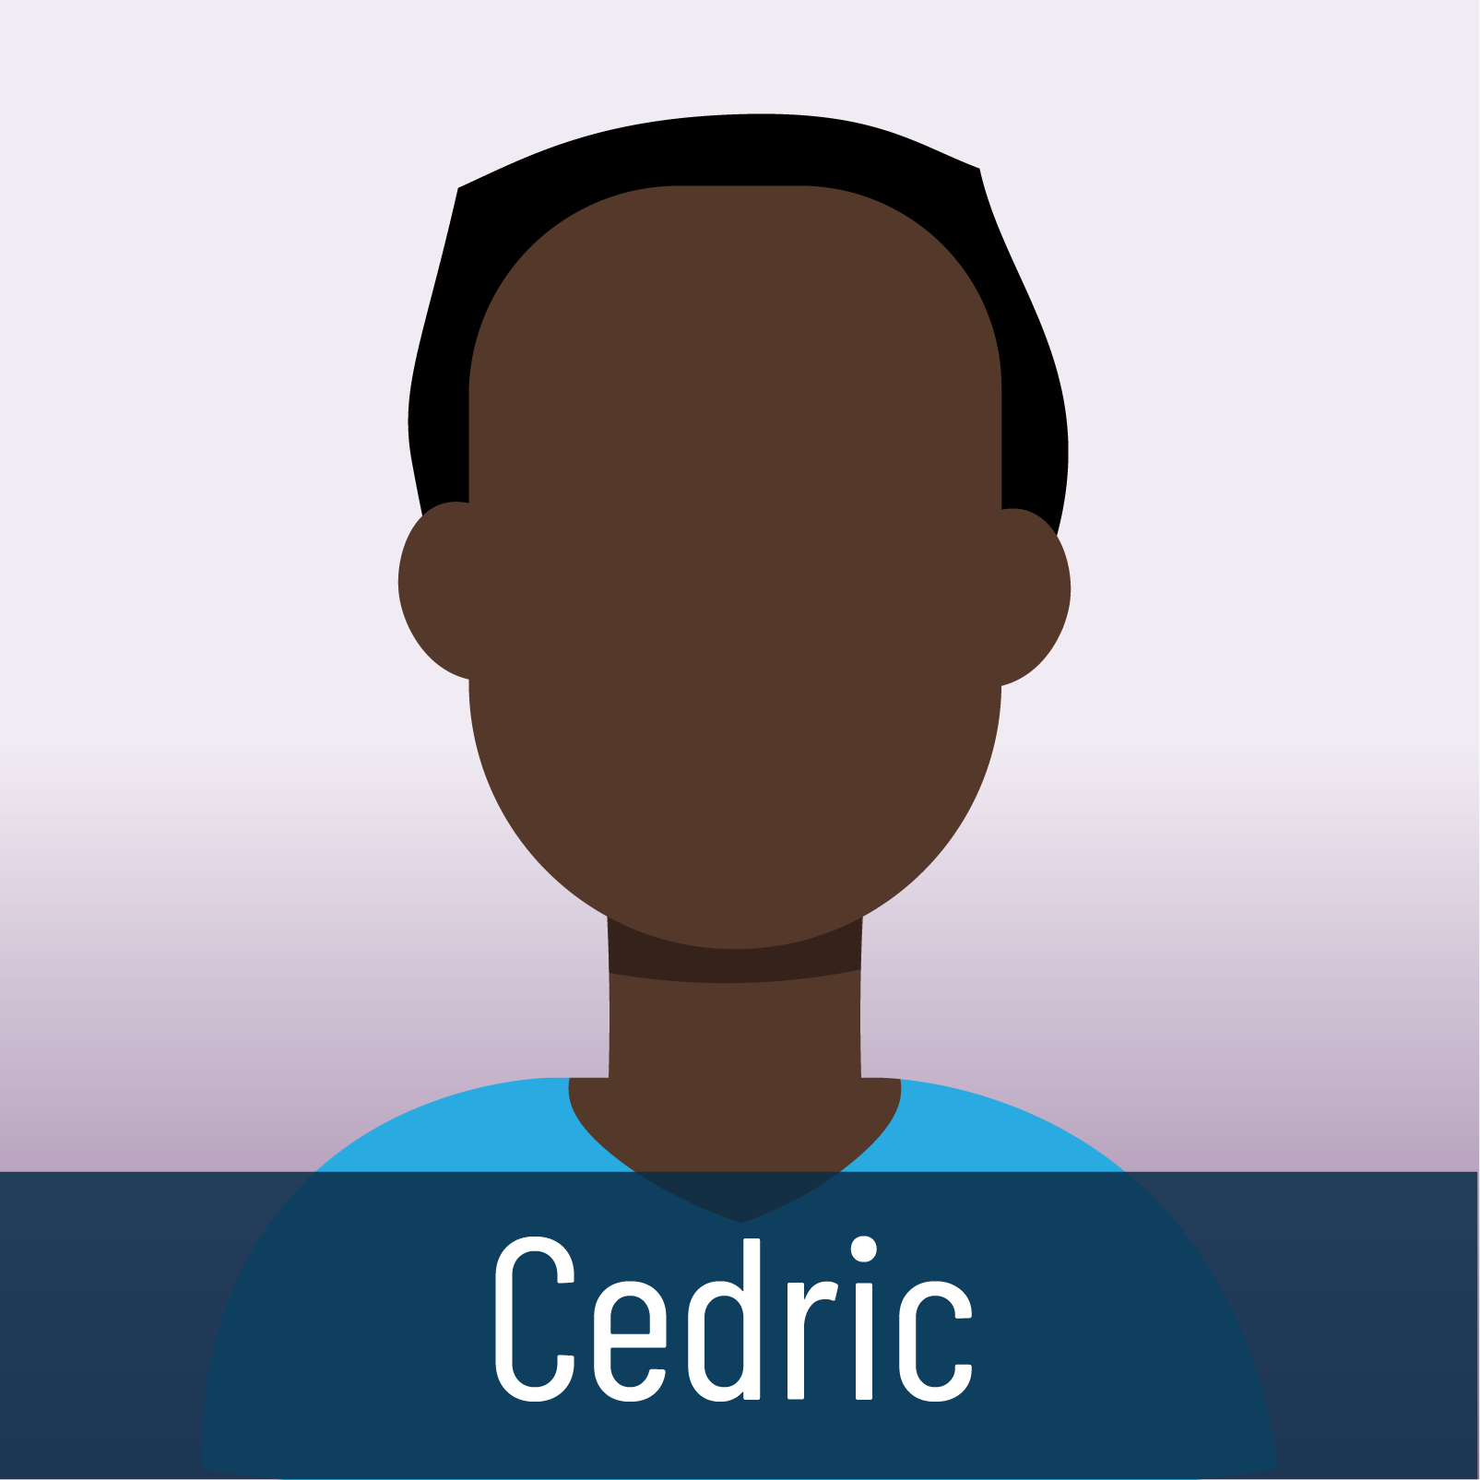


STRATEGIC SELLING
Value Statements
INSTRUCTIONS
Ask a participant to select one of the employees on the next screen. Click that employee’s square and you’ll be redirected to that employee’s profile.
Review the profile. Encourage the participant who selected the employee to read the profile out loud for the rest of the class.
Give learners a moment to come up with value statements that position our voluntary benefits products that might be suitable for that employee. As mentioned, there is likely more than 1 product that each employee could use.
If the learner struggles to put it into an effective value statement, ask the others to help. Maybe prompt them by saying, “Can anyone help them clean up that value statement?
Once the discussion on that employee is completed, select the “WHAT IS YOUR VALUE STATEMENT TO…” BOX underneath the profile table to return to this profile menu. An employee that you’ve already reviewed will be grayed out.
Notes:
Approx. time on slide: 10 minutes
[EXPLAIN]
Now we’re going to spend some time creating unique value statements for a group of individuals we’ve met at various enrollments.
Here’s how it works: I’ll call on someone to pick a square from the screen. When I click on that number, we’ll go to that employee’s profile.
Because you’ve mastered the art of deepening the conversation and active listening, you will have already gotten information from the employee, including their lifestyle, health issues, etc.
You’ll have a few minutes to review and then come up with a value statement that might fit the needs you identify from the profile. There might be more than one solution and value statement for each employee.
Remember…
Although all of this is presented in a linear fashion, the sales process – and presenting value statements – is not linear. The more you do this the more nimble you’ll get with your questions, your flow, etc.
In your value statements, be sure to emphasize the feature, the benefit, and the direct value of a plan
benefit and value, connecting every product that you offer to a pain point, health concern, etc.
[FACILITATOR INSTRUCTIONS]
Ask a participant to select one of the employees on the screen. Click that employee’s square and you’ll be redirected to that employee’s profile.
Review the profile. Encourage the participant who selected the employee to read the profile out loud for the rest of the class.
Give learners a moment to come up with value statements that position Colonial Life products that might be suitable for that employee. As mentioned, there is likely more than 1 product that each employee could use.
If the learner struggles to put it into an effective value statement, ask the others to help. Maybe prompt them by saying, “Can anyone help them clean up that value statement?”
Also, try to “reverse engineer” some of the questions. After the value statement is given, ask…
As you review this employee’s information, what questions do you think the BC asked to get this information?
What sort of follow-up questions would you ask once you obtained this information during discovery?
Once the discussion on that employee is completed, select the “WHAT IS YOUR value STATEMENT TO…” BOX underneath the profile table to return to this slide. An employee that you’ve already reviewed will be grayed out.
Once you’ve completed reviewing all of the employees, or if time has become limited, CLICK on the header title on slide 27 to advance to slide 37 and resume the PowerPoint. NOTE: If time permits, try and go through all 9 employees. At the very least, try to get through at least 3.

Slide 2
STRATEGIC SELLING
Value Statements

Slide 3
Name: | Andrés
Age: | 26
Gender: | Male
Occupation: | Mechanic
Family status: | Single
Any current or past health policies? | No
Any current or past voluntary benefits policies? | No
Miscellaneous information | Hikes on weekends Plays in pick-up soccer games 2-3 times a week
What is your value statement(s) to Andrés?

Slide 4
Name: | Billy
Age: | 42
Gender: | Male
Occupation: | Police officer
Family status: | Married, 2 kids (8, 14)
Any current or past health policies? | Currently on state health plan
Any current or past voluntary benefits policies? | Currently has a small life insurance policy
Miscellaneous information | Leads an active, healthy lifestyle
PERSONA 2
What is your value statement(s) to Billy?

Slide 5
Name: | Linda
Age: | 31
Gender: | Female
Occupation: | Nursing home employee
Family status: | Married; hoping to start a family soon
Any current or past health policies? | None currently; bought life and cancer at 21, but canceled due to expense
Any current or past voluntary benefits policies? | Currently has an accident policy
Miscellaneous information | Healthy lifestyle
PERSONA 3
What is your value statement(s) to Linda?

Slide 6
Name: | Melissa
Age: | 51
Gender: | Female
Occupation: | Lawyer
Family status: | Divorced
Any current or past health policies? | Currently has major medical
Any current or past voluntary benefits policies? | Currently has life and critical illness policies
Miscellaneous information | Tobacco user, sedentary lifestyle
PERSONA 4
What is your value statement(s) to Melissa?

Slide 7
Name: | Steven
Age: | 23
Gender: | Male
Occupation: | Landscaper
Family status: | Single
Any current or past health policies? | None
Any current or past voluntary benefits policies? | None
Miscellaneous information | Physically active, outdoors a lot Gym rat – Strength training 5x a week
PERSONA 5
What is your value statement(s) to Steven?

Slide 8
Name: | Lucía
Age: | 39
Gender: | Female
Occupation: | Physical therapist
Family status: | Married, 1 child
Any current or past health policies? | Currently has major medical
Any current or past voluntary benefits policies? | Currently has a life policy
Miscellaneous information | Has high blood pressure Sister had cancer as a child
PERSONA 6
What is your value statement(s) to Lucía?

Slide 9
Name: | Cedric
Age: | 29
Gender: | Male
Occupation: | Firefighter
Family status: | Married, 1 child
Any current or past health policies? | Currently on the state health plan
Any current or past voluntary benefits policies? | Currently has an accident
Miscellaneous information | Outdoorsy, active, good health
PERSONA 7
What is your value statement(s) to Cedric?

Slide 10
Name: | Gus
Age: | 63
Gender: | Male
Occupation: | Janitor
Family status: | Single
Any current or past health policies? | No
Any current or past voluntary benefits policies? | No
Miscellaneous information | Sedentary lifestyle; multiple health issues - cardiovascular disease, muscle weakness, joint stiffness.
PERSONA 8
What is your value statement(s) to Gus?

Slide 11
Name: | Bridget
Age: | 58
Gender: | Female
Occupation: | Receptionist
Family status: | Married, with 2 adult children
Any current or past health policies? | Currently has major medical
Any current or past voluntary benefits policies? | No
Miscellaneous information | Diabetes High Blood Pressure History of Cancer in Family
PERSONA 9
What is your value statement(s) to Bridget?

