Slide 1

The European Nanotechnology Community Informatics Platform: Bridging data and disciplinary gaps for industry and regulators
This project has received funding from the European Union Horizon 2020 Programme (H2020) under grant agreement no. 731032

Slide 2
Data management in nanomaterials research:
Hands on session
A. G. Papadiamantis and I. Lynch
School of Geography, Earth and Environmental Sciences,
University of Birmingham, UK
Spring School Alessandria
May 2019

Slide 3
Overview
Data Management and Data Lifecycle
Electronic Laboratory Notebooks (ELN)
Live demonstration and hands on practice
Case Studies
Semantic annotation
Conclusions

Slide 4
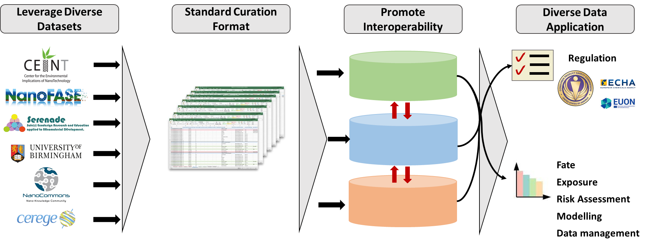

Scope of data management
Data curation and interoperability
Bridge different fields by promoting data comparability and project continuity
Shift curation focus from coordinators to data generators
Slide courtesy of

Slide 5
Data management and data lifecycle
Methods, protocols, experimental design
Instrument types and parameters, protocol refinements and deviations
Harmonisation and interoperability
Planning
FAIR*
Acquisition
Backup and store data
Assign DOI
Create metadata
Prepare documentation
Online access
Endpoint identification
Experimental design
Data management plan
Data templates creation
Data interpretation
Modelling/QSARs/Omics
Research outputs
Publications
Data Quality Control
Data cleansing
Storage
Tools implementation
Data acquisition
Data curation
Data digitisation
Storage
Manipulation
Bibliographical metadata, QC and QA, DOI assignment
Analysis
Data cleansing, gap filling, annotation, QC
Analytical and statistical protocols, modelling
*Findable, Accessible, Interoperable, Accessible

Slide 6
Overview
Data Management and Data Lifecycle
Electronic Laboratory Notebooks (ELN)
Live demonstration and hands on practice
Case Studies
Semantic Annotation
Conclusions

Slide 7
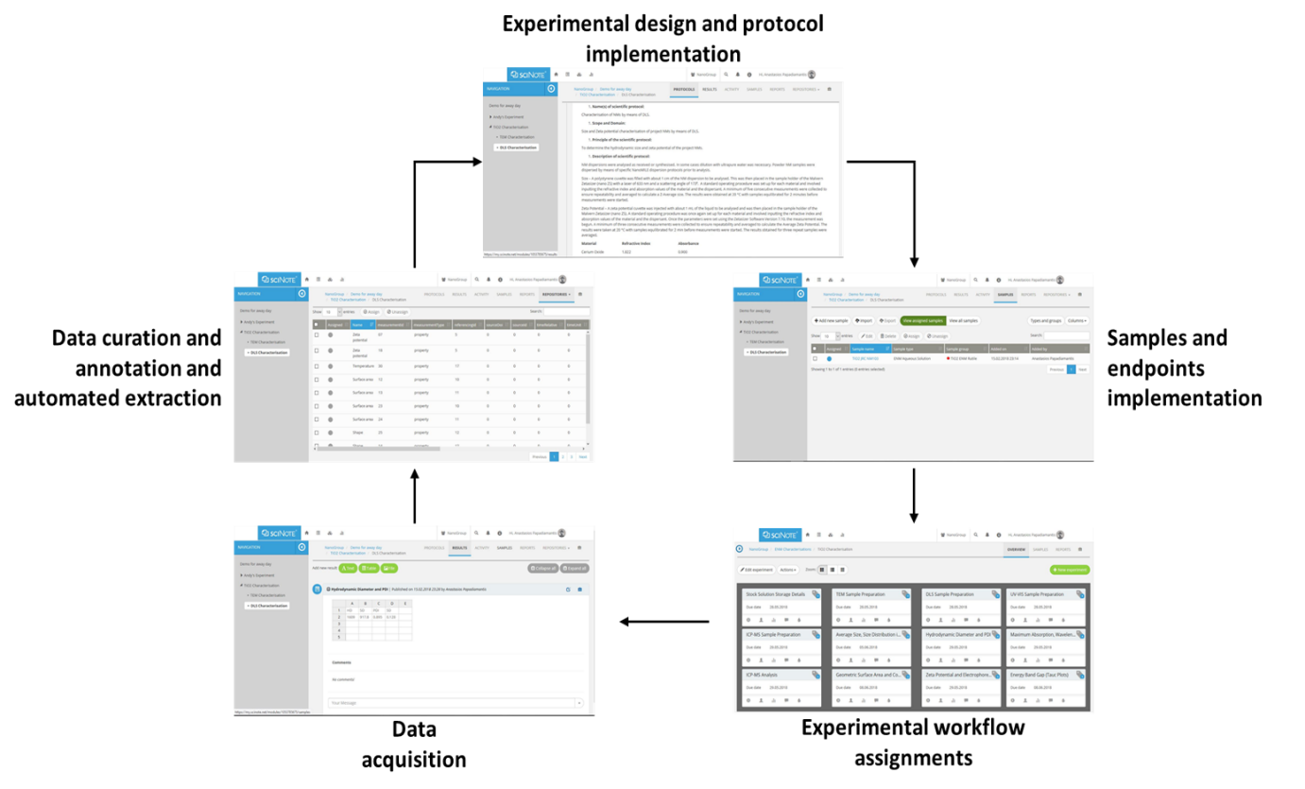
Electronic Lab Notebooks
Data acquisition and management

Slide 8
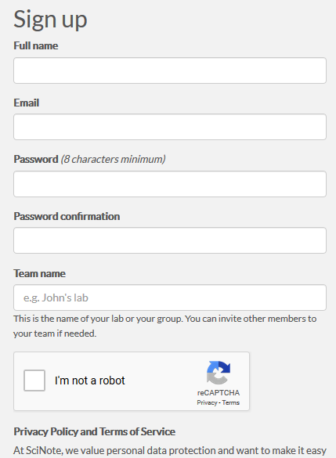
Electronic Lab Notebooks
Data acquisition and management
https://my.scinote.net/users/sign_up

Slide 9
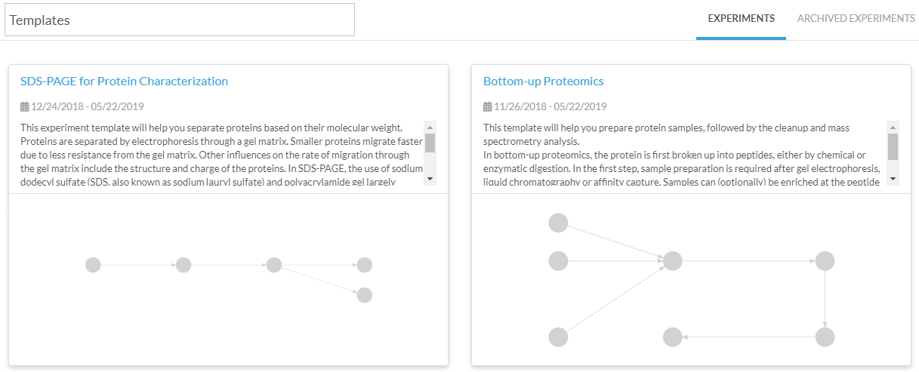
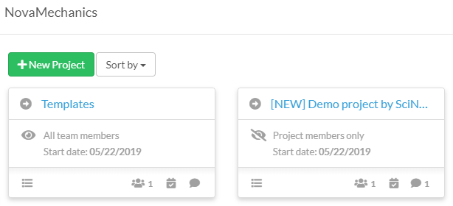
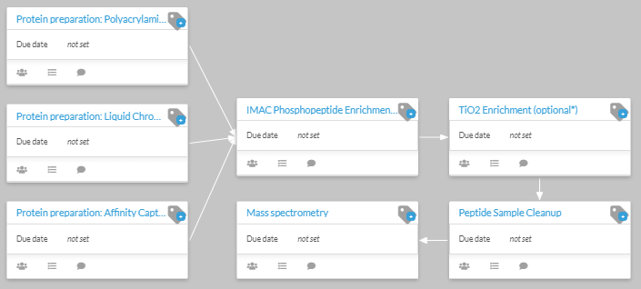
Electronic Lab Notebooks
Data acquisition and management

Slide 10
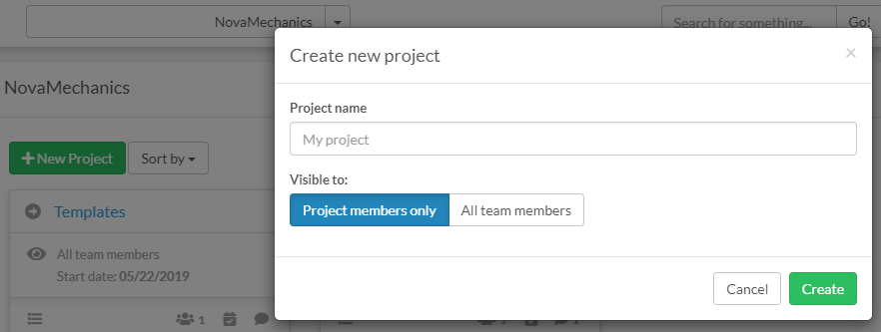
Electronic Lab Notebooks
Project creation

Slide 11
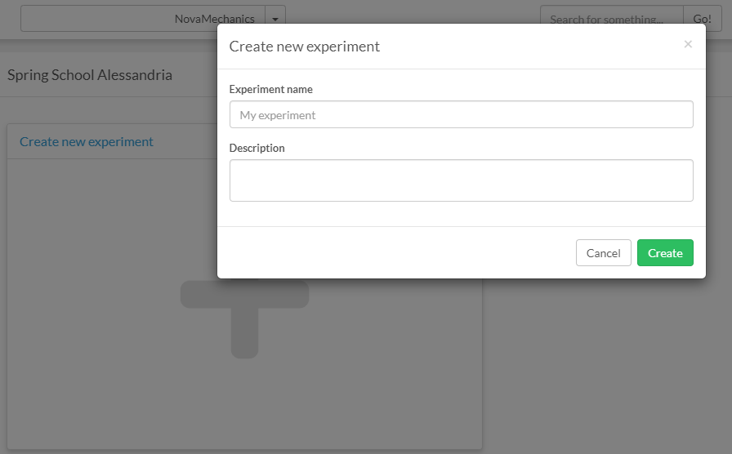
Electronic Lab Notebooks
New experiment

Slide 12
Overview
Data Management and Data Lifecycle
Electronic Laboratory Notebooks (ELN)
Live demonstration and hands on practice
Case Studies
Semantic annotation
Conclusions

Slide 13
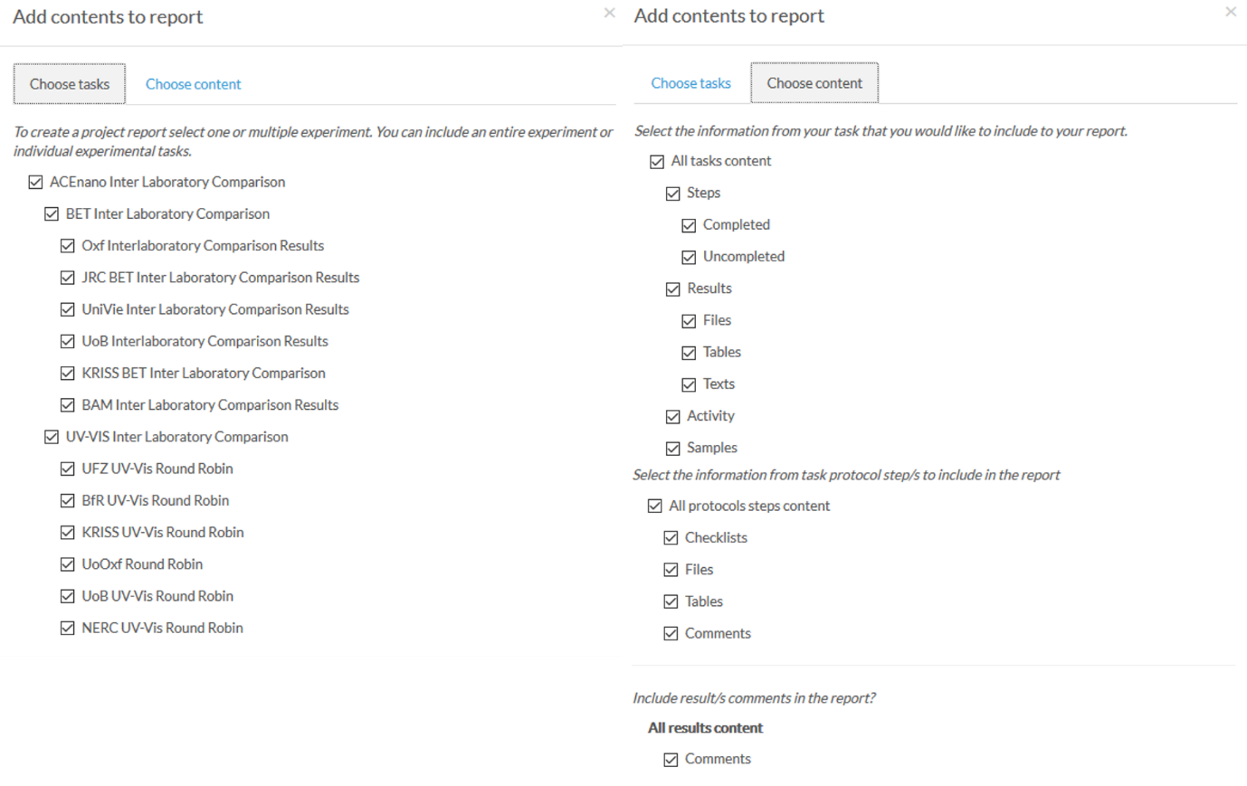
Electronic Lab Notebooks
Draft manuscript creation

Slide 14
Electronic Lab Notebooks
Live demonstration
https://www.nanocommons.eu/ngt/

Slide 15
Overview
Data Management and Data Lifecycle
Electronic Laboratory Notebooks (ELN)
Live demonstration and hands on practice
Case Studies
Semantic annotation
Conclusions

Slide 16
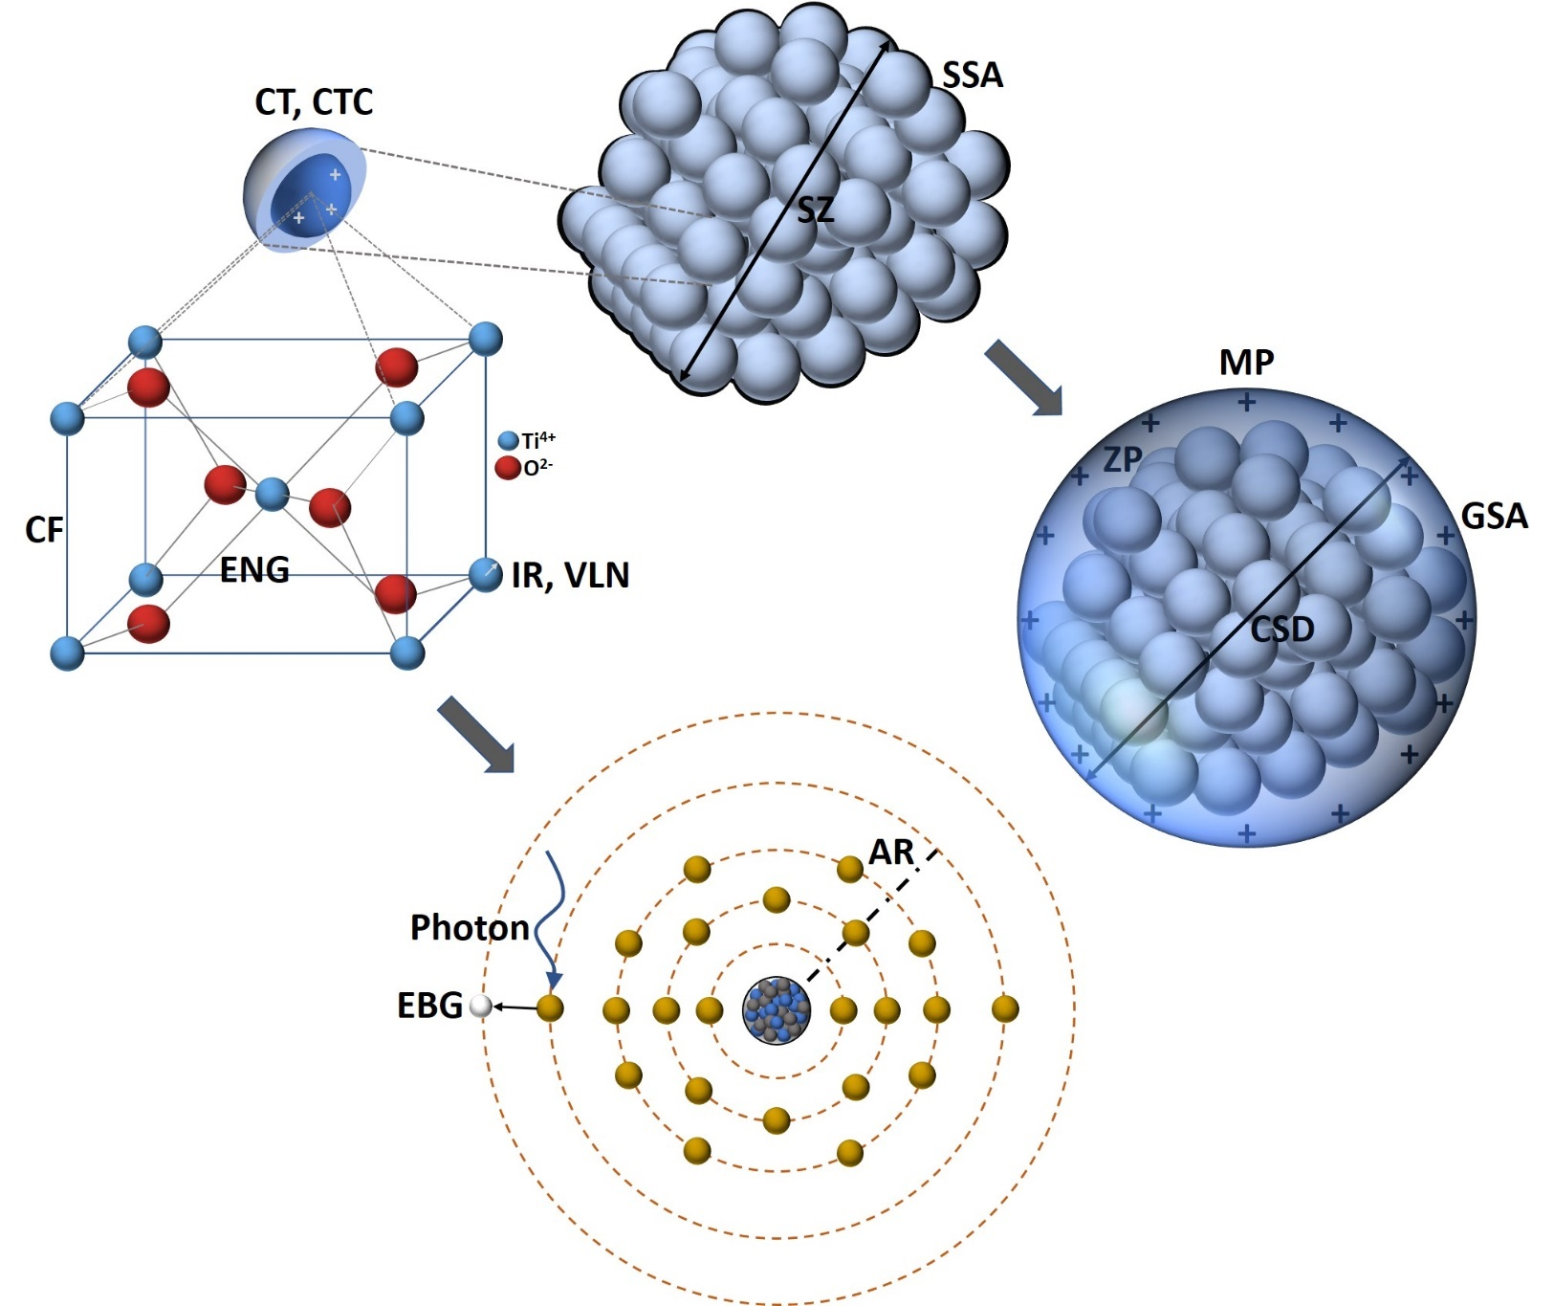
Nanomaterials Characterisation
Notes:
Detailed nanomaterial characterisation (physicochemical, structural, computational)

Slide 17
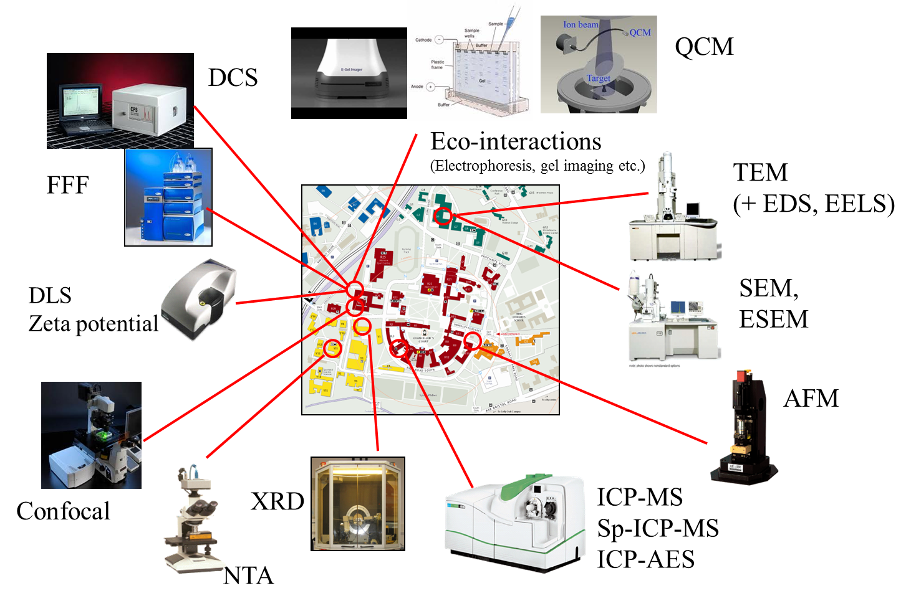
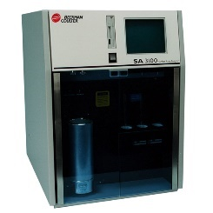
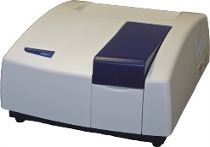
From a Local Network…
BET
UV-VIS
Sc-ICP-MS
Notes:
Detailed nanomaterial characterisation (physicochemical, structural, computational)

Slide 18
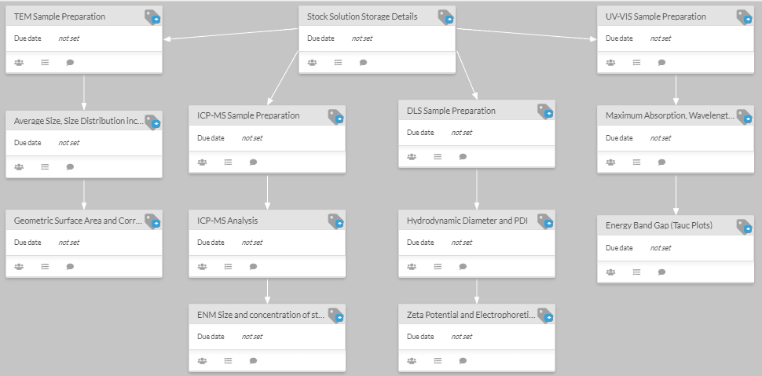
From a Local Network…
Physicochemical and computational nanomaterials characterisation
Notes:
Detailed nanomaterial characterisation (physicochemical, structural, computational)

Slide 19
To a Wide Network…
Aquatic and terrestrial mesocosm experiment, 7 EU countries and 10 Institutions

Slide 20
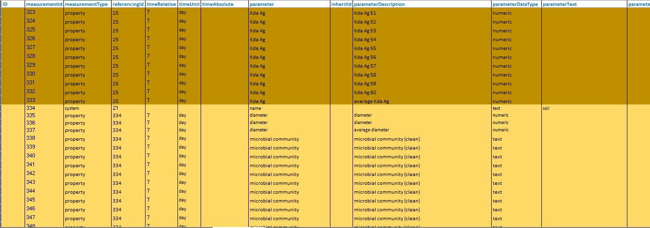
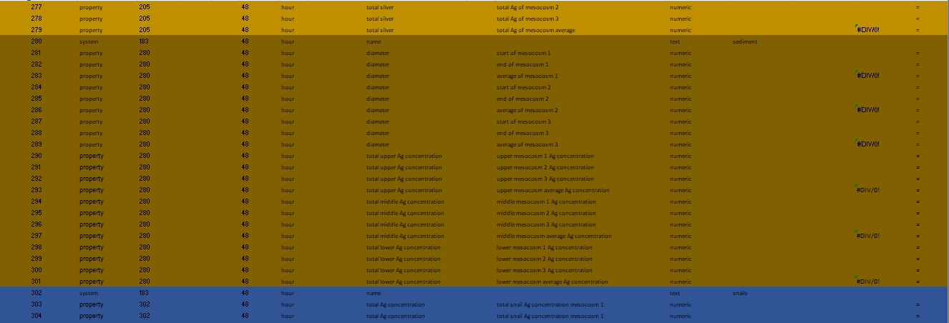
To a Wide Network…
> 10,000 data points

Slide 21
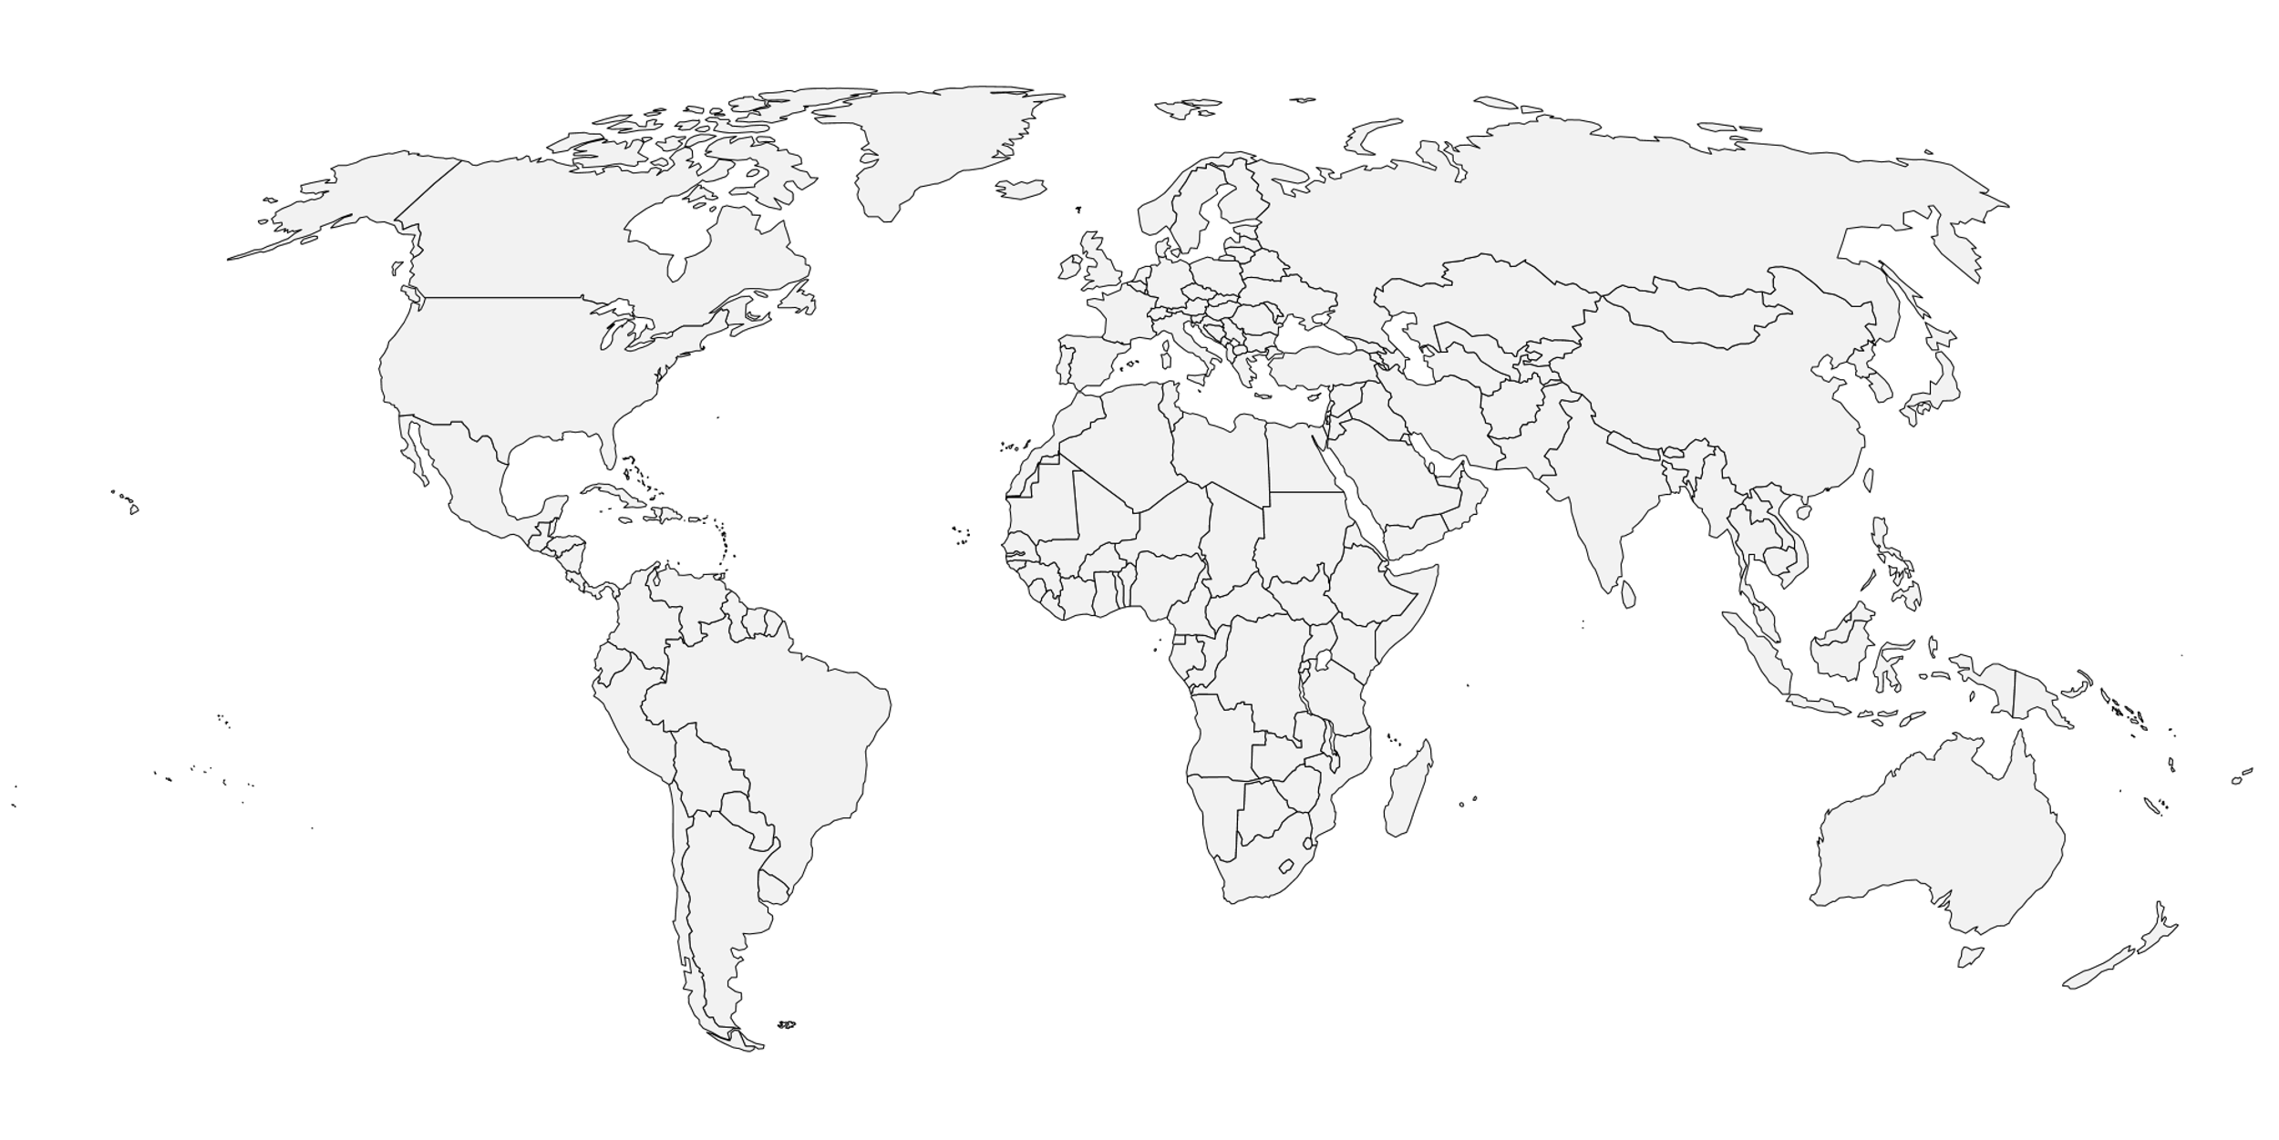
… and Global Network
Support for customised experimental workflows of varying complexity, … to wide area networks (WAN)
ACEnano round robins

Slide 22
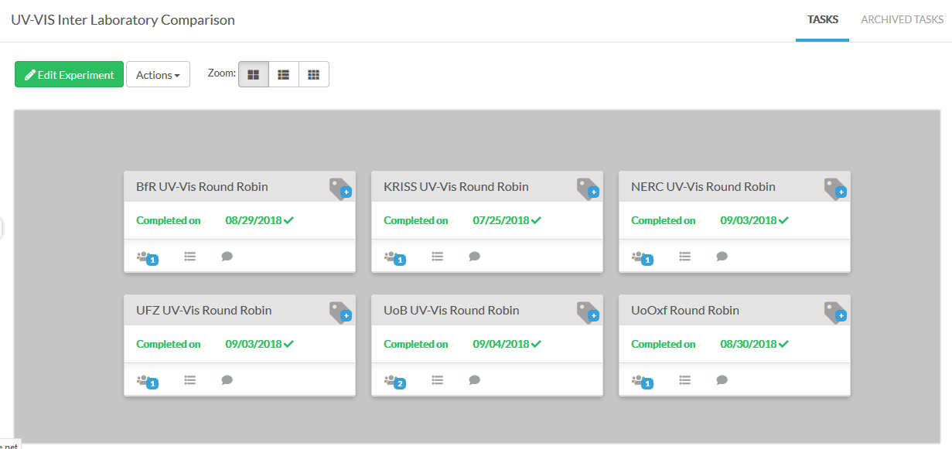
… and Global Network
ACEnano interlaboratory comparisons project
Notes:
Detailed nanomaterial characterisation (physicochemical, structural, computational)

Slide 23
Overview
Data Management and Data Lifecycle
Electronic Laboratory Notebooks (ELN)
Live demonstration and hands on practice
Case Studies
Semantic annotation
Conclusions

Slide 24
Data Hackathon
Using the NanoCommons Knowledge portal for templates and annotation upload
Beatrix Gerhard, Ivan Stambolic, Dieter Maier
nanocommons@biomax.com

Slide 25
Data harvesting and interoperability
Machine learning
Model validation
Approval
Dashboards

Slide 26
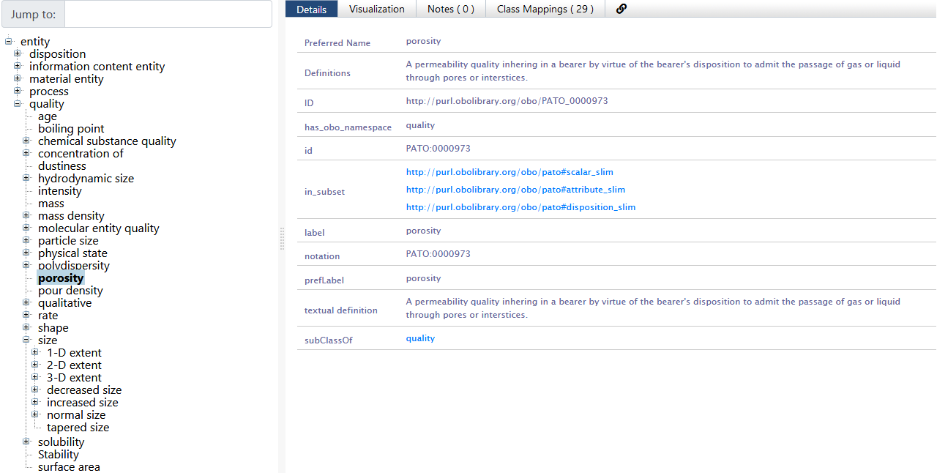
Ontologies – eNanoMapper

Slide 27
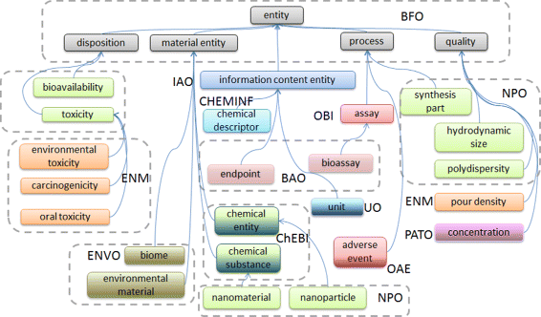
Ontologies – eNanoMapper

Slide 28
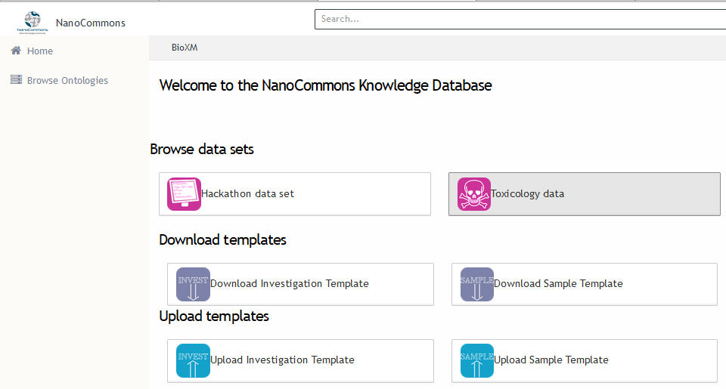

NanoCommons knowledge portal
https://ssl.biomax.de/nanocommons/
user: Hackathon
pwd: hackathon
Slide courtesy of

Slide 29
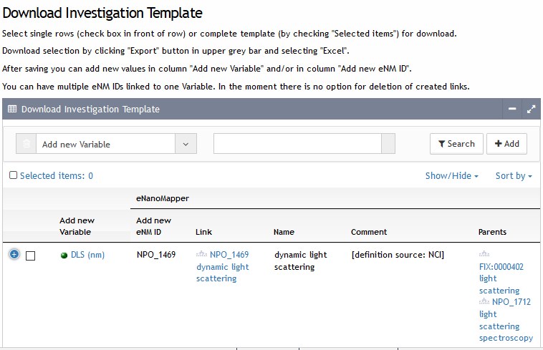
Excel template for “measured variable” metadata
Slide courtesy of

Slide 30
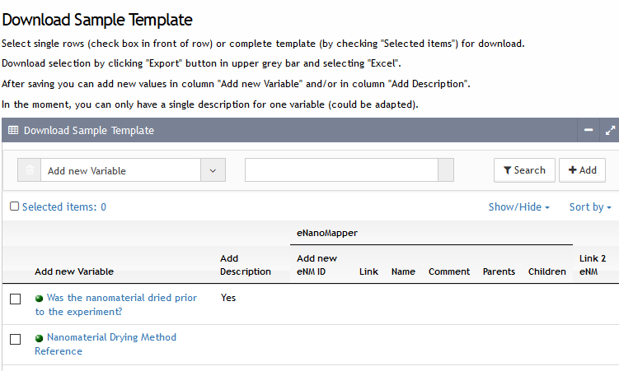
Excel template for “sample treatment” metadata
Slide courtesy of

Slide 31
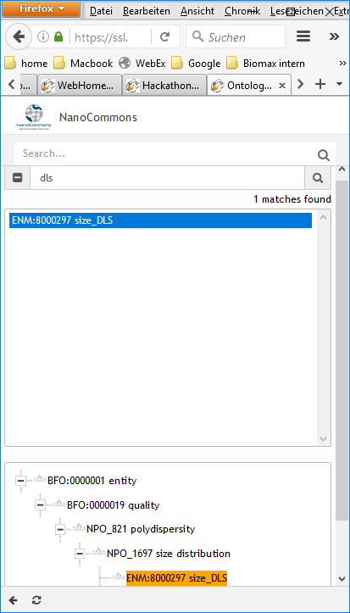
eNanoMapper Ontology search
Slide courtesy of

Slide 32
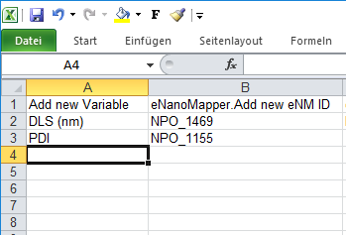
Edit Excel template
Slide courtesy of

Slide 33
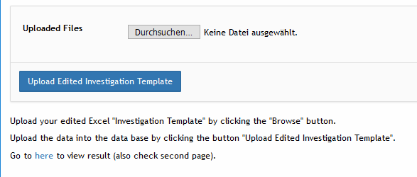
Excel template upload
Slide courtesy of

Slide 34
Overview
Data Management and Data Lifecycle
Electronic Laboratory Notebooks (ELN)
Live demonstration and hands on practice
Case Studies
Semantic annotation
Conclusions

Slide 35
Conclusions
Data Management is the most neglected, but highly significant experimental process
Can be applied from planning of experimental workflows to data analysis, preparation of research outputs and even regulatory aspects
Automated data curation and storage using versatile and dynamic data templates
Data repositories with support for tool implementation (modelling, QSARs, Omics)
Promotes data protection and security
Facilitates dataset QC, manipulation and analysis
Enhances publications and the datasets themselves are citable (DOI)
Can be applied from a local (single institution) to a wide (global) network to enhance harmonisation of data capture / storage
FAIR data and can be made Open also on demand

Slide 36
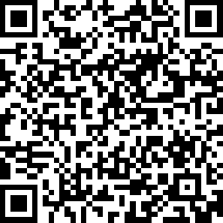
Thank you!
Contact:
A.Papadiamantis@bham.ac.uk
Please take our survey and let us know the tools the nanosafety community needs:
https://www.surveymonkey.co.uk/r/PK2KXWW

