Slide 1

NFHS Standard Penalty Summary
Created by Garry Mosier
Revised 7/12/25

Slide 2
How to Use This Presentation
The order of this presentation follows the Rule Reference Number, For example 6-1-1 is before 6-1-3.
To play this presentation, select “Slide Show” from top of the screen & then click “From Beginning”.
Words highlighted in red indicate changes this year.
Words highlighted in blue indicate a special additional penalty.

Slide 3
Delay of Game
Loss of 5 Yards
3-6-2d; 6-5-5
+

Slide 4
Illegal Substitution
Loss of 5 Yards
3-7

Slide 5
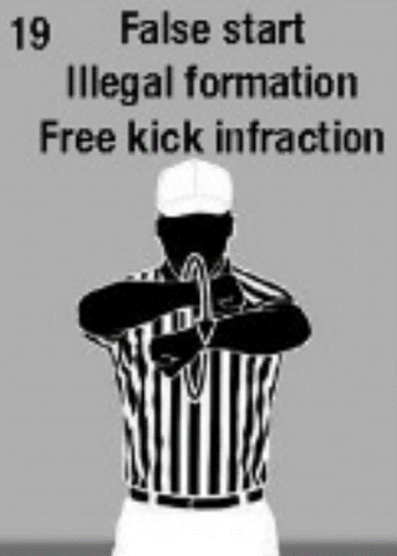
Free Kick Infraction
Loss of 5 Yards
6-1-2, 4, 11; 6-1-3b
+

Slide 6
Encroachment
Loss of 5 Yards
6-1-3a; 7-1-1, 5, & 6
+

Slide 7
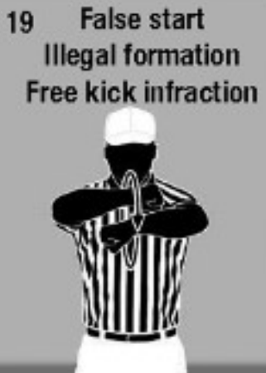
Free Kick Out of Bounds
Loss of 5 Yards
6-1-9

Slide 8
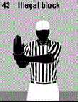
Illegal Block After Valid or Invalid Fair Catch Signal
Loss of 15 Yards
6-5-1; 9-3-3

Slide 9
Kick Catching Interference
Loss of 15 Yards
6-5-6

Slide 10
Invalid or Illegal Fair Catch Signal
Loss of 5 Yards
6-5-7; 6-5-8

Slide 11
Snap Infraction
Loss of 5 Yards
7-1-2; 7-1-3
+

Slide 12
False Start
Loss of 5 Yards
7-1-7
+

Slide 13
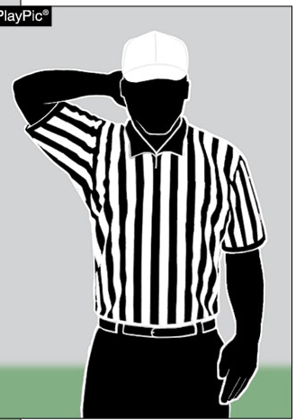
Disconcerting Act
Loss of 5 Yards
7-1 - 9
23 Disconcerting Act

Slide 14
Illegal Formation
Loss of 5 Yards
7-2-1; 7-2-2; 7-2-3

Slide 15
Less Than 5 Players on A’s LOS or Numbering Violation
Loss of 5 Yards
7-2-5

Slide 16
Illegal Shift or Illegal Motion
Loss of 5 Yards
7-2-6; 7-2-7

Slide 17
Planned Loose Ball Infraction
Loss of 5 Yards
7-2-8

Slide 18
Illegally Handing Ball forward (Also Loss of Down)
Loss of 5 Yards
7-3-2; 7-3-3
+

Slide 19
Illegal Forward Pass by A
(Also Loss of Down)
Loss of 5 Yards
7-5-2
+

Slide 20
Illegal Forward Pass by B
Loss of 5 Yards
7-5-2

Slide 21
Intentional Grounding
(Also Loss of Down)
Loss of 5 Yards
7-5-2d; 7-5-2e
+

Slide 22
Forward Pass Interference
Loss of 15 Yards
7-5-10

Slide 23
Ineligible Receiver Illegally Downfield
Loss of 5 Yards
7-5-12

Slide 24
Illegal Touching
(Also Loss of Down)
Loss of 5 Yards
7-5-13
+

Slide 25
Helping Runner
Loss of 5 Yards
9-1

Slide 26
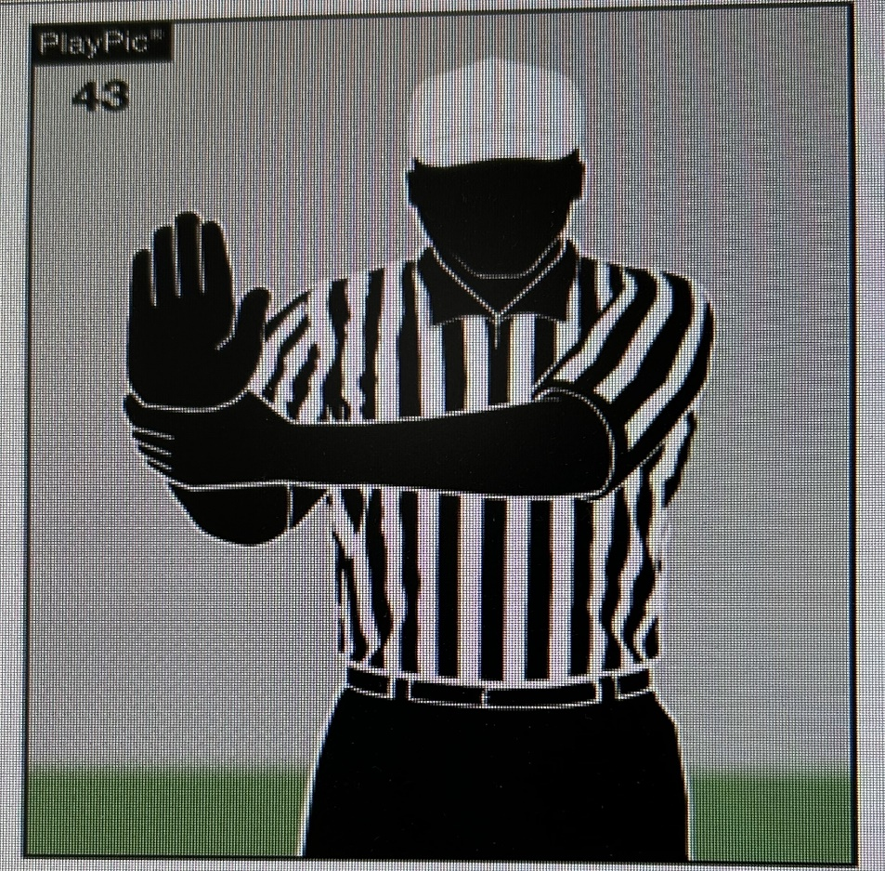
Illegal Use of Hands or Arms
Loss of 10 Yards
9-2-1a; 9-2-2; 9-2-3a, b, d

Slide 27
Interlocked Blocking
Loss of 10 Yards
9-2-1b

Slide 28
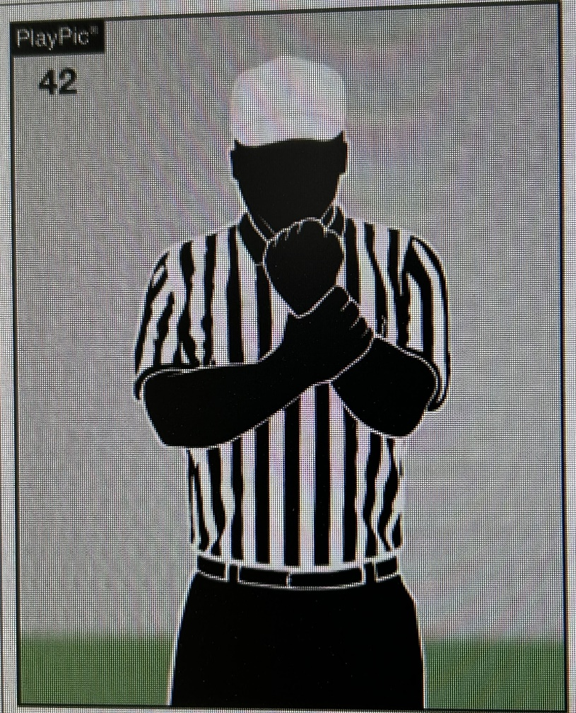
Holding
Loss of 10 Yards
9-2-1c; 9-2-3c, e

Slide 29
Runner Grasping Teammate
Loss of 10 Yards
9-2-2

Slide 30
Illegal Block Below Waist
Loss of 15 Yards
9-3-2

Slide 31
Illegal Block on Free Kicker or Holder
Loss of 15 Yards 9-3-4

Slide 32
Illegal Block in the Back
Loss of 10 Yards
9-3-5

Slide 33
Clipping
Loss of 15 Yards
9-3-6

Slide 34
Chop Block
Loss of 15 Yards
9-3-6

Slide 35
Illegal Block on Free Kicks
Loss of 10 Yards
9-3-7

Slide 36
Any Act if Unduly Rough/Flagrant (Give Proper Signal & Follow with DQ)
Loss of 15 Yards
9-4

Slide 37
Fighting by Player or Nonplayer (Plus DQ)
Loss of 15 Yards
9-4-1
+

Slide 38
Intentionally Contacting a Game Official (Plus DQ)
Loss of 15 Yards
9-4-2
+

Slide 39
Incidental Grasping an Opponent’s Face Mask (or any Helmet Opening, Chin Strap or Attached Tooth & Mouth Protector)
Loss of 5 Yards
9-4-3

Slide 40
Illegal Personal Contact Outside Restricted Area
Loss of 15 Yards
9-4-3

Slide 41
Charging Into an Opponent Obviously Out of the Play
Loss of 15 Yards
9-4-3b

Slide 42
Grasping of an Opponent’s Face Mask (or Any Helmet Opening, Chin Strap or Attached Tooth & Mouth Protector)
Loss of 15 Yards
9-4-3h
+

Slide 43
Illegal Helmet Contact (Includes: Butt Blocking, Face Tackle, & Spearing)
Loss of 15 Yards
9-4-3i
+

Slide 44
Striking, Kicking, or Kneeing
(Plus DQ)
Loss of 15 Yards
9-4-3J
+

Slide 45
Horse Collar
Loss of 15 Yards
9-4-3K
+

Slide 46
Initiate Contact With a Helmet-less Opponent
Loss of 15 Yards
9-4-3L

Slide 47
Targeting an Opponent
Loss of 15 Yards
9-4-3M
+

Slide 48
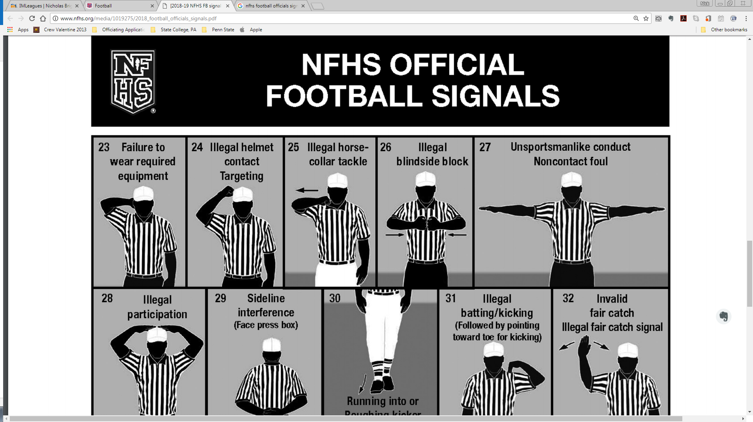
Illegal Blindside Block
Loss of 15 Yards
9-4-3N
+

Slide 49
Tripping
Loss of 15 Yards
9-4-3o
+

Slide 50
Roughing the Passer
(Also First Down)
Loss of 15 Yards 9-4-4
+

Slide 51
Running into Kicker/Holder
Loss of 5 Yards
9-4-5

Slide 52
Roughing Kicker or Holder
(Also First Down)
Loss of 15 Yards 9-4-5
+
+

Slide 53
Roughing Snapper
(Also First Down)
Loss of 15 Yards 9-4-6
+

Slide 54
Slapping Blocker’s Head
Loss of 15 Yards
9-4-7

Slide 55
Illegal Personal Contact in Restricted Area
Loss of 15 Yards
9-4-8
+

Slide 56
Unsportsmanlike Conduct by Player or Nonplayer
Loss of 15 Yards
9-5, 9-8; 1-5-3, 4

Slide 57
A Second UNS Foul by a Player or Non Player (Plus DQ)
Loss of 15 Yards
9-5; 9-8
+

Slide 58
Illegal Participation
Loss of 15 Yards
9-6

Slide 59
Participating Without a Helmet Beyond Immediate Action
Loss of 15 Yards
9-6-4

Slide 60
Illegal Kicking or Batting Ball
Loss of 10 Yards
9-7; 6-2-1

Slide 61
Sideline Interference
Loss of 5 Yards
9-8-1k
+

Slide 62
Sideline Interference
(Third & Subsequent)
Loss of 15 Yards
9-8-1k; 9-8-3
+
+

Slide 63
Attendant Illegally on Field
Loss of 5 Yards
9-8-2

Slide 64
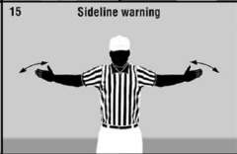
Sideline Warning
First offense
9-8-3

Slide 65
Non Player Outside of the Team Box, But Not on Field
Loss of 5 Yards
9-8-3
+

Slide 66
Non Player Illegally on Field
Loss of 15 Yards
9-8-3

Slide 67
A Substitute Leaving Team Box During a Fight (Plus DQ)
Loss of 15 Yards
9-8-1l
+

Slide 68
Unfair Acts
Loss of 15 Yards
9-9

