Slide 1

2025
SRI Meeting: OHSAA Points of Emphasis
WWW.OHSAAFB.COM

Slide 2
“High achievement takes place in the framework of high expectations” – Charles Kettering.
7/12/25

Slide 3

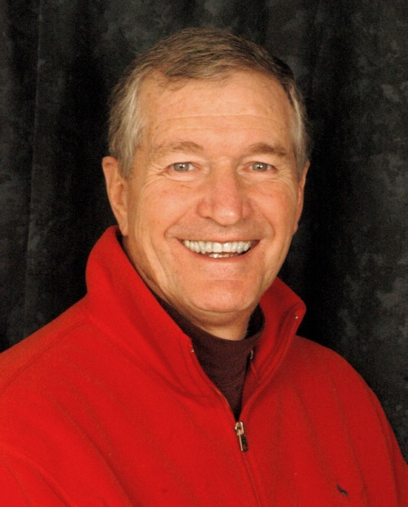
State Rules Interpreters
Beau Rugg
Director of Officiating & FB Administrator
Dr. Bruce Maurer
Director of Officiating Development (DOD)

Slide 4

Attendance will be taken at the end of this presentation. I need the top copy.

Slide 5
NFHS Rules Book Modifications
Pages 87-90: Delete all NFHS Overtime Rules.
Refer to the Gold Book for OHSAA OT Rules.
Note: OT is played in Varsity Games ONLY!

Slide 6
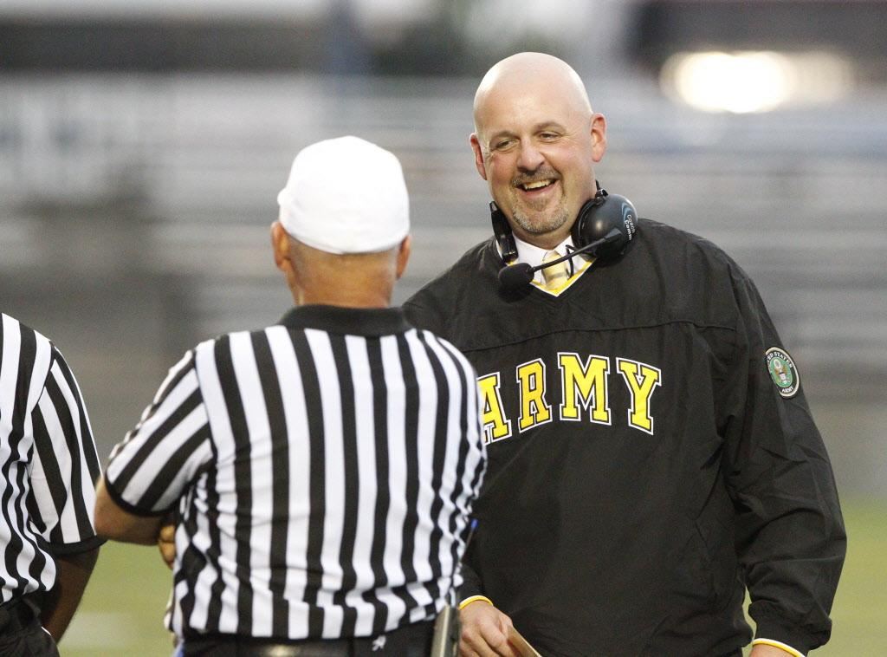
Recruitment of New Officials
It needs to be our highest priority.
We had nearly a 10% increase this past year -- from 3,010 officials to 3,296. Congrats!
It is a Journey -- “Keep it Going”!!

Slide 7
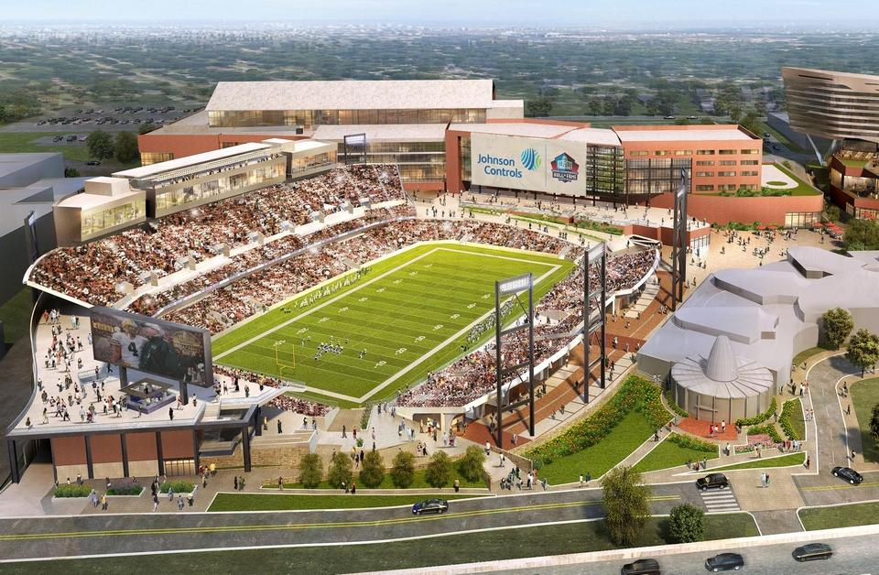
Weeks 11- 15 Playoff Games
Regular Season Crews officiate Weeks 11 & 12.
Crews made up by OHSAA will officiate Weeks 13 – 15.
KO Time is 7PM.
Most games on F.

Slide 8
OHSAA Playoff Eligibility
The OHSAA can grant an exemption either this year and/or last year for the minimum 8 games that an official must work both years.

Slide 9
OHSAA Policies & Regulations
Crew Size: Minimum Crew of at least 6, including a Center Judge (if available); 5, if 6 are not available.

Slide 10
OHSAA Regulations
ALL QUESTIONS Regarding OHSAA General Sport & FB Regulations Must be referred to their Office, other than the Gold Book, Pages 39-41.

Slide 11
OHSAA Regulations-Sub Varsity
Timing Rules may be adjusted that are agreeable to both teams that are below the NFHS Rule Book Maximum time.

Slide 12
OHSAA Point Differential (PD)
If both HC’s agree at any time during the game, the PD Rule can be implemented before the score differential reaches 30 points.

Slide 13
OHSAA Policies & Regulations
Please file a Report on DragonFly regarding any unsafe facility concerns or EQPT.
Please feel free to file a Report for Excellent Sportsmanship by a team or teams.

Slide 14
OHSAA Safety Policies: Heat & Humidity
100% Preventable
Start Hydrating the Day before the Game
Plenty of Water on Game Day

Slide 15
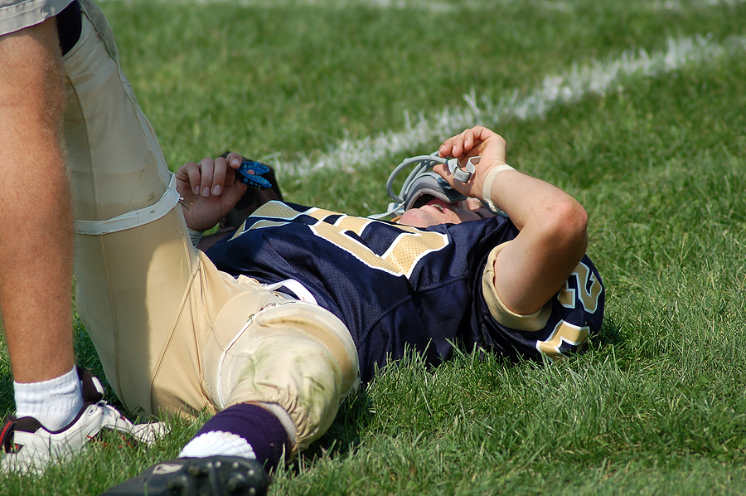
OHSAA Safety Policies: Concussion
A Player with signs &/or symptoms is suspended from the game & may NOT reenter (State Law), even if a Doctor says player is ok. If Crew suspends, file a report w/in 48 hours with OHSAA

Slide 16
OHSAA Safety Policies: Concussions – Return to Play
The schools are responsible for the “return to play” Protocol, not the officials.

Slide 17

OHSAA Safety Policies: Inclement Weather (see NFHS Rule Book P. 102)
If officials, coaches or game administrators, see lightning or hear thunder, stop the contest. They must come together & determine if it is safe to continue the game.
Utilize technology to see if the lightning is within 10 miles. If so, suspend the game.

Slide 18
OHSAA Safety Policies: Inclement Weather (see NFHS Rule Book P. 102)
Thunder? – must suspend
If lightning is within 10 miles or thunder is heard, evacuate the field & take cover for a minimum of 30 minutes.
  Record game info.
All officials, players, & coaches must leave the field.
Halftime may be shortened/eliminated

Slide 19

Restricted Area – 2 Yards
Dead Ball – HC may come 2 steps on to the field
Live Ball – No one may be in the restricted area during a live ball
RESTRICTED AREA

Slide 20
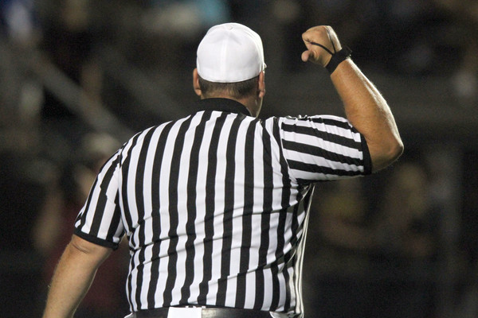
Disqualifications – Ejections
Players or Coaches may be ejected.
The OHSAA office staff will communicate with the school AD on suspension durations for ejections.

Slide 21
Disqualifications – All Contests
Complete the report within 48 hours-BE SPECIFIC.
Notify AD by email or phone

Slide 22
Disqualifications – Fighting
Players will be DQ’d for “active” fighting or act of fighting.
File a separate report for each player.

Slide 23
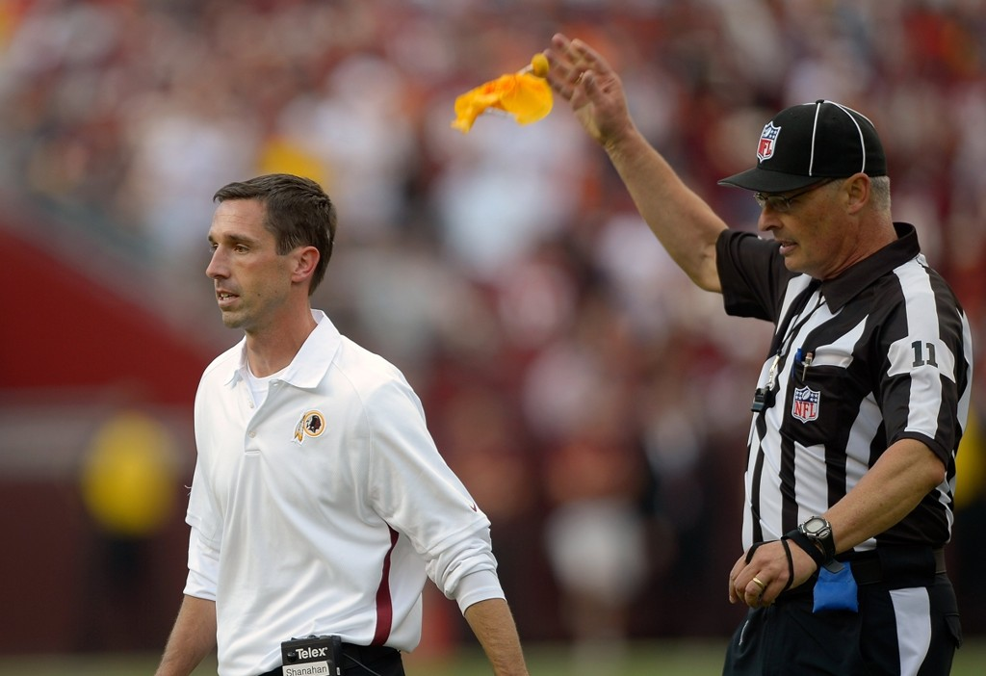
Unsportsmanlike Conduct
A UNS Foul Assessed to an Asst. Coach/Trainer is NOT charged to the HC.

Slide 24
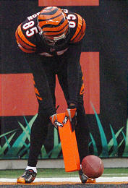
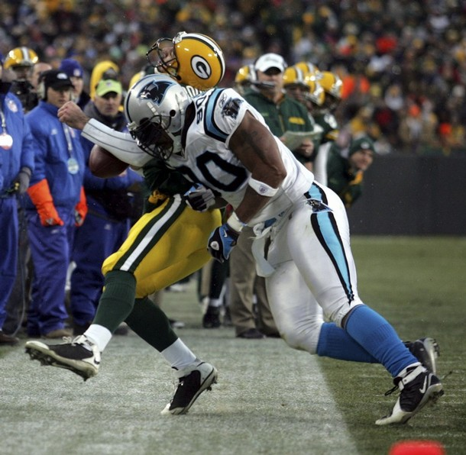
Unsportsmanlike Conduct vs. Personal Fouls
Unsportsmanlike Conduct – Non-contact
Personal Fouls – Contact

Slide 25
2025
SRI Meeting: Most NFHS New Rules & POE
WWW.OHSAAFB.COM

Slide 26
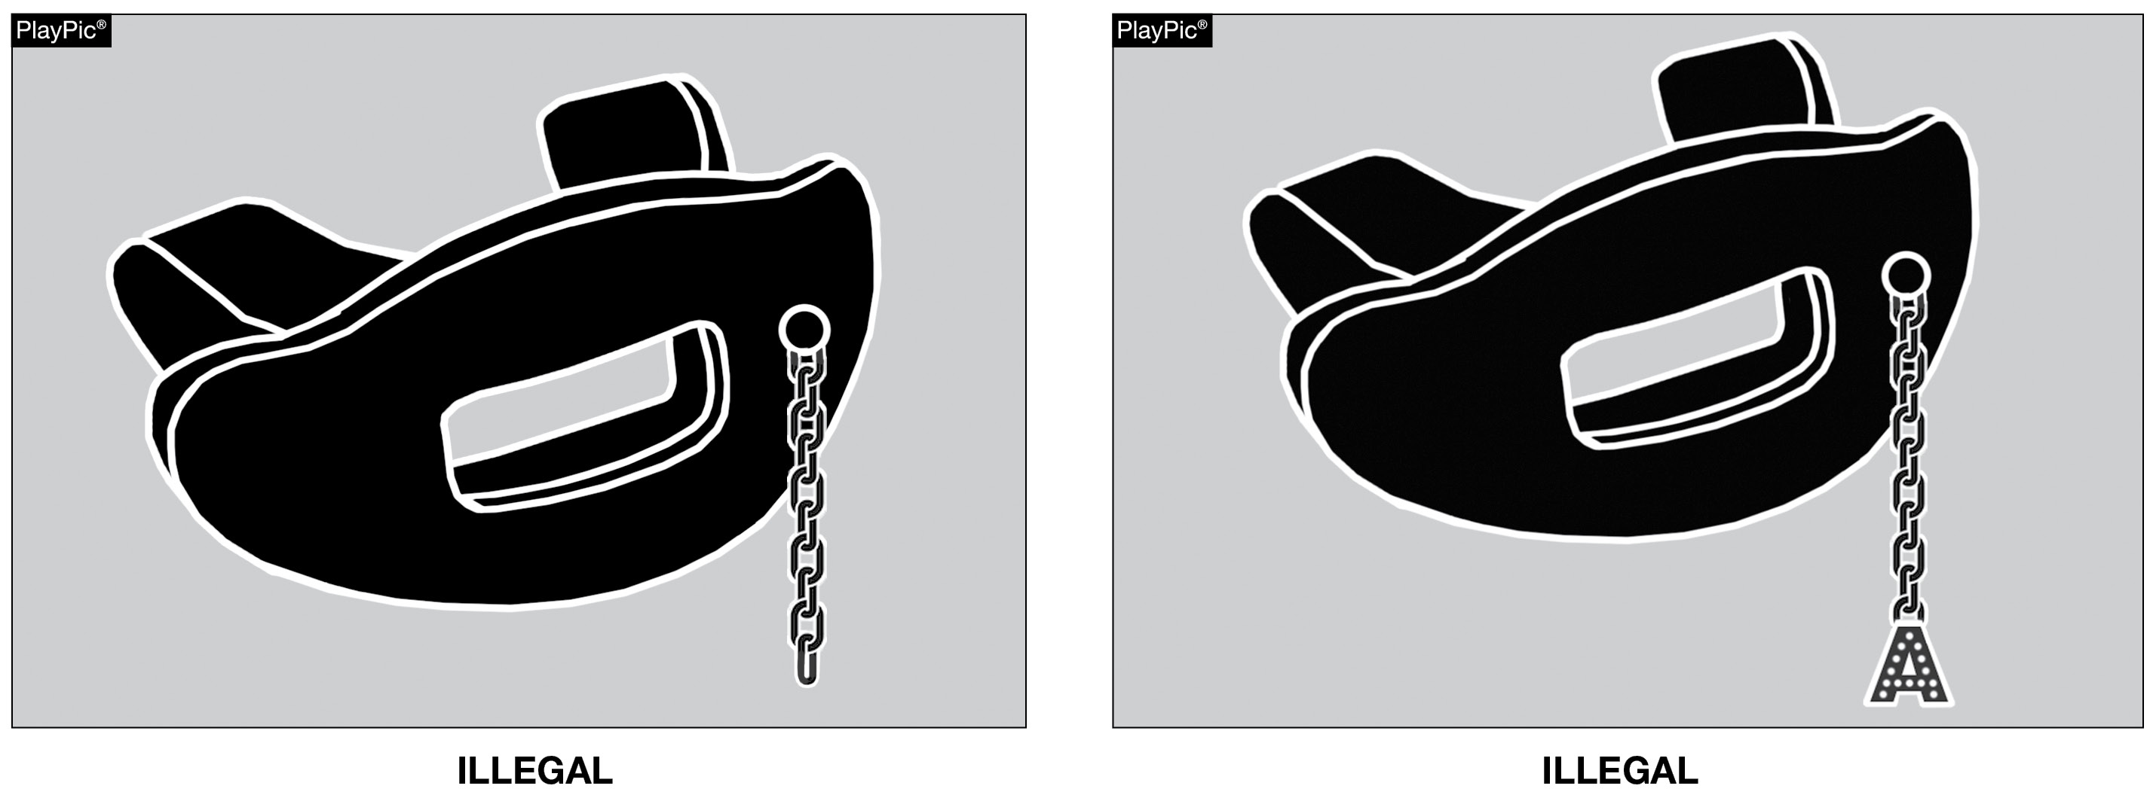
TOOTH & MOUTH PROTECTOR
Tooth and mouth protectors may not include any attachment(s) that do not serve a purpose and function in protecting the teeth or mouth. Rule 1-5-1d(5)a - 4
Notes:
Rules Changes:
RULE 1 – SECTION 5 PLAYER EQUIPMENT
ART. 1 . . . Mandatory equipment. Each player shall participate while wearing the following pieces of properly fitted equipment, which shall be professionally manufactured and not altered to decrease protection: …
d. Pads and Protective Equipment – The following pads and protective equipment are required of all players: …
5. (a) A single tooth and mouth protector (intraoral) which shall:
(1) include an occlusal (protecting and separating the biting surfaces) portion;
(2) include a labial (protecting the teeth and supporting structures) portion;
(3) cover the posterior teeth with adequate thickness;
(4) not include any attachment(s) that do not serve a purpose and function in protecting the teeth or mouth (effective 2026); and
(5) not include anything on it that is a health or risk issue and can pose a danger to themselves or other players (effective 2026).
(b) It is recommended that the protector be properly fitted, protecting the anterior (leading) dental arch and:
(1) constructed from a model made from an impression of the individual’s teeth; or
(2) constructed and fitted to the individual by impressing the teeth into the tooth and mouth protector itself. …
Rationale for Change: Items that are attached to the tooth and mouth protector that do not serve a purpose and function in protecting the teeth or mouth will not be allowed.

Slide 27
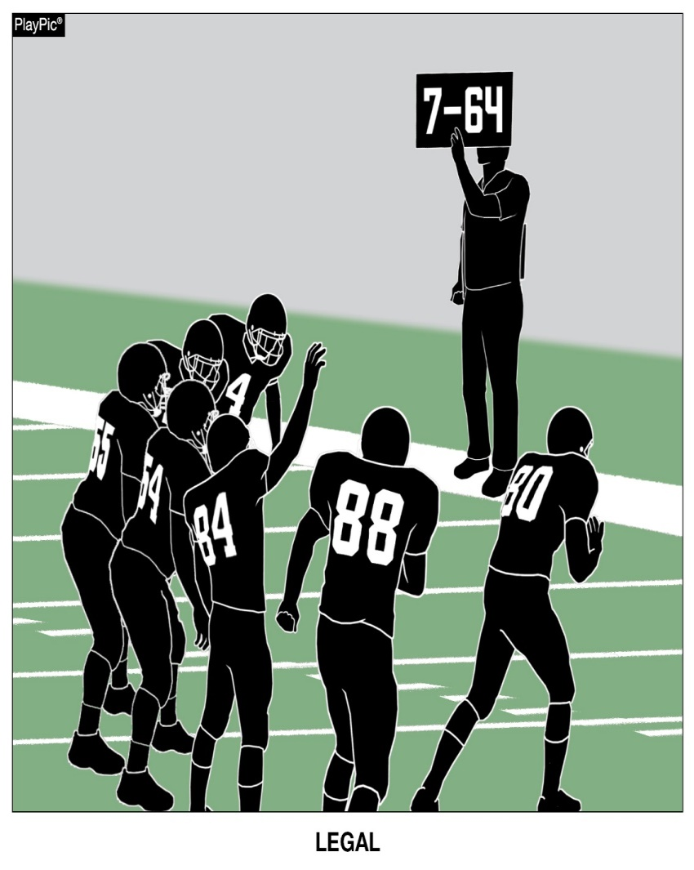
ELECTRONIC SIGNS
Fixed electronic signs (non-audio) with play signals are allowed to communicate from the sideline. Rule 1-5-3c (2)
Notes:
Rules Changes:
RULE 1 – SECTION 5 PLAYER EQUIPMENT
ART. 3 . . . Illegal equipment. No player shall participate while wearing illegal equipment. This applies to any equipment, which in the opinion of the umpire is dangerous, confusing or inappropriate. Illegal equipment shall always include but is not limited to: …
c. The following Other Illegal Equipment: …
2. Except during an outside 9-yard mark conference (7-yard marks in nine-, eight- and six-player competition), electronic audio or non-fixed video communication devices used to communicate with a player. …
Rationale for Change: This change allows for the use of some additional equipment, but continues to preclude in-helmet communication. This would allow for fixed electronic signs with play signals as well as non-audio methods but still would not permit the players between the numbers to watch video.
Case Book: See SITUATION 1.6.1F

Slide 28
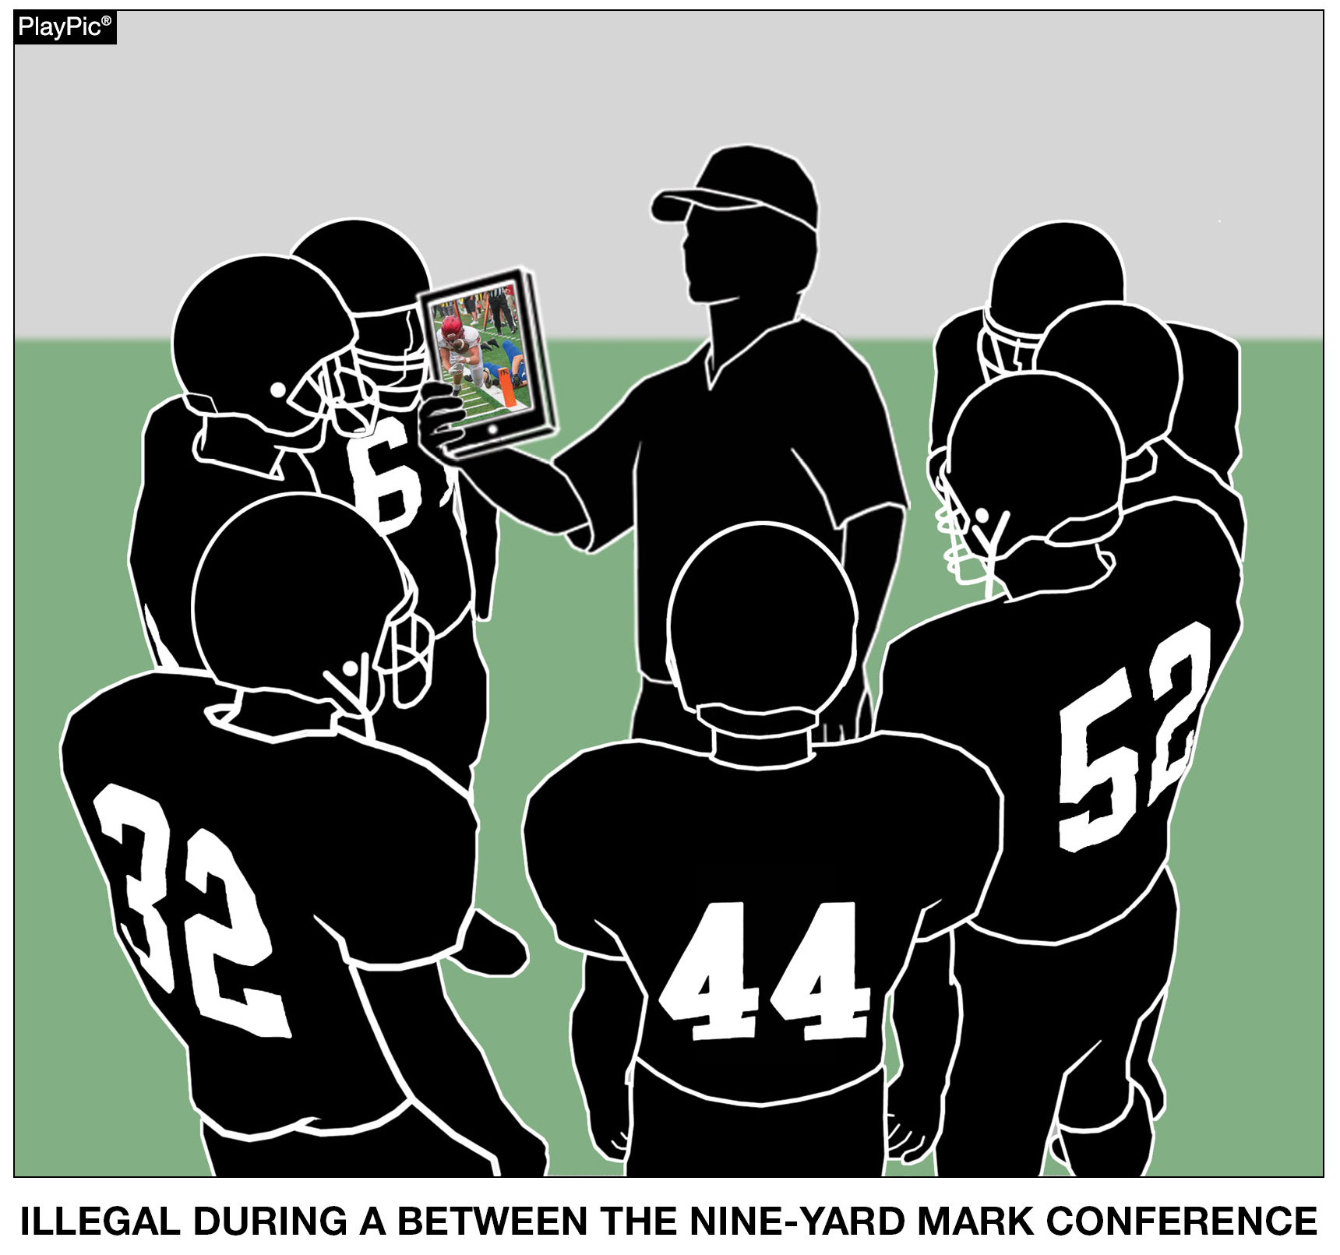

ELECTRONIC SIGNS
Scrolling graphics, video footage, connected audio communication are all examples of the use of illegal equipment if this were a between the nine-yard mark conference. Rule 1-5-3c (2)
Notes:
RULES CHANGES:
See comments on slide

Slide 29
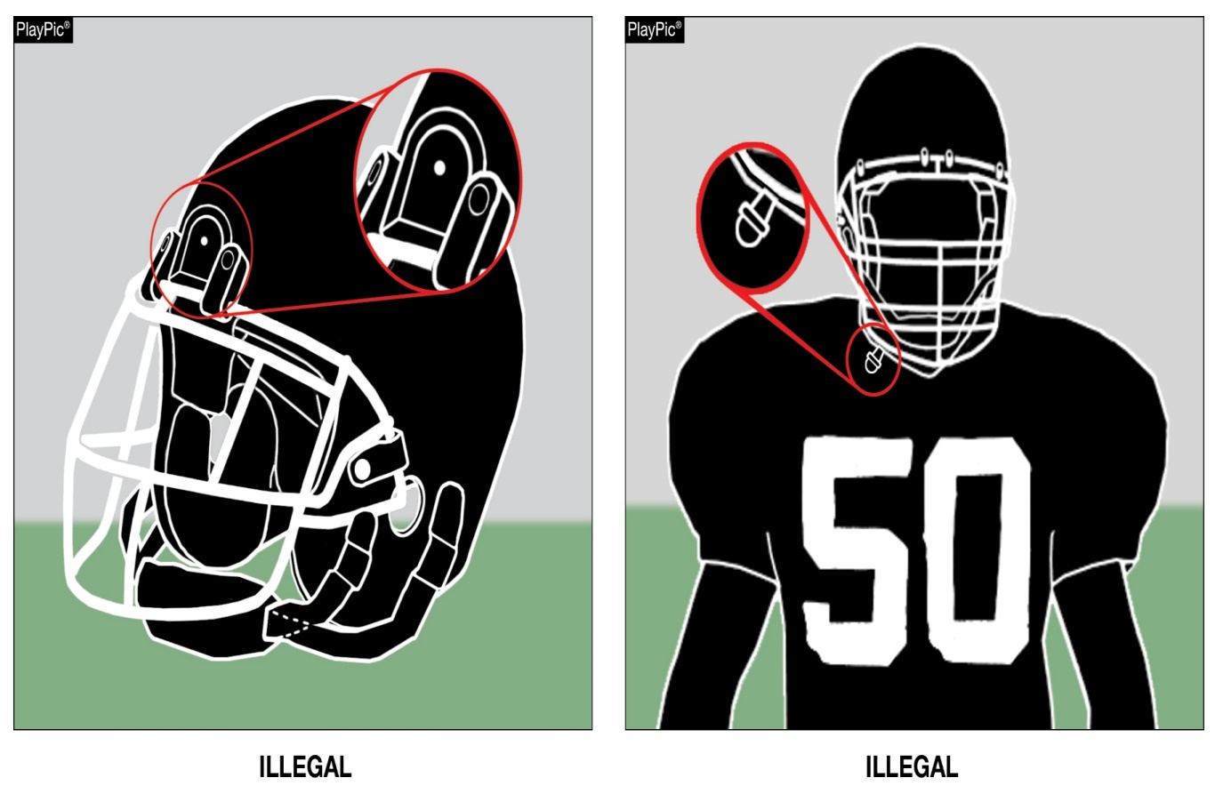
ILLEGAL EQUIPMENT
Any video (camera) device or audio (microphone) worn by a player during the game is illegal. Rule 1-5-3c(3)
Notes:
Rules Changes:
RULE 1 – SECTION 5 PLAYER EQUIPMENT
ART. 3 . . . Illegal equipment. No player shall participate while wearing illegal equipment. This applies to any equipment, which in the opinion of the umpire is dangerous, confusing or inappropriate. Illegal equipment shall always include but is not limited to: …
c. The following Other Illegal Equipment: …
3. Any audio (microphone) or video (camera) device worn by a player during the game. …
Rationale for Change: No player participating in the game will be allowed to wear any type of audio or video device in order to record or transmit audio or video.
Case Book: See SITUATION 1.6.1B

Slide 30
Illegal Participation: REVISED PENALTY ENFORCEMENT (PE)
Revisions to 9-6 PENALTY & elimination of 10-4-4b have clarified PE for illegal participation fouls.
The penalty for all illegal participation fouls has been standardized as “15 yards, live ball, basic spot” enforcement.
Notes:
RULES CHANGES:
See comments on slide

Slide 31
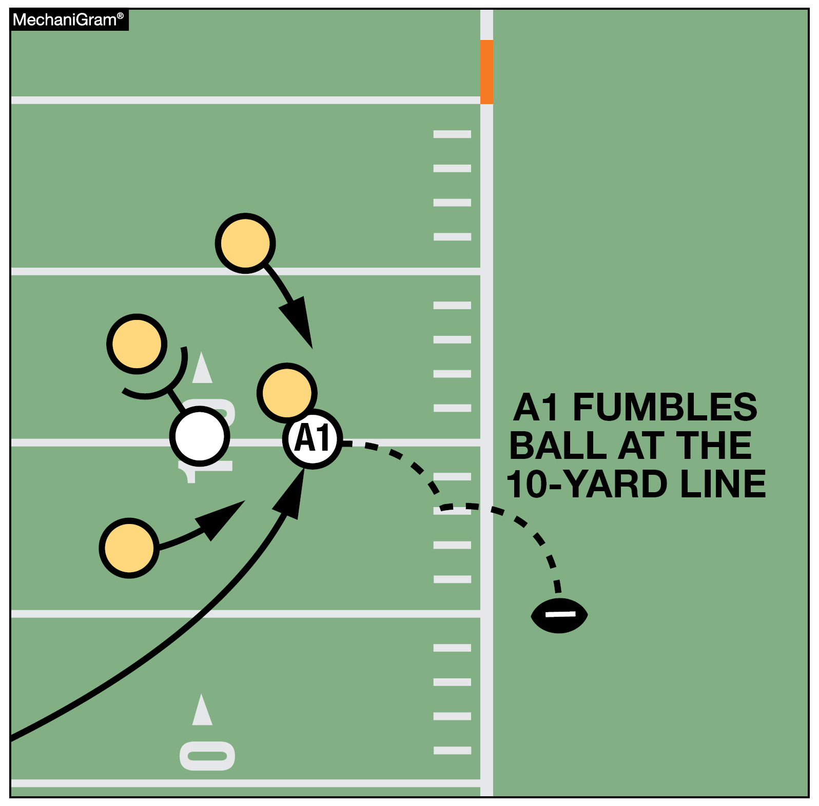
FUMBLE GOES BACKWARD & OOB
When a fumble is backward & goes OOB’s between the goal lines, the ball shall be spotted where it is ruled OOB’s and the game clock is started on the snap. Rule 3-4-3a, 4-3-1 Exc.
Notes:
RULES CHANGES:
See comments on slide

Slide 32
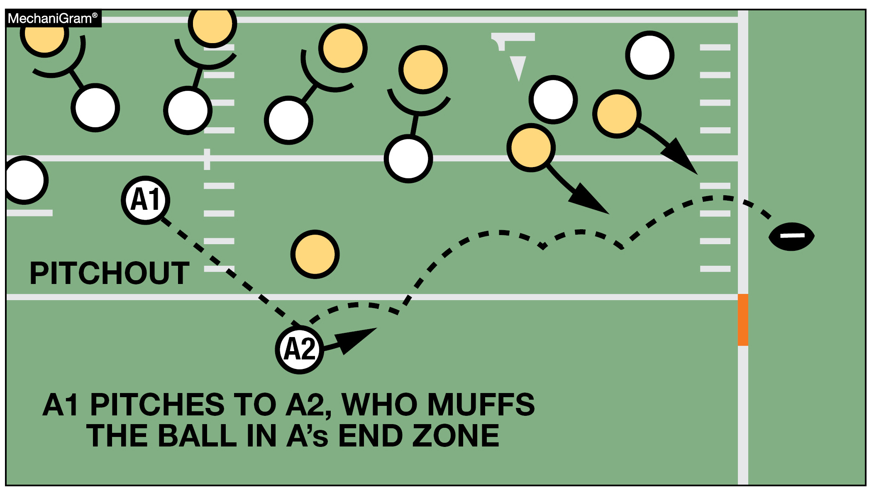
MUFF -- NOT A FUMBLE FORWARD
A muff going forward does NOT qualify for the EXCEPTION and would be placed at the OOB’s spot & the clock started on the snap.
Rules 3-4-3a, 4-3-1 EXC.
Notes:
RULES CHANGES:
See comments on slide

Slide 33
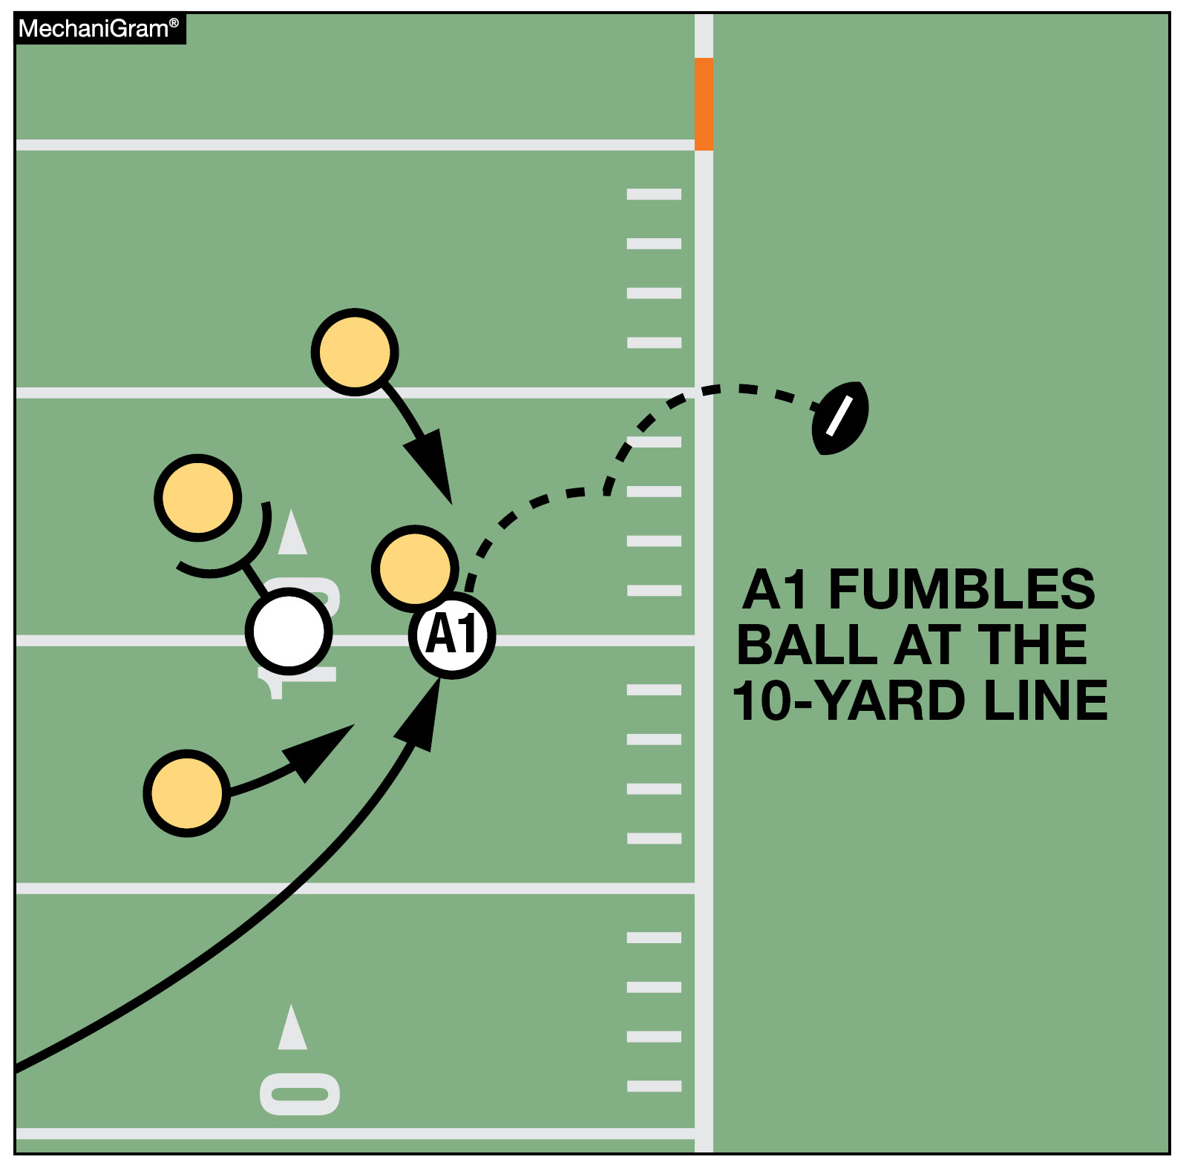
FUMBLE GOES FORWARD & OOB
When a fumble goes forward & OOB’s between the goal lines, the ball shall be returned to the spot of the fumble & the game clock is started on the ready for play. Rules 3-4-2d/3a & 4-3-1Exc.
Notes:
Rules Changes:
RULE 3 – SECTION 4 STARTING AND STOPPING THE CLOCK
ART. 2 . . . The game clock shall start with the ready-for-play on a down beginning with a snap if the game clock was stopped for any reason other than specified in Rule 3-4-3 or an untimed down: …
d. Team A forward fumble out of bounds.
ART. 3 . . . The game clock shall start with the snap or when any free kick is touched, other than first touching by K, if the game clock was stopped because:
a. The ball goes out of bounds, unless 4-3-1 EXCEPTION for forward fumble applies. …
RULE 4 – SECTION 3 OUT-OF-BOUNDS AND INBOUNDS SPOTS
ART. 1 . . . When a loose ball goes out of bounds, the out-of-bounds spot is fixed by the yard line where the foremost point of the ball crossed the sideline. When the ball becomes dead in the field of play because of touching a person who is out of bounds, the out-of-bounds spot is fixed by the yard line through the foremost point of the ball.
EXCEPTION: When a forward fumble goes out of bounds or is ruled out of bounds between the goal lines, the ball shall be returned to the spot of the fumble.
Rationale for Change: A situation potentially giving an unfair advantage to a fumbling team was revised. When a forward fumble goes out of bounds or is ruled out of bounds between the goal lines, the ball shall be returned to the spot of the fumble.
Case Book: See SITUATIONS 4.3.1A, 4.3.1B, 4.3.1C, 4.3.1D, 4.3.1E, 10.3.3C

Slide 34
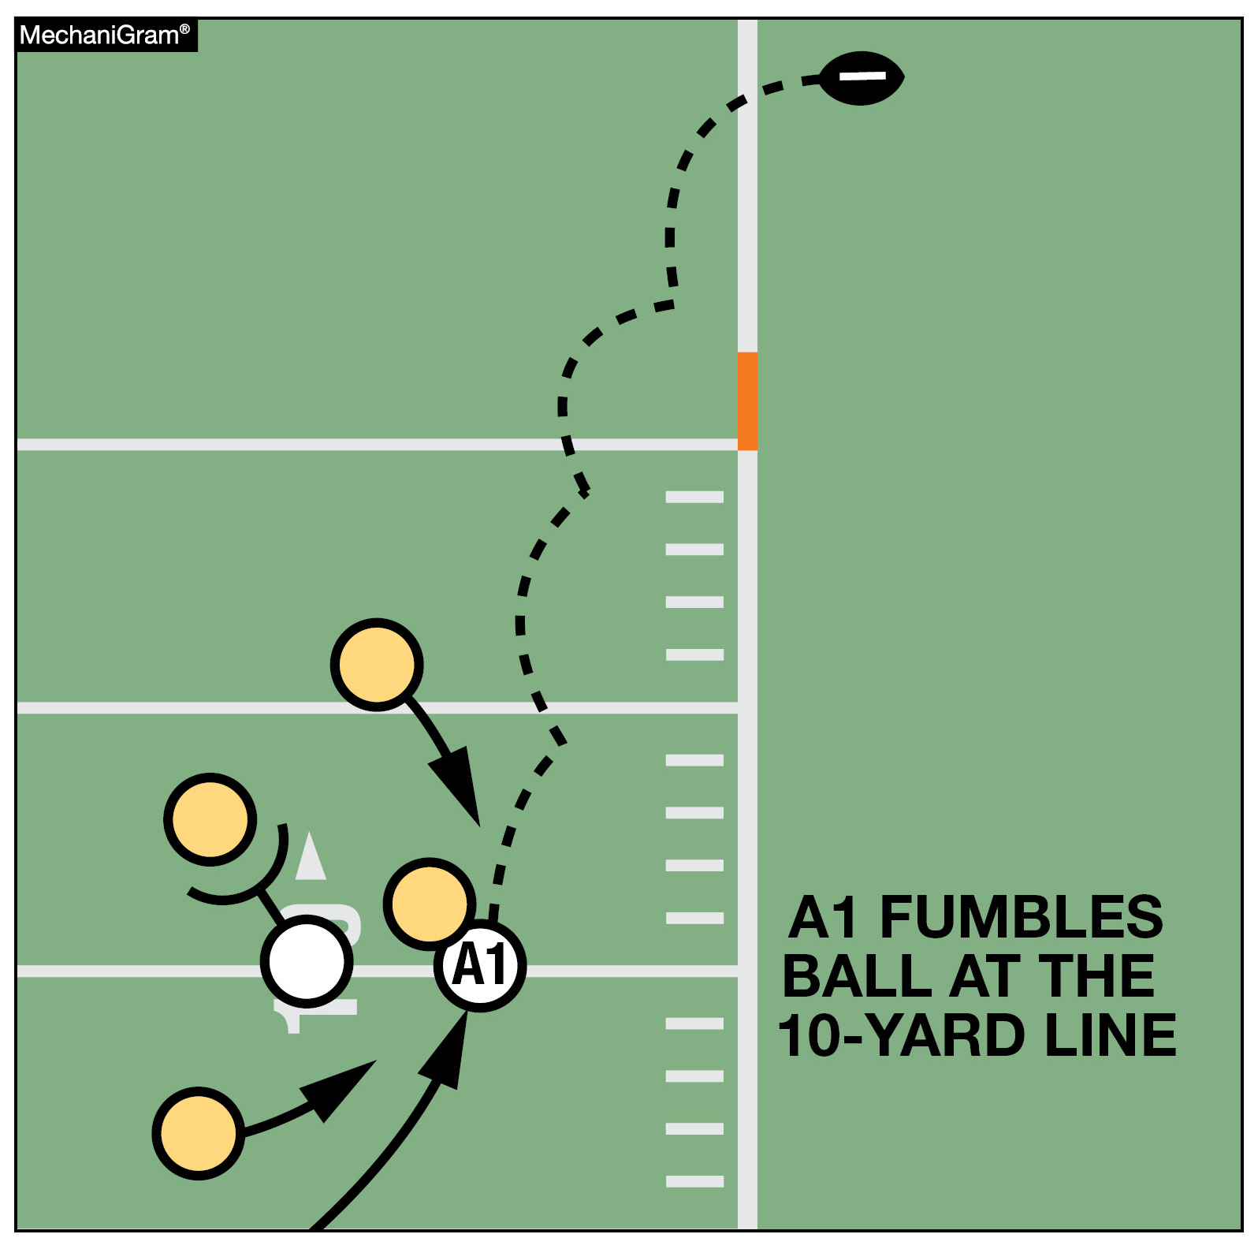
FUMBLE GOES FORWARD & OOB
When a fumble goes forward into B’s end zone & is ruled OOB’s, the ball is not returned to the spot of the fumble because it did not go OOB’s between the goal lines. This play is a touchback. Rule 4-3-1EXC.
Notes:
RULES CHANGES:
See comments on slide

Slide 35
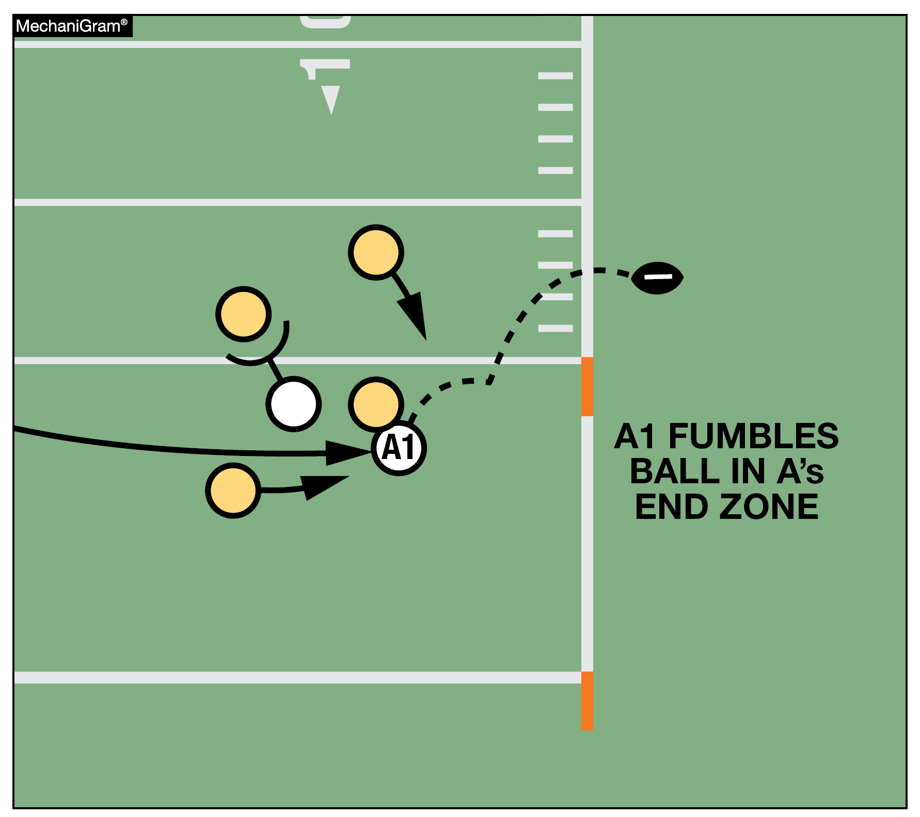
FUMBLE GOES FORWARD & OOB
When a fumble from A’s end zone goes forward & OOB’s between the goal lines, the end of the run is in the end zone & the result of the play depends on who caused the ball to be in the end zone. Rule 4-3-1EXC, 8-5-2
Notes:
Rules Changes:
RULE 4 – SECTION 3 OUT-OF-BOUNDS AND INBOUNDS SPOTS
ART. 1 . . . When a loose ball goes out of bounds, the out-of-bounds spot is fixed by the yard line where the foremost point of the ball crossed the sideline. When the ball becomes dead in the field of play because of touching a person who is out of bounds, the out-of-bounds spot is fixed by the yard line through the foremost point of the ball.
EXCEPTION: When a forward fumble goes out of bounds or is ruled out of bounds between the goal lines, the ball shall be returned to the spot of the fumble.
RULE 8 – SECTION 5 FORCE, SAFETY AND TOUCHBACK
ART. 2 . . . It is a safety when:
a. A runner carries the ball from the field of play to or across his own goal line, and it becomes dead there in his team's possession.
EXCEPTION: When a defensive player intercepts an opponent's forward pass; intercepts or recovers an opponent's fumble or backward pass; or an R player catches or recovers a scrimmage kick or free kick between his 5-yard line and the goal line, and his original momentum carries him into the end zone where the ball remains in the end zone and is declared dead in the end zone in his team's possession or it goes out of bounds in the end zone, the ball belongs to the team in possession at the spot where the pass or fumble was intercepted or recovered or the kick was caught or recovered. This includes a fumble that goes from the end zone into the field of play and out of bounds. (4-3-1 EXCEPTION)
Rationale for Change: A situation potentially giving an unfair advantage to a fumbling team was revised. When a forward fumble goes out of bounds or is ruled out of bounds between the goal lines, the ball shall be returned to the spot of the fumble.
Case Book: See SITUATIONS 4.3.1A, 4.3.1B, 4.3.1C, 4.3.1D, 4.3.1E, 10.3.3C

Slide 36
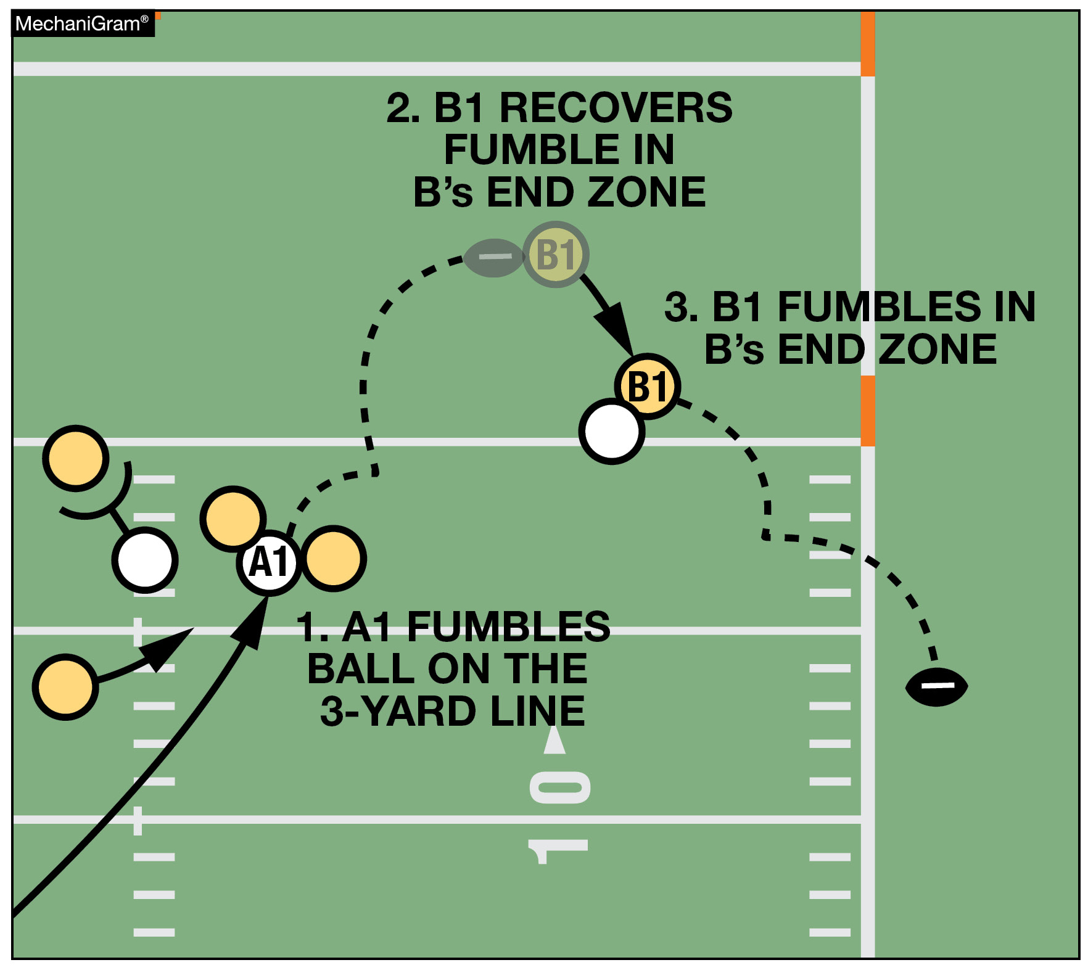
FUMBLE GOES FORWARD & OOB
When a fumble by B from B’s end zone goes forward & OOB’s between the goal lines following a change of possession, the end of the related run is where possession was lost by B and the result of the play depends on who caused the ball to be in the end zone. NOTE: If the momentum exception applies, the forward fumble exception would not apply and a safety would not be awarded. Rule 4-3-1EXC, 8-5-2a Exc.
Notes:
RULES CHANGES:
See comments on slide

Slide 37
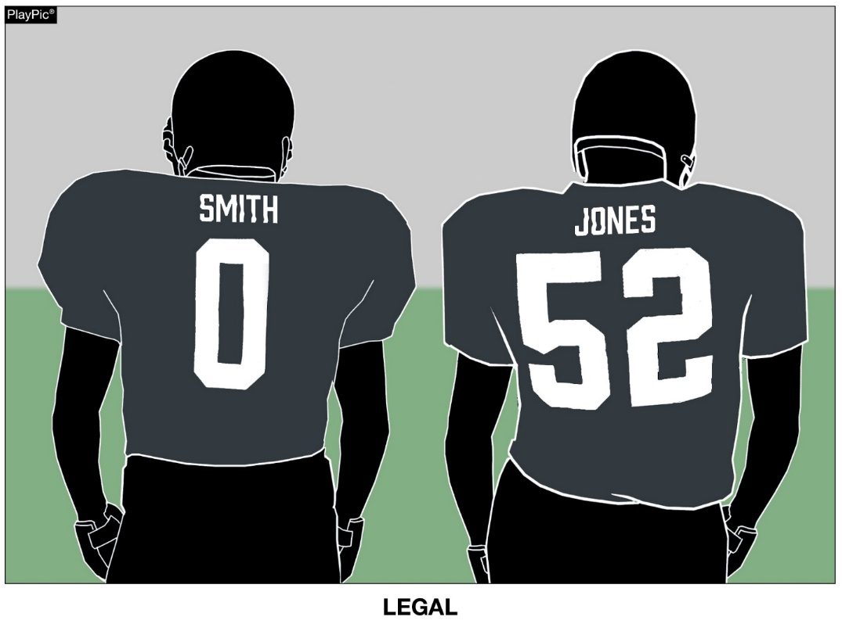
Home Jerseys
Jerseys of the home team shall all be the same dark color(s) that clearly contrasts to white.
Rule 1-5-1b (3)
Notes:
Rule Change:
RULE 1 – SECTION 5 PLAYER EQUIPMENT
ART. 1 . . . Mandatory equipment. Each player shall participate while wearing the following pieces of properly fitted equipment, which shall be professionally manufactured and not altered to decrease protection: …
b. Jersey: …
3. Players of the home team shall wear jerseys, unaltered from the manufacturer’s original design/production, that meet the following criteria:
(a) The body of the jersey (inside the shoulders, inclusive of the yoke of the jersey or the shoulders, below the collar, and to the bottom of the jersey) may not include white, except as stated below.
(b) The jerseys of the home team shall all be the same dark color(s) that clearly contrasts to white. If white appears in the body of the jersey of the home team, it may only appear: …
Rationale for Change: Clarified home team uniform requirement for each player. The jerseys of the home team shall all be the same dark color(s) that clearly contrasts with white.
Case Book: See SITUATION 9.8.1H

Slide 38
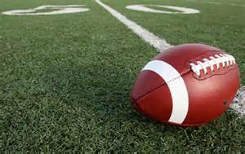
VISORS/EYESHIELD
NFHS Rule 1, Section 5, Article 3-c-5 states:
  A. Must be clear without the presence of any tint.
  B. Tinted eyewear worn on the face and under the facemask is legal.
A note from a physician does not grant permission for tinted visors.
An accommodation can be made if the player’s affliction cannot be corrected per the NFHS Rule.
A Player must have an accommodation letter from the OHSAA Football Administrator to wear a tinted visor
Documentation must be submitted to the OHSAA Football Administrator by the Athletic Director.

Slide 39
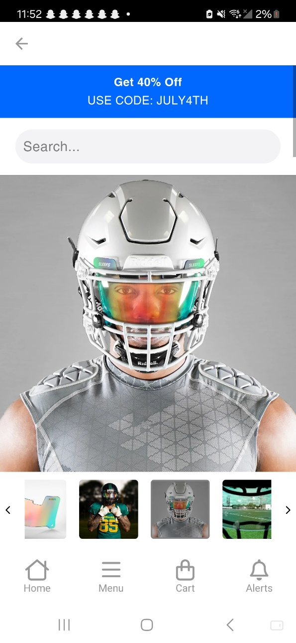
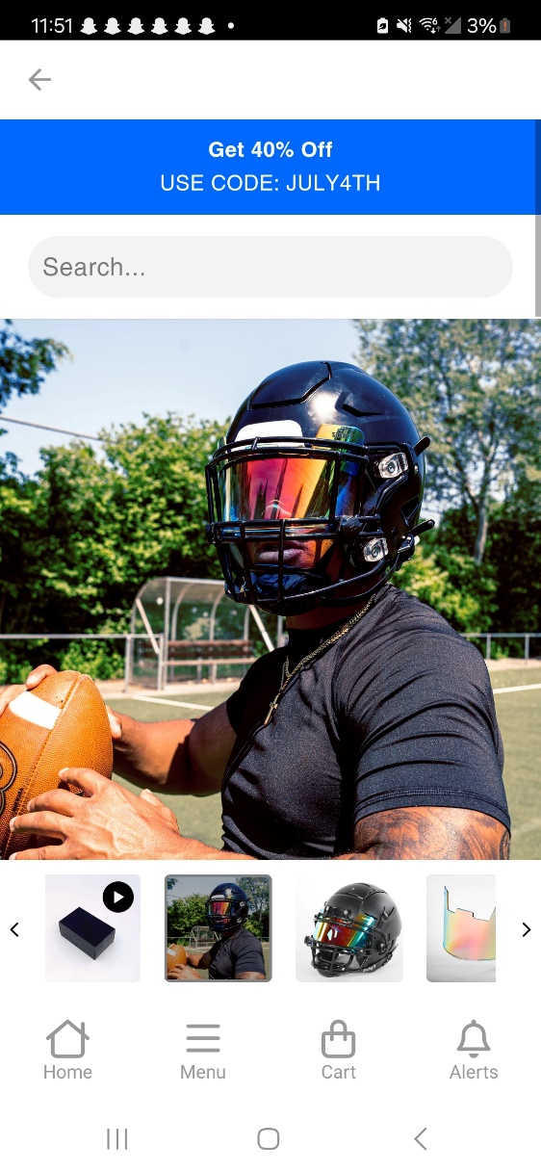
Illegal Visors

Slide 40
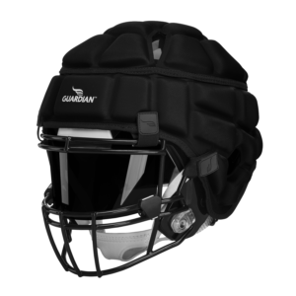
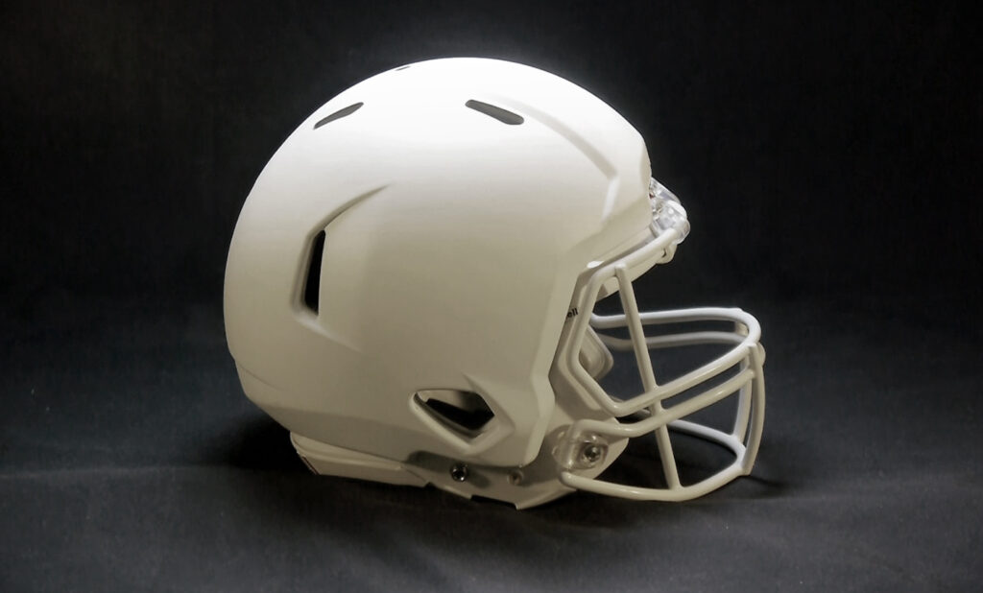
LEGAL HELMET COVERS FOR ALL SCRIMMAGES & GAMES
GUARDIAN CAPS
SAFR PRO TECH
Notes:
Comment on Slide:
See comments on the slide.

Slide 41
A Defenseless Receiver
A receiver or player intercepting a pass who is forcefully contacted by an opponent is a Personal Foul unless the contact is one of the following three types. Use the word POW -- 1. Play the ball; 2. Use Open Hands; & 3. Wrap the opponent.
Rule 2-32-16d; 9-4-3g
Notes:
Comment on Slide:
See comments on slide.

Slide 42
Targeting
Targeting is an act by any player who takes aim & initiates contact against an opponent above the shoulders…
Targeting is not an automatic DQ Foul.
The Crew Members who saw the foul need to get together & discuss it. If all agree the foul was flagrant, then rule DQ.
Rule 2-20-2; 9-4-3m; 2-16-2c
Notes:
Comment on Slide:
See comments on slide.

Slide 43
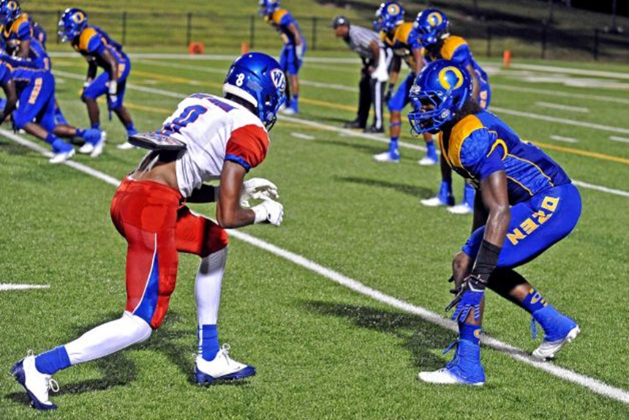
POE: Player Equipment: Jersey & Pants
Notes:
Rules Reminder:
Comment on Slide:
Illegal football jersey (Visiting Team) as the back pad is not completely covered by the white jersey. Illegal football pant (Home Team) as the blue football pant does not completely cover the knees.

Slide 44
2025
SRI Meeting: New Mechanics & POE
WWW.OHSAAFB.COM

Slide 45
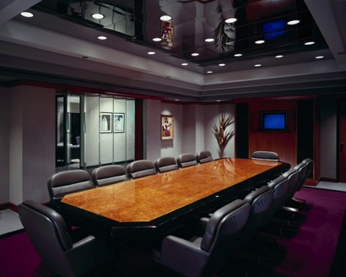
Official’s Requirements
Officials must complete:
  4 Education Credits-MTG/Clinic/Approved Presentations
  (Online or Face to Face)
  1 State Rules Meeting
    (Online or Face to Face)

Slide 46
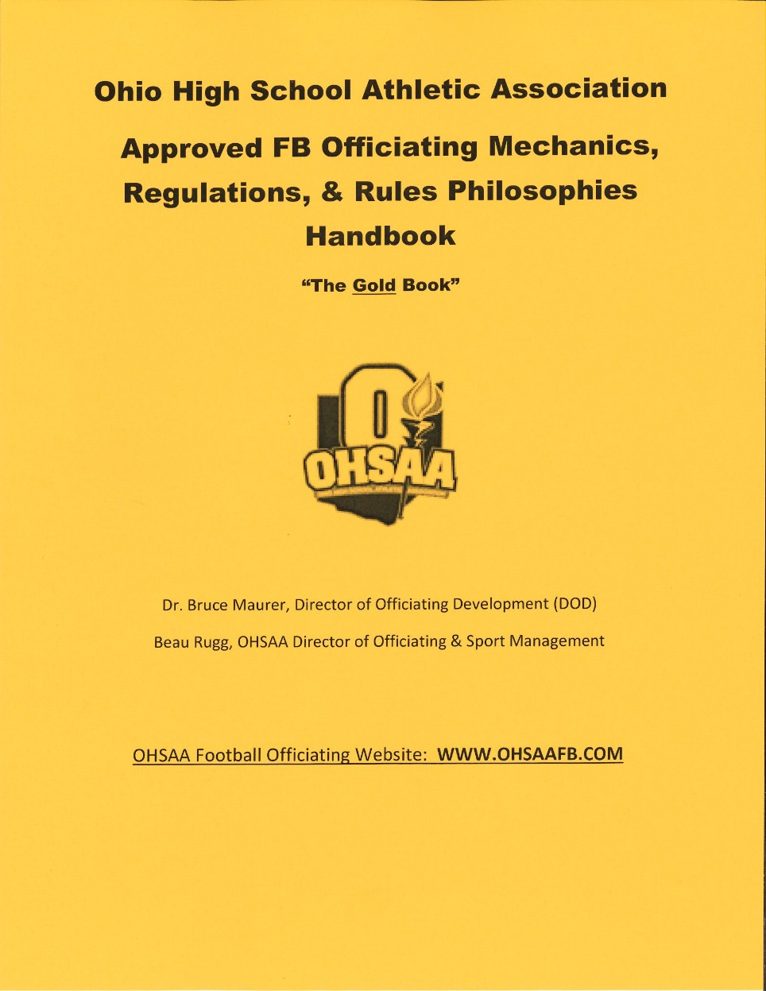
OHSAA Gold Book
Important that all officials study & use the GB Mechanics so we can continue to standardize our mechanics & improve consistency.
Officials who do not even know each other can now work a game & all are on the “same page” because they use GB Mechanics.

Slide 47

OHSAA DOD Program
2025 begins the 16th year of the DOD Program

Slide 48


Football Website
www.ohsaafb.com
Over 82,500 site visits were recorded last year.
See P. 3 of Gold Book for a Description
OHSAAFB.COM

Slide 49
Website Resources - PPTs
Two OHSAA Mechanics PPT’s include:
1). 6 Types of Kicking Plays, &
2). 5 Types of Non – Kick Plays
OHSAA Penalty Enforcement PPT.
NFHS Penalty Summary PPT. It illustrates the Foul, the Rule Reference, & the Official Signal for that Foul.

Slide 50
Sideline Interference
(Third & Subsequent)
Loss of 15 Yards
9-8-1k; 9-8-3
+
+

Slide 51
Rules Index
The Gold Book Rules Index Has over 348 Rules References.
The NFHS Rules Book Index has approximately 200 Rules References.

Slide 52
Coach/Referee Conference
If HC requests a Coach/Referee Conference, we must grant it
Don’t feel offended
Check Gold Book for the Rules Index

Slide 53
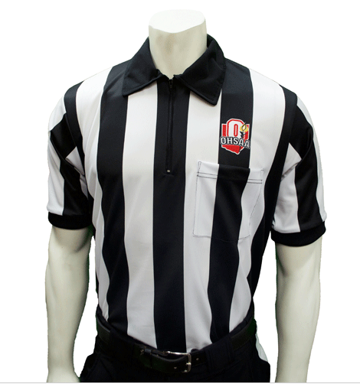
Officials Uniform
  There are NO officiating logo or uniform changes for the 2025 Season.

Slide 54
New Gold Book Additions:
1. A two page summary of the 6 Person Crew Mechanics has been added, along with
2. The “Primary Responsibilities” for a 6 Person Crew.

Slide 55
POE: Flag Mechanics:
1. A Friendly Reminder that the sequence for a Dead Ball, Line of Scrimmage Foul is:
A. Sound Your Whistle Loudly;
B. Throw Your Flag High Into the Air;
C. Signal “Stop the Game Clock” (2X); &
D. Look at the R & visibly signal the Foul.
2. Note: We all need to do a better job of SLOWING DOWN when doing Steps A – D!

Slide 56
POE: Pass/Run Mechanics:
1. We have observed too many BJ’s rarely moving into the Side Zones when they are needed there for Pass & Run Support. That is why this is an OHSAA Point of Emphasis.
2. Once the ball is dead deep in the Side Zone or OOB the BJ needs to move into the Side Zone & OOB, when needed, to support the Wing – especially when a different colored jersey is in the bench area.

Slide 57
New OHSAA Gold Book Mechanics

Slide 58
FG & Try-Kick Mechanics:
1. The U & BJ will both call out the Eligible End & Wingback Numbers on their respective sides.

Slide 59
Signaling Mechanics:
1. The LJ (along with the R), will initiate “Double Stakes”. Why? He or she is looking across the field at the stakes.
2. The Crew will then relay to each other “One Finger for each hand (2X) above their head”.

Slide 60
Timing: 4 & 5 Person Crews
1. The LJ will time the Game when the Game Clock malfunctions.

Slide 61
New CJ Mechanics for a 6 Person Crew

Slide 62
Kick Off Mechanics: 6 Person Crew
1. The CJ has responsibility for the Sideline on a long KO return to the Goal Line.
2. It is important that the CJ “reads the play” & “reacts” like a BJ and begins back pedaling on the long KO return.
3. The BJ rather than the CJ has responsibility to be at the GL when the Runner crosses it.

Slide 63
Pre Snap Mechanics: 6 Person Crew
1. The CJ will count the number of Team B & Receiving Team Players along with the BJ. They will hold the appropriate Signal to each other for approximately 2 seconds.
2. NOTE: On FG & Try Plays the CJ will count the Kicking Team Players.

Slide 64
Timing: 6 Person Crew
1. The CJ will time the Game when the Game Clock malfunctions.

Slide 65
Some Good Advice:
1. A friendly Reminder – Your Rule Book & Case Book Are Your Friends – Please use them when called upon on the Field. Now that we have a detailed Rules Index it is much easier to find a Rule when the Head Coach wants an explanation.

Slide 66
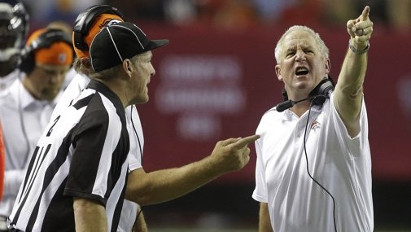
Thanks to all OHSAA FB Officials!!!
Have a great season

