Slide 1
n8n Workflow Automation
Session 3: Industrial Integration & AI
n8n Training Program
2026
1
Notes:
Welcome back everyone! Today is Session 3 — the most exciting session. We will cover two big topics: - First, Industrial Integration with MQTT protocol. This is how factories connect machines to automation systems. - Second, AI Integration. We will learn how to use LLM, build AI Agents, and explore RAG. By the end of today, you will build your own AI Agent that can analyze machine logs and give recommendations. Let's get started!

Slide 2
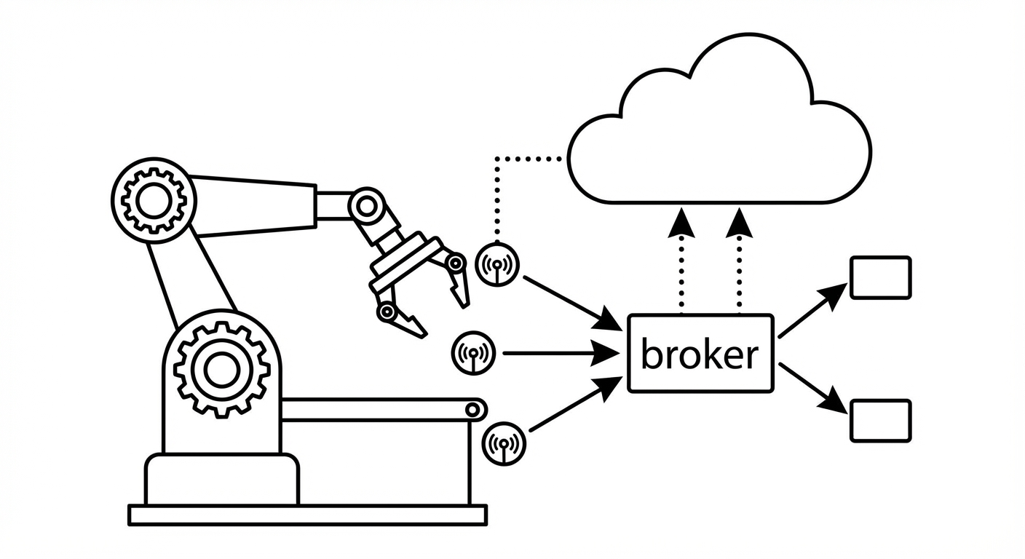
Part 1: Industrial Integration
MQTT protocol — the language of machines
Publish/Subscribe pattern for real-time data
Sensor monitoring & alerting workflows
Connect factory floor to n8n automation
2
Notes:
In the first half of today's session, we will explore Industrial Integration. This diagram shows the basic concept: machines with sensors publish data through an MQTT broker, which then flows into our n8n workflows. Think of MQTT as a messaging system designed for machines — lightweight, fast, and reliable even on poor networks. We will build a complete pipeline: sensor data → MQTT → n8n → PostgreSQL → alerts.

Slide 3
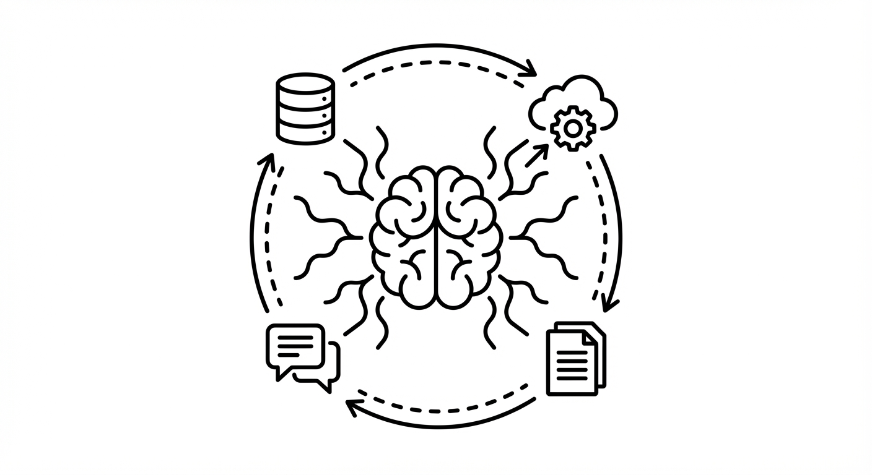
Part 2: AI-Powered Automation
LLM fundamentals — prompts, tokens, models
AI Agents that use tools autonomously
RAG — search your private documents with AI
MCP — universal standard for AI-tool connection
3
Notes:
In the second half, we dive into AI. This diagram shows an AI Agent at the center, connected to multiple tools — databases, APIs, documents. The key idea: an AI Agent is not just a chatbot. It can decide which tools to use, execute actions, and loop until the task is done. By the end of today, you will build an agent that analyzes machine data and gives recommendations. This is where automation meets intelligence.

Slide 4
Session 3 Agenda
00:00-00:10
Recap Session 2
DISCUSSION
00:10-00:40
Module 5: Industrial Integration & MQTT
LECTURE
00:40-00:50
Break
BREAK
00:50-01:15
Module 6 Part 1: AI/LLM Fundamentals
LECTURE
01:15-01:45
Module 6 Part 2: AI Agent & Tools
DEMO
01:45-02:05
Module 6 Part 3: RAG & MCP
LECTURE
02:05-02:25
Hands-on Lab: Build AI Agent
LAB
4
Notes:
Here is our agenda for today. We start with a quick recap of Session 2 — about 10 minutes. Then Module 5: MQTT and Industrial Integration. I will show you a live demo — real sensor data flowing from machines into n8n, stored in PostgreSQL database. After the break, we move to AI. Part 1: LLM basics — what is a prompt, what are tokens. Part 2: AI Agent — this is the big one. I will build an agent live that can query machine data. Part 3: RAG and MCP — advanced AI patterns. Finally, you will build your own AI Agent in the lab. Any questions about the schedule?

Slide 5
Learning Objectives
Understand MQTT protocol for industrial IoT
Build machine monitoring & alerting workflows
Learn LLM fundamentals for automation
Build AI Agents with tools and memory
Understand RAG architecture for document search
Explore MCP for AI-tool integration
5
Notes:
These are our 6 learning objectives for today. Number 1 and 2 — MQTT. You will understand how machines talk to each other using the publish/subscribe pattern. We will build a workflow that monitors temperature and sends alerts when it is too high. Number 3 and 4 — AI Agent. This is the core skill. You will learn how LLMs work at a high level, then build an AI Agent that can use tools — like querying a database or calling an API. Number 5 and 6 — RAG and MCP. RAG lets AI search your private documents. MCP is a new standard for connecting AI to any tool. Let's start with a quick recap of Session 2. Who can tell me — what does the expression dollar-sign json dot data do? What is the difference between Merge Combine and Merge Append? Good. Let's move to Module 5.

Slide 6
Section 5
Module 5: Industrial Integration
MQTT, Machine Monitoring & IoT
6
Notes:
OK, Module 5 — Industrial Integration. This module is about connecting real machines to n8n. In factories, machines produce data every second — temperature, vibration, pressure, speed. How do we collect this data? How do we react when something goes wrong? The answer is MQTT — a lightweight messaging protocol designed for IoT and industrial systems. Let me explain how it works.

Slide 7
MQTT Protocol Overview
How it works
Key features
Publish/Subscribe model (like radio)
Publisher: machine sends data
Subscriber: n8n listens for data
Broker: central server routes messages
NOT request/response like HTTP
Topic: hierarchical path (factory/line1/temp)
QoS 0: fire & forget (fastest)
QoS 1: at least once (recommended)
QoS 2: exactly once (slowest)
Wildcards: + (one level), # (all levels)
7
Notes:
MQTT is different from HTTP. HTTP is request/response — you ask, you get an answer. MQTT is publish/subscribe — you listen, and data comes to you. Think of it like a radio. - The machine is the radio station — it publishes data. - n8n is the listener — it subscribes to a channel. - The broker is the radio tower in the middle. The broker is a central server. Popular brokers: Mosquitto, EMQX, HiveMQ. For our demo today, we use HiveMQ — it is free and public. Topics are like addresses. They use a path format: factory/line1/machine001/temperature. This makes it easy to organize data. QoS means Quality of Service. - Level 0: send and forget — fastest, but might lose messages. - Level 1: at least once — good for most cases. - Level 2: exactly once — slowest, but guaranteed. Wildcards help you subscribe to many topics at once. Plus sign matches one level. Hash sign matches everything below. For example: factory/+/+/temperature — gets temperature from ALL machines. factory/line1/# — gets EVERYTHING from line 1.

Slide 8
MQTT Topic Naming Convention
Topics = hierarchical paths | Wildcards: + (one level), # (all below)
text
# Topic structure factory/line1/machine001/temperature -> specific sensor factory/line1/machine001/status -> machine state factory/line1/machine001/vibration -> vibration data # Wildcards factory/+/+/alerts -> All alerts from all machines factory/line1/# -> Everything from line 1 factory/# -> Everything in factory # n8n MQTT Nodes Subscribe (Trigger) -> Receive messages from broker Publish (Action) -> Send messages/commands to broker # Example payload (JSON) { "machine_id": "CNC-001", "temperature": 78.5, "vibration": 2.3, "status": "running", "timestamp": "2026-03-16T10:23:00Z" }
8
Notes:
Let me show you the topic naming convention. Look at the structure: factory / line1 / machine001 / temperature. Each level gives more detail. This is like a folder structure on your computer. Now look at the wildcards. factory/+/+/alerts — the plus sign matches any single level. So this gets alerts from all lines and all machines. factory/line1/# — the hash matches everything below. So this gets ALL data from line 1. In n8n, we have two MQTT nodes: - MQTT Trigger — this subscribes and listens for messages. - MQTT node — this publishes messages. The payload is usually JSON. Here you can see an example: machine ID, temperature, vibration, status, and timestamp. This is exactly what our demo workflow sends. Let me show you.

Slide 9
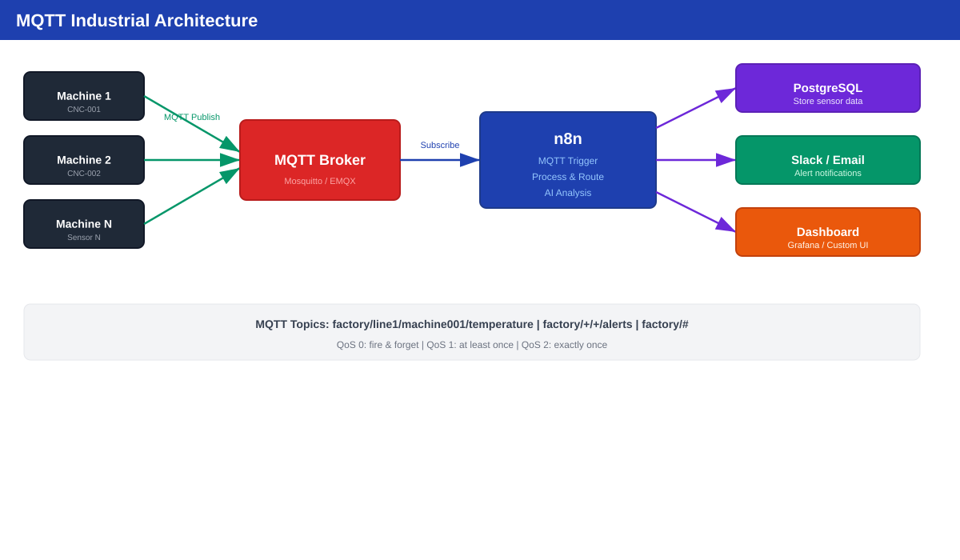
MQTT Industrial Architecture
Machines -> MQTT Broker -> n8n -> Database + Alerts + Dashboard
9
Notes:
This diagram shows the full architecture. On the left — machines on the factory floor. Each machine has sensors for temperature, vibration, pressure. These sensors publish data to the MQTT Broker. In the middle — the MQTT Broker. It receives all messages and routes them to subscribers. On the right — n8n subscribes to topics. When data arrives, n8n can: 1. Store it in PostgreSQL database. 2. Check thresholds — is temperature too high? 3. Send alerts via email or Slack. 4. Update a dashboard. This is exactly what we built for today's demo. Let me switch to n8n and show you the live workflows.

Slide 10
Live Demo: MQTT Sensor Simulator + Monitor
1
2
3
4
5
Schedule Trigger
Code Node
MQTT Publish
MQTT Trigger
PostgreSQL
Every 10 seconds
Generate CNC-001/002/003 data
broker.hivemq.com
Subscribe factory/+/sensors
Store readings + alerts
→
→
→
→
10
Notes:
Now let me show you the live demo. I have two workflows running right now on our n8n server. Workflow 1: MQTT Sensor Simulator. - Every 10 seconds, it generates fake sensor data for 3 machines: CNC-001, CNC-002, CNC-003. - It publishes the data to broker.hivemq.com on topic: n8n-lab/factory/{machine_id}/sensors. Workflow 2: MQTT Monitor and Alert. - It subscribes to: n8n-lab/factory/+/sensors. The plus sign means "any machine". - When data arrives, it parses the JSON. - Then it stores EVERY reading in PostgreSQL. - Then it checks: is temperature above 80 degrees? - If yes — it generates an alert and saves it to the database. Let me open n8n and show you the executions... [SWITCH TO n8n UI] [Show S3-Demo3 Simulator — show the Code node output] [Show S3-Demo4 Monitor — show data flowing in] [Open PostgreSQL and query: SELECT * FROM machine_sensors ORDER BY recorded_at DESC LIMIT 10] See? Real data flowing from MQTT into our database. And alerts are automatically created when temperature is high. This is the core pattern for industrial automation.

Slide 11
Use Case: Predictive Maintenance
1
2
3
4
5
Schedule
PostgreSQL
ML API
IF Check
Action
Hourly trigger
Query historical sensor data
Predict failure probability
Probability > 80%?
Create Jira ticket + Notify team
→
→
→
→
11
Notes:
This is a more advanced use case — Predictive Maintenance. The idea: Instead of waiting for a machine to break, we predict when it WILL break. How? Step 1: Every hour, query historical sensor data from PostgreSQL. Step 2: Send that data to a Machine Learning API. The ML model analyzes the pattern and says: "This machine has 85% chance of failure in the next 24 hours." Step 3: If probability is above 80%, take action. Step 4: Automatically create a Jira maintenance ticket and notify the maintenance team. This saves money — fixing before breakdown is much cheaper. We won't build this today, but you now have all the building blocks: MQTT for data collection, PostgreSQL for storage, IF node for decisions, and external API calls.

Slide 12
Use Case: Daily Production Report
1
Schedule Trigger
2
PostgreSQL Query
3
Code Node
Daily at 6 AM, before work starts
Get yesterday's production data
Calculate KPIs: uptime %, yield, incident count
4
Google Sheets
5
Email Node
Update daily report spreadsheet
Send summary to managers automatically
12
Notes:
Another common use case — the Daily Production Report. Every morning at 6 AM, before the managers arrive: 1. n8n queries yesterday's data from PostgreSQL. 2. A Code node calculates KPIs: - Uptime percentage — how long were machines running? - Yield — how many good products vs defects? - Incident count — how many alerts happened? 3. Update a Google Sheets spreadsheet. 4. Send an email summary to the managers. When the managers come to work, the report is already in their inbox. No human work needed. This is the power of automation. You connect data sources, add logic, and deliver results. OK, that's Module 5. Any questions about MQTT before we take a break? [TAKE 10 MINUTE BREAK]

Slide 13
Break Time
||
Back in 10 minutes
13
Notes:
10 minute break. When we come back, we start the AI section. Make sure your n8n is accessible. If you want, try to open the MQTT Monitor workflow and look at the execution history. You should see data flowing in every 10 seconds.

Slide 14
Section 6
Module 6: AI Integration
LLM, Agents, RAG & MCP
14
Notes:
Welcome back! Now we move to the most exciting part — AI Integration. In the last 2 years, AI has changed everything. ChatGPT, Claude, Gemini — you all have used them. But today, we go further. We will connect AI to real systems. AI that can query your database. AI that can search your documents. AI that can take actions automatically. This is not just chatting with AI. This is AI as a worker in your automation pipeline. Let's start with the basics.

Slide 15
LLM Fundamentals — 4 Key Concepts
Prompt
Tokens
0->1
$2.50
Input text you send to AI
~4 characters = 1 token (billing unit)
Temperature: 0=precise, 1=creative
GPT-4o cost per 1M input tokens
15
Notes:
Let me explain 4 key concepts. Number 1: Prompt. A prompt is the text you send to the AI. It can be a question, an instruction, or data to analyze. The better your prompt, the better the AI response. Number 2: Tokens. AI does not read characters — it reads tokens. One token is about 4 characters. The word "hello" is 1 token. The sentence "Hello, how are you?" is about 6 tokens. Why does this matter? Because you pay per token. Number 3: Temperature. This controls how creative the AI is. Temperature 0 = very precise, same answer every time. Temperature 1 = very creative, different answer each time. For data analysis, use 0 to 0.3. For creative writing, use 0.7 to 1. Number 4: Cost. GPT-4o costs about $2.50 per 1 million input tokens. That sounds expensive, but 1 million tokens is about 750,000 words. For most automation tasks, the cost is very low. Google Gemini has a free tier — that is what we use today.

Slide 16
LLM Key Concepts Reference
Concept | Description | Example
Prompt | Input text sent to model | "Summarize this machine log"
Completion | Output text from model | Generated summary text
Temperature | 0 = precise, 1 = creative | 0.3 for analysis, 0.7 for writing
Tokens | ~4 characters = 1 token | "Hello world" = 2 tokens
Context Window | Max input size | GPT-4o: 128K (~100K words)
System Prompt | Instructions for AI behavior | "You are a factory assistant"
16
Notes:
Here is a summary table for reference. One new concept here: Context Window. This is the maximum amount of text the AI can process at once. GPT-4o has 128K tokens — that is about 100,000 words. That is like a full book. But be careful: More tokens in the context = higher cost. So we want to be efficient — only send the data the AI actually needs. This will be important when we talk about RAG later. RAG helps you select the RIGHT documents instead of sending everything.

Slide 17
n8n AI Nodes Overview (70+ nodes)
�
�
�
Chat Models
AI Agent
Memory
OpenAI, Claude, Gemini, Ollama
Autonomous reasoning + tools
Buffer, Vector Store, Chat
�
�
�
Tools
Vector Stores
Text Ops
HTTP, Code, Calculator, DB
Qdrant, Pinecone, pgvector
Summarize, Classify, Extract
17
Notes:
n8n has over 70 AI nodes organized in 6 groups. Chat Models — these connect to AI providers. OpenAI, Claude, Google Gemini, or Ollama for local models. Today we use Google Gemini — it is free. AI Agent — this is the star of today. An agent can think, decide, and use tools. We will spend most of our time here. Memory — stores conversation history. Without memory, the AI forgets everything after each message. With memory, it can have a real conversation. Tools — these give the agent abilities. HTTP Request tool: call any API. Code tool: run JavaScript code. Database tool: query PostgreSQL. Vector Stores — for RAG. Qdrant, Pinecone, pgvector. We have Qdrant running on our training server. Text Operations — simple text processing. Summarize, classify, extract data. These are simpler than agents — good for basic tasks.

Slide 18
Decision Guide: When to Use What?
Scenario | Solution | Complexity
Simple Q&A, translate, summarize | Basic LLM Chain node | Low
Need to call APIs or query DB | AI Agent + Tools | Medium
Multi-turn conversation | AI Agent + Memory | Medium
Search private documents | AI Agent + Vector Store (RAG) | High
Multi-tool + external services | AI Agent + Tools + MCP | High
18
Notes:
This table helps you decide what to use. Simple question and answer? Use the Basic LLM Chain node. It takes input, sends to AI, returns output. Done. This is what Demo 1 shows. Need to call APIs or query a database? Use an AI Agent with Tools. The agent decides WHEN and HOW to use each tool. This is what Demo 2 shows. Need the AI to remember previous messages? Add Memory to the Agent. The Window Buffer Memory stores the last N messages. Need to search private documents? This is RAG — Retrieval Augmented Generation. We use a Vector Store like Qdrant. Demo 5 shows this. The key rule: Start simple. Only add complexity when you need it. Don't use an Agent if a simple LLM Chain is enough.

Slide 19
LIVE DEMO
Demo: Simple Chat Completion
1
Chat Trigger -> Basic LLM Chain -> Google Gemini
2
System prompt: "You are a factory technical assistant"
3
Test: "Machine CNC is vibrating heavily, what to check?"
4
Result: AI gives general troubleshooting advice
5
Limitation: cannot access real machine data
6
Next: AI Agent with Tools solves this!
19
Notes:
Let me show you the first demo. [SWITCH TO n8n UI] [Open workflow: S3-Demo1 Simple Chat Completion] Look at this workflow. It is very simple — only 3 nodes. Node 1: Chat Trigger. This creates a chat interface. When someone types a message, it starts the workflow. Node 2: Basic LLM Chain. This sends the message to the AI model. It has a system prompt: "You are a factory technical assistant." The system prompt tells the AI WHO it is and HOW to behave. Node 3: Google Gemini Chat Model. This is the AI brain. We use Gemini because it is free. You can replace this with OpenAI or Claude later. Let me test it. [Click Chat button] [Type: "Machine CNC is vibrating heavily, what to check?"] See the response? The AI gives practical troubleshooting advice. It knows about machines because of the system prompt. But notice — this AI cannot access real data. It can only give general advice. It does not know what CNC-001's actual temperature is. To fix that, we need an AI Agent with Tools. That is our next topic.

Slide 20
AI Agent & Tools
Building Intelligent Automation
20
Notes:
Now we move to Part 2 — AI Agent. This is the most important concept today. An AI Agent is not just a chatbot. A chatbot takes your question and gives an answer. An AI Agent takes your question, THINKS about what to do, USES tools to get real data, then gives you an answer based on real information. Let me show you the difference.

Slide 21
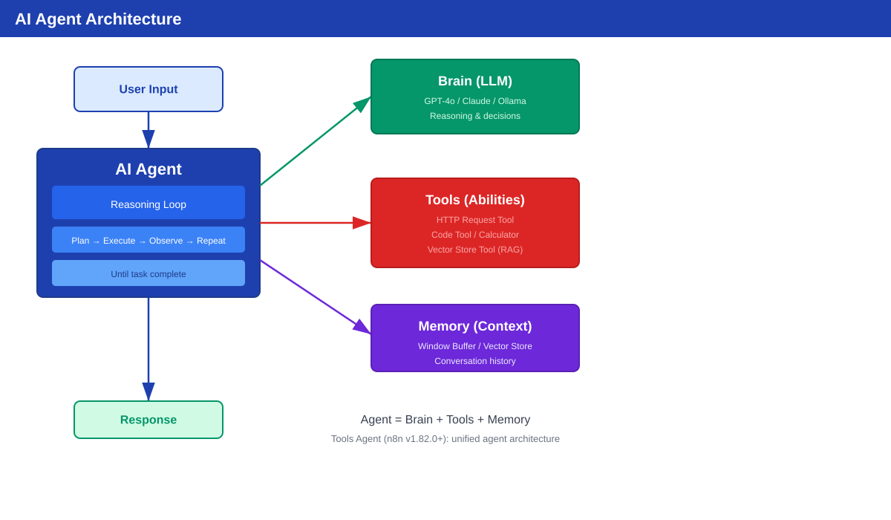
AI Agent Architecture
Agent = LLM (Brain) + Memory (Context) + Tools (Abilities)
21
Notes:
Look at this diagram. An AI Agent has 3 parts. Part 1: LLM — the Brain. This is the AI model — Gemini, GPT-4, Claude. It does the thinking and decision making. Part 2: Memory — the Context. Without memory, the AI forgets everything between messages. With memory, it remembers what you talked about before. We use Window Buffer Memory — it stores the last 5 messages. Part 3: Tools — the Abilities. This is what makes agents special. Tools let the agent DO things: - Query a database - Call an API - Run code - Search documents The agent reads the tool description and decides which tool to use. This is called "tool calling" or "function calling". Let me explain how the process works.

Slide 22
How AI Agent Works — Step by Step
1
Receive Input
2
LLM Reasons
3
Execute Tool
User asks: "How is CNC-001 doing?"
AI reads tool descriptions, picks the right one
n8n runs the tool (e.g. query PostgreSQL)
4
Observe Result
5
Decide Next
AI receives: temp=82, vibration=4.1, status=warning
Need more info? Call another tool. Done? Return answer.
22
Notes:
Here is the step-by-step process. Step 1: User asks a question. Example: "How is CNC-001 doing?" Step 2: The LLM thinks. It reads the tool descriptions and decides: "I need to use the get_machine_status tool with machine_id = CNC-001." Step 3: n8n executes the tool. The tool queries PostgreSQL and returns real data: temperature 82 degrees, vibration 4.1, status warning. Step 4: The LLM receives the tool result. Now it has real data to work with. Step 5: The LLM decides — do I need more information? Maybe it also wants downtime statistics. So it calls another tool: calculate_downtime. This loop continues until the AI has enough information. Then it gives the final answer to the user. The key insight: The AI decides WHICH tools to use and WHEN. You don't write if/else logic. The AI figures it out from the tool descriptions.

Slide 23
AI Agent vs Simple LLM Chain
Simple LLM Chain
AI Agent
Fixed: input -> output
No external data access
Single step only
No tool calling
Cheaper per query ($)
Best for: text generation, translation, Q&A
Dynamic: think -> act -> observe loop
Access tools, APIs, databases
Multi-step execution
Autonomous decisions
Higher cost per query ($$)
Best for: analysis, troubleshooting, research
23
Notes:
Let me compare the two approaches. Simple LLM Chain — what we saw in Demo 1. It goes straight from input to output. No tools, no memory, no thinking loop. It is cheap and fast. Good for: summarizing text, translating, simple Q&A. AI Agent — what we will see in Demo 2. It has a thinking loop. It can use tools to get real data. It can make multiple steps. It costs more per query because it uses more tokens. Good for: data analysis, troubleshooting, complex tasks. Think of it this way: Simple LLM is like a translator. AI Agent is like a consultant who can look things up. When to use which? If you just need to transform text — use Simple LLM. If you need the AI to access data or take actions — use Agent.

Slide 24
Memory Types in n8n
Type | How it works | Best for
Window Buffer | Stores last N messages (e.g. 5) | Default choice for most cases
Vector Store Memory | Semantic search through history | Very long conversations (100+ messages)
Chat Memory Manager | Manual load/insert/delete | Custom memory logic (advanced)
24
Notes:
About memory. n8n has 3 types of memory. Window Buffer Memory. Stores the last N messages — like the last 5 messages. This is the simplest and best for most cases. In our demos, we use this with N = 5. Vector Store Memory. Uses semantic search to find relevant past messages. Good for very long conversations where you don't want to send ALL history to the AI. Chat Memory Manager. Gives you full control — load, insert, delete messages. This is for advanced use cases. My recommendation: start with Window Buffer Memory. Set it to 5 or 10 messages. Only change if you have a specific need. Important note: Memory is stored in n8n's internal storage. If n8n restarts, memory is lost unless you use an external store like Redis. We have Redis running on our training server for this.

Slide 25
System Prompt: 5-Part Structure
ROLE + CAPABILITIES + CONSTRAINTS + OUTPUT + FALLBACK
text
ROLE: You are an industrial equipment advisor for ABC Factory. CAPABILITIES: - Query machine status via API - Search maintenance documentation - Calculate downtime statistics CONSTRAINTS: - Never execute commands that could stop production - Always cite data sources in responses - Escalate critical issues immediately OUTPUT FORMAT: - Respond in English - Include machine ID in every response - Provide actionable recommendations FALLBACK: - If unsure, ask clarifying questions - If tool fails, explain what happened and suggest alternatives
25
Notes:
The system prompt is the most important configuration. It tells the agent WHO it is and HOW to behave. I use a 5-part structure. Let me explain each part. ROLE — who is the agent? "You are an industrial equipment advisor." This gives the AI a persona and domain knowledge. CAPABILITIES — what can it do? List the tools it has access to. This helps the AI understand its own abilities. CONSTRAINTS — what must it NOT do? "Never stop production." "Always cite data sources." This prevents the AI from doing dangerous things. OUTPUT FORMAT — how should it respond? "Respond in English." "Include machine ID." This makes the output consistent and useful. FALLBACK — what to do when things go wrong? "If unsure, ask questions." "If tool fails, explain and suggest alternatives." This structure is called: ROLE + CAPABILITIES + CONSTRAINTS + OUTPUT + FALLBACK. Write it down. You will use this in the lab.

Slide 26
Tool Configuration Best Practices
Good tool description
Bad tool description
"Get current machine status by ID"
"Returns: temperature, vibration, status"
"Use when user asks about machine condition"
Clear name: get_machine_status
Specific inputs and outputs documented
"This tool gets data" (too vague)
"Tool for database" (which database? what data?)
Name: tool1 (meaningless)
No input/output description
AI will use the WRONG tool!
26
Notes:
Now let's talk about tool configuration. The most important thing: the tool DESCRIPTION. The AI reads the description to decide when to use each tool. If the description is bad, the AI will use the wrong tool. Example of a BAD description: "This tool gets data." The AI doesn't know WHAT data or WHEN to use it. Example of a GOOD description: "Get current status of a machine by its ID. Returns temperature, vibration, status, and uptime. Use this when user asks about machine condition." See the difference? The good description tells the AI: - What the tool does - What it returns - When to use it Name your tools clearly. get_machine_status — clear. tool1 — not clear. One more tip: use "Optimize Response". This tells n8n to send only the relevant data to the AI, instead of the full response. This saves tokens and reduces cost.

Slide 27
LIVE DEMO
Demo: Equipment Advisor Agent
1
AI Agent + Gemini + 3 PostgreSQL Tools + Memory
2
Tool 1: Machines DB (specs, maintenance schedule)
3
Tool 2: Sensor Readings DB (temperature, vibration, pressure)
4
Tool 3: Alerts DB (alert history, severity)
5
Test: "How is CNC-001?" -> "Compare with CNC-002"
6
Agent writes SQL queries automatically!
27
Notes:
Time for the big demo! [SWITCH TO n8n UI] [Open workflow: S3-Demo2 Equipment Advisor Agent] Look at this workflow. Chat Trigger connects to AI Agent. The Agent has: - Google Gemini as the brain. - Window Buffer Memory — 5 messages. - Three PostgreSQL Tool nodes. These are not Code Tools — they are native Postgres Tools. The agent writes its own SQL queries! Tool 1: Machines DB. Connects to the "machines" table. Has machine specs, maintenance dates, operator info. Tool 2: Sensor Readings DB. Connects to "machine_sensors" table. Has temperature, vibration, oil pressure data. Tool 3: Alerts DB. Connects to "machine_alerts" table. Has alert history, severity levels. Now let me test it. [Click Chat button] [Type: "How is CNC-001 doing?"] Watch what happens... The agent thinks: "I need machine status." It queries the machines table and the sensors table. Then it writes a summary with real data. Now let me ask a follow-up question. [Type: "What about its downtime history?"] See? It remembers we were talking about CNC-001. That is memory working. [Type: "Compare it with CNC-002"] Now it queries data for both machines and compares them. This is the power of AI Agents. You don't write the logic. The AI decides what to do based on the question.

Slide 28
RAG & MCP
Advanced AI Patterns
28
Notes:
Part 3: RAG and MCP. These are advanced AI patterns. Don't worry — I will explain them simply. RAG solves one big problem: AI models don't know your private data. ChatGPT knows about the internet, but it does NOT know your factory manuals, your machine specifications, or your company procedures. RAG fixes this. Let me show you how.

Slide 29
The Problem RAG Solves
AI does NOT know your private data
ChatGPT/Gemini trained on public internet data only
Does NOT know: your machine manuals, company procedures, internal docs
Without RAG: "I don't have information about your specific machine"
With RAG: "CNC-001 requires oil change every 500 hours (from maintenance manual)"
RAG = Retrieval-Augmented Generation
Step 1: RETRIEVE relevant docs -> Step 2: AUGMENT prompt -> Step 3: GENERATE answer
29
Notes:
RAG stands for Retrieval-Augmented Generation. Big name, simple idea. Step 1: RETRIEVE relevant documents. Step 2: AUGMENT the AI prompt with those documents. Step 3: GENERATE an answer based on real data. Example: You ask: "What is the maintenance schedule for CNC-001?" Without RAG: The AI says: "I don't know your specific machine." With RAG: 1. Search your maintenance manuals. 2. Find the CNC-001 section. 3. Give the AI that section. 4. The AI answers: "CNC-001 requires oil change every 500 hours." The AI now gives ACCURATE answers based on YOUR documents.

Slide 30
RAG Phase 1: Ingestion (one-time setup)
1
2
3
4
Documents
Chunk
Embed
Store
PDFs, manuals, knowledge base
Split into ~500 token pieces
Convert text to number vectors
Save vectors in Qdrant
→
→
→
30
Notes:
RAG has two phases. First: Ingestion. This is a one-time setup. You do it once. Step 1: Collect your documents. Machine manuals, troubleshooting guides, safety procedures. Step 2: Split them into small pieces — we call them "chunks". Each chunk is about 500 tokens — roughly one paragraph. Why? Because we don't want to send a whole 100-page manual to the AI. We only want the relevant paragraph. Step 3: Convert each chunk into a "vector" — a list of numbers. This is called "embedding". The embedding captures the MEANING of the text. Similar texts have similar numbers. Step 4: Store the vectors in a vector database. We use Qdrant — it is running on our training server. After this setup, you can search by meaning. Not just by keywords, but by WHAT the text means.

Slide 31
RAG Phase 2: Query (every user question)
1
2
3
4
Question
Embed
Search
LLM
"How to fix CNC-001 temp?"
Convert question to vector
Find top 3 similar docs in Qdrant
Question + relevant docs = accurate answer
→
→
→
31
Notes:
Second phase: Query. This happens every time a user asks. Step 1: User asks a question. "How to fix high temperature on CNC-001?" Step 2: Convert the question into a vector. Same embedding process as before. Step 3: Search Qdrant for similar vectors. Qdrant finds the 3 most relevant chunks. For example: - "CNC-001 Temperature Management..." - "CNC-001 Troubleshooting..." - "CNC-001 Maintenance Guide..." Step 4: Send the question + relevant chunks to the LLM. The AI now has CONTEXT — real documentation. It gives an accurate, specific answer. This is the key idea: We don't put ALL documents in the AI prompt. We only put the RELEVANT ones. This saves tokens and gives better answers.

Slide 32
Vector Store Options in n8n
Vector Store | Type | Best for
Qdrant | Self-hosted (free, open source) | On-premise, data privacy (our training server)
Pinecone | Cloud managed service | Quick start, no server management
pgvector | PostgreSQL extension | Already using PostgreSQL
32
Notes:
For the vector store, you have several options. Qdrant — we have it on our training server. It is open source and you can self-host it. Good for companies that want data on their own servers. Pinecone — a cloud service. Very easy to use. No server to manage. Good for startups and cloud-first companies. pgvector — PostgreSQL extension. If you already use PostgreSQL, just add the extension. No new database needed. For chunking, 500 tokens per chunk is a good default. For retrieval, K=3 to 5 means you get the top 3 to 5 results. Today I will show you a demo that searches our machine maintenance manuals.

Slide 33
LIVE DEMO
Demo: RAG Machine Manual Search
1
AI Agent + Gemini + search_maintenance_manual tool
2
12 docs: maintenance guides, troubleshooting, safety, KPIs
3
Covers: CNC-001, CNC-002, CNC-003, PRESS-001, WELD-001
4
Test: "CNC-001 temperature is 85C, what should I do?"
5
Test: "How to troubleshoot oil pressure on CNC-003?"
6
AI answers from YOUR docs, not general knowledge!
33
Notes:
Let me show you the RAG demo. [SWITCH TO n8n UI] [Open workflow: S3-Demo5 RAG Machine Manual Search] This agent has one special tool: search_maintenance_manual. It searches through 12 document chunks from our factory manuals. The documents cover: - Maintenance guides for each machine - Troubleshooting procedures - Safety protocols - KPI definitions Let me test it. [Click Chat button] [Type: "CNC-001 temperature is 85C, what should I do?"] Watch what happens. The agent calls the search tool. It finds relevant chunks: - "CNC-001 Temperature Management..." - "CNC-001 Troubleshooting..." Then the AI reads those documents and gives specific advice: "85 degrees is above the 75 degree maximum. This triggers emergency stop. Check coolant flow, check coolant filter..." This is not generic AI advice. This comes from YOUR documentation. [Type: "How to troubleshoot oil pressure on CNC-003?"] Again — it searches, finds the CNC-003 oil pressure guide, and gives step-by-step instructions. This is the power of RAG. Your AI knows YOUR data.

Slide 34
Simple RAG vs Agentic RAG
Simple RAG
Agentic RAG
Fixed pipeline: embed -> search -> answer
Single data source (vector store)
Same steps for every question
Fast response, lower cost
Easy to build and debug
Good for: FAQ, documentation search
Dynamic: agent decides the approach
Multiple sources: SQL + Vector + Web
Adapts to each question type
Slower response, higher cost
Complex but very powerful
Good for: multi-source research, analysis
34
Notes:
Here is a quick comparison. Simple RAG: One data source. Same steps every time. Fast, cheap, easy to build. Good for: FAQ chatbot, documentation search. Agentic RAG: Multiple data sources. Dynamic routing. The agent decides the best approach for each question. Slower, more expensive, but much more powerful. Good for: complex analysis, multi-source research. My advice: Build Simple RAG first. Get it working. Then upgrade to Agentic RAG only if you need more.

Slide 35
MCP: Model Context Protocol
n8n as MCP Server
n8n as MCP Client
Expose n8n workflows as tools
Claude Desktop can call your workflows
Cursor IDE can use your automations
Any MCP-compatible AI can connect
Node: MCP Server Trigger
n8n agent uses external MCP servers
GitHub MCP: manage repos/issues
Slack MCP: send messages
Database MCP: query any DB
Node: MCP Client Tool
35
Notes:
Last topic: MCP — Model Context Protocol. MCP is created by Anthropic — the company behind Claude. Think of MCP like USB-C. Before USB-C, every device had a different charger. USB-C is one standard for everything. MCP does the same thing for AI tools. Before MCP, every AI platform had its own way to connect tools. MCP is one standard for all AI tools. In n8n, you have two MCP nodes: MCP Server Trigger: This lets you expose your n8n workflows as tools for external AI systems. For example, Claude Desktop or Cursor IDE can use your n8n workflows as tools. MCP Client Tool: This lets n8n use external MCP servers. For example, GitHub MCP server, Slack MCP server. MCP is growing very fast. Many companies are creating MCP servers. This is the future of AI integration. For today, this is just an introduction. You don't need to build MCP workflows yet. But remember the concept — you will use it in the future.

Slide 36
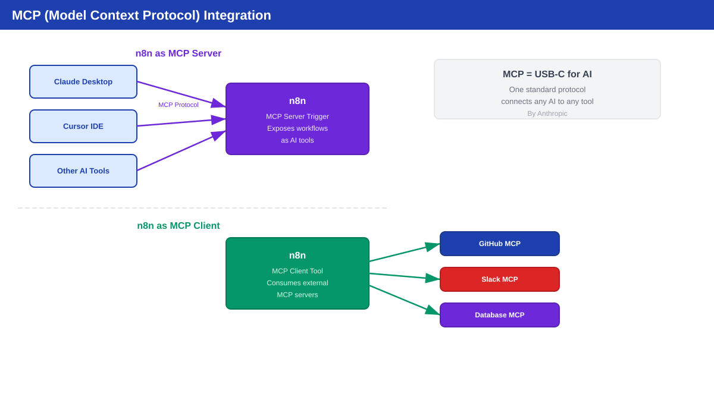
MCP Integration Architecture
n8n as MCP Server: expose workflows | n8n as MCP Client: consume external tools
36
Notes:
This diagram shows how MCP works with n8n. On the left: n8n as MCP Server. Your n8n workflows become tools that Claude Desktop, Cursor, or other AI can use. Example: You build a workflow that checks machine status. You expose it as an MCP Server. Now Claude Desktop can ask n8n: "Check CNC-001 status." n8n runs the workflow and returns the result to Claude. On the right: n8n as MCP Client. Your n8n Agent can use external MCP servers. GitHub MCP, Slack MCP, database MCP servers. Example: Your agent needs to create a GitHub issue. Instead of building an HTTP Request, it just calls the GitHub MCP server. This is the future: AI systems talking to each other through a standard protocol. OK, that's the end of the lecture part. Now it's your turn — time for the hands-on lab!

Slide 37
Hands-on Lab
Build an AI Agent
37
Notes:
OK everyone, time to build! In this lab, you will build a Log Summarizer AI Agent. This agent analyzes machine logs and tells you what is wrong and what to do. I already prepared a template workflow for you. But I want you to understand each step. Let me walk you through it.

Slide 38
Lab: Log Summarizer AI Agent
20 min
Steps:
1
Chat Trigger node (set to public)
2
AI Agent + Google Gemini Chat Model
3
Add Simple Memory (Window Buffer, 5 messages)
4
Configure system prompt (ROLE + CONSTRAINTS + OUTPUT)
5
Add Code Tool: analyze_log_pattern (parse & count errors)
6
Add Code Tool: get_machine_info (lookup machine specs)
Verify:
☐ Agent responds in English
☐ Severity classification is correct (CRITICAL/WARNING/INFO)
☐ Recommendations are specific and actionable
☐ Memory works for follow-up questions
38
Notes:
Here are the 6 steps. Step 1: Chat Trigger. Create a new workflow. Add a Chat Trigger node. Set it to Public so you can chat with it. Step 2: AI Agent. Add an AI Agent node. Connect it to the Chat Trigger. Add Google Gemini as the Chat Model. Step 3: Memory. Add Window Buffer Memory. Set context window to 5 messages. This lets the agent remember your conversation. Step 4: System Prompt. This is the most important step. Open the AI Agent settings. Paste the system prompt from the next slide. The prompt tells the agent: - You are a machine log analyst - Classify severity as CRITICAL, WARNING, or INFO - Give recommendations - Use the tools to parse data Step 5: Code Tool - analyze_log_pattern. Add a Code Tool node. Name it "analyze_log_pattern". Description: "Analyze machine log text, count errors and warnings, identify affected machines." The code parses log lines and counts errors. Step 6: Code Tool - get_machine_info. Add another Code Tool. Name it "get_machine_info". Description: "Get machine specifications by ID. Returns max temperature, max vibration, maintenance schedule." The code returns machine specs from a hardcoded database. After building, verify: - Chat with it and check responses are in English. - The severity should be correct. - Follow-up questions should work with memory. If you get stuck, open the template: [S3-Lab] Log Summarizer AI Agent. It has everything ready.

Slide 39
Lab: System Prompt Template
text
You are a machine log analyst for a manufacturing plant. When given machine logs, you must: 1. Summarize key issues 2. Classify severity: CRITICAL / WARNING / INFO 3. Recommend immediate actions 4. If severity is CRITICAL, say "IMMEDIATE INSPECTION REQUIRED" Use the analyze_log_pattern tool to parse log data. Use the get_machine_info tool to look up machine specs. Always respond in English. Include machine ID in every response.
39
Notes:
Here is the system prompt. Copy this into your AI Agent's system message field. Let me explain each part. Line 1: ROLE. "You are a machine log analyst." This tells the AI its job. Lines 3-6: TASKS. When it receives logs, it must: 1. Summarize the key issues. 2. Classify severity — CRITICAL, WARNING, or INFO. 3. Give recommendations. 4. If critical, say "IMMEDIATE INSPECTION REQUIRED". Lines 8-9: TOOLS. Tells the AI which tools to use. The AI reads this and knows: "When I get logs, I should use analyze_log_pattern." "When I need machine details, I should use get_machine_info." Lines 11-12: OUTPUT FORMAT. Respond in English. Always include the machine ID. This is the ROLE + TASKS + TOOLS + OUTPUT structure. Simple but effective.

Slide 40
Lab: Test Data
Paste this into the chat to test your agent
text
Sample logs for testing: 2026-03-16 10:23:01 [ERROR] CNC-001: Temperature exceeded 85C 2026-03-16 10:23:05 [WARN] CNC-001: Vibration level high (4.2mm/s) 2026-03-16 10:24:00 [ERROR] CNC-001: Emergency stop triggered 2026-03-16 10:25:00 [INFO] CNC-002: Normal operation resumed 2026-03-16 10:26:00 [WARN] CNC-003: Oil pressure dropping 2026-03-16 10:27:00 [INFO] CNC-002: Scheduled maintenance complete Follow-up questions to test memory: - "Which machine has the most critical issues?" - "What should the maintenance team do first?" - "Compare CNC-001 and CNC-002 status"
40
Notes:
Here is the test data. Paste the log lines into the chat. The expected result: - The agent calls analyze_log_pattern tool. - It finds: 2 errors, 2 warnings, 2 info messages. - CNC-001 has the most serious issues. - Severity should be CRITICAL because of high temperature and emergency stop. Then test the follow-up questions. These test that memory is working. "Which machine has the most critical issues?" The agent should say CNC-001 without you sending the logs again. This means memory is working. "What should the maintenance team do first?" The agent should prioritize CNC-001 and call get_machine_info to check specs. "Compare CNC-001 and CNC-002." The agent should use the tool for both machines and give a comparison. Take about 20 minutes. If you finish early, try adding your own test data. Or try changing the system prompt to make the agent respond in Vietnamese. Raise your hand if you need help!

Slide 41
Session 3: Key Takeaways
MQTT: subscribe topic -> process -> store/alert (industrial core pattern)
1
AI Agent = LLM (brain) + Memory (context) + Tools (abilities)
2
Tool description determines which tool the agent selects
3
System prompt: ROLE + CAPABILITIES + CONSTRAINTS + OUTPUT + FALLBACK
4
RAG: Ingest (chunk -> embed -> store) + Query (search -> LLM -> answer)
5
MCP: standard protocol for AI <-> tool communication
6
41
Notes:
Great work everyone! Let me summarize today. Takeaway 1: MQTT. The core pattern is simple: Subscribe to a topic, process the data, store in database or send alert. We saw this live with real sensor data and PostgreSQL. Takeaway 2: AI Agent. Agent equals Brain plus Memory plus Tools. The brain is the LLM. Memory keeps conversation context. Tools give the agent abilities. Takeaway 3: Tool descriptions matter. The AI reads the description to decide which tool to use. Write clear, specific descriptions. Bad description = agent uses wrong tool. Takeaway 4: System prompt structure. ROLE + CAPABILITIES + CONSTRAINTS + OUTPUT + FALLBACK. Write this down. Use this every time. Takeaway 5: RAG. Two phases: Ingest and Query. Ingest: chunk, embed, store. Query: search, get relevant docs, generate answer. Takeaway 6: MCP. One standard protocol for AI and tools. Like USB-C for AI. Watch this space — it is growing fast.

Slide 42
Preview: Session 4
Security: credential protection, webhook authentication
HMAC verification for payment webhooks
Production checklist (20+ items)
Backup & disaster recovery
Final Project: end-to-end automation system
Project presentations & review
42
Notes:
Next session — Session 4 — is the final session. We cover two important topics: Security and Production readiness. Security: How to protect your credentials. How to verify webhook calls are legitimate. HMAC verification for payment systems. Production checklist: 20+ items you must check before going live. Error handling, monitoring, backup, scaling. And the final project! You will build a complete end-to-end automation system. It will combine everything from all 4 sessions: webhooks, workflows, database, AI agents. Then you present your project to the class. Start thinking about your project idea. What automation would be useful for your work or studies?

Slide 43
Homework
Create an AI agent with at least 2 tools
Try the RAG demo workflow — search machine manuals
Read: n8n webhook security documentation
Prepare ideas for your final project
43
Notes:
Homework for next session. Number 1: Build your own AI agent. It must have at least 2 tools. You can modify the Lab workflow or create something completely new. Number 2: Try the RAG demo. Open S3-Demo5 and chat with it. Ask questions about different machines. See how it searches the maintenance manuals. Number 3: Read about webhook security. Go to the n8n documentation. Search for "webhook authentication". This prepares you for Session 4. Number 4: Think about your final project. What problem would you automate? What data sources would you use? Would you use AI agents? Bring your ideas to Session 4. We will discuss them before you start building. Any final questions?

Slide 44
Questions & Answers
?
44
Notes:
Open Q&A time. Common questions students might ask: "Can I use ChatGPT instead of Gemini?" Yes! Just change the Chat Model node. Add OpenAI API key in credentials. "Is the AI agent free?" Gemini has a free tier. OpenAI charges per token but it is very cheap for testing. "Can I use RAG with PDF files?" Yes! n8n can read PDFs. Use the Document Loader node to load PDFs, then chunk and embed them. "How much does Qdrant cost?" Qdrant is free and open source. You can self-host it like we do on our training server. Qdrant Cloud has a free tier too. Thank you everyone! Great work today. See you in Session 4!

