Slide 1

QUALITY CONTROL
FILE REVIEW PROCESS

Slide 2
Agenda
10 min
Objectives
10 min
Parties Involved, Software, Job Aids
(Activity & Break)
69 min
File Review Process
11 min
Closing Steps
5 min
Summary

Slide 3



OBJECTIVES
Identify Tasks for
File Review
Determine
Policy Coverage
Locate Estimate Inaccuracies

Slide 4




PARTIES
INVOLVED
1
RHT Insurance Company
2
Security Assured Claims
3
Independent Field Adjusters

Slide 5

FILETRACKER
ESTIMATOR
Security Assured Claims Portal
Transfers our documents to the insurance company’s portal.
Estimating Software
Used by field adjusters to write estimates.

Slide 6
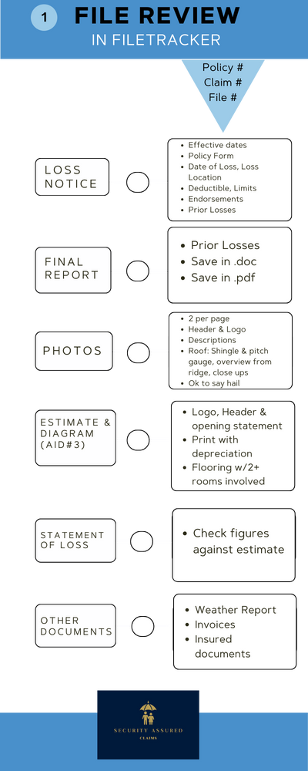
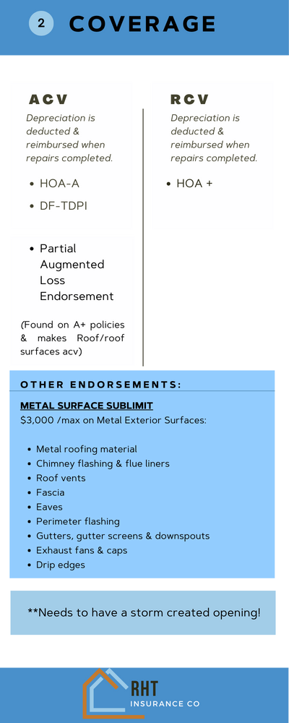
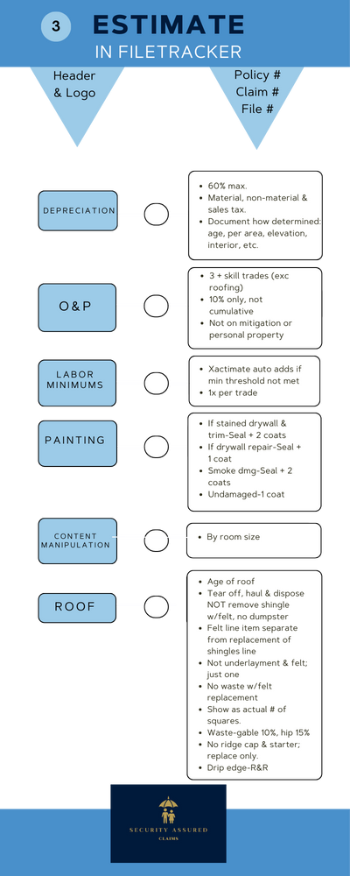
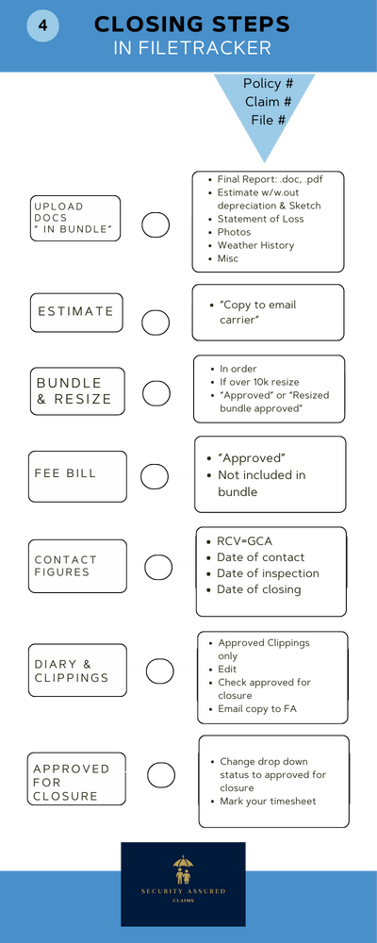
JOB AIDS

Slide 7

TASKS-FILE REVIEW
01
02
03
Loss Notice
Final Report
Photos
04
05
06
Estimate
Statement of Loss
Other Documents
*Job Aid 1

Slide 8

  1. LOSS NOTICE
  Effective dates
  Policy Form
  Date of Loss, Loss Location
  Deductible, Limits
  Endorsements
  Prior Losses
*Job Aid 2

Slide 9

2. FINAL REPORT
  Prior Losses
  Save in .doc
  Save in .pdf

Slide 10


3. PHOTOS
4. ESTIMATE & SKETCH
  Header & Logo
  Two Photos per Page
  Shingle Type & Pitch Gauge
  Document Hail Damage
  Header, Logo & Statement
  Print with Depreciation
  Flooring if Two+ Rooms
*Job Aid 3

Slide 11
ESTIMATE
REVIEW

Slide 12
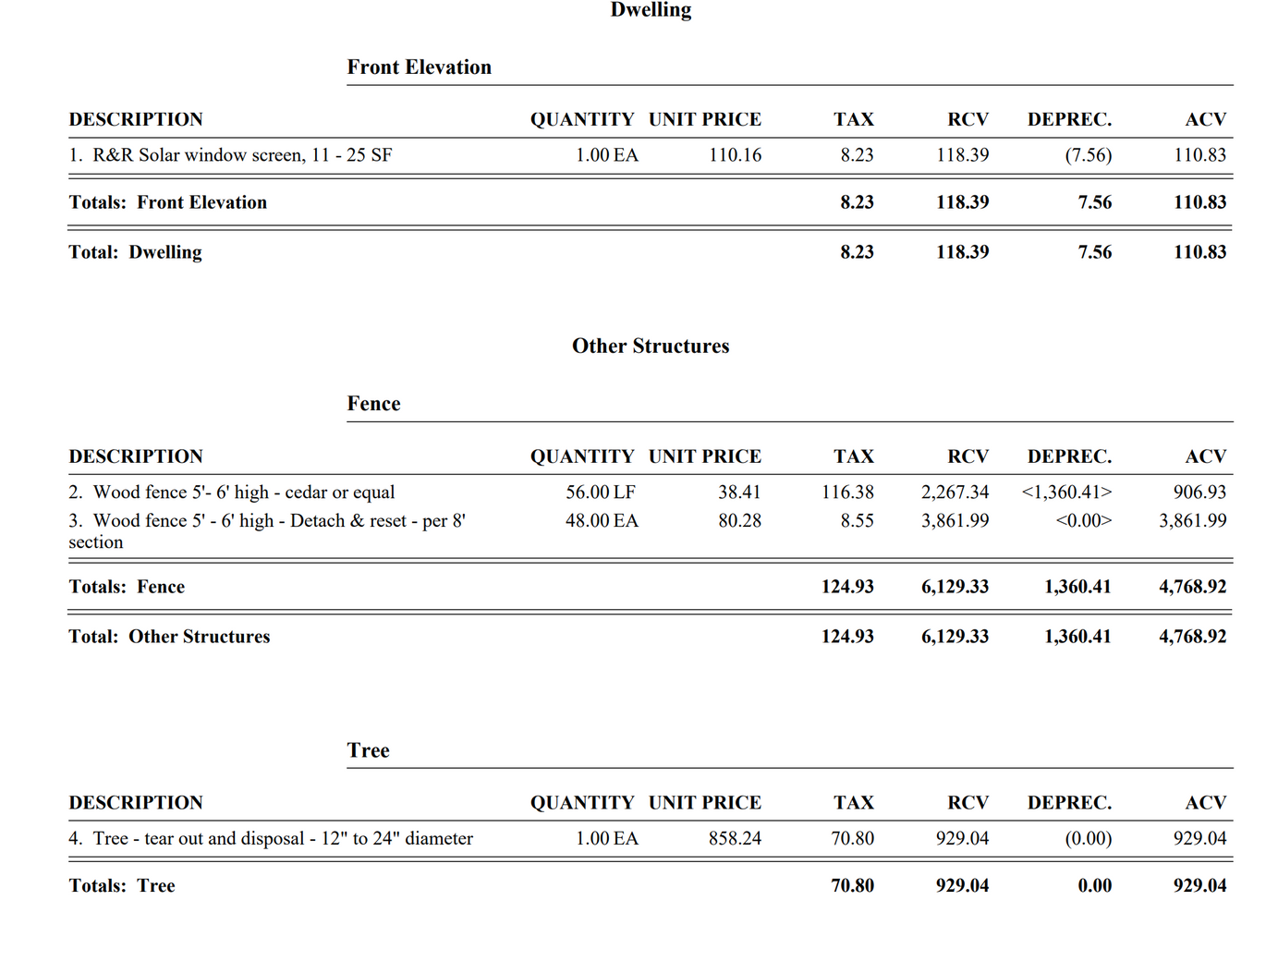
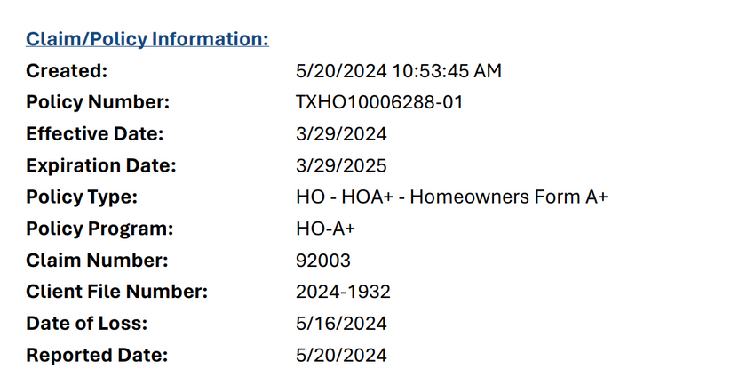
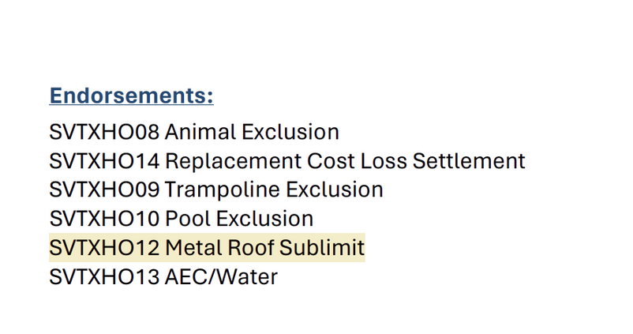
ORIGINAL ESTIMATE

Slide 13
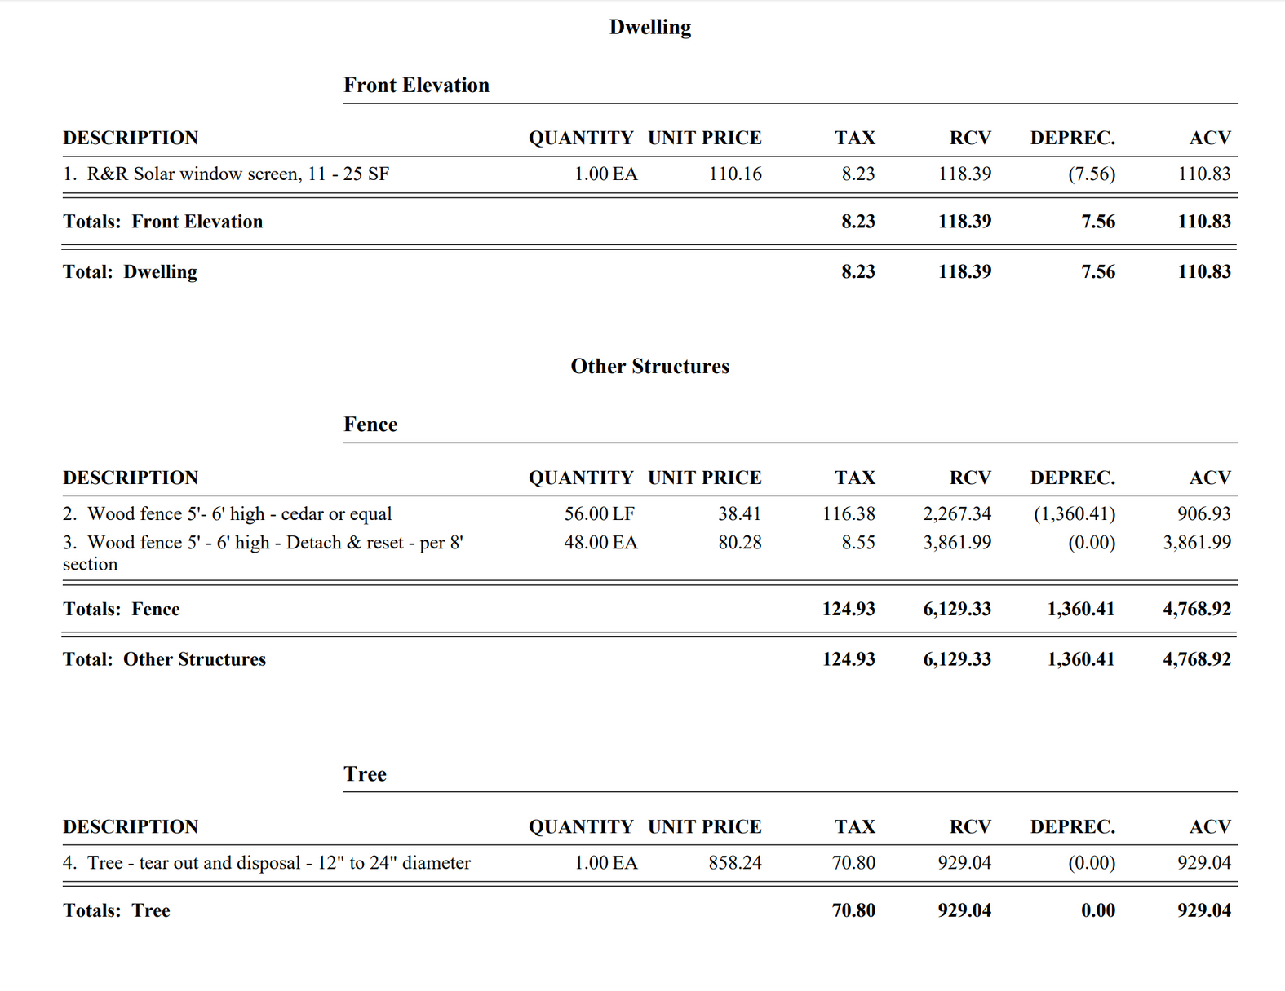
REVISED ESTIMATE
REVISIONS:
Recoverable depreciation
for fence
WHY:
  HOA +
  No Augmented Property Settlement Loss Endorsement

Slide 14


5. STATEMENT OF LOSS
6. OTHER DOCUMENTS
Compare to Estimate
Check Figures
  Weather Report
  Invoices
  Insured documents

Slide 15

CLOSING STEPS
BUNDLE
DOCUMENTS
ESTIMATE
RESIZE
  Final Report in .doc
  or .pdf form
  Estimate Without Depreciation
  Statement of Loss
  Photographs
Document “Copy to Email Carrier”
Do Not Delete Duplicate Copies
  Order of Documents
  Resize if Over 10k
  “Approved”
Job Aid 4

Slide 16
CLOSING STEPS
FEE
BILL
CONTACT FIGURES
DIARY &
CLIPPINGS
  “Approved”
  Not Included in Bundle
  RCV=GCA
  Date of Contact
  Date of Inspection
  Date of Closing
  Approved Clippings Only
  Edit
  Check Approved for Closure
  Email copy to FA

Slide 17
CLOSED
STATUS
DROP DOWN
  APPROVED FOR CLOSURE

Slide 18

SUMMARY
IDENTIFY TASKS FOR FILE REVIEW
DETERMINE
COVERAGE
LOCATE INACCURACIES IN ESTIMATES
  Job Aid 1
  Document Sequence
  Notice of Loss
  Coverage
  Endorsements
  Job Aid 3

