Slide 1


Retail 5.0:
The New Era of Invisible Loyalty
Armağan Gürkan
Chief Sales Officer

Slide 2

  01
Mobven
  02
Digital Retail Experience with Mobven
  03
Prometa.ai
  04
Autonomous Retail Experience with Prometa.ai
  05
Why Traditional Retail Needs to Evolve
  06
The New Era of Invisible Loyalty
  07
Palm
Agenda
  08
The Future of Loyalty

Slide 3





200+
Team Members
Your technology partner that grows with you.
Trusted by Leading Brands
Since 2012, we have been building technology solutions that transform the end-to-end digital customer experience for Türkiye’s leading companies.
Across
Europe & Mena
30+
Active Clients

Slide 4

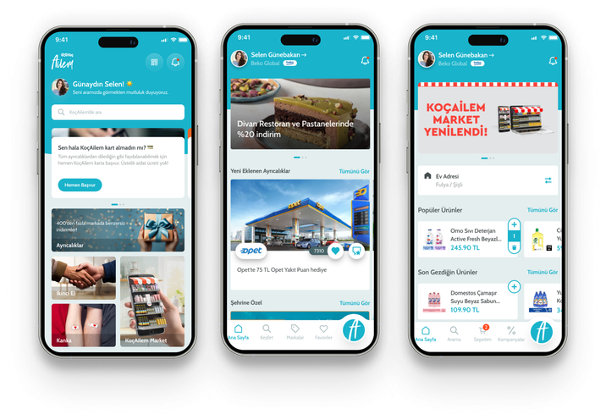
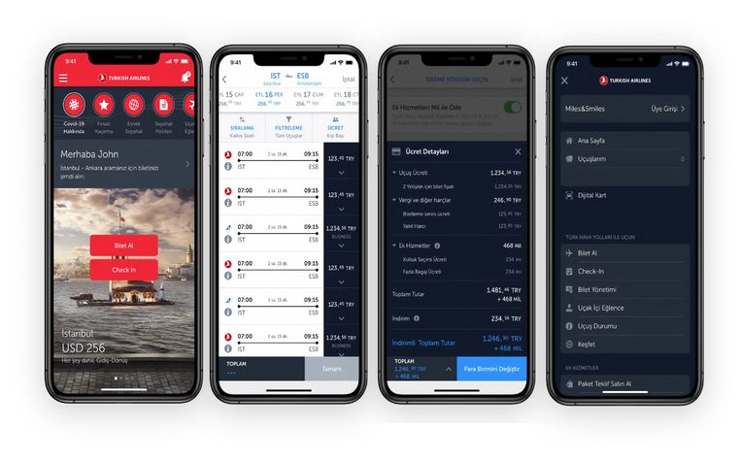
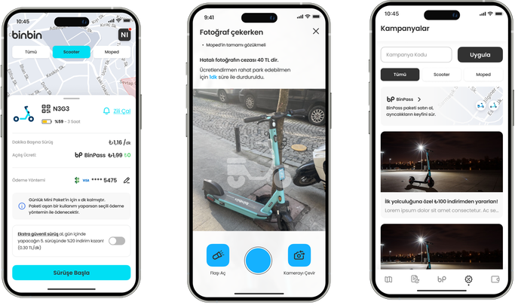

Digital Retail Experience with Mobven
Mobven builds the mobile apps, payment systems, and omnichannel infrastructures that millions of customers interact with every day. From concept to launch and beyond.
Koç Ailem
THY
BinBin
Notes:
Koç ailem :
•Mobile Application Development
•Backend Development
UI&UX Services
Binbin:
•Mobile Application Development
•Backend Development
•UI & UX Services
•Test Services
THY :
•Mobile Application
•UI&UX Services
•Back Office Development
•Test Services

Slide 5







Don’t treat AI as a tool. Make it part of your business.
We redefine customer experience through AI Assistants and intelligent recommendation systems.

Slide 6
Autonomous Retail Experience with Prometa.ai
Retail generates more data than almost any industry — yet acts on very little of it. Prometa.ai turns that data into real-time action, for every customer, at every touchpoint.
Agentic Commerce
Hypernudge
Orders, returns, campaigns fully automated. AI runs the entire flow.
Personalized content and product matching that boosts revenue and engagement.
Fashion Assistant
Sales Agent
A stylist that never clocks out. Learns taste, matches products, drives discovery.
Qualifies, recommends, closes. From first question to final purchase, fully autonomous.
Notes:
Koç ailem :
•Mobile Application Development
•Backend Development
UI&UX Services
Binbin:
•Mobile Application Development
•Backend Development
•UI & UX Services
•Test Services
THY :
•Mobile Application
•UI&UX Services
•Back Office Development
•Test Services

Slide 7
?
Why Traditional Retail Needs to Evolve
Fragmented Customer Data
Disconnected touchpoints create incomplete customer understanding.
Mass Campaign Fatigue
Generic campaigns reduce engagement and loyalty impact.
Static Loyalty Programs
Traditional systems react too late and personalize too little.

Slide 8
The New Era of Invisible Loyalty
AI-native loyalty orchestration platform, Palm.
Loyalty is no longer a program customers join.
It becomes an intelligent experience customers naturally live.
Unified Customer Intelligence
Every touchpoint — app, web, POS, CRM — flows into a single real-time profile.
Autonomous Personalization
No more mass sends. Every message earned by behavior.
Predictive Loyalty Journeys
Palm knows what the customer needs — before they do.

Slide 9





Personalization at Scale
Delivering unique experiences for every customer interaction.
Invisible Loyalty Starts Here.
AI-native loyalty platform that unifies customer data, automates engagement, and orchestrates personalized journeys in real time.
Actionable Real-Time Insights
Transforming live customer signals into immediate actions.
Invisible Loyalty
Embedding loyalty naturally into the customer experience.
Managed Customer Journey
Orchestrating seamless journeys across every touchpoint.

Slide 10
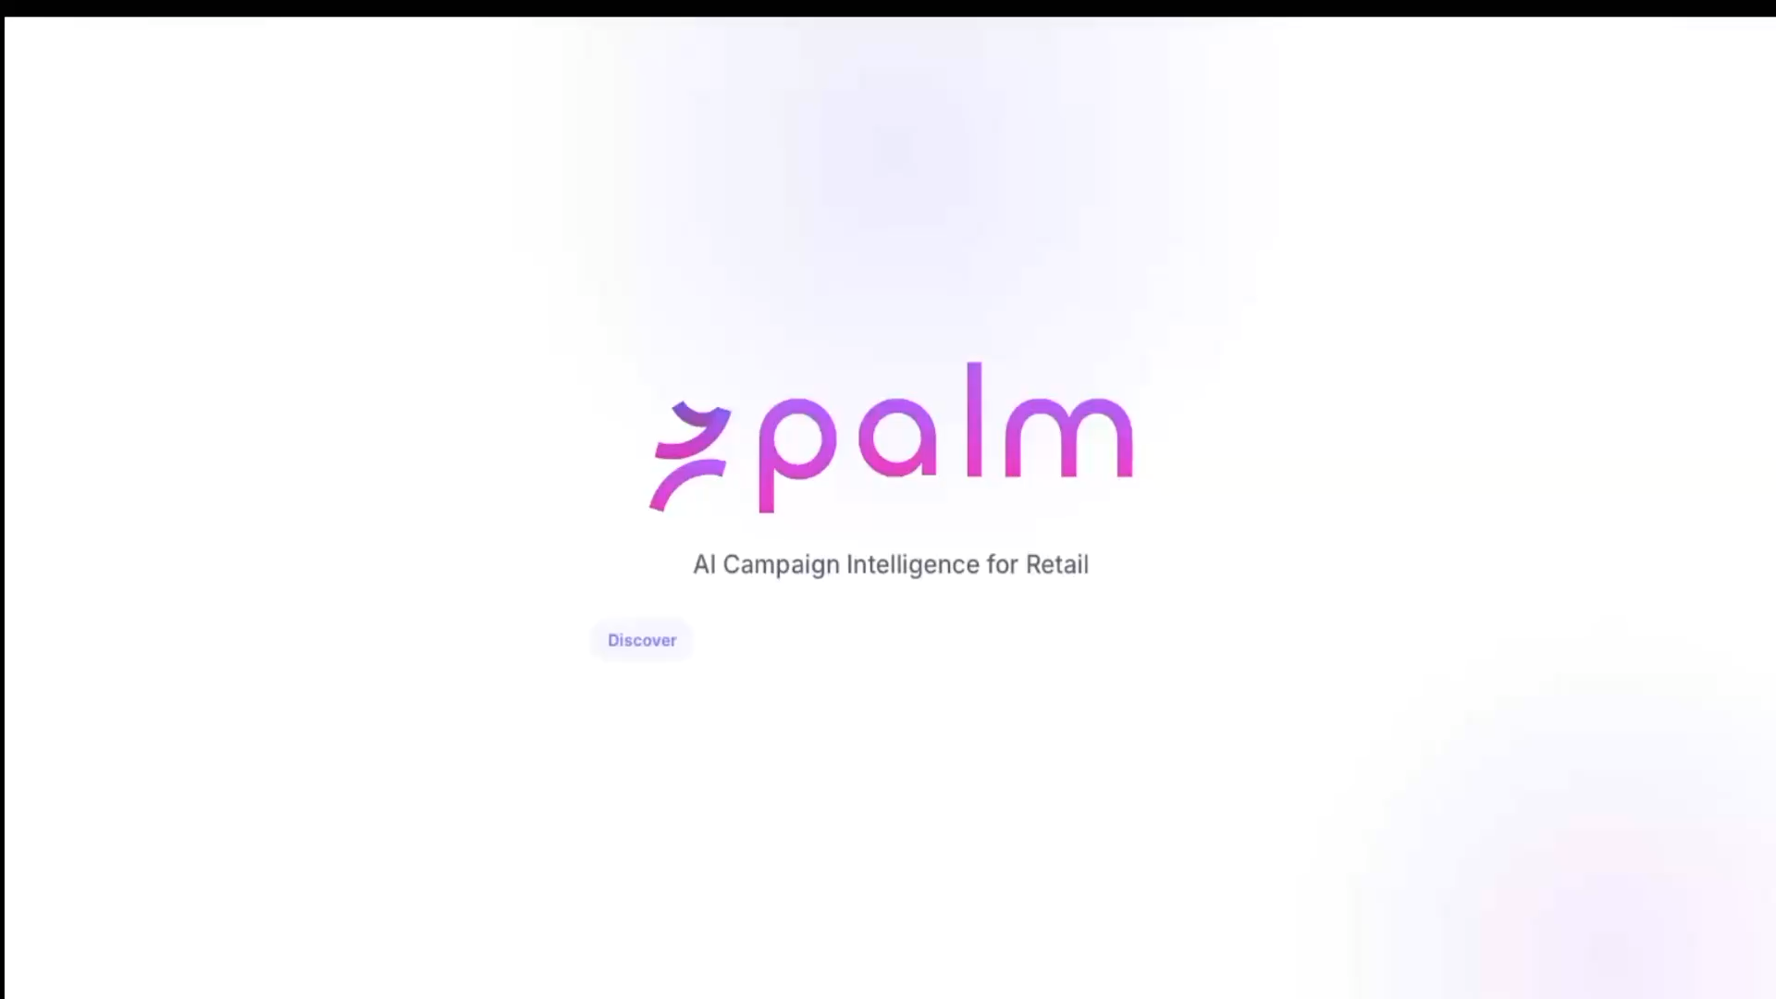
The Future of Loyalty

Slide 11

Thank You
For more details, visit us at : Hall 4, Booth 404

