Slide 1

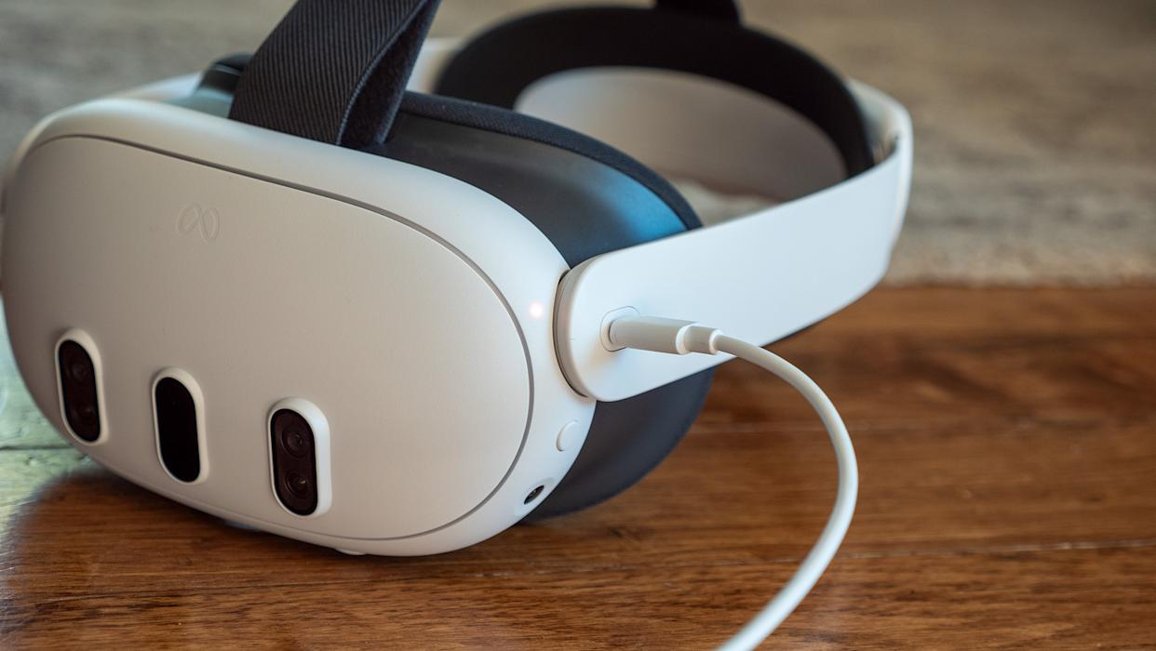
1 - Turn ON the PC and then the VR Headset
1
Press and hold the power button .
A sound will indicate that the headset has turned on.
To verify, wear the VR headset and ensure the virtual environment is visible.
1

Slide 2
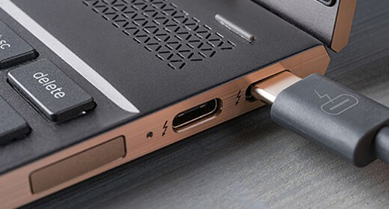
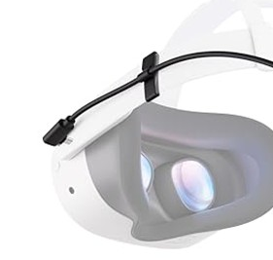
2 - Connect the VR Headset to the PC
2
1
Connect the cable to both the PC and the VR headset .
Make sure the cable is firmly secured to prevent accidental disconnection.
Note: Make sure “Meta Link” is running on the PC. If not, start the program.
1
2

Slide 3
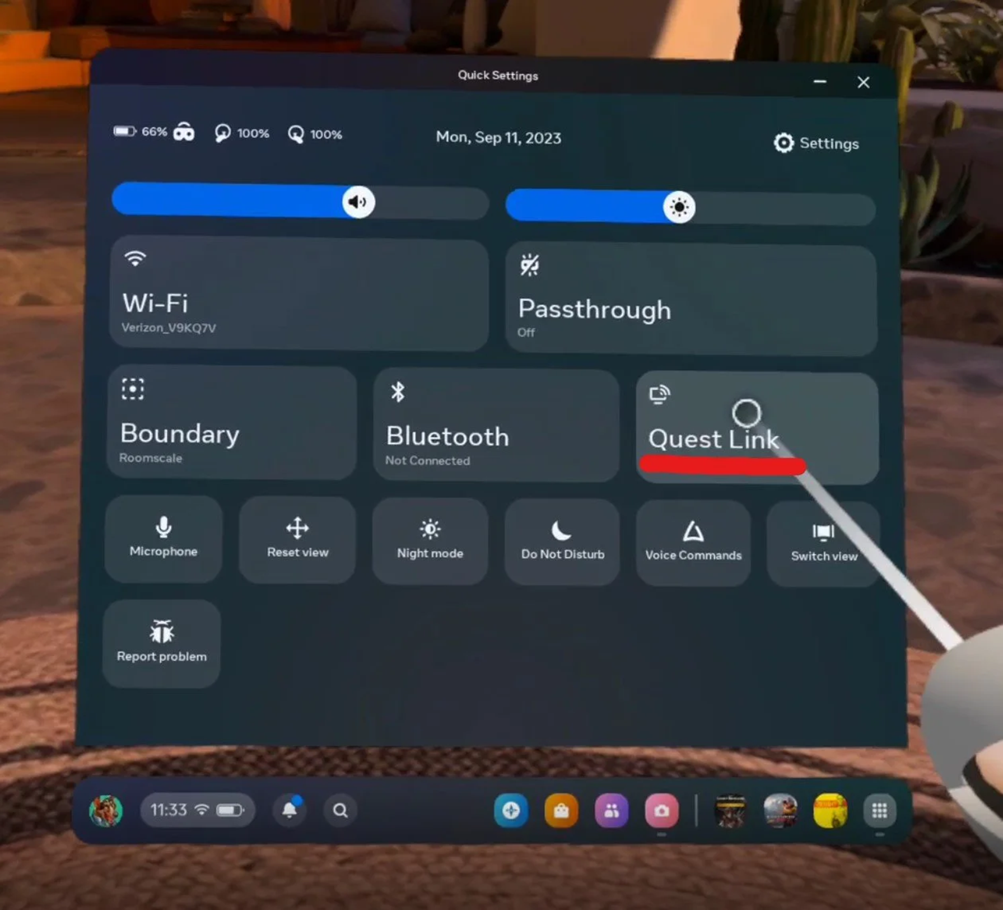
3 – Enable “Quest Link” Inside the VR Headset
Connecting the headset to the PC will automatically prompt a pop-up to enable “Quest Link”; follow the on-screen instructions for setup.
If the pop-up doesn’t show automatically:
Click on the section of the menu bar showing time and wifi .
Click on “Quest Link” and follow the instructions .
2
1
2
1

Slide 4
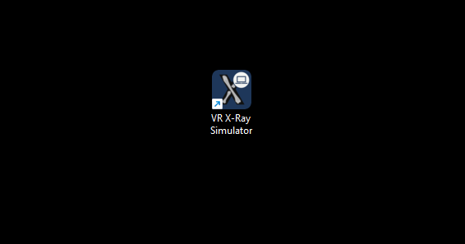

4 – Start the VR X-Ray Simulator
Start the VR X-Ray Simulator program on the PC.

Slide 5
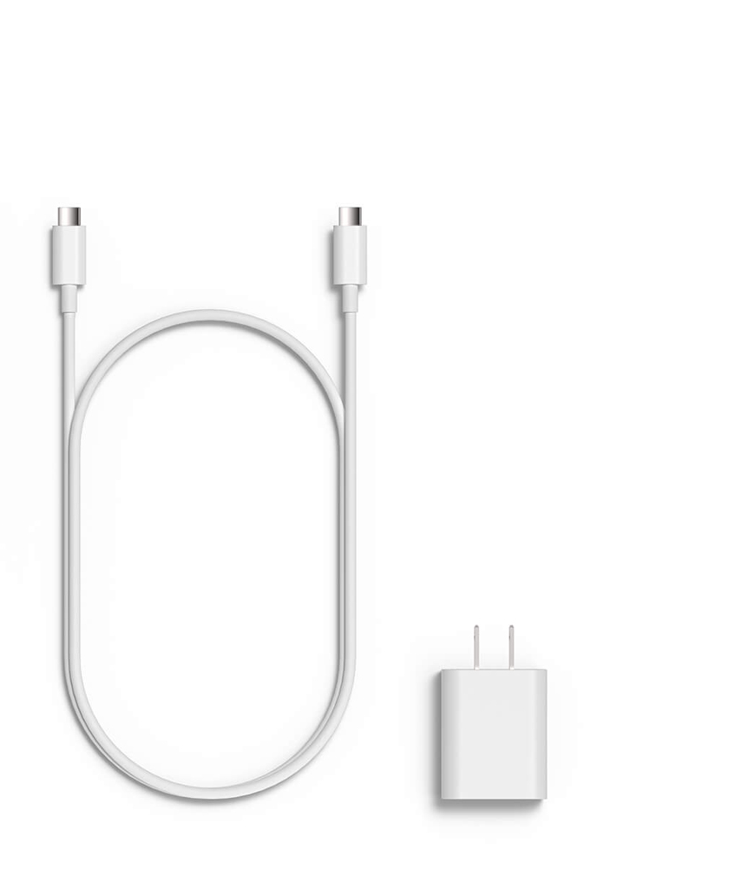
Tip 1: Charge the VR Headset
When Not in Use.
Ensure the VR headset is charging when not in use. The charging cable can
be connected to the side of the VR headset . Charge the headset by connecting it to the PC. Alternatively, use the included power plug if not connected to a PC.
1
2
3
1
2
3

Slide 6


Tip 2: Take Precautions to Ensure an Optimal VR Experience
3 meter / 9 ft
Remove any obstacles or clutter from your playing area to prevent accidents and ensure smooth navigation in the virtual world.
Keep the VR headset lenses away from direct sunlight to avoid damage. Always store and use the headset in a shaded area to maintain optimal performance.
Make sure you have a playing area of at least 3 by 3 meter to fully enjoy your VR experience.

Slide 7
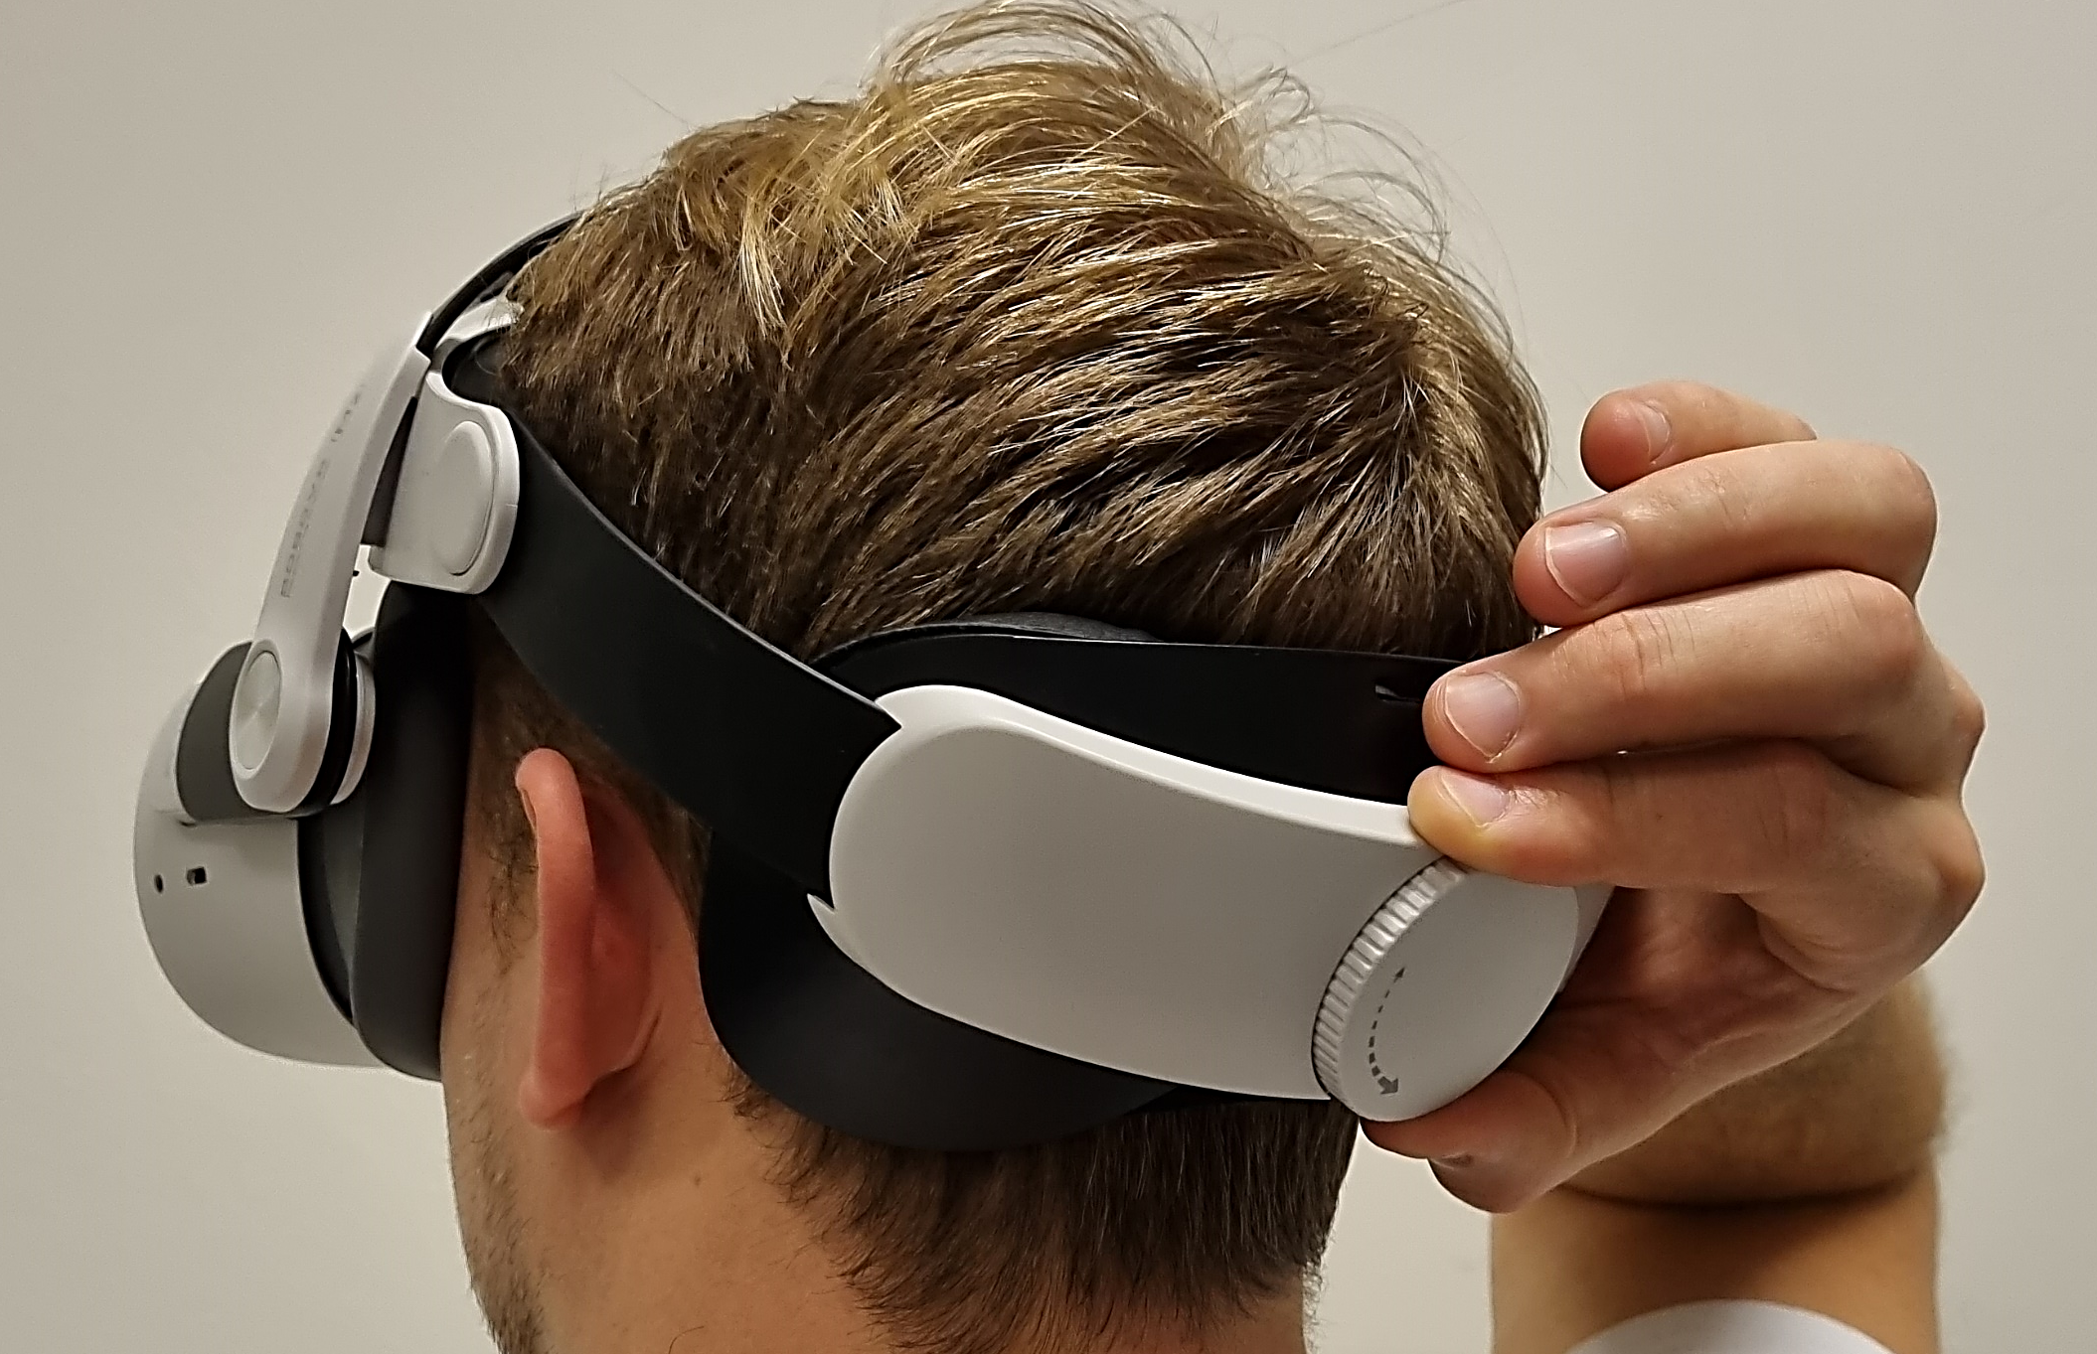
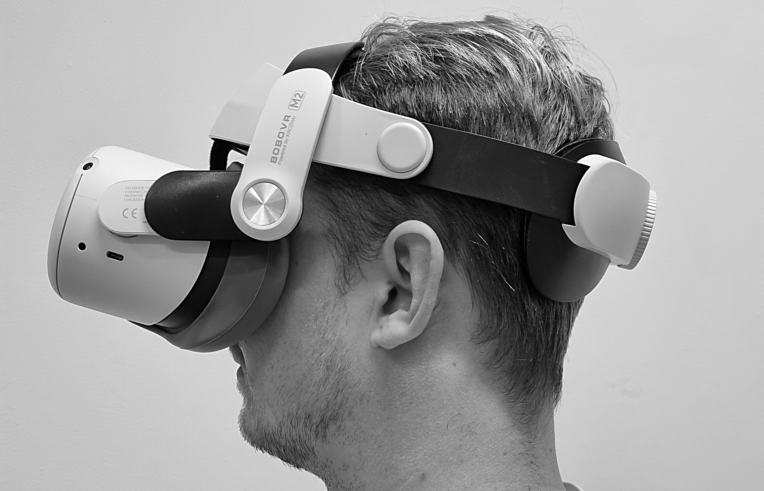
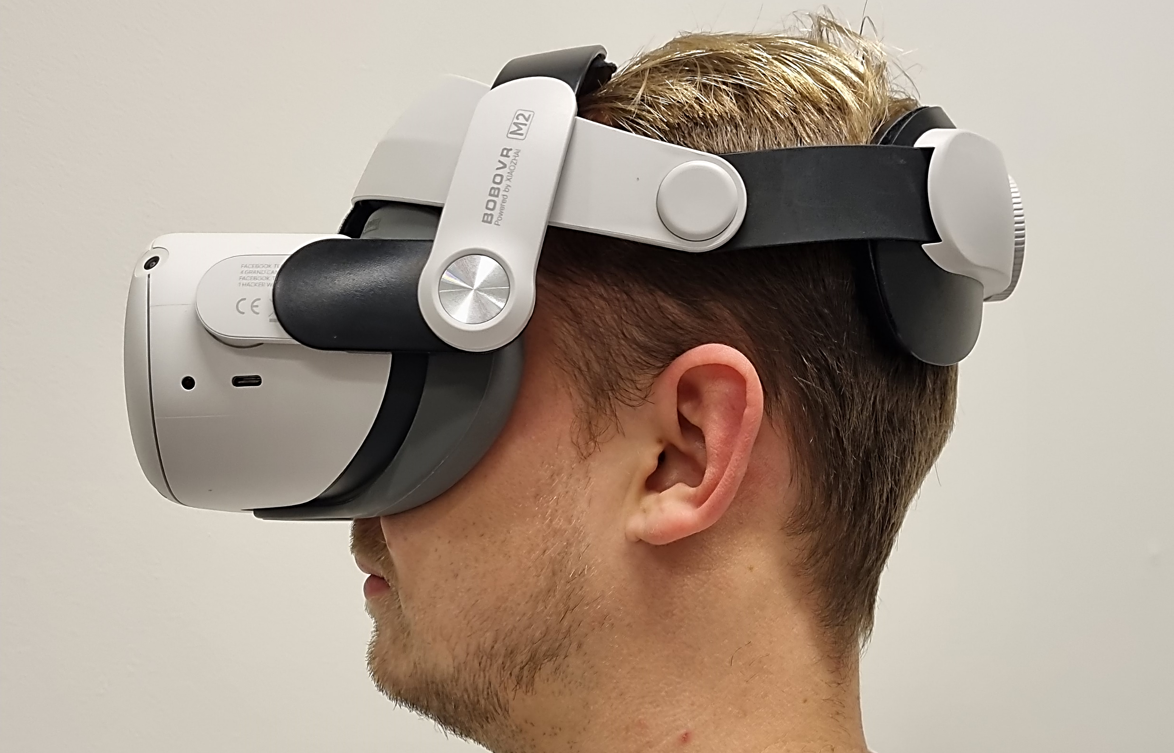


Tip 3: Wear Your VR Headset Correct
Ensure the lenses are parallel with the strap and that the strap is securely tightened behind your head . Fine-tune the tension using the knob located on the back of the strap for a comfortable immersive experience.
While in the virtual world, follow the steps provided by the VR headset to set up or confirm your playing area.
1
2
3
3
2
1

