Slide 1
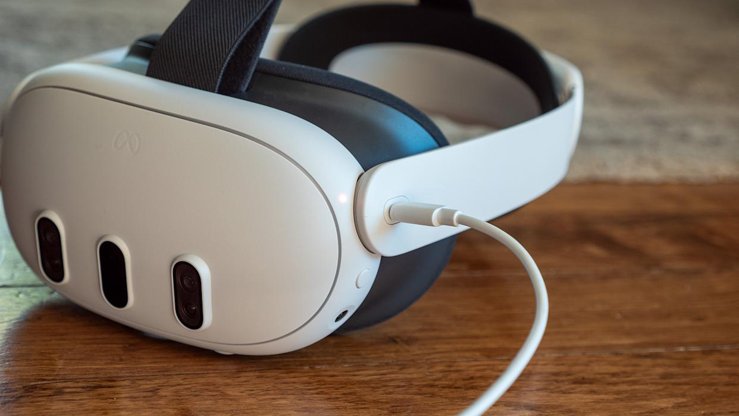
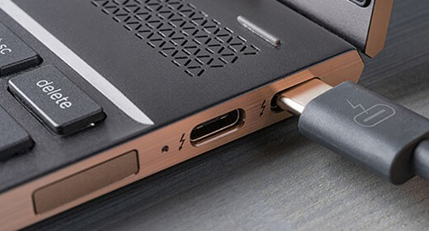
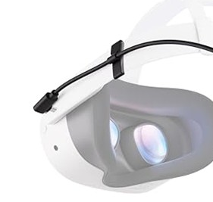

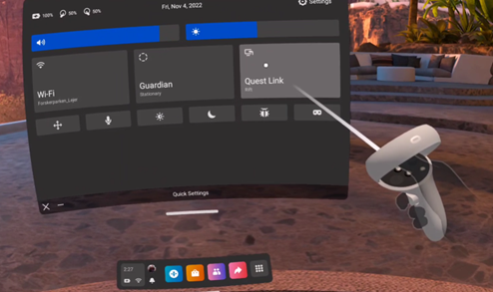

1 - Turn ON the PC and then the VR Headset
2 - Connect the VR Headset to the PC
2
1
1
Connect the cable to both the PC and the VR headset .
Make sure the cable is firmly secured to prevent accidental disconnection.
Note: Make sure “Meta Link” is running on the PC. If not, start the program.
1
2
Press and hold the power button .
A sound will indicate that the headset has turned on.
To verify, wear the VR headset and ensure the virtual environment is visible.
1
3 – Enable “Meta Link” Inside the VR Headset
4 – Start the VR X-Ray Simulator
Connecting the headset to the PC will automatically prompt a pop-up, inside the headset, to enable “Meta Link”; follow the on-screen instructions for setup..
If the pop-up doesn’t show automatically:
Click on the section of the menu bar showing time and wifi . .
Click on “Meta Link” and follow the instructions.
2
1
2
1
Start the VR X-Ray Simulator program on the PC.

