Slide 1

Fire Safety
Micro Lesson: Communication

Slide 2
Agenda
Goal Questions (Course Objective)
Discussion
Video
Conclusion
5 minutes
(ish)

Slide 3

Goal Questions:
Consider these during today’s lesson; discussion to follow!
What preventable “human” factors can override fire prevention training?
Why does it matter to be aware of them?

Slide 4
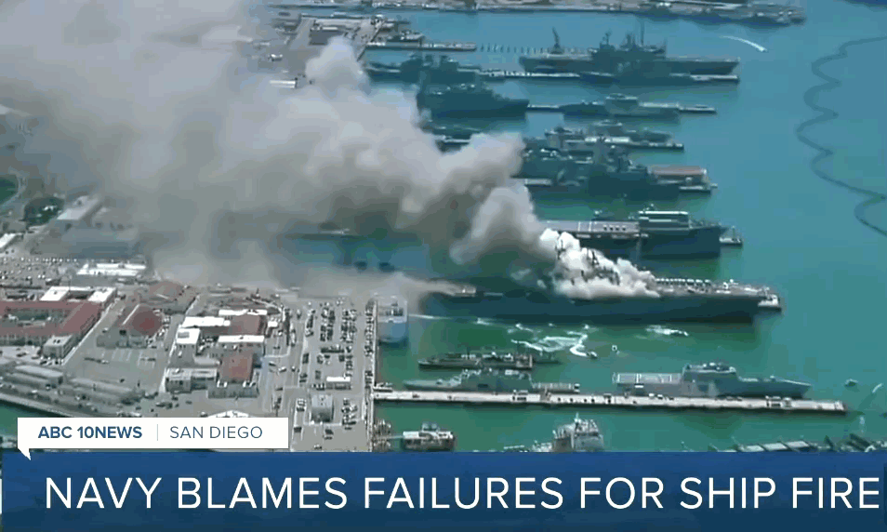
The “Human” Factor:
2020 Disaster in San Diego
“Troops failed to alert others to the fire for a full 10 minutes after spotting it, and never activated the firefighting foam system”
-BBC
Troops had been trained in fire safety new hire and annual training
$1.2 billion ship destroyed

Slide 5

Discussion
30 seconds!
What factors might make an employee uncomfortable voicing concern if they notice a potential safety hazard?

Slide 6

Video: Speed of Fire

Slide 7
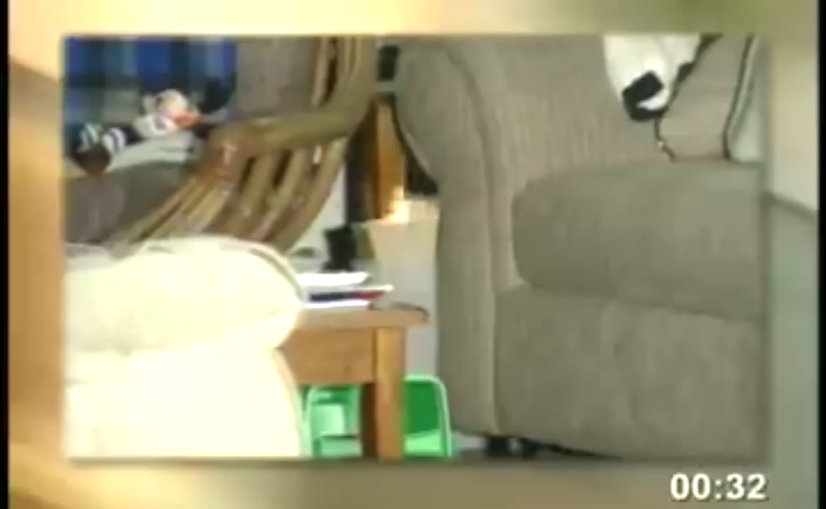
Video: Speed of Fire

Slide 8
Reactions?
Any reactions to the video?
How did it feel to only have 30 seconds in our earlier discussion?

Slide 9





Conclusion
Most of fire safety is fire prevention
!
  Less of a time crunch!
  Training is once a year; fire risk is every day
  Building a culture of open communication saves lives
!
!

Slide 10
Thank you!
Questions? Feedback?
Firesafety@yourorg.org

