Slide 1

Fire Safety
Micro Lesson: Communication
Notes:
FACILITATOR TALKING POINTS:
***Click to start idle bg motion***
Thank learners for coming. Introduce yourself/pronouns, your background, and what we’re talking about today.

Slide 2
Agenda
Goal Questions (Course Objective)
Discussion
Video
Conclusion
5 minutes
(ish)
Notes:
FACILITATOR TALKING POINTS:
Today’s lesson should take about 5 minutes and change.
We’ll first go over the course objective, which we’re calling “goal questions” in this lesson.
Next, we’ll have a brief discussion, watch a video, and discuss final takeaways.

Slide 3

Goal Questions:
Consider these during today’s lesson; discussion to follow!
What preventable “human” factors can override fire prevention training?
Why does it matter to be aware of them?
Notes:
FACILITATOR TALKING POINTS:
We will not have a quiz at the end; all you need to do is focus on these questions during the lesson: What preventable “human” factors can override fire prevention training? Why does it matter to be aware of them?

Slide 4
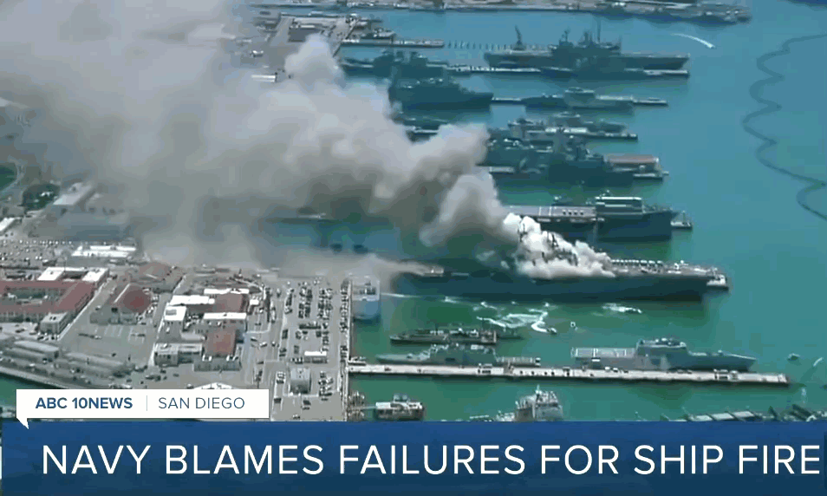
The “Human” Factor:
2020 Disaster in San Diego
“Troops failed to alert others to the fire for a full 10 minutes after spotting it, and never activated the firefighting foam system”
-BBC
Troops had been trained in fire safety new hire and annual training
$1.2 billion ship destroyed
Notes:
FACILITATOR TALKING POINTS:
I wanted to get us started with an example of how human error can happen in any organization. We think of the navy as highly trained, but in 2020, a fire broke out on a huge warship. The troops who spotted the fire didn’t act on their training. As a result, the fire got out of control and injured at least 63 people.
***Click to reveal first bullet point***
The troops had been trained in fire prevention and response, but obviously there was a gap between what they were trained to do and what they actually did.
***Click to reveal second bullet***
It destroyed a $1.2 billion ship.

Slide 5

Discussion
30 seconds!
What factors might make an employee uncomfortable voicing concern if they notice a potential safety hazard?
Notes:
FACILITATOR TALKING POINTS:
Now we’re going to have a group discussion, but you will only have a tight 30 seconds.
***Click to reveal square***
***Click to reveal text***
What factors might make an employee uncomfortable voicing concern if they notice a potential safety hazard?
Okay, your time begins now.
***Click to start timer***
(Encourage discussion)
(If shy audience, consider mentioning any of the following:
Normalized hazards in company culture can lead to silence
Hesitance of reputation with peers or authority, afraid of being “wrong”
Complacency or everyday distractions
Poor training can contribute to not recognizing hazards or lack of confidence that employee knows this is a hazard
When employees don’t know how to recognize danger or know what they are supposed to
do, one of the most dangerous things and time-wasting things they can do is nothing, or wait
to be told what to do.
Never finding “the right time” or putting it off)
(Given the very short discussion time and the possibility that the class members may be
unfamiliar with each other, it is likely some groups won’t have robust answers, or may not
even come up with an answer at all. Make a note of this; hesitance to communicate openly
in a short span of time is relevant to revisit at the end of the lesson.)
***When timer ends*** That’s our 30 seconds! Thank you for your thoughts; we will definitely revisit this after our next segment.

Slide 6

Video: Speed of Fire
Notes:
FACILITATOR TALKING POINTS:
Now, we’re going to watch footage of a fire destroy a room. What we’re about to watch was created by a fire department in a controlled setting.
***Click play button; video will start immediately***

Slide 7
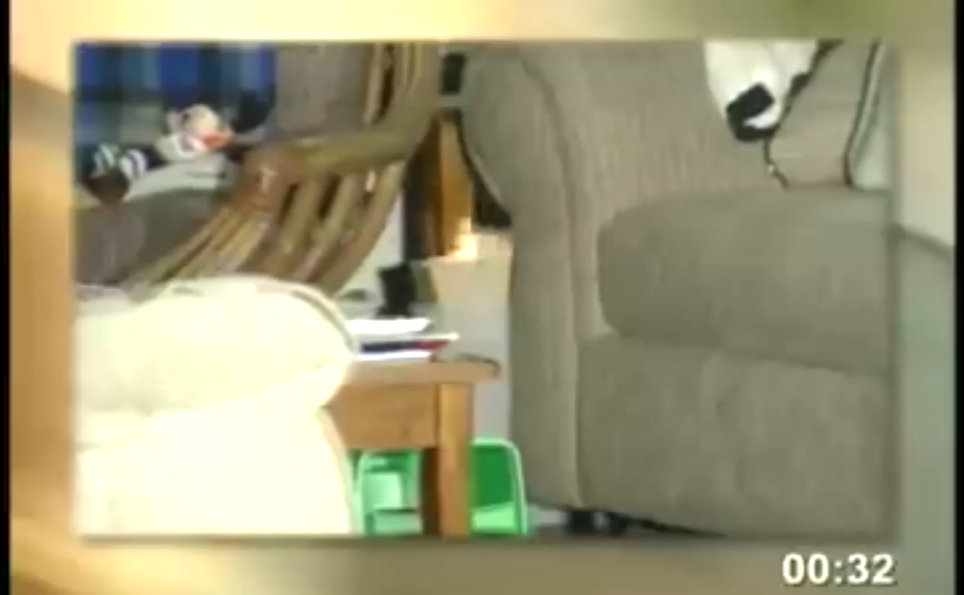
Video: Speed of Fire
Notes:
FACILITATOR NOTES:
(Video will end when entire room, including scorched chair, is engulfed in flame)

Slide 8
Reactions?
Any reactions to the video?
How did it feel to only have 30 seconds in our earlier discussion?
Notes:
FACILITATOR TALKING POINTS:
All done! So, what were your reactions to the video? Does anyone want to share?
(Allow discussion)
And how did it feel to only have 30 seconds to share what factors might make an employee hesitant to point out a fire hazard?
(Be mindful of time)
(Consider bringing up any hesitance to get the discussion started earlier)
The reason I gave you 30 seconds earlier is because people who don’t know each other tend to freeze up rather than dive in.
And even if they do know each other, this topic can be a lot to unpack.
It takes time and thought to intentionally build a culture that makes people comfortable voicing concerns.
Whereas as we saw, when an emergency has already started, we have no time and all reaction, which can lead to destruction and harm.

Slide 9





Conclusion
Most of fire safety is fire prevention
!
  Less of a time crunch!
  Training is once a year; fire risk is every day
  Building a culture of open communication saves lives
!
!
Notes:
FACILITATOR TALKING POINTS:
So the final thoughts I want to leave you with today are that most of fire safety is fire prevention.
It’s not just training; it’s a culture of communication and alertness.
***Click to reveal square***
***Click to reveal text***
Prevention is less of a “time crunch” than reaction. We will always have time to build a strong safety culture. If a fire breaks out, we don’t have time. We’re reacting.
***Click to reveal square***
***Click to reveal text***
You are required to take training annually, but we all face the risk of a fire every day. Carry it with you when, even months later, you notice something blocking a possible escape route.
***Click to reveal square***
***Click to reveal text***
Building a culture of open communication, especially when it comes to employees feeling safe voicing potential safety concerns, quite literally saves lives.

Slide 10
Thank you!
Questions? Feedback?
Firesafety@yourorg.org
Notes:
FACILITATOR TALKING POINTS:
This concludes our time together today. Thank you so much!

