Slide 1
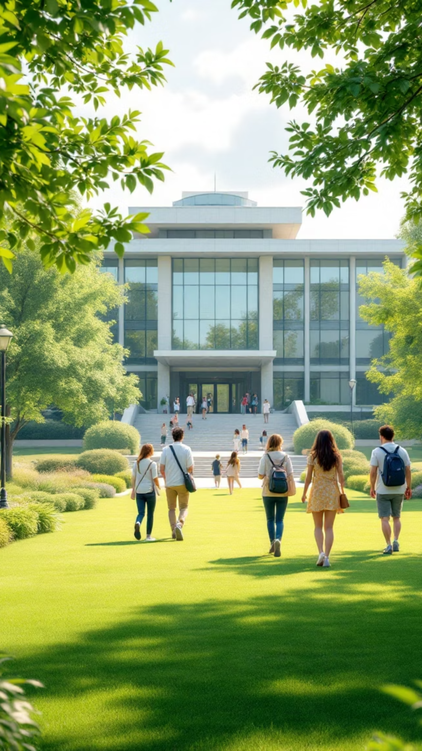
Campus Life
Discover the vibrant world of university life, where academic excellence meets personal growth. Your campus experience extends far beyond the classroom, offering endless opportunities to connect, explore, and thrive in a supportive community environment.
3D AVATAR

Slide 2





Dormitories & Essential Facilities
Modern Dormitories
Dining Services
Comfortable living spaces featuring furnished rooms, high-speed internet, and 24/7 security. Choose from traditional halls to apartment-style suites with kitchen facilities and study lounges.
Multiple cafeterias offering diverse cuisine options, including vegetarian, vegan, and international dishes. Flexible meal plans accommodate various dietary needs and preferences.
Library Resources
Recreation Centers
State-of-the-art libraries with extensive digital collections, quiet study areas, group collaboration spaces, and research assistance from professional librarians available daily.
Comprehensive fitness facilities including gyms, swimming pools, tennis courts, and sports fields. Intramural leagues and fitness classes promote healthy, active lifestyles.

Slide 3
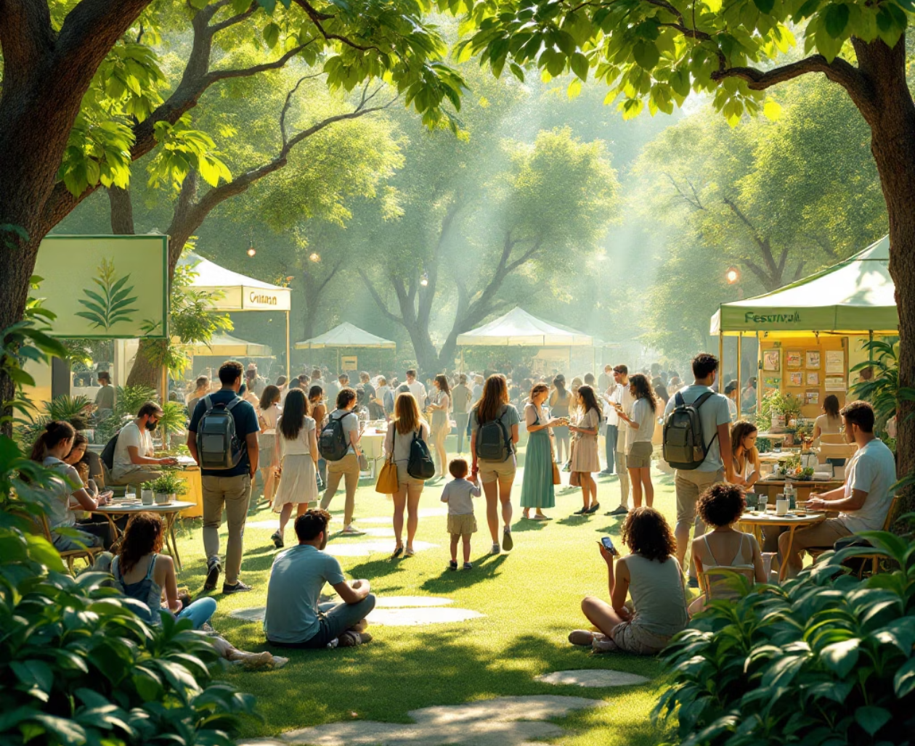
Student Activities & Community
Academic Clubs
Cultural Groups
Join discipline-specific organizations, honor societies, and academic competitions that enhance your learning experience and build professional networks.
Celebrate diversity through cultural associations, international student organizations, and heritage clubs that foster cross-cultural understanding.
Special Interest
Explore hobbies and passions through photography clubs, debate societies, volunteer groups, and recreational organizations tailored to your interests.
Over 200+ student organizations create endless opportunities for personal growth and lasting friendships.

Slide 4





Student Support Services
Counseling & Wellness
Career Development
Professional counselors provide confidential mental health support, stress management workshops, and wellness programs. Services include individual therapy, group sessions, and crisis intervention available 24/7.
Comprehensive career services including resume building, interview preparation, internship placement, and job search assistance. Industry professionals provide mentorship and networking opportunities.
Academic Support
Financial Guidance
Tutoring centers, writing assistance, study skills workshops, and peer mentoring programs ensure academic success. Specialized support available for students with learning differences.
Financial aid advisors help navigate scholarships, loans, and work-study programs. Budget counseling and financial literacy workshops prepare students for financial independence.
Early engagement with support services correlates with higher graduation rates and career satisfaction.

Slide 5
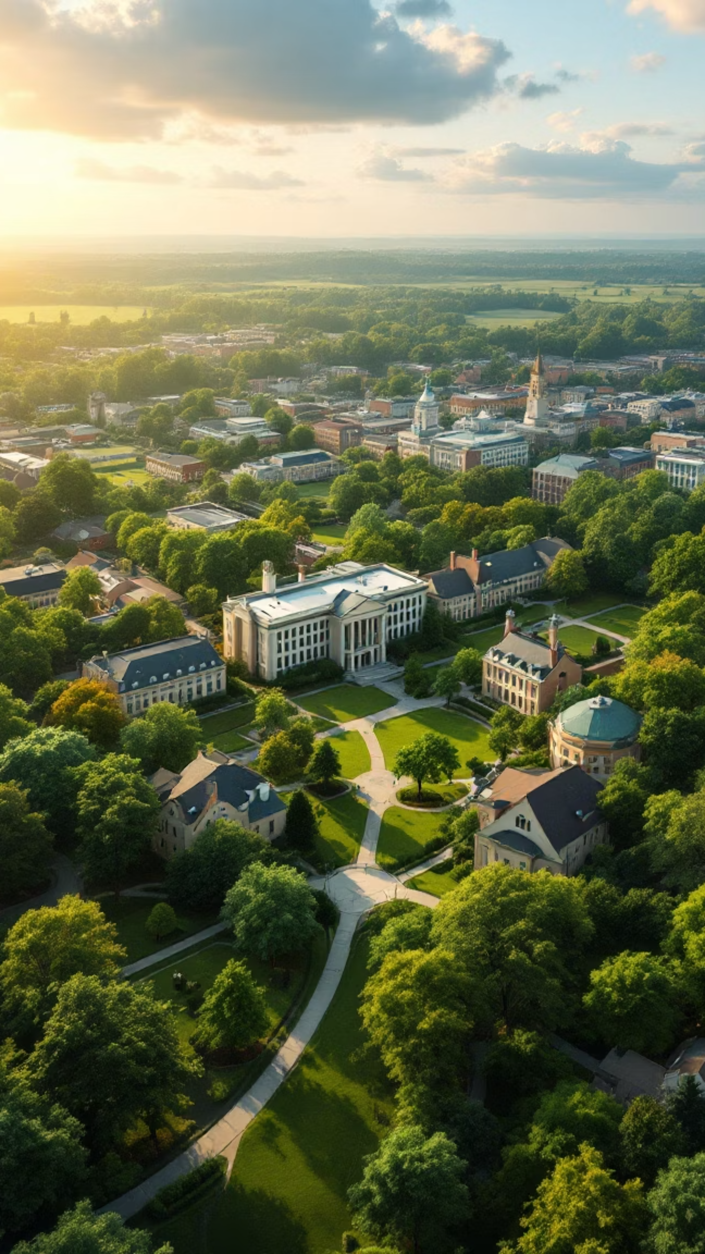
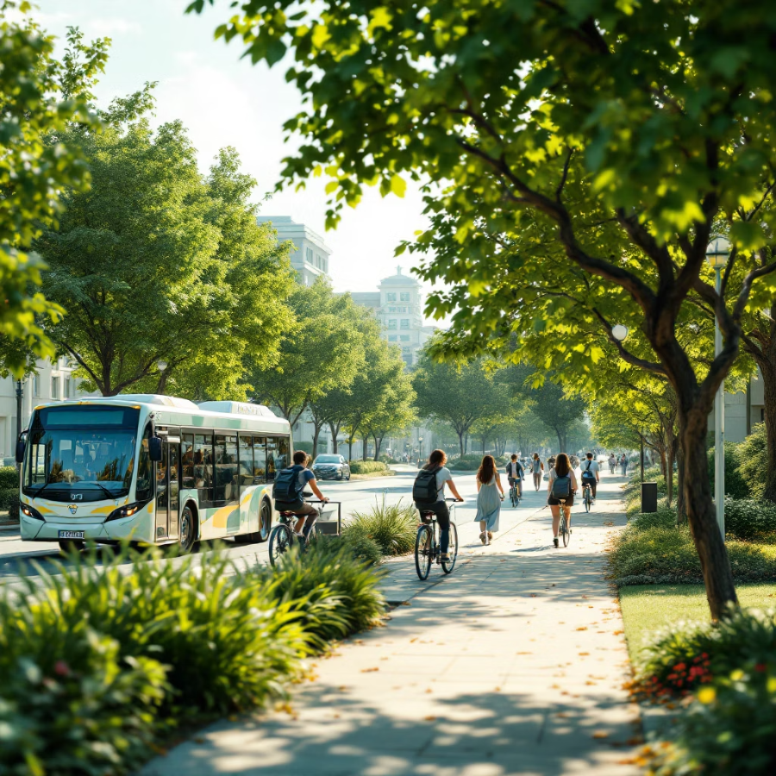



Campus Transportation & Environment
Getting Around Campus
Free Shuttle Service
Regular campus shuttles connect dormitories, academic buildings, and parking areas every 10 minutes during peak hours.
Local Community
Bike-Friendly Paths
Shopping centers and restaurants within walking distance
Dedicated bike lanes and rental programs encourage eco-friendly transportation across campus.
Walkable Design
Public transportation connections to downtown areas
Pedestrian-friendly layout with covered walkways, well-lit paths, and accessible routes for all students.
Safe, student-friendly neighborhood environment
Internship and job opportunities in surrounding businesses

