Slide 1
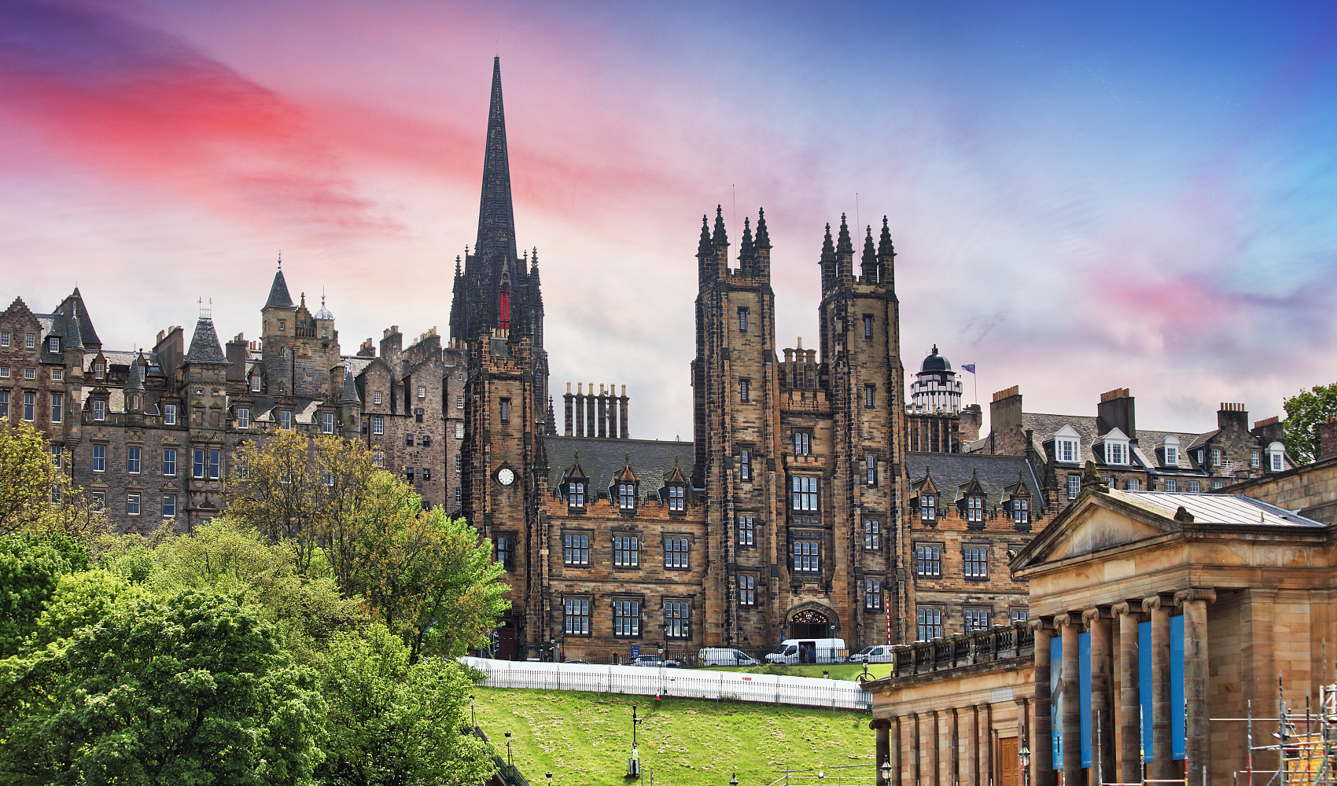
Colleges & Departments
Discover our comprehensive academic divisions designed to nurture tomorrow's leaders. From cutting-edge research facilities to world-class faculty, explore what makes our institution a premier destination for higher education.
3D AVATAR

Slide 2




Academic Excellence Across Disciplines
Our diverse colleges offer comprehensive programs designed to meet evolving industry demands and student aspirations.
Engineering & Technology
Business Administration
Health Sciences
Mechanical, Electrical, Computer Science, and Civil Engineering programs with state-of-the-art laboratories.
MBA, Finance, Marketing, and International Business with industry partnerships and case study methodology.
Medicine, Nursing, Pharmacy, and Public Health with clinical training in affiliated hospitals.
Liberal Arts & Sciences
Psychology, Literature, Mathematics, and Social Sciences fostering critical thinking and cultural understanding.
Creative Arts
Fine Arts, Design, Music, and Media Studies with professional studios and performance spaces.

Slide 3



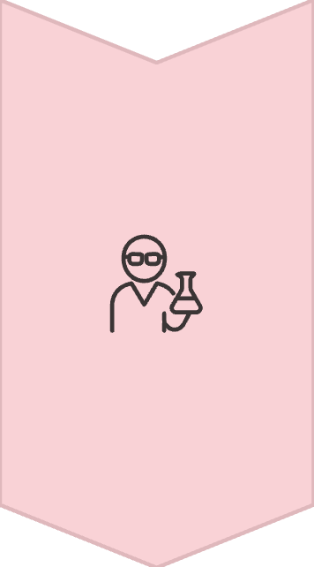
Research & Innovation Centers
Our key disciplines drive breakthrough research that addresses global challenges and shapes future industries.
Artificial Intelligence & Data Science
Machine learning, robotics, and big data analytics with applications in healthcare, finance, and smart cities.
Sustainable Energy Research
Renewable energy systems, smart grids, and environmental engineering solutions for climate change mitigation.
Biotechnology & Life Sciences
Genetic research, pharmaceutical development, and biomedical innovations advancing human health and longevity.

Slide 4


Distinguished Faculty Excellence
89%
15:1
PhD Holders
Student Ratio
Faculty with doctoral degrees from top global universities
Ensuring personalized attention and mentorship
"Our mentorship approach ensures every student receives personalized guidance to achieve their academic and career goals."
250+
Publications
Annual research papers in peer-reviewed journals
Our faculty combines academic excellence with industry experience, providing students with both theoretical foundations and practical insights. Many professors serve as consultants to leading corporations and government agencies.

Slide 5









Global Partnerships & Exchange
Expanding horizons through international collaboration and cultural
exchange opportunities.
Study Abroad
Dual Degrees
Semester and year-long programs in 45+ countries with credit transfer agreements.
Joint programs with prestigious international universities offering dual credentials.
Cultural Integration
Research Collaborations
International student support services and cross-cultural learning opportunities.
Joint research projects with global institutions advancing knowledge and innovation.
Partner Universities
Oxford University, UK
University of Tokyo, Japan
Stanford University, USA
Technical University of Munich,
Germany
Australian National University

