Slide 1

Grow Beyond: Cultivating Enterprise Talent
Welcome to our vision for employee development and engagement.
This presentation outlines how we're building a culture where every team member can thrive, develop new skills, and find their sense of belonging within our organization.

Slide 2


Our Learning Culture
Encouraging Growth & Innovation
We believe that continuous learning isn't just beneficial—it's essential. Our organization thrives when employees feel empowered to explore new ideas, take calculated risks, and share insights.
Learning Organization Philosophy
We've built our culture around Peter Senge's learning organization principles, where systemic thinking and personal mastery drive both individual and collective success.

Slide 3

Training Programs That Transform
1
2
3
Orientation Training
Job Skills Training
Management Development
Our comprehensive 2-week onboarding process connects new hires with mentors and introduces them to our company values, processes, and tools through interactive workshops and real-world scenarios.
Access to over 2,000 courses through our learning platform, custom skill paths based on your role, and quarterly technical bootcamps to keep your skills cutting-edge.
Our leadership pipeline program includes executive shadowing, management simulations, and 360° feedback to prepare high-potential employees for future leadership roles.
Each program is designed to support different career stages and learning styles, with both self-paced and instructor-led options available.

Slide 4



Performance & Career Pathways
Quarterly Performance
Dialogues
Transparent Promotion
Criteria
Moving beyond annual reviews to continuous feedback and development planning through our new Growth Conversations framework.
Clear competency matrices for each role level help you understand exactly what's needed to advance your career with us.

Slide 5
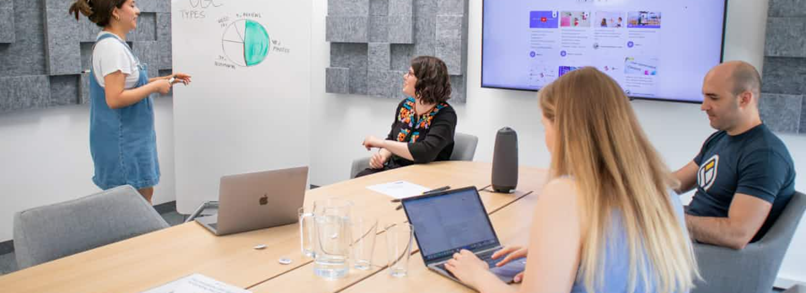
Cross-Department Collaboration
Project Participation Opportunities
Cross-Team Knowledge Sharing
Our Innovation Lab allows employees to dedicate 10% of their time to cross-functional projects outside their normal responsibilities, expanding skills while solving real business challenges.
Monthly "Wisdom Wednesdays" feature lightning talks from different departments, while our internal knowledge base captures learnings from completed projects for enterprise-wide access.

Slide 6









Future Growth Opportunities
Internal Job Rotation
Global Opportunities
Spend 3-6 months in a different department to gain new perspectives and broaden your organizational understanding.
International assignments in our 15 global offices ranging from 3-month projects to multi-year relocations.
Advanced Certification
Innovation Incubator
Our tuition reimbursement program covers up to $10,000 annually for approved professional certifications and degrees.
Submit your business idea to our annual innovation challenge for a chance to lead its development with dedicated resources.
Your career journey is limited only by your ambition

