Slide 1
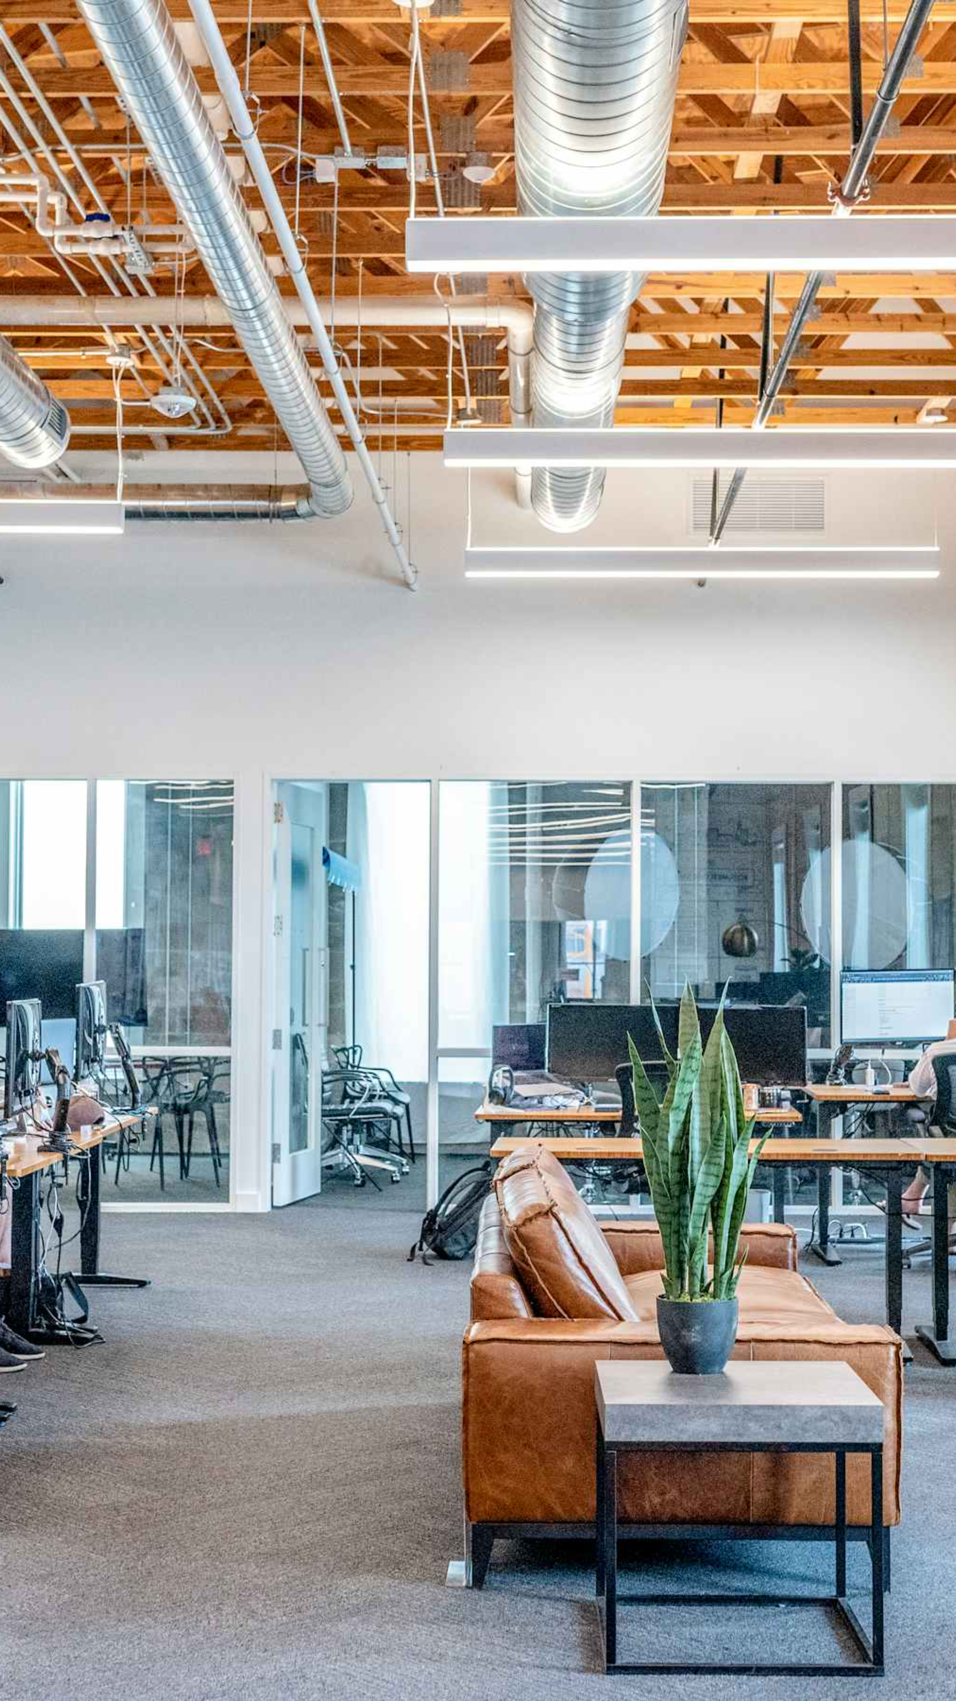
Building strong connections and shared values that make our workplace extraordinary. Your journey into our company culture starts here.
Welcome to Our Culture
3D AVATAR

Slide 2




Our Core Values Drive Everything We Do
These aren't just words on a wall—they're the foundation of how we work, grow, and succeed together every day.
Integrity
Innovation
We do the right thing, even when no one is watching. Honesty and transparency build trust.
We embrace new ideas and creative solutions. Every challenge is an opportunity to improve.
Collaboration
Excellence
Together we achieve more. Diverse perspectives create better outcomes for everyone.
We strive for quality in everything we do. Continuous improvement is our standard.

Slide 3
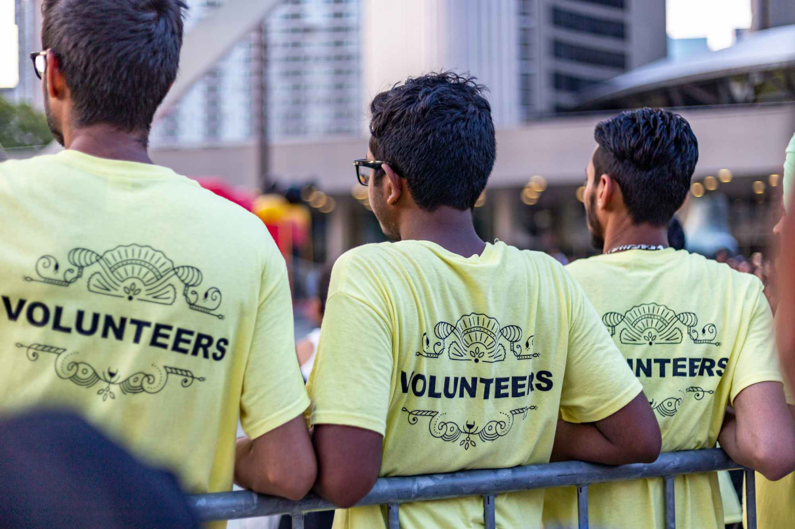
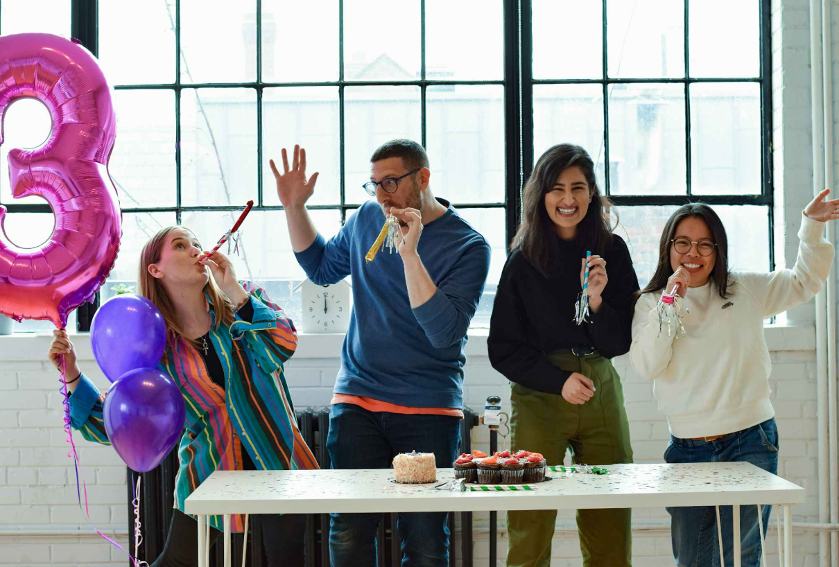
Living Our Culture Through Shared Experiences
Annual Celebrations & Team Building
Company-wide summer picnic and holiday party
Monthly team-building activities and workshops
Quarterly all-hands meetings with celebrations
Innovation showcases and recognition ceremonies
Community Impact & Volunteering
We believe in giving back to our communities. Every employee gets 16 hours of paid volunteer time annually to support causes they care about.

Slide 4




Stay Connected, Stay Informed
Open communication is the heartbeat of our culture. Here's how we keep everyone in the loop and create opportunities for your voice to be heard.
Email & Messaging
Digital Bulletin Boards
Feedback Channels
Company-wide updates, team communications, and instant messaging through Slack for quick collaboration.
Department news, event announcements, and employee spotlights on our interactive company portal.
Monthly pulse surveys, suggestion boxes, open office hours with leadership, and anonymous feedback systems.
Your ideas matter! We actively implement employee suggestions—last year, 67% of submitted ideas were adopted company-wide.

Slide 5

Stories That Inspire Us
"When I started here five years ago, I felt welcomed from day one. The mentorship I received didn't just help me grow professionally—it helped me find my purpose."
— Sarah Chen, Senior Project Manager
Real Impact Stories
1.The Innovation That Started Small
A junior developer's coffee break conversation led to our award-winning customer app, now used by over 2 million people.
2.Growing Together
73% of our leadership team started in entry-level positions, proving our commitment to internal growth and development.
3.Community Champions
Our volunteer program helped build three homes for Habitat for Humanity, with 89% employee participation.

Slide 6

Remember: You're not just joining a company—you're becoming part of a community that values who you are and what you bring. Welcome aboard!
Your Culture Journey Starts Now
Observe & Learn
Connect & Participate
Contribute & Lead
Notice how our values show up in daily interactions, meetings, and decision-making processes.
Share your ideas, take initiative, and help shape the future of our workplace culture.
Join team activities, volunteer events, and informal gatherings. Your fresh perspective enriches our culture.

