Slide 1

Welcome to Our
K-12 School Family
We're delighted to welcome you and your child to our vibrant learning community. This orientation will give you a complete picture of our school, our values, and the exceptional educational journey that awaits your family.
3D AVATAR

Slide 2
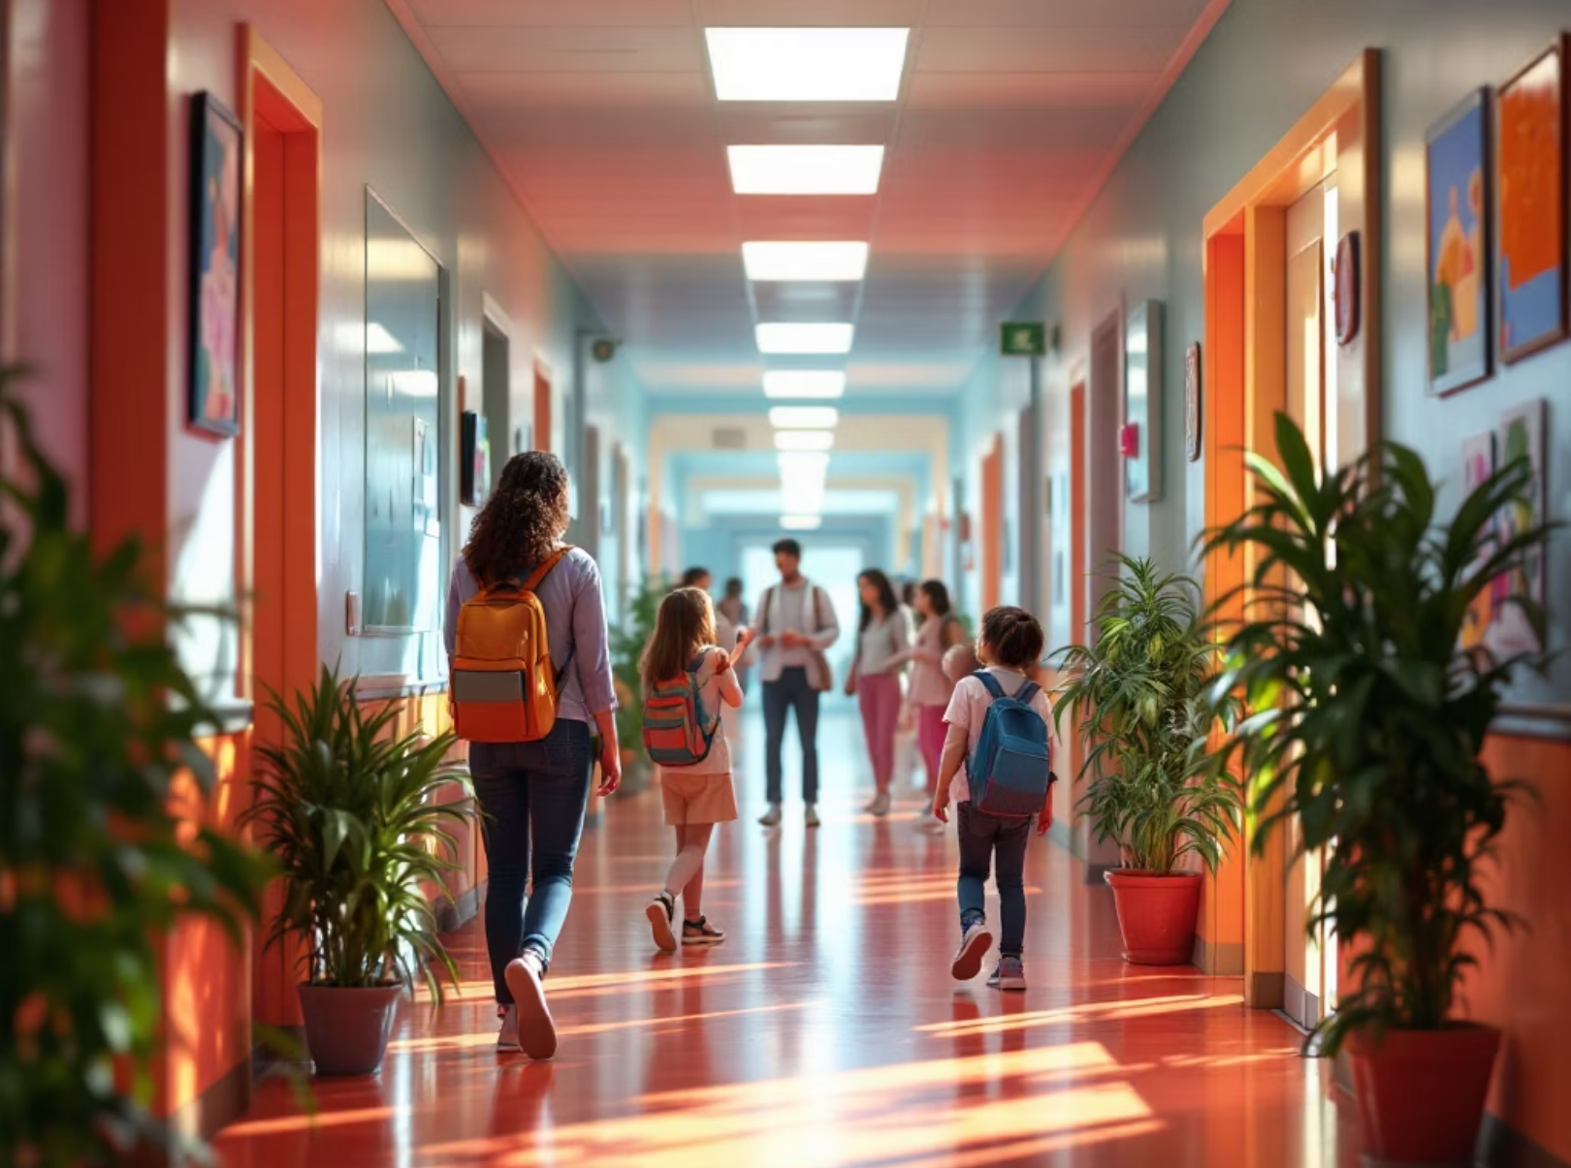
A Personal Welcome From Our Leadership
"Welcome to our school family! Every child who walks through our doors brings unique talents, dreams, and potential. Our dedicated team is committed to nurturing each student's growth academically, socially, and personally."
Our principal and grade directors look forward to partnering with you in your child's educational journey. We believe that strong relationships between school and home create the foundation for student success.

Slide 3

Our Foundation: History & Educational Philosophy
Our Founding Story
Our Mission
Established with the vision of creating an inclusive, academically excellent learning environment where every child can thrive and reach their full potential in a supportive community.
To inspire lifelong learners who think critically, communicate effectively, and contribute positively to their global community through innovative teaching and personalized support.
Educational Vision
We prepare students for future success by fostering curiosity, creativity, and character while building strong academic foundations and 21st-century skills.

Slide 4





World-Class Campus Facilities
Modern Classrooms
Athletic Facilities
Spacious, well-lit learning spaces designed for collaboration and engagement, equipped with flexible furniture and interactive displays.
Comprehensive sports grounds including basketball courts, soccer fields, and a modern gymnasium for physical education and competitive sports.
Science & Tech Labs
Learning Commons
State-of-the-art laboratories for chemistry, physics, biology, and computer science, fostering hands-on discovery and innovation.
Our library serves as a hub for research, quiet study, and collaborative projects, featuring both digital resources and traditional books.
Smart Campus Technology: Every classroom features interactive whiteboards, wireless connectivity, and access to educational apps that enhance learning through technology integration.

Slide 5

What Makes Our School Special
Bilingual Excellence
Arts & Creativity
Our international curriculum offers bilingual education that prepares students for global citizenship while maintaining strong cultural roots and academic rigor.
Comprehensive arts programs including music, visual arts, drama, and creative writing help students express themselves and develop artistic talents.
Athletic Programs
STEM Innovation
Competitive and recreational sports programs build teamwork, discipline, and physical fitness while promoting healthy lifestyle habits.
Cutting-edge science, technology, engineering, and mathematics programs encourage problem-solving, critical thinking, and preparation for future careers.
Ready to join our community? We can't wait to welcome your family and watch your child flourish in our nurturing, challenging environment.

