Slide 1

Welcome to Your Employee Experience
Starting a new role can be both exciting and overwhelming. This guide will help you navigate your early days with us, understand the support systems available to you, and make the most of your employee benefits.
3D AVATAR

Slide 2
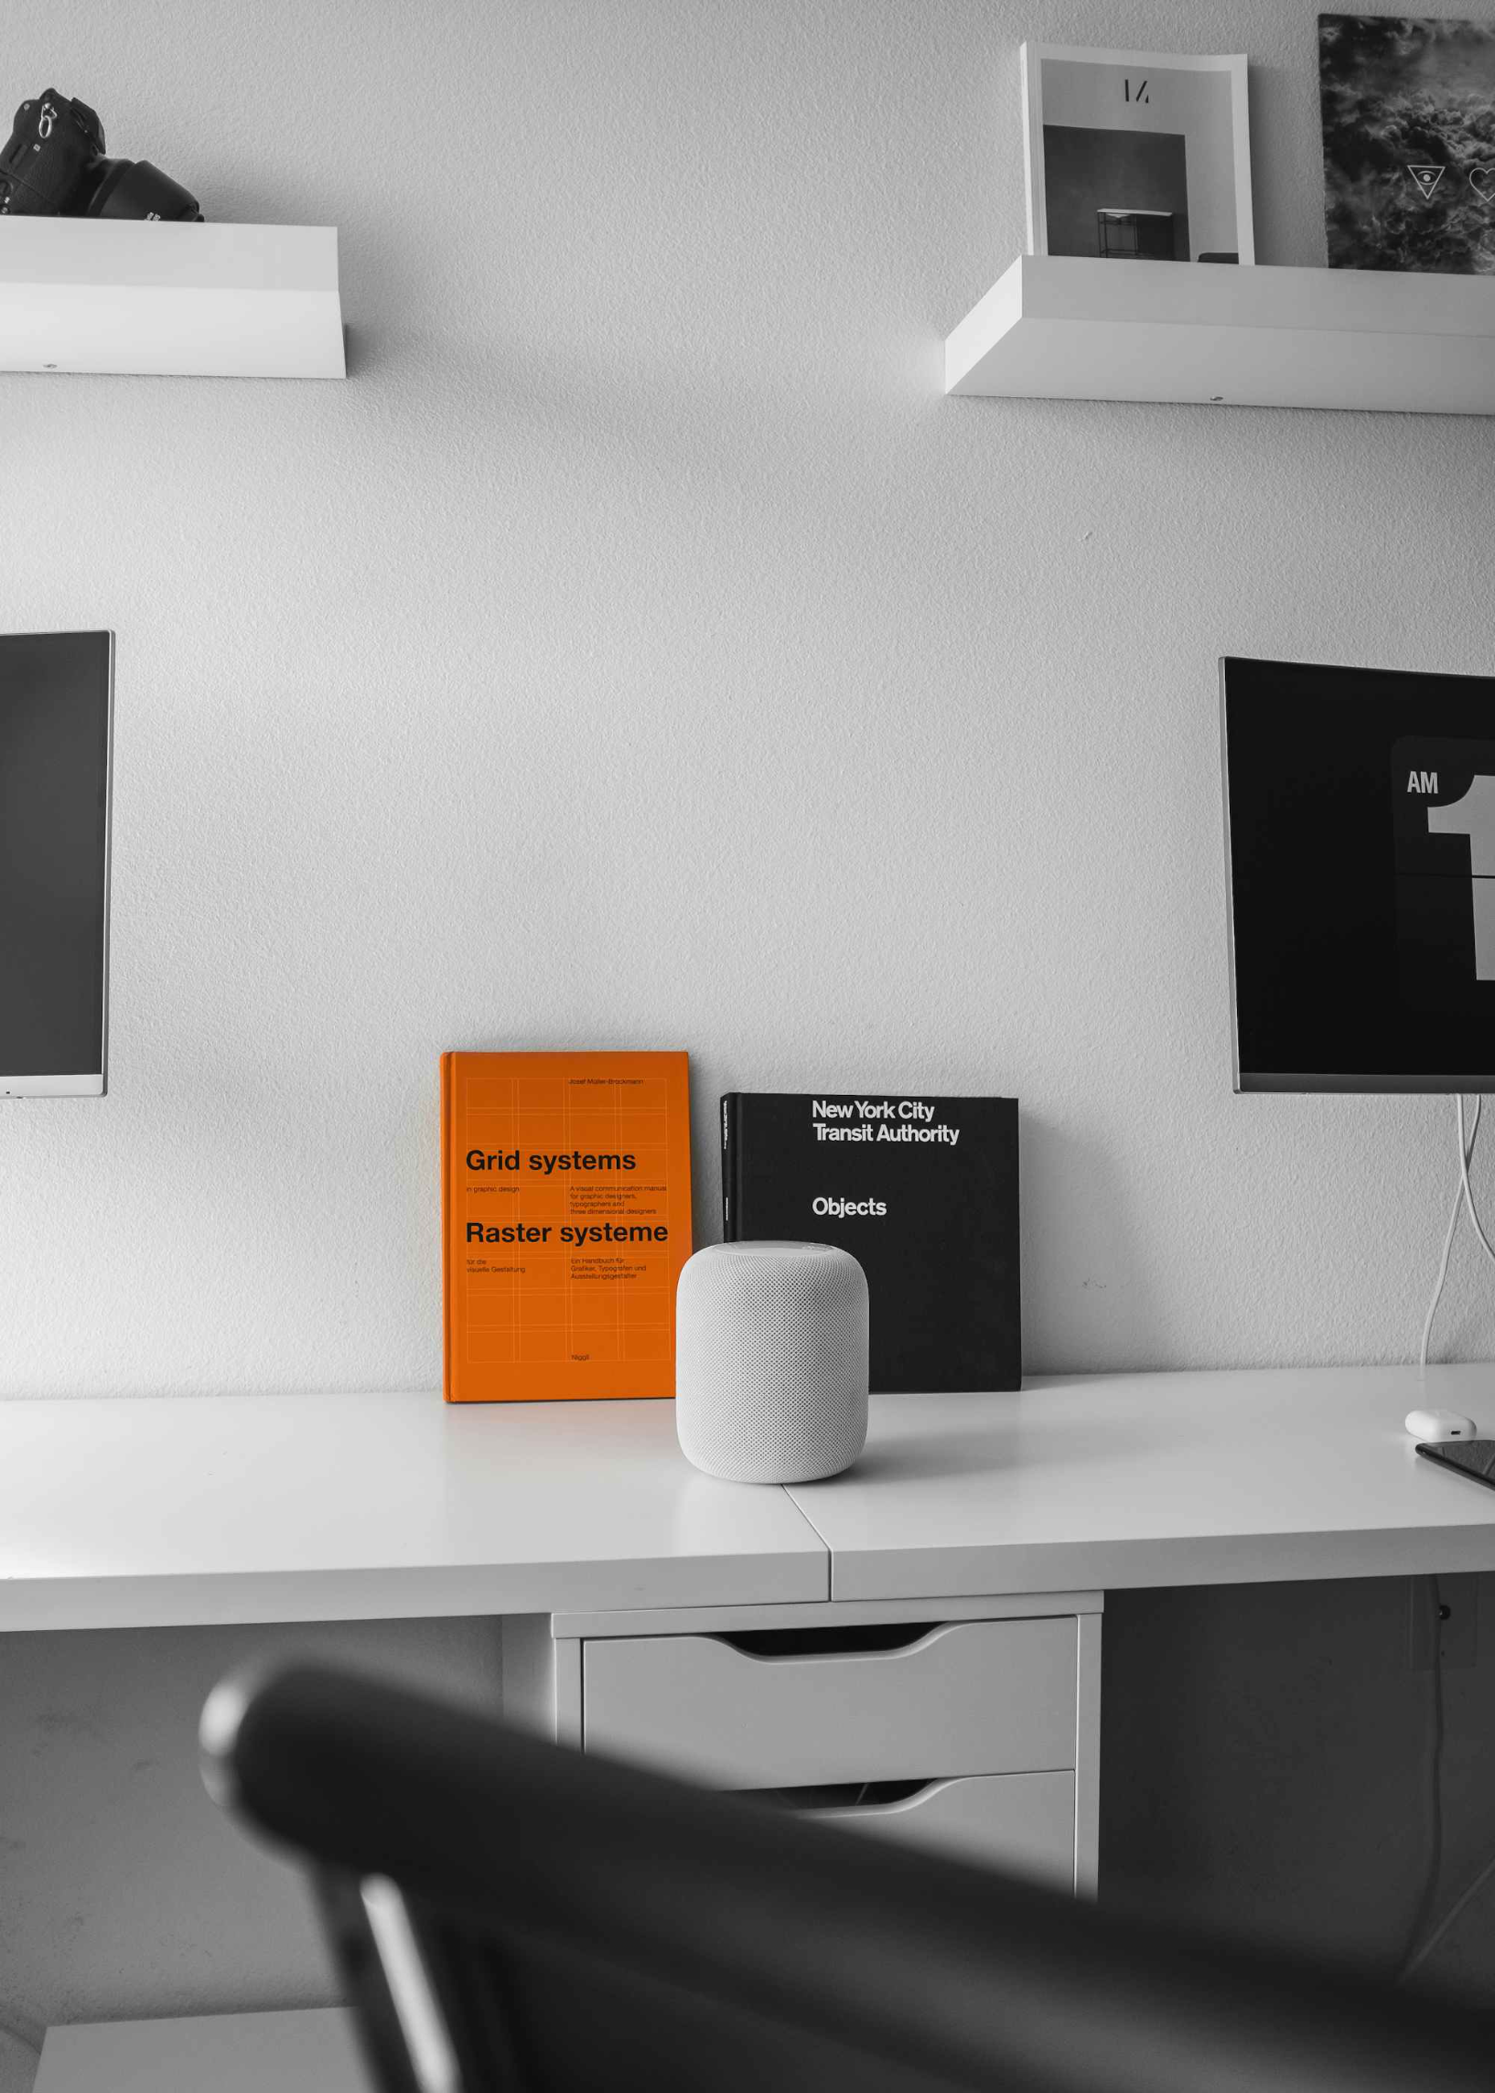
Your Work Environment
Office Locations & Facilities
Our headquarters in Seattle features open-plan workspaces, 12 meeting rooms, and a fully stocked kitchen. Regional offices in Austin, Chicago, and Boston follow similar layouts with localized amenities.
All locations include:
Standing desk options
Wellness rooms
Coffee bars & snack stations
Workplace Systems Guide
You'll receive access to our core platforms within your first 48 hours:
Workday - HR & payroll
Slack - Team communication
Asana - Project management

Slide 3
Your Onboarding Journey
1
Document Signing
Complete your digital paperwork package through our secure DocuSign portal within your first week. This includes:
Employment contract
Tax forms (W-4, I-9)
NDA & code of conduct
2
Account Setup
Our IT team will guide you through setting up your:
Company email & calendar
Password manager & 2FA
VPN access for remote work
Department-specific software
3
Training Schedule
Your first month includes structured learning sessions:
Company culture & values (Week 1)
Department-specific training (Weeks 2-3)
Cross-functional collaborations (Week 4)
Your manager will schedule weekly check-ins during your first 90 days to ensure you're settling in comfortably.

Slide 4

Your Benefits & Policies
Compensation & Payroll
Leave Policies
Insurance & Allowances
We operate on a bi-weekly pay schedule with direct deposits every other Friday. Your first paycheck will arrive on your second pay period. Annual performance reviews happen each November, with compensation adjustments taking effect in January.
Our flexible time-off approach includes:
Coverage begins on your first day with premium options for:
15 days paid vacation (accrued monthly)
Medical, dental & vision insurance
10 days sick leave
401(k) with 4% company match
11 company holidays
Parental leave: 12 weeks paid for all parents
$1,000 annual professional development stipend
$500 home office allowance

Slide 5

Your Day-to-Day Support
IT Help Desk
HR Contact Information
Frequently Asked Questions
Available 24/7 for urgent issues. Submit tickets through:
Your dedicated HR partner is assigned by last name:
Common questions are addressed in our internal knowledge base:
help@company.com
A-H: Jennifer Lopez (jlopez@company.com)
Slack channel: #it-support
Visit support.company.intranet
Phone: 555-123-4567
I-P: Michael Chen (mchen@company.com)
Check #ask-anything Slack channel
Q-Z: David Washington (dwash@company.com)
Monthly "No Question Too Small" office hours

Slide 6

Workplace Safety & Compliance
Safety Guidelines
Company Rules & Regulations
Your wellbeing is our priority. Familiarize yourself with:
Emergency evacuation routes (posted by elevators)
First aid kit locations (kitchens and reception)
AED devices (lobby and 4th floor)
Incident reporting procedures via the Safety App
Our Code of Conduct outlines expectations for:
Complete mandatory safety training within 30 days of your start date through our learning portal.
Professional behavior & communication
Conflict of interest policies
Data privacy & confidentiality
Ethical business practices
Annual compliance refresher courses are required for all employees.

