Slide 1
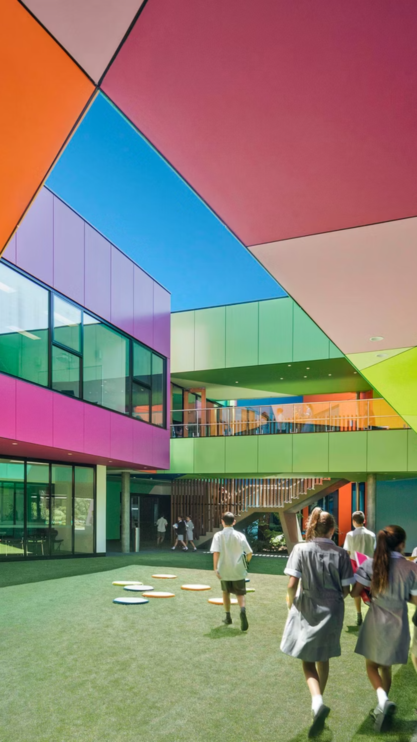
Westfield Academy
Shaping tomorrow's leaders through excellence in education, innovation, and character development since 1885.
3D AVATAR

Slide 2
A Legacy of Excellence
1
1885 - Foundation
Established by visionary educator Margaret Westfield with just 32 students in a converted Victorian mansion.
2
1920s - Expansion Era
Added the iconic limestone library and expanded enrollment to 200 students during the post-war boom.
3
1965 - Innovation Hub
Pioneered integrated STEM education with the construction of the first school-based research laboratory.
4
2010 - Global Vision
Launched international exchange programs and sustainable campus initiatives, becoming carbon-neutral by 2018.

Slide 3
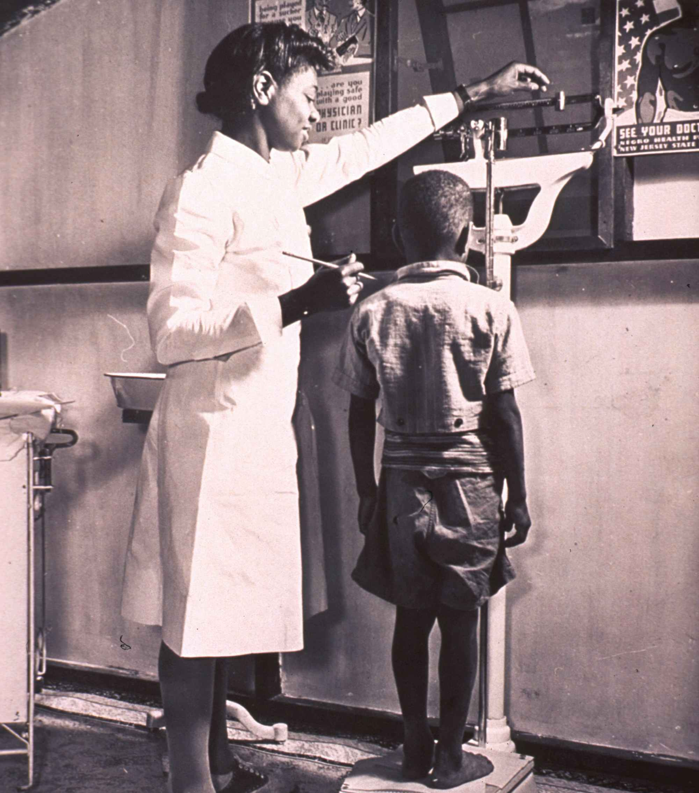



Educational Excellence Redefined
Our Philosophy
We believe education extends beyond textbooks. Our holistic approach develops critical thinking, creativity, and character through personalized learning experiences.
STEM Innovation
Global Perspective
Creative Arts
State-of-the-art laboratories and maker spaces foster scientific discovery and technological advancement.
International partnerships and cultural exchange programs prepare students for a connected world.
Award-winning music, theater, and visual arts programs nurture artistic expression and cultural appreciation.

Slide 4

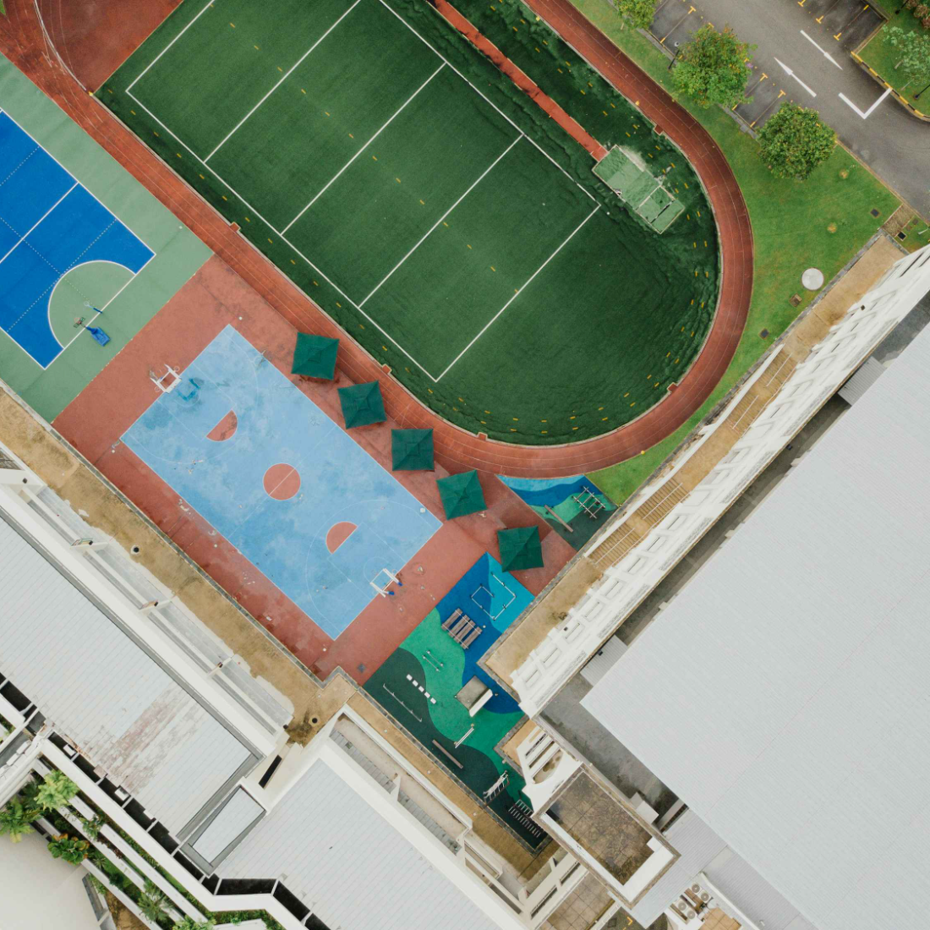
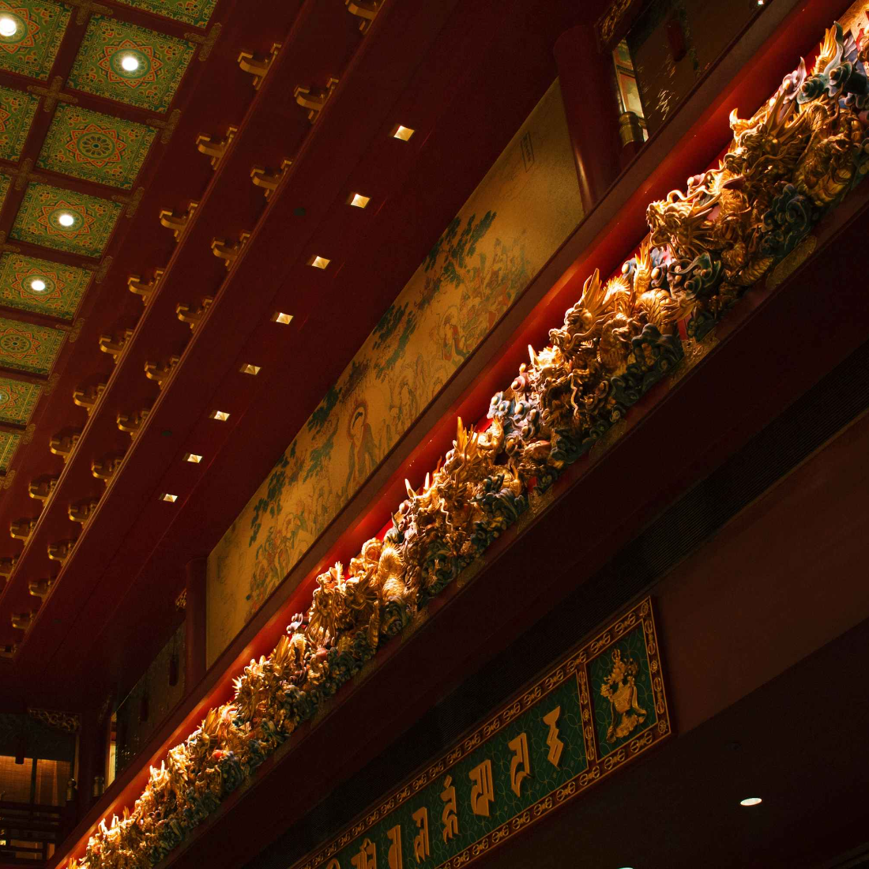
Campus & Facilities
127
24
1,200
Acres
Buildings
Students
Sprawling campus with diverse learning environments
Modern facilities and historic architecture
Vibrant community from 40+ countries
Our sustainable campus features solar panels, rainwater collection systems, and LEED-certified buildings, creating an environmentally conscious learning environment.

Slide 5

Recognition & Rankings
1
2
3
#3 National Ranking
98% College Acceptance
$2.8M Merit Scholarships
Ranked among America's top independent schools by Educational Excellence Magazine for five consecutive years.
Graduates gain admission to prestigious universities worldwide, including Ivy League institutions and top liberal arts colleges.
Our graduates earn substantial merit-based financial aid, reflecting their exceptional academic preparation and achievements.
"Westfield Academy consistently produces graduates who excel in higher education and make meaningful contributions to society."
— Dr. Sarah Chen, Director of Admissions, Stanford University

Slide 6

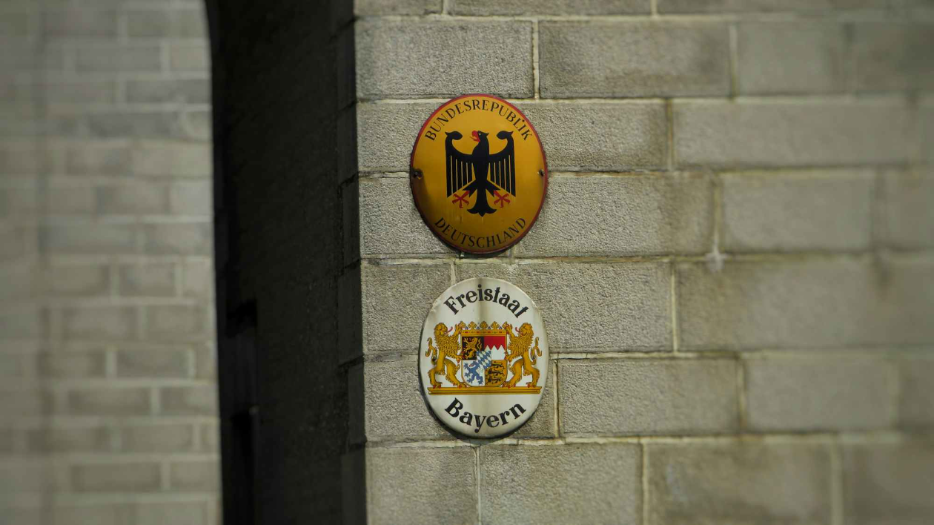


Spirit & Tradition
Our Emblem
The golden phoenix rising above an open book symbolizes renewal, knowledge, and the transformative power of education.
School Colors
"Sapientia et Virtus"
Royal purple and gold represent nobility of purpose and the pursuit of excellence in all endeavors.
Wisdom and Virtue
Community Service
Athletic Excellence
Students complete 100+ volunteer hours, fostering civic responsibility and social awareness.
Championship teams in 18 sports promote teamwork, discipline, and healthy competition.

