Slide 1
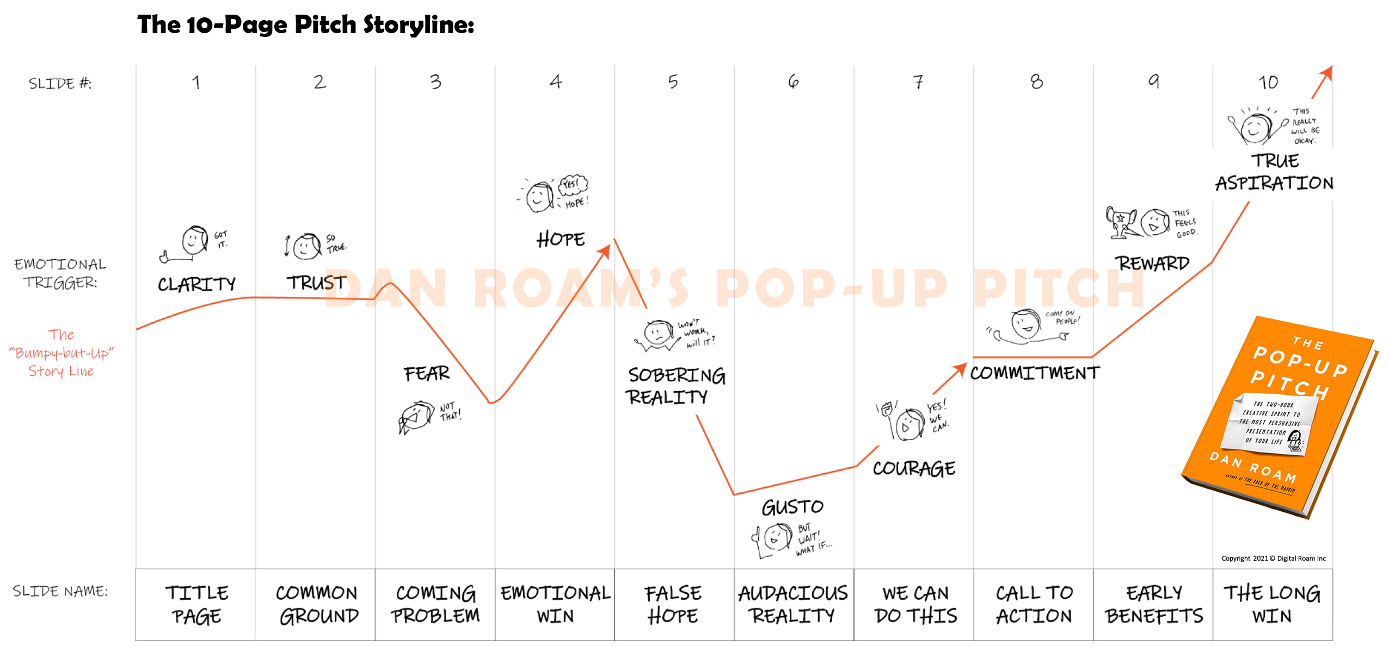
Give your pitch a WHO & WHY title. (Clarity)
Establish an authentic connection to your audience and the issues that concern them. Show them you know them, for real. (Trust)
State the facts and numbers that might be so scary that no one really wants to look at them. (Fear)
Paint a picture of what it might feel like to have already solved the problem. (Hope)
Admit that the hoped-for simple solution won’t really work at all. (Sobering reality)
State the bold alternative; the slightly crazy yet potentially viable solution that just might, with courage and commitment, actually work. (Gusto)
Walk through your bold alternative with a grounding sense of real possibility; get into a few key details to show there’s no real reason to fear them. (Courage)
List the five things that need to get done first to make it happen. Take personal responsibility for two. Request help with the other three. (Commitment)
State at least two near-term measurable benefits that getting started now will trigger. (Reward)
Close with an unexpected giant win that could truly come to pass once the new solution becomes the new normal. (Aspiration)
Copyright 2021 © Digital Roam Inc
Notes:
This is the roadmap of the 10-Page Pitch storyline.
It is the schematic diagram showing the “ten-turn persuasion journey” that will emerge as you fill in the following pages.

Slide 2
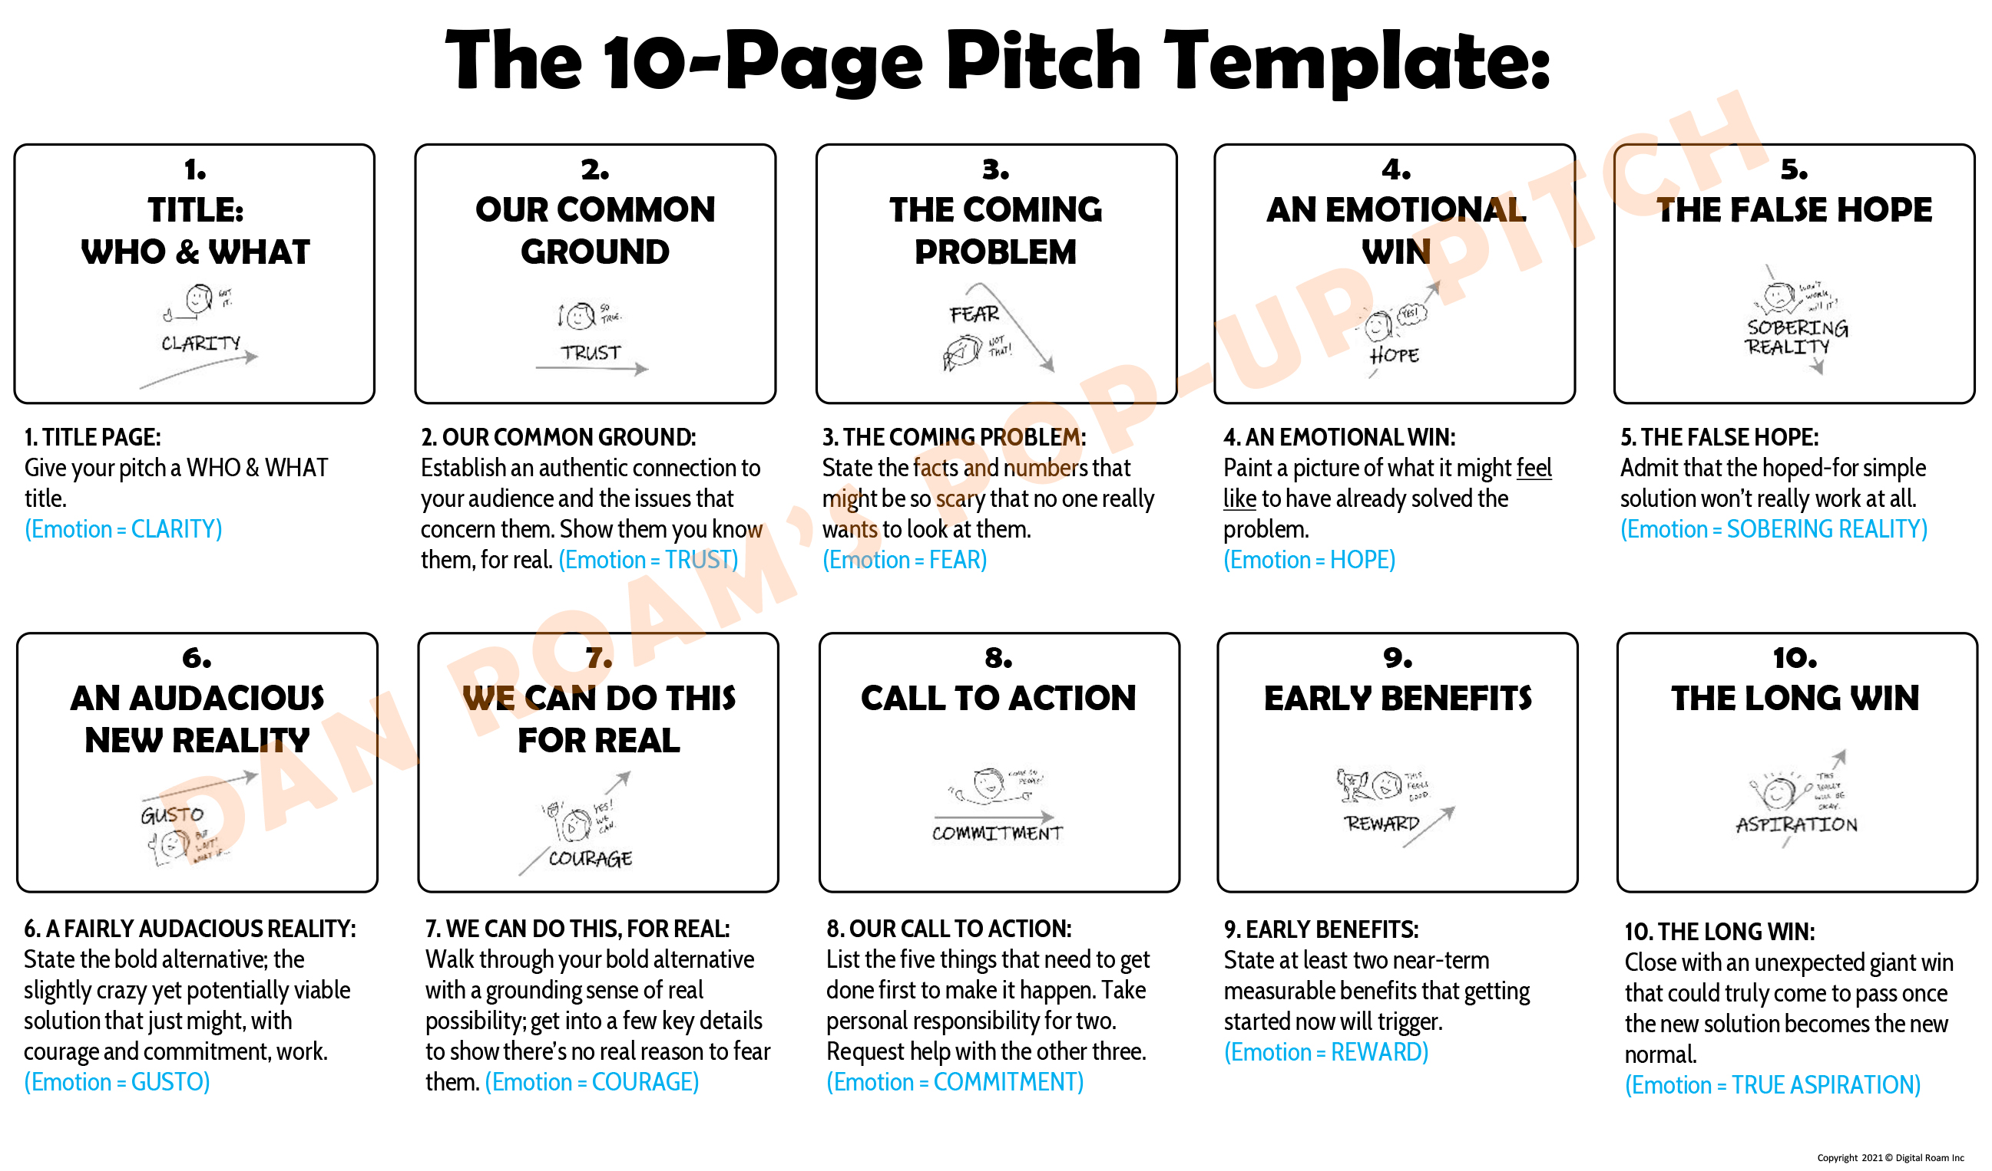
Notes:
These are the 10 pages of the 10-Page Pitch, shown in order from BEGINNING to MIDDLE to END.
On the following pages, you will fill-in-the-blanks to create your own 10-Page Pitch document.

Slide 3

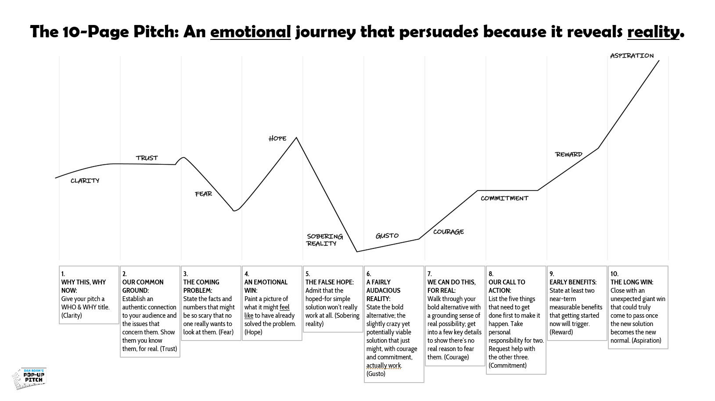
My Pop-Up Pitch
The fine situation today…
My name
Notes:
For a good title, just state who you’re talking to and what you’re talking about:
Keep it to a single sentence that contains a who (your audience), a what (the benefit they want), and a verb (the action they want to take).
Remember: it isn’t about you:
In a persuasive pitch the who in the title isn’t you; it’s your audience. Make sure they can see themselves in your title.
The what in your title isn’t the product or feature you’re hoping to sell; it’s the positive outcome your audience will receive from taking the action you suggest. Make sure they can clearly see a benefit that matters to them.
Title page fill-in-the-blanks:
1. Who is your target audience for this presentation?
"My target audience is: _(insert name, group, role, demographic, etc.)__."
2. What is the #1 payoff your target audience wants in the topic you’re presenting?
"My target audience really wants to _(insert a verb that describes what your audience wants to accomplish.)__."
3. What do you want your audience to do once they have heard your pitch?
"I want them to _(insert the action you want them to take.)____."
Title page sketch from your Visual Decoder: No sketch yet – just text is fine.

Slide 4
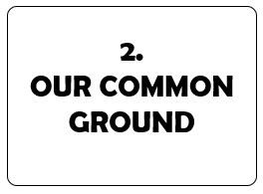
The fine situation today…
Text & Image
Notes:
This is your opportunity to introduce yourself by showing that you have real knowledge of and empathy for your audience’s realities, their objectives, and their hopes.
“Our Common Ground” trigger phrase: We’re in this together and we know these things are true...
“Our Common Ground” fill-in-the-blanks:
1. What is the common ground we all share right now? What do you and your audience share in your work, your life, or your situation?
"Our common ground is: _(What do we have in common; what do we share?)__."
2. What do you know about your audience that they don't know that you know?
"Something I know about my audience that they don’t know I know is: _(What is a goal, opportunity, or challenge they face that might not be obvious to you – or even to them?_."
3. What is an experience that you've had that you believe your audience has also had?
"Something that I suspect we’ve both experienced is: _(Write down a memorable experience that you believe you’ve both shared.)__.

Slide 5
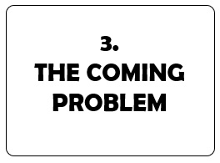
But there is a problem coming!
Text & Image
Notes:
“The Coming Problem” trigger phrase: “What wakes you up in the middle of the night...”
“The Coming Problem” fill-in-the-blanks:
1. What is the BIG problem on the horizon that we simply can’t deny any longer – because it’s about to kick us in the face?
“The big problem coming up is: __(summarize the coming problem in a single thought.)__”
2. Is there an emerging challenge coming right at us that we have no clue how to solve for?
“We might not want to think about this now, but we have to: __(state in a single sentence a truly menacing threat that you haven’t yet seriously planned for.)___”

Slide 6
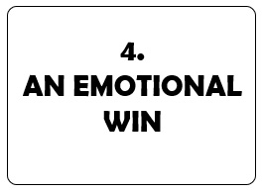
It will feel great to beat it!
Text & Image
Notes:
“The Emotional Win” trigger phrase: “Imagine a world...”
“The Emotional Win” fill-in-the-blanks:
1. What does it feel like when this problem is solved, once and for all?
“When this is all over: __(summarize the feeling of living in a world without this problem.)__”
2. What will it look like when you’ve reached the light at the end of the tunnel?
“When we’ve passed into the light on the other side, we will: __(share the joy and relief of knowing we beat the dragon.)__”

Slide 7

But our usual approach won’t work…
Text & Image
Notes:
“The False Hope” trigger phrase: “What got us here won’t get us there...”
“The False Hope” fill-in-the-blanks:
1. What are the usual solutions we’re relying on that won’t actually work?
“Despite what people might think, __(fill in the business-as-usual non-solution)___ won't solve this problem.”
“The easy answer here that everyone wants to default to – but that never actually works in the long term is: ___(summarize the false hope / misplaced trust in a single thought.)___
2. What is it about this problem that guarantees that the easy old solutions are not going to work?
“What makes this problem bigger / thornier / more complex than usual is:___(summarize in a single sentence what makes this problem unique)___.
“The usual solutions won’t solve this problem because: ___ (write in the salvation that people are depending on that just plain won't work)___ .

Slide 8

However, what if we tried something new?
Text & Image
Notes:
“The Fairly Audacious Reality” trigger phrase: “Wait a second... what if we could…”
“The Fairly Audacious Reality” fill-in-the-blanks:
1. What does your bold new reality look like?
“Instead of the old way, here's what we need to do instead: ___ (Summarize the BOLD new path or solution in a single thought)___.
2. What is the name of this audacious solution?
“The name of this product, solution, etc. is _(insert the name of your bold solution / product / offering / concept)__.”
3. What is it about this audacious solution that makes it unique compared to every other alternative?
“What makes this solution unique is: __(insert two or three ‘features’ that make this solution unique)___.”

Slide 9

We really can do it. We know how!
Text & Image
Notes:
The “we can do this for real” trigger phrase: “We’ve done this before…”
The “we can do this for real” fill-in-the-blanks:
1. What reasons / rationale / data can you give that this audacious solution will work?
This is actually achievable because:__(insert sentence on how this has been done before)___.
This approach makes sense because: __(summarize new data / insight / process / technical breakthrough that directly supports your bold approach)___.
2. Why do you know in your gut you / we / the team can do this?
“I know we can do this because _(summarize why your audience can take courage from your plan)____.”
It makes absolute sense that, if we pull together, we can make this our bold new reality because: __(summarize your and your audiences’ collective experience in achieving amazing things before)___.

Slide 10

Here are the first things to do to get started…
Text & Image
Notes:
The “our call to action” trigger phrase: “Here’s all you need to do to get started…”
The “our call to action” fill-in-the-blanks:
1. What is this new path we’re committing to?
If we proceed, this new path we’re committing to includes:___(insert the 3-5 big steps ahead, stated as large but well-defined chunks)___.
2. What are the steps we need to commit to in order to begin to reach the solution?
The first 3/4/5 things we would need to do are:__(insert 3-5 one-line next-step action items – perhaps with proposed owners and dates)___.

Slide 11

We will quickly reap these early benefits…
Text & Image
Notes:
The “early reward” trigger phrase: “Just by getting started, we already gain…”
The “early reward” fill-in-the-blanks:
1. What is an immediate reward for all of us for taking even one action now?
One early benefit we will see from taking this action now is:__(insert one measurable potential early win)___.
2. What are we going to see right away that will prove this is the right way to go?
An near-term payoff that might happily surprise us is: ______(insert one unexpected benefit that will begin to accrue right away and that might help pay for the program later on down the line)____.”

Slide 12
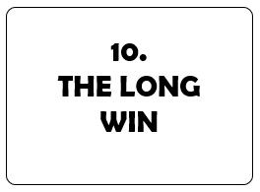
And in the long-run, our success can be huge.
Text & Image
Notes:
The “long win” trigger phrase: “Opportunities we can’t even imagine right now…”
The “long win” fill-in-the-blanks:
1. Why do we need to do this amazing thing?
Summarize the long win in a single statement:__(insert sentence describing the long-win benefit of solving this problem now – and why it helps us well into the future)___.
2. Then flip it around: by doing this amazing thing, what additional unexpected payoff might we one day earn?
The amazing long term payoff we might gain when we commit and take action is: __(summarize a potentially unexpected and gloriously aspiration win )____.”
And that’s why we really need to do this now; just think what it will mean when we can finally: __(write in one world-changing aspiration that you’d truly love to participate in making real.)__.

