Slide 1

Dar Al Mehrab for Hotels Investment
Your Trusted Partner in Hospitality Development

Slide 2
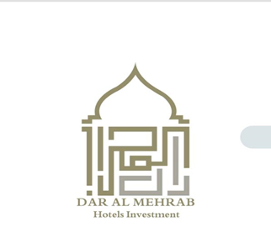
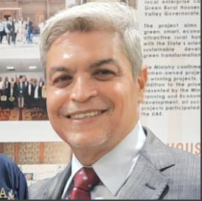
Daralmehrab Company—Pioneering Hospitality Investment
Daralmehrab is a premier investment company specializing in the development, acquisition, and management of high-value hotel and hospitality assets across strategic locations. Dar Almehrab's forward-looking vision and deep understanding of global tourism trends drive its commitment to transforming opportunities into landmark hospitality destinations.
Our expertise spans the full investment lifecycle—from feasibility studies and financial structuring to project development and operational optimization. We partner with international hotel brands that deliver long-term value for investors and unforgettable experiences for guests.
At the heart of Daralmehrab strategy lies a commitment to innovation, sustainability, and excellence. Whether revitalizing heritage hotels , we prioritize quality, location, and guest-centric design to ensure every asset achieves its highest potential.
Daralmehrab – Investing in Hospitality, Building Legacies.

Slide 3
Who We Are
Dar Al Mehrab for Hotels Investment is a visionary company dedicated to pioneering luxury, comfort, and innovation in the hospitality sector. We specialize in hotel investment, development, and consultancy, creating opportunities that redefine the travel experience in Egypt and beyond.

Slide 4
What We Do
- Hotel Investment & Financing
- Strategic Hospitality Consulting
- Market Feasibility & Research
- Brand Partnerships

Slide 5
Why Choose Us
- Proven track record in hotel ventures
- Deep market insight & strategic foresight
- Commitment to excellence and long-term growth
- Strong local and international partnerships

Slide 6


Slide 7
Contact Us
Address:
13 Al Obour Building, Salah Salem Street,
Second Floor, Flat No. 5, Cairo, Egypt
Mobile: 01111119250
Website: www.daralmehrab.com
Email:info@daralmehrab.com

