Slide 1

Breakfast Cookie Xpert Monadic Price Demo
Prepared by Julia Maier
June 2, 2022

Slide 2


BREAKFAST COOKIE XPERT MONADIC PRICE DEMO
Objective
The purpose of this study is to better understand buyers' price sensitivity for this package of 4 servings concept, and to identify the optimal price point that maximizes revenue and/or profit.
To provide a holistic view of the perceptions of the concept, the following have also been assessed:
-Price expectations
-For people like me versus Not for me
-Unbelievable versus Believable
-Unique versus Ordinary
The key findings from this price test are:
-Revenue is maximized at the $2.21 price point, resulting in projected revenue of $6.6B.
-At $2.21, an estimated 28.9% would be interested in purchasing, and intenders would purchase 2B per year on average.
-Profits are maximized at the $5.18 price point, resulting in projected profits of $4.8B per year.
-At $5.18, an estimated 14.9% would be interested in purchasing, and intenders would purchase 1B per year on average.
-Setting the price point at $1.00 would be the break-even price point, resulting in $0 profits.
-Expectations for this package of 4 servings are that it would be priced around $3.99.
Prepared by
Dale Gilliam

Slide 3
XQ2. Methodology
The study was conducted online among 400 respondents. Respondents underwent a Monadic exercise, where one of the four price points was shown to each participant, resulting in a sample of about 100 per price point.
The maximum margin of error on proportions was 4.9% at a 95% confidence level.
To obtain Purchase Probability estimates for the entire range of prices a logistic regression was used. Binary Intender, defined by the Top 2 Box, is the independent variable, and it is explained by the four log-adjusted price points. Constraints are placed to ensure predicted curve never increases as the price is increasing.
Similarly, the purchase frequency estimations were smoothed using a linear regression to predict frequency based on the natural log of the price tested.

Slide 4
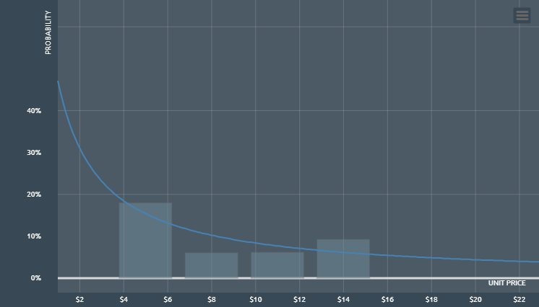
XQ4. Purchase probability
N=400

Slide 5
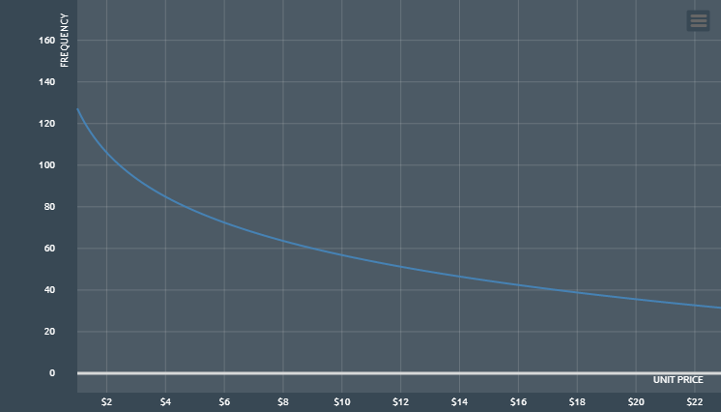
XQ4. Purchase frequency in 1 year
N=400

Slide 6
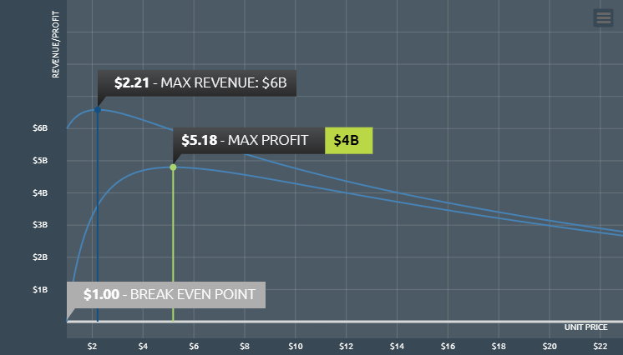
XQ4. Maximum Revenues & Profit in 1 year
N=400

Slide 7
XQ4. Takeaway points
N=400
Under assumptions about costs and total addressable market size, combined with the collected price preferences, probabilities, and frequencies, the optimal price point to maximize REVENUE is $2.21 per package of 4 servings. Assuming no pressure from competitors, ideal marketing, no cancellation/returns, etc. (or that everything is embedded into the TAM and cost), projected revenues are expected to be $6B per year. Still, profit value would not be optimized if the cost per package of 4 servings remained at $2.21.Maximum PROFITS can be achieved at $5.18 per package of 4 servings. For a 100,000,000 TAM it projects 1B sales per year, but the total profit is expected to be $4B per year with $5B revenue.

Slide 8
XQ4. Takeaway points
N=400
Price Sensitivity Meter Results | PRICE.POINTS | UNIT.PRICE | BUYERS | REVENUE | COST | P&L | SALES | FREQUENCY
PRICE POINT #P1 | PRICE POINT #P1 | $4.99 | 15M (15.4%) | $5B | $1B | $4B | 1B | 78.1/year
PRICE POINT #P2 | PRICE POINT #P2 | $7.99 | 10M (10.3%) | $5B | $653M | $4B | 653M | 63.7/year
PRICE POINT #P3 | PRICE POINT #P3 | $10.99 | 7M (7.7%) | $4B | $415M | $4B | 415M | 53.9/year
PRICE POINT #P4 | PRICE POINT #P4 | $13.99 | 6M (6.2%) | $4B | $286M | $3B | 286M | 46.5/year
BREAK EVEN POINT | BREAK EVEN POINT | $1.00 | 47M (47.1%) | $5B | $5B | $0 | 5B | 127.2/year
MAX REVENUE | MAX REVENUE | $2.21 | 28M (28.9%) | $6B | $2B | $3B | 2B | 102.9/year
AVERAGE EXPECTED PRICE | AVERAGE EXPECTED PRICE | $4.32 | 17M (17.3%) | $6B | $1B | $4B | 1B | 82.5/year
MAX PROFIT | MAX PROFIT | $5.18 | 14M (14.9%) | $5B | $1B | $4B | 1B | 76.9/year

Slide 9
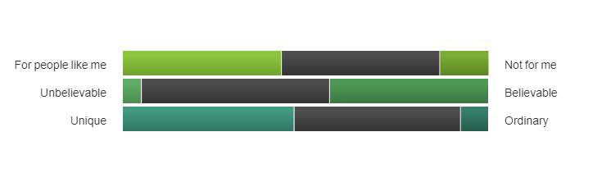
XQ5. Additional Sentiments About the Concept
N=400
For people like me | Neutral (±5) | Not for me
43.50% | 43.25% | 13.25%
Unbelievable | Neutral (±5) | Believable
5.00% | 51.50% | 43.50%
Unique | Neutral (±5) | Ordinary
47.00% | 45.50% | 7.50%

Slide 10
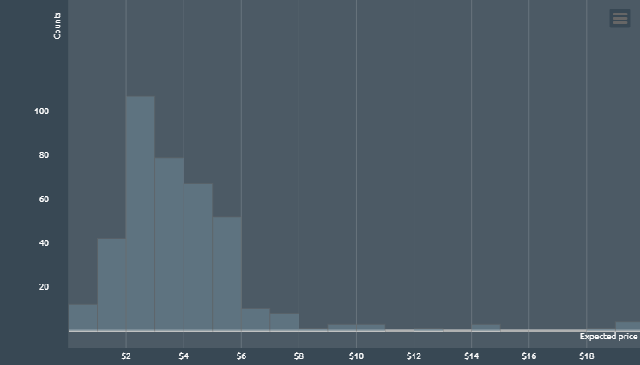
XQ6. Expected Price to Pay
N=393
Total Respondents* | 393
Average | $4.32
Standard Deviation | $2.67
Minimum | $0.99
Median | $3.99
Maximum | $20.00

