Slide 1
Xpert Monadic Price - Demo
Prepared by Julia Maier
November 17, 2022

Slide 2
XPERT MONADIC PRICE - DEMO
Objective
The purpose of this study is to better understand buyers' price sensitivity for this product concept, and to identify the optimal price point that maximizes revenue. To provide a holistic view of the perceptions of the concept, the following have also been assessed:
The key findings from this price test are: -Revenue is maximized at the $15.99 price point, resulting in projected revenue of $266.1k. -At $15.99, an estimated 24% would be interested in purchasing, and intenders would purchase 16k per year on average.
Prepared by
Dale Gilliam
OPEN LIVE REPORT
PREVIEW SURVEY
NEW SURVEY

Slide 3
XQ2. Methodology
The study was conducted online among 500 respondents. Respondents underwent a Monadic exercise, where one of the five price points was shown to each participant, resulting in a sample of about 100 per price point. The maximum margin of error on proportions was 4.39% at a 95% confidence level. To obtain Purchase Probability estimates for the entire range of prices a logistic regression was used. Binary Intender, defined by the Top 2 Box, is the independent variable, and it is explained by the four log-adjusted price points. Constraints are placed to ensure predicted curve never increases as the price is increasing. Similarly, the purchase frequency estimations were smoothed using a linear regression to predict frequency based on the natural log of the price tested.

Slide 4
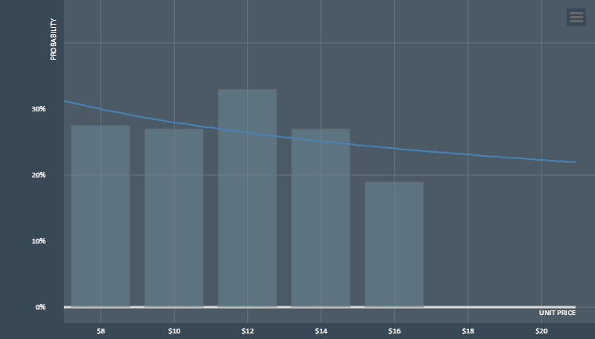
XQ4. Purchase probability
N=500

Slide 5
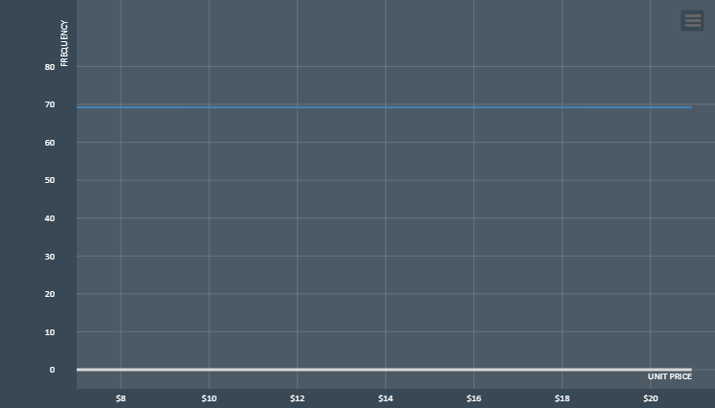
XQ4. Purchase frequency in 1 year
N=500

Slide 6
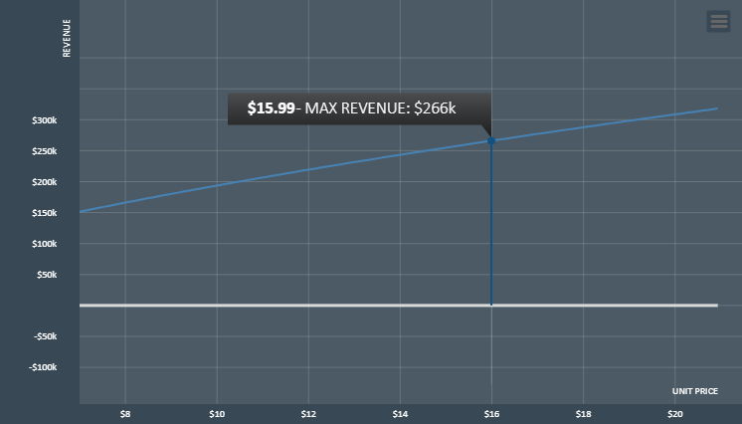
XQ4. Maximum Revenues in 1 year
N=500

Slide 7
XQ4. Takeaway points
N=500
Under assumptions about costs and total addressable market size, combined with the collected price preferences, probabilities, and frequencies, the optimal price point to maximize REVENUE is $15.99 per product. Assuming no pressure from competitors, ideal marketing, no cancellation/returns, etc. (or that everything is embedded into the TAM and cost), projected revenues are expected to be $266k per year.

Slide 8
XQ4. Takeaway points
N=500
Price Sensitivity Meter Results | PRICE.POINTS | UNIT.PRICE | BUYERS | REVENUE | SALES | FREQUENCY
PRICE POINT #P1 | PRICE POINT #P1 | $7.99 | 300 (30.0%) | $165k | 20k | 69.2/year
PRICE POINT #P2 | PRICE POINT #P2 | $9.99 | 280 (28.0%) | $193k | 19k | 69.2/year
PRICE POINT #P3 | PRICE POINT #P3 | $11.99 | 264 (26.4%) | $219k | 18k | 69.2/year
PRICE POINT #P4 | PRICE POINT #P4 | $13.99 | 251 (25.1%) | $243k | 17k | 69.2/year
PRICE POINT #P5 | PRICE POINT #P5 | $15.99 | 240 (24.0%) | $266k | 16k | 69.2/year
MAX REVENUE | MAX REVENUE | $15.99 | 240 (24.0%) | $266k | 16k | 69.2/year

Slide 9
XQ5. Additional Sentiments About the Concept | Stacked Percents
N=500

Slide 10
. SQ1. This product is new and different
N=500
 | Answer | % | N
A1 | Strongly disagree | 2.00 | 10
A2 | Disagree | 9.20 | 46
A3 | Neither agree nor disagree | 34.00 | 170
A4 | Agree | 37.20 | 186
A5 | Strongly agree | 17.60 | 88

Slide 11
. SQ2. The product benefits are believable
N=500
 | Answer | % | N
A1 | Strongly disagree | 1.80 | 9
A2 | Disagree | 5.60 | 28
A3 | Neither agree nor disagree | 39.60 | 198
A4 | Agree | 40.80 | 204
A5 | Strongly agree | 12.20 | 61

Slide 12
. SQ3. The product benefits are important to me
N=500
 | Answer | % | N
A1 | Strongly disagree | 3.40 | 17
A2 | Disagree | 7.60 | 38
A3 | Neither agree nor disagree | 33.40 | 167
A4 | Agree | 35.60 | 178
A5 | Strongly agree | 20.00 | 100

