Slide 1
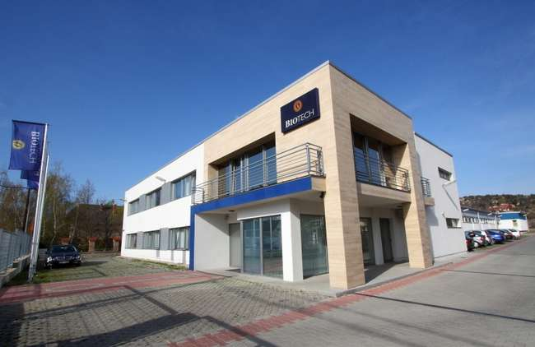
BIOTECH Group
„Movement is Life”

Slide 2
Innovation in Medical Technology

Slide 3
BIOTECH MULTI-NATIONAL GERMAN - BASED
DEVELOPER, MANUFACTURER, DISTRIBUTOR OF HIGH QUALITY
ORTHOPAEDY TRAUMA, SPINE, PECTUS IMPLANTS AND INSTRUMENTS

Slide 4
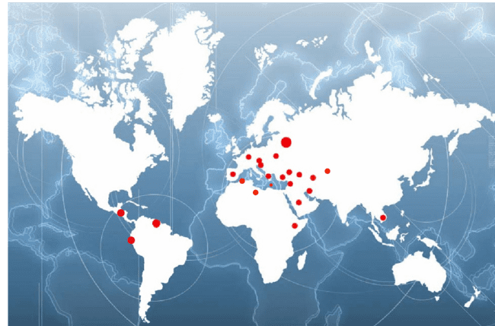
BIOTECH GROUP CO. – WORLD-WIDE SALES Biotech GmbH Germany sells annually several thousands of Hip, Knee, Spine, Pectus and Trauma implants overall in:
Germany
Hungary
Croatia
Syria
Turkey
Iran
Iraq
Saudi Arabia
Kenya
Thailand
Greece
UK
Bulgaria
Tunisia
Libya
Spain
Ukraine
Georgia
Uzbekistan
Venezuela
Guatemala
Ecuador
Russia
Argentina
Columbia
Mexico
Vietnam
Azerbaijan
Malta

Slide 5
BIOTECH GmbH GERMANY Certified German Producer
BIOTECH GmbH is a German manufacturer
-All BIOTECH products are CE Marked (CE1011)
-BIOTECH GmbH Germany is an ISO 13485 certified producer

Slide 6
PRODUCTION
German headquoters (mother company):
BIOTECH GmbH
address: Hauptstraße 113. 56598 Rheinbrohl
Raw material processing: precision casting, forging
Coating

Slide 7
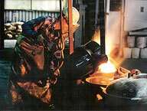
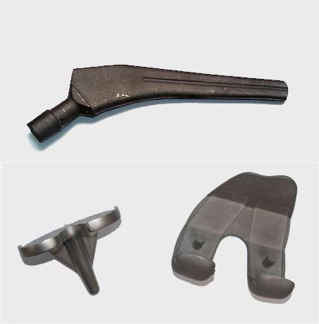
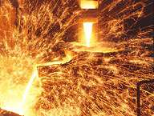
PRODUCTION – Precision Casting
Casting of Knee and Hip components
Cobalt Chrome raw material

Slide 8
PRODUCTION – Forging
Forging of Hip Stems
Titanium
High-Nitrogen Stainless Steel

Slide 9
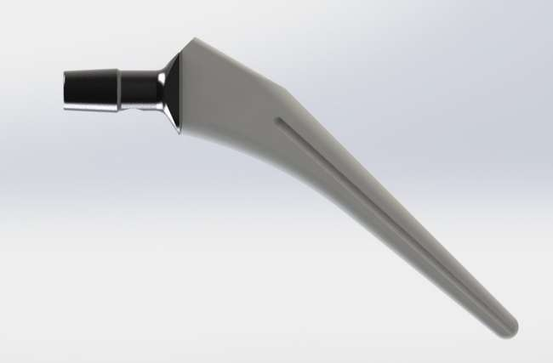
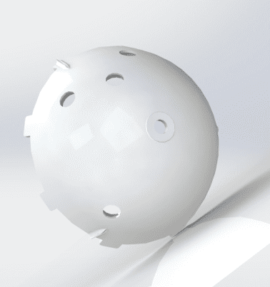
HYDROXYAPATITE COATED
Hydroxyapatite coated parts

Slide 10
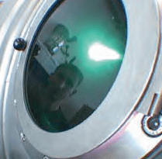
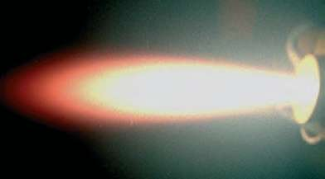
BIOTAN TITANIUM POROUS COATING
Titanium Plasma Spray (TPS) porous coating

Slide 11
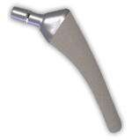
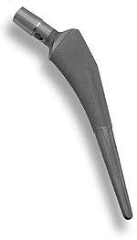
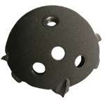
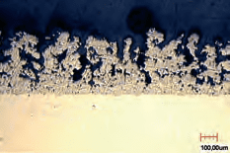
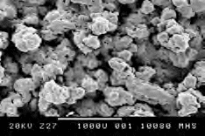
BIOTAN TITANIUM POROUS COATING
TPS coated parts

Slide 12
BIOTAN TITANIUM POROUS COATING 300 micron

Slide 13
PRODUCT DEVELOPEMENT
Innovations
- continuous developement of the BIOTECH product range
- In close cooperation with professional surgeons and high qualified engineer team
Design
– Biotech engineering team
– 2D technical drawings
– 3D modelling

Slide 14
PRODUCTION
Product developement and design engineering
Finishing procedures, until packaging
Grinding and polishing
CNC machining
Cleaning and packaging in clean room
Quality control
Gamma-Ray sterilisation in nuclear power stations in the European Union

Slide 15
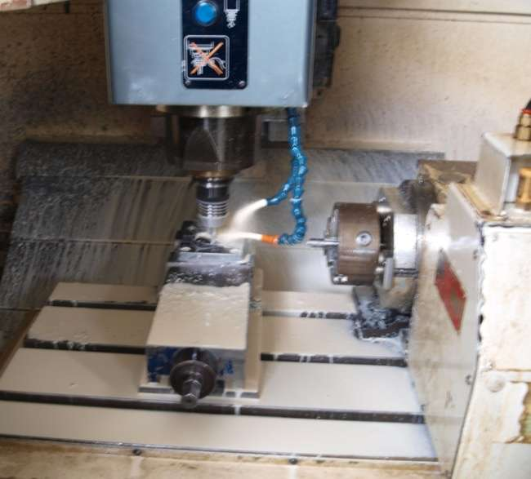
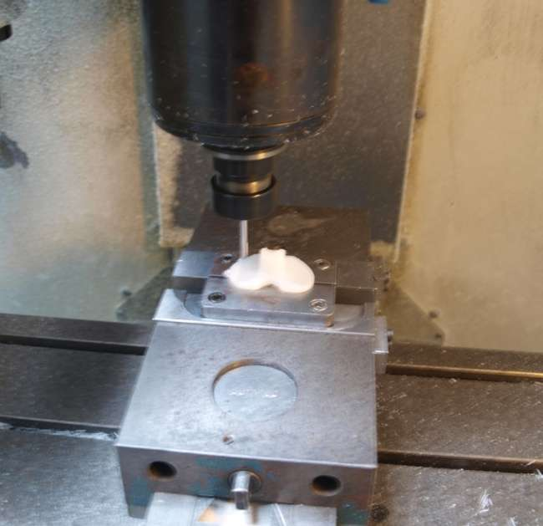
PRODUCTION
CNC Machining of tibial casting parts and tibia inserts

Slide 16
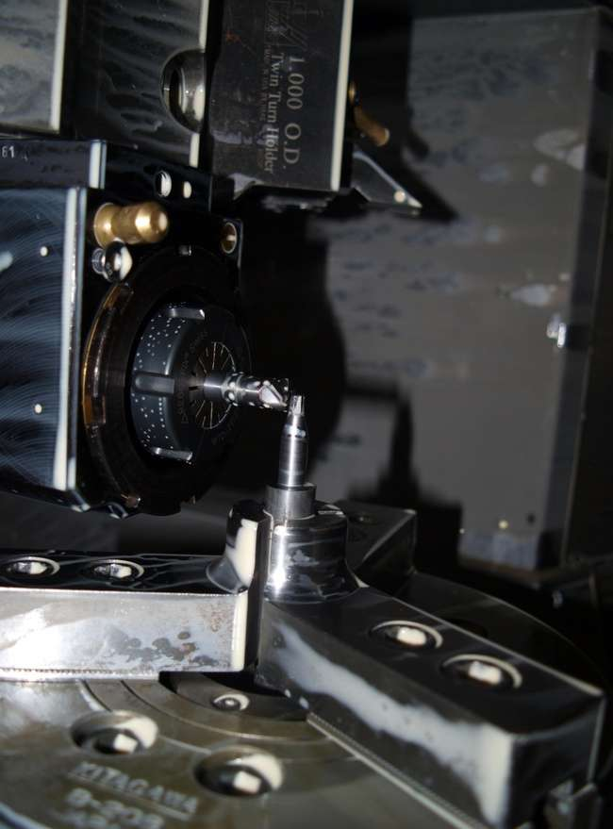
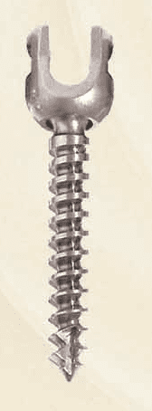
PRODUCTION
CNC machining of titanium spinal screws

Slide 17
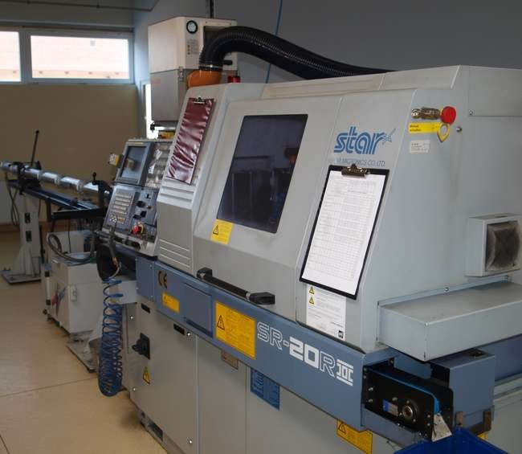
PRODUCTION
Trauma bone screw manufacturing by special CNC machine

Slide 18
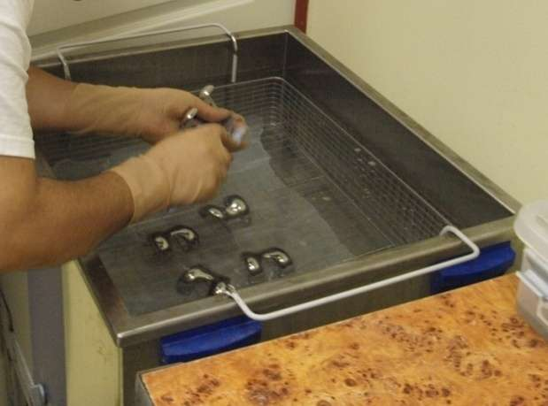
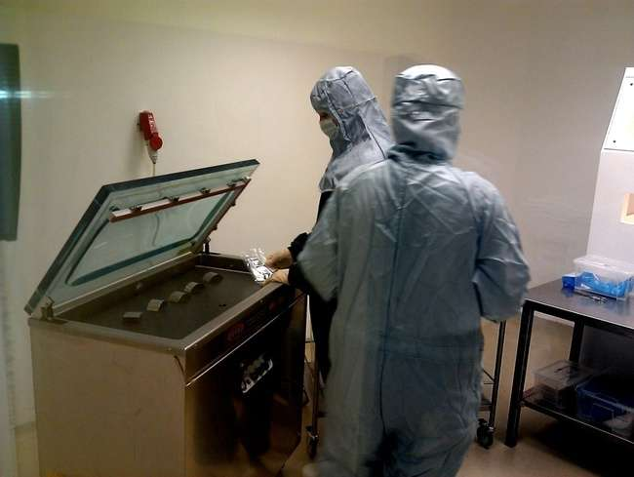
PRODUCTION
Cleaning and Packaging in Clean Room

Slide 19
BIOTECH Products Range
Orthopaedics
Hip prosthesis implant and instrument Systems (1238 items)
Knee prosthesis implant and instrument Systems (3584 items)
Shoulder prosthesis implant and instrument Systems (66 items)

Slide 20
BIOTECH Products Range
Trauma
Intra-Medullary nailing implant and instrument systems (1824 items)
Bone plate and screw implant and instrument Systems (5847 items)
Pectus
implant and instrument Systems (30 items)

Slide 21
BIOTECH Products Range
Spine
Spinal screw fixation implant and instrument Systems (394 items)
Interbody Fusion implant and instrument Systems (104 items)
Surgical Power Tool Systems
(70 items)

Slide 22
BIOTECH TOTAL HIP SYSTEMS
Biotech Modular Head System
Biotech Acetabular Cup System
BA Hip Stem System
SKM – Short Anatomical – Stem System
BET Hip Stem System
BQS – Biotech Quattro - Stem System
Biotech Modular Revision Hip Stem System
Austin Moore Hip Stem System

Slide 23
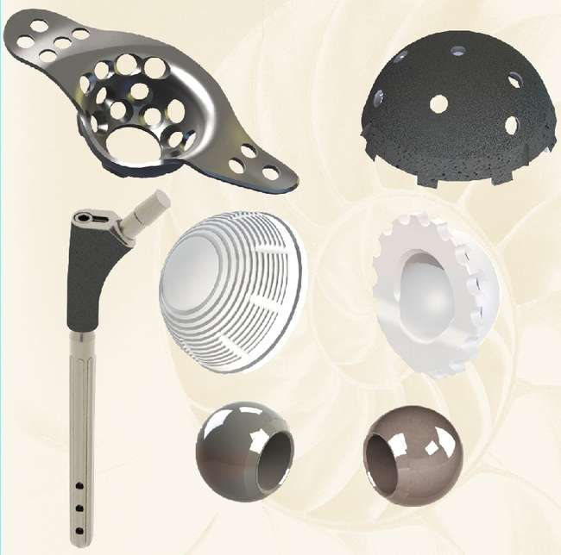
Biotech Modular Revision Hip System

Slide 24
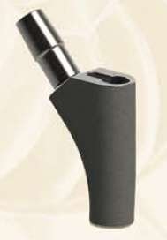
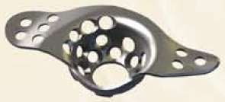
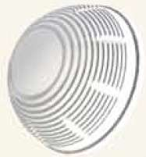
Biotech Modular Revision Hip System
Biotech Modular Revision Hip Stem Cemented/Uncemented proximal component
Biotech Modular Revision Hip Stem Uncemented Distal component
Revision Hip Cup
Müller Acetabular Cup for Revision

Slide 25
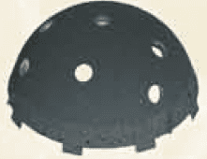
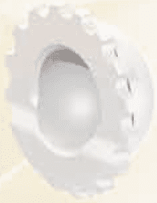
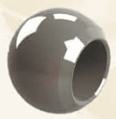
Biotech Modular Revision Hip System
CIF BIOTAN Revision Modular 8 holed Uncemented press fit actabular shell
Revision Modular Acetabular Insert High Wall
Metal Modular Head CoCr / HNSS

Slide 26
BA CEMENTED and UNCEMENTED „MÜLLER TYPE” STEMS
- PROVED SUCCESS

Slide 27
BA STEMS
Ideal geometry: Tappered non-collared stems – to improve rotational stability
Uncemented:
Titanium alloy TiAL6V4 or CoCr
Lasting fixation: Titanium plasma sprayed porous coating 300 microns, 30 % porosity
Wide range of sizes: from 6,25 mm – to 20,00 mm in 1,25mm steps
Solution for dysplasia cases: 6,25mm stems
Cemented:
High N stainless steel or CoCr
Wide range of sizes: from 6,25 mm – to 20,00 mm in 1,25mm steps
Solution for dysplasia cases: 6,25 mm stems

Slide 28
BA REVISION STEMS
Raw material: CoCr
Cemented
Uncemented - with titanium plasma sprayed porous coating
Wide range of stem lenghts: 180mm, 200mm, 220mm, 240mm, 260mm
Distal locking possiblity

Slide 29
BET stem
Cemented
raw material: High N Stainless Steel
Uncemented
raw material: CoCr or TiAl6V4 - with titanium plasma sprayed porous coating

Slide 30
BQS Biotech Quattro Stem
Raw material – TiAl6V4
Uncemented - with titanium plasma sprayed porous coating
11 sizes

Slide 31
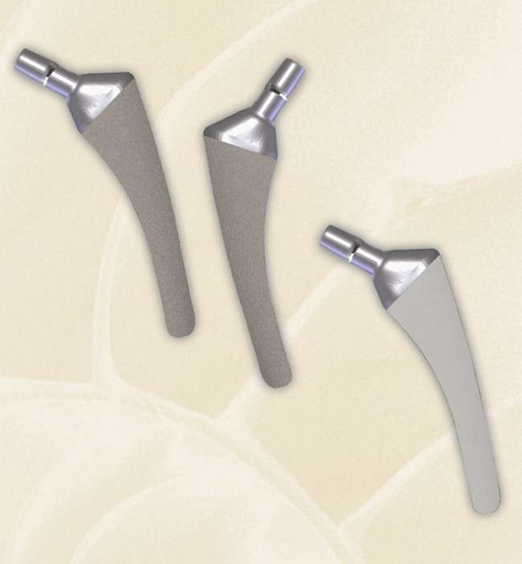
SKM-Short Anatomical Stems
NEW GENERATION of bone saving option for primary hip implantation
Specially designed for Minimally Invasive surgery – to preserve valuable muscles and bone structures
Raw material: CoCr
Uncemented - with titanium plasma sprayed porous coating or HA coating
Unique anatomical design, 12 left and 12 rigth sizes – to obtain intial fixation and cover wide spectrum of indications
The small sizes: Excellent solution for dysplasia cases
Modularity: the SKM stem system is perfectly compatible with the cemented and uncemented cup systems and modular heads BIOTECH BA Total Hip System

Slide 32
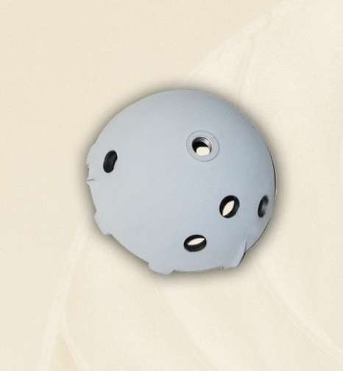
Cups, Shells, Inserts & Accessories
Uncemented CIF BIOTAN Acetabular Press-fit Shell
Hemisperical press-fit shell, raw material: TiAl6V4
solid and 5 holed version (for additional screw fixation)
BIOTAN – Titanium Plasma Sprayed porous coating – „scratch fit” stability or HA coating
Oblique rim fins – for maximal rotation stability,firm hold
wide range of sizes: 38-74mm in 2mm step
UHMWPE inserts
Cliploc fixation:locks the insert securely, maximal resistance to lever-out and push-out forces
Cemented Müller Cup
Hemisperical cup, raw material: UHMWPE
Size range 40-64 mm in 2mm step
Optionally: asymmetric cups and cup support

Slide 33
Modular Heads
Raw material: CoCr
Optionally: ceramic heads
Wide range of outer diameters:
22mm, 26mm, 28mm, 32mm
Wide range of neck lenghts:
XS, S, M, L, XL, XXL, XXXL, XXXXL
Modularity: the BIOTECH MODULAR
HEAD SYSTEMS is compatible with all type
of cemented and uncemented BIOTECH HIP
stems and cups

Slide 34
Offset heads
INNOVATIVE OFFSET SOLUTION!
offset heads are available in 5º and 10º versions with different neck lenghts
raw material: CoCr
Modularity: compatible with all type of cemented and uncemented BIOTECH HIP stems and cups

Slide 35
Modular Bipolar Head System
Raw material: High-N Stainless steel shell with UHMWPE inlay
Modularity: CoCr modular heads with various neck lenghts can be connected
Compatible with all BIOTECH cemented and uncemented stems
Easy to use

Slide 36
BIOTECH Knee-Systems
TP Total Knee System
TRK Total Revision Knee System
FUTURE KNEE Modular System
FUTURE KNEE 1 System
High Flexion Knee System
Biotech CONSTRAINED Knee System
BMI –Biotech Minimally Invasive - Unicondylar Knee System
TMB Total Rotating Knee System

Slide 37
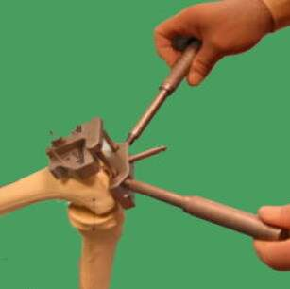
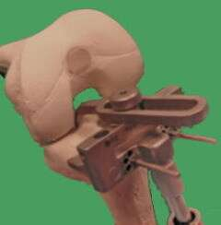
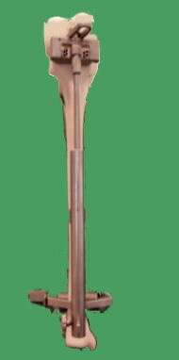
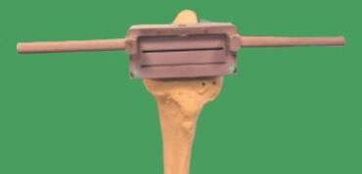
TP TOTAL KNEE SYSTEM
For standard operation techniques

Slide 38
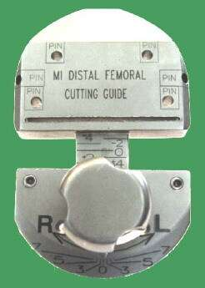
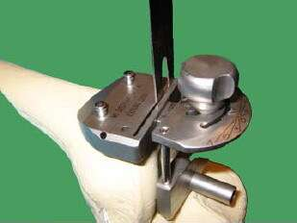
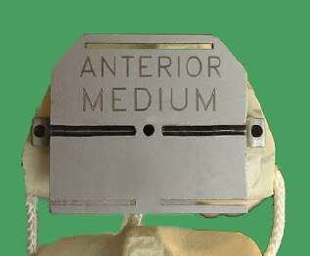
TP TOTAL KNEE SYSTEM
For standard and Minimal Invasive operation techniques

Slide 39
TP TOTAL KNEE SYSTEM
For standard and Minimal Invasive operation techniques

Slide 40
BIOTECH TP - Total Knee system
Femoral components - anatomical design, raw material: CoCr
„One Piece” Tibial trays, raw material: CoCr
Tibial inserts, raw material: UHMWPE
Cemented and optionally uncemented version
Modularity: inter-changeability of 3 sizes
Primary and P/S implants
Meniscal bearing components
Maximal surface contact of Femoral and tibial components – to minimize polyethylene wear
Insert screw fixation – to reduce micro motion between insert and tibia tray

Slide 41
FUTURE KNEE
Modular Total Knee System
For standard and Minimal Invasive operation techniques
Primary, P/S and all types of revision

Slide 42
FUTURE KNEE Modular Total Knee System
Femoral components in CoCr
Anatomical design, Primary and P/S versions

Slide 43
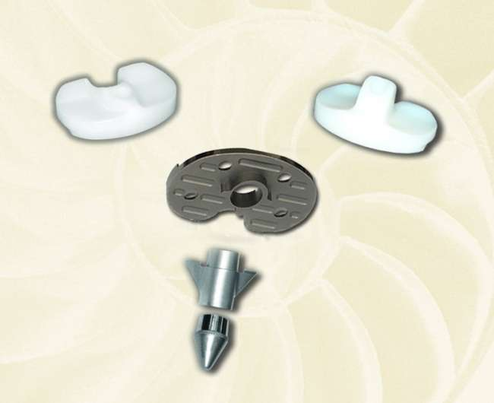
FUTURE KNEE Modular Total Knee System
MODULAR titanium tibia tray
Primary and P/S inserts in UHMWPE

Slide 44
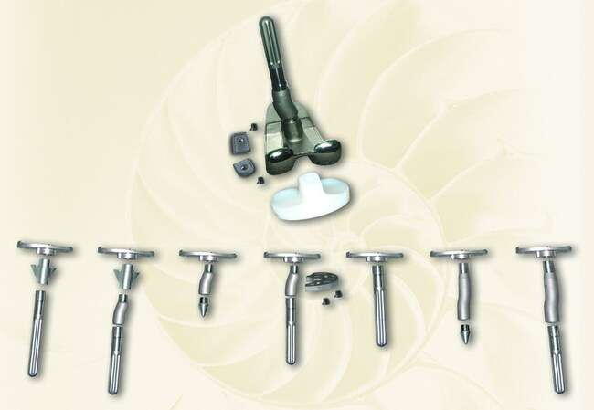
FUTURE KNEE Modular Total Knee System
Complete modularity: Primary, P/S and Revision components can be flexibly combined during surgery, according to the surgeon’s choice
Additional extention by offsets and augumentation blocks.
Flexible intra-operative variability of primary or revision tibia stems.

Slide 45
TRK REVISION TOTAL KNEE SYSTEM
Modular Systems
Compatible with the BIOTECH TP KNEE and FUTURE KNEE Systems
Revision Femoral components in CoCr, Anatomical design
Revision Tibial Tray components in TiAl6V4
Revision inserts in UHMWPE
Tibial and Femoral Augumentation Blocks - with screw fixation
Universal stems for Tibial and Femoral components
Adapter on the femoral side for stem and offset – 5 ⁰ , 7 ⁰ , 9 ⁰
360 ^{c} offsets on Tibial and Femoral sides

Slide 46
BIOTECH CONSTRAINED Total Knee
For additional stabilization in case of lack of functional ligaments
Special high stability adapter – provides adequate stable connection between tibial and femoral interconylar boxes
Revision stem and offset extension possibility

Slide 47
BMI- BIOTECH Minimally Invasive Unicondylar Knee System
Unique minimal invasive approach
Only 5 cm Incision
Patients may leave the hospital within 24hours
Femoral components in CoCr
Anatomical design
Metall Back Tibia tray in TiAl6V4 with UHMWPE Inlay
All-Poly Tibia version

Slide 48
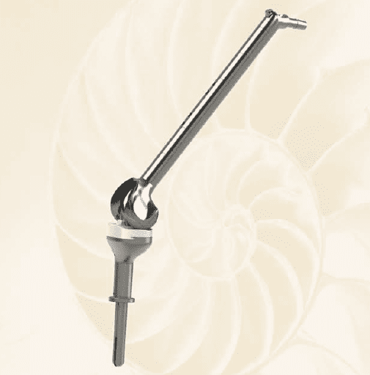
Biotech Extrem Hip and Knee System

Slide 49
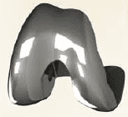
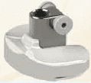
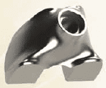
Biotech Extrem Knee
Modular Femoral Component CoCr
Modular Tibial Tray Ti6Al4V
Modular Tibial Insert
TI6AL4V / UHMWPE
Modular Femoral Internal deposit TI6AL4V / UHMWPE

Slide 50
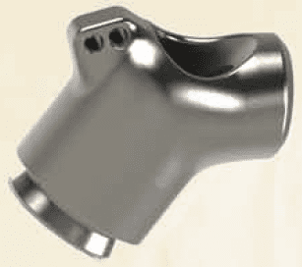
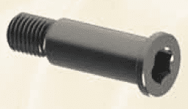
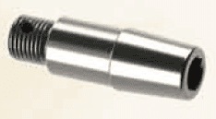
Biotech Hip
Hip Neck Component Ti6Al4V
Modular Hip Neck Screw Component Ti6Al4V
Modular Hip Cone Component Ti6Al4V
Modular Hip Stem Cemented/Uncemented Distal component

Slide 51
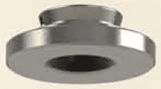
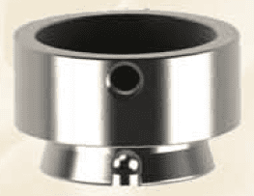
Biotech Extrem System
Hip and Knee Component
Modular Locking cap Cemented/Uncemented Component
Modular Extension Component Ti6Al4V
Modular Spacer Component Ti6Al4V
Modular Femoral/Tibial Stem Cemented/Uncemented Component

Slide 52
Biotech Modular Shoulder System
STEMS
CoCr stems in 4 sizes: 6, 8, 10, 12 cemented/uncemented with titanium plasma-sprayed coating
Reverse morse taper – optimal access to the surgical field,
Fenestration of the stem – appropriate rotator cuff function
Revision stems – 190 mm length

Slide 53
Biotech Modular Shoulder System
HEADS
Modular Offset heads –with unique index ability
Adjustable degree of posterior and superior displacement to +5 mm, +3 mm or 0 mm
GLENOID COMPONENTS
Cemeneted Glenoid components, UHMWPE
Uncemented titanium Tray and UHMWPE insert

Slide 54
BIOTECH SPINAL IMPLANT SYSTEM
DL-P Dorso-Lumbar BIOTECH Polyaxial and Monoaxial System
Posterior Spinal Fixation System
DL-C Dorso-Lumbar BIOTECH Coupling System
Posterior Spinal Fixation System
CPS – Cervical Plate System
Biotech Interbody Fusion Systems:
– BCC Cervial Cage System
– BTC BI-Lateral Thoracolumbar Cage System
– LTC Lateral Thoracolumbar Cage System

Slide 55
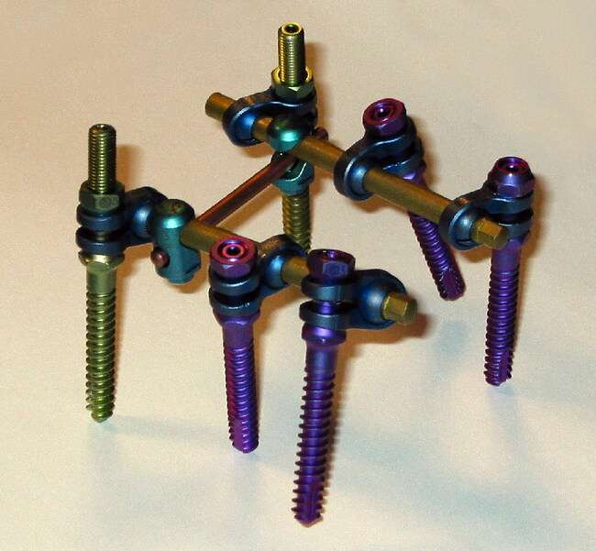
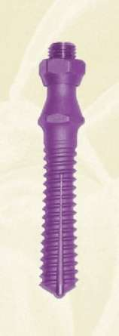
DL-C Dorso-Lumbar BIOTECH Coupling System
Indications: Spondylolysthesis, fractures, disc herniation, canal stenosis, metastatic bone tumours, primary bone tumours, vertebral instability
Variability of the system
High stabilty
Easy-locking system
Raw material: TiAL6V4
Multidirectional 3D – coupling, 360 ⁰ flexible fixation
Self-tapping screws and spondylolysthesis screws in 6.35 mm and 7.50 mm diameters with various lengths.
Expansive screws
Rods from 45 mm upto 600 mm
Transversal rods and transversal connector

Slide 56
DL–P Dorso-Lumbar BIOTECH Polyaxial and Monoaxial Screw System
Raw material TiAl6V4
Easy locking mechanism
Polyaxial and monoaxial screws in diameter 4.0mm, 5.0mm, 6.0mm, 7.0mm – different lenghts

Slide 57
BIOTECH CPS - Cervical Plate System
Angle stabilised screw fixation
Fixation to cervical cage
Solid graft fixation
Precise adjustment onto the anterior surface
Raw material: TiAl6V4
Plates are available from 25 mm to 95 mm
Fixation screws : 14 mm to 22 mm

Slide 58
BIOTECH INTERBODY FUSION SYSTEMS
BCC – BIOTECH CERVICAL CAGE
Raw material: PEEK or TITANIUM
In standard and large sizes, with different heights from 4 mm to 8 mm
LTC – Lateral Thoracolumbar Cage System
Raw material: PEEK or TITANIUM
Wide range of sizes S, M, L - from 4mm/5mm to 12/13 mm
BTC – BI-Lateral Thoracolumbar Cage System
Raw material: PEEK or TITANIUM
Wide range of sizes from 6 to 18 mm

Slide 59
BIOTECH TRAUMATOLOGIAL IMPLANT SYSTEMS FOR OSTEOSYNTHESIS
Intramedullary Nailing Systems
Plates
Screws

Slide 60
BIOTECH INTRA-MEDULLARY NAIL SYSTEM
BSP- Biotech Short Pertrochanter Nail
Biotech Tibia Nail
BLF- Biotech Long Femoral Nail
Biotech Humeral Nail

Slide 61
BIOTECH INTRA-MEDULLARY NAILING SYSTEMS
BLF – BIOTECH Long Anterograd and Retrograd Femoral Nails
BIOTECH Tibial Nails
BIOTECH Humeral Nails
BSP - BIOTECH Short Pertrochanter Nails
The Biotech Intramedullary Nails can be utilized in both reamed or nonreamed mode, based on surgeon preference and individual patient requirements.

Slide 62
BLF – Biotech Long A/R Femoral Nail
The Biotech Long Femoral nail offers a solution for both, anterograd and retrograd approach.

Slide 63
BLF – Biotech Long A/R Femoral Nail
Indications:
Simple, middle-third, transverse and short oblique fractures of the shaft of the femur
Prevention of fractures secondary to malignant, osteolytic processes
The additional use of a lock extends the indications in both proximal and distal direction, and also to splintered and comminuted fractures

Slide 64
BLF – Biotech Long A/R Femoral Nail
Proximal aiming
Anterograd Retrograd
Distal aiming

Slide 65
BLF Biotech Long A/R Femoral Nail

Slide 66
BIOTECH Tibial Nail
Indications:
Simple, middle-third, transverse and short oblique, spiral fractures of the tibia
Locking of the proximal and distal pieces of extrastrictural fractures.
Steril hypertrophic pseudoarthroses

Slide 67
BIOTECH Tibial Nail
Proximal aiming
Distal aiming

Slide 68
BIOTECH Tibial Nail

Slide 69
BIOTECH Humeral Nail
Indications:
Simple, middle-third, transverse and short oblique, spiral fractures of the humerus
Subcapital fractures (with the use of short nail)

Slide 70
BIOTECH Humeral Nail
Proximal aiming
Distal aiming

Slide 71
BIOTECH Humeral Nail

Slide 72
BSP – Biotech Short Pertrochanter Nail
Indications:
Intertrochanteric fractures
Pertrochanteric fractures
Subtrochanteric fractures
Fragmented per-, and subtrochanteric fractures

Slide 73
BSP – Biotech Short Pertrochanter Nail

Slide 74
BSP – Biotech Short Pertrochanter Nail

Slide 75
BIOTECH TRAUMA Complete Range of Trauma

Slide 76
BIOTECH TRAUMA Locking Plate System

Slide 77
BIOTECH TRAUMA Locking Plate System

Slide 78
BIOTECH Pectus System
Pectus implant
Pectus Stabilizer
Pectus Screwed Stabilizer
Screw

Slide 79
BIOTECH GERMANY
„Movement Is Life”

