Slide 1
LAW & ETHICS
Prosecuting a capital murder trial against a pro se defendant

Slide 2
Timeline
April 13, 2014
  Three people murdered at two locations in OPKS
  Multiple attempted murders
  Suspect –Frazier Glenn Cross/Miller surrenders and is arrested
  Invokes right to remain silent
  Demands an attorney

Slide 3
Timeline
April 15, 2014
  Defendant charged with capital murder and other charges
  Death penalty defense unit appointed to case
  Lead counsel Ron Evans
  Case assigned to Judge Kelly Ryan

Slide 4
Timeline
April 24, May 29, 2014
  Death Penalty Defense Unit Appears with defendant
  Case set for prelim 11/12/2014: three days set aside
  Standard motions filed on behalf of defendant

Slide 5
Timeline
  November 2014
  Ron Evans files Motion to Determine Competency on morning of preliminary hearing
  Court holds in camera ex parte hearing and orders competency evaluation
  Defendant examined and found competent 12/18/14
  Case re-set for prelim March 2015
  State files notice of intent to seek death penalty

Slide 6
Timeline
January 14, 2015
  Outside counsel and second DPDU attorney complete his three-man defense team
  Attorneys file two motions:
    Motion for Internet Access
    Motion for Return of Property

Slide 7
Timeline
February 6, 2015
  Ron Evans files Motion to Withdraw
    Ex Parte hearing held, motion granted
    Mark Manna enters appearance

Slide 8
Timeline
March 2, 2015
  Preliminary hearing conducted over three days
  Attorney Martin Warhurst conducts cross-examination of State’s witnesses
  Defendant bound over, arraignment postponed at request of defense counsel

Slide 9
Timeline
March 27, 2015
  Arraignment
  Attorneys file supplemental internet access motion
  Attorneys file motion to set trial date beyond statutory speedy trial
  Defendant verbally demands speedy trial
  Jury trial set August 15, 2015

Slide 10
Timeline
April 2, 2015: State’s Motion and Brief Re: Self-Representation
April 8, 2015: Defendant still wants his attorneys
April 30, 2015: Defense counsel file numerous motions

Slide 11
Timeline
May 14, 2015
  Defendant granted right to represent himself
  His three lawyers become backup counsel
  Defendant begins to file motions in earnest
  Appeared before judge in camera several times
  Represented himself for the rest of the case

Slide 12
The Right to Self-Representation

Slide 13
A personal right
State v. Vann, 280 Kan. 782, 127 P.3d 307 (2006)
The Sixth Amendment, as made applicable to the states by the Fourteenth Amendment, guarantees that a defendant in a state criminal trial has an independent constitutional right to self-representation

Slide 14
Faretta v. California
Faretta v. California, 422 U.S. 806, 95 S.Ct. 2525, 45 L. Ed.2d 562 (1975)
Language and spirit of Sixth Amendment contemplate that counsel, like other defense tools guaranteed by it, shall be an aid to willing defendant, and not an organ of state interposed between an unwilling defendant and his right to defend himself personally.

Slide 15
Regardless of skill or training…
A defendant need not himself have skills and experience of lawyer in order competently and intelligently to choose self-representation, but he should be made aware of the dangers and disadvantages of self-representation, so that record will establish that he knows what he is doing and that his choice is made with his eyes open.

Slide 16
A dilemma?
  Law clearly states you can represent yourself if you know what you are doing
  Public defender stated they could not be ready by speedy trial date
  Defendant wanted a speedy trial above all other things (except internet access)
  Self-representation clearly a terrible idea in this case
  The standard is NOT whether you will be good at it or whether it’s a good idea
  Judge really had no choice
  Remedy might have been new trial

Slide 17
Solution?
  Bring the issue out in the open
  Too many “hints” in record
  Motion and Brief Re: Self Representation
  Hearing on the issue
  Eventually, Defendant demanded to represent himself

Slide 18
Solution!
Defendant represented himself
Had three backup counsel
Liberal use of in camera proceedings
Judge placed limits on what attorneys could and could not do
  Not seated at counsel table during trial
  No consultation during trial
  No speaking on behalf of defendant in front of jury
  Limited ability to address the court outside of the jury
  State had to deal with an anarchist, anti-Semitic, American Nazi

Slide 19
In JT for Attempted Capital Murder in Wichita
Filed a motion in Limine to Prohibit the Admission of Inadmissible Evidence. Provided Statutes/ case law on . . .
The right to present a defense remains subject to the statutory rules of evidence and case law interpreting those rules. State v. Baker, 281 Kan. 997, 1008, 135 P.3d 1098 (2006)
1. Relevance: It is improper to confuse the jury by introduction of irrelevant evidence. All relevant evidence, defined as “evidence having any tendency in reason to prove any material fact” is admissible. K.S.A. 60-401(b); 60-407(f). Evidence is relevant if it renders the desired inference more probable than it would be without the evidence, or if it has any tendency in reason to prove any material fact. State v. Sexton, 256 Kan. 344, 349 (1994).

Slide 20
Motion cont. . .
2. Sympathy/ appeals to prejudice: It has been long established that “that jurors ‘must decide a case on evidence and controlling law, and not on sympathy, emotion, or prejudice.’” State v. Jones, 298 Kan. 324, 338 (2013); State v. Holt, 300 Kan. 985, 992 (2014).
3. Rearguing issues already litigated by the court - “it is improper for counsel in his argument to the jury to comment on evidence which was excluded by the court when offered.” State v. Kahler, 307 Kan. 374, 394 (2018)
4. Defendant’s Decision to Represent himself – Defendant has indicated in conversations from the jail to friends and family that he intends to argue to the jury that his rights are being infringed upon because he is representing himself.
What the defendant’s motivation may have been in reaching the decision to represent himself in this matter is his business. The court fully advised him of the risks attendant with such a decision, pursuant to State v. Lowe, 18 Kan. App. 72 (1993) and he chose to accept the same. The jury will clearly know he is representing himself. Why he is doing so and under what circumstances are not relevant to any material fact: i.e., whether he committed the crimes for which he stands charged.

Slide 21
Motion cont . . .
4. Defendant’s Decision to Represent himself – Defendant has indicated in conversations from the jail to friends and family that he intends to argue to the jury that his rights are being infringed upon because he is representing himself.
What the defendant’s motivation may have been in reaching the decision to represent himself in this matter is his business. The court fully advised him of the risks attendant with such a decision, pursuant to State v. Lowe, 18 Kan. App. 72 (1993) and he chose to accept the same. The jury will clearly know he is representing himself. Why he is doing so and under what circumstances are not relevant to any material fact: i.e., whether he committed the crimes for which he stands charged.
* What’s the plan if the defendant tells jury he is being forced to represent himself?

Slide 22
An Ethical Dilemma

Slide 23
Competing Interests
Zealous Advocate for the State
Seeking Death Sentence against Defendant
Fairness to Unrepresented Person
Compliance With All Discovery Rules
Fairness to Opposing Party and Tribunal

Slide 24
Professional Obligations
The Kansas Rules of Professional Conduct (KRPC) are binding on all attorneys licensed to practice law in the state of Kansas. Failure to adhere to the KRPC can subject the lawyer to discipline.
The National Prosecutions Standards (NPS) are advisory and aspirational. An attorney’s failure to adhere to the NPS’s will not subject the attorney to discipline. It is our position that adherence to the NPS is a best practice and in the event you receive a disciplinary complaint against you in your role as a prosecutor, adherence to the NPS may be of benefit in your defense

Slide 25
PREAMBLE TO CODE OF ETHICS
A lawyer, as a member of the legal profession, is…an officer of the legal system and a public citizen having special responsibility for the quality of justice.

Slide 26
Rule 3.8- Comment
A prosecutor has the responsibility of a minister of justice and not simply that of an advocate. This responsibility carries with it specific obligations to see that the defendant is accorded procedural justice and that guilt is decided upon the basis of sufficient evidence.

Slide 27
Rule 3.8
KPRC – Rule 3.8: Special Responsibilities of a Prosecutor:
(a) charging – “refrain from prosecuting a charge that the prosecutor knows is not supported by probable cause.” See also NDAA’s Nat. Prosecution Standards 4-2.2 re: Propriety of Charges
(b) defendant’s access to counsel;
(c) waiver from pro se defendant;
(d) discovery - An area ripe for mistakes. Says we must provide “all evidence or information known to the prosecutor that tends to negate the guilt of the accused or mitigates the offense . . .” See In re Jordan.
(e) subpoena;
(f) public statements. See 3.6 also. Rules expressly limit topics that can be discussed in the public arena. See also N.P.S. 2-14.1, 2-14.3, 2-14.4 & 2-14.5. See discussion, In re Kline, 298 Kan. 96, 148-49 (2013).

Slide 28
3.8(f) cont . . .
f) Except for statements that are necessary to inform the public of the nature and extent of the prosecutor’s action and that serve a legitimate law enforcement purpose, refrain from making extrajudicial comments that have a substantial likelihood of heightening public condemnation of the accused and exercise reasonable care to prevent investigators, law enforcement personnel, employees or other persons assisting or associated with the prosecutor in a criminal case form making an extrajudicial statement that the prosecutor would be prohibited from making under rule 3.6 or this rule

Slide 29
KRPC 4.3
KRPC 4.3 Dealing with Unrepresented Persons: In dealing on behalf of a client with a person who is not represented by counsel, a lawyer shall not state or imply that the lawyer is disinterested. When the lawyer knows or reasonably should know that the unrepresented person misunderstands the lawyer’s role in the matter, the lawyer shall make reasonable efforts to correct the misunderstanding.

Slide 30
Chris McMullin’s Life Rule #1
DON’T GET CUTE

Slide 31
In Re Swarts, 271 Kan 28
County Attorney Respondent, Crime Victim
Angry, took matters in his own hands
Spoke with unrepresented defendant
Tried to negotiate a plea deal despite special prosecutor
Deviated from normal process = GOT CUTE

Slide 32
In Re Millett 291 Kan. 369
Defense attorney accompanied client’s brother to police interview
Brother thought attorney represented him
Attorney tried to get brother to confess to client’s crime
What was he thinking? GOT CUTE

Slide 33
Professionalism
Ethically handling a pro-se capital defendant

Slide 34
1. Keep your cool
Be calm in the storm
  Steve was “HOWDY DOODY” (Get it?)
  I “TALKED GOOBELDY GOCK” LIKE A “WOMAN”
  Judge Ryan was an “EGG SUCKING MULE”
We did not “take the bait”
  Communicate in writing
  Talked only on the record, only to the Court

Slide 35
2. Make a good record
Always ask: “HOW WILL THIS LOOK IN BLACK AND WHITE ON A TRANSCRIPT?”
  When defendant asked to break early…we agreed
  When he mentioned entering a plea…we held a hearing
Choose words carefully
State the obvious, i.e. “THE DEFENDANT IS RAISING HIS VOICE”
NO OFF THE RECORD ANYTHING
BE METICULOUSLY FAIR

Slide 36
3. Don’t Get Cute
Earn the Judge’s trust every day
  This was not the case to test the limits of discovery law
    If in doubt, we chose disclosure or sought a hearing
  We did not test the limits of “wide discretion” in argument
    If in doubt, we went conservative- it was a really strong case
  Not the case to play games with evidentiary foundation
    We made sure to take our time with each piece of evidence even if it bored the defendant
  Written response to every motion, even the manifestos

Slide 37
3 . Cont . . . Don’t Get Cute with Discovery
Statutory Discovery: K.S.A. 22-3212 & K.S.A. 22-3213
Case law:
(1) Brady v. Maryland, 373 U.S. 83, 87 (1963) - all “material” information must be provided to the defense by the prosecution.
(2) Kyles v. Whitley, 514 U.S. 419 (1995) - If any law enforcement agent possesses the information/ evidence, prosecutor obliged to learn the information and turn it over to the defense.
(3) Strickler v. Greene, 527 U.S. 263, 281-82 (1999) - “Material” evidence includes exculpatory, impeachment evidence re government witnesses, including cops. See also,
(4) Giglio v. United States, 405 U.S. 150 (1972).

Slide 38
3. Discovery cont . . .
KSA 22-3212 contains over 20 subsections detailing discovery obligations per statute, from general obligations to granular. Ex: how to handle personal identifiers and vehicle identification information.
Pay attention to redactions – how do you redact for a pro se defendant? What about body camera videos; surveillance tapes; video taped interviews?

Slide 39
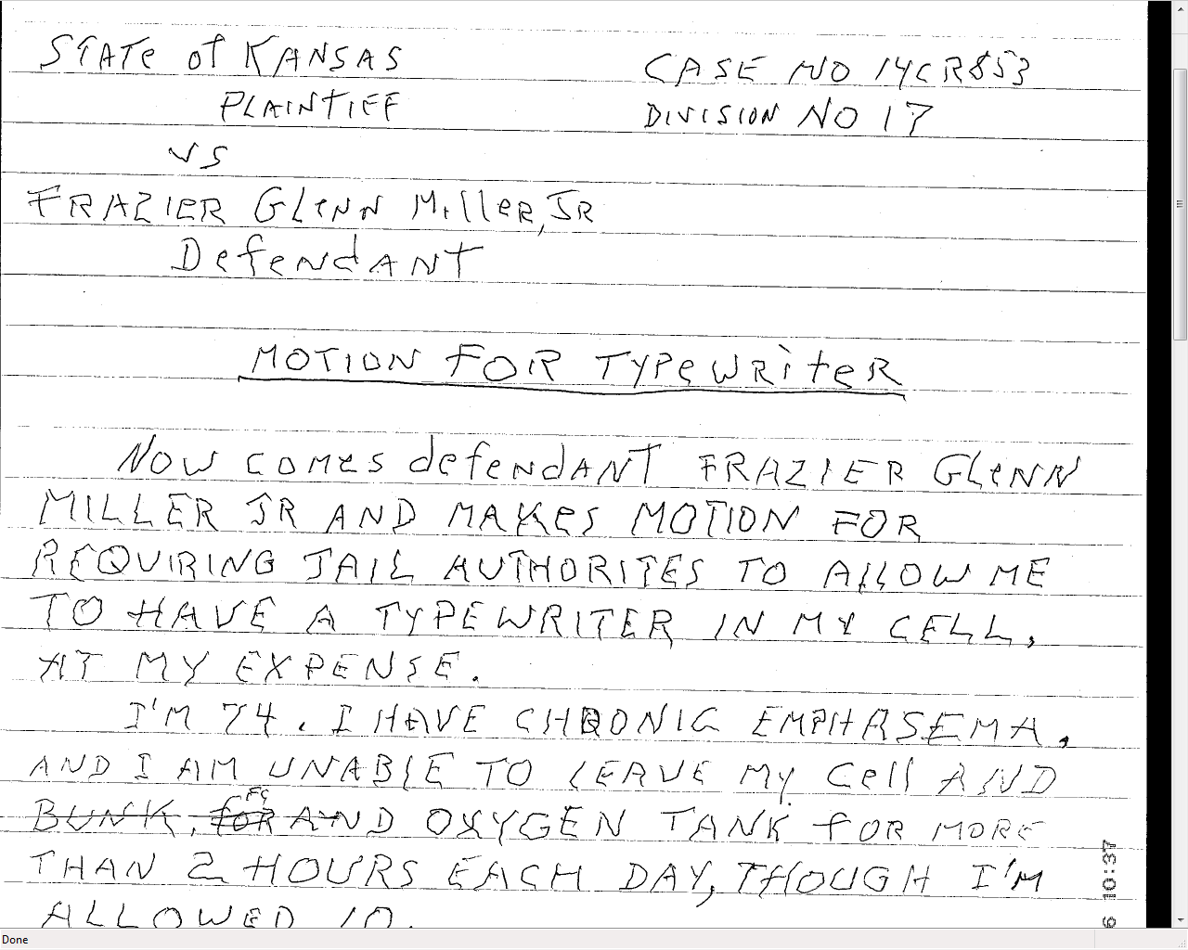

Slide 40
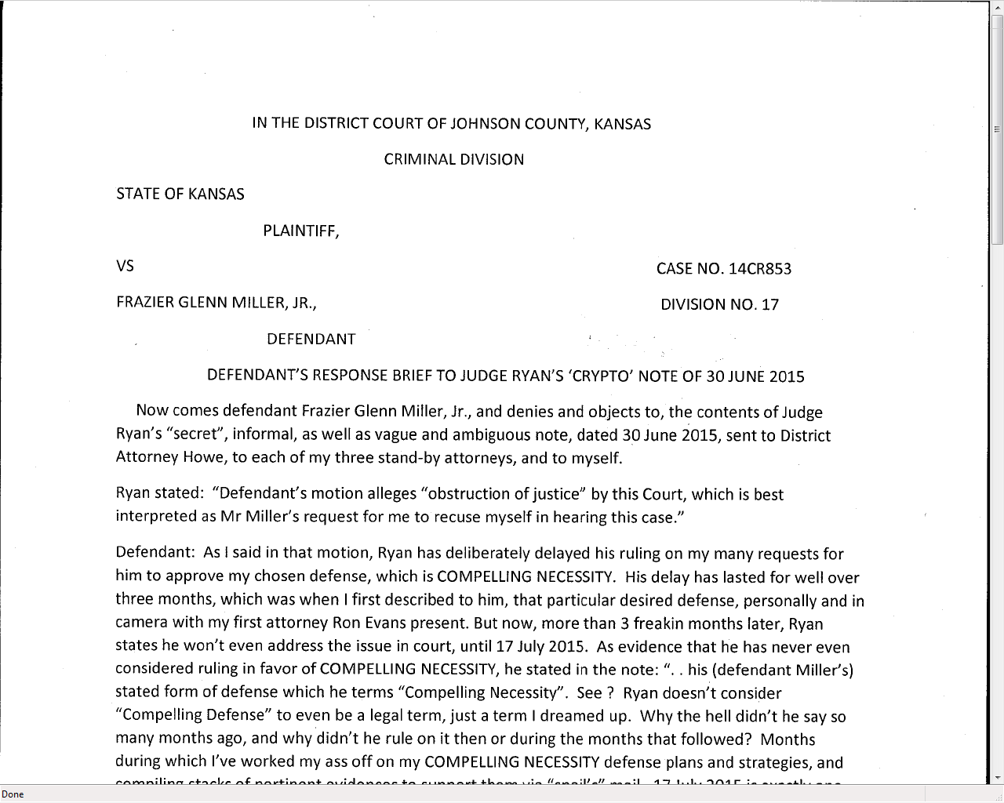

Slide 41
4. Follow the Rules
Rule 3.6 and 3.8 limit what a prosecutor can say about the case
  This defendant spoke to the media at length and in detail
We scrupulously followed the Rules and the “Gag Order”
  Despite an argument that 3.6 (c) allows an attorney to “mitigate recent adverse publicity”

Slide 42
5. Know the law and follow it
TAKE CARE OF THE JUDGE!
  Jury selection procedure
  Trial planning and calendaring
  Daily planning and calendaring
  Written jury instructions
  Memoranda of law on all important issues
WHAT WILL THIS LOOK LIKE IN BLACK AND WHITE???
ARE YOU BEING A “MINISTER OF JUSTICE”
* Motion in Limine or Brief to the court

Slide 43
6. Be a Zealous Advocate
This was an act of domestic terrorism by a cold-blooded fanatic
An assault on our community
We did not pull punches
  Sought death penalty against a pro se defendant
Fair, yet firm
Being “too nice” can get you in trouble too

Slide 44
Remember . . .
A claim of Prosecutorial Misconduct can be made on appeal without a contemporaneous objection preserving the issue in the trial court. So, just because the pro se defendant didn’t catch it, doesn’t mean it wont be raised.
Whenever a claim is asserted that any act of a prosecutor has denied a criminal defendant his or her due process rights to a fair trial, we will refer to the claim and resulting judicial inquiry as a claim of “prosecutorial error.” State v. Sherman, 305 Kan 88, Syl. 5 (2016).

Slide 45
Chris McMullin
Marc Bennett
Chief Deputy District Attorney District Attorney
Tenth Judicial District 18th Judicial District
Olathe, KS Wichita, Ks
Chris.mcmullin@jocogov.org Marc.Bennett@Sedgwick.gov

