Slide 1
Closing Argument: What to Include and How to Persuade
-Jennifer Tatum
Chief Assistant District Attorney
Douglas County District Attorney’s Office
March 9-10, 2023

Slide 2
CLOSING ARGUMENT- see NDAA Trial Advocacy Manual for this presentation
Arguments do not win cases, facts win cases
Film critic v. what you want to watch/ Food critic v. what you want to eat
Credibility is everything—from beginning to end
First argument- factual theory supports legal theory

Slide 3
COMPONENTS
1. Attention Step
First minute or two- your theme, why decide in your favor, your confidence in the case (without saying “I).
2. Facts
3. Law
4. Exit Line- why is justice important in this case. Call back to opening statement or attention step?
Note Facts and Law can be intertwined.
Primacy/Recency/ Repetition
Use technology

Slide 4
Tips
Do not chase the defense, make the argument for your case
Discuss with trial partner/others
Credibility of Witnesses/ Defendant
Argue specific holes- lack of DNA, poor police work, no motive, etc.
Use exhibits and organize in advance
Voice
Movement
Be yourself
Use something for everyone- color, tactile, appeal to reason/law, visual

Slide 5
Ronald Clark checklist
Appear prepared
Use understandable terms
Summarize concisely what happened- voice? Chronological?
Keep comments within evidence
Avoid making impermissible arguments
Persuasively present reasons for guilty
Create desire to convict- ,most do not want to
Use diagrams/ exhibits/ technology

Slide 6
Ronald Clark checklist
Explain elements of the crime and other important instructions
Point out unreasonable arguments of the defense
Use body language and eye contact
Planned initialand rebuttal statements
Avoid personal belief comments
Start strong/ end strong
Use common sense

Slide 7
REBUTTAL
Prepare in advance
Combo of planning and reaction to persuasive defense arguments
Exit line
Sound bites
Motivate to convict
Respond to defense arguments but do not let them control your rebuttal
Start strong/End strong
Be mindful of time
Continue to use technology

Slide 8

DO NOT
Become emotional
1
Shift or misstate the burden
2
Appeal to emotions or sympathy or fear
3
Comment on right to remain silent
4
Comment on Defendant prior criminal history or propensity
5
Argue personal feelings or beliefs. No “I.” “The evidence shows…”
6
Make personal attacks
7
Refer to inadmissible evidence
8
Misstate the facts
9

Slide 9
MY METHOD
When case is assigned, make the theme as simple as possible. What happened? What is compelling about it?
Always be closing, throughout witness preparation to rebuttal
For directs, highlight the necessary facts for your closing
During trial, highlight what you will use for closing from opening on (including defense opening)
At end of trial continue to summarize case in strongest light
Prepare a PowerPoint combining facts/ exhibits/law
Practice do not read

Slide 10
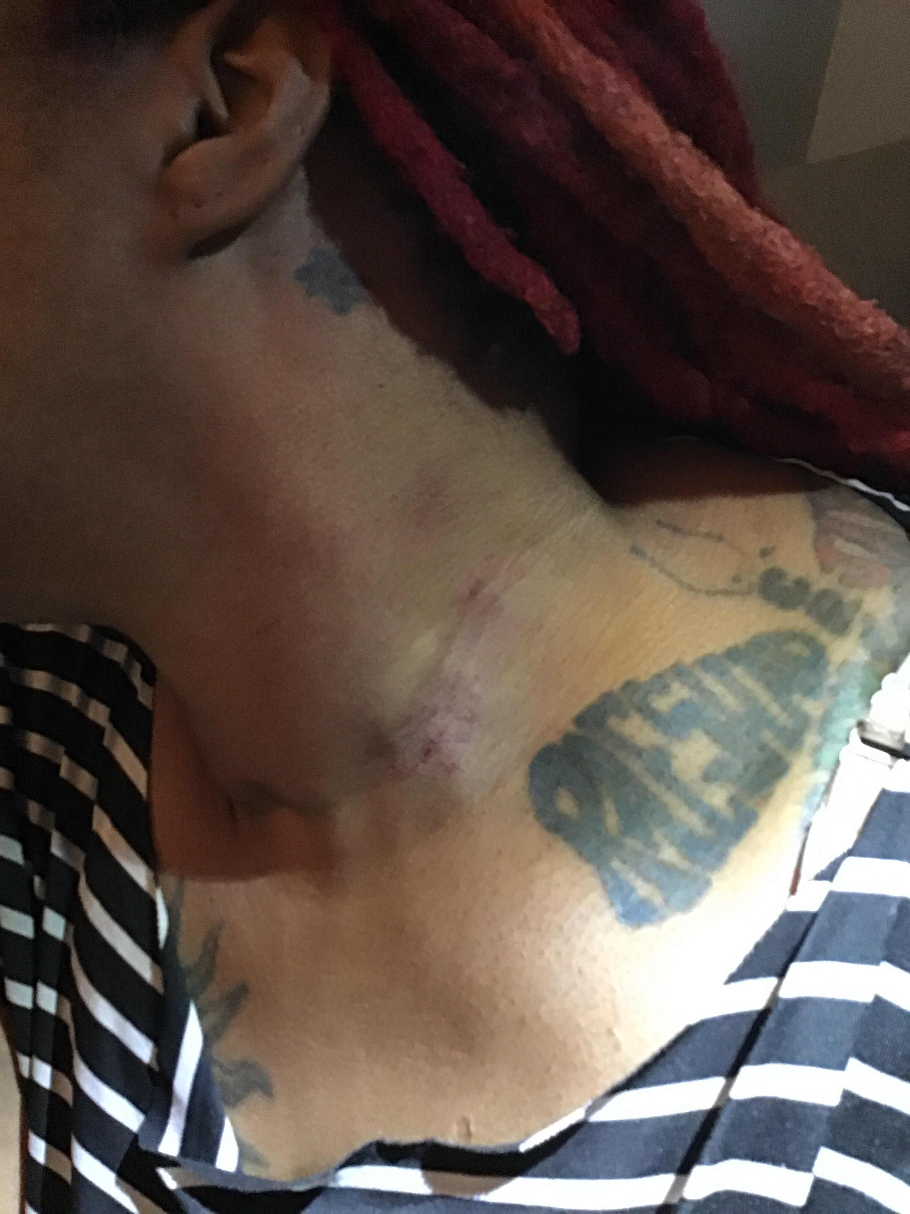
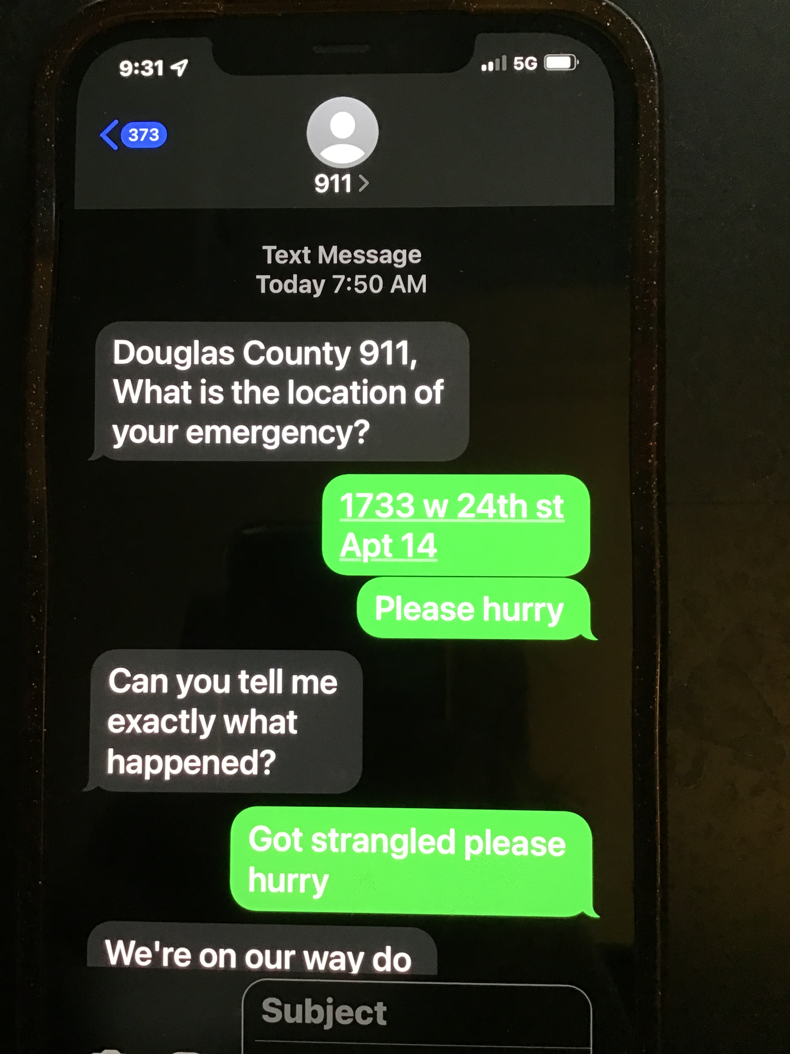
Defendant attempts to flee

Slide 11
INSTRUCTIONS
No. 1. Evidence- testimony of witnesses…any admitted exhibits
No. 4. Statements of attorneys are not evidence
No. 8. You have the right to use common knowledge and experience in regard to the matter about which a witness has testified.

Slide 12
CT 1:AGGRAVATED DOMESTIC BATTERY
1. The defendant knowingly impeded the normal breathing or circulation of the blood of Erin. J. Pitillo by applying pressure on her throat, neck or chest;
2. The defendant committed this act in a rude, angry, or insulting manner;
3. The defendant and Erin J. Pitllo were family or household members;
4. On March 10, 2020 in DGCO, Kansas.
Family or household members 18 years or age of older who have resided together in the past.
Knowingly, when defendant is aware of the circumstances in which he is acting.

Slide 13
The defendant knowingly impeded the normal breathing or circulation of the blood of Erin. J. Pitillo by applying pressure on her throat, neck or chest;

Slide 16
Reynolds- sees injury
Pruett- sees injury
Pruett- She is strangled on the couch, she cannot breath,, it is getting black, she thought she would die. ST. 22
The mark is not there before and it burns to the touch.

Slide 17
VERDICT
Law
Evidence
Guilty of Aggravated Domestic Battery and Aggravated Assault
Domestic Violence Offenses

Slide 18
WORKSHOP CLOSING ARGUMENT
9-10 minutes
Consider: use of first minute and last minute, structure of the argument, persuasive segments, plausibility of the argument
Use at least one visual in the argument

Slide 19
References
National District Attorney’s Association Trial Advocacy Manual ($85)
Ronald Clark Closing Argument Checklists
Ladies and Gentlemen Of the Jury: Greatest Closing Arguments in Modern Law- Michael S. Leif, H. Mitchell Caldwell, Ben Bycel.
Trial Techniques- Thomas Mauet

Slide 20
Thank you !
Jennifer Tatum
jtatum@douglascountyks.org
785-841-0211

