Slide 1
Approach Point℠
Cross-Examination
Developed by the National College of District Attorneys
Presented by
Tom Weilert
For
The Kansas County and District Attorneys Association

Slide 2
Required Opening Slide Notice
This multi-media presentation contains the creative works of others which are being used by permission, license, through a claim of fair use, or because they are in the public domain. This presentation was prepared under the “fair use guidelines” for education and further use or distribution is not permitted.
(17 U.S.C. 107)
Electronic Graphics © 2004 Animation Factory
Media Elements © Microsoft Corporation

Slide 3
The Basics
Case Analysis
Rules
Preparation
Performance

Slide 4
Case Analysis
Prosecution Theory
Factual Theory
Legal Theory

Slide 5
Case Analysis
Defendant’s Theory
Alibi
Accident
Self Defense
Consent
Misidentification
Intoxication
No Criminal responsibility

Slide 6
Rules
60-401 Relevance
60-419 Knowledge & experience
60-420, 421, 422 Credibility
60-446, 447 & 448 Character

Slide 7
Preparation
Discovery
Research /
Investigation
Brainstorming
Organizing

Slide 8
Discovery
Formal Motions
Subpoenas
Statements
In Court Arguments
Informal Discussions
Pre-trial Conferences

Slide 9
Research/
Investigation
Visit Scene
Internet
Photographs
Cell Phone Records
Criminal Records
Interview Witnesses
Physical Evidence

Slide 10
Concept of Cross-Examination
I don’t
know who that is.
I believe
that’s
Joe.
What is
your name?
You’re
Joe,
aren’t you?

Slide 11
The person concedes his name
Good faith belief
that his name is Joe
I believe
that’s
Joe.
Person concedes
his name.
Yes, I concede I’m Joe.
You’re
Joe,
aren’t you?

Slide 12
The objective is to secure concessions favorable to the prosecution case theory.
[Fact beneficial to my case theory], isn’t it?
I must concede that fact (to your benefit)
Witness
Prosecutor

Slide 13
OR secure concessions unfavorable to the defense case theory or the defense witness.
I must concede that fact (to my/our detriment)
[Impeachment fact], isn’t it?
Witness
Prosecutor

Slide 14
“I don’t know what the witness is going to say.”
?
Witness
Prosecutor

Slide 15
Based on the facts and the reasonable inferences, what must the witness concede?
I don’t think I’m going to like this.
Hmmm…
brainstorm
Witness
Prosecutor

Slide 16
Both Case Theories Can’t Be True
Facts & Evidence
Impossible/
Improbable
Prosecution
Case Theory
Defense
Case Theory
Bend
Point this out
in argument
Lock-in here

Slide 17
Got away from the scene
Lock in his concessions;
show similarities
But he matches a lot of the facts
Somebody was using
my face
Defendant
Prosecutor

Slide 18
She knew him; knew who he was
Lock in his concessions;
show inconsistencies
But the facts aren’t consistent with consent
Consent
Defendant
Prosecutor

Slide 19
Killer ID known
Lock in his concessions;
show inconsistencies
But the facts suggest otherwise
Self-defense
Defendant
Prosecutor

Slide 20
Very, very strong case
Lock in his concessions;
show inconsistencies
A lot of normal behavior
I was out of touch with reality
Defendant
Prosecutor

Slide 21
Think about concessions about similarities
I can get
the Defendant to
admit everything
he has in common
with the “criminal”
I’m going to
avoid admitting
anything if
I can.
Defendant
Prosecutor

Slide 22
Criminal
Defendant
Descriptions
Locations
Times
Relationships
Property

Slide 23
Think about concessions about those similarities
You heard the
witness say the
robber’s height was
between 5’8”
and 5’10”. You’re
between 5’8” and
5’10” aren’t
you?
I have to
concede that
or look
foolish.
Defendant
Prosecutor

Slide 24
Think about concessions about dissimilarities
I want to
contrast this
“expert” with
our experts who did it right.
I wonder if
I can smash
this
prosecutor?
Expert
Prosecutor

Slide 25
Expert
"Expert"
Reliable
Improbable
Accepted
Unlikely
Credible
Unlikely
Correct
Improbable
Logical
Improbable

Slide 26
Concessions
Contrast
But if I have to
tell you what
I didn’t follow
about it,
I’m doomed.
The
best.
Scientific
method?
Prosecutor
"Expert"

Slide 27
Concessions
Contrast
Uh, oh! It’s the old comparison – contrast cross-examination.
First I’m going to walk him through the Scientific Method, then walk him through what he did different
Prosecutor
"Expert"

Slide 28
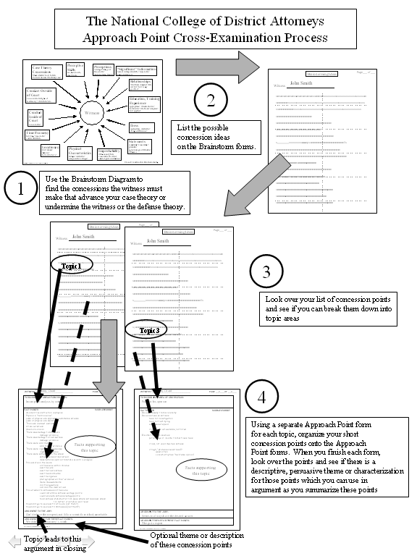
Approach PointSM Cross-Examination
The Process

Slide 29
Brainstorming
What they must
say to win
Facts in support
Why they can’t say it
Topics for organization
Argument to jury

Slide 30
Perceptive
Skills
see, hear, touch,
smell, taste
Perceptions
Vantage Point good?
Reasonable?
obstacles/impediments
Case Theory
Concessions
Must admit or look foolish
Can corroborate what in my case?
“Significant” Information
not act on important info? reasonable?
knew/didn’t know
Relationships
who/what connected with
and how? how long?
good/bad?
Conduct Outside of Court
reasonable in light of
testimony? did/didn’t do
Education, Training
Experience
appropriate? what is known?
how known? who from? complete?
how applied?
Witness
Conduct
Inside of
Court
reasonable?
Dress
appropriate, distinctive?
changes/differences?
Time Frame(s)
how long? reasonable?
could/couldn’t do
Statements
consistent? reasonable?
probable?
agree/not agree with other
witnesses
Location(s)
know about?
distance?
how arrive/leave?
Physical
Characteristics
unique? distinctive?
compared to? changes?
Improbability
witness story/facts
reasonable if carried
out to logical conclusions?
Cross-Examination Brainstorming
Dedman - National College of District Attorneys

Slide 31
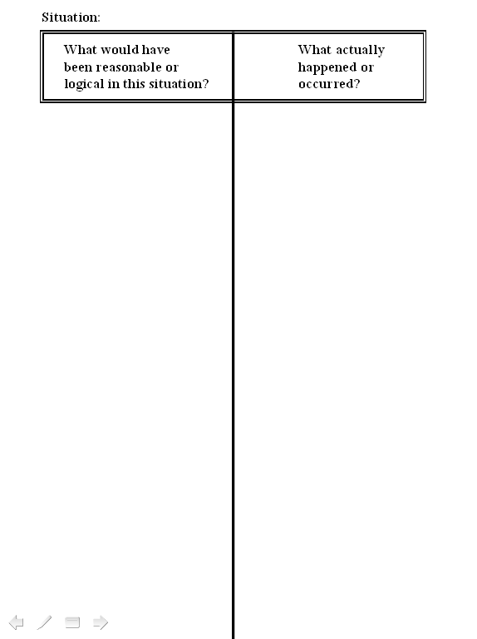
Approach PointSM Cross-Examination
Collecting Brainstorming Ideas

Slide 32
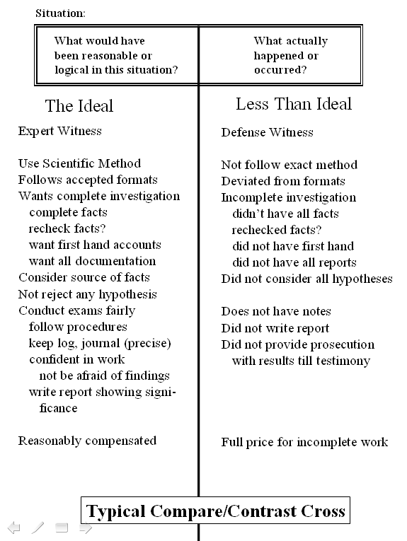
Approach PointSM Cross-Examination
Organizing a
Comparative/Contrast
Cross-Examination

Slide 33
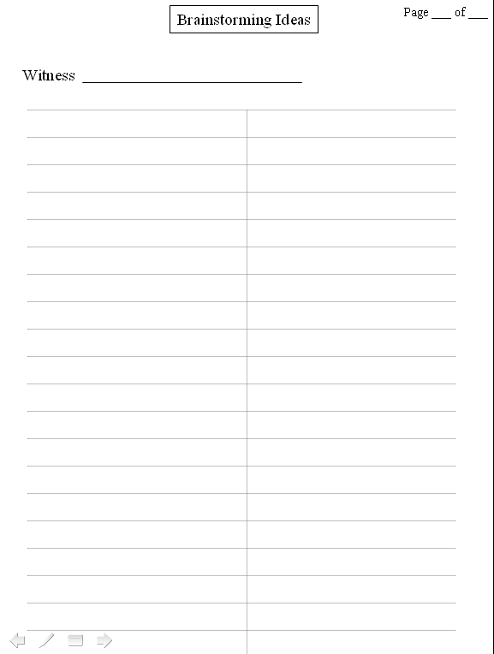
Approach PointSM Cross-Examination
Collecting Brainstorming Ideas

Slide 34
Organizing
Chunking Information
Approach Point Sheets

Slide 35
Argument/Cross Structure
Argument Point (Bias/Credibility)
  Topic/Subject (“close neighbors”)
    Fact Point 1
    Fact Point 2
    Fact Point 3
    Fact Point 4
  Topic/Subject (“socialize frequently”)
    Fact Point 1
    Fact Point 2
These are my cross-exam
questions
These are organizational
headings/topics
This is what I argue
to the jury

Slide 36
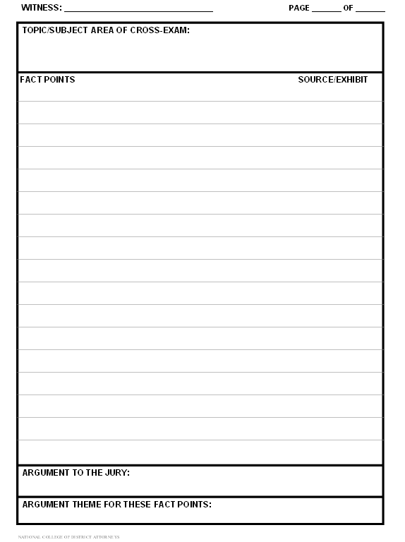
Approach PointSM Cross-Examination
Organizing Brainstorming Ideas onto the Approach Point form

Slide 37
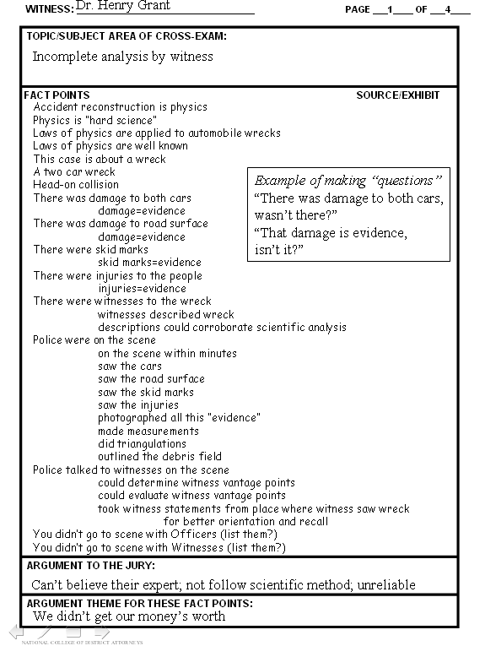

Slide 38
Performance
The Question
Bad Habits
The Answer
Argument

Slide 39
Bad habits in
Cross-examinations
Not listening to
the answers
Answers a
different
question
Good answer ignored
By prosecutor

Slide 40
Not listening to the answers ignoring good content
While you were watching him there, what did you see him do next?
Well, he kinda glared at [the victim], then went down the hill
Prosecutor
Witness

Slide 41
Not listening to the answers to incorporate the good content
Compare
As you watched him go down the hill, . . .
When you saw him glare at [the victim]
Prosecutor
And, as he was glaring at [the victim]

Slide 42
Not listening to the answers
(deflected answer)
How many questioned
document examinations
did you conduct
last year?
We did over three hundred
questioned document exams last year
Prosecutor
Witness

Slide 43
Correcting the deflection
Of those three hundred plus exams last year, how many did you do?
Four.
Prosecutor
Witness

Slide 44
Bad habits in
Cross-examinations
Literally true
answers
Poorly constructed
questions
Compound or
multiple elements
Questions too long
for jury to
follow

Slide 45
Literal truth
Is it your testimony…
Are you telling this jury…
Do you want us to believe…
D

Slide 46
Literal Truth
Are you
telling
this jury
you did
not shoot
the victim?
Truthfully,
that is what I’m
telling them,
although I
did shoot him.
Yes
Prosecutor
Defendant

Slide 47
Compound or multiple elements in the question
Did you take that loaded gun to your Ford truck and then drive to [the victim’s] house and shoot her?
No.
Prosecutor
Witness

Slide 48
Jurors may not be able to follow long questions
We were only half way through understanding the question when the witness began to answer, so we are confused.
You had the gun, the loaded gun, and you had the truck, and that was when you decided to go over to [the victim’s] house because you knew she was going to be over there, wasn’t it?
Prosecutor
Jury

Slide 49
Compound or too long questions corrected
Short facts –
general to specific
Repetition
Drove to victim’s house
You had a gun
A loaded gun
Your Ford truck
Got into a
truck

Slide 50
Bad habits in
Cross-examinations
Improper,
argumentative
questions
Asks for an
evaluation of
evidence
Argues case theory
with witness

Slide 51
Calls for opinion without predicate; asks for an evaluation of the evidence
You heard the police officers say they found the drugs in your car. Were they lying?
Objection, argumentative question. Calls for an opinion and evaluation of the evidence
Prosecutor
Def. Atty

Slide 52
Argues the case theory with the witness
You had the gun
Didn’t have a gun.
Didn’t have a gun.
And you loaded the gun
Didn’t have a gun.
And you aimed the gun
Prosecutor
Witness

Slide 53
Argues the case theory with the witness
You murdered her, didn’t you?.
Self-defense
It was consent
You raped her . . .
They gave me the money
You stole the money . . .
Prosecutor
Witness

Slide 54
Cross-examination Truths and Myths
Don’t ever
ask a question to
which
you don’t
know the
answer.
Always use
leading
questions.

Slide 55
Conventional Wisdom
Take witness back over defense direct

Slide 56
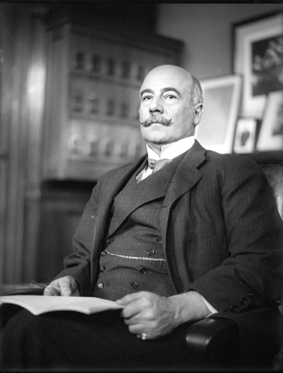
Francis L. Wellman
“ . . . earmarks of fabrication, it is often useful, as your first question, to ask him to repeat this story.”
public domain

Slide 57
Questions
Question Formats
Interrogatory
question
Accusatory
question
Anticipatory
question

Slide 58
Interrogatory Question dangerous words
Permits open-ended
answers
Who, what, where,
when, how, why
So, therefore,
because, since
Encourage wandering
Explain different conclusion

Slide 59
A dangerous word can make a closed- ended format question and open-ended one.
And you did that BECAUSE you were upset, weren’t you?
No. I’ll tell you exactly WHY I did it. I did it BECAUSE (and the answer goes on forever).
Prosecutor
Witness

Slide 60
Anticipatory question can highlight credibility problems
Doctor, you are board certified in this state, aren’t you?
No.
No?
Prosecutor
Witness

Slide 61
Accusatory Question
Offers the most control
[I give you a fact and a tag line, and you answer YES or NO]
[But that doesn’t allow me much, if any, wiggle room, if you do it that way. How can I fudge?]
Prosecutor
Witness

Slide 62
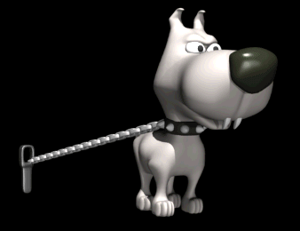
Accusatory Question
Offers the most control
Witness
?
Accusatory question
acts as a leash on
the witness.
Prosecutor

Slide 63
Deflection &
Evasion
Repeat
Let Ramble
Stay calm ?
Don’t go for help too soon !

Slide 64
The Trial Event
Jury
Selection
Opening
Direct
Cross
Closing
Concessions
Rebuttal
Impeachment

