Slide 1

1970s

Slide 2

MINIMUM WAGE

Slide 3


Slide 4
$1.45
Notes:
1970

Slide 5
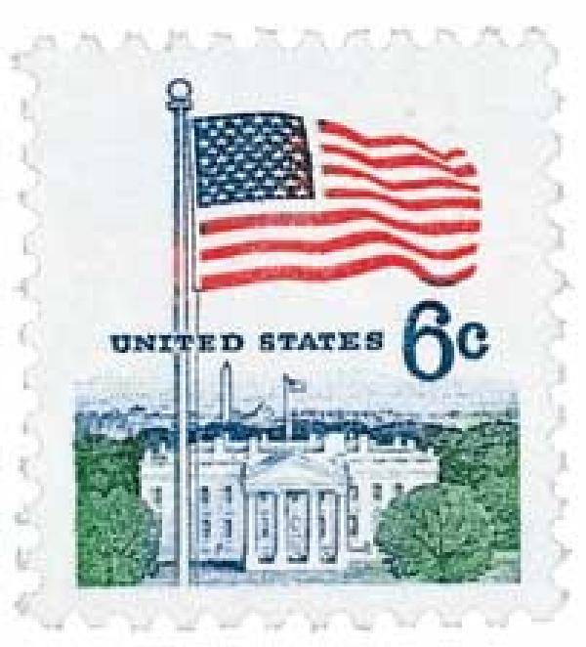
First class stamp

Slide 7
$0.06
Notes:
1970

Slide 8
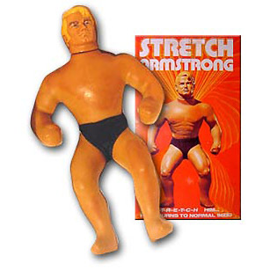
STRETCH ARMSTRONG

Slide 10
$11.00
Notes:
1970

Slide 11
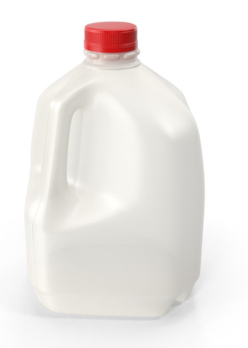
Gallon of milk

Slide 13
$1.15
Notes:
1970

Slide 14
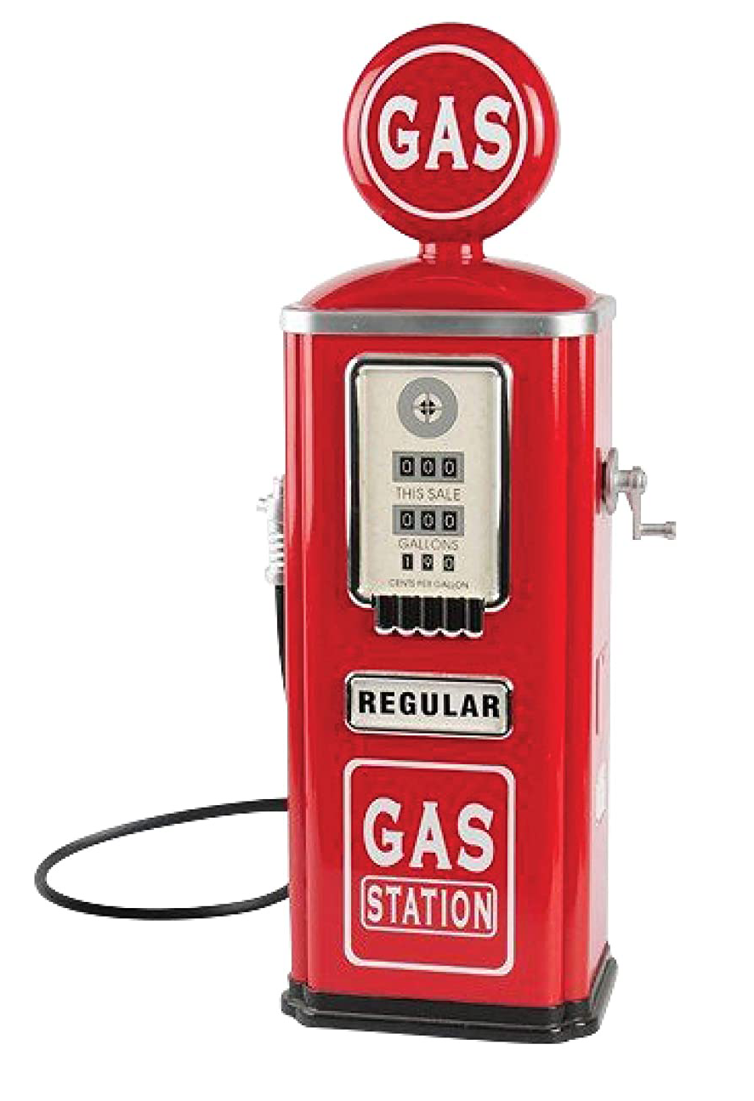
GASOLINE PER GALLON

Slide 16
$0.36/gal
Notes:
1970

Slide 17

Moon boots

Slide 19
$14.99
Notes:
1970

Slide 20
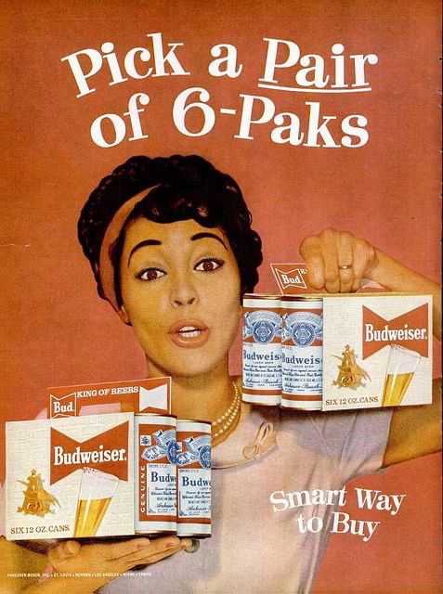
Six pack of beer

Slide 22
$1.98
Notes:
1970

Slide 23
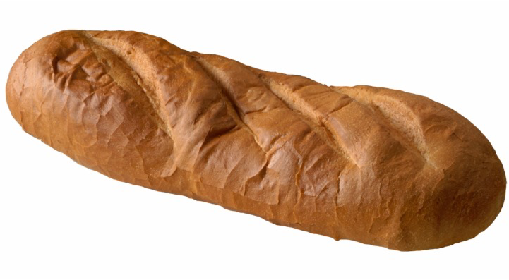
Loaf of bread

Slide 25
$0.25
Notes:
1970

Slide 26
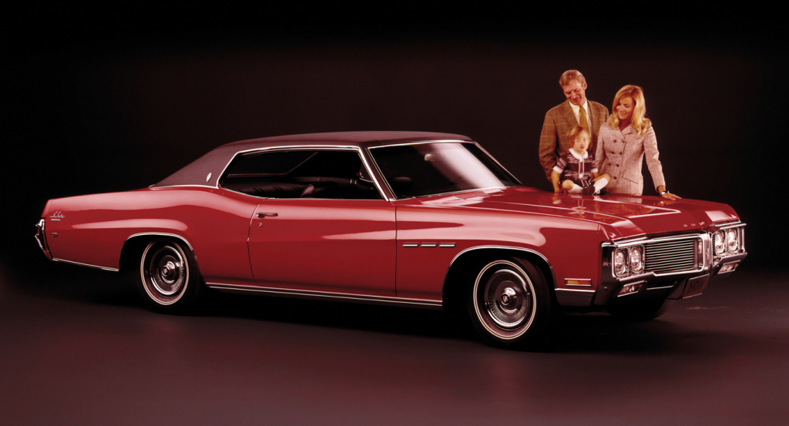
1970 Buick lesabre

Slide 28
$3,337
Notes:
1970

Slide 29

One dozen eggs

Slide 31
$0.61
Notes:
1970

Slide 32
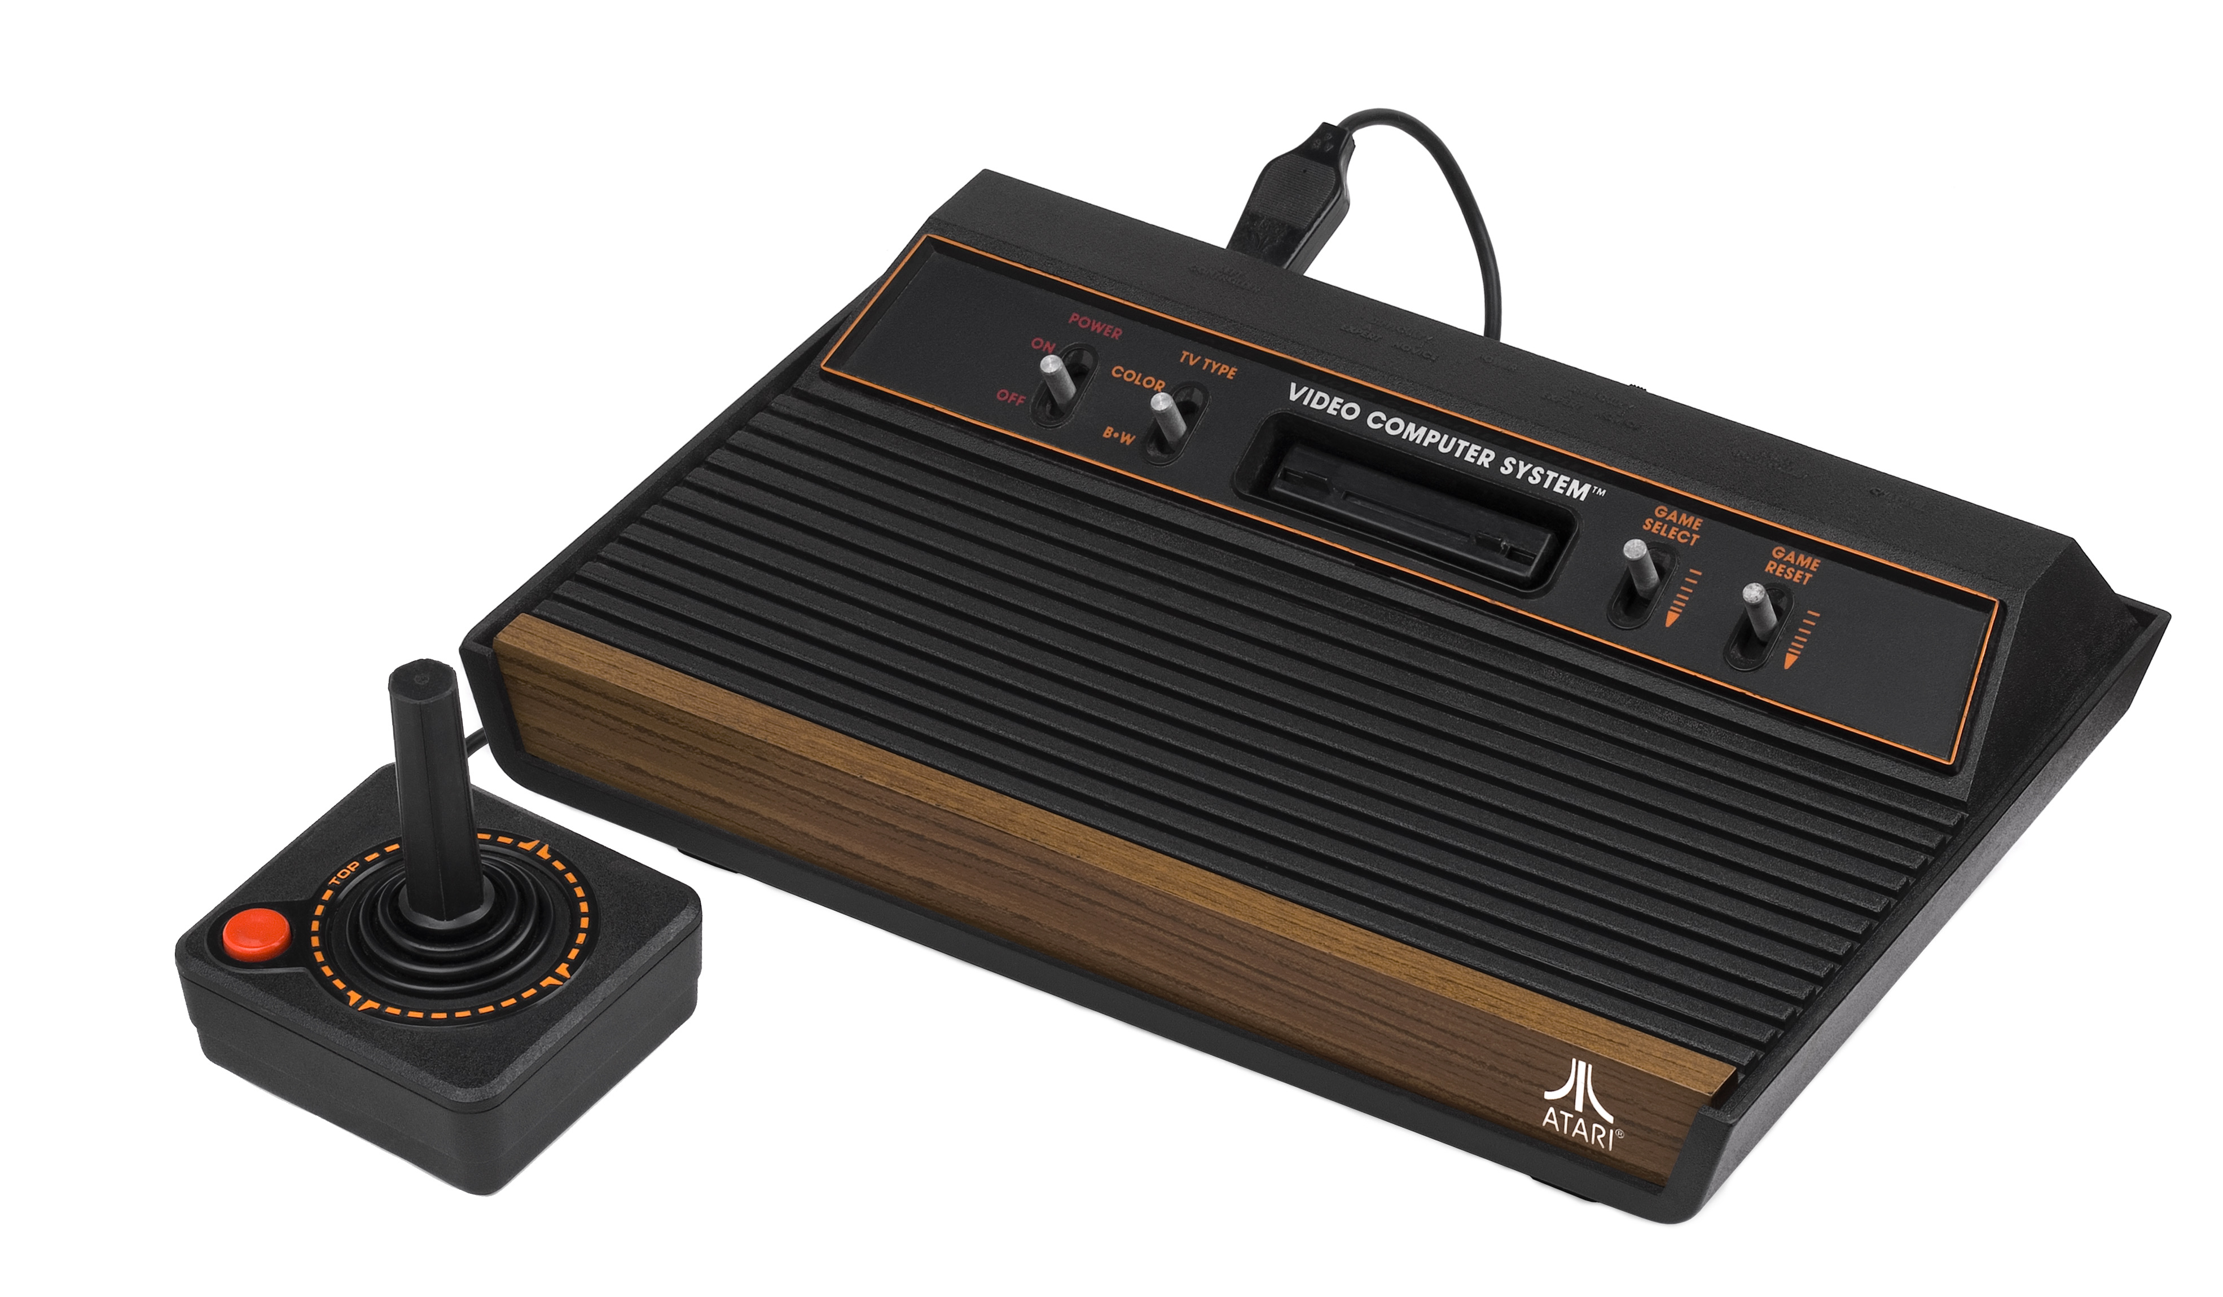
Atari video game

Slide 34
$199.99
Notes:
1970

Slide 35

One MOVIE TICKET

Slide 37
$1.55

Slide 38
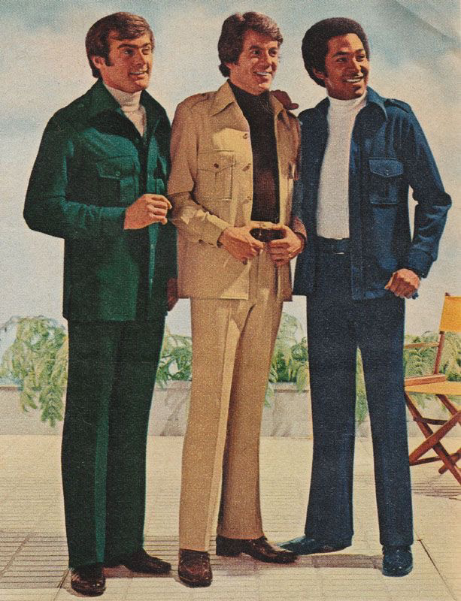
Men’s suit

Slide 40
$29.99
Notes:
1970

Slide 41
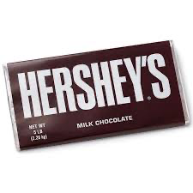
Hershey’s chocolate bar

Slide 43
$0.15
Notes:
1970

Slide 44
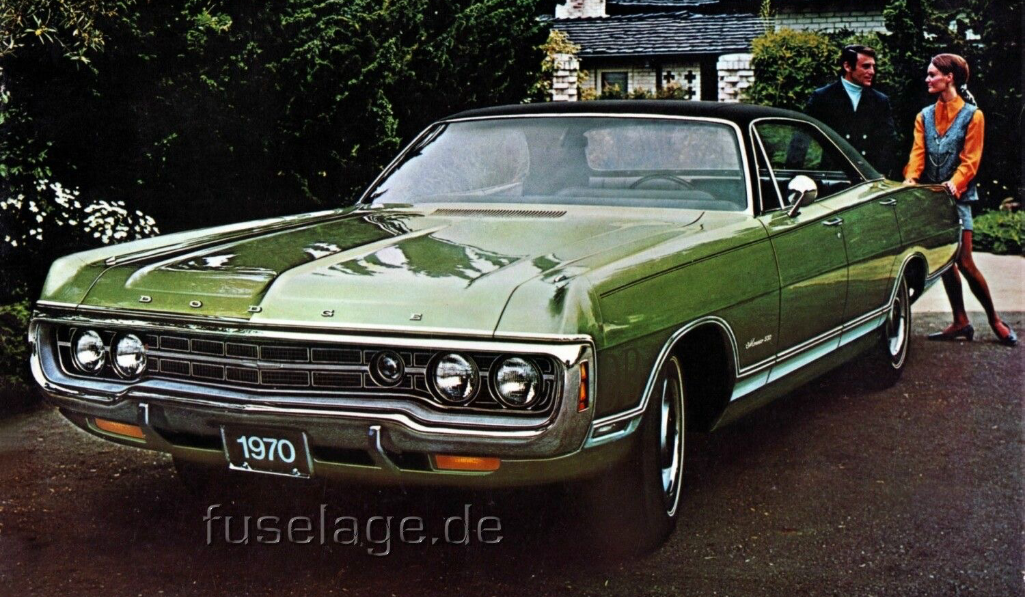
1970 DODGE MONACO

Slide 46
$3,743
Notes:
1970

Slide 47

McDonald’s big mac

Slide 49
$0.65

Slide 50

Malibu Barbie

Slide 52
$1.97
Notes:
1970

Slide 53

COFFEE per pound

Slide 55
$0.91
Notes:
1970

Slide 56
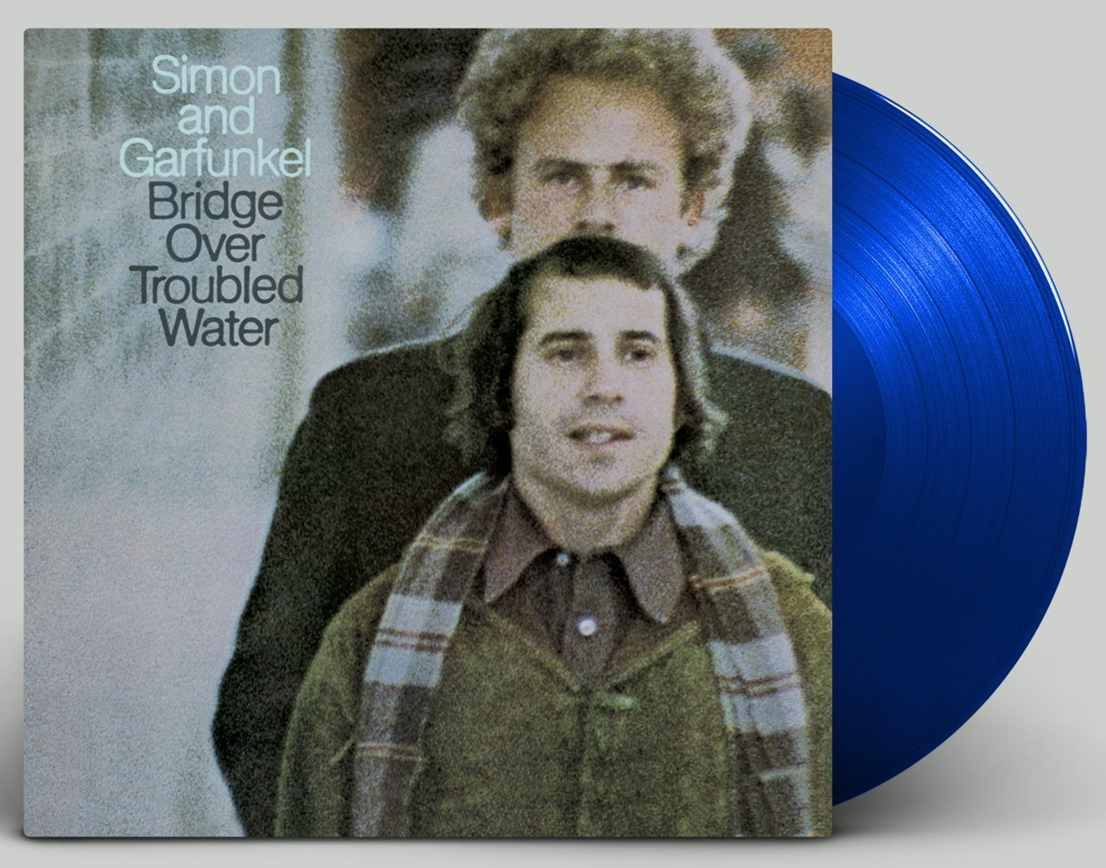
Simon & GARFUNKEL vinyl

Slide 58
$4.99
Notes:
1970

