Slide 1

Learn More About Living Better
Delsheda Khanii, President
Lisa Gibson, Vice President
Dennis Berry, Dir. of Nutrition & Fitness Programs

Slide 2
THE GOALS OF THIS INITIATIVE
To educating the community about obesity and some of the risk factors that plague the community as a result of it.
To educate individuals about diabetes, hypertension, and high cholesterol, and the fact that all of these require nutrition intervention.
To educate the community about the importance of health literacy.
To help individuals make conscious decisions about the food they eat, exercise and how it can lead to a healthier lifestyle.
To emphasize being fit & healthy over being skinny.

Slide 3
THIS IS AN ONGOING INITIATIVE THAT WILL:
Offer health related activities/services to the community
Offer options for reasonable food choices
Educate the community on overcoming income restrictions
Educate the community on overcoming resource restrictions
Promote food and health literacy
Keep the community engaged and active
Inspire individuals to reach their health and fitness goals

Slide 4
The importance of getting our Health from Nature
We, like every other living thing on the planet, are from Nature.
Everything that we need to survive has been provided by God.
By eating, drinking and breathing, what has been provided, we sustain our lives.
It’s been going on since the beginning of time.
Unfortunately, some people think they know better than God.

Slide 5
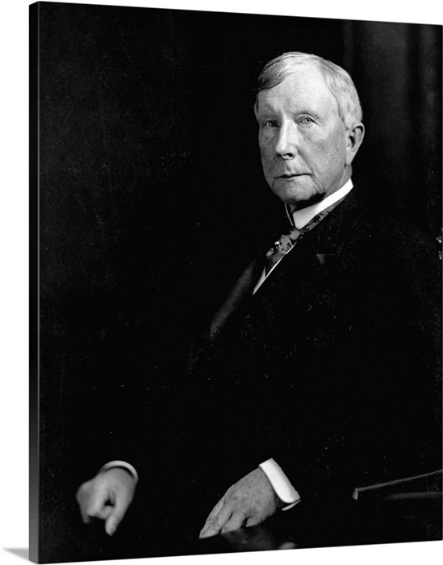
John D. Rockefeller
John D. Rockefeller- owned 90% of the oil industry in the U.S.
In early 1900, he realized that oil could be used to make pharmaceuticals.
He developed synthetic vitamins in 1935.

Slide 6

Holistic Medicine
Natural and Herbal Medicine was very popular at the time.
Almost half the doctors and Medical Colleges in the United State were practicing Holistic Medicine, using knowledge from Europe and Native Americans.
Rockefeller had to figure out a way to get rid of his biggest competition.
He used the classic strategy of “Problem-Reaction-Solution”.
That is, create a problem first and scare people, and then offer a solution.

Slide 7
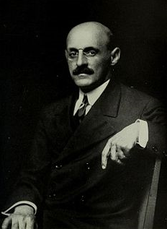
Abraham Flexner
Abraham Flexner was assigned by Rockefeller and Andrew Carnegie to look at hospitals and Medical schools.
The idea was to promote pharmaceuticals instead of Natural remedies.
He lied and said that Natural healing modalities which were used for 100’s of years was unscientific quackery.
He said that the medical industry needed revamping and centralizing, of the medical education institutions.
Based on this report, more that half of all medical colleges were closed.
Homeopathy and natural medicine were mocked and demonized, and doctors were even jailed.

Slide 8
Donations
Rockefeller gave more that $100 million to colleges and hospitals to make the transition and change the minds of doctors and scientists.
He created the General Education Board(G.E.B).
In a very short time medical schools and colleges were streamlined and homogenized.
All the students were learning the same thing, that medicine was all about using patented drugs.

Slide 9

Using Nature
Scientists received huge grants to study how plants cure diseases.
Their goal was to identify which chemicals in the plants were effective, and then create a similar synthetic chemical in the lab- but not identical, so that it could be patented.
“A Pill for an Ill” became the Mantra for Modern Medicine.

Slide 10
100 Years Later
Here we are now, 100 years later churning out doctors, who know nothing about the benefit of nutrition or herbs or any Holistic practice.
America spend 15% of it’s GDP on health care, which should really be called “Sick Care”.
It is focused not on cure, only on symptoms, thus creating repeat customers.
There is no cure for Caner, Diabetes, Autism, Asthma or even the Flu.
The American Cancer Society was started by John D. Rockefeller in 1913. Over 100 years later, they don’t appear to have a cure yet.

Slide 11
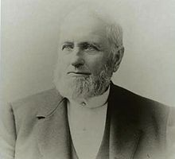
Like Father, Like Son
John D. Rockefeller’s father, William Rockefeller Senior, used to make his living by selling Snake Oil, and other plant oils and elixirs.
He used to introduce himself as “Dr. Bill Levingston, Celebrated Cancer Specialist”.
He used to sell his Snake Oil as a “cure-all tonic”, and charged $25 per bottle, which was equivalent to 2 months salary of an American worker at that time.

Slide 12
William Avery "Devil Bill" Rockefeller Sr.
William Avery "Devil Bill" Rockefeller Sr. (November 13, 1810 – May 11, 1906) was an American businessman, lumberman, herbalist, salesman, and con-artist who went by the alias of Dr. William Levingston. He worked as a lumberman and then a traveling salesman who identified himself as a "botanic physician" and sold elixirs.^{[1]} He was known to buy and sell horses, and was also known at one point to have bought a barge-load of salt in Syracuse. Land speculation was another type of his business, and the selling of elixirs served to keep him with cash and aided in his scouting of land deals. He loaned money to farmers at twelve percent, but tried to lend to farmers who could not pay so as to foreclose and take the farms.^{[2]} Two of his sons were Standard Oil co-founders John Davison Rockefeller Sr. and William Avery Rockefeller Jr.

Slide 13
In Conclusion
The Rockefeller Empire, in Tandem with his Chase Manhattan Bank, which is now J.P. Morgan, owns over half the Pharmaceutical interests in the United States.
It is the largest drug manufacturer in the world!
Pharmaceuticals do not cure disease, they only mask the symptoms.
By giving our body Proper Nutrition from nature, our body will cure itself.
As Hippocrates stated,
“Natural Forces Within Us Are The True Healers.
Let Your Food Be Your Medicine.
Let Your Medicine Be Your Food.”

