Slide 1
Wounding of the Soul: All of Us
“Moral Injury”
Presentation Provided to NASW-OK
March 19, 2022
Lanny Endicott, D.Min., LCSW, LMFT
Professor Emeritus Oral Roberts University
Email: lannyendicott@gmail.com
Cell: 918-830-1523

Slide 2
Objectives
Participants will gain an understanding of wounding of the soul or moral injury : its definition and application specifically to the military
Discuss the application of moral injury to social work and other people serving professions: pastors, first responders, medical professionals, and more
Examine resources to further understand and treat moral injury
Share your thoughts and testimonies as appropriate in Chat. This presentation is for all of us.

Slide 3
PTSD -5 key elements
A life threatening event: actual event or perception of person who experienced or witnessed an event that it could happen again.
Internal reminders of the event: typically nightmares or flashbacks – unwelcome intrusive, unwanted, one’s feeling he/she is threatened again (like watching a movie or seeing traumatic event unfold before them again). Feels real to the victim
Avoidance of external reminders: try not to think of traumatic event; suppress feelings; practice avoidance of place(s)
Altered anxiety state: leads to feeling on edge, hyper vigilant, exaggerated startle reflex; jumpy; anxiety; alert to threats
World is seen as a dangerous place: may lead to reclusiveness, isolation, depression, questioning one’s future - possibly leading to risky behavior
https://rogersbh.org/about-us/newsroom/blog/ptsd-5-signs-you-need-know

Slide 4
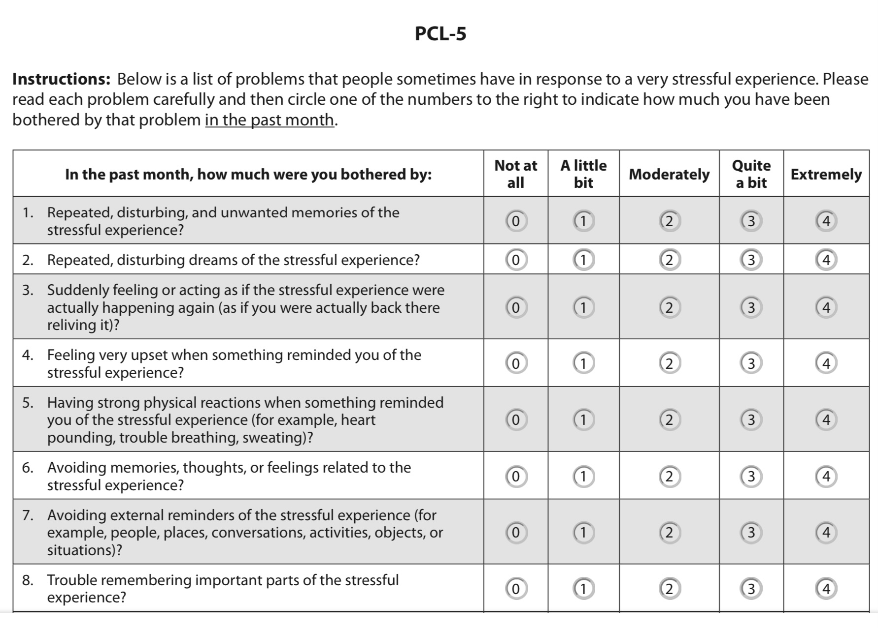

Slide 5
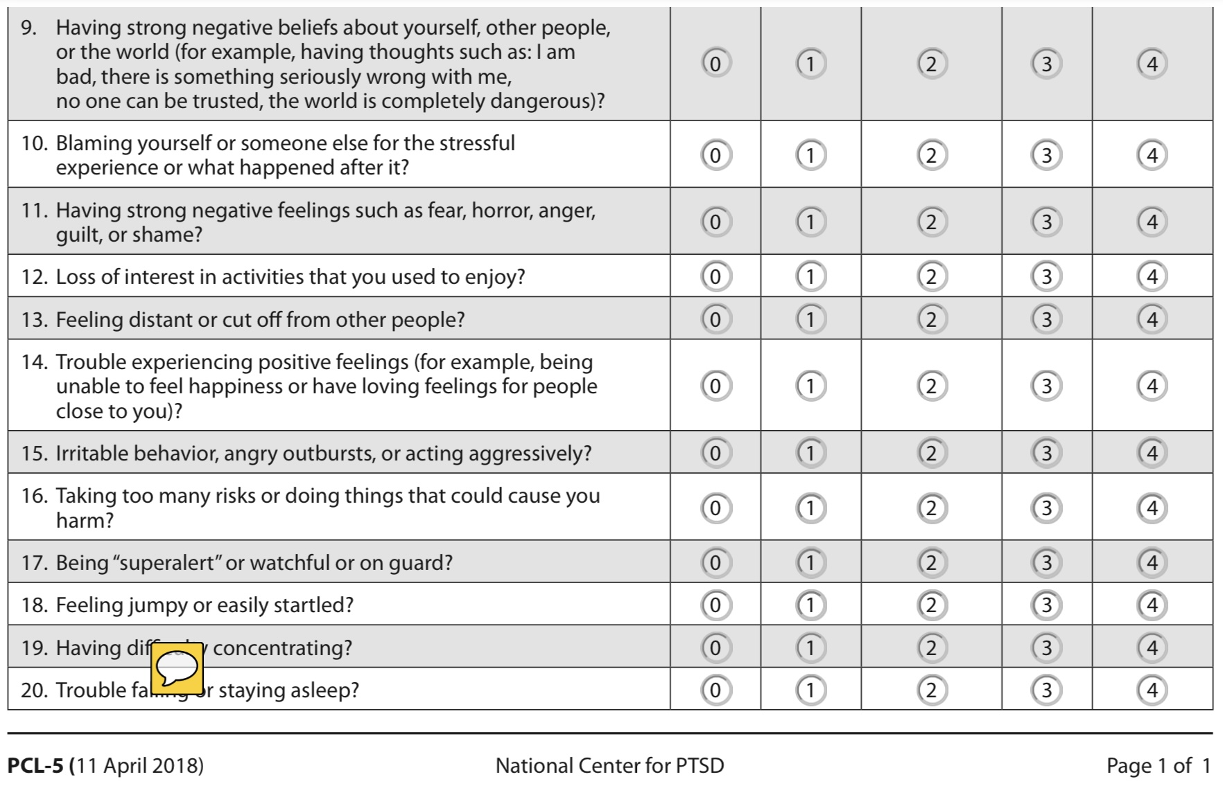

Slide 6
Moral Injury
Moral injury is the damage done to one’s conscience or moral compass when that person perpetrates, witnesses, or fails to prevent acts that transgress his/her moral beliefs, values, or ethical codes of conduct.
https://moralinjuryproject.syr.edu/about-moral-injury/

Slide 7
Moral Injury Events Scale (MIES)
 | Strongly Disagree | Moderately Disagree | Slightly Disagree | Slightly Agree | Moderately Agree | Strongly Agree
1. I saw things that were morally wrong. | 1 | 2 | 3 | 4 | 5 | 6
2. I am troubled by having witnessed others' immoral acts. | 1 | 2 | 3 | 4 | 5 | 6
3. I acted in ways that violated my own moral code or values. | 1 | 2 | 3 | 4 | 5 | 6
4. I am troubled by having acted in ways that violated my own morals or values. | 1 | 2 | 3 | 4 | 5 | 6
5. I violated my own morals by failing to do something that I felt I should have done. | 1 | 2 | 3 | 4 | 5 | 6
6. I am troubled because I violated my morals by failing to do something I felt I should have done. | 1 | 2 | 3 | 4 | 5 | 6
7. I feel betrayed by leaders who I once trusted. | 1 | 2 | 3 | 4 | 5 | 6
8. I feel betrayed by fellow service members who I once trusted. | 1 | 2 | 3 | 4 | 5 | 6
9. I feel betrayed by others outside the U.S. military who I once trusted. | 1 | 2 | 3 | 4 | 5 | 6
William Nash, MD. et al., Presented at Zarrow Symposium, Tulsa, OK , 20 September 2012

Slide 8
PTSD vs Moral Injury
MORAL INJURY – values not fear/trauma based; person has time to reflect on a values wrenching experience and asks: did I do the right thing? Or, I shouldn’t have done what I did. Could I have done something different? I was ordered to do something that violated my moral code. Or, I was personally violated in some way: rape, blame, being accused for a contested wrong (i.e. rules of engagement or ROE).
Soldier says: “We blew up the building, but didn’t realize children were inside – killing one, injuring two others. Feeling shame & dejection, he says: “I killed a child!”
Soldier kills enemy combatant who fires at him; afterward he checks the man’s pockets, only to find pictures of his parents, wife, and children. He regrets: “I killed a father.”
PTSD – fear triggers alarm system in the amygdala; adrenaline and cortisol spurt into the bloodstream > hyper-alert, breathing hard, tense muscles, eyes wide open, pulse racing, triggering a reaction of fight or flight.
False alarm - in bustling crowded and noisy supermarket, amygdala picks up on potential sign of danger and goes into action, not knowing that the person is no longer in a war zone – response is the same: sweating, gasping, runs out of the store, gets in his car panicking, slumping over the steering wheel out of breath.
Adapted from David Wood, What Have We Done: The Moral Injury of Our Longest Wars

Slide 9
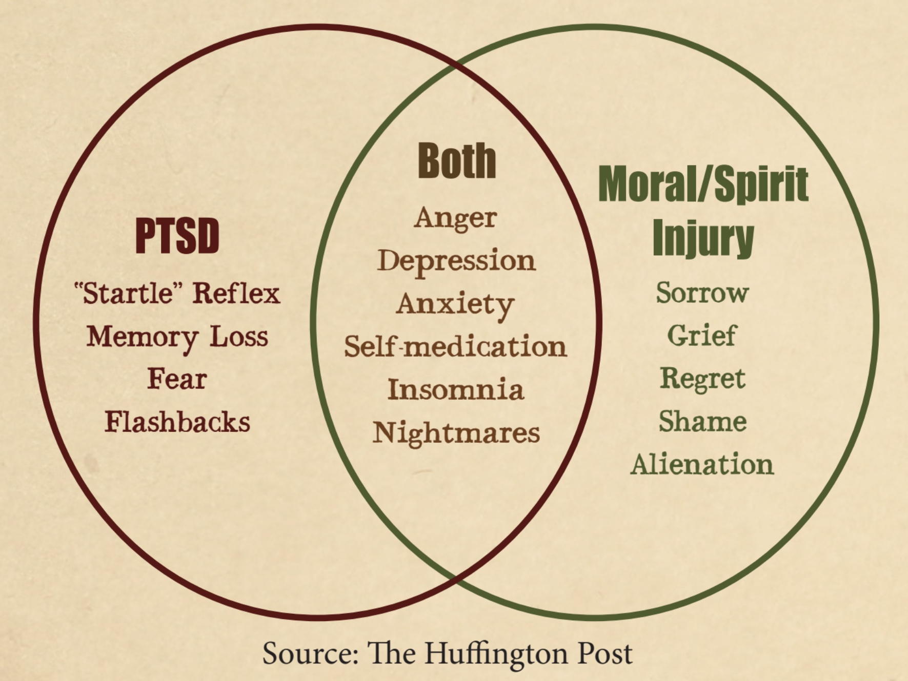
PTSD & Moral Injury Combined

Slide 10
US Military
Many soldiers are barely out of their teens and not developmentally prepared for the high stress of the military.
Military has been stretched by multiple deployments, all volunteer (initiated by Nixon) professional military, reserve, and National Guard.
Names of Recent Wars:
OIF - Operation Iraqi Freedom 2003 -2011 (Iraq)
OND - Operation New Dawn 2010-2011 (Iraq)
OEF - Operation Enduring Freedom 2001-2014 (Afghanistan)
MOS: military occupational code; AFSC: Air Force Specialty Code; Navy: NEC – Ask about MOS when visiting with a veteran

Slide 11
“Just War” and Rules of Engagement (ROE)
War should be a moral response to a grave wrong: a self-defense response to aggression or to protect victims of injustice. Killing is either the moral thing to do or it’s murder. (Obama)
St. Augustine’s doctrine relieved individual soldiers for killing if they did so in obedience to a higher authority: the church.
The Catholic Church’s position is that the use of arms should not produce evils greater than the evil to be eliminated.
Often US soldiers get caught being left to decide on their own whether a particular action is just or not – resulting in an epidemic of moral injury and personal tragedy
Adapted from David Wood, What Have We Done: The Moral Injury of Our Longest Wars

Slide 12
Deep grief, sorrow, shame, guilt, loss > moral injury
For some soldiers, the feelings of loss of combat buddies can linger for years.
Some societies past and present (i.e., Native American tribes) have recognized and honored soldiers with moral pain and offered healing.
Today we are likely to bring soldiers home, calling them heroes, thanking them for their service, yet ignoring their struggles – while leaving it to the VA to provide help.
Killing is linked to suicide – veterans in combat can have suicidal thoughts twice those who had no combat killing experiences.
Because of their killing experiences, many cannot go back to their spiritual communities, having feelings they don’t deserve to be happy, have children, or successful marital relationships, believing they are non-deserving of happiness.

Slide 13
Getting Help
Veterans struggle with self-forgiveness: 1) to forgive self would mean condoning one’s actions; 2) subverting the need for punishment; and 3) interfering with the need to feel unworthy and non-deserving of forgiveness.
Families and friends don’t understand their veterans when they return from war: survival there depended on adrenaline to keep them alive, along with paranoia, hyper-vigilance, aggressiveness, sleeplessness.
Some therapies:
Cognitive Processing (CPT) EMDR Exposure Therapy (ET) *Writing Exposure Therapy (WET) Group Therapy (GT) *Adaptive Disclosure (AD)
(including writing & telling the story, empty chair, apportioning blame, self-forgiveness)

Slide 14
Assessment: Watch for Moral Injury
1) Come along side 2) Listen reflectively 3) Listen for the moral injury 4) Ask questions about the moral injury 5) Explore options for helping
Professionals Affected
Social Workers Hidden Language of Moral Injury
Therapists “I regret that I…”
Child Welfare “I’m ashamed for what I did/didn’t do…”
Teachers “I can’t tell anyone about…”
Medical “I don’t deserve…”
First Responders “I’m not the same after…”
Police “No one really understands…”
Religious “If I could redo…”
“All of us” (Sitting in silence, not talking)

Slide 15
Marine Sgt Troubled Killing Innocents
https://youtu.be/aUOWZAXYhPs
Marine Talks About Killing Teens
https://youtu.be/VzRMKWyI9-Y
Medic Returning from War with Moral Injury
https://youtu.be/WNROYryPo0A
Physician Burnout, Depression, Moral Injury, Suicide
https://Youtu.be/E2bS_7Xps0M
Moral Injury in Child Protection Workers
https://youtu.be/iocWw9LBcpw

Slide 16
Discussion
My Journey

Slide 17
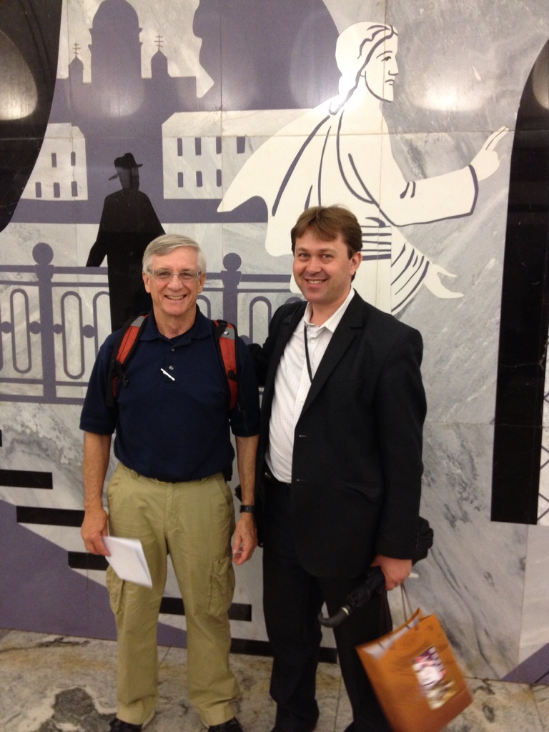
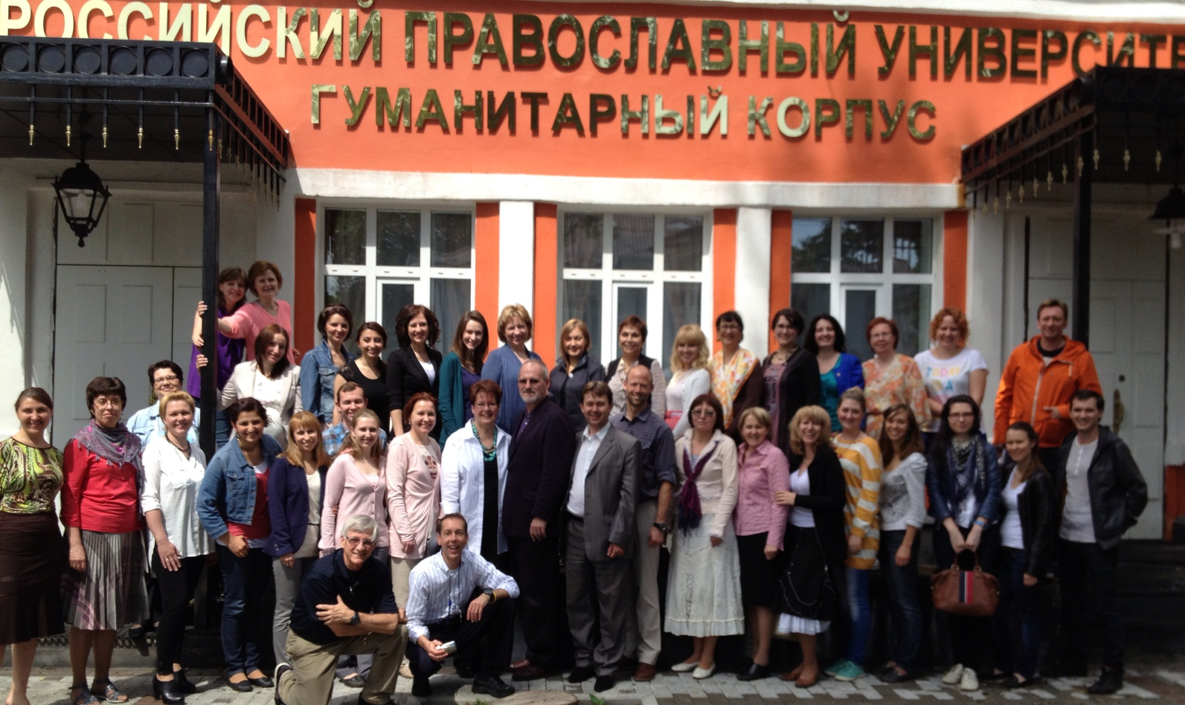
Dr Lanny Endicott Dr Ruslan Nadyuk
Students and Faculty
Russian Orthodox University - Moscow

Slide 18
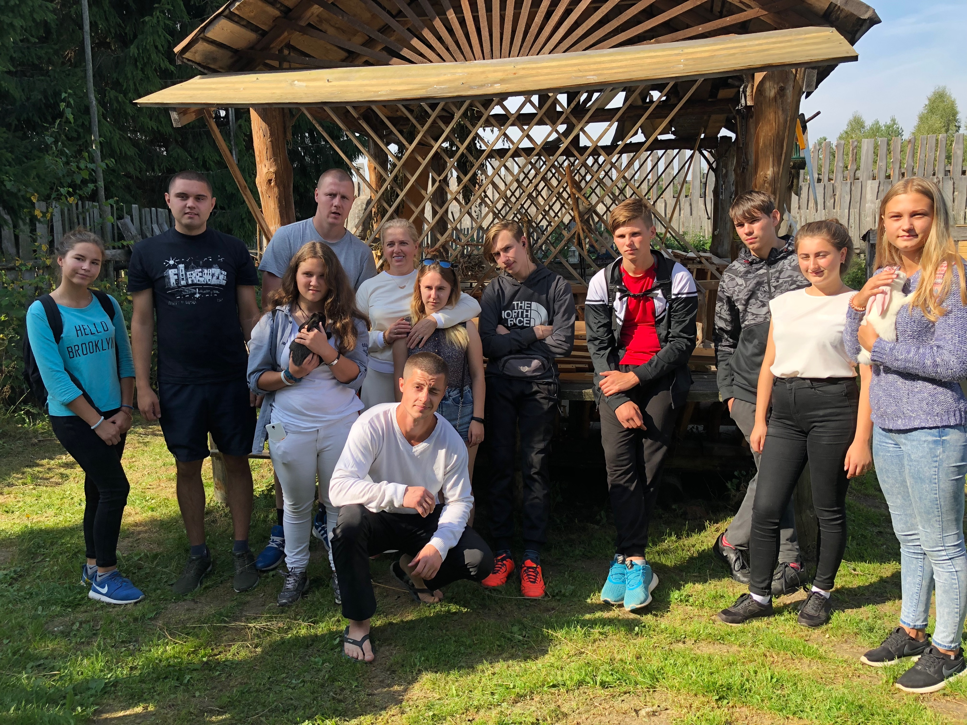
Orphan teens, Vladimer Oblast,
Russia

Slide 19
Rita Brock – Soul Repair http://youtu.be/A4ZbCxU0vW4

Slide 20
Soul Wounding? Friends – connect with Russian friends Orphans – military conscripts Mission – work with local universities currently on hold/ended What I’m seriously considering Trip to Poland to work with refugees/relieve caregivers (address compassion fatigue, moral injury, self-care) Connect with local academic institutions – social work programs Make the trip early this summer

Slide 21
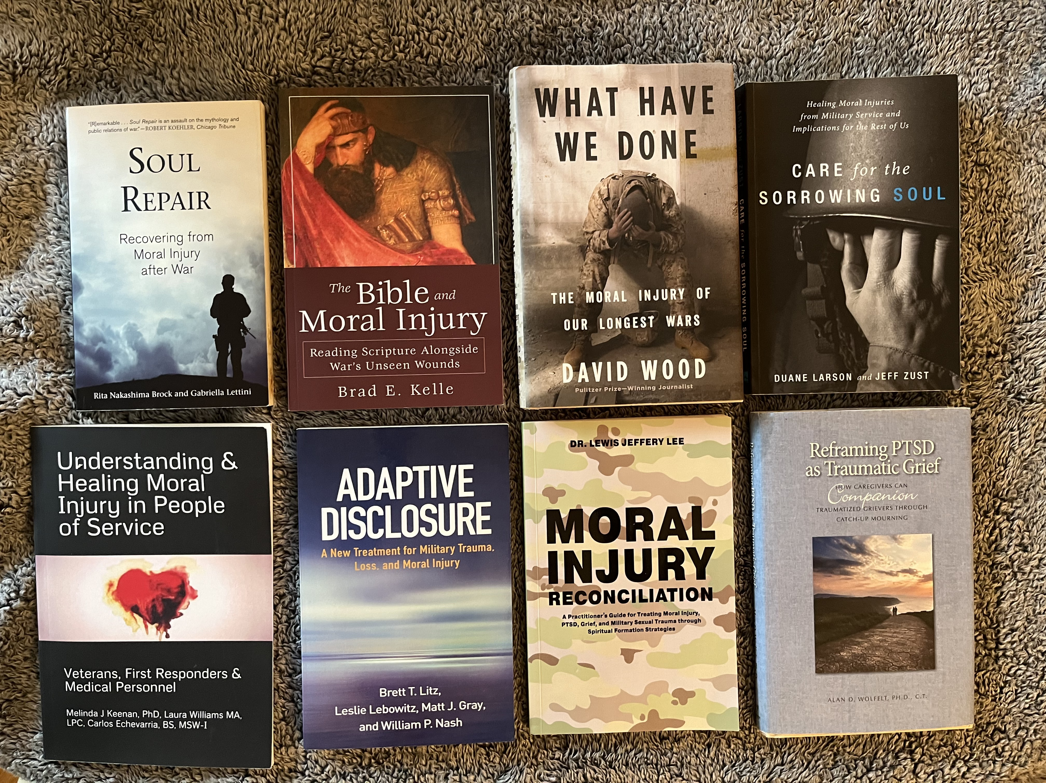

Slide 22
For further discussion contact:
Lanny Endicott
lannyendicott@gmail.com
918-830-1523
Thanks for Zooming in and sharing!

