Slide 1


Your future is cleared for takeoff!
2019

Slide 2
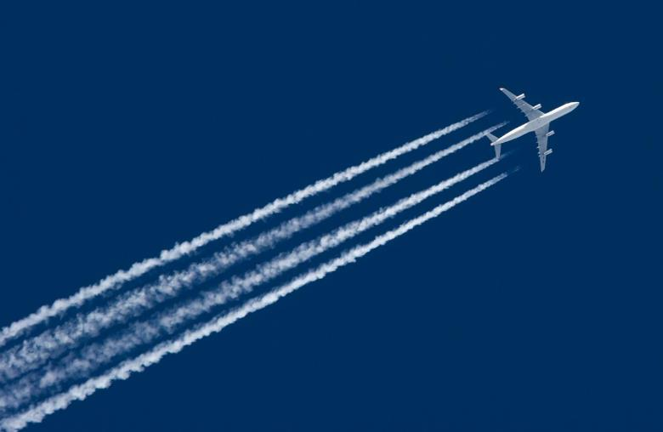
Aviation careers video
https://www.youtube.com/watch?v=Q3kn2sid4-M

Slide 3

When it comes to aviation…
the SKY’s the limit
The United States National Airspace System is the biggest and most complex in the world
On average, our aviation and aerospace system supports over 5 million square miles of airspace, including
  More than 2.6 million passengers fly in and out of U.S. airports every day
  Nearly 16 million flights every year
  And up to 5,000 aircraft in the sky at a time

Slide 4
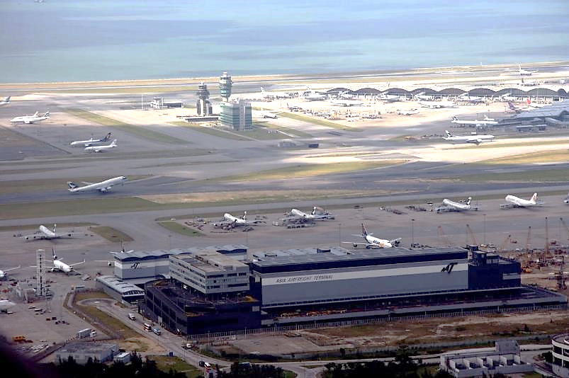
Who keeps the planes on the move?
Notes:
How many aviation jobs do you think are pictured here?
Less than 5?
More than 5?
More than 10?

Slide 5
Who keeps the planes on the move?
Corporate Jet Pilot
Aviation Safety Inspector
Air Traffic Controller
Flight Dispatcher
Front Line Manager
Tech Ops Specialist
Aircraft Certification Specialist
Baggage or Cargo Handler
Commercial Airline Pilot
Ground Crew
Flight Attendant
IT Support
Airport Engineer
Flight Inspector
Airport Security
Aircraft Engineer
Staff Support Specialist
Maintenance Technician
Notes:
There are actually 18 aviation jobs in this picture. All of these aviation professionals work together everyday in support of the United States National Airspace System.

Slide 6

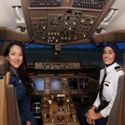
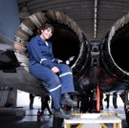
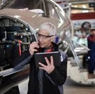


Hello, I am a…
Air Traffic Control Specialist –
promote airplane safety by coordinating and directing the movement of air traffic
Pilot – fly aircraft and passengers around the world
Mechanic – inspect, diagnose, and repair aircraft
Engineer – design and develop aircraft and related aviation/aerospace technologies
Ground Crew Member – support many aspects of the aircraft while it's on the ramp and parking area
Flight Attendant – travel the world and ensure the safety and comfort of airplane passengers
Notes:
The National Airspace System has a career/job for everyone, from professionals like engineers and mechanics on the ground to pilots and flight attendants in the sky. Their skills range from the technical to the intangible, blending science, technology, engineering, mathematics, and communication skills to keep the system running smoothly.

Slide 7
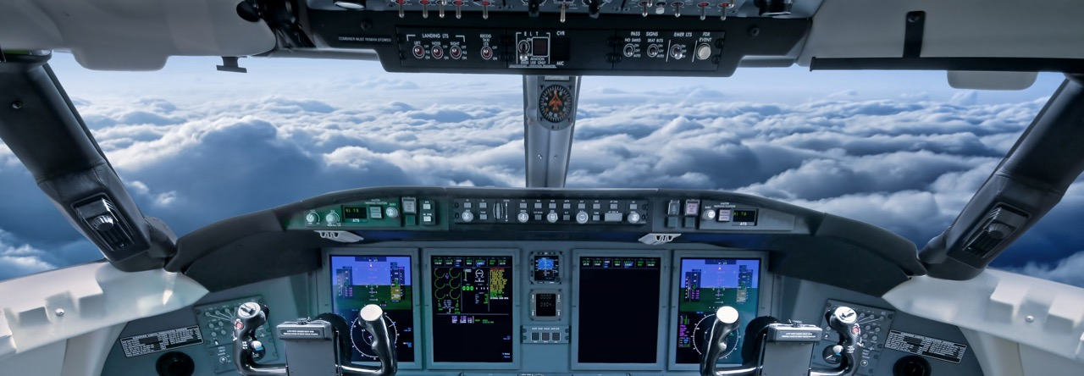

Who has the best view?
They operate important machinery
They have a breathtaking view from the “office”
They travel and learn about new cultures
They enjoy camaraderie and teamwork
Pilots do!
Notes:
Does anyone know how pilots and air traffic controllers talk to each other?
What if I told you pilots speak in code?
“Pilot language” includes:
Wilco – an abbreviation of “will comply”
Roger – message received
Use of the International Phonetic alphabet (Alfa, Bravo, Charlie, etc.)

Slide 8
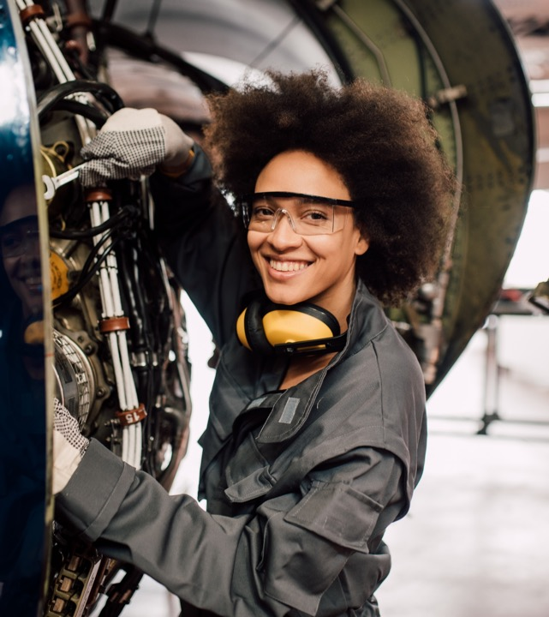

Who keeps the planes in the air?
Aviation maintenance technicians do!
They maintain and repair airplanes and helicopters
They work on jet engines and essential machinery
They create and test futuristic aircraft components
Notes:
Aviation maintenance technicians are “fixers”. Planes are incredibly complex vehicles. It’s up to technicians to know everything there is to know about the inside of the plane. They work everyday to keep the planes flying.

Slide 9
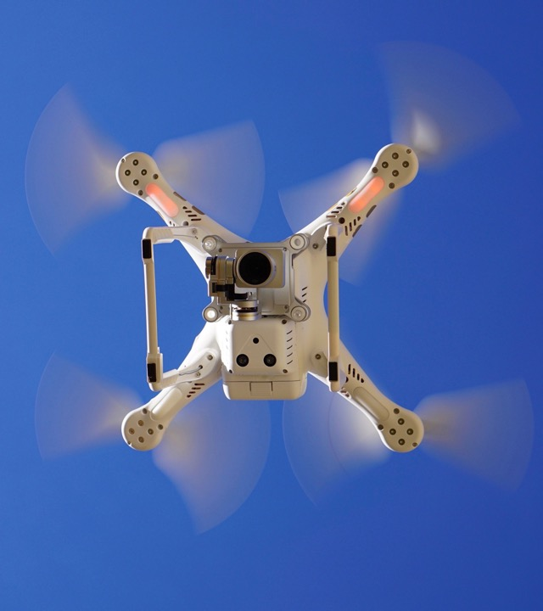

Who flies without
passengers?
Unmanned Aerial Vehicles do!
UAV pilots fly drones and other unmanned aerial vehicles
They stay on the ground, but see the world from a unique perspective
They help their communities
Notes:
How many of you have ever flown a toy plane or controlled a robot with a remote control? For some people, that’s their job! Drone pilots help us take videos and pictures, deliver packages, and even collect snot from whales!

Slide 10
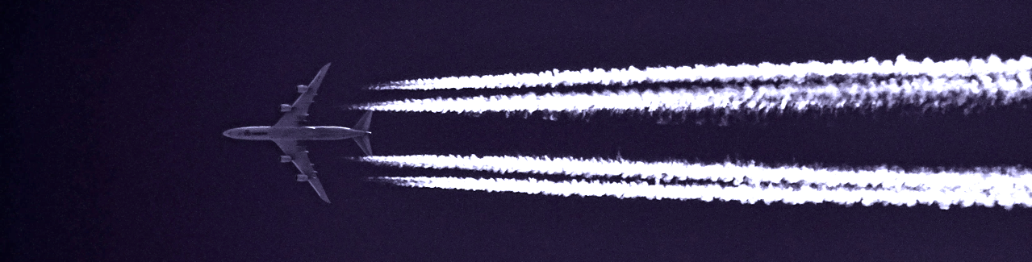
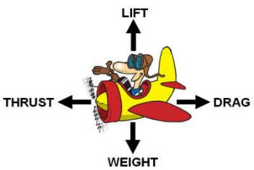
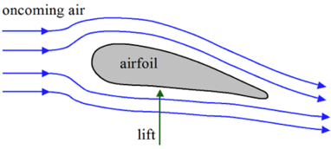
How do planes fly?
The force available for overcoming the force of gravity
wing
The forward-directed force from a propeller, jet, or rocket engine
The force exerted on a moving object by a medium (such as air) that slows it down
A measure of the heaviness of an object
Notes:
Have you ever wondering how planes that weigh thousands of pounds fly?

Slide 11

Activity: let’s fly!
You’re going to build a paper airplane!
  Get two pieces of paper – you will build two planes
  Fold your first paper plane
  Launch it!
  How far did it go? How high? How could you improve it?
  Make your second plane
  Test which design works better
Notes:
Engineers make small-scale models of things like airplanes to test their ideas before they build the real thing to make sure their design work properly. This helps them be sustainable by testing their ideas using less expensive materials and save resources by making improvements early on in the design process.
Today, I want you to be the engineer and build a paper airplane!

Slide 12
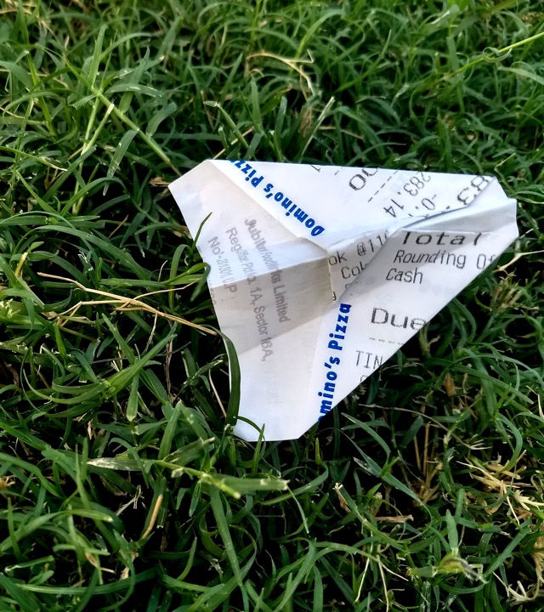
Let’s talk
What made your airplanes fly well?
How could you design a better airplane than the one you just made?
Would a plane made with heavier paper fly farther?
Notes:
Engineers rely on trial and error to evolve their designs, make them better and better.
What did we learn through this trial and error?
Examples of things that made their planes fly well include: wing size and shape, how hard they threw it, type of paper the plane is constructed from, etc.
True or False Questions:
- Design, weight and drag are all things that can affect paper airplane flight - True
- Engineers make models of things like airplanes to test their ideas in a laboratory setting before they build the real thing - True
- When an engineer designs and builds something, it usually works the first time and they are done – False. Engineers almost always have to redesign something several times before it is finished

Slide 13
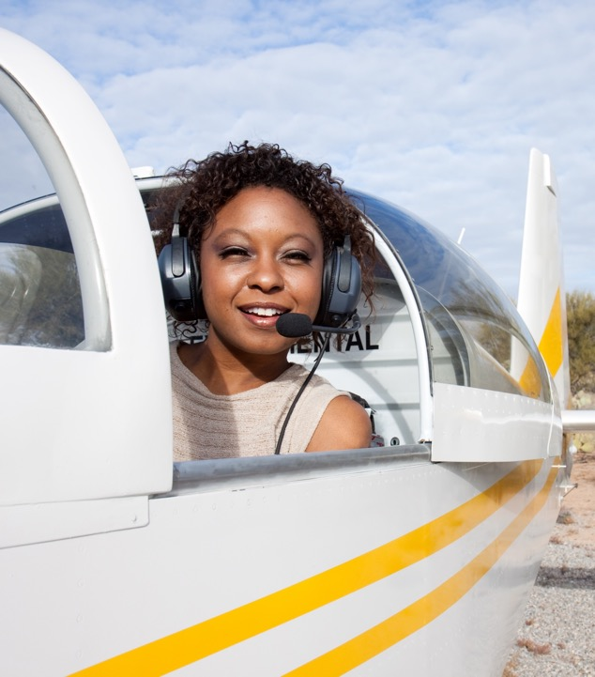

What’s your flight plan?
It starts with Science, Technology, Engineering, and Math
(STEM)
Pilots need STEM knowledge to calculate plane take off and landing trajectories
They understand various aircraft functions and know how to use all of the aircraft systems
UAV pilots need to understand how weather
affects their ability to pilot a drone
They require math skills to calculate safe
paths for their UAVs
They operate information systems to control
their unmanned vehicles
Maintenance technicians need strong math and engineering skills to repair and maintain aircraft
Engineers use 3D modeling technology to design, fabricate, and assemble aircraft parts

Slide 14
Let your dreams soar!
The sky’s the limit!

Slide 15
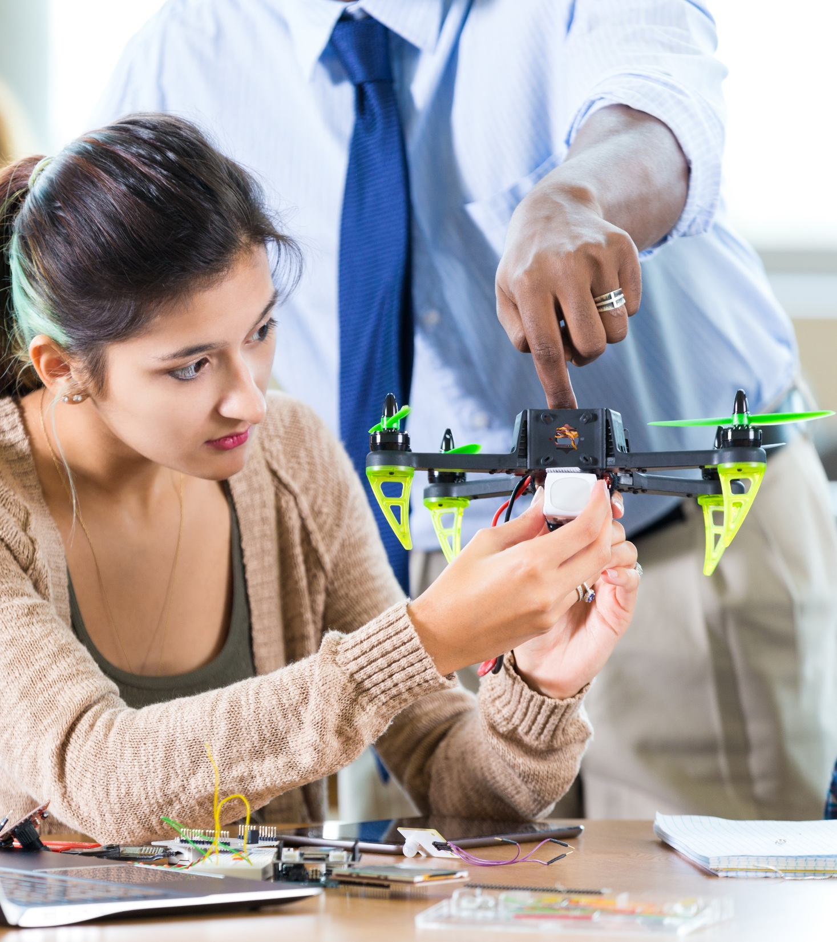
Want to learn more?
Aviation events near you
Placeholder for FAA STEM AVSED
Outreach Representatives to
promote local events & programs

Slide 16

Thank you!
To learn more about aviation, visit www.faa.gov/education

