Slide 1

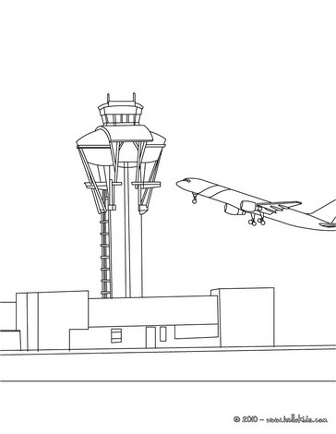
PWC Activity Book

Slide 2
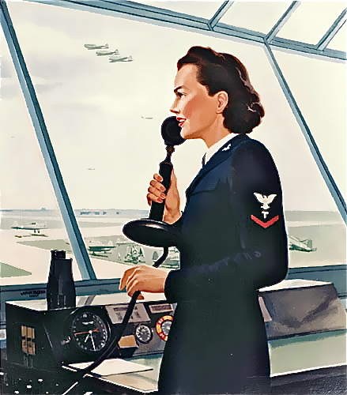
Air Traffic Controller
Air traffic controllers are the people who coordinate the movement of airplanes. Their job is to be sure that planes stay a safe distance apart. They also direct planes to keep flying schedules on time. Some control traffic at airports. Other air traffic controllers handle planes between airports. Every plane that is taking off or landing is handled by an air traffic controller.
English, speech communication, mathematics, science, foreign languages, and electronics courses are helpful for this career.

Slide 3
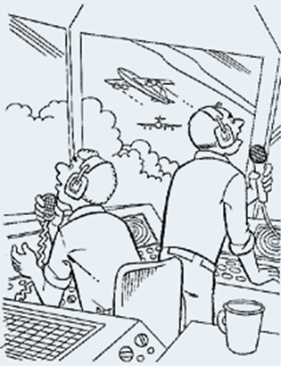
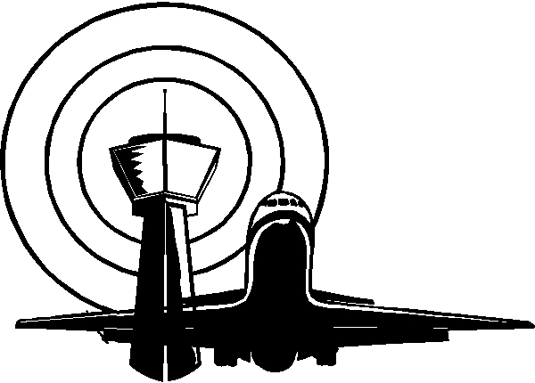

Slide 4
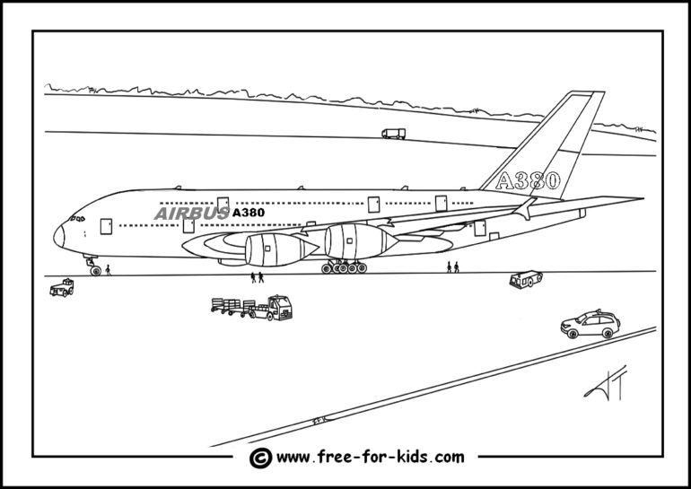

Slide 5
G | P | U | A | V | I | A | T | I | O | N | W | Y | U | L | Y
R | D | T | M | P | Z | P | R | C | L | H | O | L | F | R | S
U | E | O | N | L | A | K | A | D | K | B | M | U | R | F | U
N | F | W | H | O | Q | H | F | G | Q | Z | E | K | T | L | C
W | G | E | B | G | A | L | F | H | T | P | N | Y | U | V | L
A | H | R | F | C | R | F | I | K | Y | O | T | Z | P | D | E
Y | A | P | P | R | O | A | C | H | U | G | M | L | Y | W | A
H | R | D | D | A | K | N | P | L | R | V | E | C | T | O | R
J | C | F | S | Z | T | D | T | P | G | Q | E | O | I | Q | A
K | S | Q | U | A | W | K | X | R | H | S | T | N | L | X | N
L | K | H | Q | C | G | W | T | U | A | B | R | T | M | A | C
O | A | I | R | P | O | R | T | Q | F | I | F | R | U | F | E
P | L | J | Y | F | D | A | R | W | D | P | L | O | Y | R | G
I | T | A | X | I | E | Q | A | B | S | P | I | L | N | O | B
U | I | K | A | G | W | Z | D | N | Z | Y | G | L | Q | G | D
Y | T | L | I | K | S | H | A | R | X | F | H | E | W | E | R
T | U | P | R | B | N | J | R | J | V | S | T | R | D | R | J
T | D | T | C | H | C | O | W | Y | B | P | Z | X | G | M | O
R | E | W | R | N | V | K | T | P | N | E | H | O | J | E | T
M | X | G | A | M | L | P | D | I | V | E | R | T | T | L | T
N | Z | J | F | L | I | G | I | T | M | D | Y | W | G | E | X
W | E | A | T | H | E | R | V | M | U | Q | G | E | J | Q | A
PWC AVIATION WORD SEARCH
FIND THE WORD.
AVIATION AIRCRAFT
SPEED TOWER
JET VECTOR
WOMEN TAXI
DIVERT SQUAWK
ROGER APPROACH
CONTROLLER TRAFFIC
CONTRAIL FLIGHT
WEATHER ALTITUDE
RADAR AIRPORT
KNOT RUNWAY
ZULU CLEARANCE

Slide 6
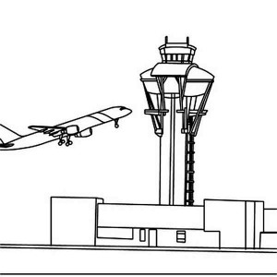

Slide 7
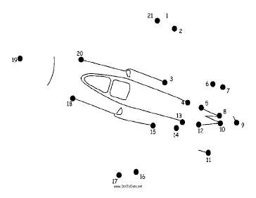
Connect the dots

Slide 8
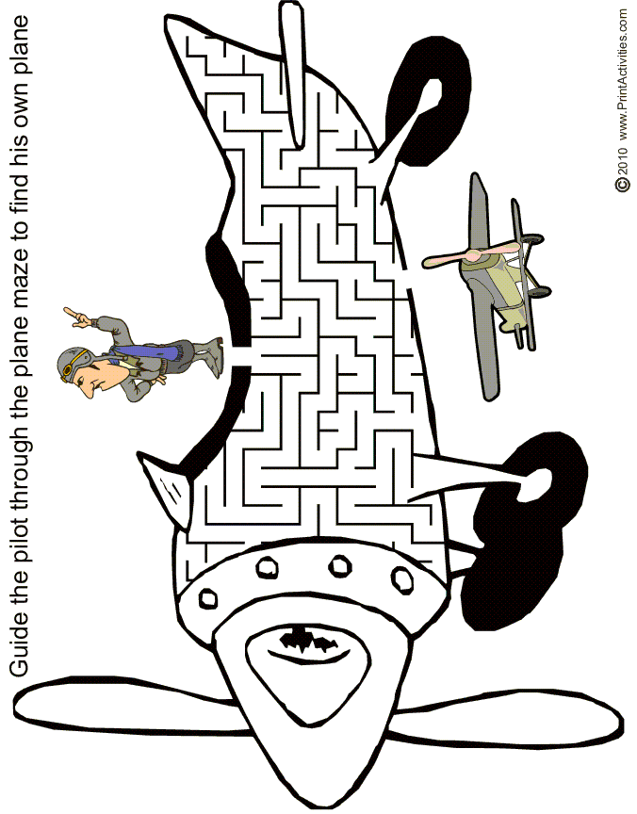

Slide 9
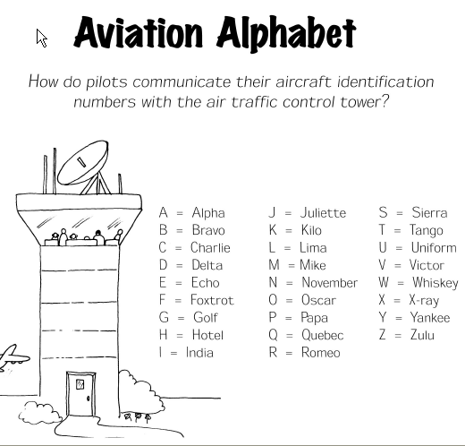

Slide 10
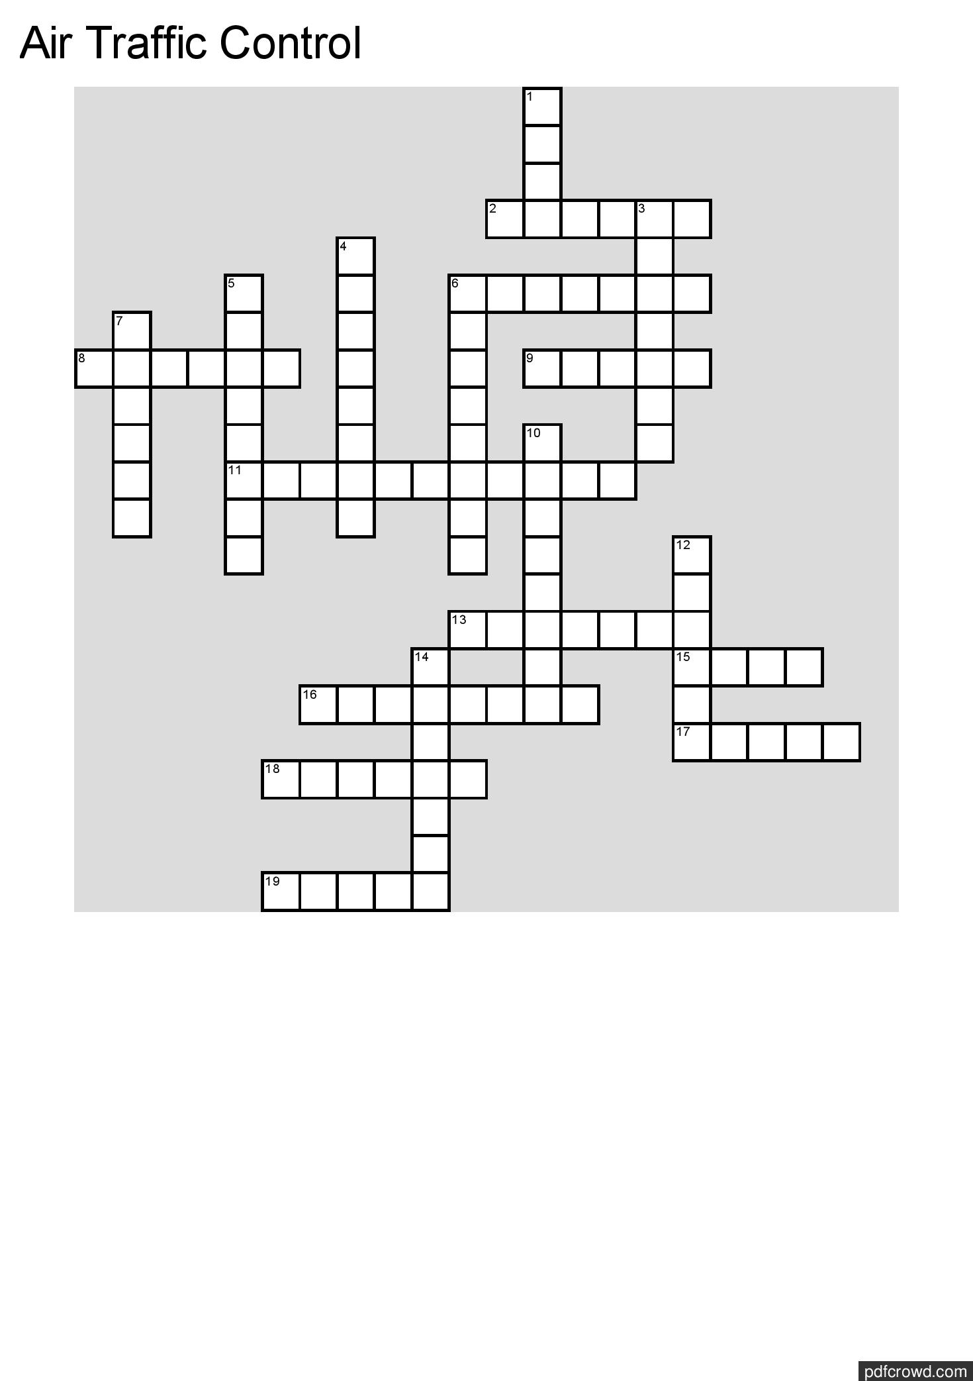

Slide 11
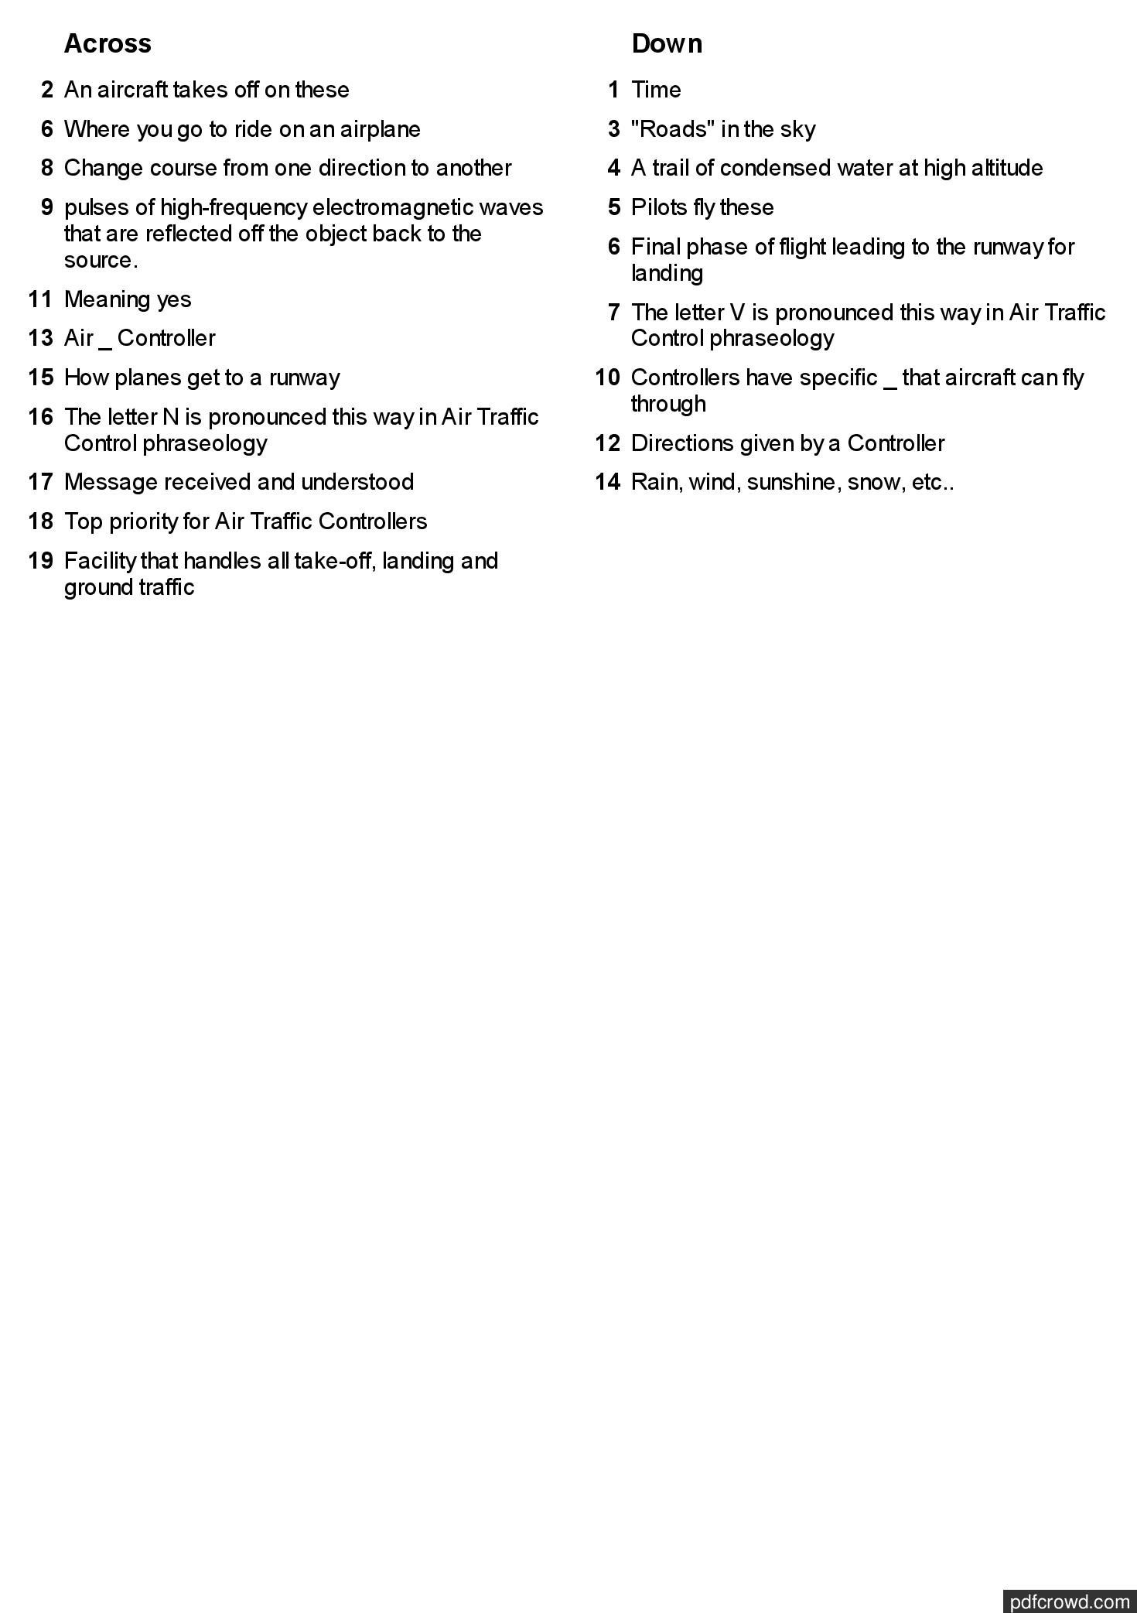

Slide 12


Slide 13
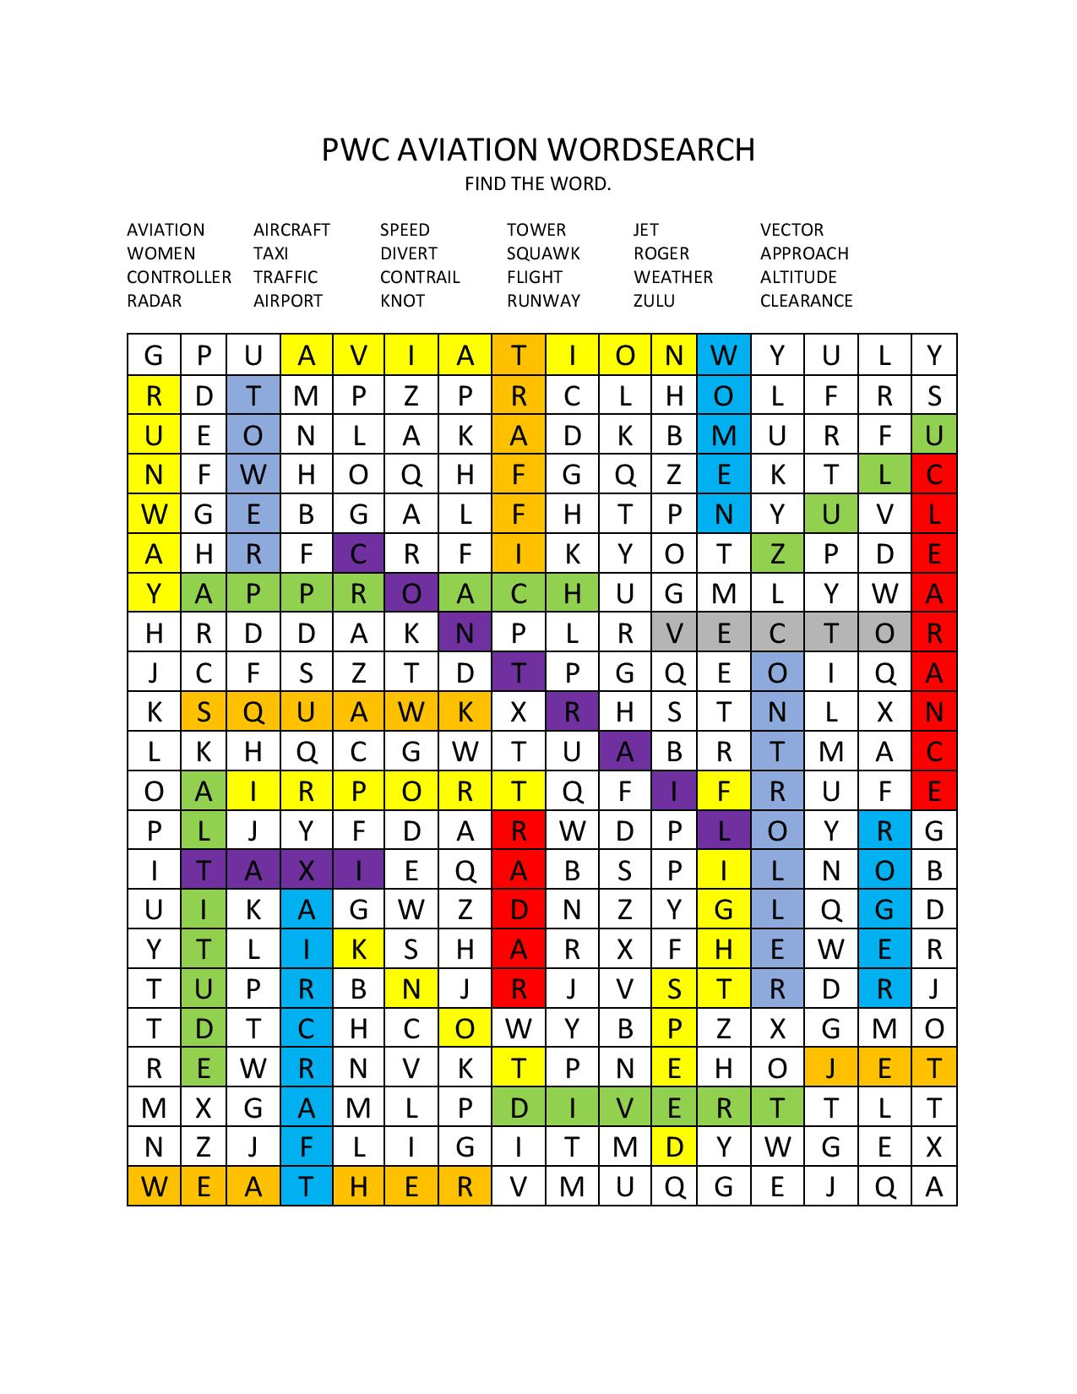

Slide 14
