Slide 1
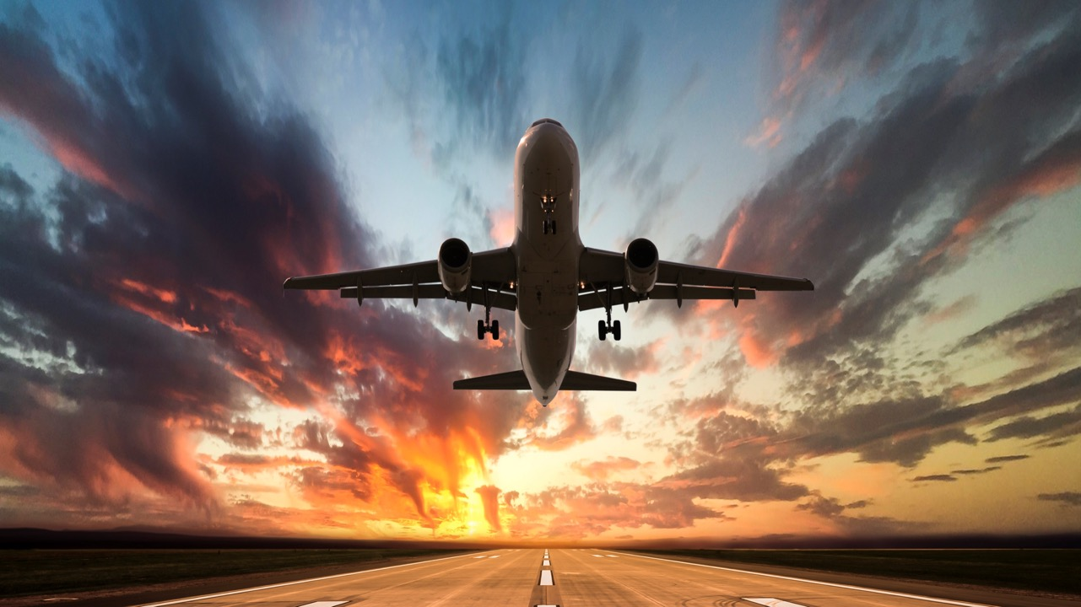

Your future is cleared for takeoff!
2019

Slide 2
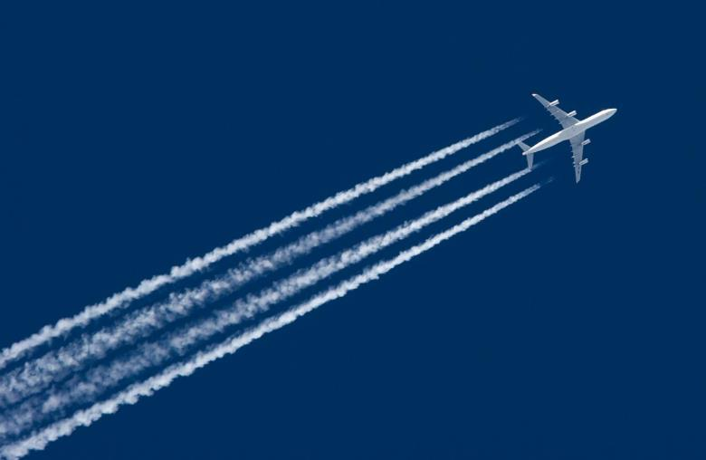
Aviation careers video
https://www.youtube.com/watch?v=Q3kn2sid4-M

Slide 3
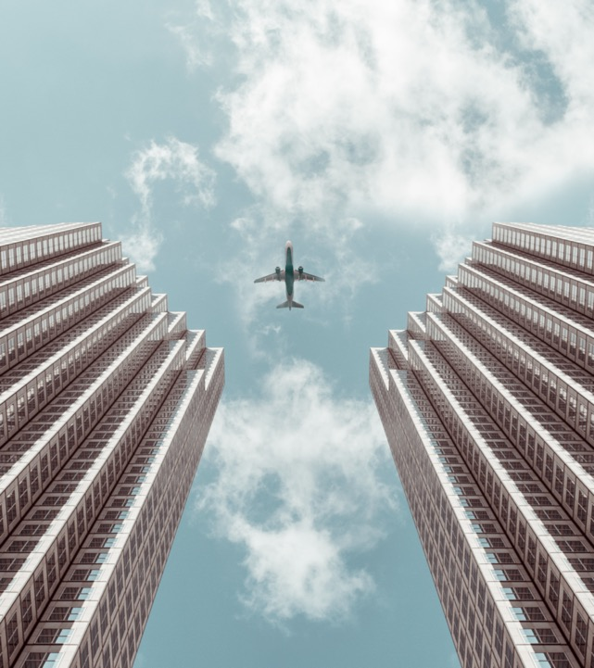
When it comes to aviation…
the SKY’s the limit
The United States National Airspace System is the biggest and most complex in the world
On average, our aviation and aerospace system supports over 5 million square miles of airspace, including
  More than 2.6 million passengers fly in and out of U.S. airports every day
  Nearly 16 million flights every year
  And up to 5,000 aircraft in the sky at a time

Slide 4
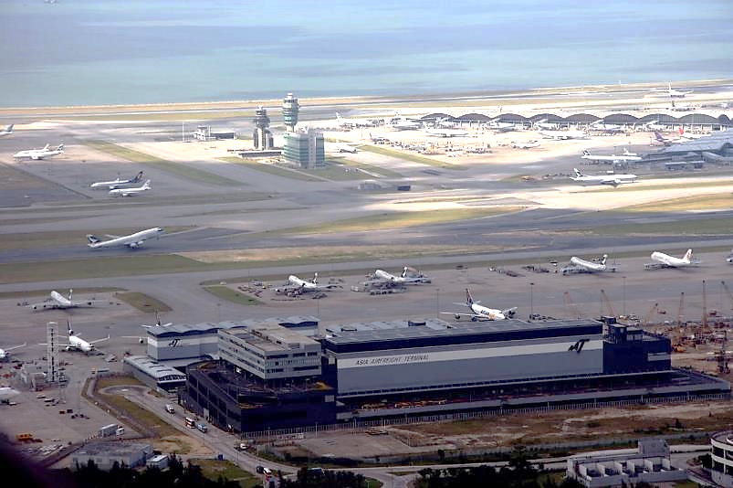
Who keeps the planes on the move?
Notes:
How many aviation jobs do you think are pictured here?
Less than 5?
More than 5?
More than 10?

Slide 5
Who keeps the planes on the move?
Corporate Jet Pilot
Aviation Safety Inspector
Air Traffic Controller
Flight Dispatcher
Front Line Manager
Tech Ops Specialist
Aircraft Certification Specialist
Baggage or Cargo Handler
Commercial Airline Pilot
Ground Crew
Flight Attendant
IT Support
Airport Engineer
Flight Inspector
Airport Security
Aircraft Engineer
Staff Support Specialist
Maintenance Technician
Notes:
There are 18 aviation jobs in this picture. All of these aviation professionals work together everyday to make the United States National Airspace System work.

Slide 6

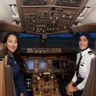
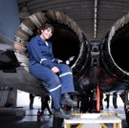
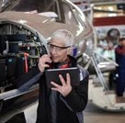


Hello, I am a…
Air Traffic Control Specialist –coordinate and direct the
movement of airplanes in the sky
Pilot – fly aircraft and passengers around the world
Mechanic – inspect, diagnose, and repair aircraft
Engineer – design and develop aircraft and related aviation/aerospace technologies
Ground Crew Member – support many aspects of the aircraft while it's on the ramp and parking area
Flight Attendant – travel the world and ensure the safety and comfort of airplane passengers
Notes:
The National Airspace System has a career/job for everyone, from professionals like engineers and mechanics on the ground to pilots and flight attendants in the sky. Their skills range from the technical to the intangible, blending science, technology, engineering, mathematics, and communication skills to keep the system running smoothly.

Slide 7
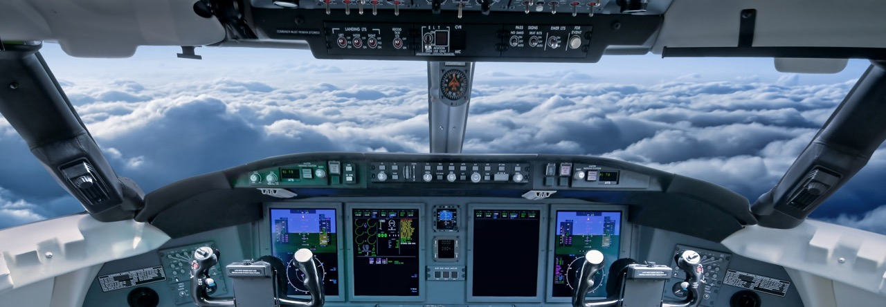

Who has the best view?
They fly planes
They wear sleek uniforms
They travel around the world
They speak their own “pilot” language
Pilots do!
Notes:
Does anyone know how pilots and air traffic controllers talk to each other?
What if I told you pilots speak in code?
“Pilot language” includes:
Wilco – an abbreviation of “will comply”
Roger – message received
Use of the International Phonetic alphabet (Alfa, Bravo, Charlie, etc.)

Slide 8
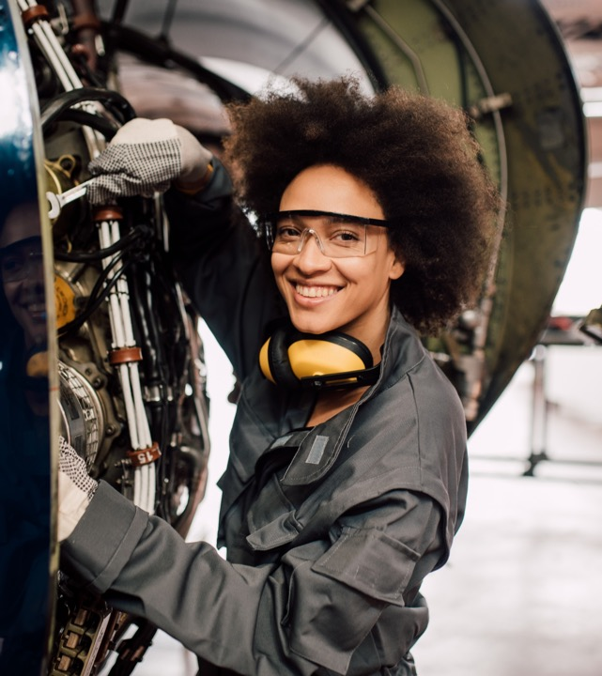

Who keeps the planes in the air?
Aviation maintenance technicians do!
They maintain and fix airplanes and helicopters
They work on jet engines and large machinery
Notes:
Aviation maintenance technicians are “fixers”. Planes are incredibly complex vehicles. It’s up to technicians to know everything there is to know about the inside of the plane. They work everyday to keep the planes flying.

Slide 9
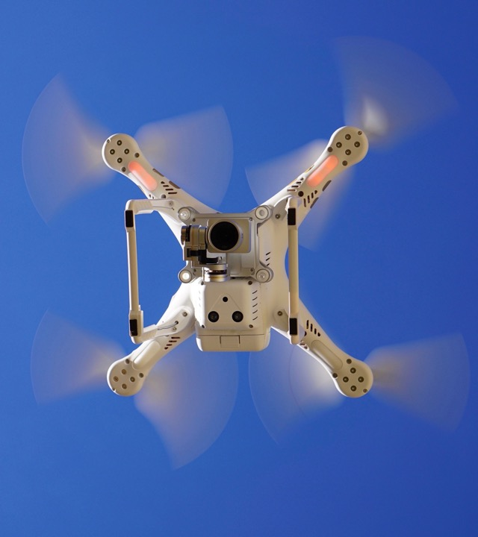
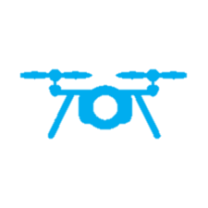
Who flies without
passengers?
Unmanned Aerial Vehicles do!
UAV pilots fly drones and other unmanned aerial vehicles
They stay on the ground, but see the world from a unique perspective
They help their communities
Notes:
How many of you have ever flown a toy plane or controlled a robot with a remote control? For some people, that’s their job! Drone pilots help us take videos and pictures, deliver packages, and even collect snot from whales!

Slide 10

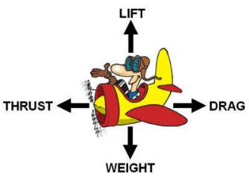
How do planes fly?
The force available for overcoming the force of gravity
The forward-directed force from a propeller, jet, or rocket engine
The force exerted on a moving object (air) that slows it down
A measure of the heaviness of an object
Notes:
Have you ever wondering how planes that weigh thousands of pounds fly?

Slide 11

Activity: Let’s fly!
You’re going to build a paper airplane!
  Get two pieces of paper – you will build two planes
  Fold your first paper plane
  Launch it!
  How far did it go? How high? How could you improve it?
  Make your second plane
  Test which design works better
Notes:
Engineers make small-scale models of things like airplanes to test their ideas before they build the real thing to make sure that they work properly. Today, I want you to be the engineer and build a paper airplane!

Slide 12
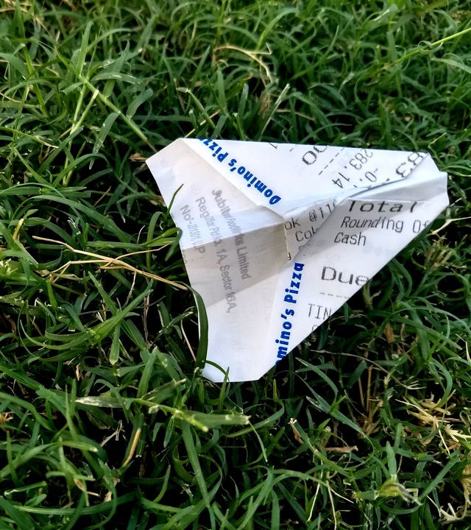
Let’s talk
What made your airplanes fly well?
How could you design a better airplane than the one you just made?
Would a plane made with heavier paper fly farther?
Notes:
Discuss what they learned about trial and error. Remind them that engineers rely on trial and error to evolve their designs, make them better and better.
Examples of things that made their planes fly well include: wing size and shape, how hard they threw it, type of paper the plane is constructed from, etc.
True or False Questions:
- Design, weight and drag are all things that can affect paper airplane flight
- Engineers make models of things like airplanes to test their ideas in a laboratory setting before they build the real thing
- When an engineer designs and builds something, it usually works the first time and they are done
Answers:
True
True
False (Engineers almost always have to redesign something several times before it is finished)

Slide 13
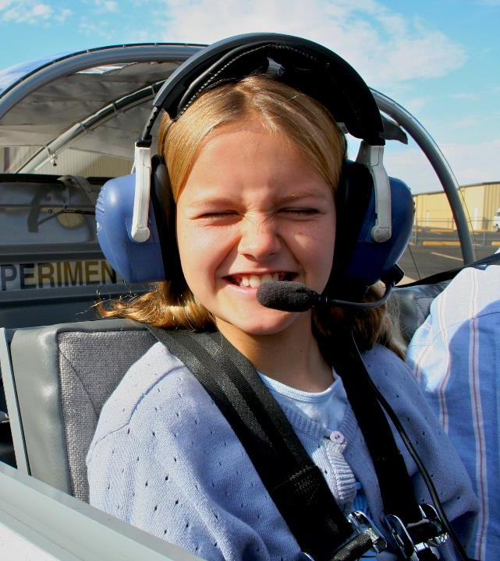

What’s your flight plan?
It starts with Science, Technology, Engineering, and Math
(STEM)
Pilots need STEM knowledge to safely take off and land planes, to understand how aircraft fly, and to know how to use all of the aircraft systems in the cockpit
UAV pilots need to know how weather affects their ability to pilot a drone
They need to understand and operate information systems to control their unmanned vehicles
Engineers use computers to create 3D models of
new aircraft parts
Maintenance technicians need math skills to repair and maintain aircraft

Slide 14
Let your dreams soar!
The sky’s the limit!

Slide 15
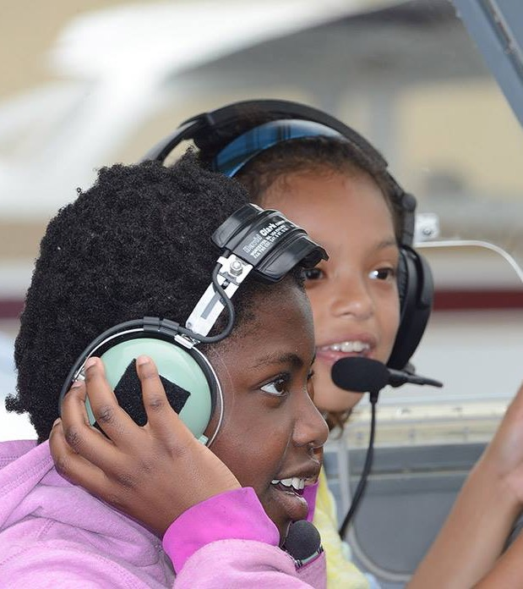
Want to learn more?
Aviation events near you
Placeholder for FAA STEM AVSED
Outreach Representatives to
promote local events & programs

Slide 16

Thank you!
To learn more about aviation, visit www.faa.gov/education

