Slide 1
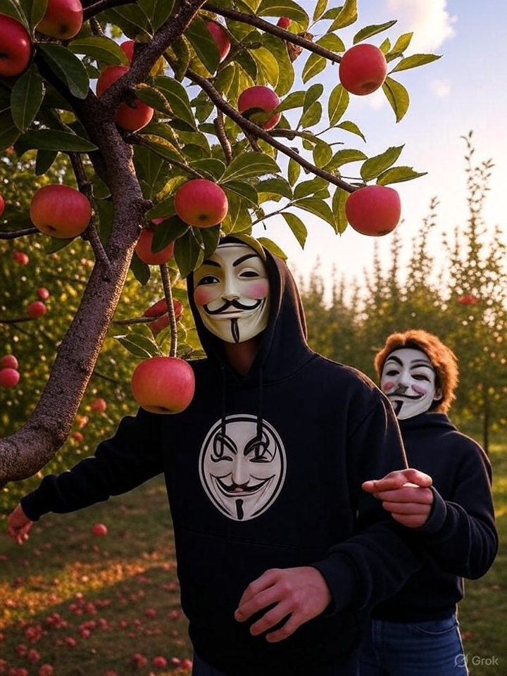
Georgia Installment Loan (GILA) Conference
How Not to Be Low Hanging Fruit
Julie Baker, Chief Information Security Officer, retired
June 2025

Slide 2
Cybersecurity and AI – Why Do They Matter?

Slide 3
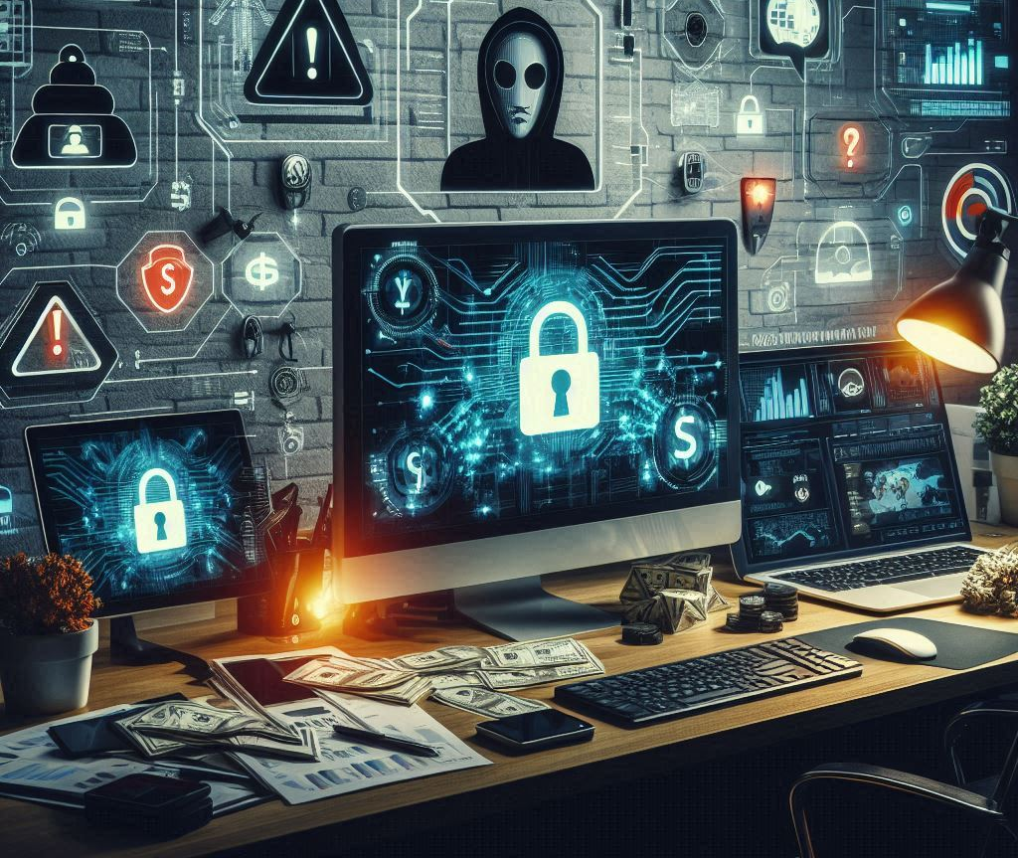
Key Threats

Slide 4

How do you Protect Yourself and Your Business?

Slide 5

Lead!

Slide 6
Top 4 Initiatives
MFA
Training
Anti-phishing
Anti-virus/EDR

Slide 7

Multi-Factor Authentication (MFA)

Slide 8

Training

Slide 9

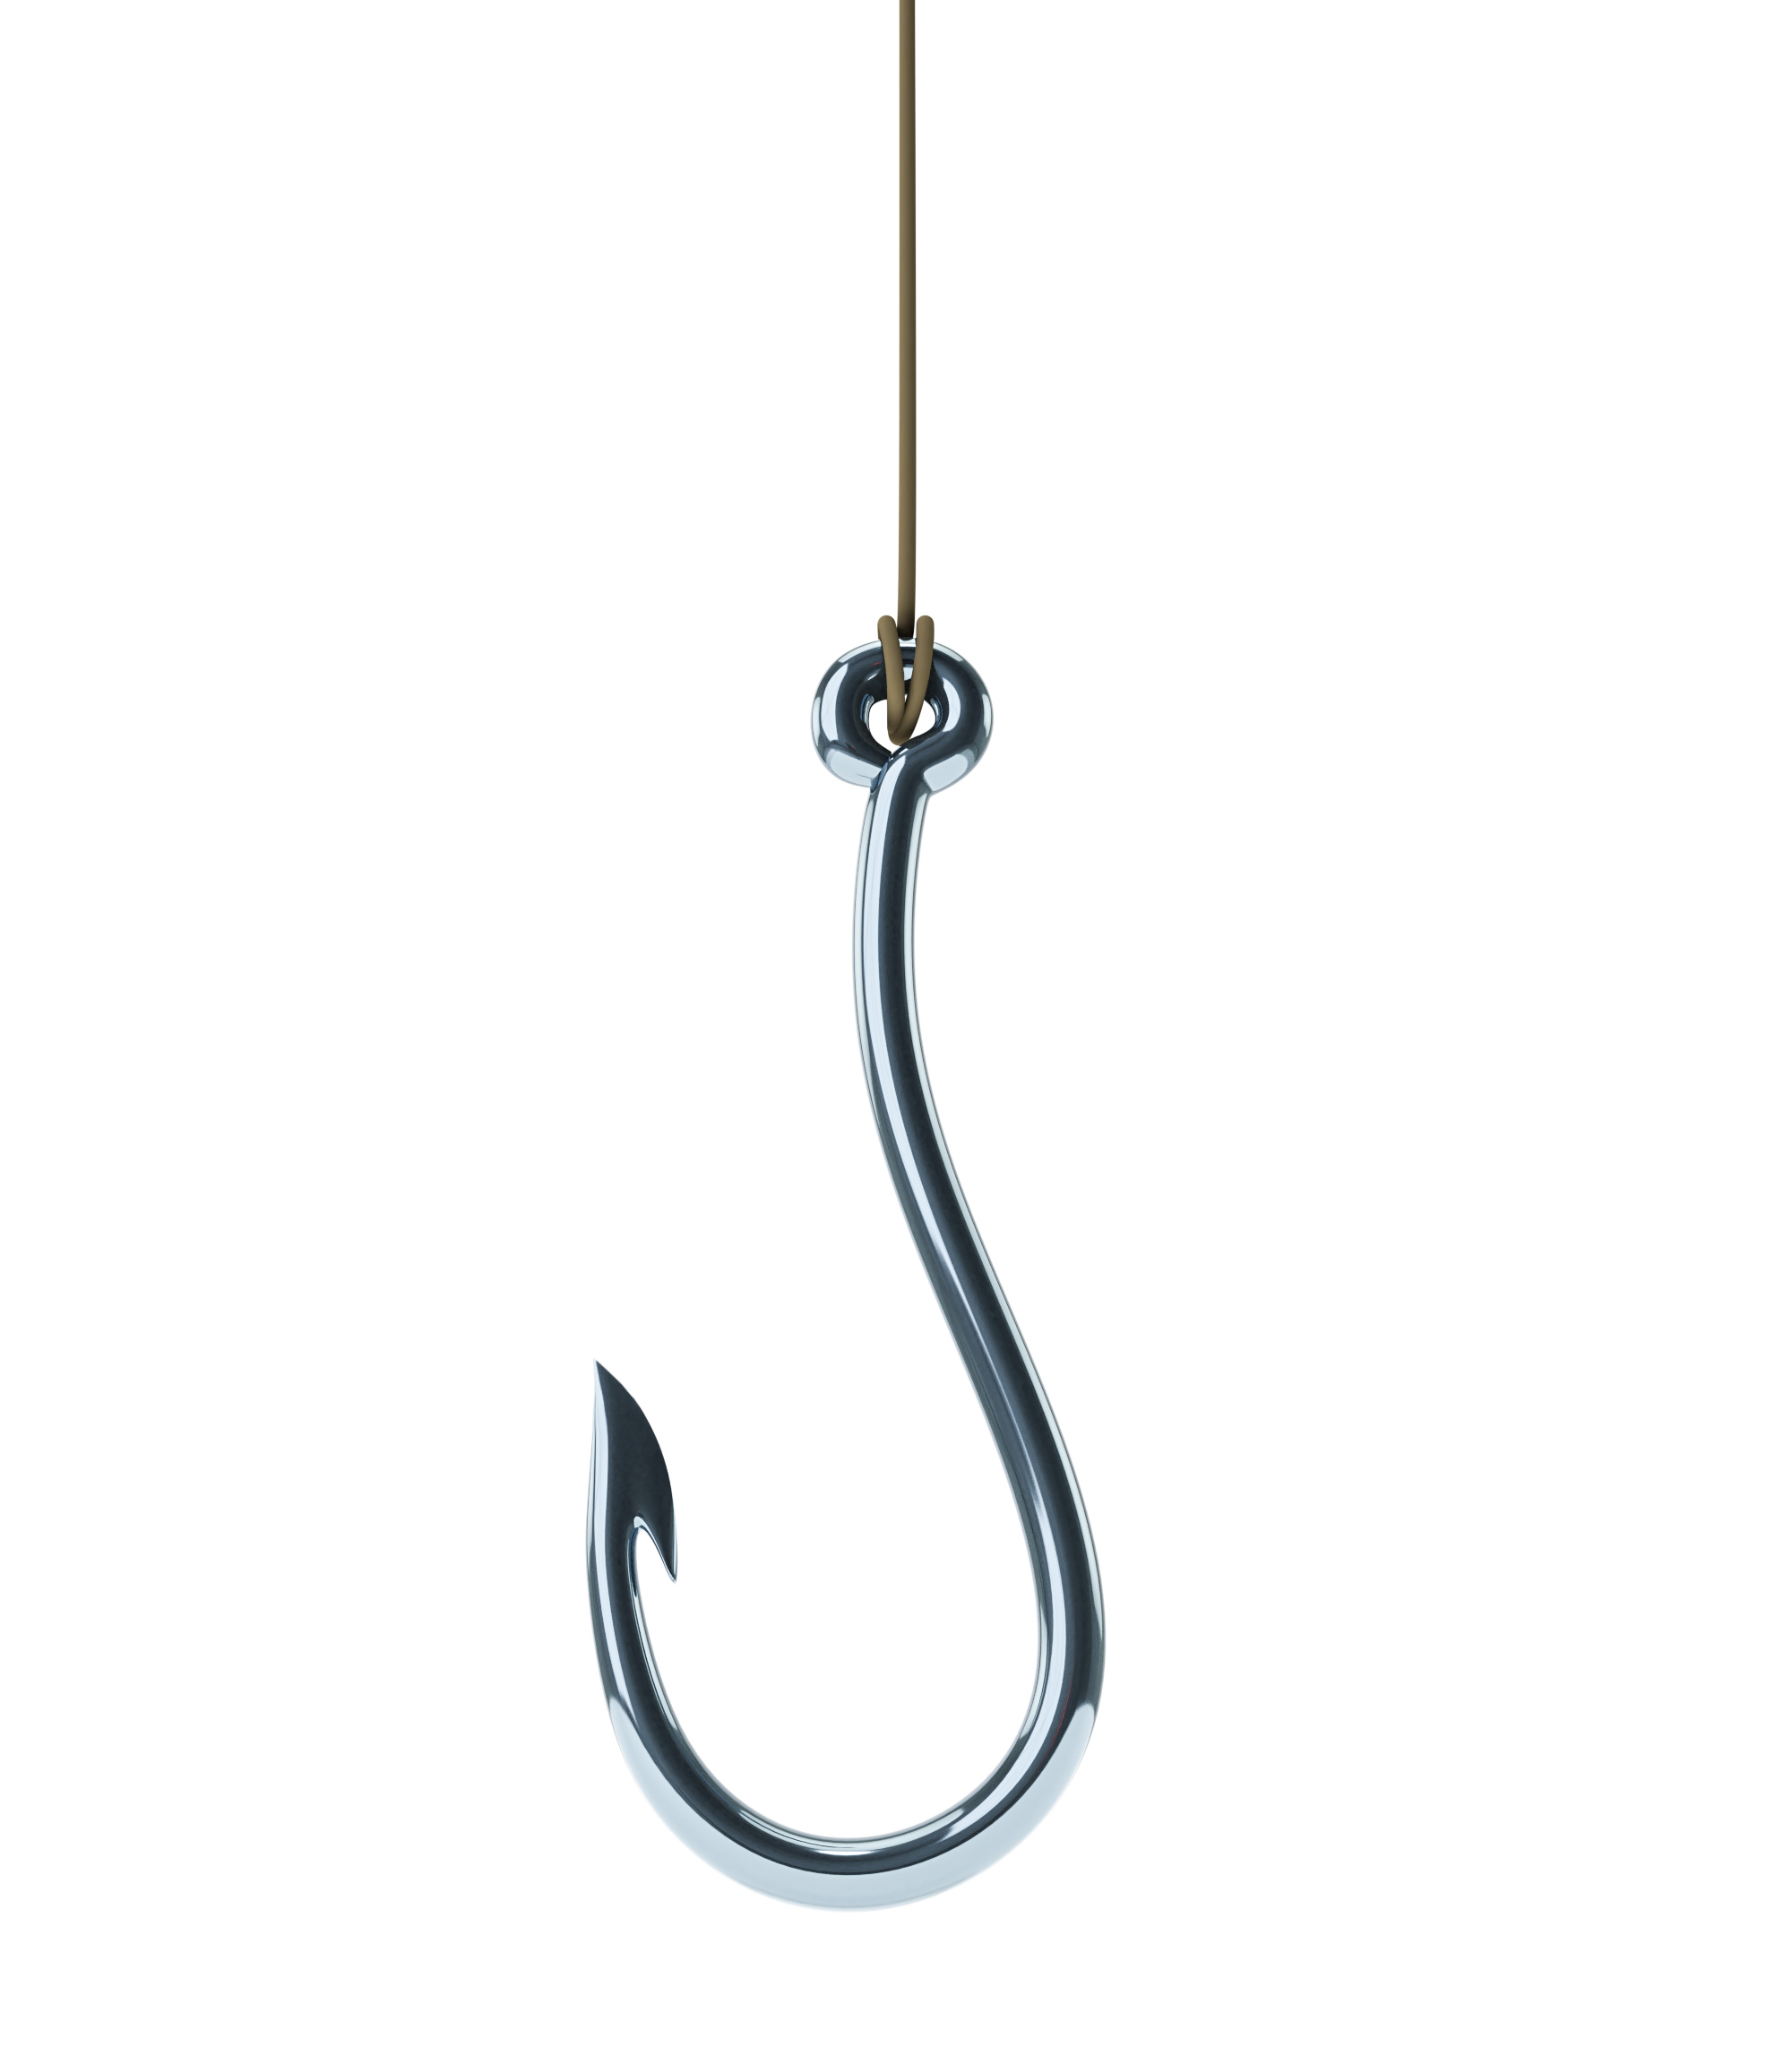
Phishing Protections

Slide 10

Anti-Virus and Endpoint Protections
XX

Slide 11

Congratulations!

Slide 12
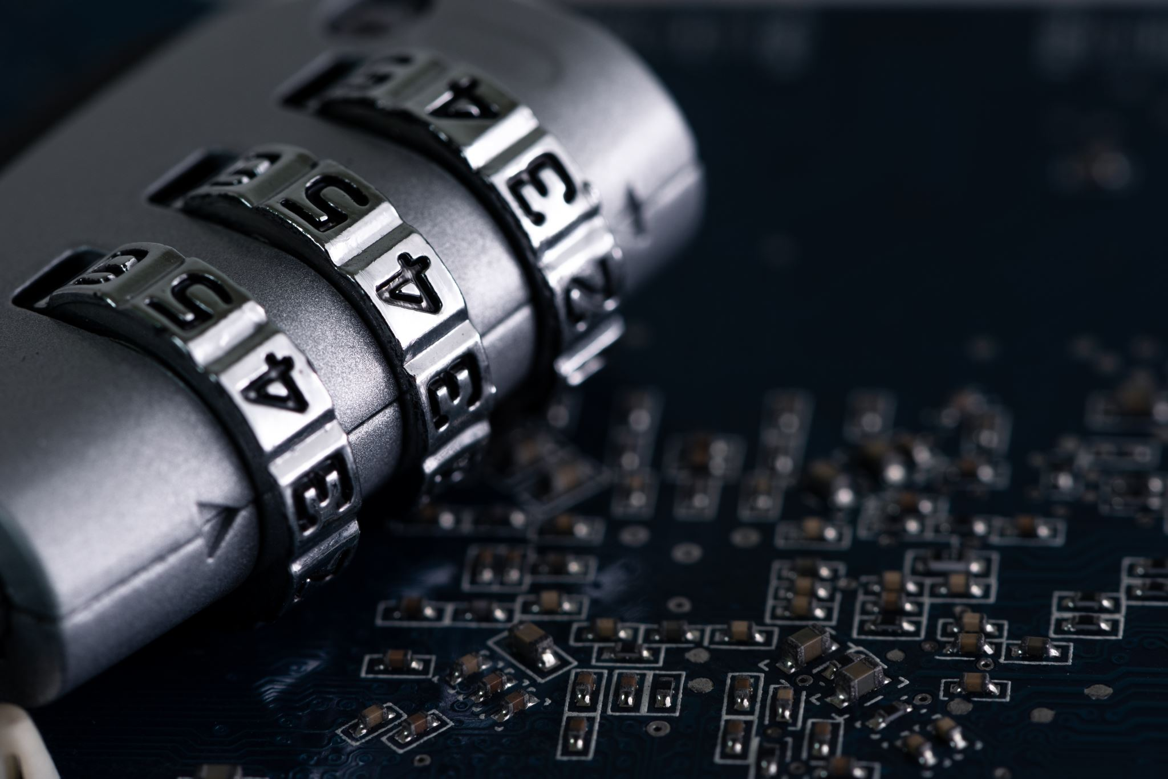
Password Managers & Password Hygiene

Slide 13
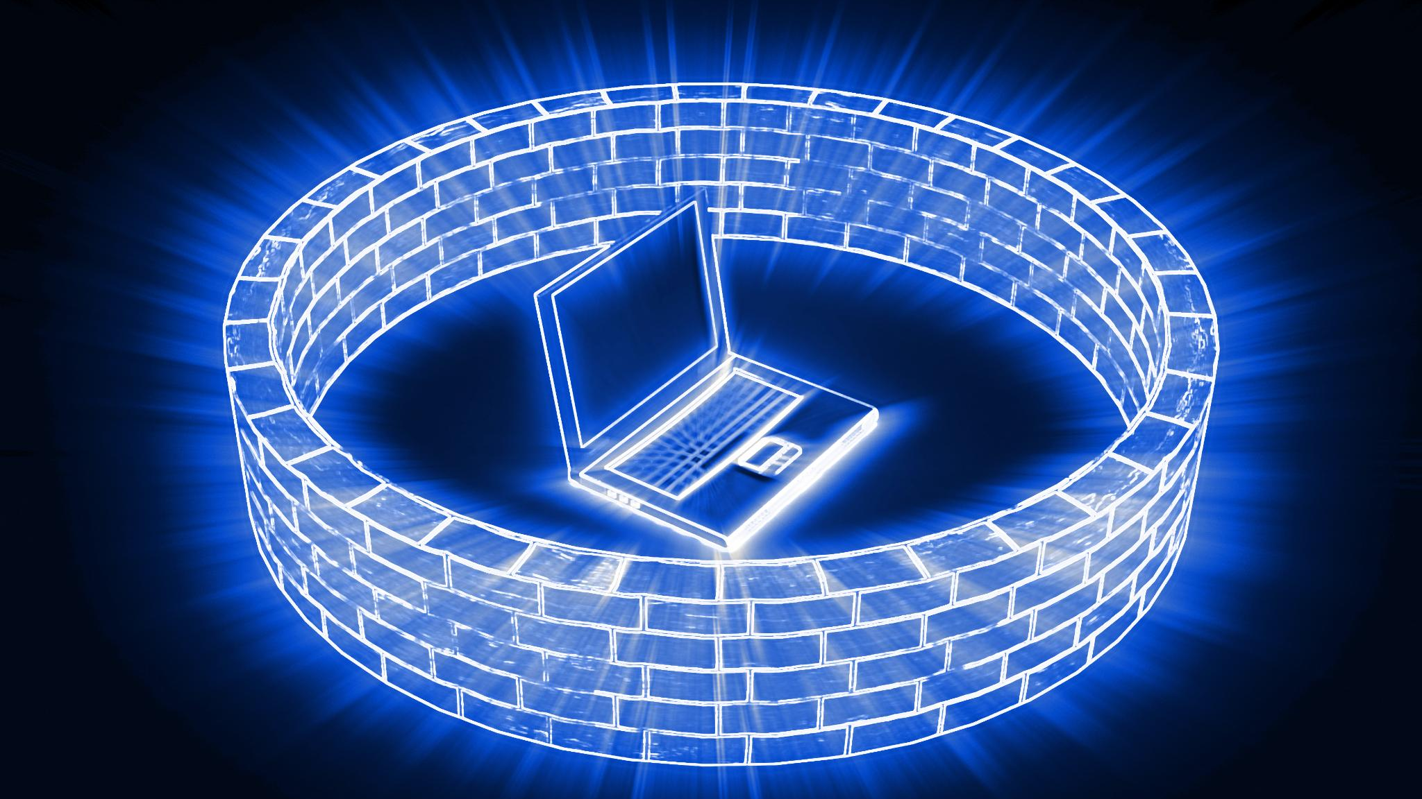
Firewalls and remote access

Slide 14

Encryption and Backups

Slide 15

Vulnerability Scanning and Patching

Slide 16

Incident Response Plan

Slide 17
Regulatory Compliance
SEC Cybersecurity Rule
FTC Safeguard Rule
HIPAA
PCI DSS
State Breach laws
CFPB

Slide 18
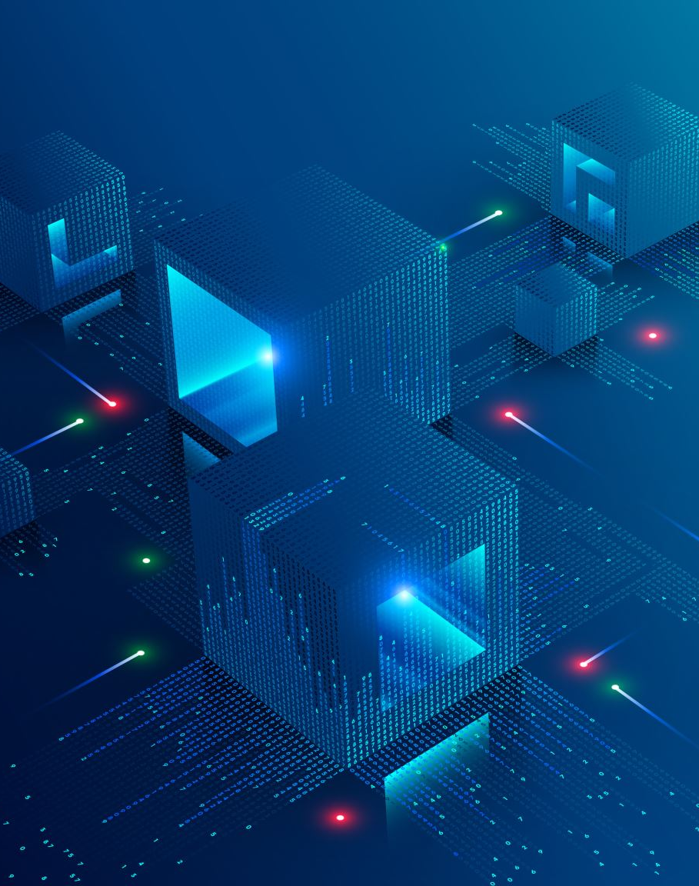
Free Resources
Free Resources and Support
CISA: Free vulnerability scanning, StopRansomware.gov, tabletop exercise templates.
NIST Cybersecurity Framework: Guidelines for SMBs to build a security program.
FCC Small Biz Cyber Planner: Customizable cybersecurity plan tool.
SBA Cybersecurity Events: Virtual and in-person training.
Global Cyber Alliance Toolkit: Free cybersecurity resources for SMBs.
Talking Point: “You don’t need a big budget to start. CISA and NIST offer free tools and guidance to get you on track.”

Slide 19
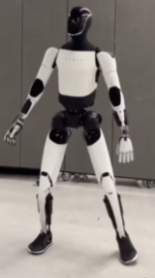
A I

Slide 20
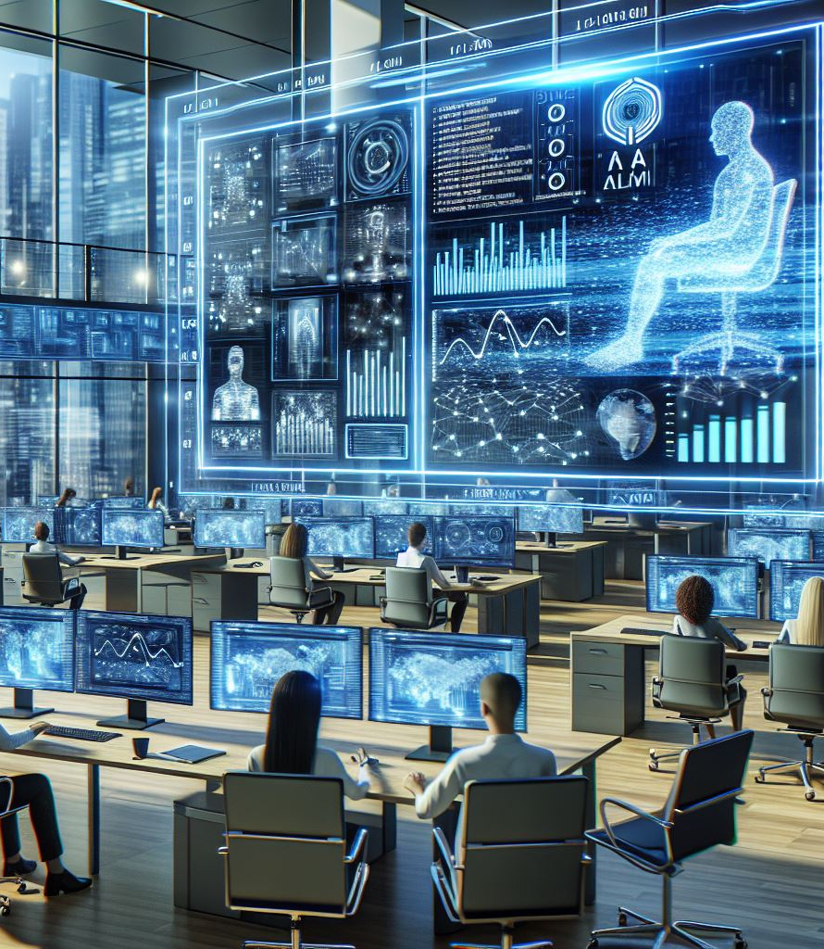
Definition of AI

Slide 21
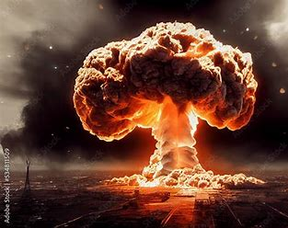
AI the Disrupter

Slide 22
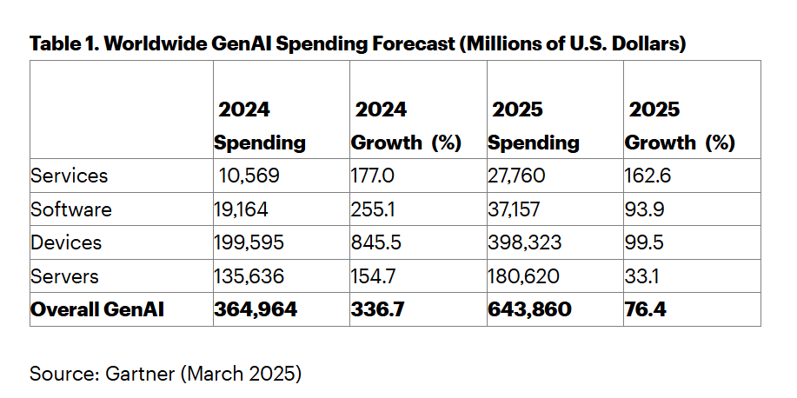
AI Global Spending
Gartner Forecasts Worldwide GenAI Spending to Reach $644 Billion in 2025

Slide 23

Benefits of AI in Consumer Lending

Slide 24
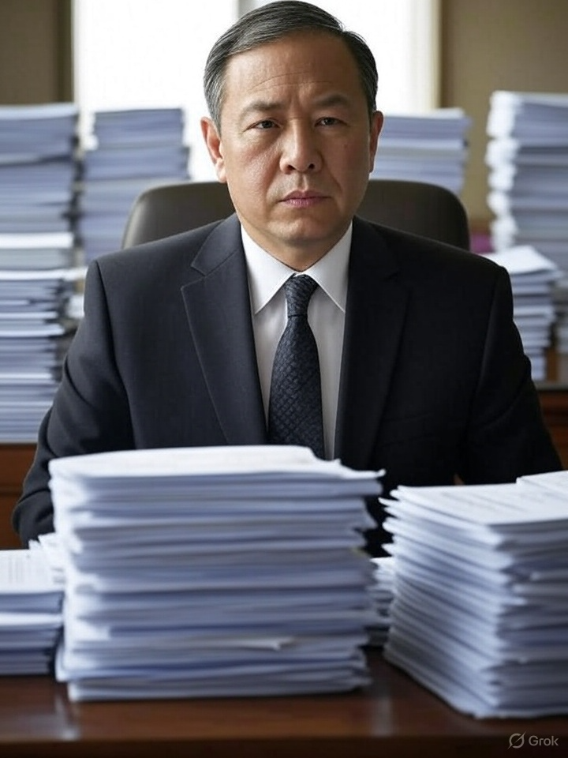
AI Operational and AdministrativeEfficiencies

Slide 25
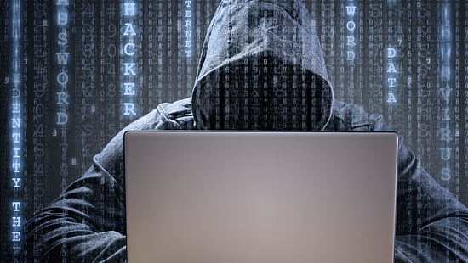
How to use AI to find Fraud

Slide 26




AI-Powered Underwriting for Smarter Lending Decisions

Slide 27

AI - Not All Rainbows and Unicorns

Slide 28
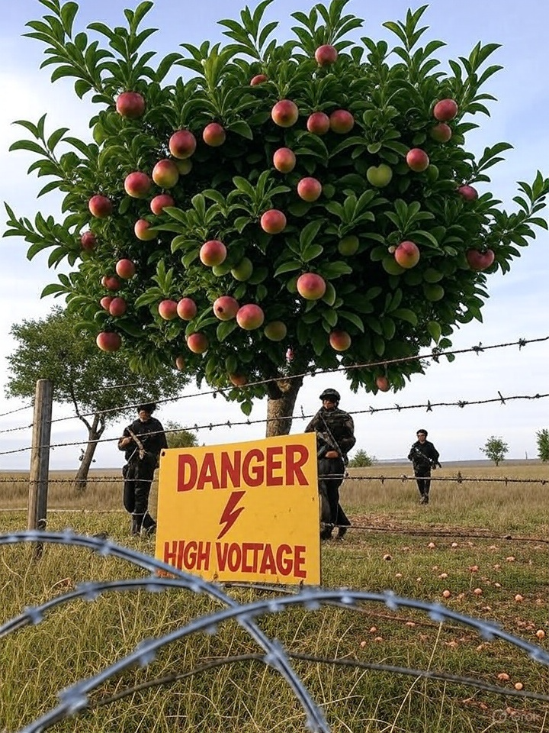
Final Words

