Slide 1
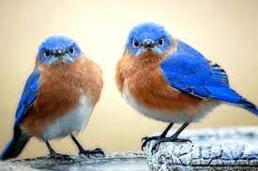
TN Bluebird Society
Data Presentation
2023
Beth Allison

Slide 2
Our Numbers for 2023:
Clubs: 7
Trails: 125
Backyard Monitors: 166
Nest Boxes: 1,578
Bluebirds Fledged: 5,554

Slide 3
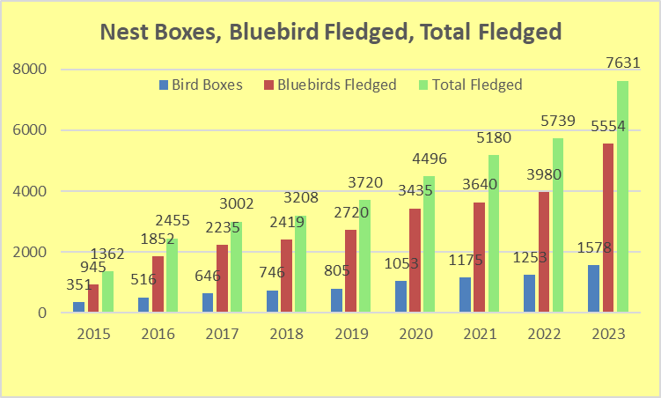
2015 – 2023 Growth of Nest Boxes, BB Fledged and Total Birds Fledged

Slide 4
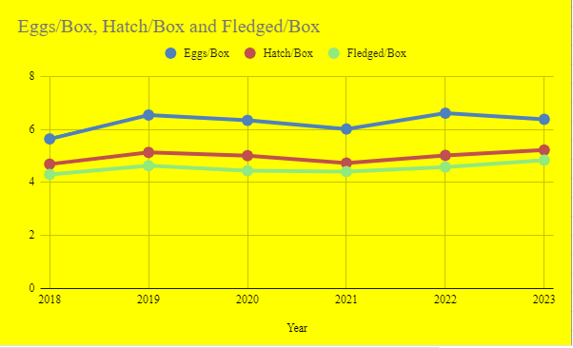
2018 – 2023 Comparison of Eggs/Box, Hatched/Box, and Fledged/Box

Slide 5
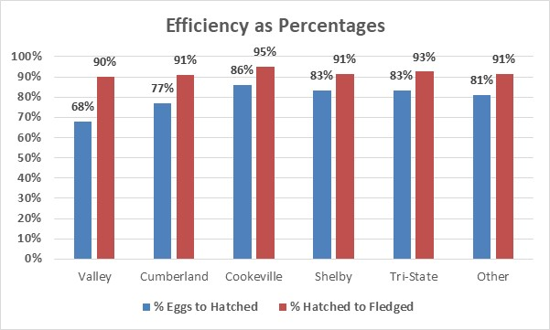
Club Level Efficiency Percentages 2022
Natural Egg Loss Level (17%) Beyond Our Control

Slide 6
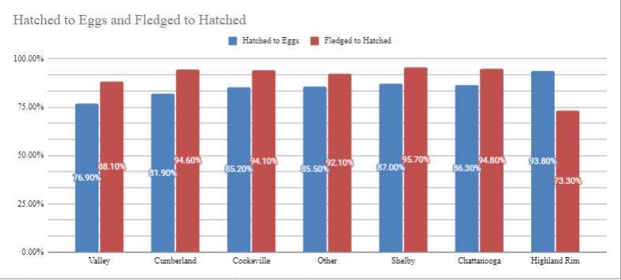
Club Level Efficiency Percentages 2023
Natural Egg Loss Level (17%) Beyond Our Control

Slide 7
Comparison to Last Year for Trails and Nest Boxes
 | 2022 | 2023 | change
Trails | 107 | 133 | + 24%
Nest Boxes | 1,253 | 1,578 | + 26%

Slide 8
Variety of Birds 2023
Eastern Bluebird: 5,554
Carolina Chickadee: 370
Carolina Wren: 45
Tufted Titmouse: 17
House Wren: 169
Brown Headed Nuthatch: 10
White Breasted Nuthatch: 3
Tree Swallow: 1,448
Prothonotary Warbler: 9
Purple Martin: 6

Slide 9
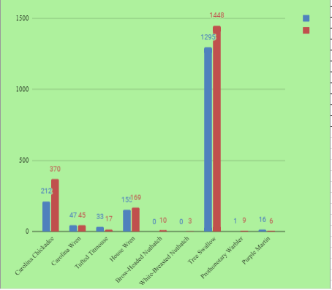
2022 – 2023 Comparison of Other Birds
2022
2023

Slide 10
2023
Eastern Bluebirds
Eggs: 7,238
Hatched: 5,920 (82% of eggs)
Fledged: 5,554 (94% of hatched and 77% of eggs)

Slide 11
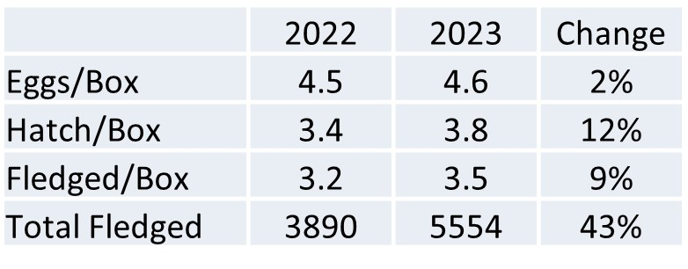
Comparison to Last Year for Eastern Bluebirds

Slide 12
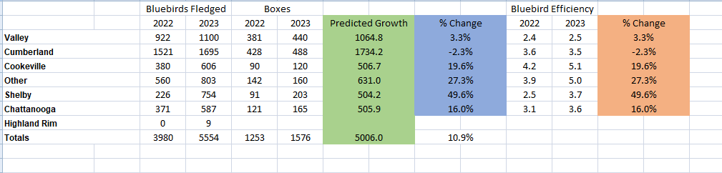
Why has the Bluebird fledged count increase by 43 % ?
Nest Box growth alone, would predict a much lower amount. Short by 500 Bluebirds fledged.
Is efficiency (BB Fledged/box) making up the difference between predicted and actual?

Slide 13
Comparison to Last Year for All Birds
 | 2022 | 2023 | change
Eggs per Box | 6.61 | 6.38 | - 3%
Hatched per Box | 5.02 | 5.22 | + 4%
Fledged per Box | 4.58 | 4.84 | + 6%
Total Fledged | 5739 | 7631 | + 33%

Slide 14
How did the total fledge count increase by such a high number (33%)?
Growth in Nest Boxes deployed (26%) and the increase in efficiency (6%) is the answer. 1.26 (nest box growth) x 1.06 (efficiency improvement) =1.33 or 33%.

Slide 15
Yearly Summary
All clubs increased their hatched to eggs and fledged to hatched percentages from their 2022 numbers.
Significant increases in all birds and Bluebirds fledged year over year.
A good 2023 season.

