Slide 1


Invested in Your Goals
Our Evidence-Based Approach to Advice
Presenter Name
Title
Symmetry Partners, LLC is not affiliated with any firm mentioned in this presentation.
Symmetry Partners, LLC, is an investment advisory firm registered with the Securities and Exchange Commission. The firm only transacts business in states where it is properly registered or excluded or exempted from registration requirements. No one should assume that future performance of any specific investment, investment strategy, product, or non-investment related content made reference to directly or indirectly in this material will be profitable. As with any investment strategy, there is a possibility of profitability as well as loss. All data is from sources believed to be reliable but cannot be guaranteed or warranted. For additional information regarding Symmetry Partners, LLC please see disclosure at the end of this presentation labeled Important Information.
*It is the responsibility of the financial advisor to check with their compliance department or OSJ for use restrictions.

Slide 2
The 3 Key Questions for Investors
1
What’s Most Important to You—Personally & Financially?
2
Do I Have the Right Plan (and Portfolio) to Get There?
3
How Will You Stay on Track?
Notes:
As an investor, you may have many questions, but for most of us, when it comes to achieving a more secure financial future, these are the three biggest questions.

Slide 3
1
What’s Most Important to You
—Personally &Financially?
Notes:
Read slide

Slide 4
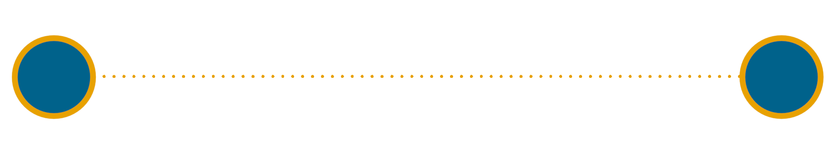
What’s Most Important to You —
Personally & Financially?
1
?
TODAY
Vision/Values
Family
Lifestyle
Business
Protection
Vision/Values
Education
Family
Lifestyle
Business
Protection
Taxes
Retirement
Health
Philanthropy
Legacy
Education
Taxes
Retirement
Health
Philanthropy
Legacy
To develop the best possible long-term plan,
we need to understand what matters most to you
Notes:
A typical 65-year-old baby boomer couple today has a 30 years of joint life expectancy, meaning there is a high probability that at least one of them is going to live to age 95. They need a long-term plan they can have confidence in.
And any good plan should refelect what is important to each person personally and financially. What do you want to achieve? What are you concerned about? What do you want your future to look like? Everyone is different, and that is why your plan should be as different as you are.

Slide 5
2
Do You Have the Right Plan (and Portfolio) to Get There?
Notes:
That leads us to our next question: Read slide

Slide 6
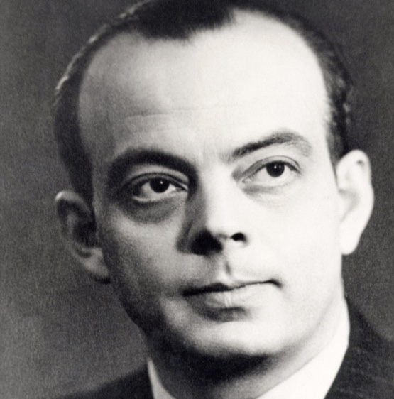
“A goal without a plan
is just a wish.”
Antoine de Saint Exupéry
Notes:
Read quote. As the quote suggests, achieving your goals depends on having the right, written plan for your individual situation.

Slide 7
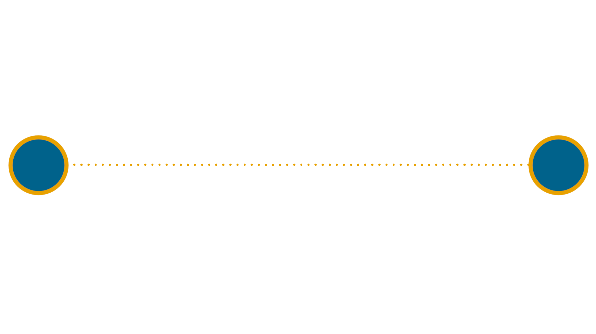
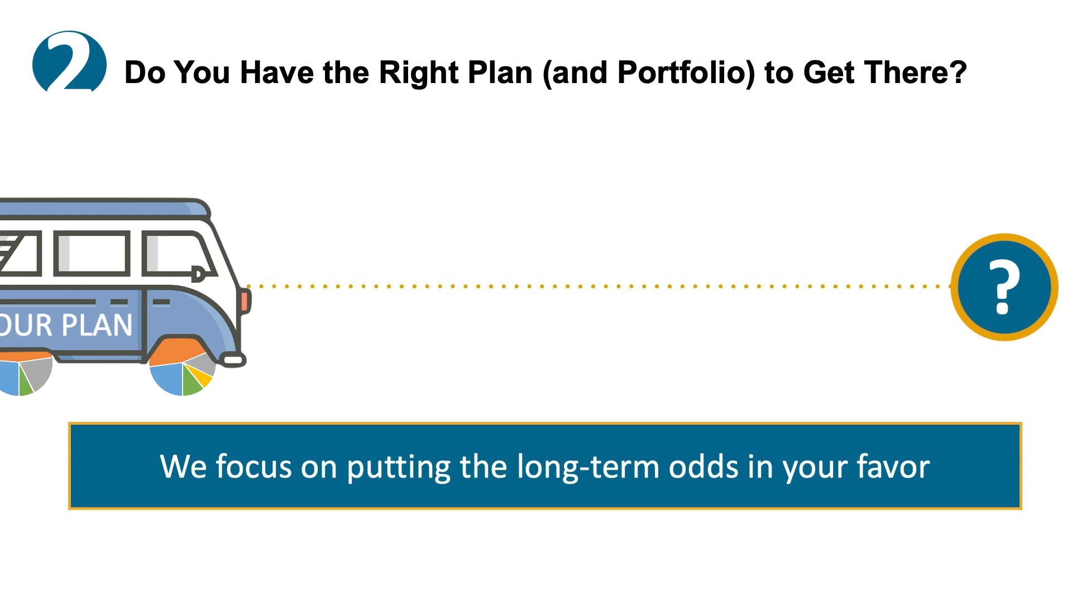
Do You Have the Right Plan
(and Portfolio) to Get There?
2
We focus on putting the long-term odds in your favor
Notes:
And one of the biggest drivers of your plan will be your portfolio, which provides the growth and—once you retire—income that most plans require.
And while there are no guarantees in investing—or life---what we focus on is putting the odds in your favor in a way that matches your comfort with risk.

Slide 8



First, We Try to Minimize the Odds Against You
Market Underperformance
Market Overperformance
Notes:
And to do this, we first work to minimize some of the things that can potentially compromise your long-term goals because they make underperformance more likely.

Slide 9
Minimizing the Odds Against You
Active Management
Market Overperformance
Market Underperformance
Notes:
One of these is active management. Which simply means trying to beat the market through timing and/or stock selection. This is hard to do..

Slide 10
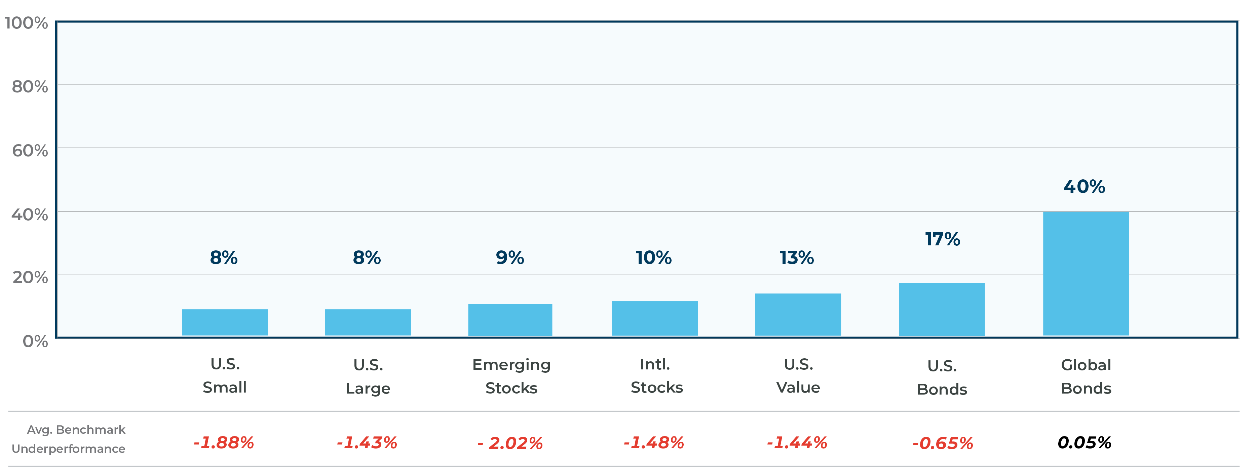
Poor Track Record for Active Managers
Percentage of Active Funds that Outperformed Their Index 2005 - 2019
Source: Standard & Poor’s Indices Versus Active Funds Scorecard (SPIVA) 2019. Index used for comparison: US Large— S&P 500 Index; U.S. Small—S&P SmallCap 600; U.S. Value--S&P Composite 1500 Value; International — S&P 700 Index; Emerging Markets — S&P/IFCI Composite; US Bonds — Barclays US Government (1-3 Year) Index; Global Bonds — Barclays Global Aggregate. Outperformance is based upon equal weight fund counts. Index returns do not include payment of any sales charges or fees an investor would pay to purchase the securities they represent. Such costs would lower performance. Past performance is not an indication of future results. More recent performance may alter these assessments or outcomes.
Time period based on 15-year period provided by SPIVA Report, ending 12/31/19. Chart is for illustrative purposes only. For additional time periods and active fund manager, please see full SPIVA report
For further information regarding SPIVA scorecard, please go to https://www.spglobal.com/_assets/documents/corporate/us-spiva-report-11-march-2019.pdf.
Notes:
As studies by SPIVA have shown repeatedly, typically 70% - 80% or more of active managers typically underperform their benchmarks every year. And the longer the time horizon, the higher the likelihood of underperformance. Even top performing managers struggle to maintain outperformance over time. And in some cases, their average performance has been significantly below the benchmark.

Slide 11

And Top Performance Rarely Lasts…
From Heroes to Zero
128 Funds
Top-Quartile
U.S. Small Cap Funds
22 Funds Remain
4 Funds Remain
1 Fund Remains
0 Funds Remain
Sept 2014
Sept 2015
Sept 2016
Sept 2017
Sept 2018
Source: S&P Persistence Scorecard, December 2018
Notes:
But perhaps you believe you can pick those few top managers who outperform. Unfortunately, top performers rarely persist as this chart shows, taking the example of small cap funds. In September of 2014, 128 US Small Cap Managers were in the top quartile. 4 years later, none of these managers were still in the top quartile. Consistently beating the market is hard.

Slide 12
Minimizing the Odds Against You
Active Management
Market Overperformance
Market Underperformance
Source: SPIVA: Standard & Poor's Indices Versus Active Funds Scorecard.
For further information regarding SPIVA scorecard, please go to https://www.spglobal.com/_assets/documents/corporate/us-spiva-report-11-march-2019.pdf. Past performance does not guarantee future results.
All data is from sources believed to be reliable but cannot be guaranteed or warranted.
Notes:
In addition to active management…

Slide 13
Tilting the Odds Against You
Passive Management
Market Overperformance
Active Management
Market Underperformance
Notes:
Passive investing—or trying to replicate the performance of an index such as the S&P 500—can also lead to underformance..

Slide 14
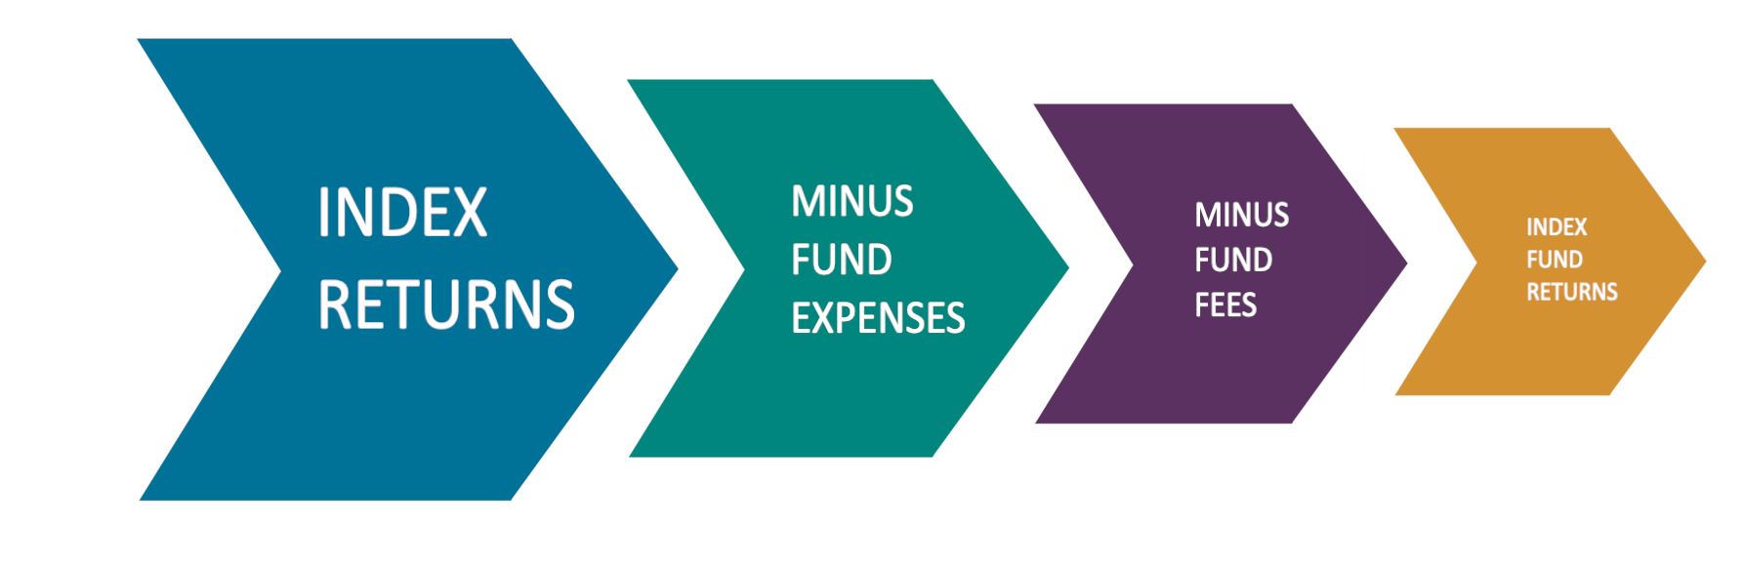
Index Funds Try to Mimic Returns of Various Indices, But…
Notes:
While we are in agreement broadly with passive investing—certainly as an alternative to active management—it makes underperformance almost certain, since manager fees and expenses mean that most index funds will do worse than the index they are trying to replicate.

Slide 15
Tilting the Odds Against You
Passive Management
Market Overperformance
Active Management
Market Underperformance
Notes:
In addition to passive management…

Slide 16
Tilting the Odds Against You
Investor Behavior
Market Overperformance
Passive Management
Active Management
Market Underperformance
Notes:
Investor behavior can also be a great threat to long-term goals.

Slide 17

“The dominant determinant
of real-life, long-term
investment outcomes is
not investment performance,
it's investor behavior.”
Nick Murray
Notes:
Read quote.

Slide 18

Emotional & Cognitive Biases
Restraint Bias
Loss Aversion
Bandwagon Effect
Primacy Effect
Overconfidence
Dunning-Kruger Effect
Action Bias
Projection Bias
Optimism Bias
Bias Blind Spot
Hindsight Bias
Semmelweis Reflex
Confirmation Bias
Herding
Anchoring Bias
Focusing Bias
Authority Bias
Availability Cascade
Choice Supportive Bias
Pareidolia
Behavioral Confirmation Effect
Hyperbolic Discounting
Impact Bias
Status Quo Bias
Von Restorff Effect
Notes:
Behavioral finance is the study of the influence of psychology on the behavior of investors or financial practitioners and ultimately, the subsequent effect on the markets. It focuses on the fact that investors are not always rational, have limits to their self-control, and are influenced by their own biases.
It is such an important field of study that the psychologist Daniel Kahneman was awarded the Nobel Prize in economics in 2002 for his lifetime of work.
These are some of the biases identified by Kahneman and others over the last few decades that can get in our way as investors. We all have them. Which is why we work to build real plans for real people.

Slide 19
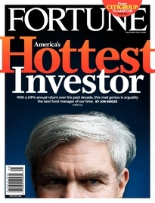
Investments vs.
Investor Outcomes
January 1, 2000 – December 31, 2009
S&P 500 Annualized Return: | -1%
CGM Focus Fund Annualized Return | 18%
Average Annualized Return for an Investor in the CGM Focus Fund | -11%
Source: “Best Stock Fund of the Decade: CGM Focus,” The Wall Street Journal, 12/31/2009, https://www.wsj.com/articles/SB10001424052748704876804574628561609012716
Fortune Magazine,
June 9, 2008
Notes:
What happens when investors let their emotions get the best of them, and buy towards the top, and sell towards the bottom. You end up getting an experience like those of the average investor in the top performing mutual fund of the lost decade. Anyone remember Kenneth Heebner’s CGM Focus Fund? During a period when the S&P 500 returned an annualized rate of -1%, the CGM Focus Fund returned an annualized 18%. Unfortunately, the average investor in that fund had a much different experience, seeing a -11% annual return over this period. They bought

Slide 20
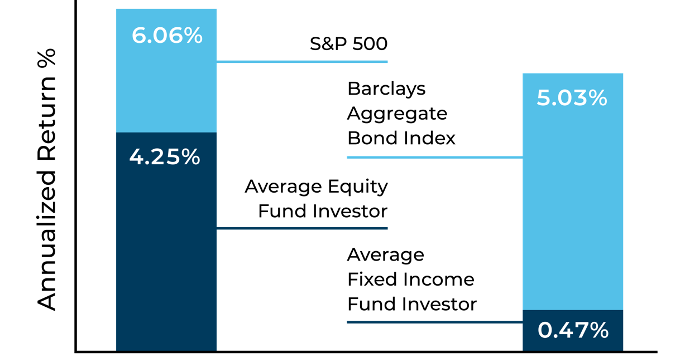
The Critical Role of the Financial Advisor
The Value of a Financial Advisor: The Opportunity for Greater Returns – 2000 - 2019
Hypothetical Illustration
Source: “Quantitative Analysis of Investor Behavior, 2020” DALBAR, Inc. www.dalbar.com
Past performance does not guarantee future results. All data is from sources believed to be reliable but cannot be guaranteed or warranted. For additional information regarding Symmetry Partners,
the Dalbar study and the S&P 500 index, see the disclosure information at the end of presentation labeled The Critical Role of the Financial Advisor Disclosure.
Notes:
First of all, why do I believe that most investors have a greater chance of financial success when they partner with a professional financial advisor, and more specifically, why should you choose to partner with me? ( Address the second part of the question first, and tailor your response to reflect your own uniqueness.)
If we take a look at some hard data regarding investors in general, however, you’ll see how the advice and service of an advisor may help many to have a better overall investment experience.
DALBAR, a widely renowned independent research firm conducted a study of the average equity fund investor’s investment experience over the last 20 years and found that their return substantially lagged behind the S&P 500. How does this happen? It happens because the avg. investor owned their holdings for only about 3 years.
What you see here is a visual representation of what may be referred to as a “fear and greed” approach to investing. As stock prices fall, investors tend to get scared and sell their holdings. When the trend reverses and prices start to go back up, investors re-gain confidence and buy back into the market. In other words, they sell low & buy high resulting in considerable underperformance relative to the index.
As an advisor, it’s my responsibility to help take the emotion out of investing, and to be a calming voice in times of uncertainty. Through careful planning and portfolio selection, regular communication, and ongoing education, my goal is to keep you focused on your long-term objectives, and the plan we have implemented, so you have every opportunity to achieve financial success. My goal is to help you avoid being the “average investor” who barely outpaces inflation, but rather the investor who captures the returns that the markets have to offer.

Slide 21
Our Investment Approach:
The Best of Active & Passive
EVIDENCE-BASED
Rule-Based & Transparent
Factor, Risk & Behavioral Tilts
PASSIVE
ACTIVE
Notes:
And one of the ways we do this is via an evidence-based investment philosophy that is neither passive nor active, but includes some of the best of these two approaches.
Passive: the funds are rule based and transparent
Active: the funds feature factor, risk and behavioral tilts.

Slide 22



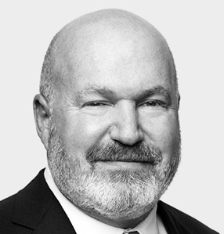
The Science of Evidence-Based Investing
Adam
Smith
Friedrich
Hayek*
Paul
Samuelson*
Harry
Markowitz*
Daniel
Kahneman*
Myron
Scholes*
Robert
Novy-Marx
Richard
Thaler*
Andrew
Ang
Franco
Modigliani*
Milton
Friedman*
Merton
Miller*
Bill
Sharpe*
Eugene
Fama*
Robert
C. Merton*
Ken
French
Cliff
Asness
*Nobel Laureate
Put Science on Your Side
Notes:
We believe that science and academic research are critical to building a prudent portfolio. Great thinkers and economists such as Adam Smith, Frederich Hayek, Paul Samuelson, Merton Miller, Bill Sharpe, Daniel Kahneman and of course Harry Markowitz have provided us with powerful insights into how portfolios should be constructed.

Slide 23
Next, We Try to Put the Odds in Your Favor
Market Underperformance
Market Overperformance
Notes:
So we’ve seen some of the things that can lead to underperformance. Let’s look at what can potentially help you outperform the market over the long –term—the key findings identified by academic science. As in all things in life, there are no guarantees. Past performance is certainly no guarantee of future results. But with our evidence-based approach, what we are trying to do is tilt the odds in your favor

Slide 24
Putting the Odds in Your Favor
Diversify Globally
Market Underperformance
Market Overperformance
Notes:
We begin by diversifying globally.

Slide 25

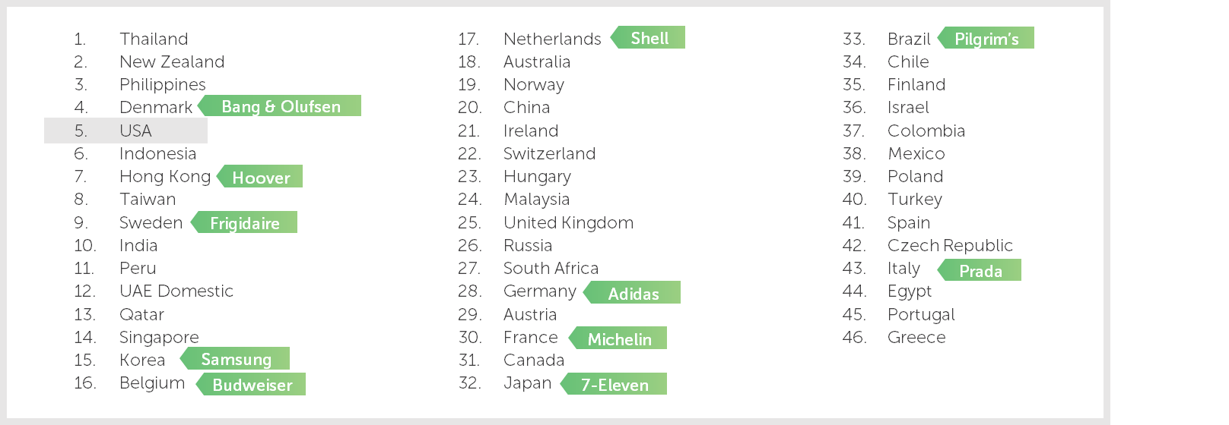




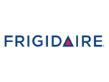





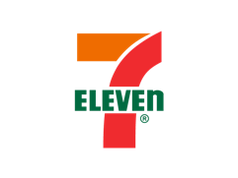
Diversify Globally: Ranking of World Market Returns
Ten-Year Returns 2009 – 2018
Source: Morningstar Direct 2019. Countries represented by their respective MSCI IMI (net div.). Past performance is not indicative of future results. Companies listed are for illustrative purposes only and are not to be viewed as investment recommendations. Past performance does not guarantee future results. All data is from sources believed to be reliable but cannot be guaranteed or warranted.
Notes:
The US represents less than half the value of total world markets. Many of the brands you use every day are made by countries headquartered outside the U.S.
While it has outperformed many developed and emerging markets, the long-term picture still points to a need for international diversification, with the U.S. coming in 5th out of 46 countries in terms of 10-year stock market returns. The US has never been the #1 global market in any ten-year period.
Ten years ago, almost no one would have predicted that countries like Thailand would do so well. Ten years from now, this list will almost certainly look very different.
Nobody knows what the future will bring. But if you own a lot of companies around the world you can worry less if any one company or even one country experiences losses. Nor do you need to be as concerned about picking countries that might outperform.
Top performer in 2018 was Ukraine at 80%

Slide 26
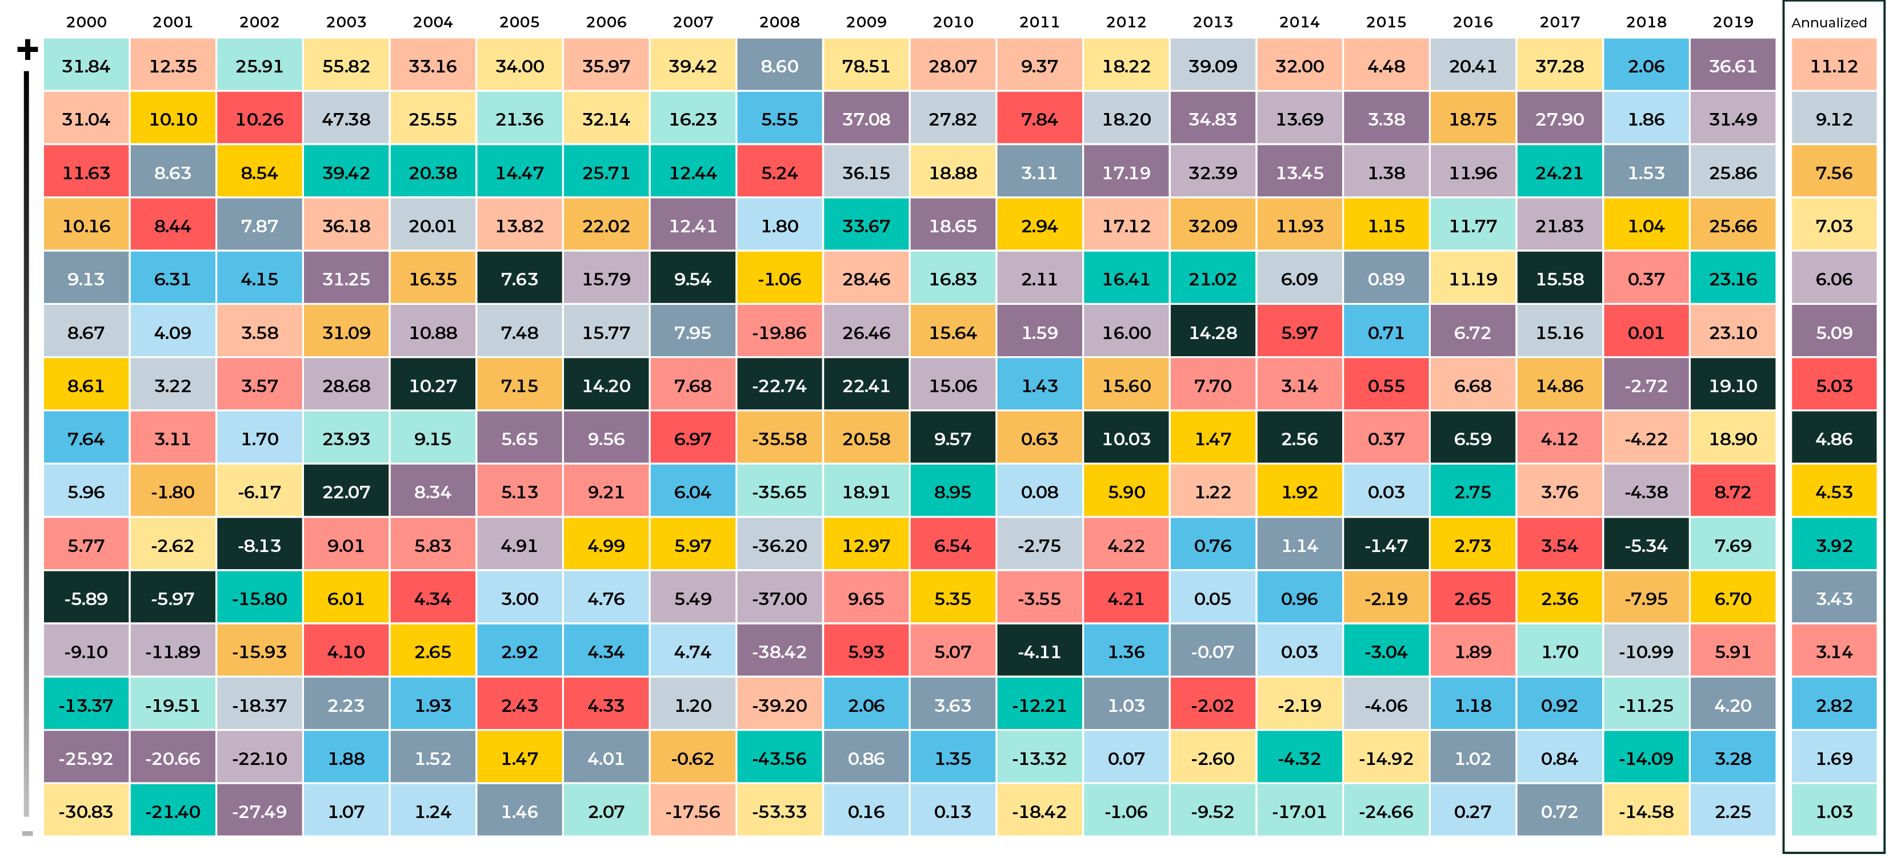
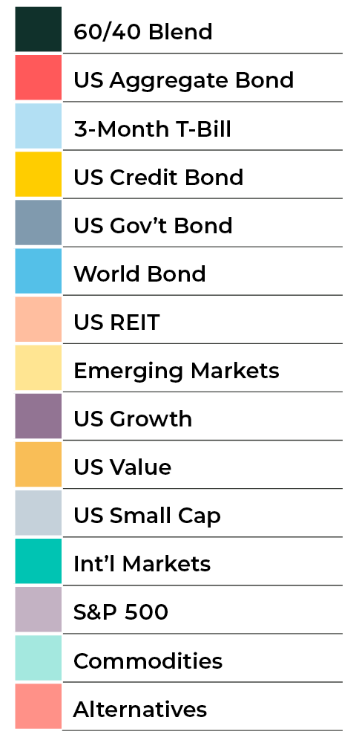
Diversify Globally—Performance of Various Asset Classes
2000 - 2019
Source: Morningstar Direct and www.hedgefundresearch.com
Diversification seeks to improve performance by spreading your investment dollars into various asset classes to add balance to your portfolio. Using this methodology, however, does not guarantee a profit or protection from loss in a declining market. Past performance does not guarantee future results. Investors cannot invest directly in an index. Actual performance for client accounts will differ. Please see disclosure at the end of presentation titled “Periodic Table of Asset Class and Sector Returns.” The data should be reviewed in conjunction with the disclosure of the performance information.
Annualized returns from 1999 through 2019. Annualized return: is calculated as a geometric average to show what an investment would earn over a period of time if the annual return was compounded.
Source: www.Investopedia.com
All data is from sources believed to be reliable but cannot be guaranteed or warranted. Past performance does not guarantee future results.
Notes:
So what are these “factors,” and how might they benefit investors? Very simply, factors are sources of expected returns that we believe are available in the capital markets.
Given our belief that factors are the true drivers of asset class returns, Symmetry targets the return opportunities of multiple factors in their portfolios by broadly diversifying their portfolios across multiple asset classes.
This chart represents the asset classes that are included in a balanced Symmetry portfolio ranked from best to worst performing from 2000 through 2019. As you can see, it’s very difficult to identify any sort of pattern which would indicate the asset classes that may be next year’s top performers.
Take Emerging Small Caps, for example. In 2008 it was the worst performer. Then in 2009, it was back to being the best performer. By 2011 it was at the bottom again, then in 2012 it was second from the top. From 2013-2016, this asset trended toward the bottom half of asset classes, but in 2017, it finished second from the top again with a return of more than 34%.
Instead of attempting to pick next year’s top performer and risk being wrong while still incurring transaction costs and possibly triggering taxable events, my recommendation is to buy every asset class, and hold it for the duration of your investment period. This means you will own the best performing asset class every year, but you will also own the worst.
I believe this broadly diversified strategy is an investment in capitalism and free markets on a global scale. It’s why I want to help you harness the power of capitalism and capture the returns that capital markets have to offer, not fight capitalism in a losing effort to beat the market.

Slide 27


Diversify Globally—Performance of Various Asset Classes
Notes:
As a though experiment…if you were driving on a bridge, and the guardrails were removed….
Where would you drive?
Most of us would try to drive right down the middle.
And investing and diversification are not much different

Slide 28
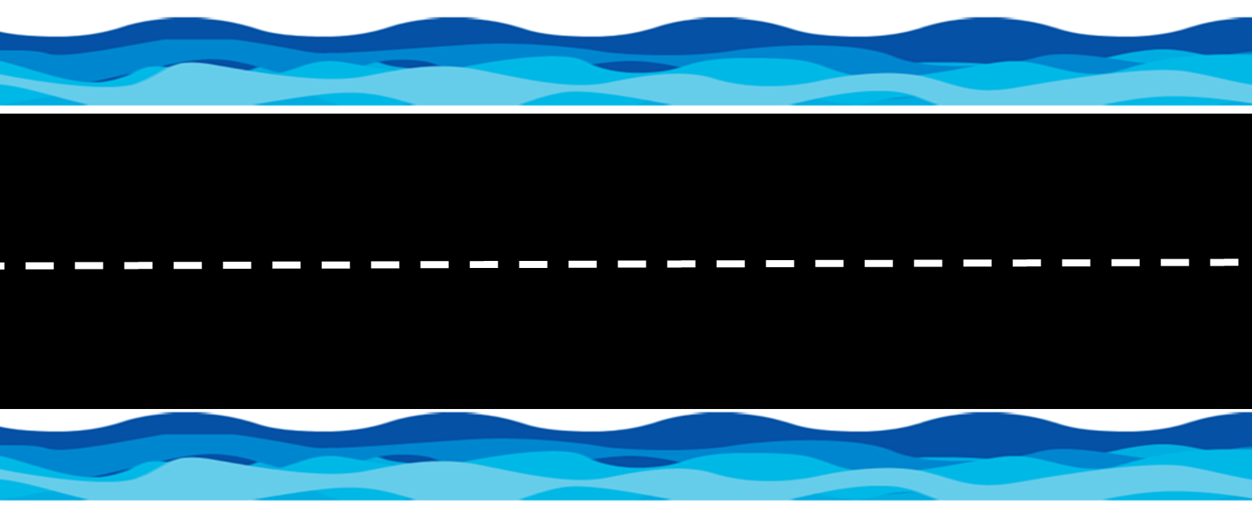
Diversify Globally—Performance of Various Asset Classes
2000 - 2019
US Growth
US Growth
US Growth
US Growth
US Growth
US Growth
US Growth
US Growth
US Growth
US Growth
US Growth
US Growth
US Growth
US Growth
US Growth
US Growth
US Growth
US Growth
US Growth
US Growth
US Growth
Source: Morningstar Direct and www.hedgefundresearch.com
Diversification seeks to improve performance by spreading your investment dollars into various asset classes to add balance to your portfolio. Using this methodology, however, does not guarantee a profit or protection from loss in a declining market. Past performance does not guarantee future results. Investors cannot invest directly in an index. Actual performance for client accounts will differ. Please see disclosure at the end of presentation titled “Periodic Table of Asset Class and Sector Returns.” The data should be reviewed in conjunction with the disclosure of the performance information.
Annualized returns from 1999 through 2019. Annualized return: is calculated as a geometric average to show what an investment would earn over a period of time if the annual return was compounded.
Source: www.Investopedia.com
All data is from sources believed to be reliable but cannot be guaranteed or warranted. Past performance does not guarantee future results.
Notes:
If you were in just one asset class, such as US Growth in this example, you would have been all over the road over the last 20 years…and have risked going off it several times

Slide 29
Diversify Globally—Performance of Various Asset Classes
2000 - 2019
60/40
60/40
60/40
60/40
60/40
60/40
60/40
60/40
60/40
60/40
60/40
60/40
60/40
60/40
60/40
60/40
60/40
60/40
60/40
60/40
60/40
Source: Morningstar Direct and www.hedgefundresearch.com
Diversification seeks to improve performance by spreading your investment dollars into various asset classes to add balance to your portfolio. Using this methodology, however, does not guarantee a profit or protection from loss in a declining market. Past performance does not guarantee future results. Investors cannot invest directly in an index. Actual performance for client accounts will differ. Please see disclosure at the end of presentation titled “Periodic Table of Asset Class and Sector Returns.” The data should be reviewed in conjunction with the disclosure of the performance information.
Annualized returns from 1999 through 2019. Annualized return: is calculated as a geometric average to show what an investment would earn over a period of time if the annual return was compounded.
Source: www.Investopedia.com
All data is from sources believed to be reliable but cannot be guaranteed or warranted. Past performance does not guarantee future results.
Notes:
But in the diversified portfolio, over the last 20 years, you stayed on the road. With a diversified portfolio, you will never be at the top in terms of performance. But you will also not be at the bottom. And when you invest for the long-term, these more consistent, more predictable results are what we are focused on.

Slide 30
Putting the Odds in Your Favor
Diversify Globally
Market Underperformance
Market Overperformance
Notes:
Beyond diversifying globally…

Slide 31
Putting the Odds in Your Favor
Tilt to Factors of Return
Diversify Globally
Market Underperformance
Market Overperformance
Please be advised that adding these factors may not ensure increased return over a market-weighted investment and may lead to underperformance relative to the benchmark over the investor’s time horizon. Information regarding these factors can be found on the back page. See disclosure behind presentation labeled “Notable Research” for additional information. Past performance does not guarantee future results. All data is from sources believed to be reliable but cannot be guaranteed or warranted.
Notes:
Our evidence-based approach also involves tilting to the factors that help drive returns.

Slide 32

What Are Factors?
Characteristics of stocks & bonds identified by financial science as offering potential for:
Higher returns over time
Reduced risk
Just as healthy diets depend on
the right nutrients…
Portfolio returns depend largely
on the right factors
Please be advised that adding these factors may not ensure increased return over a market-weighted investment and may lead to underperformance relative to the benchmark over the investor’s time horizon. Information regarding these factors can be found on the back page. See disclosure in back of presentation labeled “Notable Research” for additional information. Past performance does not guarantee future results. All data is from sources believed to be reliable but cannot be guaranteed or warranted.
For Advisor Use Only. Not for Public Distribution.
Notes:
Academic research has identified a number of factors that offer the potential for:
Higher returns over time
Reduced risk
In some ways these are even more fundamental than asset classes. Let’s use nutrition as an example. When you think of a salad, you think of lettuce, tomatoes, olives, croutons, etc.
But what drives the nutritional value of that salad. What are the various factors of nutrition that you need for a healthy diet.
These are Proteins, Vitamins, minerals, etc. Factors play a similar rle for portfolios and can help drive healthy returns.

Slide 33

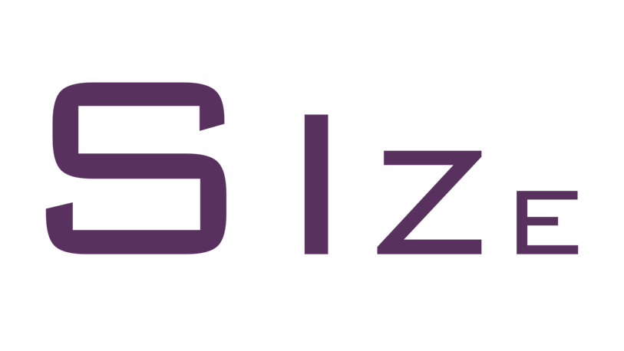

Factors We Target
Stocks tend to outperform bonds
Small company stocks tend to outperform those of large companies
Cheap stocks tend to outperform expensive stocks
Factor Premiums Source: Market, Size and Momentum are proxied by the Fama/French factors from Kenneth French Data Library. Quality and Style are proxied by the QMJ (Quality) and HMLd (Style) factors from AQR data library. Please note that different definitions of the factor premiums may lead to different average return numbers. This piece is for conceptual understanding of factors only and does not reflect Symmetry’s actual factor implementation. Mutual funds and ETFs chosen for Symmetry portfolios may not use these factor formulations. Numbers are annualized from 7/1957 through 12/2016 and reflect U.S. markets only. Please see disclosure in back of presentation labeled “Notable Research” for additional information.
Notes:
Here are some of the factors that can influence stock returns. Read slide

Slide 34
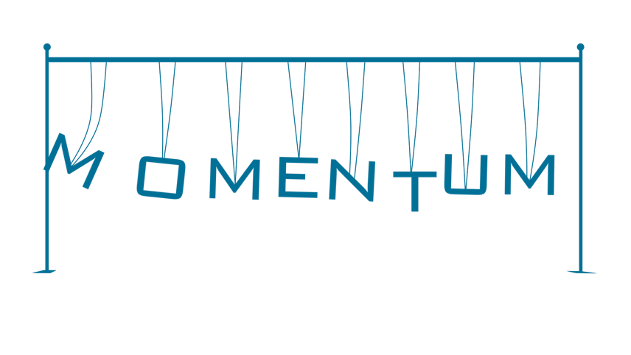
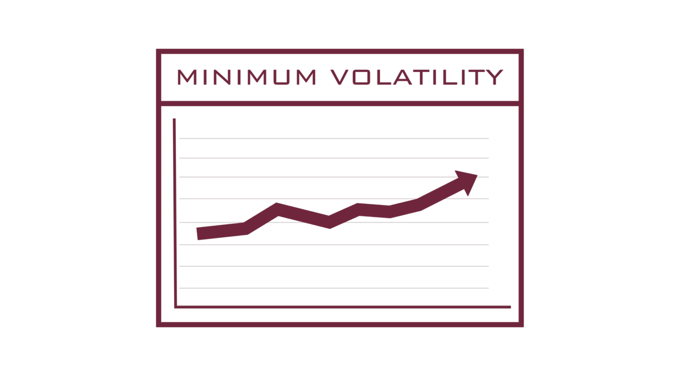

Factors We Target
Stocks that outperform in the near term tend to continue to do so
Minimum Volatility stocks tend to outperform high volatility stocks while offering better risk-adjusted returns
Stocks of high quality companies tend to outperform those of large companies
Factor Premiums Source: Market, Size and Momentum are proxied by the Fama/French factors from Kenneth French Data Library. Quality and Style are proxied by the QMJ (Quality) and HMLd (Style) factors from AQR data library. Please note that different definitions of the factor premiums may lead to different average return numbers. This piece is for conceptual understanding of factors only and does not reflect Symmetry’s actual factor implementation. Mutual funds and ETFs chosen for Symmetry portfolios may not use these factor formulations. Numbers are annualized from 7/1957 through 12/2016 and reflect U.S. markets only. Please see disclosure in back of presentation labeled “Notable Research” for additional information.
Notes:
Here are more of the factors that can influence stock returns. Read slide

Slide 35
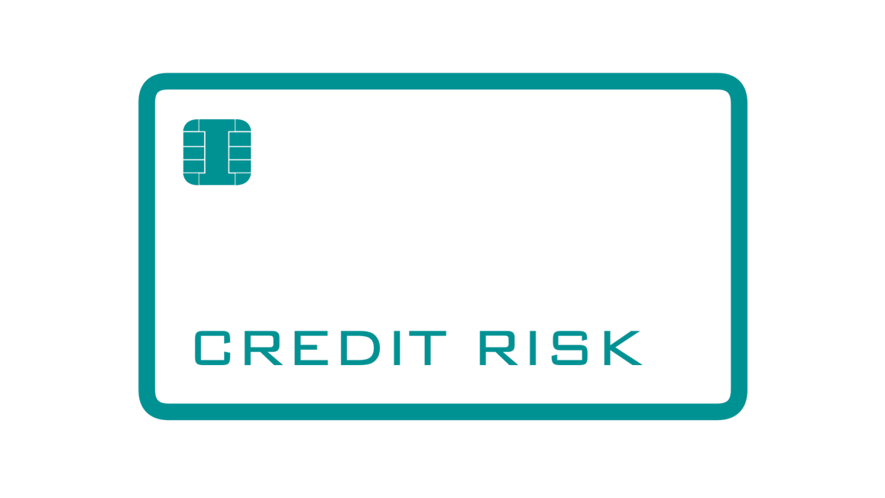
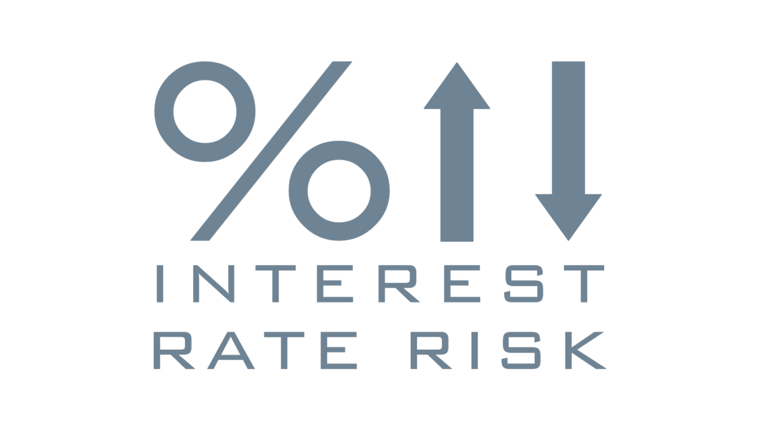
Factors We Target
Bonds with lower credit quality tend to outperform bonds
with higher credit quality
Bonds with longer durations or maturities tend to outperform shorter term bonds
Factor Premiums Source: Market, Size and Momentum are proxied by the Fama/French factors from Kenneth French Data Library. Quality and Style are proxied by the QMJ (Quality) and HMLd (Style) factors from AQR data library. Please note that different definitions of the factor premiums may lead to different average return numbers. This piece is for conceptual understanding of factors only and does not reflect Symmetry’s actual factor implementation. Mutual funds and ETFs chosen for Symmetry portfolios may not use these factor formulations. Numbers are annualized from 7/1957 through 12/2016 and reflect U.S. markets only. Please see disclosure in back of presentation labeled “Notable Research” for additional information.
Notes:
And ere are some of the factors that can influence bond returns. Read slide

Slide 36
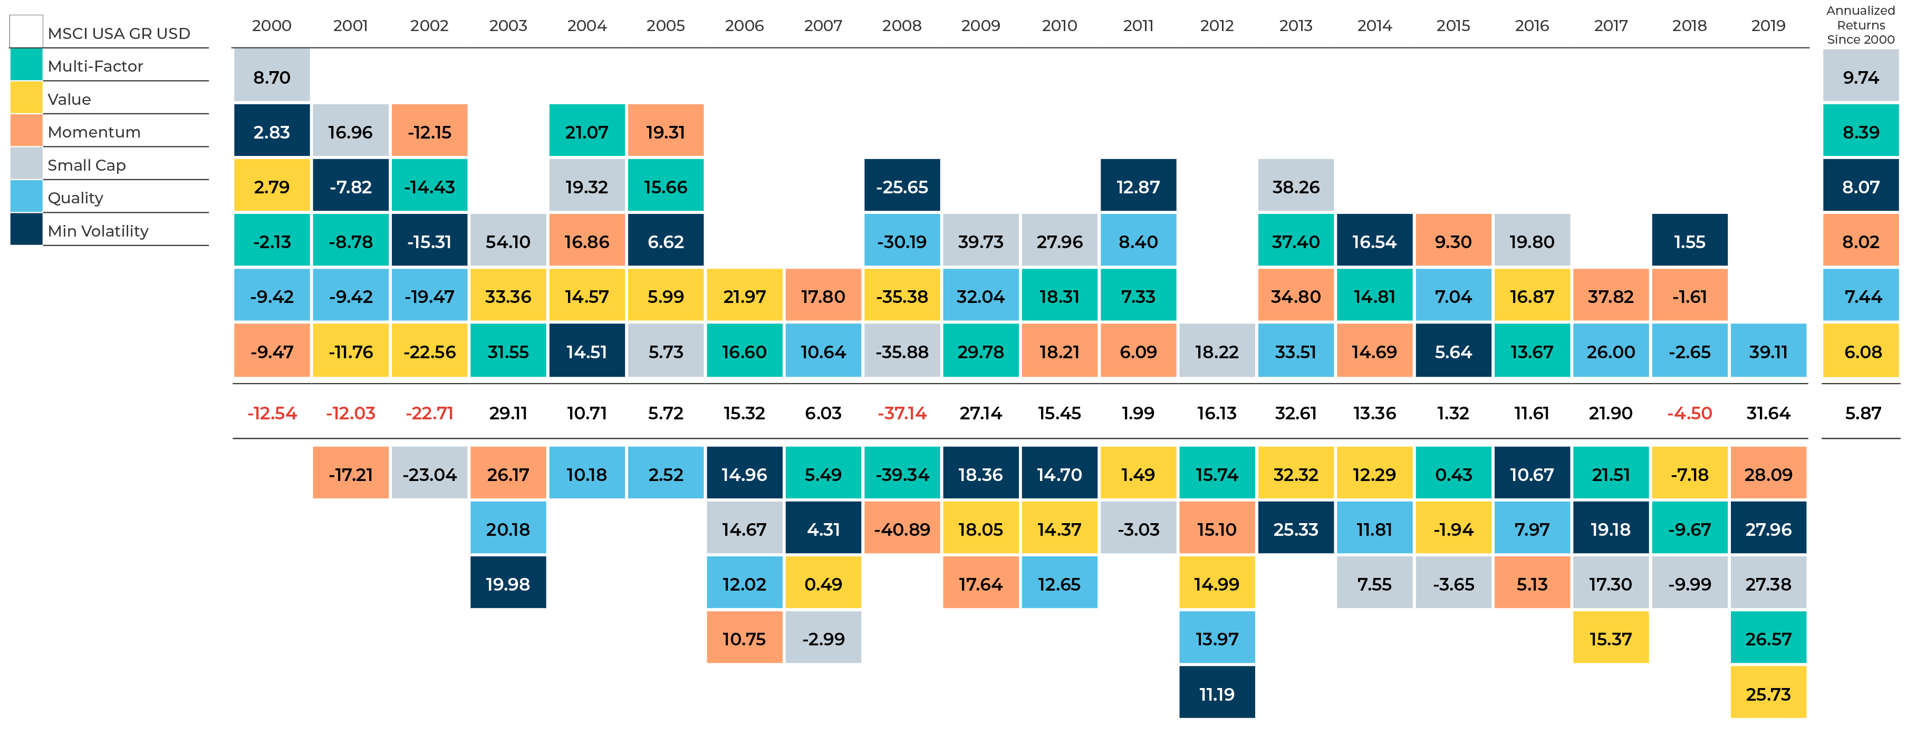
The Power of Factors & Diversification - Stocks
January 1, 2000 – December 31, 2019 (Annual Return %)
The chart above represents factor performance as illustrated by MSCI factor indices. They are representative of how single factors can vary in results and multi-factor can smooth out these variations.
Source: All returns from Morningstar. Annualized return is calculated as a geometric average to show what an investment would earn over a period of time if the annual return was compounded. For additional information regarding the limitations and description of the performance information, please see disclosure in the back.
Past performance does not guarantee future results. All data is from sources believed to be reliable but cannot be guaranteed or warranted. This piece is for conceptual understanding of factors only and does not reflect Symmetrys actual factor implementation. Mutual Funds and ETFs chosen for Symmetry portfolios may not use these factor formulations.
Symmetry charges an investment management fee for its services. For detailed information about Symmetry Partners fees and expenses please see Symmetry Partners, LLC ADV part 2A located on the Symmetry website at www.symmetrypartners.com. As with any investment philosophy, there is a possibility of profitability as well as loss. Diversification seeks to reduce volatility by spreading your investment dollars into various asset classes to add balance to your portfolio. Please note that you should not assume that any discussion or information contained in this material serves as the receipt of, or as a substitute for, personalized investment advice from Symmetry Partners, LLC or your advisor.
Notes:
Previously, we mentioned that factors are sources of expected returns that have robust academic support.
The Diversification of Factors table illustrates, on a year-by-year basis, the positive or negative excess return contributions that various equity factors have provided with respect to a benchmark index. For example, in 2016, Small Cap stocks outpaced the benchmark by 8. 19% for the year, while Quality trailed the benchmark by 3.64%.
Because the performance of factors varies just as asset class performance varies, you want to be diversified.
Over the last 20 years, a diversified multi factor index underperformed the benchmark 6 times and outperformed more than twice as often – 14 times.
Again, there are no guarantees, but we are trying to put the odds in your favor.

Slide 37
Putting the Odds in Your Favor
Tilt to Factors of Return
Diversify Globally
Market Underperformance
Market Overperformance
Please be advised that adding these factors may not ensure increased return over a market-weighted investment and may lead to underperformance relative to the benchmark over the investor’s time horizon. Information regarding these factors can be found on the back page. See disclosure behind presentation labeled “Notable Research” for additional information. Past performance does not guarantee future results. All data is from sources believed to be reliable but cannot be guaranteed or warranted.
Notes:
Finally, in addition to tilting towards the factors of return…

Slide 38
Putting the Odds in Your Favor
Market Underperformance
Invest for the Long-Term
Market Underperformance
Tilt to Factors of Return
Market Overperformance
Diversify Globally
Market Overperformance
Notes:
We take a long-term approach. Diversification and investing in factors requires patience and discipline. For example, the chance of losing money in the stock market (as represented by the S&P 500) is 46% on any one day. 10% over any 5 year period. And we’ve never seen a negative 20 year period.

Slide 39


“Money is like soap,
the more you handle it
the less you will have.”
Eugene Fama, Sr.
Nobel Laureate
Notes:
Read quote. At Symmetry, we believe that the biggest challenge Advisors face is not investing--nine decades of research and analysis and the insights of 11 Nobel laureates point o a prudent, evidence-based way to invest. But the investor problem has to be solved every day

Slide 40
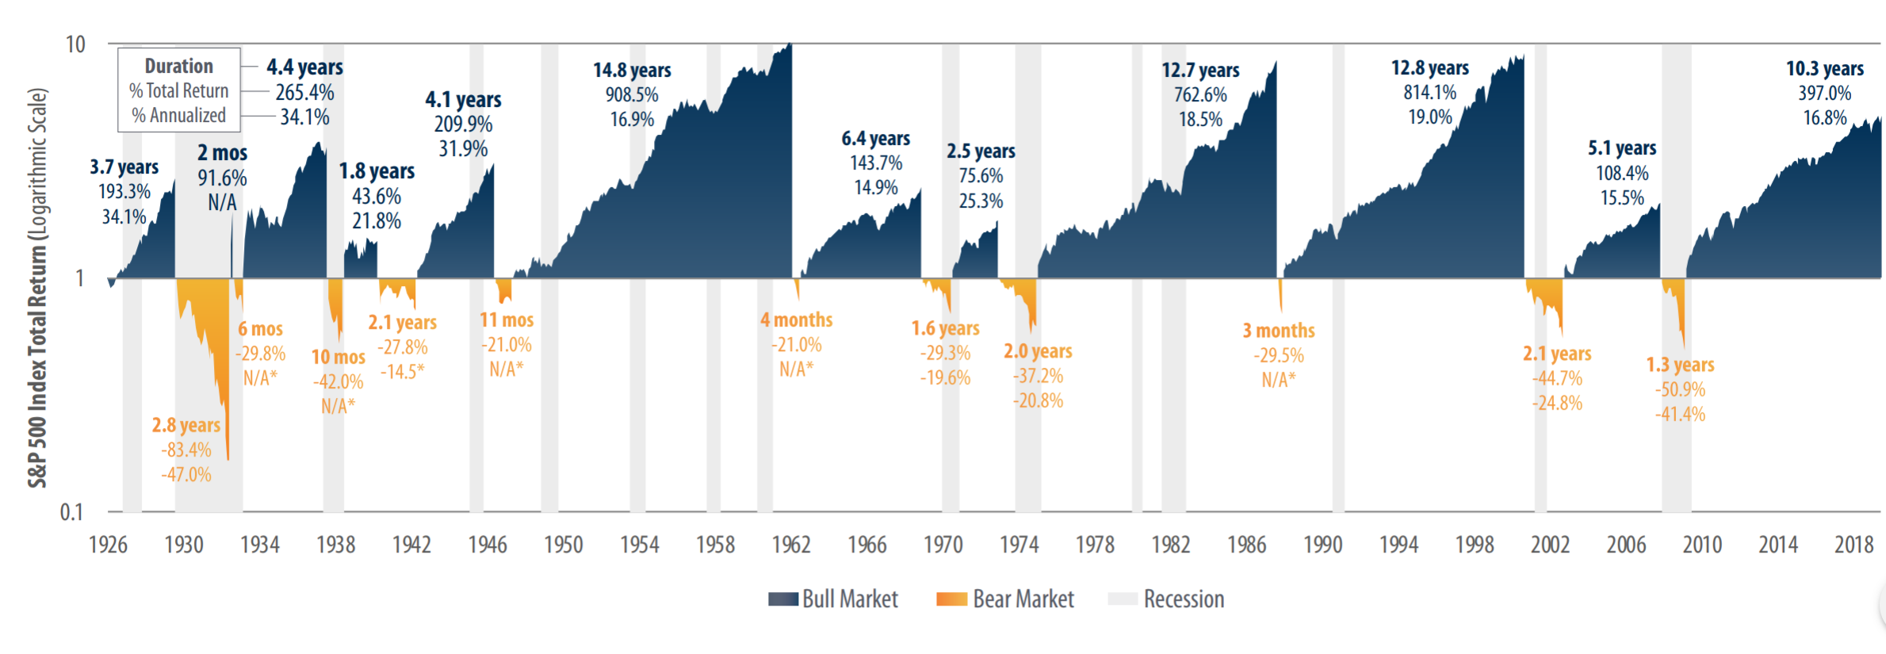
Bear & Bull Markets & Recessions
1926 – 2019
Average Bull Market: 6.6 years w/ average cumulative return of 334%
Average Bear Market: 1.3 years w/ average cumulative loss of -38%
10.9 years
451.0%
16.9%
Source: First Trust Advisors L.P., Bloomberg. Returns from 1926 – 12/30/19.
These results are based on monthly returns–returns using different periods would produce different results. The S&P 500 Index is an unmanaged index of 500 stocks used to measure large-cap U.S. stock market performance. Investors cannot invest directly in an index. Index returns do not reflect any fees, expenses, or sales charges. This chart is for illustrative purposes only and not indicative of any actual investment. These returns were the result of certain market factors and events which may not be repeated in the future. Past performance is no guarantee of future results. The information presented is not intended to constitute an investment recommendation for, or advice to, any specific person. All data is from sources believed to be reliable but cannot be guaranteed or warranted.
Notes:
As you can see there have been many more bull markets than bear markets historically. And bear markets do not correlate necessarily with economic recessions.
Over time, markets have historically rewarded investors for the risks of being invested.

Slide 41
Putting the Odds in Your Favor
Result: Potential long-term market outperformance of @ 200 bps
Market Underperformance
Invest for the Long-Term
Market Underperformance
Tilt to Factors of Return
Market Overperformance
Diversify Globally
Market Overperformance
Please be advised that adding these factors may not ensure increased return over a market-weighted investment and may lead to underperformance relative to the benchmark over the investor’s time horizon. Information regarding these factors can be found on the back page. See disclosure behind presentation labeled “Notable Research” for additional information. Past performance does not guarantee future results. All data is from sources believed to be reliable but cannot be guaranteed or warranted.
Past performance does not guarantee future results. All data is from sources believed to be reliable but cannot be guaranteed or warranted.
Notes:
When you add up all this up, we believe, based on decades of data, that there is a potential market outperformance of as much as 200 bps. Obviously, past performance is no guarantee of future results. We are just tryting to tilt the long-tem odds in your favor.

Slide 42
What Combining Factors Can Mean
Growth of $100,000 – 20 Years (1999 – 2019)
Hypothetical Illustration
Global Multi-Factor
Sharpe Ratio: .50
U.S. Multi-Factor
Sharpe Ratio: .49
Global Multi-Factor
$523,000
S&P 500
Sharpe Ratio: .32
U.S. Multi-Factor
$501,000
S&P 500
$324,000
Source: Morningstar Direct. Please be advised that adding these factors may not ensure increased return over a market-weighted investment and may lead to underperformance relative to the benchmark over the investor’s time horizon. Information regarding these factors can be found on the back page. For a description of the charts and various definitions, as well as additional information and limitations to index performance, please see the Disclosure in the back labeled Factors Over Time Disclosure. Symmetry Partners’ investment approach seeks enhanced returns by overweighting assets that exhibit characteristics that tend to be in accordance with one or more “factors” identified in academic research as historically associated with higher returns. The factors Symmetry seeks to capture may change over time at its discretion. Past performance does not guarantee future results. All data is from sources believed to be reliable but cannot be guaranteed or warranted.
Notes:
Let’s look at how various factors have done over the last 20 years, using index data. If you’d invested $100,000 in the S&P 500 20 years ago, it would now be worth more than $324,000. However, if you’d put the same $100,000 in a multi-factor index—the MSCI USA Diversified Multi Index, it would have turned into more than $501,000. And if you’d invested in a globally diversified factor index—the MSCI ACWI Diversified Multi Index—it would have returned more than $523,000.

Slide 43
3
How Will You Stay on Track?
Notes:
And finally—the last key investor question. Read slide.

Slide 44


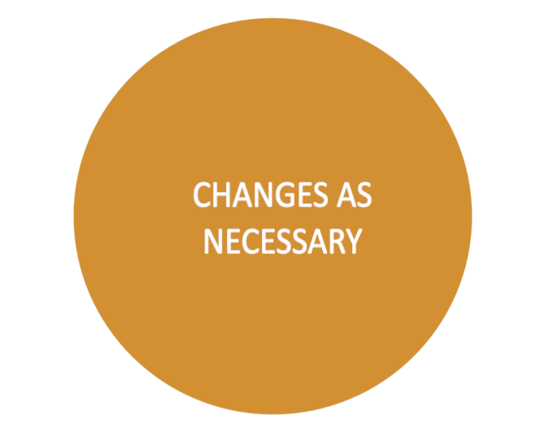
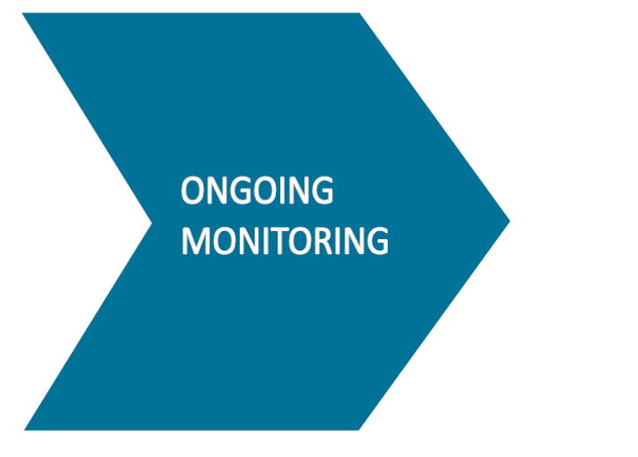
How Will You Stay on Track?
3
?
TODAY
Even uncertainty can be planned for
Notes:
Once we have a plan and portfolio in place, we will work closely together to make sure you stay on track. And while we don’t know what the future will bring, we can plan for uncertainty ….and as your life and circumstances change, we can make any adjustments and changes as necessary

Slide 45
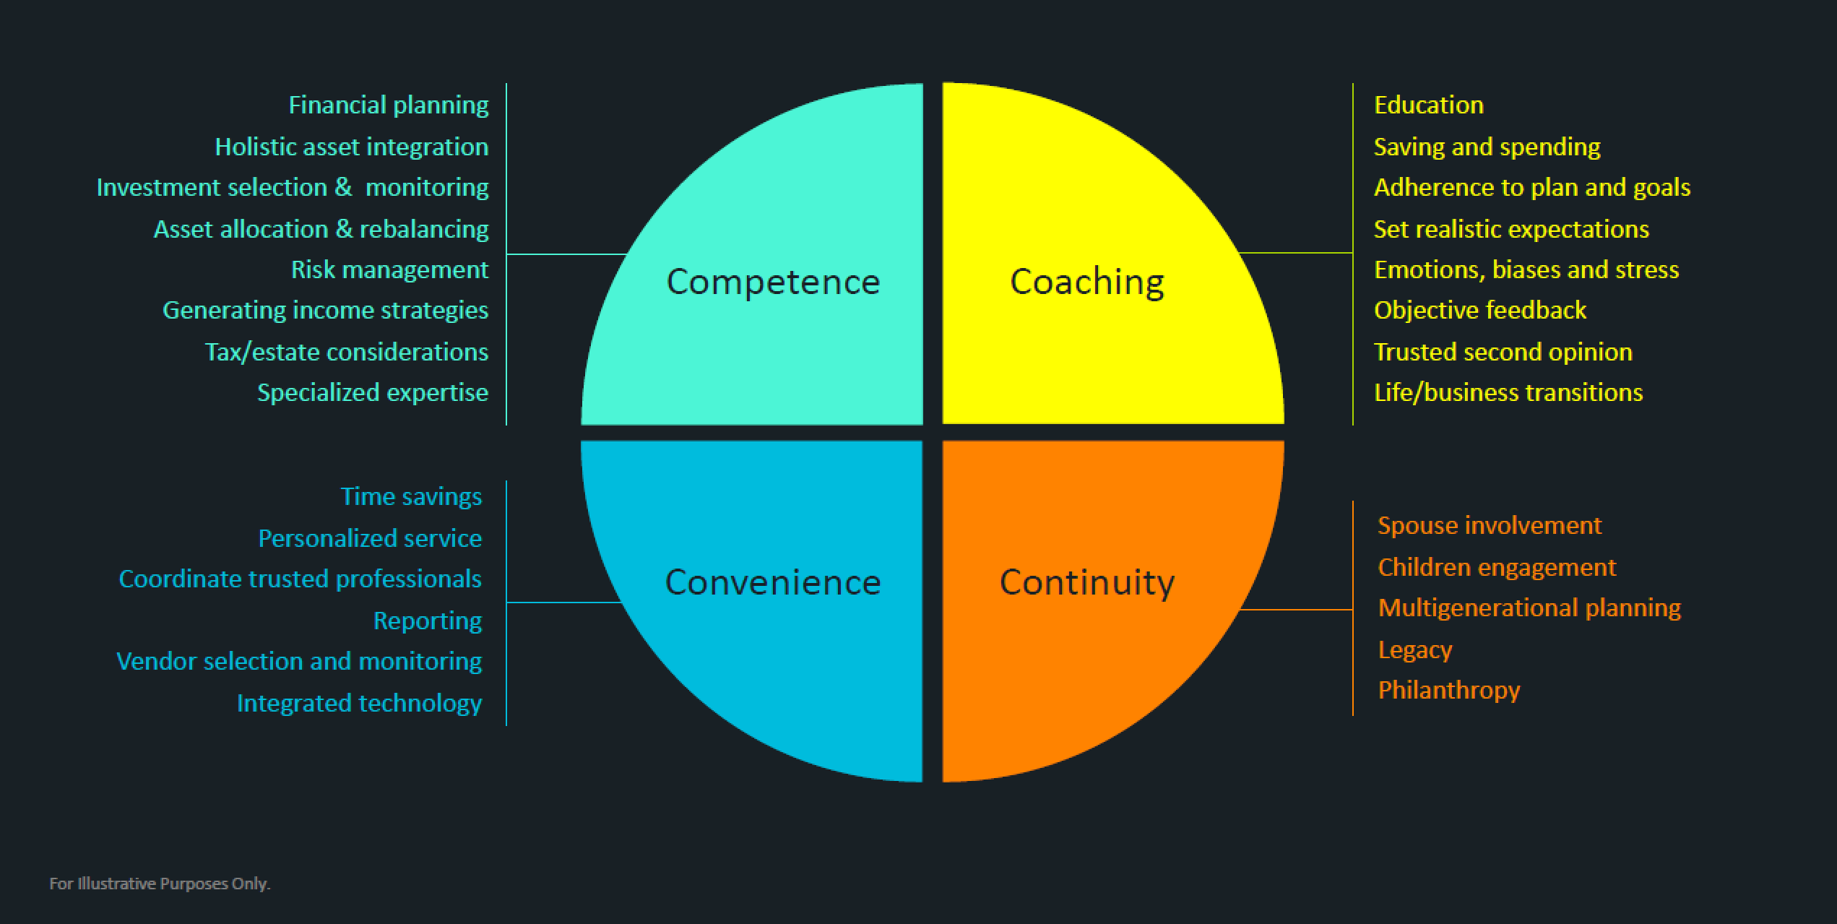
Working Together
Notes:
And this is just part of what I will do for you as your Advisor. These are all the areas I can help you with—many we covered today– many that will make more sense to focus on in the future or for others you know who may need help. I am committed to being with you every step of this journey and helping make it as successful as it can be.

Slide 46

The 3 Key Questions for Investors
1
What’s Most Important to You—Personally & Financially?
2
Do I Have the Right Plan (and Portfolio) to Get There?
3
How Will You Stay on Track?
Notes:
We started with these questions, and I hope I’ve given you a good sense of how I can help you answer them if we decide to work together.

Slide 47

Thank You
“Scrappy,” the Symmetry bull is a symbol of our firm’s belief in the long-term power of markets.
Symmetry Partners, LLC is not affiliated with any firm mentioned in this presentation.
Symmetry Partners’ investment approach seeks enhanced returns by overweighting assets that exhibit characteristics that tend to be in accordance with one or more “factors” identified in academic research as historically associated with higher returns. Please be advised that adding these factors may not ensure increased return over a market weighted investment and may lead to underperformance relative to the benchmark over the investor’s time horizon. The factors Symmetry seeks to capture may change over time at its discretion. Currently, the major factors in equity markets used by Symmetry and some associated academic research are: the market risk premium (Sharpe, William F. “Capital Asset Prices: A Theory of Market Equilibrium under Conditions of Risk.” The Journal of Finance, Vol. 19, No. 3 (Sept. 1964), 425-442.), value (Fama, Eugene and Ken French. “Common risk factors in the returns on stocks and bonds.” Journal of Financial Economics, 33, (1993), 3-56.), small (Banz, Rolf W. “The Relationship Between Return and Market Value of Common Stocks.” Journal of Financial Economics, 9 (1981), 3-18.), profitability (Novy-Marx, Robert. “The Other Side of Value: The Gross Profitability Premium.” Journal of Financial Economics, 108(1), (2013), 1-28. ), quality (Asness, Clifford S.; Andrea Frazzini; and Lasse H. Pedersen. “Quality Minus Junk.” Working Paper.), momentum (Jegadeesh,Narasimhan and Sheridan Titman. “Returns to Buying Winners and Selling Losers: Implications for Stock Market Efficiency.” The Journal of Finance, Vol. 48, No. 1, (March 1993), 65-91), and minimum volatility (Ang, Andrew, Robert J. Hodrick, Yuhang Xing and Xiaoyan Zhang. “The Cross-Section of Volatility and Expected Returns.” The Journal of Finance, Vol. 61, No. 1 (Feb. 2006), pp. 259-299.) On the bond side, Symmetry primarily seeks to capture maturity and credit risk premiums (Ilmanen, Antti. Expected Returns: An Investor’s Guide to Harvesting Market Rewards. WileyFinance, 2011, p157-158 and 183-185.). All data is from sources believed to be reliable but cannot be guaranteed or warranted.
Notes:
Do you have any questions for me?

Slide 48
SPIVA DISCLOSURE
Past performance is no guarantee of future results. Data courtesy of Standard & Poor’s Index Versus Active (SPIVA) report as of 12/31/18. The SPIVA Scorecard presents the performances of actively managed mutual funds as compared to benchmark indices. It covers U.S. equity, international equity and fixed income categories. Percentages represent the percent of the equal-weighted asset class that is outperformed by its relative benchmark as defined below. The analysis shows that in most cases the number of active managers in the given asset classes underperforming the benchmark is higher than the number outperforming, though randomly in any one asset class the number of active managers outperforming the relevant benchmark is more than 50%. This same general conclusion holds for each five-year holding period ending December going back to Dec. 2002, as analyzed by SPIVA, except for the period ending Dec. 2007, for which SPIVA did not create a report. Active manager data is obtained from the CRSP Survivorship-Bias-Free US Mutual Fund Database for the 2008 analysis and from the S&P Mutual Fund database, a continuous, consistent, survivorship-bias free database. Data is from sources believed to be reliable, but cannot be guaranteed or warranted.
All indexes have certain limitations. Investors cannot invest directly in an index. Indexes have no fees. Historical performance results for investment indexes generally do not reflect the deduction of transaction and/or custodial charges or the deduction of an investment management fee, the incurrence of which would have the effect of decreasing historical performance results. Actual performance for client accounts may differ materially from the index portfolios. The SPIVA comparison is made against the “average” active manager performance. Investors cannot invest in the “average active manager.”
S&P 500 Index: Widely regarded as the best single gauge of the U.S. equities market, this market capitalization-weighted index includes a representative sample of 500 leading companies in leading industries of the U.S. economy and provides over 80% coverage of U.S. equities.
S&P MidCap 400 Index: This index consists of 400 mid-sized companies and covers approximately 7% of the U.S. equities market.
S&P SmallCap 600 Index: This index consists of 600 small-cap stocks and covers approximately 3% of the U.S. equities market.
S&P United States REIT Index: The S&P U.S. REIT Index defines and measures the investable universe of publicly traded real estate investment trusts domiciled in the United States
S&P International 700 Index: This index measures the non-United States component of the global equity markets. The index covers all of the regions included in the S&P Global 1200 except for the United States (S&P 500).
S&P/IFCI Composite Index: This index is widely recognized as a comprehensive and reliable measure of the world’s emerging markets. It measures the returns of stocks that are legally and practically available to foreign investors.
S&P National AMT-Free Municipal Bond Index: This index is a broad, comprehensive, market value-weighted index designed to measure the performance of the investment-grade U.S. municipal bonds that are exempt from the Alternative Minimum Tax.
Barclays US Government 1-3 Year Bond Index: This index consists of U.S. Treasury and U.S. Government agency bonds with maturities from one to three years.
Barclays US Government/Credit 1-3 Year Bond Index: This index covers corporate and non-corporate fixed-income securities that are rated investment grade and have 1-3 yrs to final maturity.
Barclays US Government/Credit Intermediate: This index covers corporate and non-corporate fixed income securities that are rated investment-grade with maturities from one to ten years.
For further information regarding Standard and Poor’s Indices Versus Active Funds Scorecard, please go to www.us.spindices.com/spiva.

Slide 49
CRITICAL ROLE OF AN ADVISOR DISCLOSURE
Source: “Quantitative Analysis of Investor Behavior, 2019,” DALBAR, Inc. www.dalbar.com
Equity benchmark performance and systematic equity investing examples are represented by the Standard & Poor’s 500 Composite Index, an unmanaged index of 500 common stocks generally considered representative of the U.S. stock market. Indexes do not take into account the fees and expenses associated with investing, and individuals cannot invest directly in any index. Past performance cannot guarantee of future results.
Average equity investor performance results are calculated using data supplied by the Investment Company Institute. DALBAR is an independent, Boston-based financial research firm. Investor returns are represented by the change in total mutual fund assets after excluding sales, redemptions and exchanges. This method of calculation captures realized and unrealized capital gains, dividends, interest, trading costs, sales charges, fees, expenses and any other costs. After calculating investor returns in dollar terms, two percentages are calculated for the period examined: Total investor return rate and annualized investor return rate. Total return rate is determined by calculating the investor return dollars as a percentage of the net of the sales, redemptions and exchanges for each period.
Indices are unmanaged. Investors cannot directly invest in an index. Indexes have no fees. Historical performance results for indexes generally do not reflect the deduction of transaction and/or custodial charges or investment management fees, the incurrence of which have the effect of decreasing historical performance results. Actual performance for client accounts may differ materially from index portfolios.

Slide 50
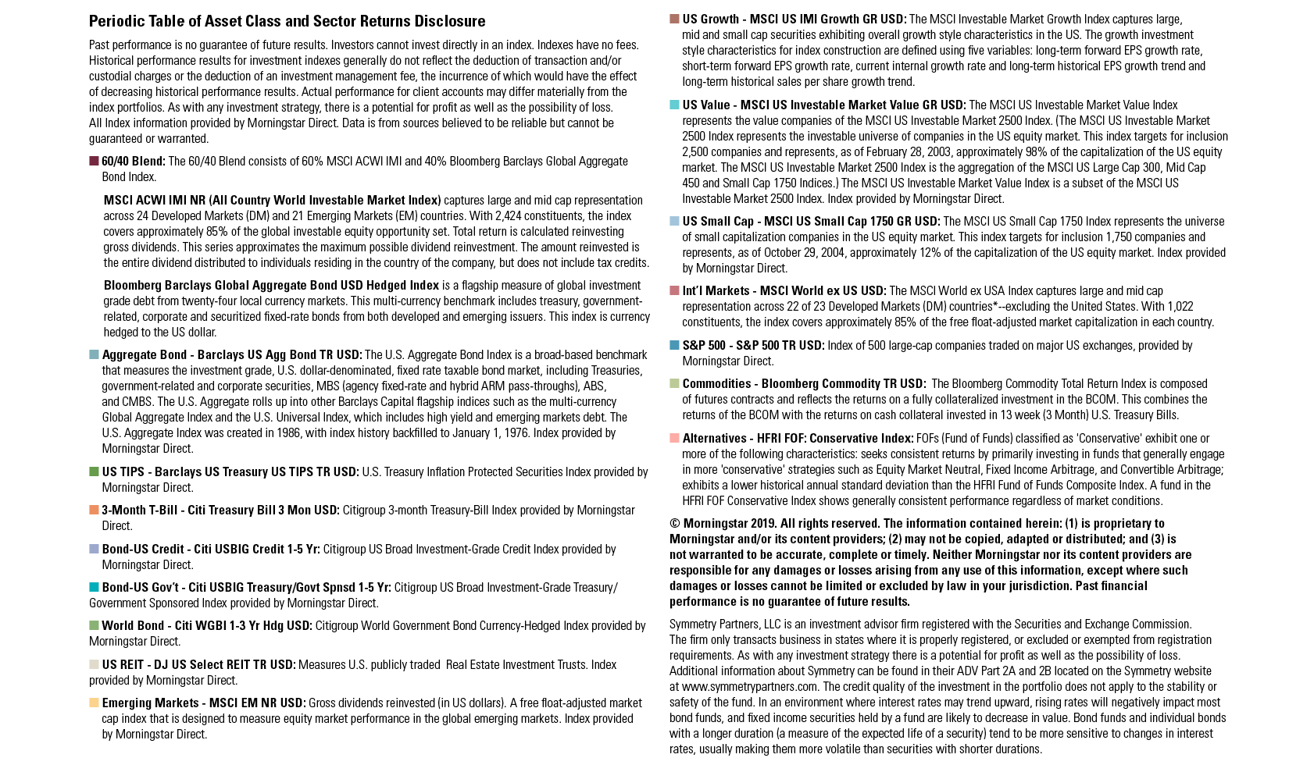
PERIODIC TABLE OF ASSET CLASS AND SECTOR RETURNS DISCLOSURE

Slide 51
NOTABLE RESEARCH DISCLOSURE
QMJ (Quality minus Junk) or Quality Factor is constructed as the intersection of six value-weighted portfolios formed on size and quality. The factor is long the top 30% high-quality stocks and short the bottom 30% junk stocks within the universe of large stocks and similarly within the universe of small stocks.
Sharpe: Bill Sharpe, Professor of Finance Emeritus at Stanford University Graduate School of Business, and winner of the Nobel Prize in Economics in 1990. Known for his work on the Capital Asset Pricing Model.
Banz: Rolf Banz, published “The Relationship Between Return and Market Value of Common Stocks” in 1981 showing the higher return on small cap stocks than large.
Fama and French: Eugene Fama, Robert R. McCormick Distinguished Service Professor of Finance at the University of Chicago and Kenneth R. French, Roth Family Distinguished Professor of Finance at the Tuck School of Business at Dartmouth. Known for their work on value and small cap premiums and the “Fama-French Three-Factor Model.”
Basu: S. Basu, published “Investment Performance of Common Stocks in Relation to their Price-Earnings Ratio: A Test of the Efficient Market Hypothesis,”in 1977 regarding value stocks.
Novy-Marx, Robert. “The other side of value: The gross profitability premium.” Journal of Financial Economics, 2013.
Asness, Clifford S.; Andrea Frazzini; and Lasse H. Pedersen. “Quality Minus Junk.” Working Paper.
Jegadeesh, Narasimhan and Sheridan Titman. “Returns to Buying Winners and Selling Losers: Implications for Stock Market Efficiency.” The Journal of Finance, 1993.
Ang, Hodrick, Xing and Zhang. “The Cross-Section of Volatility and Expected Returns.” The Journal of Finance, 2006.
Yakov Amihud of Tel Aviv University and Haim Mendelson of University of Rochester, for their work on liquidity.
Longstaff, Francis A. and Eduardo S. Schwartz. “A Simple Approach to Valuing Risky Fixed and Floating Rate Debt.” The Journal of Finance, 1995.
Merton: Robert C. Merton, published “On the Pricing of Corporate Debt: The risk structure of interest rates,” in the Journal of Finance in 1974.
Elton, Gruber, Agrawal, and Mann: Edwin J. Elton, Martin J. Gruber, Deepak Agrawal and Christopher Mann published “Explaining the rate spread on corporate bonds,” in the Journal of Finance in 2001.
Ilmanen, Antti. Expected Returns: An Investor’s Guide to Harvesting Market Rewards. Wiley, 2011, pp. 157-158 and pp. 183-185 for other fixed income factor references.
Stanley Fischer. “The Demand for Index Bonds,” Journal of Political Economy, Volume 83 (June 1975), pp. 509-534.

Slide 52
FACTORS OVER TIME DISCLOSURE
Factors are sources of expected returns. Symmetry searches for factors that have been shown historically to deliver higher returns over time. Symmetry Partners’ investment approach seeks enhanced returns by overweighting assets that exhibit characteristics that tend to be in accordance with one or more “factors” identified in academic research as historically associated with higher returns. Please be advised that adding these factors may not ensure increased return over a market weighted investment and may lead to underperformance relative to the benchmark over the investor’s time horizon.
Historical performance results for investment indices and/or categories have been provided for general comparison purposes only, and generally do not reflect the deduction of transaction and/or custodial charges, the deduction of an investment management fee, nor the impact of taxes, the incurrence of which would have the effect of decreasing historical performance results. It should not be assumed that your account holdings correspond directly to any comparative indices.
All indexes have certain limitations. Investors cannot invest directly in an index. Indexes have no fees. Historical performance results for investment indexes generally do not reflect the deduction of transaction and/or custodial charges or the deduction of an investment management fee, the incurrence of which would have the effect of decreasing historical performance. Actual performance for client accounts may differ materially from the index portfolios.
Value = MSCI USA Value Index: MSCI USA Value Index captures large and mid-cap US securities exhibiting overall value style characteristics. The value investment style characteristics for index construction are defined using three variables: book value to price, 12-month forward earnings to price and dividend yield. With 322 constituents, the index targets 50% coverage of the free float-adjusted market capitalization of the MSCI USA Index. (launched Dec 08, 1997)
Quality = MSCI USA Quality Index: MSCI USA Quality Index is based on the MSCI USA Index, its parent index, which includes large and mid-cap stocks in the US equity market. The index aims to capture the performance of quality growth stocks by identifying stocks with high quality scores based on three main fundamental variables: high return on equity (ROE), stable year-over-year earnings growth and low financial leverage. (launched on Dec 18, 2012. Data prior to the launch date is back-tested data )
Momentum = MSCI USA Momentum Index: MSCI USA Momentum Index is based on MSCI USA Index, its parent index, which captures large and mid-cap stocks of the US market. It is designed to reflect the performance of an equity momentum strategy by emphasizing stocks with high price momentum, while maintaining reasonably high trading liquidity, investment capacity and moderate index turnover. (launched on Feb 15, 2013. Data prior to the launch date is back-tested data)
Small-Cap = MSCI USA Small Cap Index: MSCI USA Small Cap Index is designed to measure the performance of the small cap segment of the US equity market. With 1,864 constituents, the index represents approximately 14% of the free float-adjusted market capitalization in the US. (launched on Jan 15, 1998)
Multi-Factor = MSCI USA Diversified Multiple-Factor Index: MSCI USA Diversified Multiple-Factor Index is based on a traditional market cap weighted parent index, the MSCI USA Index, which includes US large and mid-cap stocks. The index aims to maximize exposure to four factors – Value, Momentum, Quality and Low Size -- while maintaining a risk profile similar to that of the underlying parent index. (launched on Feb 17, 2015. Data prior to the launch date is back-tested data)
Min-Volatility = MSCI USA Minimum Volatility Index: MSCI USA Minimum Volatility Index aims to reflect the performance characteristics of a minimum variance strategy applied to the large and mid-cap USA equity universe. The index is calculated by optimizing the MSCI USA Index, its parent index, in USD for the lowest absolute risk (within a given set of constraints). Historically, the index has shown lower beta and volatility characteristics relative to the MSCI USA Index. (launched on Jun 02, 2008. Data prior to the launch date is back-tested data)
MSCI USA = MSCI USA GR USD: which is designed to measure the performance of the large and mid cap segments of the US market. With 622 constituents, the index covers approximately 85% of the free float-adjusted market capitalization in the US. (launched on Mar 31, 1986)
S&P 500 Index: Widely regarded as the best single gauge of the U.S. equities market, this market capitalization-weighted index includes a representative sample of 500 leading companies in leading industries of the U.S. economy and provides over 80% coverage of U.S. equities. (launched in 1957)
© Morningstar 2019. All rights reserved. The information contained herein: (1) is proprietary to Morningstar and/or its content providers; (2) may not be copied, adapted or distributed; and (3) is not warranted to be accurate, complete or timely. Neither Morningstar nor its content providers are responsible for any damages or losses arising from any use of this information, except where such damages or losses cannot be limited or excluded by law in your jurisdiction. Past financial performance is no guarantee of future results.

