Slide 1

Media Selection for Distance Learning

Slide 2
Objectives
  Introduce Distance Learning
  Describe Various Media—Pros & Cons
  Review of Research
  Introduce Guiding Principles

Slide 3
The No-Spin Zone of Distance Learning
Caution! You are about to enter…

Slide 4
By way of introduction…
Who am I? What about you?
How are you involved in distance learning?
Trainer or Educator? Instructional Designer?
Media Manager? Media Operator?
Academic, Corporate, Government?
Have you ever taken a course using . . .
  The Web (Webinars, online CBI)?
  VTC or ITV (BTV)?
  Mobile media (smart pads, smart phones)?
  Paper-based?

Slide 5
The purpose of this session…
Oliver Wendell Holmes said:
I wouldn’t give one wit for simplicity this side of complexity…
but I would give my right arm for simplicity on the far side of complexity.
It’s the difference between unrealistic and realistic principles when…
separating hype from reality

Slide 6
Overview
The learning climate
What is distance learning
What are its benefits & limiting factors?
Advantages & disadvantages of each medium
  Media Selection
Panacea Syndrome
What does the research say?
General considerations in media selection
A few guiding principles
Media Selection Resources

Slide 7
THE LEARNING CLIMATE - 01
“...today we are the first generation in human history where knowledge is going to be obsolete, not just once during our careers but several times.”
  Dr. Arno Penzias, Nobel Prize winner & Vice President of Research at Bell Labs
“Rate of information creation in our global society is 200,000 times faster than the growth of human population.”
  Dr. Joseph Pelton, Director of Telecommunications Program, Univ. of Colorado
Notes:
5

Slide 8
The Learning Climate 1
Major drivers of distance learning:
A growing training & educational needs
  Rapid growth of information
  Perishability of current knowledge
A need for learning to be “anytime—anywhere”
An increasing need to stay in the workplace
Leaner budgets
Downsizing
Notes:
5

Slide 9
THE LEARNING CLIMATE
In all cases, when instructionally feasible, alternatives to residence instruction must:
Meet instructional objectives
Preserve instructional quality
In some cases, these alternatives may also need to be:
Cost effective
Geographically unconstrained
Interactive
Responsive to frequent change
Notes:
5

Slide 10
THE LEARNING CLIMATE
DISTANCE LEARNING…
may be critical to your survival
Notes:
5

Slide 11
Overview
The learning climate
What is distance learning
What are its benefits & limiting factors?
Advantages & disadvantages of each medium
Panacea Syndrome
What does the research say?
General considerations in media selection
A few guiding principles
Media Selection Resources

Slide 12
WHAT IS
“DISTANCE LEARNING?”
“Structured learning that takes place
without the physical presence
of the instructor”
National Conference on Distance Learning,
Los Alamos National Labs & Univ. of California (1989)
and . . .
DoD Instruction 1322.26 16 June 2006

Slide 13
WHAT IS
“DISTANCE LEARNING?”
AKA:
Distance Education/Training
Distributed Learning/Education/ Training
Interactive Distance Learning (IDL)
“A rose by any other name…”

Slide 14
WHAT IS
“DISTANCE LEARNING?”
But what, then, is “e-Learning?”
One of two things:
Either everything but print
      or . . .
Just online learning

Slide 15
WHAT IS
“DISTANCE LEARNING?”
Basic features of Distance Learning:
Physical Distance
Institutional Base
Curriculum
Measurement of Learning
Notes:
8

Slide 16
Overview
The learning climate
What is distance learning
What are its benefits & limiting factors?
Advantages & disadvantages of each medium
Panacea Syndrome
What does the research say?
General considerations in media selection
A few guiding principles
Media Selection Resources

Slide 17
Short list of DL benefits: it’s EFFECTIVE
When properly designed, just as effective as resident instruction
Anytime—anywhere learning
Use experts & standardize instruction

Slide 18
Short list of DL benefits: it’s EFFECTIVE
Saves travel time
Saves travel and per diem costs
Bottom line: Can gain a ten-fold increase in student throughput, with ten-fold decrease in per student costs

Slide 19
Short list of DL benefits:
it EXPANDS opportunities
Reach students unable to attend in residence
Reduce backlog of requirements
Share programs & facilities with other agencies

Slide 20
Short list of DL benefits:
it ENHANCES instruction
Use as prerequisite or as follow-on to resident study
Add real-time methods of communication and feedback to nonresident programs
Enhance textbook format

Slide 21
General Considerations
But you may be facing some limiting factors if you require:
Direct observation of performance (especially psychomotor skills—simulation only approximates)
Laboratory or special facilities
Field trips
Research not available at a distance
Notes:
26

Slide 22
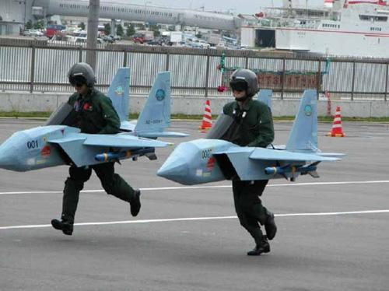
Not everything can be done through distance learning!

Slide 23
Overview
The learning climate
What is distance learning
What are its benefits & limiting factors?
Advantages & disadvantages of each medium
Panacea Syndrome
What does the research say?
General considerations in media selection
A few guiding principles
Media Selection Resources

Slide 24
WHAT IS
“DISTANCE LEARNING?”
Two dimensions…
time
place
Notes:
8

Slide 25
WHAT IS
“DISTANCE LEARNING?”
Dimensions vs. Instructional Modes
Residence Synchronous Asynchronous
same
same
different
Dimension
different
different
same
Notes:
8

Slide 26
Media Components
Text-Based: Print, e-Readers
Audio: CD, Podcasting, M Media
Video: DVD, Streaming, F & M Media
Computer-Based Instruction (CBI)
Online Learning (WBI) (VLE)
Audioteleconferencing: F & M Media
Videoteleconferencing: F & M Media
Interactive Television
Notes:
14

Slide 27
It’s a Digital World
Why go digital? Compression!
Reduces transmission cost
Reduces bandwidth requirements
Allows transmission via low bandwidth media (i.e. POTS)
Decreases storage requirements
Allows for establishing common standards (e.g. IP) & blending of media types
Going Digital

Slide 28
Video Compression
Analog
  Full motion (30 fps)
  “Broadcast” quality
  Data rate equivalent to 90 Mbps of uncompressed video
  Uses full satellite transponder

Slide 29
Video Compression
Digital—transmits only video “updates”—a tradeoff between resolution and motion
Low bit rate video (LBRV) is 384 Kbps or lower (low resolution compression includes POTS, Webcasting, VTC)
Full motion (30 fps) begins at 384 Kbps
“DVD Quality” (60 fps with 4 x 3 aspect ratio) achieved at 4 Mbps
HDTV (60-240 fps with 16 x 9 aspect ratio) is variably compressed between 512Kbps and 6 Mbps—resolution varies
4K UHD on the market 3840 pixels by 2160 (4 x HD) requires 25 Mbps stream
Uses fractional transponder

Slide 30
Satellite or Wireline?
Satellite
  Generally more cost-effective for large-scale distribution of video or large-file transfer
  Quality of service generally better especially when avoiding agency firewalls or network bandwidth limitations
  Most cases less expensive to install downlink than adding wireline service
Wireline
  More cost-effective for smaller networks
  More cost-effective for LBRV
  More practical for distributed population outside organizational sites
Notes:
26

Slide 31
WHAT IS
“DISTANCE LEARNING?”
Making the right choice
Residence Synchronous Asynchronous
same
same
different
Dimension
different
different
same
Notes:
8

Slide 32



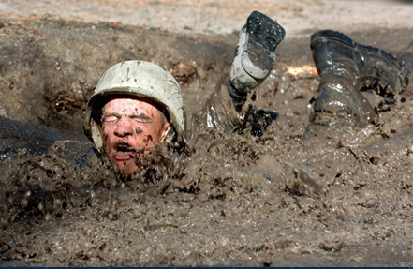

Residence
Classrooms
Educational Research Facilities
Laboratories
Training Facilities
General Considerations

Slide 33
Residence
Advantages
  Direct contact
  Observation of psychomotor behavior
  Low student-teacher ratio (high interaction)
  Use of labs/research facilities
  Most preferred by students
Notes:
26

Slide 34
Residence
Disadvantages
  Very high per-student costs (low Student-Teacher ratio)
  Low student throughput (facility limitations)
  Travel time, travel cost
Notes:
26

Slide 35
Overview
The learning climate
What is distance learning
What are its benefits & limiting factors?
Advantages & disadvantages of each medium
  Media Selection
Panacea Syndrome
What does the research say?
General considerations in media selection
A few guiding principles
Media Selection Resources

Slide 36
Instructional Media
(Sub-menu)
Asynchonous
  Print
  Pre-recorded audio/video
  Computer Based Instruction (CBI)
  Web Based Instruction (WBI)
Synchronous
  Classroom
  Web Conferencing
  Virtual Learning Environment (VLE)
  Audio Conferencing
  Video Teleconferencing (VTC)
  Interactive Television (ITV)
    Government Education & Training Network (GETN)
    VTC vs. ITV

Slide 37
WHAT IS
“DISTANCE LEARNING?”
Making the right choice
Residence Synchronous Asynchronous
same
same
different
Dimension
different
different
same
Notes:
8

Slide 38
Asynchronous
Advantages
  Self-paced
  Not constrained by time or place (“anytime, anywhere”)
  Flexible delivery of content
  High student satisfaction for short courses (microlearning)
Disadvantages
  No live interaction
  Longer completion times—affected by distractions
  “Just-in-time” = “do-it-on-your-own-time”
  “Anytime, anywhere = not now, maybe later”
  High drop-out rates—pacing not optimized
  Low student satisfaction for long courses
Return to sub menu
Notes:
26

Slide 39

MEDIA COMPONENTS
Print
Return to sub menu
Notes:
14

Slide 40
Print
Advantages
  Self-paced, low tech
  Inexpensive in-house development & delivery
  Ubiquitous—the only truly “anytime-anywhere” DL medium!
  University surveys indicate that if price is no object, print is 1st choice over e-readers or Web
Disadvantages
  No interaction
Notes:
26

Slide 41

e-Textbooks
Advantages
  Self-paced
  Generally half as
  expensive as commercially
  produced textbooks
  Can be read on lap/desktops
  Report says 17% studied more because it was easier to use – CHE 12 Jun 09
  Some can cut-and-paste into Word processing docs
Notes:
26

Slide 42
e-Textbooks
Disadvantages
  Awkward to navigate—no set standards
  No interaction—legibility sometimes a problem
  Report says 40% studied less because more difficult to use – CHE 12 Jun 2009
  Biggest complaint: Battery life limitations (1-2 hrs)—many need to carry around power cord—need to remember to charge
Notes:
26

Slide 43
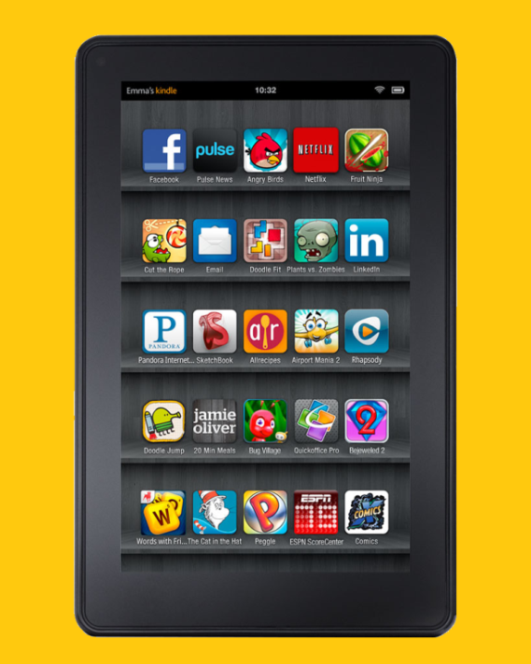


Print vs. on Screen
Screen Paper Comp’n Reader Profile
100 wpm 110 wpm 50% Insufficient
200 wpm 240 wpm 60% Average
300 wpm 400 wpm 80% Good
700 wpm 1000 wpm 85% Excellent
ReadingSoft.com

Slide 44
Print vs. on Screen
Reading Patterns are different—based on eye tracking research:
Only 1 in 6 read Web pages linearly—the rest jump around chasing key words, bullet points, visuals, and color and typeface variations—an “F-Pattern”
Jakob Nielsen, Web researcher for New York Times

Slide 45
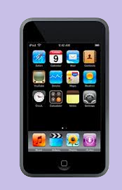
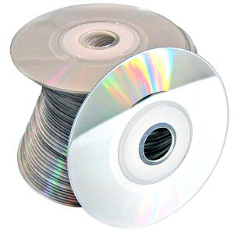
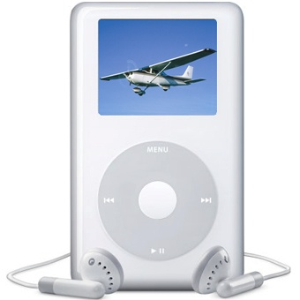

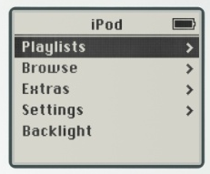

Audio: CD, Podcast, Mobile Media
One-way audio
Return to sub menu
Notes:
26

Slide 46
Audio: CD, Podcast, Mobile Media
Advantages
  Self-paced
  Inexpensive development & delivery
  Standardized Instruction
  Ubiquitous
Disadvantages
  No interaction
  No graphics or video
Notes:
26

Slide 47

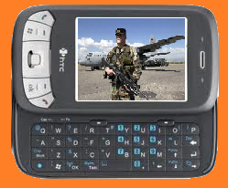

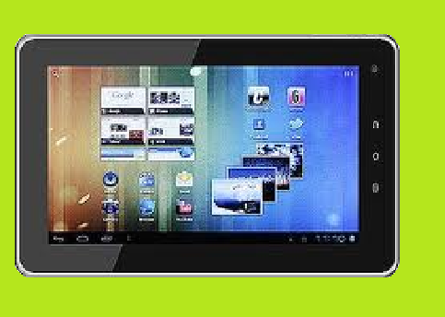


DVD, Broadcasting, Streaming to Smart Pads & Smart Phones
One-way video & one-way audio
Notes:
26

Slide 48
DVD, Broadcasting, Streaming
Advantages
  Self-paced or scheduled
  High-quality video & audio
  Inexpensive development and delivery
  Standardized Instruction
  Ubiquitous
Disadvantages
  No interaction
  Prerecorded courses tend not to be updated frequently
Notes:
26

Slide 49
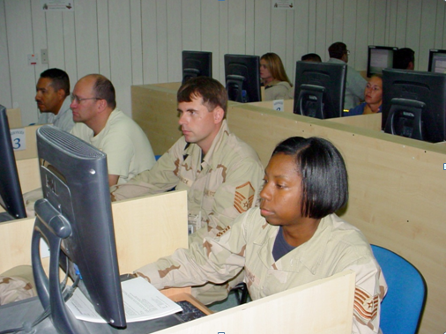

Computer-Based Instruction
Interactive Courseware (CD, DVD, or local server)
Return to sub menu
Notes:
26

Slide 50
Computer-Based Instruction (CBI & IMI)
Advantages
  Interaction (complex branching)
  Multimedia
  Reduces learning time
  Standardized Instruction
  On-the-spot remediation
  Inexpensive delivery
Notes:
26

Slide 51
Computer-Based Instruction (CBI & IMI)
Advantages (cont.)
  Nearly ubiquitous
  Allows for large student enrollment
  Allows students to work at own pace & place
  Great choice for large amounts of text (reference documents)
  Not constrained by bandwidth (allows for media rich learning environment)
Notes:
26

Slide 52
Computer-Based Instruction (CBI & IMI)
Disadvantages
  No unprogrammed interaction (canned)
  Platform & software limitations
  Outsourcing can be expensive & high risk
  Poor selection for large amounts of text (reading through—slower reading speed)
  Hard/Software incompatibilities
  High attrition rates
Notes:
26

Slide 53
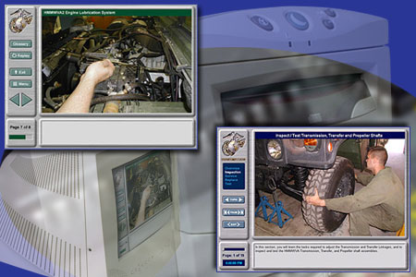
Web-Based Instruction (WBI) a.k.a. online or e-learning (IMI)
One-way text, graphics, CBI
Two-way text (threaded discussion) & graphics (Whiteboard)
One-way video & audio (streaming media/Webcast & IP multicasting)
Return to sub menu
Notes:
26

Slide 54
Web-Based Instruction (WBI)
Advantages
  Inexpensive if developed in-house (Rapid e-Learning)
  Can be updated & controlled from a central location
  Offers standardized instruction
  Nearly ubiquitous—mobile media greatly enhance access—ideal for microlearning
  Allows for large student enrollment
  Allows students to work at own pace
  Student progress can be tracked & remediated
  Greatly expands potential for informal learning
Notes:
26

Slide 55
Web-Based Instruction (WBI)
Disadvantages
  Need access—agency firewalls problematic
  Bandwidth/browser limitations may restrict instructional methodologies
  Limited bandwidth means slower performance for sound, video, and intense graphics—especially with mobile devices
  Outsourcing can be expensive & high risk
  Updating can be slow when outsourced
Notes:
26

Slide 56
Web-Based Instruction (WBI)
Disadvantages (cont.)
  Poor selection for large amounts of text (slower reading speed)
  Need additional personnel for help desks
  Most institutions restrict student enrollment for synchronous applications
  Asynchronous versions experience high attrition rates
Notes:
26

Slide 57
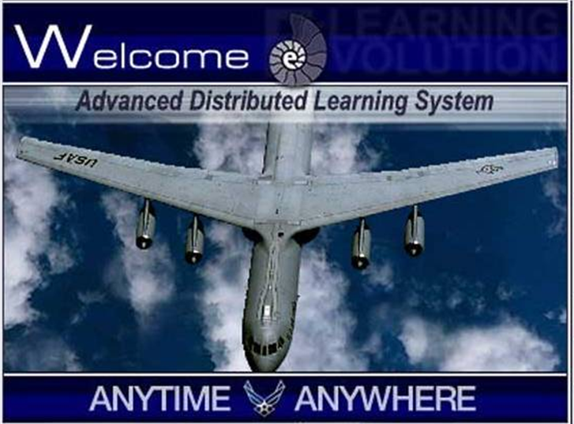
Extensively used by AETC for Ancillary Training

Slide 58

DOD’s Advanced Distributed Learning System (ADL)
Development of online learning standards in cooperation with industry & academia
Jan 2000—DOD released first version of encyclopedic document called Sharable Content Object Reference Model, or SCORM
Excludes synchronous media, simulators, and non-digital media
Notes:
26

Slide 59
DOD’s Advanced Distributed Learning Initiative (ADL)
Features
Asynchronous Web-based instruction
XML-based sharable object standards
Meta-tagging scheme for object retrieval
Guidelines to parse/granularize instructional materials—designed for reuse
Common LMS, common repositories
Notes:
26

Slide 60
WBI SCORM
Advantage
SCORM emerging as the international standard for asynchronous Web-based instruction
Offers reusability, accessibility, durability, and interoperability of learning objects
“Repository of repositories” Content Object Repository Discovery and Registration Architecture (CORDRA) being designed to foster contextualized search, discovery, identification, resolution, retrieval and delivery of content
ADL looking to expand to include simulation, performance support, mobile systems, intelligent tutoring, multiplayer online games
Notes:
26

Slide 61
WBI SCORM
Challenges
Does not address principles of instructional design and cognitive information processing: instructionally based sequencing, scope, structure of lesson segments
Objects need to be re-tooled to adapt to curriculum to meet student’s prior knowledge and context of instruction
Meta-tagging useful for developers, but difficult to target meaningful instruction for students
The higher the granularity, the more difficult the sequencing—the lower the granularity, the more difficult the reusability
The higher the granularity, the greater the expense
Trend is to develop courses as single objects
Notes:
26

Slide 62
WBI SCORM
Challenges (cont.)
SCORM has provided interoperability and accessibility characteristics to content; however, durability, reusability, and discoverability have remained unattainable.
Durability: withstand technological evolution
Reusability: repurpose for other applications or contexts
Discoverability: Metadata taxonomy to support
searching and identifying content
Past, Present, and Future Challenges, Will Peratino Director of Innovation, Emerging Solutions, Office of Personnel Management, 18 Aug 2010
Notes:
26

Slide 63
WHAT IS
“DISTANCE LEARNING?”
Making the right choice
Residence Synchronous Asynchronous
same
same
different
Dimension
different
different
same
Notes:
8

Slide 64
Synchronous
Advantages
  Provides engaging learning environment
  Live interaction—spontaneity, immediate reinforcement
  Shorter completion time
  High completion rates—optimizes pacing
Disadvantages
  Schedule may be inconvenient
  Requires a dedicated facility
Return to sub menu
Notes:
26

Slide 65
Classroom or Office?
Classroom (ITV, VTC)
  Closely approximates in resident classroom student interaction & facilitation
  Best for multi-hour/multi-day courses—reduces distractions
  Classroom may not be conveniently located
Office (VTC, Web conferencing)
  Convenient
  Best for short courses (1 hr or less)
  Office distractions are problematic
Notes:
26

Slide 66
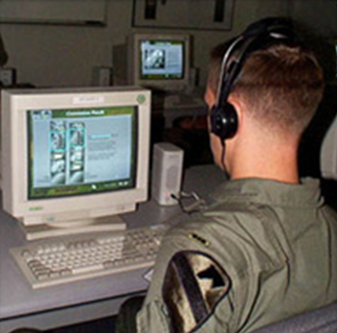
Web-Based Instruction (WBI)
Webinar/Webconferencing
Two-way text, (online chat)
Two-way graphics (whiteboard)
One-way video (streaming media/Web- cast & IP multicasting)
Two-way audio
Return to sub menu
Notes:
26

Slide 67
Web-Based Instruction (WBI)
Webinar/Webconferencing
Advantages
  Real-time
  Inexpensive development & delivery
  Interactive (whiteboard, file sharing, graphics)
  Interactive audio (VoIP or POTS)
Notes:
26

Slide 68
Web-Based Instruction (WBI)
Webinar/Webconferencing
Disadvantages
  Video streaming induces latency
  VoIP QoS may be poor—may need to rely on desk phones
  Webinars may be slowed by low bandwidth
  Typing speed limits speed of interaction
  High conversion time
  Most institutions restrict student enrollment for synchronous applications
  Requires specialized software
Notes:
26

Slide 69
Web-Based Instruction (WBI)
Webinar/Webconferencing
Defense Collaboration Services (DCS)
  Instant access to enterprise-wide collaboration services—no specialized software
  On demand or scheduled video streaming
  Multiuser text, video, & VoIP conferencing
  http://www.disa.mil/dcs
Notes:
26

Slide 70
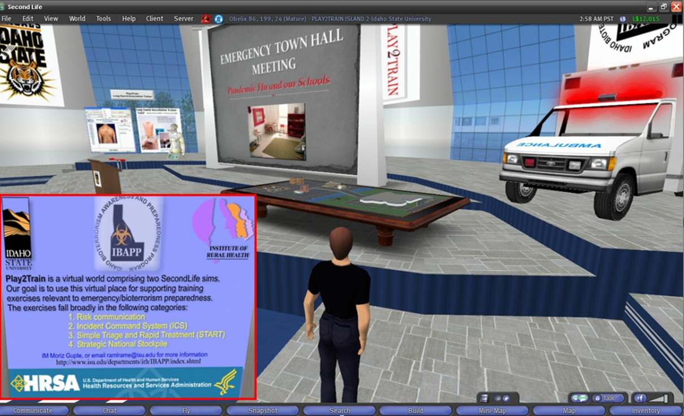
Virtual Learning Environments
Return to sub menu

Slide 71
Virtual Learning Environments
Online virtual world depicted as 3D—uses “avatars” as a means of live interaction with other participants or “intelligent tutors”
Training meeting spaces in DOD often associated with Second LifeTM, hosted by Linden Labs

Slide 72
Virtual Learning Environments
Advantages
Expands the capability of the Web to provide simulation & gaming
Sense of presence & immediacy facilitates interaction & engagement
Alternative to inefficient & expensive real-life exercises
Can provide a stable, controlled environment
Motivating
Intelligent tutors can replace live instructors in “light-weight” applications

Slide 73
Virtual Learning Environments
Challenges
Often lacks robust audio capabilities
Difficulties mimicking humans for intelligent tutors
Can be slow on lower performance desktops
Security & identity issues
May require more time to achieve desired outcomes in formal learning when compared to face-to-face approaches
No interoperability between virtual world systems
Need to outsource development if no 3D developers on staff

Slide 74
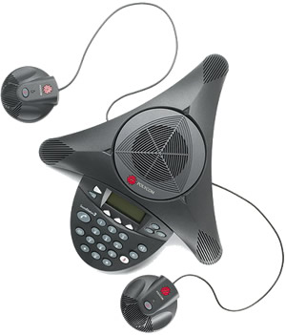
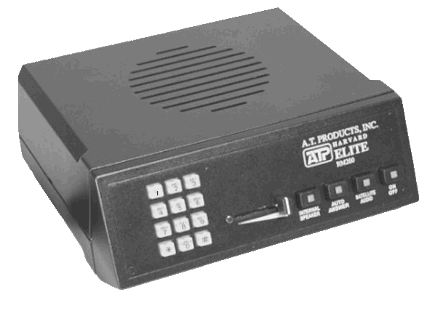
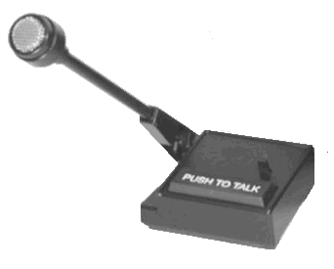

Audioteleconference (ATC)
Return to sub menu
Notes:
26

Slide 75
Audioteleconference (ATC)
Advantages
Real-time
Inexpensive
Ubiquitous
Large throughput
Few technical problems
Disadvantages
No video interaction
Often needs supporting media (e.g. print, Web)
Notes:
26

Slide 76
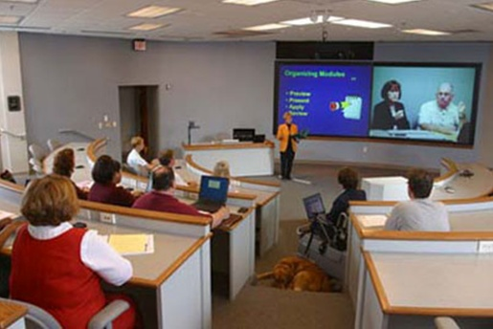
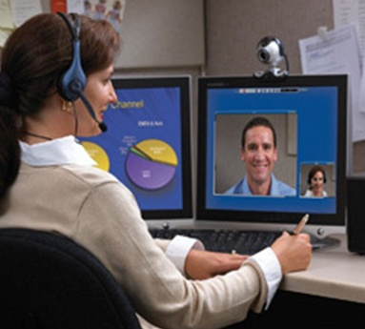
Videoteleconference (VTC)
Two-way video & audio
Primarily land-based (microwave/cable), some satellite
Return to sub menu
Notes:
26

Slide 77
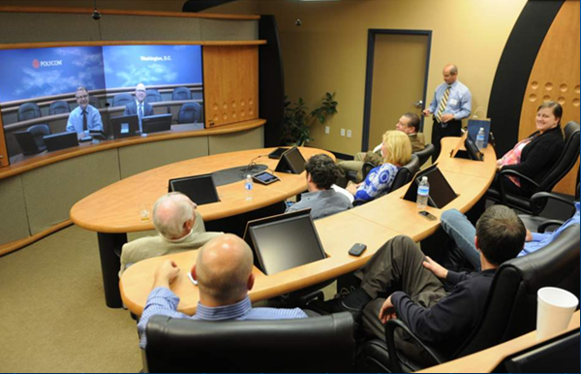
Videoteleconference (VTC)
The newest iteration of VTC: Virtual Presence

Slide 78
Videoteleconference (VTC)
Using mobile devices

Slide 79
Videoteleconference (VTC)
Advantages
Real-time
Instructor-student and student-student video and audio interaction
HD video (variable compression rates)
Standardized instruction
Inexpensive course development
Multiple instructor sites
Inexpensive (desk-top or mobile device)
Notes:
26

Slide 80
Videoteleconference (VTC)
Disadvantages
Bridging system limits & problems
Ineffective with large groups
Expensive infrastructure (room-size)
Requires trained technical staff (room-size) at all sites
Note: DCS, which has a VTC feature, is not generally used due to bandwidth limitations DOD-wide
Notes:
26

Slide 81
DOD VTC Networks for DL
Army T-Net & Classroom XXI
AF – No standard network
Navy Learning Network - Discontinued
Return to sub menu

Slide 82
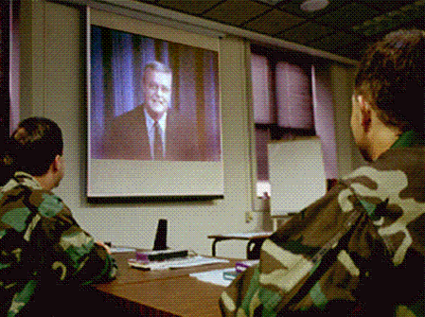
Interactive Television (ITV)
One-way video & two-way audio (aka IVT, VTT, BTV, IBV, SBT)
Via satellite, CCTV
Return to sub menu
Notes:
26

Slide 83
Interactive Television (ITV)
Advantages
  Real-time
  HD video (variable compression rates)
  Instructor-student and student-student audio interaction
  Enhanced on-site student-student interaction
  Standardized instruction
Notes:
26

Slide 84
Interactive Television (ITV)
Advantages (cont.)
  Inexpensive course development
  Inexpensive delivery for medium-to-large audiences
  Inexpensive downlink equipment
  No professional tech support team required at downlinks
Notes:
26

Slide 85
Interactive Television (ITV)
Disadvantages
  No video return
  Expensive uplink equipment
  Expensive for small enterprises
  Professional tech support team required at uplink
  And when the satellite fails . . .
Notes:
26

Slide 86

Government Education & Training Network
GETN
Return to sub menu
Interactive television for distance learning
A network of Government networks
Shared facilities & programs
Currently the only interagency distance learning network

Slide 87
GETN MAP
GETN
4 uplinks
reaching over
800 locations
USAF
WRIGHT-PATT AFB, OH
DOJ
COLUMBIA SC
ANG
MCGHEE TYSON AFB, TN
FAA
OKLAHOMA CITY, OK

Slide 88












GETN
Government Education
& Training Network
Defense Education
& Training Network
Contract Support

Slide 89
Other Government Satellite Networks
Federal Executive Agencies
Social Security Administration – 1 UL (8 Ch), 8 BC, 1,640 DLs
Veterans Health Administration — 1 UL (4ch) - 145 DLs

Slide 90
VTC vs. ITV
If one-way video is good,
isn’t two-way video better?
Return to sub menu
Notes:
26

Slide 91
VTC vs. ITV
Quality
  Application (learning objectives)
  HBRV vs. LBRV
    High vs. low resolution video & graphics
    Full motion vs. lower fps motion
  No difference in learning outcomes
  Broadcast vs. point-to-point (symmetry)
  Location of desk-top & mobile devices for VTCs and IP Multicasting impact quality of learning environment
Notes:
26

Slide 92
VTC vs. ITV
Throughput
  Unlimited sites vs. system bridging limits
  LAN distribution vs. single room
  Large on-site audience vs. VTC room limits of single monitor
Notes:
26

Slide 93
VTC vs. ITV
Cost
  Constant vs. variable video cost
  High uplink/low downlink costs vs. moderate/low costs at all sites
  Low vs moderate-to-high cost for additional classrooms at same site
Notes:
26

Slide 94
VTC vs. ITV
ITV/VTC Used In Combination
  Shared programming
  Guest speaker not at uplink facility (used as one-way)
  Student has access only to VTC or mobile device (used as one-way—quality permitting, including IP multicasting)
Notes:
26

Slide 95
VTC vs. ITV
Bottom Line
  Can’t compare ITV to VTC unless you have first determined :
      Specific application
      Student throughput
      Need for shared programming & facilities
Notes:
26

Slide 96
Overview
The learning climate
What is distance learning
What are its benefits & limiting factors?
Advantages & disadvantages of each medium
Panacea Syndrome
What does the research say?
General considerations in media selection
A few guiding principles
Media Selection Resources

Slide 97
Guiding Principles
As Oliver said, “I wouldn’t give one wit for simplicity this side of complexity…”
…or what I call the Panacea Syndrome
…which is the fallacy of hasty generalization: One medium is found to work best for some learning objectives, therefore it must work best for all learning objectives
Notes:
26

Slide 98
Panacea Syndrome
“I believe motion pictures are destined to revolutionize our educational system and in a few years will supplant largely, if not entirely, the use of textbooks.”
Thomas Edison, 1922
Notes:
26

Slide 99
Panacea Syndrome
“One of the goals should be to replace all textbooks with a PC. I would hope within five years they would have no more textbooks.”
and . . .
“A 24-hour-a-day Internet should be used to replace the traditional classroom lecture.”
Newt Gingrich Atlanta-Journal Constitution 9 Jun 98
Notes:
26

Slide 100
Hype-to-Productivity Curve
(adapted from Centra & Gartner Group)
Visibility
PEAK OF INFLATED
EXPECTATION
SCORM for all
LEARNING PORTALS
END-TO-END PROVIDERS
YOUTUBE
MIDDLEWARE
PLATEAU OF
PRODUCTIVITY
SELF-PACED WBI
CHAT ROOMS
SLOPE OF
ENLIGHTENMENT
BLENDED MEDIA
MOBILE DEVICES
“LEGACY” MEDIA
PALMTOP COURSES
CAI-CBI
VIRTUAL CLASSROOMS
SCORM for some
SYNCHRONOUS WBI
TECHNOLOGY TRIGGER
TROUGH OF DISILUSIONMENT
Time
Notes:
26

Slide 101
Simplicity on the far side of complexity
Let’s find…
Notes:
26

Slide 102
Overview
The learning climate
What is distance learning
What are its benefits & limiting factors?
Advantages & disadvantages of each medium
Panacea Syndrome
What does the research say?
General considerations in media selection
A few guiding principles
Media Selection Resources

Slide 103
What does the research say about
Inaccuracy of research?
Distance learning vs. face-to-face?
Learning styles & “Cone of Learning”?
Interactivity?
Learner satisfaction?
“High-tech” vs. “low-tech”?
Generational differences?
Most significant learner variables?

Slide 104
Research
Caveat Emptor:
The Inaccuracy of Research
Beware of the “Proteus Phenomenon”: Early replication of initial scientific research often gives contradictory yet statistically significant results
Did you know that most results even in medicine, including those that appear in top-flight peer-reviewed journals, can't be replicated?

Slide 105
Caveat Emptor:
The Inaccuracy of Research
“Many recent reports have raised the alarm that a shocking amount of the published literature in fields ranging from cancer biology to psychology is not reproducible.”
“More than half of biomedical findings cannot be reproduced…Amgen admitted that ‘over the past decade its oncology and hematology researchers could not replicate 47 of 53 highly promising results they examined.’…Bayer revealed it fails to replicate about two-thirds of published studies identifying possible drug targets.”
“The reasons for this are myriad. The natural world is complex, and experimental methods do not always capture all possible variables. Funding is limited and the need to publish quickly is increasing. There are human factors, too. The pressure to cut corners, to see what one wants and believes to be true, to extract a positive outcome from months or years of hard work, and the impossibility of being an expert in all the experimental techniques required in a high-impact paper are all contributing factors.”
Elizabeth Iorns, CEO of Science Exchange - New Scientist, Sep 2012

Slide 106
Caveat Emptor:
The Inaccuracy of Research
Watch your prejudices, or you’ll miss the right answers…
“When led by [one’s] personal prejudices, [one] will not be persuaded of the truth no matter what evidence you lay before him [or her].”
Dr. R.C. Sproul, Theologian, Tabletalk June 1999
Notes:
26

Slide 107
Research
Caveat Emptor:
The Inaccuracy of Research
Yet we need research to find truth! So, when looking at research, examine to see whether:
Results are replicated in other studies (meta-analyses & literature reviews can be useful)
There is no conflict of interest
It is from a reputable source
It is generalizable (e.g. large “n”)
Acceptable test of statistical significance (P-value <0.05 for social sciences)
It is accurately reported

Slide 108
Research
What about distance learning?
Research shows no significant difference in learning outcomes with residence instruction when appropriate media are selected.
Any literature review over the past 20 years
Thomas L. Russell: "The No Significant Difference Phenomenon: A Comparative Research Annotated Bibliography on Technology for Distance Education" (2001, IDECC, fifth edition), fully indexed, comprehensive research bibliography of 355 research reports 1928 through 2009

Slide 109
Research
“The best current evidence is that media are mere vehicles that deliver instruction but do not influence student achievement any more than the truck that delivers our groceries causes changes in nutrition... only the content of the vehicle can influence achievement.”
Richard Clark, Review of Educational Research Journal, 1993

Slide 110
What do meta analyses reveal about effective DL instructional design?
Blended learning is slightly better than individual media or classroom instruction alone -
US Dept of Ed meta analysis 2009
The most effective designs for learning include a variety of media, combinations of modalities, levels of interactivity, learner characteristics, and pedagogy based on a complex set of circumstances.
Metiri Group, 2008

Slide 111
Research
What about learning styles?*
Most common models are “VAK”: visual, aural, & kinesthetic—but some have presented over 70 distinct styles, and over a dozen models
Not a new debate—research on their effects has been ongoing for over 60 years
Neuroscience research has estimated that 85% of the human brain is designed to process visual information, and that 90% of what the brain processes is visual information—human primary learning modality is visual
Memory usually stored independent of any modality—but based in terms of meaning or context
*Dr. Jolly Holden, An Instructional Media Selection Guide for Distance Learning (2010)

Slide 112
Research
What about learning styles?*
No significant relationship between learning styles and ITV, CBI, and in-residence instruction
Dee Taylor, AU staff research conducted at AFIT

Slide 113
Research
What about learning styles?*
Investigators found “no evidence for validating the educational applications of learning styles into general educational practice.”
Chronicle of Higher Education article (Dec, 2009) entitled Matching Teaching Style to Learning Style May Not Help Students
Research has not made a compelling argument that learning styles have a significant effect on student performance

Slide 114
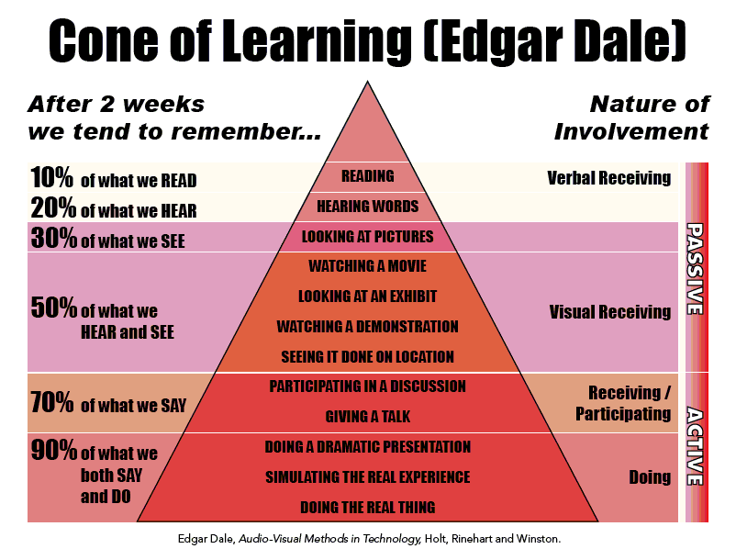
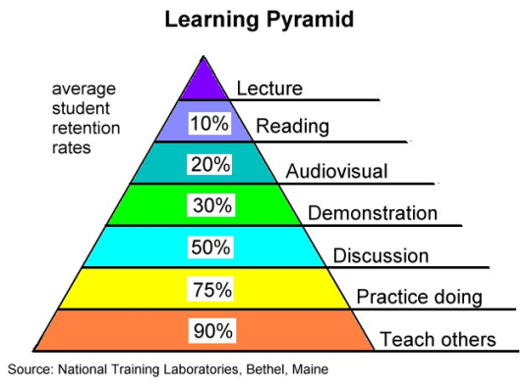
Surely you have heard that we remember…
10% of what we read
20% of what we hear
30% of what we see
50% of what we see and hear
70% of what we say
90% of what we say and do
Totally unsubstantiated attempt to simplify
a complex phenomenon based upon
Edgar Dale’s Cone of Experience*
*Multimodal Learning Through Media: What the Research Says,
Metiri Group, 2008 https://www.cisco.com/c/dam/en_us/solutions/industries/docs/education/Multimodal-Learning-Through-Media.pdf)

Slide 115
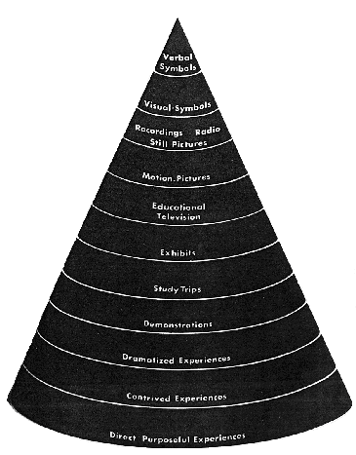
Cone of Learning: A perpetuated myth?
There is a popular misperception which has been perpetuated over time and transformed into generally accepted information on how individuals “remember”. One such “myth” used to account for the variability in learning and erroneously used to predict retention is Edgar Dale’s Cone of Experience, which recently has been “debunked”*.
Dale’s original Cone of Experience is a “visual metaphor” depicting types of learning, from the concrete to the abstract. Dale did not intend to place value on one modality over another:“The shape of the cone is not related to retention, but rather to the degree of abstraction.”
*Multimodal Learning Through Media: What the Research Says, Metiri Group, 2008

Slide 116
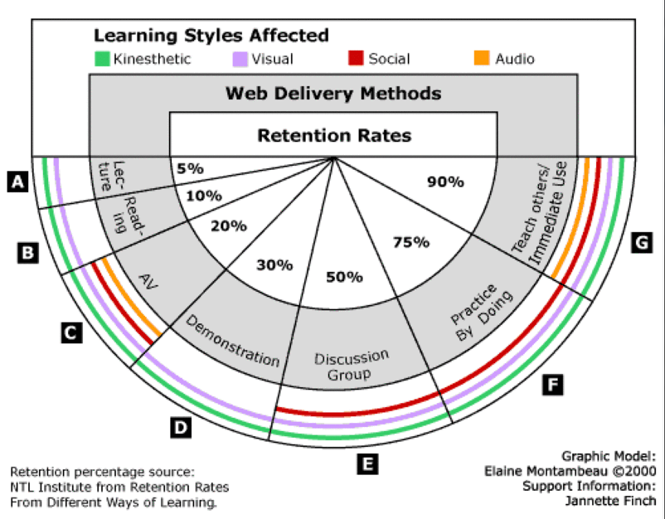
And subsequently morphed into this…
The percentages have been passed around in our field from reputable person to reputable person, but there is no credible data or research to support them.

Slide 117
Research
What about interactivity?
“As long as student/faculty interaction is at a tier necessary to support quality instruction, learning will not decline in the absence of interactivity, but may actually increase.”
Dr. Harvey Stone, Rensselaer Polytechnic Institute

Slide 118
Research
What about interactivity?
“…(for ITV) interaction affects learner satisfaction but not learner achievement.”
Dr. Hank Payne, A Review of The Literature: IVT in DL Courses, 1997

Slide 119
Research
What about interactivity?
“No relationship has been proven to link learner satisfaction to learner achievement.”
Dr. Hank Payne, A Review of The Literature: IVT in DL Courses, 1997

Slide 120
research
What about “high tech” vs. low tech?
“None of the performance differences observed were significant, indicating that performance is roughly the same using either the [online] modules or a textbook.”
Larry Press, California State University - 2005

Slide 121
What about “high tech” vs. low tech?
Greatest disappointment of our time: Huge investments made in technology (beginning with Telecommunications Act of 1996) in public schools with negative results.
  Online Literacy Is a Lesser Kind, Mark Bauerlein, Chronicle of Higher Education,
  Sept. 2008

Slide 122
What about the Digital Generation?
Should generational membership be considered when designing and delivering instruction?

Slide 123
What about the Digital Generation?
Researchers at the University of Western Ontario, Michigan State University, and the University of California, Davis, argue that the… “generational stereotypes perpetuated in pop-culture media, misguided organizational training, and lunchroom conversations have very little basis in fact.”
Age-Based Stereotypes: Silent Killer of Collaboration and Productivity - by Chris Blauth, Jack McDaniel, Craig Perrin, Paul B. Perrin, Ph.D. Published by AchieveGlobal

Slide 124
What about the Digital Generation?
Chronicle of Higher Education’s The Millennial Muddle, October 2009:
  “To accept generational thinking, one must find a way to swallow two large assumptions. That tens of millions of people, born over about 20 years, are fundamentally different from people of other age groups—and that those tens of millions of people are similar to each other in meaningful ways.”
  Palmer H Muntz director of admissions Lincoln Christian Univ
Notes:
26

Slide 125
What about the Digital Generation?
Playing games doesn’t translate to improving educational outcomes
  Chronicle of Higher Education’s “Generational Myth” report of research on literacy and technology, Sept 2008
Leisure-time tech skills don’t translate to educational & training use of technology. Fast scanning doesn’t translate into academic reading. Intellectual habits such as deep reflection decrease with increase time spent on browsing, blogging, IMing, Twittering, and Facebooking
  Online Literacy Is a Lesser Kind, Mark Bauerlein, Chronicle of Higher Education, Sept. 2008

Slide 126
What about the Digital Generation?
“Today’s young people—including college students—are just more complicated than any analysis of imaginary generations can ever reveal.”
Must consider vast range of skills, knowledge & experience of many segments of society—avoid focusing more on needs of socially or financially privileged and overestimating the digital skills of young people in general
Familiarity with, understanding of, and dexterity with technology varies greatly within the 18-23 age group a few with amazing skills, a large number who can’t deal with computers
Chronicle of Higher Education’s “Generational Myth” report of research on literacy and technology, Sept 2008
Notes:
26

Slide 127
What about the Digital Generation?
“Once we assume that all young people love certain forms of interaction and hate others, we forge policies and design systems and devices that match those predispositions. By doing so, we either pander to some marketing cliché or force otherwise diverse group of potential users into a one size-fits-all system that might not meet their needs.”
Chronicle of Higher Education’s “Generational Myth” report of research on literacy and technology, Sept 2008

Slide 128
Research
What about the Digital Generation?
  Although generational differences are evident in workplace, they are not salient enough to warrant different instructional designs or learning technologies.
A comprehensive literature review in 2006 conducted by Professor Thomas Reeves , U of Georgia: Do Generational Differences Matter in Instructional Design?

Slide 129
What about the Digital Generation?
Instead of worrying about whether Boomers, GenXers or Millennials will learn more from direct instruction or virtual reality games,…[one] should begin by identifying the needs of any given set of learners, design the best possible prototype learning environments in situ.
The Millennial Muddle by E. Hoover, Chronicle of Higher Education, Oct 2009

Slide 130
General Considerations
What about the Digital Generation?
Student performance is not based in a significant way on:
student satisfaction
learning style
technology
interaction beyond requirement
generational membership
Notes:
26

Slide 131
General Considerations
What about the Digital Generation?
So what are the most significant learner variables? The two factors that have the highest significant predictive validity:
Prior knowledge (cognitive: aptitude/ability/self-regulation)
  SAT scores r=0.64
  USAFA PlaVal predictive validity r=0.67
Motivation (affective: intrinsic value/self-efficacy)
  Journal of Ed Psy (APA), r=0.32-0.36
The rest of it is noise-level
Notes:
26

Slide 132
Overview
The learning climate
What is distance learning
What are its benefits & limiting factors?
Advantages & disadvantages of each medium
Panacea Syndrome
What does the research say?
General considerations in media selection
A few guiding principles
Media Selection Resources

Slide 133
Instructional Media Selection Process
Success in distance learning depends on:
A systematic approach that ensures appropriate media are selected to support desired learning objectives
Analysis of available technologies including a thorough examination of the advantages and limitations of each medium
Consideration given first to instructional objectives, but many other factors come into play

Slide 134
General Considerations
Instructional Media Selection Process
When selecting media, what are the most important design factors?
Remember, first, that the most significant factor in student learning: Quality instruction—not technology
The most important factor in media selection: Instructional objectives (cognitive, affective, & psychomotor)
The next most important factor in media selection: Student throughput (the larger the better)
Notes:
26

Slide 135
Instructional Media Selection Process
When selecting media you should also consider:
Complexity of content
Identification of knowledge and skill gaps Level & domain (cognitive, affective, psychomotor) of learning objectives
Effective assessment & measurement tools
Instructional strategies
Student Environment (office, home, classroom, or in between)
Frequency of content change
Development time
Degree & type of interactivity (audio/video/text)
Ease of administration
Notes:
26

Slide 136
Instructional Media Selection Process
When selecting media, what are the most important delivery factors?
  Audience size & distribution
  Cost (In house vs. outsourcing development
  Availability of selected medium for delivery
  Availability of existing infrastructure (LAN/WAN connectivity & system limits)
  Hardware endpoints: TV/monitor, display devices, servers/computers
  Portability (smartphones, tablets)
  Synchronicity
  Symmetry
Notes:
26

Slide 137
Factor Comparison
FACTORS PRINT CBI WWW ITV/VTC RES
Self Pacing A A/B A/B D D
Optimal Pacing C C C A A/C
Throughput A A/B A/B D D
Completion Rate C C C A A/C
Develop Cost/Time A A/B A/B D D
Face-to-Face C C C A A/C
Collaborative Learning A A/B A/B D D
Volatility C C C A A/C
Technical Problems A A/B A/B D D
Review C C C A A/C
Consistency A A/B A/B D D
Travel C C C A A/C
KEY: A—D: EFFECTIVENESS
Notes:
27

Slide 138
Choice is a matter of symmetry…
Symmetrical Technologies
work best in highly collaborative
environments
(tend to be lower capacity)
Internet
LAN/WAN
Telephones (wireline)
Mobile devices (wireless)
Videoteleconferencing
Satellite (LEO-VSAT)
Asymmetrical Technologies
work best in low–interaction
applications
(tend to be higher capacity)
Satellite (FSS)
Print, e-Readers
CDROM – DVD
CCTV
Commercial Broadcast
…and success is a matter of blending
Notes:
31

Slide 139
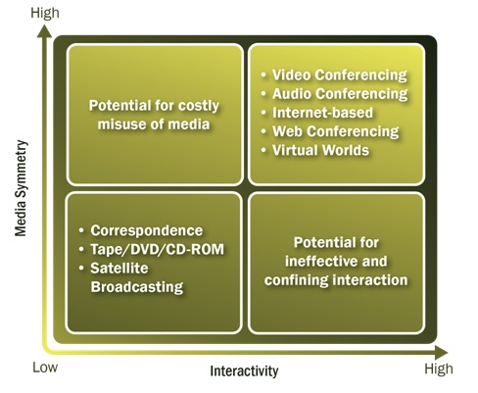
Choice is a matter of symmetry…

Slide 140
Choice is a matter of symmetry…
  ITV for example, is an effective blending of symmetrical & asymmetrical media—content is delivered using an asymetrical medium, but interaction is provided audio conferencing, e-mail, or polling from mobile devices
Notes:
31

Slide 141
Interaction
Asynchronous media may be more appropriate for the lower cognitive levels where knowledge & comprehension, repetition or drill & practice are the primary focus
Synchronous media may be more appropriate for the higher cognitive levels (synthesis, analysis, evaluation)

Slide 142
Education vs. Training
No significant difference in basic instructional design.
Cannot directly measure effectiveness of education (divergent applications in unknown environments)
Training is directly measurable by performing target behavior (convergent applications in defined environments)
University models are restricted to availability of media—but corporate/industry models more apt to Government enterprise-wide applications for both education & training applications

Slide 143
Cost Analysis
No consensus on what to include, but in general, should consider:
Course development, delivery, and annual maintenance
Telecommunications equipment
Additional staffing
In-house vs. contract
Purchase vs. lease
General Considerations

Slide 144
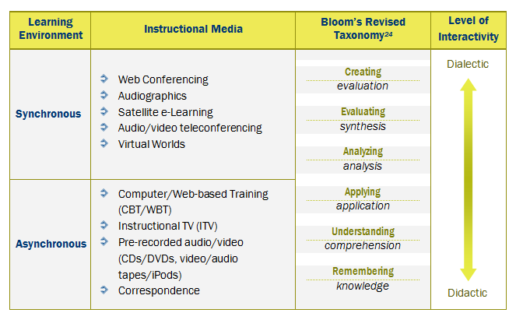
Bloom’s Revised Taxonomy Mapped to Instructional Strategies

Slide 145
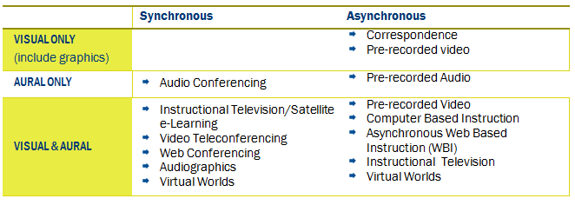
Taxonomy of Distance Learning Media
The Taxonomy of Distance Learning Instructional Media is designed to assist in determining the most appropriate medium for a specific distance learning application.
The taxonomy is focused primarily on a dichotomous learning environment—the initial selection criterion being either synchronous or asynchronous, and aids the instructor in determining the most appropriate medium to be selected.

Slide 146
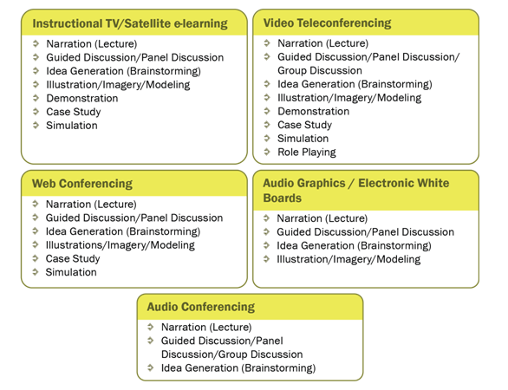
Synchronous Media Mapped to Instructional Strategies

Slide 147
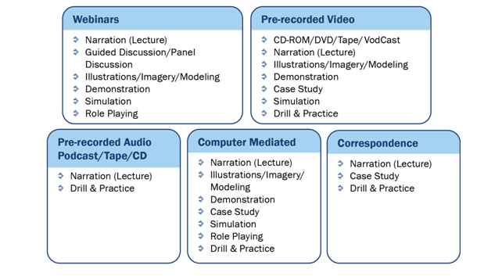
Asynchronous Media Mapped to Instructional Strategies

Slide 148
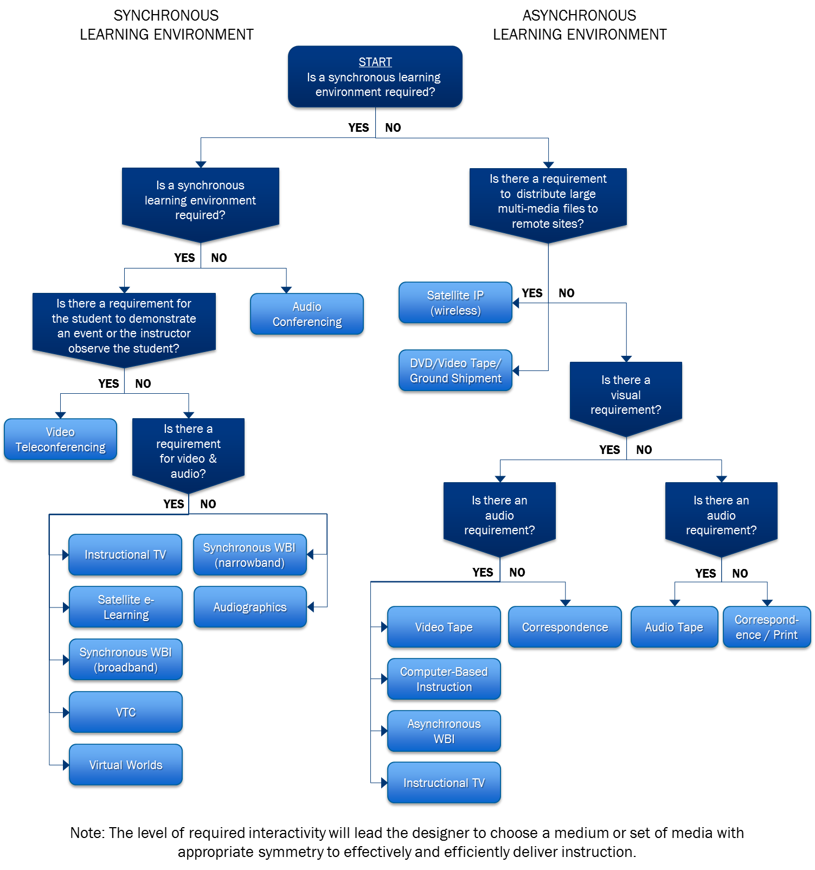
Instructional Media Selection Matrix

Slide 149
Overview
The learning climate
What is distance learning
What are its benefits & limiting factors?
Advantages & disadvantages of each medium
Panacea Syndrome
What does the research say?
General considerations in media selection
A few guiding principles
Media Selection Resources

Slide 150
Trends in Distance Learning
DL not growing “by leaps & bounds”
Dissatisfaction with purely asynchronous programs encourages growth of blended approaches
  Web fastest growing sector of DL, but there is some pull-back from asynchronous for long courses due to high dropout rates—blended approach becoming more common
Paper (text-book) based DL, however, not going away anytime soon—continues to be used in blended programs (increased local printing)
Firewalls and security continue to make Internet delivery problematic
Use of mobile technologies expanding
Satellite competing with wireline for multipoint distribution of synch & asynch DL—many networks are now hybrids

Slide 151
Simplicity on the far side of complexity
“Just because one medium can be best for some learning objectives, does not mean it is the best for all learning objectives.”
“No single technology is a panacea for distance learning.”
Me, 1998
Notes:
26

Slide 152
Simplicity on the far side of complexity
“Blended learning seems to have arisen from a general sense of disillusionment with the stand-alone adoption of online media.”
Janet MacDonald - Blended Learning & Online Tutoring, 2007
Notes:
26

Slide 153
Simplicity on the far side of complexity
“Blended media is the right approach”
Most DL practitioners in their right minds
Notes:
26

Slide 154
Simplicity on the far side of complexity
“It’s time we stop worrying so much about ‘what’s hot and what’s not’ and put more energy into discerning ‘what works and what doesn’t.’
Ron Zemke Sr editor of Training Magazine Mar. 2002
Notes:
31

Slide 155
Simplicity on the far side of complexity
If you are a practitioner or manager, your aim should not be to design, fund, and install the most advanced technology to anticipate any and all possible uses (real or imagined) for distance learning.
Notes:
31

Slide 156
Simplicity on the far side of complexity
…Rather, your aim should be to:
Provide timely, high-quality instruction while keeping costs down (don’t apply more technology to the DL solution than you have to)
…Unless you have money to burn, of course!
Notes:
31

Slide 157
Bottom Line
Don’t select media
before identifying applications
Notes:
30

Slide 158
Bottom Line
Or more bluntly:
Prescription before diagnosis is malpractice!
Notes:
31

Slide 159
Overview
The learning climate
What is distance learning
What are its benefits & limiting factors?
Advantages & disadvantages of each medium
Panacea Syndrome
What does the research say?
General considerations in media selection
A few guiding principles
Media Selection Resources

Slide 160
Media Selection Resources*
Instructional Media Selection Guide
Developing a Blended Learning Strategy
A Guide to Developing Cognitive Learning Objectives
* http://www.fgdla.us/white_papers.html

Slide 161
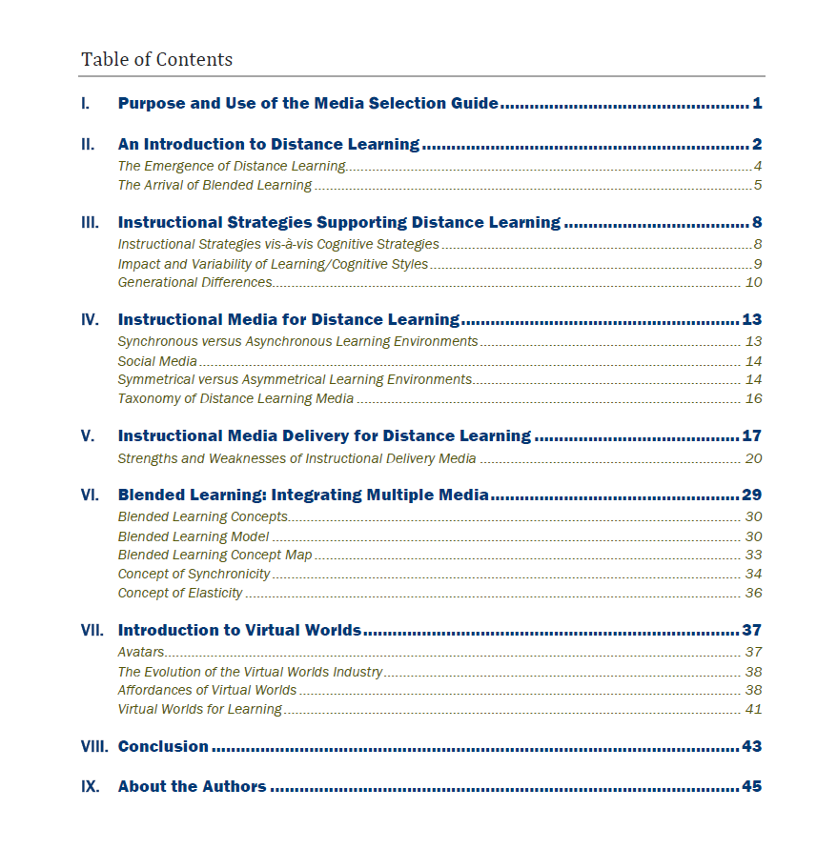
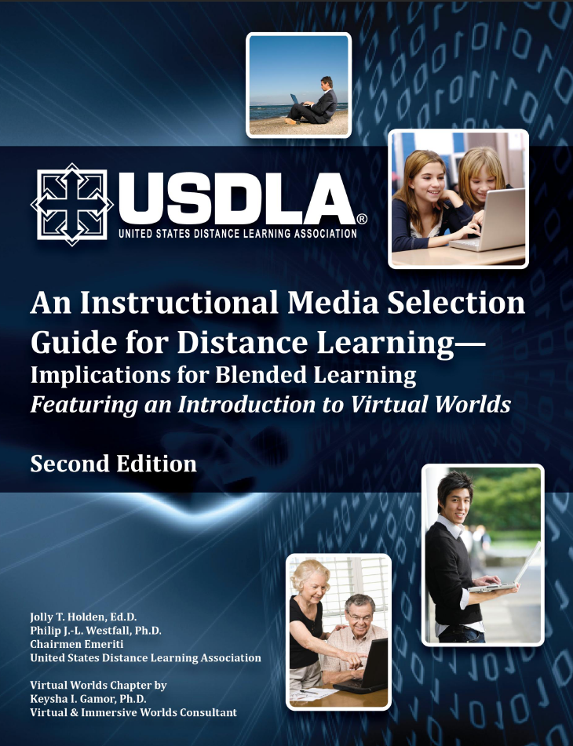
A Blended Learning Guide
https://www.usdla.org/wp-content/uploads/2015/05/AIMSGDL_2nd_Ed_styled_010311.pdf

Slide 162





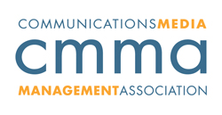



Professional Organizations
FEDERAL GOVERNMENT DISTANCE LEARNING ASSOCIATION
www.fgdla.us
www.usdla.org
Association for Talent Development
www.atd.org
Association for Educational Communications & Technology
International Society for Performance Improvement
www.aect.org
www.ispi.org
Council for Adult & Experiential Learning
www.cmma.org
www.cael.org

Slide 163

End

