Slide 1
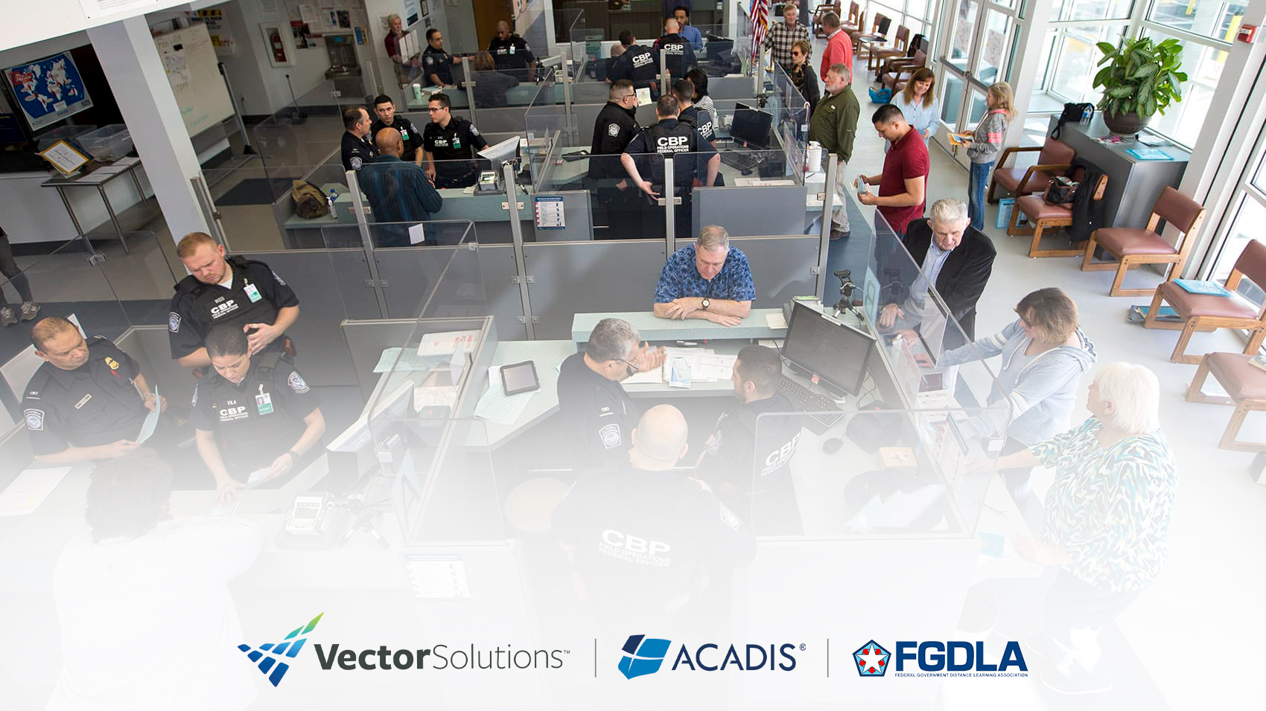
Title Slide
Supercharging Training Operations:
The Acadis Readiness Suite

Slide 2


Meet Today’s Speakers
Ari Vidali
Founder & Chief Strategist, Acadis | Vector Solutions
Jeremy Keller
Senior Solutions Engineer
Acadis | Vector Solutions
2

Slide 3
Our Time Together
By the end of this webinar, we’ll have explored:
1
2
3
Training Ecosystems
Move beyond fragmented learning with scalable architectures and clear organizational benefits.
6 Ways to Reduce Cost and Supercharge Ops
Discover proven methods to cut costs, enhance efficiency, and track training quality.
The Acadis Readiness Suite in Action
See how Acadis supports blended training, cross-functional workflows, operational automation and complex scheduling.
Notes:
3 key takeaways
Just a quick recap, regarding technologies
Most people think LMS when we talk about training technology, but that is just the “tip of the iceberg”

Slide 4

Mandatory Training
eLearning/Content Library
Professional Development
LMS
TMS
Personnel Records
Document Management
Surveys
Forecasting & Budgeting
Compliance Management
Advanced Reporting
Process Workflows
Scheduling
Online Registration
Housing Management
Online Testing
Equipment & Inventory Tracking
4
Notes:
Why?,
Because there are myriad functions below the waterline
Explain the ice berg (80% under the water line)
Academies need to….capacity plan, register etc.
Now, I have visited and helped modernize many training environments and almost all of them look something like this

Slide 5
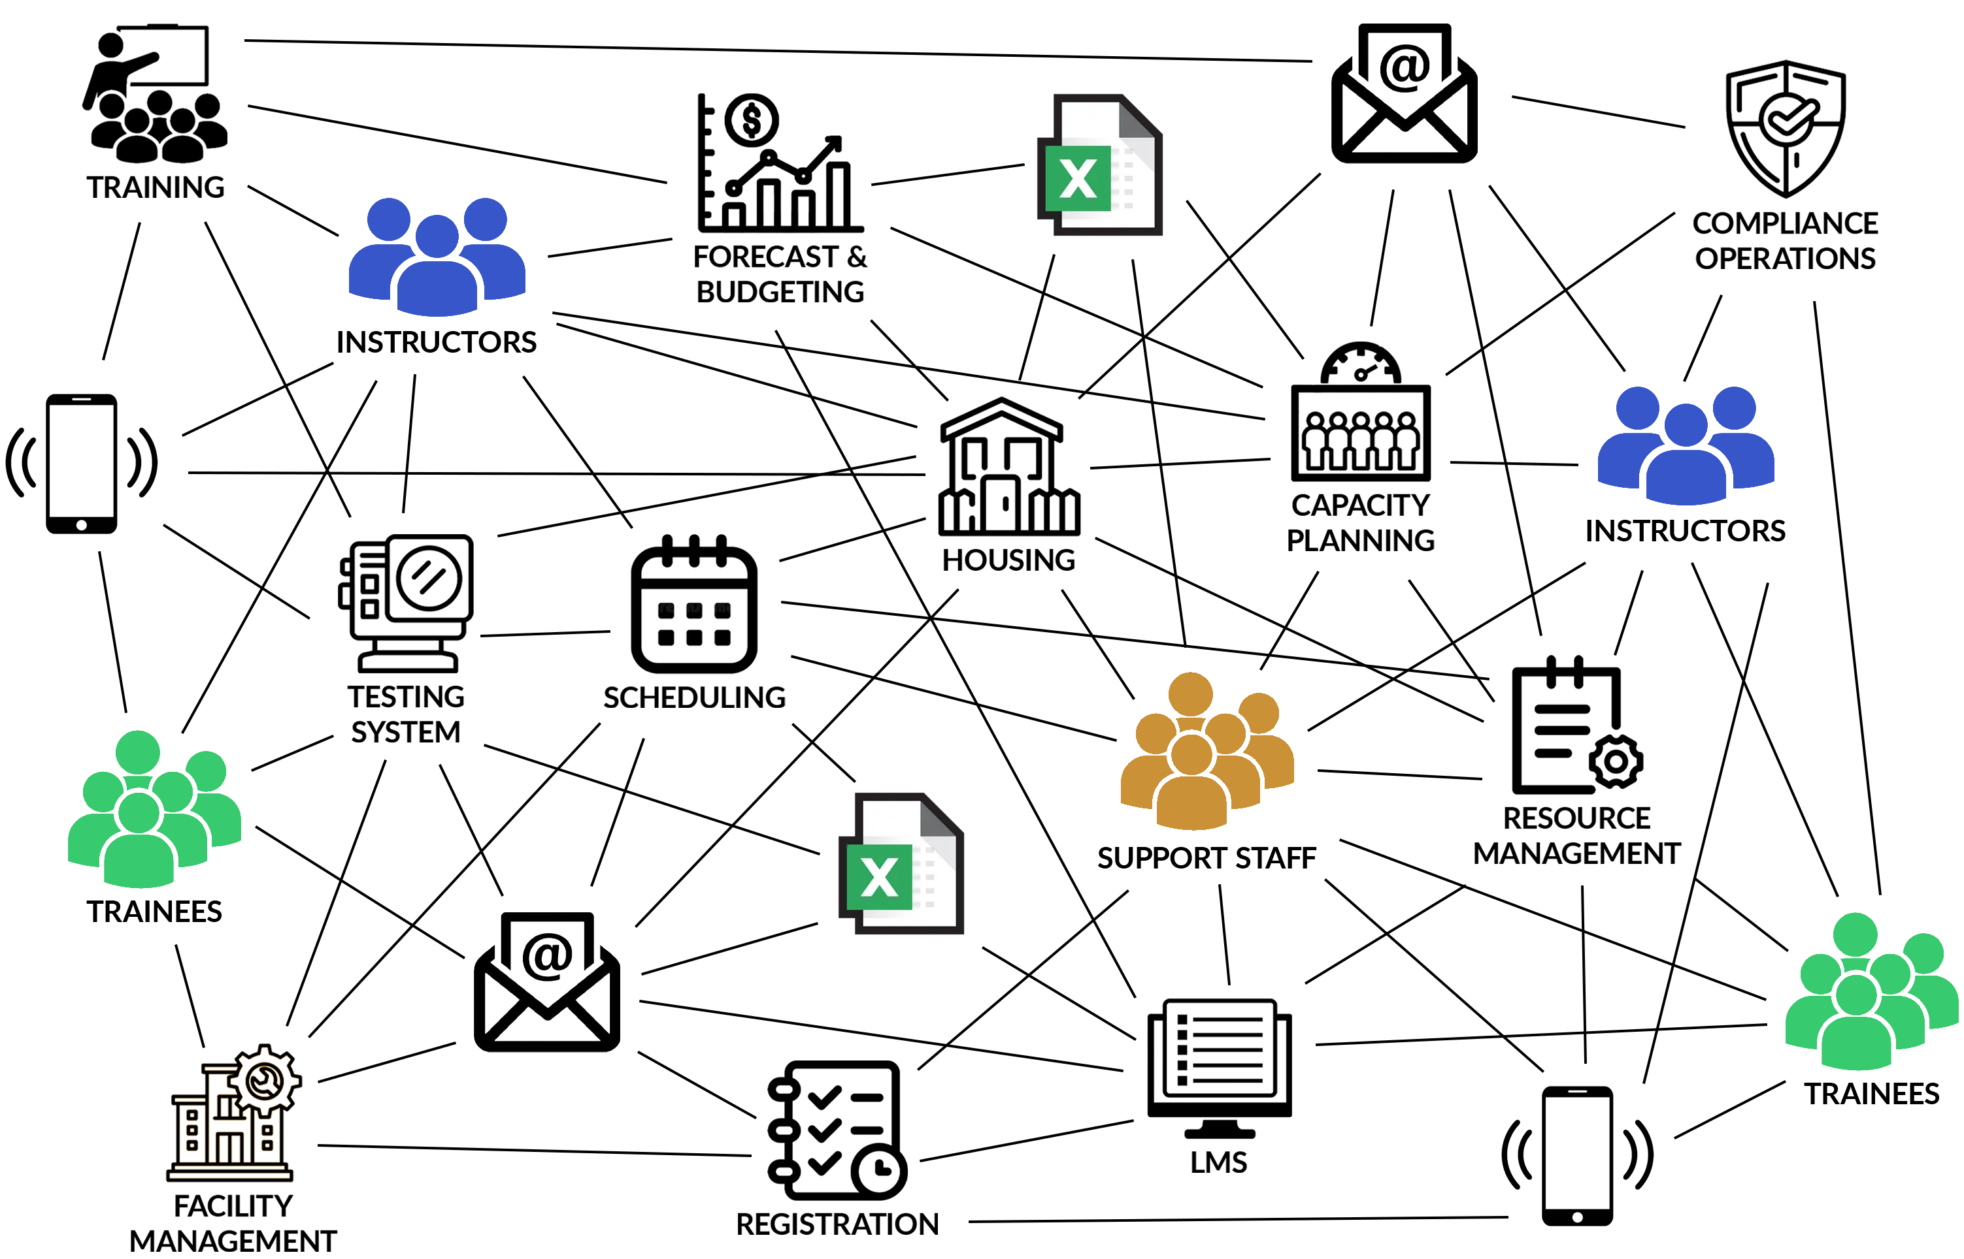
Current State = Fragmentation
Significant Process and
Messaging Friction
  Lack of scheduling coordination
  Highly manual processes
  No automated communications
  Minimal visibility into resource utilization
  High administrative overhead
  Inefficient use of instructor time
  Inability to accurately plan & forecast
5
Notes:
In almost all cases, they are
Highly fragmented and siloed across functions:
Budgeting & Forecasting
Capacity planning
Scheduling
Registration
Student Housing
Facility & Resource Management
Instructor management
Training management
Testing
Compliance
Systems are single purpose, often redundant lots of paper/whiteboards
I have literally walked into conference rooms where scheduling was done via whiteboards and Excel
Mountains of paper files
Access databases
Comms via email and phone
Tons of duplication of data entry

Slide 6

From Fragmented to Integrated Ecosystem
reduce the cost
of training?
Measure everything?
Notes:
Now most organizations understand that they need to evolve from Fragmented to Integrated ecosystem model
In an ecosystem,
Each process becomes Natively Aware of all the others
Because they are inherently interrelated
Data is the vital Nutrient that is shared by all the different processes.
Examples
Capacity planning → Resource management→ Instructor availability → Scheduling → Registration → Housing
These are all INTERRELATED processes that consume similar information
All of these processes need each other to work well
Data needs to be COMMON or Shared across training functions
Does that make sense??
If you can achieve the transition, there are 6 key ways that Ecosystems create Huge savings

Slide 7












6 Ways Training Ecosystems Create Savings
Minimize
Operational &
Hardware
Costs
Eliminate
Redundant
Systems
Simplify Costly
Security
Compliance
Software
Consolidation
Cloud
Hosting
Security
Reduce Manual
Processing
Institutionalize
Process
Forecast Costs
Measure
Utilization
Measure Quality
Minimize Travel
Reduce Fixed
Overhead
Workflow
Automation
Blended
Learning
Measurement
Notes:
6-Ways to create Real and durable savings
Software Consolidation
Cloud Hosting
Security
Workflow Automation
Blended Learning
Measurement
For the actual case study, see our previous webinar “Doing more with less, Leveraging training technology”
Ari, we love the idea of eliminating fragmentation, but how can we achieve this?
Well, today we are going to show you

Slide 8
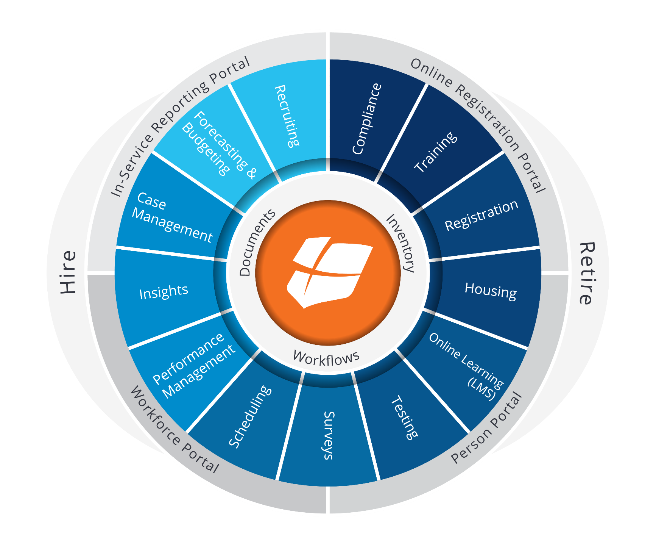
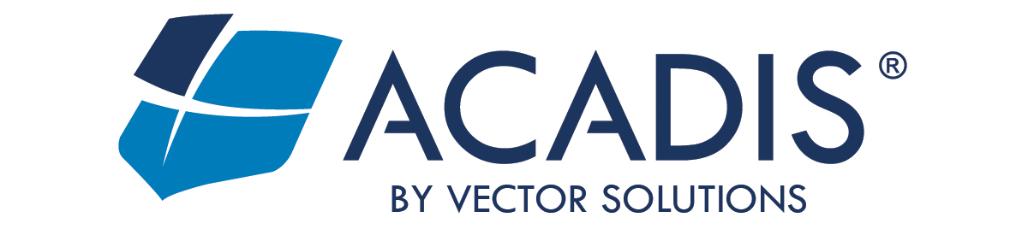
COTS/ Modular Suite – Acadis Readiness Suite
A unified platform that just works
Seamless integration by design
Resilient, platform-native connections
Streamlined cross-functional workflows from a single system/UX
Centralized security and compliance controls
Unified data view enhances decision making/eliminates dual-entry
Real-time visibility into key performance trends
Extensible via new modules and features
reduce the cost
of training?
Measure everything?
Notes:
Today, we are going to give you a taste of the power of a COTS training ecosystem.
Acadis is a HIRE TO RETIRE solution built over many years by working collaboratively with some of the most innovative training organizations in the world.
It evolved over time into the framework you are about to experience.
22 modules, solves 7 critical needs
Seamless integration by design
Resilient, platform-native connections
Streamlined cross-functional workflows from a single system/UX
Centralized security and compliance controls
Unified data view enhances decision making/eliminates dual-entry
Real-time visibility into key performance trends across all dimensions
Extensible via new modules and features
Are you ready to see this framework in action?
Handoff to Jeremy

Slide 9
Architecture Types in Government Learning
Acadis Demonstration
Exploring the Three Phases of Training Management
1
2
3
Planning
Capacity Planning
Course Scheduling
Resource Availability
Conflict Resolution
Overall Compliance and Readiness
Executing
Training Program Design
Training Management
High Stakes Testing
Skills Evaluations
Online Learning
Measuring
Unified Records
Purpose-built Reports
Forecasting
Custom Report Designer

Slide 10
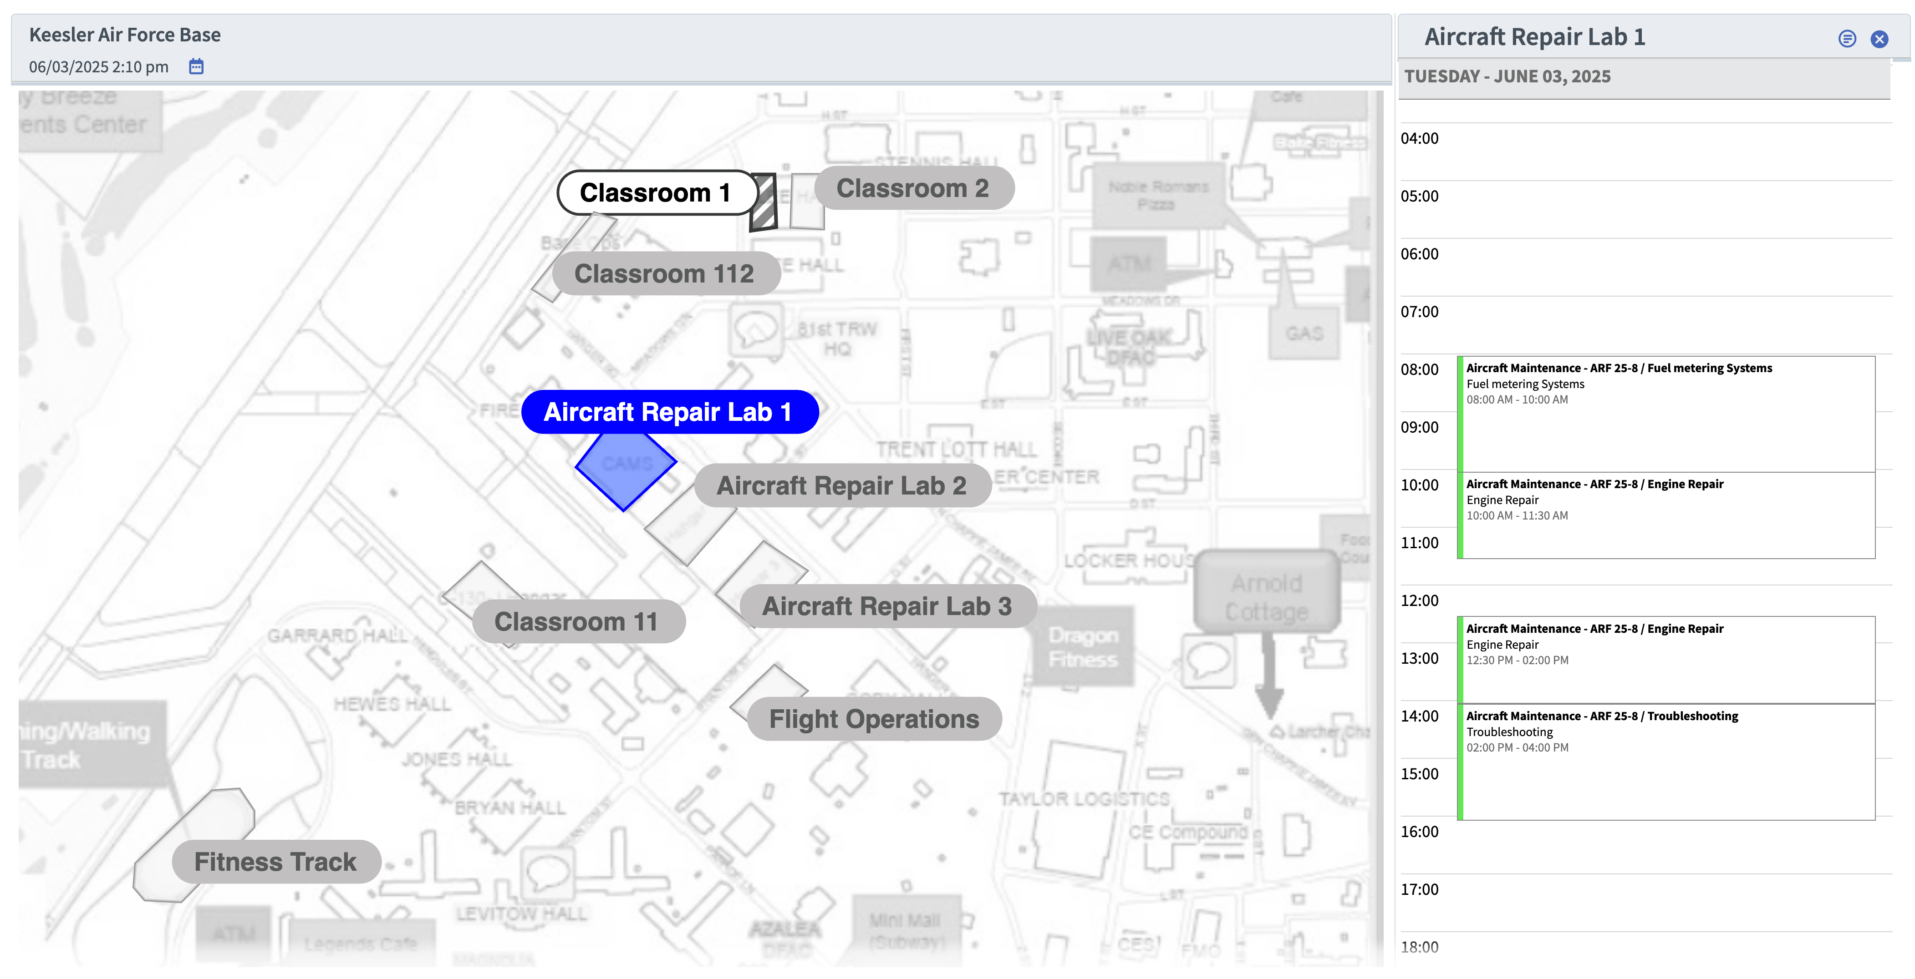
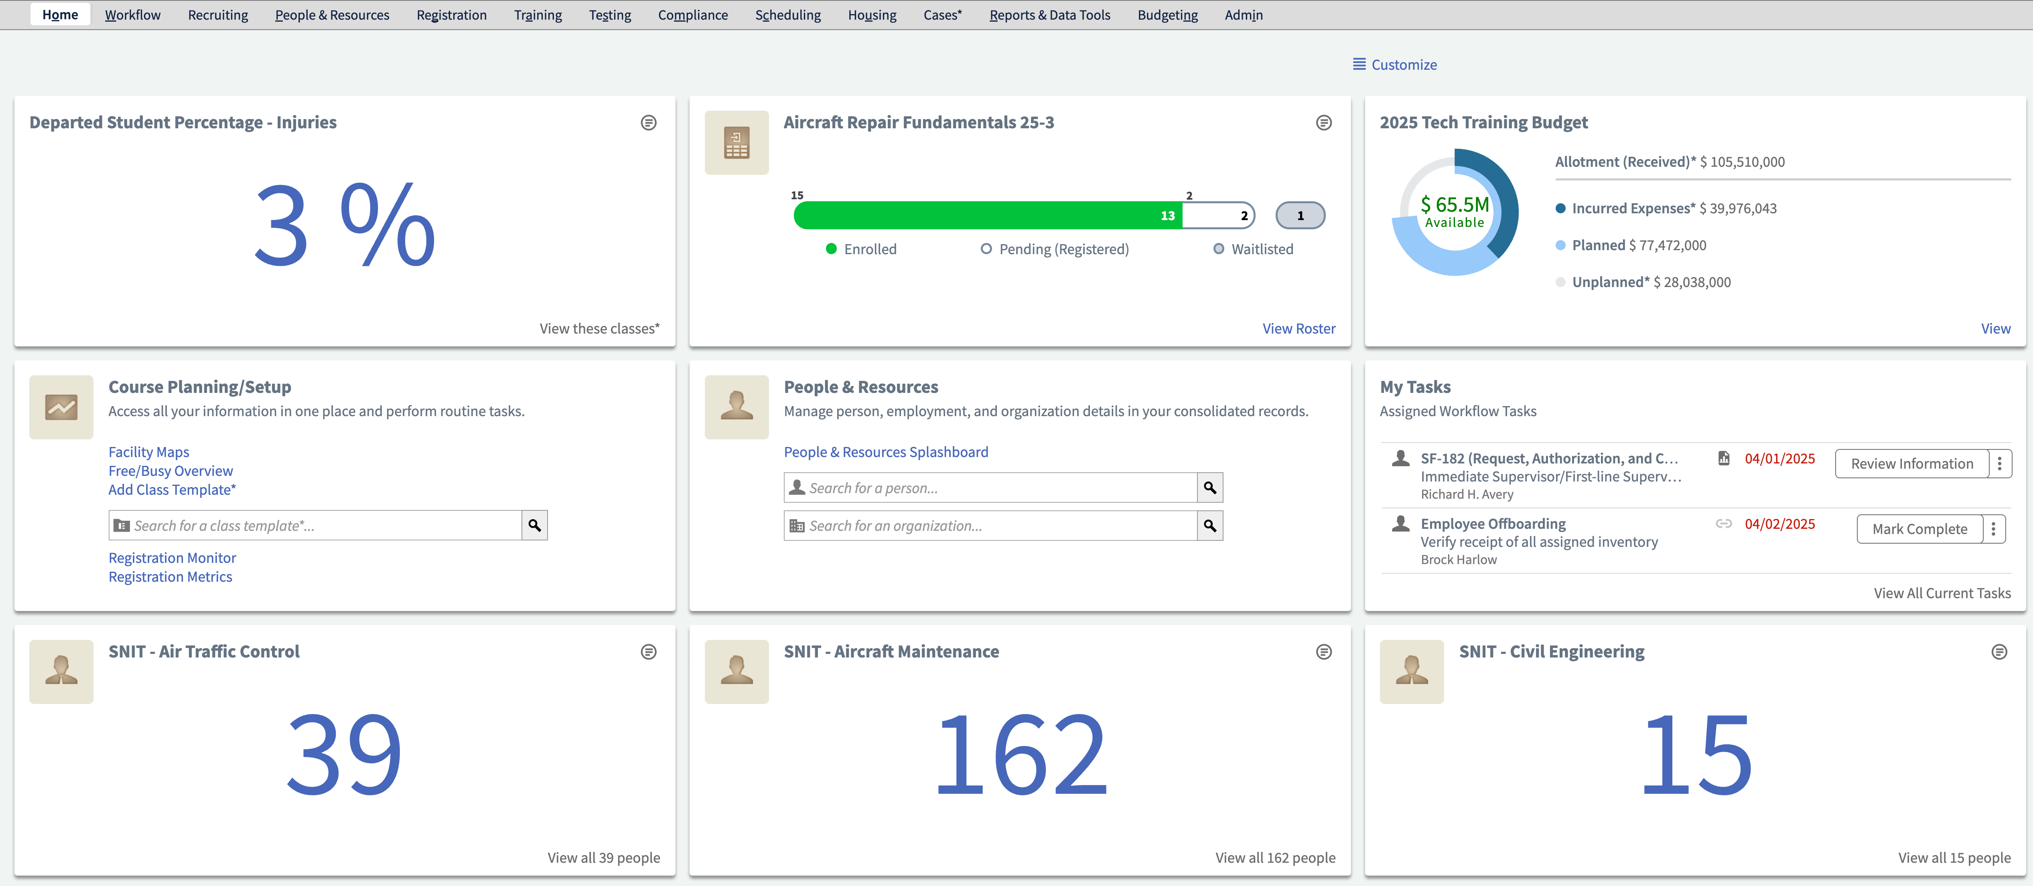
Key Takeaways: The Power of the Acadis Readiness Suite
Lifecycle Alignment: Unifies training planning, execution, and measurement in a single system—enabling end-to-end visibility and process consistency.
Centralized Data: Consolidates training data into a secure, scalable system—reducing fragmentation and enableling measurement.
Seamless Integration: Connects data across multiple systems supporting comprehensive visibility into training performance and workforce preparedness.
Reduced Redundancy: Retires outdated, siloed, and resource-intensive systems, eliminating inefficiencies.
Operational Efficiency: Enhances performance, alleviates personnel burden, and enables agencies to “do more with less.”
Cyber Security: Reduced security risk due to minimal APIs and attack vectors

Slide 11

Live Q&A
Please enter your questions in the chat.

Slide 12

Helpful Resources
Copy of Today’s Presentation
Blog: Why Purpose-Built Training Platforms Outperform Open Source in Federal Environments
Blog: Building Smarter Training Ecosystem: LMS, TMS, and Beyond
Whitepaper: How Federal and Military Agencies Can Effectively Automate Training Operations
Success Stories from other federal agencies
Consultation Request
Or you can email us:
Ari.Vidali@acadis.com | Jeremy.Keller@acadis.com
Scan QR Code or
Click the Link in the Chat

Slide 13

Thank you!

