Slide 1


Webinars: Making them Engaging and Effective
Government Learning Technology Symposium
Patrick Ahearn
As everyone gets settled, please think about some positive and negative experiences you’ve had with “online events”

Slide 2
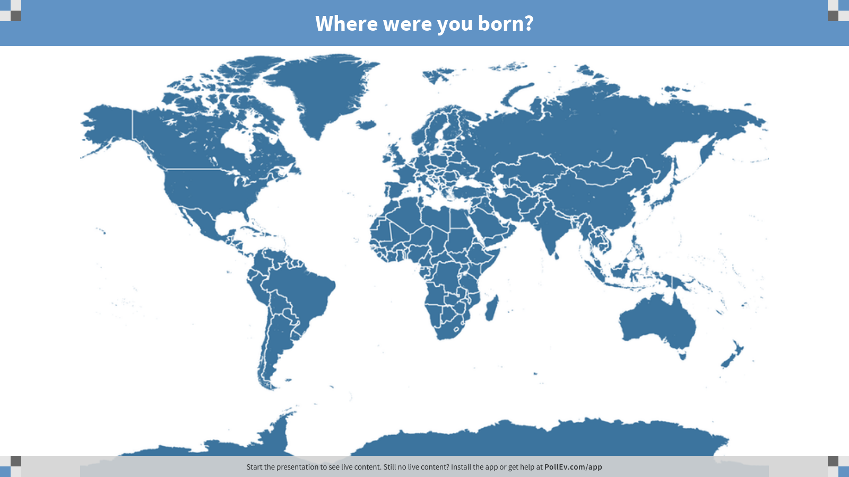

Slide 3

ABOUT ME:
Born in DC and raised in suburban Maryland
Masters degree in Applied Sociology
With RTI since 2007
Producing and facilitating ~1000 webinars since 2010
    8 years of experience with Cisco’s WebEx
    3 years of experience with Adobe Connect

Slide 4
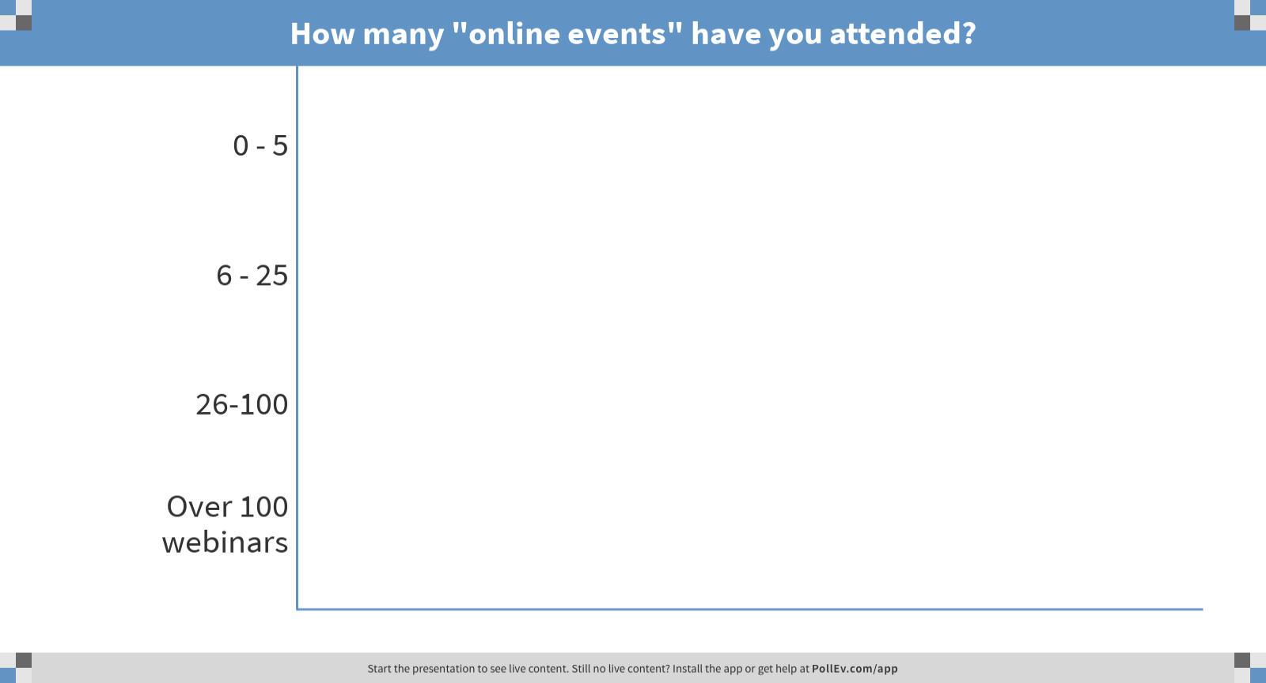

Slide 5

What are the various types of online events?
Webcasts
Live streams of in-person events to remote viewers
Content prepared and staged in advance
More likely to have on-site Audio/Video Technicians
Minimal or no online interactivity between on-site room and remote viewers
Webcasts
Virtual events
Online Meetings
Webinars

Slide 6
What are the various types of online events?
Virtual Event
A hybrid, on-site event with online attendance
Content prepared and staged in advance
Less availability for online interaction with on-site room
Some on-site Audio/Video Assistance
Webcasts
Virtual events
Online Meetings
Webinars

Slide 7
What are the various types of online events?
Online Meeting
A small group of individuals
(usually 25 or fewer attendees) with free-flowing, informal conversation
Meeting flow/direction driven by discussion, agenda, or action items
Project staff meetings
Takes place either at your desk, or in a small conference room
Webcasts
Virtual events
Online Meetings
Webinars

Slide 8
What are the various types of online events?
Webinar
Web-only event, often e-learning or distance education
Small number of presenters (1-10)
Anywhere from 1 - 3,000(?) attendees
Content prepared and staged in advance
Takes place either at your desk or in a small conference room
Audience can engage & interact with online presenters: chat, polling, Q&A
Webcasts
Virtual events
Online Meetings
Webinars

Slide 9
Outline
Producing an Effective Webinar
Mastering the Basics
Advanced Engagement
Best Practices & Key
Takeaways

Slide 10
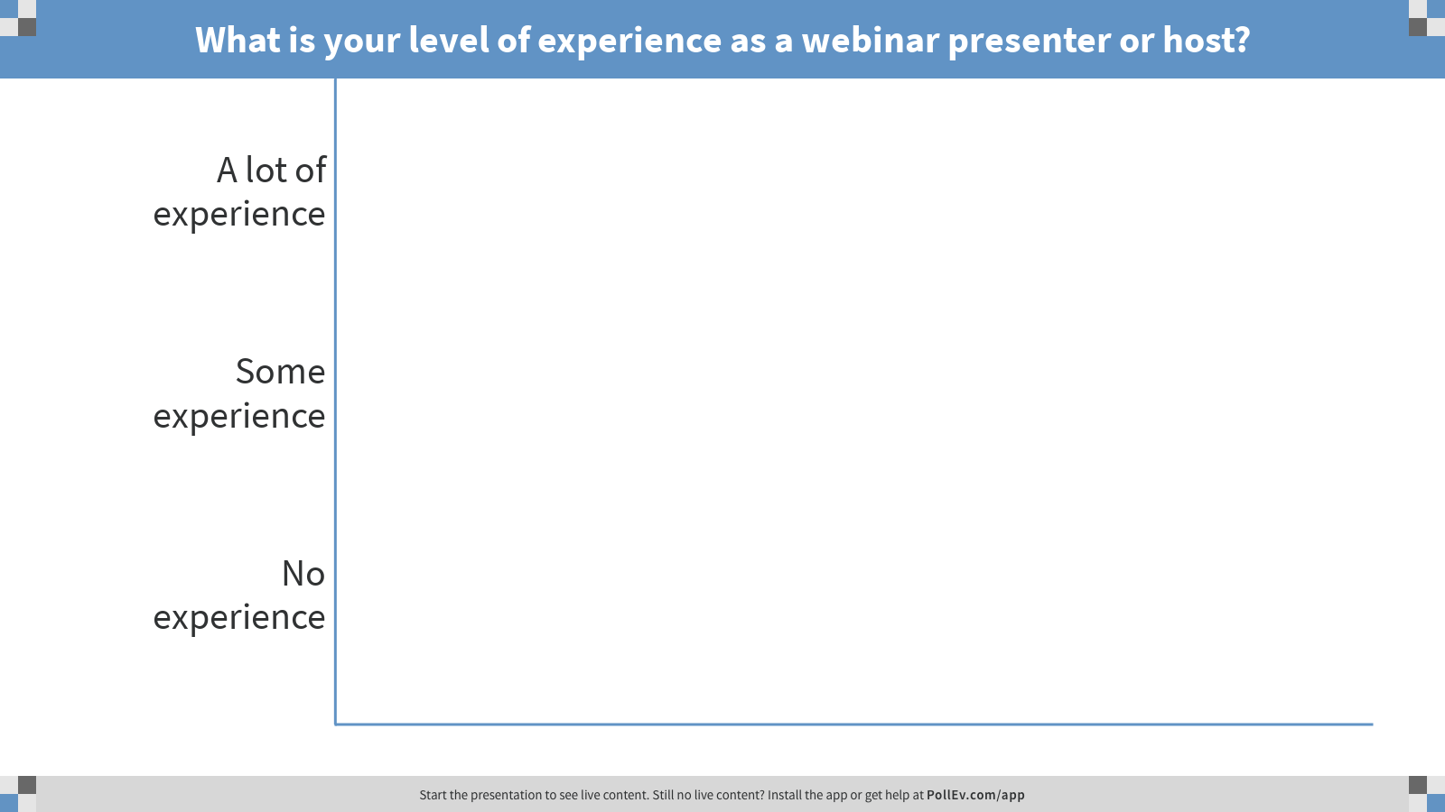

Slide 11





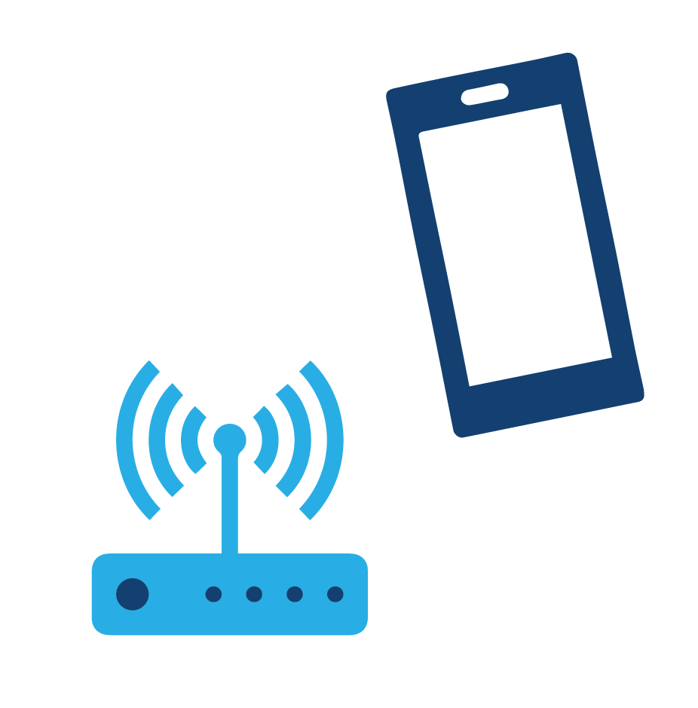
So you’re ready to host a webinar…
What could possibly go wrong?

Slide 12
So you’re ready to host a webinar…
What could possibly go wrong?
Technology Barriers
Participants can’t log onto the webinar / software issues
Internet connection / Bandwidth hiccups
Poor audio quality
  Phones & Bluetooth headsets

Slide 13
So you’re ready to host a webinar…
What could possibly go wrong?
Accidental “Oversharing”
Too many open phone lines
Office background noise
Unintentional display of personal or confidential files/information

Slide 14
So you’re ready to host a webinar…
What could possibly go wrong?
Distracted Audience
Content misses the mark
Not enough interactivity, visual content, audience engagement
Overly ambitious agenda / webinar run-time

Slide 15
What makes
an effective webinar?

Slide 16



Let’s Start With Some Considerations
Audience & Pre-Event
Content
Post-Event

Slide 17

Pre- Event,
Audience
What You Need to Know About Planning
  6-8 weeks production lead time is ideal
  A dedicated webinar producer can manage the entire lifecycle
    Let your presenters focus on presenting
  2-3 weeks ahead for promotion
  Coordination of technical and content practice
  Provide pre-event materials to registrants (emails, resources, documentation)
Content
Post-Event

Slide 18
Pre- Event,
Audience
What You Need to Know About Your Audience
  Smaller audience (15-50 attendees)
  Larger audience (50+ attendees)
  “Inside vs. Outside” webinars
    Internal: Project, contractor staff only
    External: Public facing, client-focused
Content
Post-Event

Slide 19

Pre- Event,
Audience
Content is key
  Keep slide content concise
  60 minutes is the ideal webinar runtime
  Help the audience identify and focus on what they don’t know
  Engage the audience by pausing for questions and comments
Content
Post-Event

Slide 20
Pre- Event,
Audience
Interactive Webinar Content
  Change the visual layout: include video and audio clips
  Use the Chat and Q&A to communicate with your audience
  Facilitate smaller discussions by utilizing webinar “breakout” rooms
  Support slide content with downloadable resources
Content
Post-Event

Slide 21
Pre- Event,
Audience
Follow-up with Attendees
  55% of webinar-type events are viewed after-the-fact as a recording (Adobe)
  Solicit feedback by including a post-event survey
  Support slide content with downloadable resources and/or contact information for additional questions
Content
Post-Event

Slide 22
Outline
Producing an Engaging, Interactive Webinar
Mastering the Basics
Advanced Engagement
Best Practices & Key
Takeaways

Slide 23
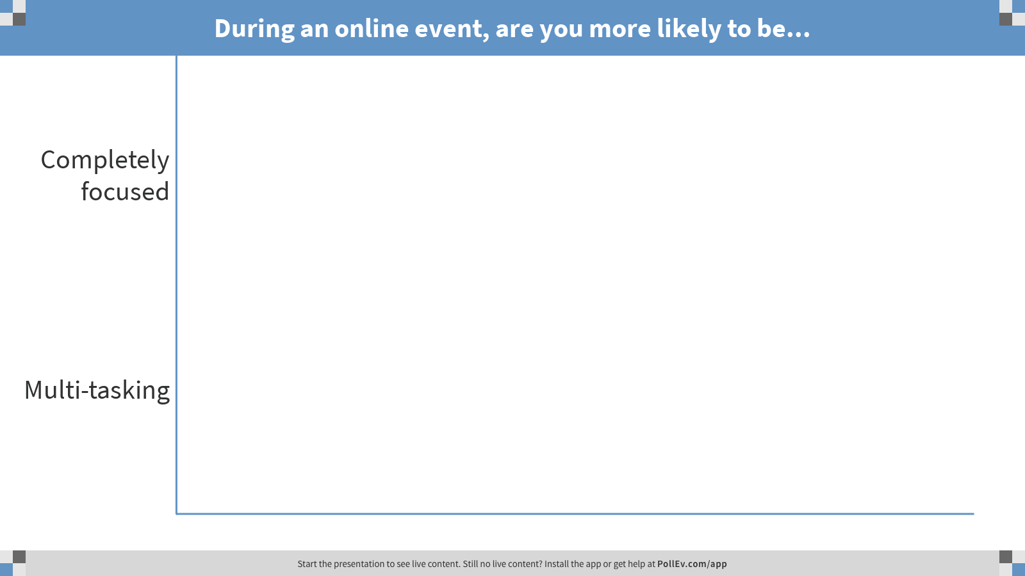

Slide 24
Challenges of Distractions and Multitasking
What are people doing?

Slide 25

Visuals help store information in long-term memory, so be mindful to choose images that link strongly to your point.
— INXPO

Slide 26

Visual Design
  Use images that reinforce your point
  Consider simple infographics for complex information
  Enabling webcams (for presenters) can add a personal touch
  Video and audio can reset audience focus
  Follow-up or support engagement questions with a visual

Slide 27


  60% of college students ages 18–22 drink alcohol
How the content is presented amplifies your message
  Share a surprising statistic
  Use compelling quotation
  Change the tone, have multiple presenters/voices
  2 of 3 engage in Binge Drinking

Slide 28

Keep’em at the Keyboard
Attendees should be touching the keyboard every few minutes
  Ask an open-ended question and allow audience to respond via Chat
  Allow attendees to interact using a webinar whiteboard
  Allow attendees to “raise their hands”
  Add a poll question
Engagement Tools
  In-platform polling
  Small group
  “breakout rooms”
  3rd Party Add-Ins
  (PollEverywhere)
  Chat / Q&A
  Raise Hand
  Webinar Whiteboards

Slide 29

Webinars as Social Media Tools
  If lacking a prominent social media component, webinars can be used in a way to communicate your message with your clients and/or the public
  Webinars can also be used in conjunction with social media programs to keep the messaging consistent

Slide 30

Gathering Data & Feedback
  Registration questions before the event can help you tailor webinars to your exact audience
  Use post-event surveys to learn what attendees found useful

Slide 31

Making webinars more inclusive
  Can coordinate with a 3rd party transcribing service for live, closed captioning of webinars
    Can also create transcripts after the fact from webinar recordings
  “Breakout rooms” can facilitate smaller conversations, and give more attendees a chance for their voice to be heard

Slide 32

Be creative and experiment
  Find out which interactive tools work best with the size of your audience and type of webinar

Slide 33
Outline
Mastering the Basics
Advanced Engagement
Best Practices & Key
Takeaways

Slide 34
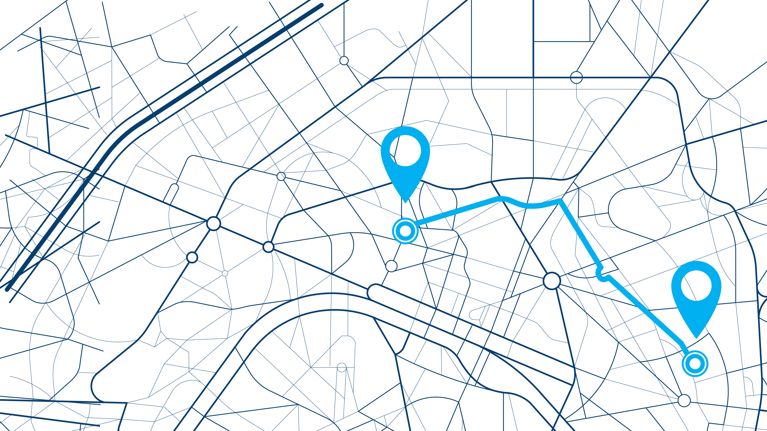
  Formulate a plan,
  and stick to it

Slide 35

Practice, Practice, Practice

Slide 36

Navigating The Unknown
  Recommendations
  Coordination
  Expertise
  Draw on previous
  experience

Slide 37


  Hybrid Onsite-Virtual Events
  Onsite audience should be main focus,
  but don’t neglect your virtual attendees
  Arrange for an onsite-to-virtual
  “translator”
  Engaging live presentations are easily
  adapted to virtual environments

Slide 38
  The Archival Audience
  Potential data gathering
    Pre-event registration
    Post-event survey
  Create bite-sized modules
  Provide additional resources &
  contact information
  Follow-up

Slide 39

Leave the audience with your message.
This is the end goal, no matter which type of event.

Slide 40
QUESTIONS?

Slide 41
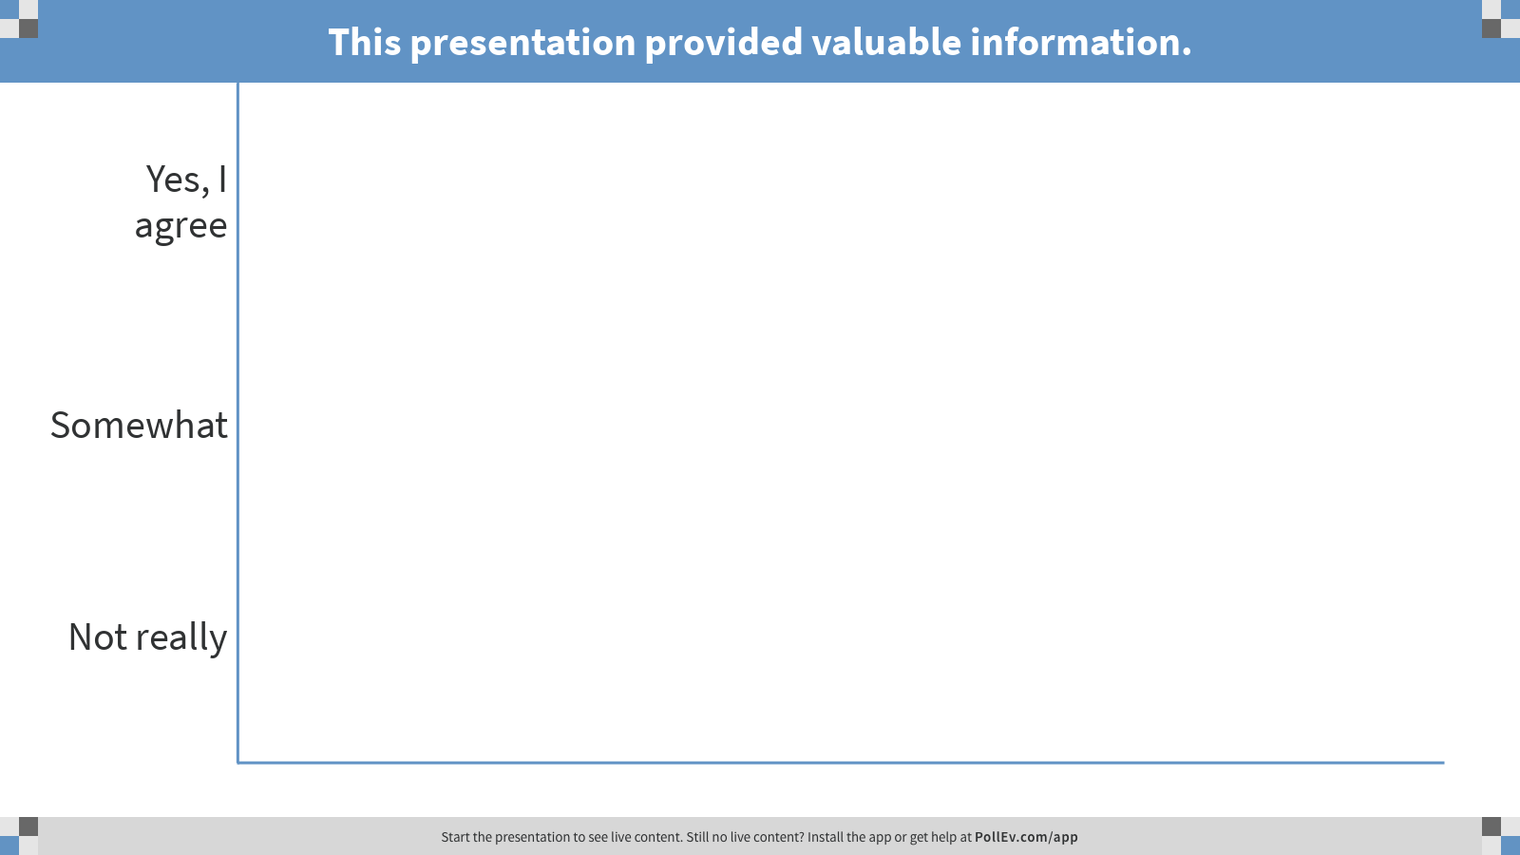
THANK YOU!

