Slide 1
The Revised Section 508 Standard
presented by
Helen Chamberlain
General Services Administration
Office of Government wide Policy
Notes:
Section 508 of the Rehabilitation Act and what it means to you

Slide 2

Section 508 of the Rehabilitation Act
  Section 508 of the Rehabilitation Act, as amended in 1998 - requires that when Federal agencies ‘develop, procure, maintain, or use’ electronic and information technology, they shall ensure that the electronic and information technology allows Federal employees with disabilities and members of the public with disabilities to have access to and use of information and data that is comparable to the access to and use of data by Federal employees and members of the public who are not individuals with disabilities, unless an undue burden would be imposed on the agency.
  NOTE: The new terminology is ‘Information and Communication Technology’
2
Notes:
Section 508 of the Rehabilitation Act
Section 508 of the Rehabilitation Act, as amended in 1998 - requires that when Federal agencies develop, procure, maintain, or use electronic and information technology, they shall ensure that the electronic and information technology allows Federal employees with disabilities and members of the public with disabilities to have access to and use of information and data that is comparable to the access to and use of data by Federal employees and members of the public who are not individuals with disabilities, unless an undue burden would be imposed on the agency.

Slide 3
Federal Agencies Accountable for oversight, support and reporting
US Access Board – An independent Federal agency, whose primary mission is to promote accessibility for individuals with disabilities. The Access Board is responsible for the development and periodic updating of the Section 508 Standards.
General Services Administration (GSA) – GSA provides tools and analysis to support government agencies in providing Section 508 electronic service technology to businesses, other government customers, and citizens.
Department of Justice (DoJ) – Judicial oversight responsibilities. Every two years the Department of Justice reports to Congress and the President on the government's progress in complying with Section 508.
Office of Management and Budget (OMB) – Provides Federal Section 508 Program Oversight, and issues policy guidance.

Slide 4

Champions for the Cause
Notes:
Champions for the Cause

Slide 5



Chief Information Officer
  BE A CHAMPION
  Demonstrate
  Influence
  Passion
  Understanding
  INVESTIGATE
  Determine
  Identify current needs for IT purchases
  Identify applicable Sec508 technical requirements
  Coordinate
  Facilitate
  Identify current needs for IT purchases
  Coordinate with the Requirements developer
  Develop and conduct accessibility training
  EDUCATE
  Encourage
  Awareness from Executives down
  How do we integrate §508 into the procurement life cycle process?
Notes:
IT/CIO Responsibilities
BE A CHAMPION
Demonstrate
Influence
Passion
Understanding
INVESTIGATE
Determine
Identify current needs for IT purchases
Identify applicable Sec508 technical requirements
Coordinate
Facilitate
Identify current needs for IT purchases
Coordinate with the Requirements developer
Develop and conduct accessibility training
EDUCATE
Encourage
Awareness from Executives down
How do we integrate §508 into the procurement life cycle process?

Slide 6
Chief Acquisition Officer
  BE A CHAMPION
  Demonstrate
  Influence
  Passion
  Understanding
  INVESTIGATE
  Determine
  How do we integrate §508 into the procurement life cycle process?
  EDUCATE
  Encourage
  Training at all levels
  Awareness from Executives down
  Resources for learning
Notes:
Vendor/Acquisition Outreach Subcommittee
The mission: Develop strategies and initiatives to increase collaboration and awareness between the Federal government acquisition community and Industry with regard to Section 508 of the Rehabilitation Act of 1973, as Amended.
What is Section 508?
Section 508 (§508) was enacted to eliminate barriers in information technology, to make available new opportunities for people with disabilities, and to encourage development of technologies that will help achieve these goals.
Who does Section 508 affect? It impacts all Federal agencies that share information within its agency or to the public. It also affects the procurement of any IT goods or service since all solicitations need to be S508 compliant.
What are the ramifications of non-compliance?
Possible lawsuits, administrative complaints, non conformant ICT products and services.
So what is your role?
If you leave remembering anything, remember that the CAO and CIO has the responsibility to do 3 things:
Inspire, investigate, and educate.
Inspire means being a champion for S508 in your agency. Influence resources, policy, and program development to ensure S508 is taken seriously in your agency. Show passion and a sense of inclusion by discussing its importance and continuing to put it on the strategic radar. And finally, a champion demonstrates his or her understanding of how important S508 is and the scope of its impact and the ramifications of it not being met. How S508 is integrated into your Understanding of resources.
Investigate: If you’re not familiar with where your agency leads or lags in S508, you need to do some investigating. Make sure you know who your Section 508 Coordinator is. Determine where is S508 embedded in your procurement life cycle? Other areas? What % of your solicitations are compliant or not? Do you have any best-practices and are you sharing them? How active are your S508 Program managers. Knowing this will help you assess the maturity of your program and to focus resources for the future. Investigate how best your agency can leverage its FITARA and category management engagement to ensure accessibility is built into your IT procurement process.
Educate: You can’t move the needle on S508 unless you’ve got an agency full of people who know what it is and what it means for their day to day work. Whether its creating an RFP or converting documents to post on the web, there are varying levels of training that need to happen throughout every agency to make sure people are up on the latest developments.
Shortfalls:
No comprehensive Sec508 requirements in requirements documents
Lack of follow through by CO
No Post award monitoring
Non conformant products and services accepted

Slide 7


The Human Side – Why 508 Matters
Section 508 is about doing the right thing to provide equal access to Information and Communication Technology for Federal employees and members of the public.
Example: A blind employee relies on assistive technology, as well as accessible web applications to do his job.
Section 508 benefits Service Disabled Veterans who are entering the Federal workforce in record numbers by providing job opportunities with accessible environments
Section 508 benefits persons with disabilities who work for or are seeking employment with the Federal government by providing an accessible workplace
Notes:
The Human Side – Why 508 Matters
Section 508 is about doing the right thing to provide equal access to information for Federal employees and members of the public.
A blind employee relies on assistive technology, as well as accessible web applications to do his job.
Section 508 benefits Service Disabled Veterans who are entering the Federal workforce in record numbers by providing job opportunities with accessible environments
Section 508 benefits persons with disabilities who work for or are seeking employment with the Federal government by providing an accessible workplace

Slide 8
Important Dates
Published in the Federal Register: Jan. 18, 2017
Effective Date: March 21, 2017
Compliance Date: January 18, 2018
Compliance date for procurements: TBD by the FAR Council.
Notes:
Published in the Federal Register: Jan. 18, 2017
Effective Date: March 21, 2017
Compliance Date: January 18, 2018
Compliance date for procurements: TBD by the FAR Council.

Slide 9
Revised 508 Standard:
Updated Terminology
Updated terminology
Information and Communication Technology (ICT)
  instead of “Electronic and Information Technology (EIT)”
Function-based approach instead of product categories
Examples:
  ICT with Two-Way Voice Communication
  instead of “Telecommunications products”
  ICT with Closed Functionality
  Instead of “Self-contained, closed products”
Notes:
Revised 508 Standard:
Updated Terminology
Updated terminology
Information and Communication Technology (ICT)
instead of “Electronic and Information Technology (EIT)”
Function-based approach instead of product categories
Examples:
ICT with Two-Way Voice Communication
instead of “Telecommunications products”
ICT with Closed Functionality
Instead of “Self-contained, closed products”

Slide 10
More Changes
Broad Application of WCAG 2.0 A and AA Success Criteria and Conformance Requirements
Delineation of Electronic Content (Public facing or Official Communications)
  Specifies which “electronic content” has to be accessible
Expanded Interoperability Requirements
  How hardware and software (i.e. Apps) needs to interact with Assistive Technology
Notes:
Broad Application of WCAG 2.0 A and AA Success Criteria and Conformance Requirements
Delineation of Electronic Content (Public facing or Official Communications)
Specifies which “electronic content” has to be accessible
Expanded Interoperability Requirements
How hardware and software (i.e. Apps) needs to interact with Assistive Technology

Slide 11
WCAG 2.0
Web Content Accessibility Guidelines 2.0 (WCAG 2.0)
Widely used international standard
Are technology-neutral and can be can be applied to any web-based technology and, with few changes, to non-web documents and software as well
The Success Criteria are the provisions
Level A and AA Success Criteria are Incorporated by reference (IBR) into the Revised Section 508 Standards
Robust technical assistance built-in
Notes:
Web Content Accessibility Guidelines 2.0 (WCAG 2.0)
Widely used international standard
Are technology-neutral and can be can be applied to any web-based technology and, with few changes, to non-web documents and software as well
The Success Criteria are the provisions
Level A and AA Success Criteria are Incorporated by reference (IBR) into the Revised Section 508 Standards
Robust technical assistance built-in

Slide 12
Index for ICT Standards and Guidelines: 36 CFR Part 1194
Appendix A
  508 Chapter 1: Application and Administration
  508 Chapter 2: Scoping
Appendix B
  255 Chapter 1: Application and Administration
  255 Chapter 2: Scoping
Notes:
Index for ICT Standards and Guidelines: 36 CFR Part 1194
Appendix A
508 Chapter 1: Application and Administration
508 Chapter 2: Scoping
Appendix B
255 Chapter 1: Application and Administration
255 Chapter 2: Scoping

Slide 13
Index for ICT Standards and Guidelines: 36 CFR Part 1194
Appendix C
  Chapter 3: Functional Performance Criteria
  Chapter 4: Hardware
  Chapter 5: Software
  Chapter 6: Support Documentation and Services
  Chapter 7: Referenced Standards
Appendix D
  EIT Accessibility Standards as Originally Published on December 21, 2000
Notes:
Index for ICT Standards and Guidelines: 36 CFR Part 1194
Appendix C
Chapter 3: Functional Performance Criteria
Chapter 4: Hardware
Chapter 5: Software
Chapter 6: Support Documentation and Services
Chapter 7: Referenced Standards
Appendix D
EIT Accessibility Standards as Originally Published on December 21, 2000

Slide 14
Function vs Product
Example: Mobile, No separate chapter or section.
Mobile phones are covered under hardware
  Chapter 4: Hardware
Mobile apps are covered under software
  Chapter 2 citation to WCAG 2.0 for software (E207.2)
  Chapter 5: Software
Notes:
Example: Mobile, No separate chapter or section.
Mobile phones are covered under hardware
Chapter 4: Hardware
Mobile apps are covered under software
Chapter 2 citation to WCAG 2.0 for software (E207.2)
Chapter 5: Software

Slide 15
How does Section 508 affect ICT?
Section 508 applies to ALL ICT contract vehicles and procurement actions, including micro-purchases.
All ICT that is “developed, procured, maintained, or used”
Enforced through the FAR, DFAR,
etc.
Notes:
How does Section 508 affect ICT?
Section 508 applies to ALL ICT contract vehicles and procurement actions, including micro-purchases.
All ICT that is “developed, procured, maintained, or used”
Enforced through the FAR, DFAR,
etc.

Slide 16

Why Enforce the Law?
It’s the right thing to do
An agency can be sued
  Legal responsibility for compliance resides with your agency, not with the vendor.
YOU have a vested interest
Notes:
Why Enforce the Law?
It’s the right thing to do
An agency can be sued
Legal responsibility for compliance resides with your agency, not with the vendor.
YOU have a vested interest

Slide 17
You are at Risk
Lawsuits are becoming more common - according to a 2012 DoJ report, since 2001, 140 administrative complaints and 7 civil actions had been filed against Agencies over Section 508.
It is not just lawsuits - for the past 10 years, “people have often used arbitration to enforce the provision in cases filed through unions and other organizations. Some arbitration cases result in large fines, which agencies must pay” - FCW, Jan 22, 2007
Failing to specify 508 technical requirements in your procurement, and not developing to the standard from the beginning of the process, or accepting a partially compliant or non-compliant product can lead to remediation costing a lot of money.
Claiming “Undue Burden” is a high bar - The DoJ Office of Civil Rights has stated that even significant expense does not constitute an Undue Burden if it can be proven that the cost of complying could have been reduced by planning for accessibility from the outset.
Notes:
You are at Risk
Lawsuits are becoming more common - according to a 2012 DoJ report, since 2001, 140 administrative complaints and 7 civil actions had been filed against Agencies over Section 508.
It is not just lawsuits - for the past 10 years, “people have often used arbitration to enforce the provision in cases filed through unions and other organizations. Some arbitration cases result in large fines, which agencies must pay” - FCW, Jan 22, 2007
Failing to specify 508 technical requirements in your procurement, and not developing to the standard from the beginning of the process, or accepting a partially compliant or non-compliant product can lead to remediation costing a lot of money.
No Undue Burden Exceptions! - The DoJ Office of Civil Rights has stated that even significant expense does not constitute an Undue Burden if it can be proven that the cost of complying could have been reduced by planning for accessibility from the outset.

Slide 18
Procuring ICT Products and Services
Section 508 is included throughout the procurement and development life cycles.
Notes:
Procuring EIT Products and Services
Section 508 is included throughout the procurement and development life cycles.

Slide 19
How will this affect Procuring ICT?
The way Section 508 requirements are written into the requirements document will change.
  Function-based approach instead of product categories
    Example: Two-way communication instead of telecommunications products
  Refreshed tools and training will be provided by GSA
The procurement guidelines in the FAR will not change
The Section 508 part 39.2 in the FAR will be updated to reflect the refreshed standards and set the starting date for procurement to comply.
Market research is still required
Notes:
The way Section 508 requirements are written into the requirements document will change.
Function-based approach instead of product categories
Example: Two-way communication instead of telecommunications products
Refreshed tools and training will be provided by GSA
The procurement guidelines in the FAR will not change
The Section 508 part 39.2 in the FAR will be updated to reflect the refreshed standards and set the starting date for procurement to comply.
Market research is still required

Slide 20
Integrating Accessibility Into Federal Contracts
The acquisition process in four phases:
  Need
  Requirement
  Research
  Solicitation
  Section 508 must be considered in ALL these phases.
Notes:
The acquisition process in four phases:
Need
Requirement
Research
Solicitation
Section 508 must be considered in ALL these phases.

Slide 21
Requiring Office Responsibilities
  The most important person in the procurement process!
  Identify and document Section 508 requirements to be included in SOW, SOO, PWS, etc
  Use ART Tool
  Conduct market research
  Sit on evaluation panel
  Evaluate and test deliverables for Section 508
  May coordinate with:
  IT Specialist to: Identify 508 technical requirements
  IT Testers to: Identify inspection and acceptance criteria for deliverables
  Program Management
  Contracting Officers
Notes:
Requiring Office Responsibilities
The most important person in the procurement process!
Identify and document Section 508 requirements to be included in SOW, SOO, PWS, etc
Use ART Tool
Conduct market research
Sit on evaluation panel
Evaluate and test deliverables for Section 508
May coordinate with:
IT Specialist to: Identify 508 technical requirements
IT Testers to: Identify inspection and acceptance criteria for deliverables
Program Management
Contracting Officers

Slide 22
Contracting Officer Responsibilities
  Will have more responsibility when FAR is updated
  Ensuring that the Requiring Office:
      Properly identifies Section 508 technical requirements
      Conducts market research
      Documents Section 508 due diligence (ART)
    Complex Purchases
      The above plus:
      Ensuring that requirements, inspection and acceptance criteria and evaluation factors are appropriately represented in the solicitation
      Participates in proposal evaluation
    Makes sure the solicitation is in an accessible format
Notes:
Contracting Officer Responsibilities
Will have more responsibility when FAR is updated
Ensuring that the Requiring Office:
Properly identifies Section 508 technical requirements
Conducts market research
Documents Section 508 due diligence (ART)
Complex Purchases
The above plus:
Ensuring that requirements, inspection and acceptance criteria and evaluation factors are appropriately represented in the solicitation
Participates in proposal evaluation
Makes sure the solicitation is in an accessible format

Slide 23
Micro Purchases
Section 508 still applies!
Still have to do market research
Purchases under $3500
Usually with a Purchase Card
Can request a VPAT 2.0 from the vendor
Notes:
Micro Purchases
Section 508 still applies!
Still have to do market research
Purchases under $3500
Usually with a Purchase Card
Can request a VPAT 2.0 from the vendor

Slide 24
Tools and Resources
www.section508.gov
The Accessibility Requirements Tool (ART) is a web-based tool that:
In Beta testing
Solicitation Review Tool
In Beta testing
Notes:
www.section508.gov
The Accessibility Requirements Tool (ART) is a web-based tool that:
In Beta testing
Solicitation Review Tool
In Beta testing

Slide 25
VPAT vs GPAT
What will happen now?
Notes:
GPAT VS VPAT

Slide 26
VPATS and GPATS
What is a VPAT 2.0?
Voluntary Product Accessibility Template
Created by Industry
VPAT 2.0 released October 2017
Who uses it?
What is replacing the Government Product Accessibility Template (GPAT)?
Refreshed tool with new output format in the form of a report
Notes:
VPATS and GPATS
What is a VPAT 2.0?
Voluntary Product Accessibility Template
Created by Industry
VPAT 2.0 released October 2017
Who uses it?
What is replacing the Government Product Accessibility Template (GPAT)?
Refreshed tool with new output format in the form of a report

Slide 27

First Cell Phone - 1973
Notes:
Picture of a man holding the first cell phone in 1973

Slide 28
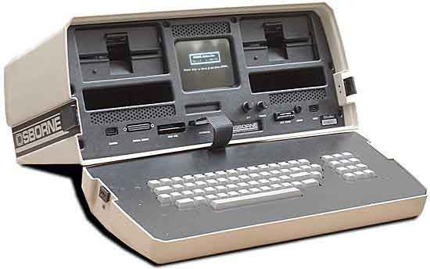
First Portable Computer - 1981
Notes:
Picture of the first portable computer in 1981

Slide 29
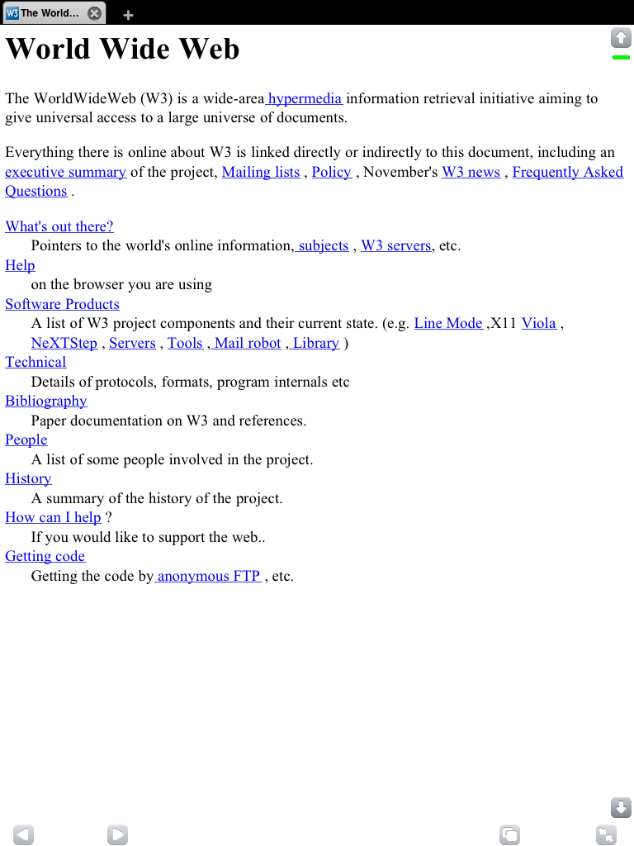
First Website - 1991
Notes:
Picture of the first website in 1991

Slide 30
Summary
Make a strong statement of Section 508 relevance
Identify applicable technical provisions
Support Documentation always applies!
If you have an EXCEPTION, state it!
Ensure your documents are in an accessible format!
Ask vendors to conform to accessibility requirements, do not ask vendors to comply or “certify” accessibility
Inspection and acceptance are important!
Document and audit
To do all this, use the Accessibility Requirements Tool (ART) and the Solicitation Review Tool (SRT)
Notes:
Summary
Make a strong statement of Section 508 relevance
Identify applicable technical provisions
Support Documentation always applies!
If you have an EXCEPTION, state it!
Ensure your documents are in an accessible format!
Ask vendors to conform to accessibility requirements, do not ask vendors to comply or “certify” accessibility
Inspection and acceptance are important!
Document and audit
To do all this, use the Accessibility Requirements Tool (ART) and the Solicitation Review Tool (SRT)

Slide 31
The Bottom Line
Section 508 should ultimately become transparent and simply part of doing business
Section 508 affects all ICT that is “developed, procured, maintained or used” by the Federal government
Not recognizing our responsibility for Section 508 in today’s environment is not a good business decision and can lead to lawsuits.
Federal government is the leader in promoting the hiring and accommodating of persons with disabilities.
Virtual and mobile workplaces present new requirements and challenges
Notes:
The Bottom Line
Section 508 affects all ICT that is “developed, procured, maintained or used” by the Federal government
Not recognizing our responsibility for Section 508 in today’s environment is not a good business decision.
Federal government is the leader in promoting the hiring and accommodating of persons with disabilities.
Virtual and mobile workplaces present new requirements and challenges
Watchdog organizations, advocacy groups, and unions have successfully filed lawsuits or arbitration cases.
With the refreshed standards there will be new challenges.
Implementation
Training
Collaboration

Slide 32
Resources
www.section508.gov
  Guidance on everything to do with Section 508
    Section 508 Training
    Accessibility Requirements Tool (ART)
    Solicitation Review Tool (SRT)
    Best Practices
    Section 508 and the Law
    Section 508 Coordinators
    Section 508 Toolkit
    And much more
Notes:
Resources
www.section508.gov
Guidance on everything to do with Section 508
Section 508 Training
Accessibility Requirements Tool (ART)
Solicitation Review Tool (SRT)
Best Practices
Section 508 and the Law
Section 508 Coordinators
Section 508 Toolkit
And much more

Slide 33
More Resources
www.Access-Board.gov – Revised Section 508 Standards, technical assistance;
http://w3.org/tr/wcag – WCAG 2.0 materials:
  WCAG 2.0 Guidelines and Success Criteria
  Understanding WCAG 2.0 (Technical Assistance (TA))
  Techniques for WCAG 2.0 (TA)
  Customizable and interactive Quick Reference (TA)
  www.adaconferences.org/CIOC/Archives – Section 508 “Best
  Practices” Webinar series (2013-2017). Sponsored by the U.S.
  Access Board and CIO Council (CIOC). Held bi-monthly.
Notes:
www.Access-Board.gov – Revised Section 508 Standards, technical assistance;
http://w3.org/tr/wcag – WCAG 2.0 materials:
WCAG 2.0 Guidelines and Success Criteria
Understanding WCAG 2.0 (Technical Assistance (TA))
Techniques for WCAG 2.0 (TA)
Customizable and interactive Quick Reference (TA)
www.adaconferences.org/CIOC/Archives – Section 508 “Best
Practices” Webinar series (2013-2017). Sponsored by the U.S.
Access Board and CIO Council (CIOC). Held bi-monthly.

Slide 34

Helping at the Bank
Notes:
Picture of a working dog putting a card into an automatic teller machine.

Slide 35
Suggestions Please!
The Section 508 team encourages your input so:
  Go to www.section508.gov
  Take a tour
  Review the content
  Test the links
  Take the Training
  Open the documents
  Send us your input
  This is your site and we want to make sure you can find all the information you need to do your job successfully!
Notes:
Suggestions Please!
The Section 508 team encourages your input so:
Go to www.section508.gov
Take a tour
Review the content
Test the links
Take the Training
Open the documents
Send us your input
This is your site and we want to make sure you can find all the information you need to do your job successfully!

Slide 36

Questions?
Notes:
Cat with computer mouse in dangling in mouth

Slide 37
Contact Information
Helen Chamberlain
General Services Administration
Office of Government-wide Policy
If you would like a copy email helen.chamberlain@gsa.gov
Notes:
Helen Chamberlain
General Services Administration
Office of Government-wide Policy
helen.chamberlain@gsa.gov

Slide 38


