Slide 1
The Cognitive Science of Learning--Concepts and Misperceptions: Implications for Instructional Design
Dr. Jolly Holden
Associate Professor
&
Executive Director,
Federal Government Distance Learning Association
Presentation available at: http://www.fgdla.us/glts_presentations.html
White Paper available at: www.fgdla.us/white_papers.html

Slide 2
Objectives of This Presentation
Analyze the role of memory in learning
Describe the neuroscience of learning
Discuss the impact of the Cognitive Information Processing (CIP) model on memory
Asses the Forgetting Curve’s implication on learning/retention
Evaluate the efficacy and implications of learning styles on designing instruction
Analyze the Cone of Learning
Review Brain-based discoveries

Slide 3
Menu (Click any of the hyperlinks to go directly to that topic)
The Science of Learning
Cognitive Information Processing (CIP) Model
Forgetting Curve
Learning Styles
Cone of Learning
Recent Brain Research Discoveries
Previous Slide
Navigation Bar
(Click on any of the hyperlinks for direct access to that topic)
Next Slide
Home (Menu) Science of Learning Forgetting Curve Learning Styles Cone of Learning Brain Research Discoveries

Slide 4
The Science of Learning: What We Know About Memory
Since prior knowledge and learning are related, by connecting new information to prior knowledge will facilitate the learning process.
Human learning is a constructive and iterative process in that humans construct meaning from existing knowledge structures.
People take past experiences and make conceptual building blocks from them, upon which new knowledge is developed…this forms the foundation of the constructivist philosophy of education.
Remember is hard…forgetting is easy
Home (Menu) Science of Learning Forgetting Curve Learning Styles Cone of Learning Brain Research Discoveries

Slide 5
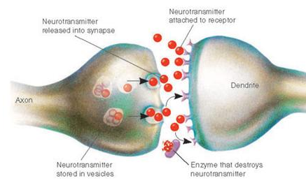
The “Neuroscience” of Memory: How the Brain Learns
Cells of the nervous system are called neurons.
Information from one neuron flows to another neuron across a synapse.
Human brain has a million billion synapses.
Your brain creates synapses whenever you learn something new.
Sleeping helps "update" your brain cells. Literally.
Home (Menu) Science of Learning Forgetting Curve Learning Styles Cone of Learning Brain Research Discoveries

Slide 6
The “Neuroscience” of Memory: How the Brain Learns
When exposed to new information from our senses (modalities), our brain needs to form an association between what we see and [sometimes] hear, which are then encoded by different groups of neurons in various parts of your brain.
Each time that input is repeated (reinforced), those sets of neurons fire simultaneously, strengthening the synaptic pathway that connects them…effectively creating memory (How Does Our Brain Learn New Information? Scientific American, Nov., 2011)
In scientific (neuroscience) terms, learning is a neurobiological process indicated by the growth and strengthening of connections between neurons.
Home (Menu) Science of Learning Forgetting Curve Learning Styles Cone of Learning Brain Research Discoveries

Slide 7
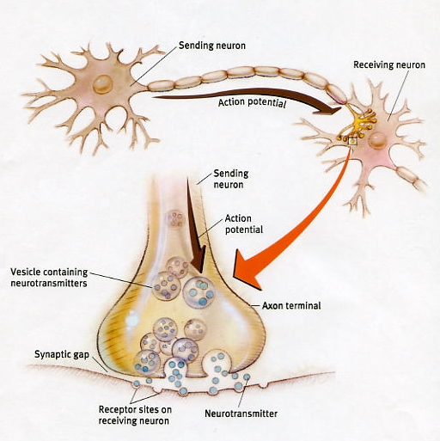
The “Neuroscience” of Memory: How the Brain Learns
Many different events can increase a synapse’s strength when we learn new information.
That process is called long-term potentiation where repeatedly stimulating two neurons at the same time fortifies the link between them.
After a strong connection is established between these neurons, stimulating the first neuron will more likely excite the second.
Learning is not how the information gets in, it’s what happens to the information once it is ‘in’.
Home (Menu) Science of Learning Forgetting Curve Learning Styles Cone of Learning Brain Research Discoveries

Slide 8
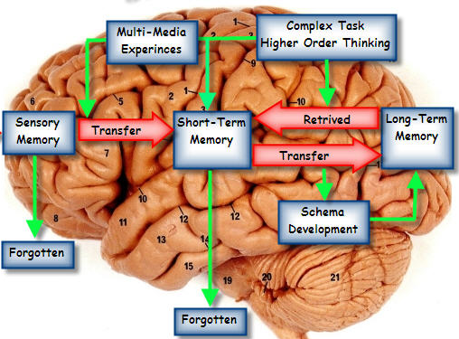
Cognitive Information Processing (CIP) Model
Cognitive Information Processing (CIP) model views learning when information is received from the environment via the senses (modalities), processed and stored into memory, and then output in some form of learned capability.
Sensory Input
Sensory Memory
Short-term Memory
Long-term Memory
Home (Menu) Science of Learning Forgetting Curve Learning Styles Cone of Learning Brain Research Discoveries

Slide 9
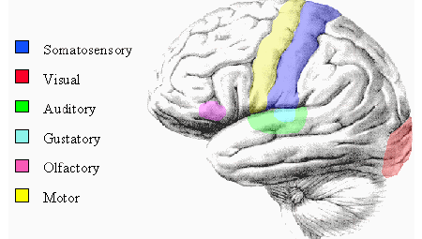
How the Brain Learns— Memory and the CIP Model
The first stage, sensory memory, is associated with the senses where information is stored briefly for processing. Information is stored for only a fraction of a second (milliseconds) before the subconscious decision is made on how to process the information. After entering sensory memory, a limited amount of information is transferred into short-term memory.
E
X
T
E
R
N
A
L
Sight
I
N
P
U
T
Sound
Sensory Input
Transfer thru
attention & pattern recognition
Sensory Memory
Smell
Taste
Touch
90% is not cognitively processed and subsequently forgotten
Modalities
Humans possess separate channels for processing visual and auditory information
Sensory perception is very complex in that incoming stimuli are essentially bombarding the brain at any given moment in time. This incoming information would quickly result in sensory overload without the buffering mechanism that is referred to as sensory memory. As information is received by sensory receptors, the sensory memory begins to filter, or truly perceive, the information before being passed to short-term memory.
Home (Menu) Science of Learning Forgetting Curve Learning Styles Cone of Learning Brain Research Discoveries

Slide 10
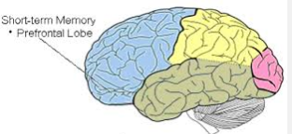
How the Brain Learns— Cognitive Information Processing Model
Short-term memory is the stage where further consciousness processing occurs, per se, actively thinking about what has occurred. After entering sensory memory, a limited amount of information is transferred into short-term memory (STM). Within STM, there are three basic operations:
Iconic memory - the ability to hold visual images
Acoustic memory - the ability to hold sounds, and…
Working memory - an active process to keep it until it is put to use.
Sensory Input
Sensory Memory
Short-term Memory
George Miller’s “Magic Number”: Can hold 5-7 (+/-2) concepts for ~30-40 seconds before it decays… cognitive load can impede the transfer of information. Distractions & cognitive load decays information, and complexity limits the amount processed.
NOTE: STM is vulnerable to interruption or interference, per se, the brain is easily distracted, where attention can be displaced when integrating multimedia components.
Home (Menu) Science of Learning Forgetting Curve Learning Styles Cone of Learning Brain Research Discoveries

Slide 11
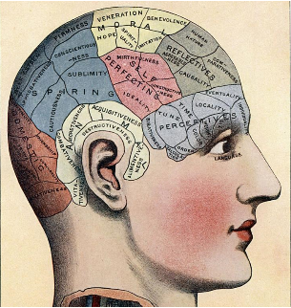
How the Brain Learns— Cognitive Information Processing Model
STM holds limited information for a limited amount of time…by employing cognitive learning strategies, transfer of information from working memory to long term memory can be facilitated.
Only information that has moved from working to long-term memory is retrievable and remembered. As instructional designers, we must find ways to make learning relevant and meaningful enough for the learner to make the important transfer of information to long-term memory.
Rehearsal, association & consolidation
Sensory Input
Sensory Memory
Short-term Memory
Long-term Memory
transfer of learning facilitated through the integration of cognitive learning strategies
context meaning
Memory Storage
(declarative & procedural)
Episodic & Semantic implicit
(unconscious)
Note: Be aware of selective attention
Home (Menu) Science of Learning Forgetting Curve Learning Styles Cone of Learning Brain Research Discoveries

Slide 12
How the Brain Learns— Cognitive Information Processing Model
Based upon recent research from neuroscience, “separate structures in the brain are highly interconnected and there is profound cross-modal activation and transfer of information between sensory modalities”.
Learning, or perceptual modalities, are sensory based and refer to the primary way our bodies take in information though our senses: visual (seeing), auditory (hearing), kinesthetic (moving), and tactile (touching).
When content is presented through two different channels (visual and auditory),working memory can be increased (dual coding theory).
“it is incorrect to assume that only one sensory modality is involved with cognitive information processing.” Neuromyths in education: Prevalence and predictors of misconceptions among teachers, frontiers in Educational Psychology, 2012: http://www.frontiersin.org/Educational_Psychology/10.3389/fpsyg.2012.00429/full
Home (Menu) Science of Learning Forgetting Curve Learning Styles Cone of Learning Brain Research Discoveries

Slide 13
How the Brain Learns— Cognitive Information Processing Model
Furthermore, you typically store memories in terms of meaning (context)-- not in terms of whether you saw (visual), heard (aural), or physically (tactile/ kinesthetic) interacted with the information.
The more numerous and varied the media is used, the richer and more secure will be the concepts we develop.
For learning and instruction to be meaningful and relevant, it must build upon the learner's prior knowledge and help the learner to make connections between what they already know and what they are about to learn.
I get how we learn, but how and why do we forget?
Home (Menu) Science of Learning Forgetting Curve Learning Styles Cone of Learning Brain Research Discoveries

Slide 14
The Forgetting Curve
Articles appearing in several professional T&D magazines
“70% of all training is forgotten in 24 hours”
“70% of everything we learn is forgotten in 24 hours”
We forget 70% of all formal education
Inquiring minds want to know…
do we really forget 70% of what we’ve learned?
Home (Menu) Science of Learning Forgetting Curve Learning Styles Cone of Learning Brain Research Discoveries

Slide 15
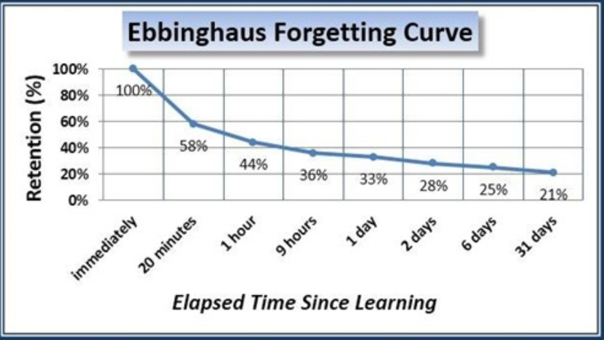
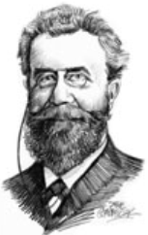
The Forgetting Curve
The forgetting curve hypothesizes the decline of memory retention in time, based upon the pioneering research of 19th century German psychologist Hermann Ebbinghaus.
In 1885, he published his groundbreaking research, Memory. A Contribution to Experimental Psychology) in which he described experiments he conducted on himself to describe the processes of learning and forgetting.
Home (Menu) Science of Learning Forgetting Curve Learning Styles Cone of Learning Brain Research Discoveries

Slide 16
Forgetting Curve Research
Ebbinghaus was determined to show that higher mental processes could actually be studied using experimentation.
To control for most potentially confounding variables, Ebbinghaus used nonsense syllables, since he needed something that could be easily memorized but had no prior cognitive associations
This is known as the CVC trigram (a nonsense syllable is a consonant-vowel-consonant combination, where the consonant does not repeat and the syllable does not have prior meaning, e.g., DOT, BOK, YAT, etc.
After eliminating the meaning-laden syllables, Ebbinghaus ended up with 2,300 resultant syllables that he would read out loud and attempt to recall them at the end of the procedure.
The learning material consisted of 70 lists, with each list consisting of 104 nonsense syllables, which in turn consisted of 8 rows of 13 syllables.
Note: Recently, Ebbinghaus’ research has been replicated of a study entitled Replication and Analysis of Ebbinghaus’ Forgetting Curve: http://journals.plos.org/plosone/article?id=10.1371/journal.pone.0120644
Home (Menu) Science of Learning Forgetting Curve Learning Styles Cone of Learning Brain Research Discoveries

Slide 17
Forgetting Curve Principles
According to Ebbinghaus' research, there are a few key principles involved in the forgetting curve:
It is often easier for learners to memorize new information if it ties into real world situations. Information must be relevant and meaningful to them, or else they are likely to forget it more rapidly.
When there is more learning material involved, the amount of time it takes to absorb information significantly increases.
Home (Menu) Science of Learning Forgetting Curve Learning Styles Cone of Learning Brain Research Discoveries

Slide 18
Forgetting Curve Principles
As a general rule, learners are able to relearn information more easily than learning the subject matter for the first time. In addition, each time information is relearned, the length of time it takes to forget the information goes up.
Learners start to forget information immediately after the learning experience and forgetting will slow down over the course of time.
Bottom line…without reinforcement, people will forget 30-90% of what they’ve learned
Home (Menu) Science of Learning Forgetting Curve Learning Styles Cone of Learning Brain Research Discoveries

Slide 19
How to Overcome the Forgetting Curve
Spacing effect (spaced repetition): Learners are able to learn more effectively when information is spread over a longer period of time (spacing effect), as opposed to having to learn it all at once.
Cognition: Cognitive learning strategies are methods used to help learners link new information to prior knowledge in facilitating the transfer of learning from short term memory to long term memory.
Relevance: For learning and instruction to be meaningful, it must build upon the learner's prior knowledge and help the learner to make connections between what they already know and what they are about to learn.
Formative feedback: Is a teachable moment that reinforces the content in moving information from working memory to long term memory for recall.
Home (Menu) Science of Learning Forgetting Curve Learning Styles Cone of Learning Brain Research Discoveries

Slide 20
How to Overcome the Forgetting Curve
Emotions: Design learning events that can evoke strong emotional appeal
Motivation: Intrinsic motivation is the largest single variability in the learning process
The human dynamics of learning is so complex that attempting to isolate independent variables that affect learning is like trying to determine your car’s gas mileage by studying petroleum chemistry.
me, conceptualizing at the 20 mile mark in the Honolulu marathon
Click here for variables that affect the human dynamics of learning
Home (Menu) Science of Learning Forgetting Curve Learning Styles Cone of Learning Brain Research Discoveries

Slide 21
Learning Styles
Opinion: The concept of learning styles in predicting learning outcomes is a commonly misunderstood and misapplied instructional strategy when designing content.
Fact: Research has revealed that learning styles have little, if any, affect on predicting learning outcomes.
Result: While the perception is people learn better when information is presented in their preferred learning style, current research has not confirmed this.
“The learning style myth leads to some very unproductive training approaches that are counter to modern evidence of what works…The time and energy spent perpetuating the various learning style myths can be more wisely invested in supporting individual differences that are proven to make a difference—namely, prior knowledge of the learner.” (Evidence-Based Training Methods: A Guide for Training Professionals, Ruth Clark, 2010, p. 10)
Home (Menu) Science of Learning Forgetting Curve Learning Styles Cone of Learning Brain Research Discoveries

Slide 22
What are Learning Styles?
Basically, learning styles refers to the concept that individuals differ in regard as to what specific mode in acquiring information is most effective for them, and that learning styles are not a fixed trait, but a differential preference for learning.
However, learning style definitions are characterized by considerable conceptual confusion and the lack of any generally accepted definition.
“…there is no evidence of stable interactions between learning styles and instructional methods”…and, “basis for attributing enhanced learning to learning styles.” (Tobias & Fletcher (eds.), 2000. Training and Retraining: A handbook for business, industry, government, and the military)
Home (Menu) Science of Learning Forgetting Curve Learning Styles Cone of Learning Brain Research Discoveries

Slide 23
Do You Know Your Learning Style(s)?
Are you a…
Converger; diverger; assimilator; accommodator (Kolb’s LSI)
Concrete sequential; abstract random; abstract sequential; concrete random (Gregorc’s learning style topography)
Leveling/Sharpening cognitive styles (Klein)
Impulsive/Reflective cognitive styles (Kagan)
Visual/Haptic (Lowenfeld & Brittain)
Sensory/intuitive; visual/verbal; active/reflective; sequential/global (Felder & Silverman four-dimension model)
Grasha-Reichmann Student Learning Style Scales
Activists; reflectors; pragmatists; theorists (Honey & Mumford's learning styles)
Analytic/non-analytic; conceptualizing (Messick)
Canfield Learning Styles Inventory
Verbalizer-Visualizer learning styles
Field dependent/field independent (Witkin’s cognitive styles)
Visual, aural, kinesthetic (Dunn & Dunn VAK learning styles)
Note: The literature has identified 71 different learning styles!
Home (Menu) Science of Learning Forgetting Curve Learning Styles Cone of Learning Brain Research Discoveries

Slide 24
Insight [and research] into Learning Styles
A study published in the Psychological Science in the Public Interest challenged the prevailing concept of learning styles and their affect on student performance. The investigators (four prominent cognitive psychologists) found “no evidence…for validating the educational applications of learning styles into general educational practice.”
A 2010 article from the Australian Journal of Educational Research stated “research conducted over the last 40 years has failed to show that individual attributes can be used to guide effective teaching practice.”
According to a 2013 study, learning styles are considered an educational legend (Kirschner & van Merrinboer, 2013) .
“The notion of ’learning styles’ is itself not coherent. Those who use this term do not define the criteria for a style, nor where styles come from, how they are recognized/ assessed/ exploited. “ Dr. Howard Gardner: Washington Post‘ (2013). Multiple intelligences’ are not ‘learning styles (http://www.washingtonpost.com/blogs/answer-sheet/wp/2013/10/16/howard-gardner-multiple-intelligences-are-not-learning-styles)
Home (Menu) Science of Learning Forgetting Curve Learning Styles Cone of Learning Brain Research Discoveries

Slide 25
The Essence of the Debate
This is not a new debate but a continuing investigation into the efficacy of learning styles that has spanned 60 years.
To that end, there is a strong intuitive appeal to the notion there are individual preferences and styles of learning.
Cognitive science has discovered that recent research by neuroscience in how the brain stores and retrieves information supports their statement concerning the accuracy of learning styles as a predictor of performance.
No current holistic [overall] theory of learning preferences.
“Review of 150 studies found none supported learning styles. The mind is so complex and malleable that variance within a person is so great as to make the point [learning styles] moot.” Busted Learning Myths, Chief Learning Officer Magazine, Feb 2012
Home (Menu) Science of Learning Forgetting Curve Learning Styles Cone of Learning Brain Research Discoveries

Slide 26
The Essence of the Debate
There are three ‘learning styles’ that are most commonly referenced: visual, auditory, and kinesthetic (VAK).
Advocates argue that better learning outcomes can be achieved when a teacher takes a student’s learning style into consideration.
Adversaries argue that this particular concept is scientifically not proven.
There is no convincing evidence to prove that when an instructor changes the presentation mode of their course to match the learning style of the students it actually helps them.
“There is no strong evidence that teachers should tailor their instruction to their students' particular learning styles …and, warned learning styles “trivialize human complexity” by “denying human individuality” rather than characterizing it. David Kolb, Matching Teaching Style to Learning Style May Not Help Students, Chronicle of Higher Education: http://chronicle.com/article/Matching-Teaching-Style-to/49497/
Home (Menu) Science of Learning Forgetting Curve Learning Styles Cone of Learning Brain Research Discoveries

Slide 27
The Essence of the Debate [the disagreement]
Claims for adapting instruction to learning styles assume they are stable, replicable interactions between measures of learning styles and instructional methods.
Not supported by available research evidence that “visualizers” learn better with visual forms of instruction and “verbalizers” learn better with verbal modes of instruction.
A number of reviews of ATI (aptitude treatment interactions) research have found similar conclusions about the types of interactions and instructional methods (click here for more about ATI).
“verbalizer-visualizer measures failed to produce significant attribute treatment interactions (ATIs). There was not strong support for the hypothesis that verbal learners and visual learners should be given different kinds of multimedia instruction”. Massa, L.J., & Mayer, R., 2006. Testing the ATI hypothesis: Should multimedia instruction accommodate verbalizer-visualizer cognitive style? Science Direct
Home (Menu) Science of Learning Forgetting Curve Learning Styles Cone of Learning Brain Research Discoveries

Slide 28
Predicting Learning Styles: The Basis of the Theory [and the confusion]
The genesis of the [VAK] theory of learning styles is that if you can identify a students “style”, then you can design instruction that matches their “style” and they should learn better.
The assumption is once you identify a specific style, you can design instruction that best fits the style.
The visual learner will understand best when information (content) is presented to the visually.
The auditory learner will understand best when information is described to them orally.
The kinesthetic learner will understand best when they can touch/feel what is being presented to them.
These are statements of predictability, per se, you are predicting learning outcomes based upon learning “styles”
Home (Menu) Science of Learning Forgetting Curve Learning Styles Cone of Learning Brain Research Discoveries

Slide 29
What Does the Research Reveal About Learning Styles?
Simply stated, the research has not revealed a compelling argument as to the impact of learning styles and their effect on predicting learning outcomes.
Small sample sizes, flawed sampling methodology, and non-experimental research designs casts doubt on the results of VAK learning style research.
No substantial, uncontested, and hard empirical evidence has been found to prove that matching the styles of learner and instructor improves learning and attention.
The study concluded that some of the most used [learning style] models have serious issues and weaknesses regarding “low reliability, poor validity and negligible impact on pedagogy.” Learning styles and pedagogy in post-16 learning: A Systematic and Critical Review (2004)
Home (Menu) Science of Learning Forgetting Curve Learning Styles Cone of Learning Brain Research Discoveries

Slide 30
What Does the Research Reveal About Learning Styles?
The research does not support designing instruction to match learning styles, and the opinions of ID experts concur.
After more than 30 years of research, no consensus has been reached about the most effective instrument for measuring learning styles, and there is no agreement about the most appropriate learning interventions.
“The findings of this [VAK] research adds to the existing body of discourse and consolidates the belief that learning styles as determined by self-assessment instruments do not necessarily improve performances”. Effectiveness of Personalized Learning Paths on Students Learning Experiences in an e-Learning Environment, European Journal of Open, Distance and E-Learning , 2013
Home (Menu) Science of Learning Forgetting Curve Learning Styles Cone of Learning Brain Research Discoveries

Slide 31
What Does the Research Reveal About Learning Style Instruments?
Low validity and reliability scores of the VAK instruments used to identify specific learning styles raise serious doubts about their psychometric properties.
In other words, if the tests used to identify learning styles are not reliable or valid, then any conclusions or results based upon them are suspect.
Intervening variables confound the results.
Since self-assessments are used to determine specific learning styles, the adequacy of such self-assessments as a basis for identifying learning styles are questionable (Kirschner & van Merrinboer, 2013)
Research reveals that most learning style instruments have such serious weaknesses (e.g. low reliability & poor validity) it is recommend their use in research and practice should be dis-continued. Investigations of the properties of a variety of scales have revealed that even the most widely used are inadequate in this regard.
Australian Journal of Education, Vol. 54, No. I, 2010, 5-17
Home (Menu) Science of Learning Forgetting Curve Learning Styles Cone of Learning Brain Research Discoveries

Slide 32
What Does the Research Reveal About Learning Style Instruments?
Scores on the VAK learning style tests vary greatly among same individual.
VAK test questions focus on out-of-context preferences which allows for wide range of interpretations.
Learning style instruments tend to be self-assessments that rely on students to answer honestly and to have enough self-awareness to answer accurately.
Intervening variables confound the results
Assessment of learning styles based on sensory modality has no correlation with learning and memory.
“Based on several decades of empirical evidence, matching learning activities/ strategies with specific learning styles does not often result in improved learning.” Howles & Jeong 2009. Learning Styles and the Design of E-learning: What the Research Says.
Home (Menu) Science of Learning Forgetting Curve Learning Styles Cone of Learning Brain Research Discoveries

Slide 33
Given the Research, Why the Confusion?
It’ s not surprising the reference to learning styles is one of the most misunderstood and overused issues confronting educational and training communities.
There is continued debate as to whether learning styles even exist, with the only current evidence of their existence being the tests used to identify them.
Confusion also exists between ability, per se, what you can do, and modalities, which is how you do it…there is a difference.
Confusion is further exacerbated in that research has identified over 71 different types of learning styles.
“The theory of learning styles is attractive, and it sounds like common sense. It is also convenient, offering a rationale of escaping accountability and getting rid of responsibility”.
Learning Styles Fray: Brilliant or Batty? Performance Improvement, Vol49, Number 10 , 2010
Home (Menu) Science of Learning Forgetting Curve Learning Styles Cone of Learning Brain Research Discoveries

Slide 34
What are Learning Modalities?
Learning, or perceptual modalities, are sensory based and refer to the primary way our bodies take in information though our senses: visual (seeing), auditory (hearing), kinesthetic (moving), and tactile (touching).
Learning modalities are derived from biologically designed sensory and processing systems and stand on their own as worthy domains of thought and reason in human experience.
Sensory input modalities in the brain are interlinked: visual with auditory; visual with motor; motor with auditory; visual with taste, and so on.
“Visual representation is not entirely visual. Good visual representations typically included a great deal of textual information”. Robert Gagné, ca. 1993
Home (Menu) Science of Learning Forgetting Curve Learning Styles Cone of Learning Brain Research Discoveries

Slide 35
What are Learning Modalities?
Humans are multi-sensory in that the brain performs several activities at once when processing information (e.g., tasting and smelling, hearing and seeing), but are processed through different channels in our brain.
The implicit assumption is that the information gained through one sensory modality is processed in the brain to be learned independently from information gained through another sensory modality.
The cross-modal nature of sensory experience is that the brain sees with its ears and touch, and hears with its eyes, per se, the physical properties of the modality is what is remembered (emphasis, contrast, colors, etc.)
“Separate structures in the brain are highly interconnected and there is profound cross- modal activation and transfer of information between sensory modalities . Thus, it is incorrect to assume that only one sensory modality is involved with information processing”.
Neuromyths in education: Prevalence and predictors of misconceptions among teachers, frontiers in Educational Psychology, 2012: http://www.frontiersin.org/Educational_Psychology/10.3389/fpsyg.2012.00429/full
Home (Menu) Science of Learning Forgetting Curve Learning Styles Cone of Learning Brain Research Discoveries

Slide 36
What’s the Difference?
Not surprisingly, there is substantial confusion between learning styles and learning modalities where the terms are often used interchangeably.
One of the reasons is the complexity of how the human brain functions as it relates to one’s modalities in receiving information (visual, aural, kinesthetic) and how the brain processes that information (cognition).
An important finding from research is that learning (retention) is generally independent of the modality used to acquire whatever is learned, where studies have shown that how information is presented determines the retention level of the information.
Note: Although neuroscience has revealed 90% of what the brain processes is visual information, most learners are multi-modal and multi-sensory and adapt their strategies accordingly.
Home (Menu) Science of Learning Forgetting Curve Learning Styles Cone of Learning Brain Research Discoveries

Slide 37
What’s the Difference?
You typically store memories in terms of meaning (context)-- not in terms of whether you saw (visual), heard (aural), or physically (tactile/kinesthetic) interacted with the information.
It often follows, then, that the more numerous and varied the media is used, the richer and more secure will be the concepts we develop.
In the absence of visual cues, our brains create “mental pictures” based upon our schema to add context to what is printed/spoken. To that end, our brain is constantly searching its memory for context based on prior knowledge/experience.
“There is little evidence that knowledge of one’s learning styles is a benefit to learning and, “based upon the most thorough review of experimental studies known to date, there is no evidence in favor of the learning style hypothesis, per se, that learning is more effective when teaching matches the learner’s style” Learning Styles: Concepts and Evidence, Psychological Science in the Public Interest, 2008
Home (Menu) Science of Learning Forgetting Curve Learning Styles Cone of Learning Brain Research Discoveries

Slide 38
Summary
Studies have shown that how information is presented determines the retention level of the information.
Cognitive science has revealed learners differ in their abilities with different modalities, but teaching to a learner’s best modality doesn't affect learning outcomes.
What does matter is whether the learner is taught in the content's best modality…people learn more when content drives the choice of modality.
However, there is some misperception that media affects retention, and is often illustrated erroneously and incorrectly by attributing it to Edgar Dale’s Cone of Experience.
Home (Menu) Science of Learning Forgetting Curve Learning Styles Cone of Learning Brain Research Discoveries

Slide 39
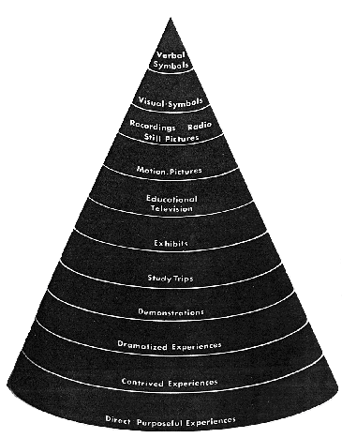
Cone of Learning: A Perpetuated Myth?
There is a popular misperception which has been perpetuated over time and transformed into generally accepted information on how individuals “remember”. One such “myth” used to account for the variability in learning and erroneously used to predict retention is Edgar Dale’s Cone of Experience, which recently has been “debunked”*.
This is Dale’s original Cone of Experience, which is a “visual metaphor” depicting types of learning, from the concrete to the abstract. Dale did not intend to place value on one modality over another:“The shape of the cone is not related to retention, but rather to the degree of abstraction.”
So it went from this metaphor, to the perceived fact (perpetual myth) depicted on next page
*Sources:
https://elearningindustry.com/cone-of-experience-what-really-is
http://www2.potsdam.edu/betrusak/AECT2002/dalescone_files/dalescone.html.ppt;
http://www.cisco.com/web/strategy/docs/education/Multimodal-Learning-Through-Media.pdf
Home (Menu) Science of Learning Forgetting Curve Learning Styles Cone of Learning Brain Research Discoveries

Slide 40
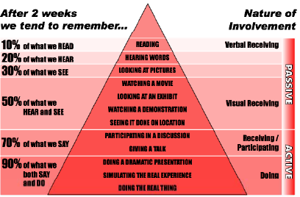
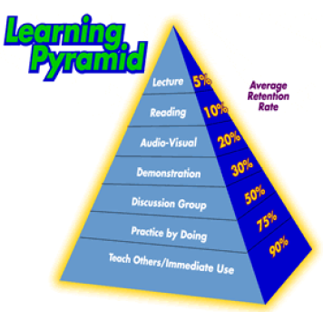
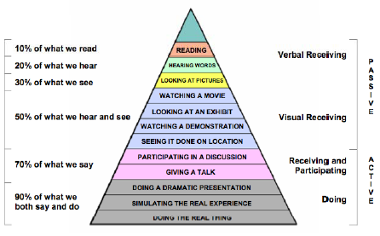
Home (Menu) Science of Learning Forgetting Curve Learning Styles Cone of Learning Brain Research Discoveries

Slide 41
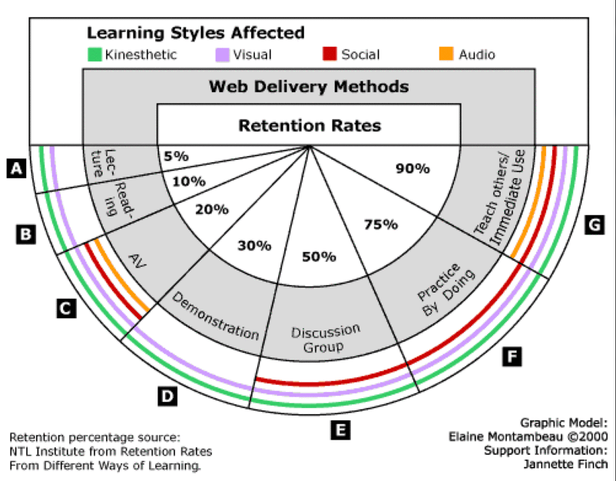
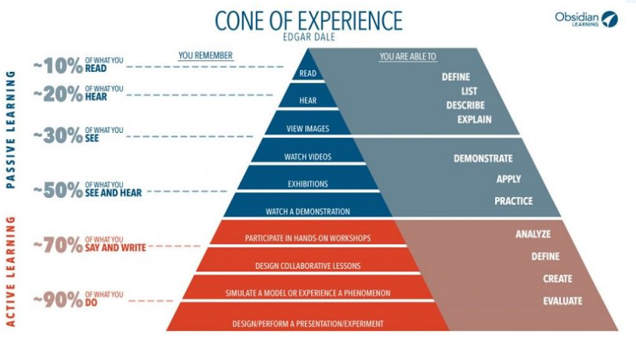
And Subsequently Morphed Into This
The percentages have been passed around in our field from reputable person to reputable person, but there is no credible data or research to support them.
Home (Menu) Science of Learning Forgetting Curve Learning Styles Cone of Learning Brain Research Discoveries

Slide 42
Cognitive Theory of Multimedia Learning
Studies have shown that how information is presented determines the retention level of the information.
Cognitive science has revealed learners differ in their abilities with different modalities, but teaching to a learner’s best modality doesn't affect learning outcomes.
What does matter is whether the learner is taught in the content's best modality…people learn more when content drives the choice of modality. Meaningful learning occurs when the learner appropriately engages in all of these processes.
Cognitive Theory of Multimedia Learning*
* Clark & Mayer, 2016, E-Learing and the Science of Instruction, 4th Ed.
Home (Menu) Science of Learning Forgetting Curve Learning Styles Cone of Learning Brain Research Discoveries

Slide 43
Brain Research Discoveries*
* Source: http://info.shiftelearning.com/blog/bid/324035/8-Brain-Research-Discoveries-Every-Instructional-Designer-Should-Know-About?utm_source=linkedin&utm_medium=social&utm_content=2617406
Home (Menu) Science of Learning Forgetting Curve Learning Styles Cone of Learning Brain Research Discoveries

Slide 44
Brain Research Discoveries*
The brain is plastic. The brain is constantly changing, a concept referred to as neuroplasticity. Neuroplasticity means the brain can be improved and continues to adapt and learn through life, even after middle age and during old age. This also means that the brain can learn better, that the human potential for learning is limitless (Norman Doidge, 2007, The Brain That Changes Itself, Random House).
2. The brain responds to reward due to several factors. Recent discoveries by neuroscientists reveals rewards is influenced by many factors, and among them are context and individual differences. In the context of reinforcement learning, the individual learner’s reward system responds to prediction error, which is the difference between the result an individual expects from his or her action and the outcome he or she actually gets (Garrison, J., Erdeniz, B., & Done, J., 2013. Prediction error in reinforcement learning: A meta-analysis of neuroimaging studies. Neuroscience & Biobehavioral Reviews, Volume 37, Issue 7, pp. 1297–1310).
* Source: http://info.shiftelearning.com/blog/bid/324035/8-Brain-Research-Discoveries-Every-Instructional-Designer-Should-Know-About?utm_source=linkedin&utm_medium=social&utm_content=2617406
Home (Menu) Science of Learning Forgetting Curve Learning Styles Cone of Learning Brain Research Discoveries

Slide 45
Brain Research Discoveries
3. The adult brain CAN grow new cells. Recent studies have revealed the brain does grow new cells in the hippocampus, and these new cells take on functional roles and interact with existing cells.
Learners use most areas of the brain. This runs contrary to the myth that individuals are using only 5 to 10 percent of their brain. There’s no proof of this. Neuroscientists and neurologists have already presented evidence that refute this “10 percent” myth (Do People Only Use 10 Percent Of Their Brains? Scientific American, 2008, retrieved from http://www.scientificamerican.com/article.cfm?id=people-only-use-10-percent-of-brain).
5. Cells that fire together, wire together. In other words, the “use-it-or-lose-it” phenomenon, or simply put, if you want to retain new information, you have to use it constantly or else lose it. When you stop practicing a new skill or a new language, for instance, your brain will eventually prune or eliminate certain pathways. You’ll eventually lose a new skill unless you keep on practicing (Retrieval-Based Learning: Active Retrieval Promotes Meaningful Learning: http://learninglab.psych.purdue.edu/downloads/2012_Karpicke_CDPS.pdf )
Home (Menu) Science of Learning Forgetting Curve Learning Styles Cone of Learning Brain Research Discoveries

Slide 46
Brain Research Discoveries
No one is neither right-brained nor left-brained. While it’s true that some brain functions occur on either part of the brain, researchers have confirmed that personality traits have nothing to do with which side of their brain learners use more (Nielsen, J.A., Zielinski, B.A., Ferguson, M.A., Lainhart, J.E., & Anderson, J.S., 2013, An Evaluation of the Left-Brain vs. Right-Brain Hypothesis with Resting State Functional Connectivity Magnetic Resonance Imaging, retrieved from http://www.plosone.org/article/info%3Adoi%2F10.1371%2Fjournal.pone.0071275)
7. The human brain CAN'T multitask. The human brain, cannot focus on all these tasks at once. Multitasking simply splits the brain by frantically switching from one task to another. This results in significant inefficiency in filtering irrelevant information and simply doesn’t work (Ophira E., Nass, C., & Wagnerc, A.D., 2009. Cognitive control in media multitaskers, retrieved from http://www.pnas.org/content/106/37/15583.full.pdf+html?sid=7f096f1f-ca07-41d4-b7b6-9f7f7e9890c3)
Home (Menu) Science of Learning Forgetting Curve Learning Styles Cone of Learning Brain Research Discoveries

Slide 47
Brain Research Discoveries
8. Your brain works a lot like the Internet. A recent study which exposes the basic principles of brain function. Researchers studied brain activity using a functional magnetic resonance imaging (fMRI) and found that the brain works like a complex interacting network, like the Internet. It depends on nodes to efficiently pass on information from place to place. This runs counter to the neurological assumption that the brain works in a hierarchical order (Feldman, J., Lee, D., &Thaw, D., 2012, Computer, Neural, and Social Networks , retrieved from http://www.stanford.edu/class/ee380/Abstracts/070418-Feldman-Lee-Thaw-EE380.pdf).
Home (Menu) Science of Learning Forgetting Curve Learning Styles Cone of Learning Brain Research Discoveries

Slide 48
What Do the Experts Say?
Foremost ISD text: The Systematic Design of Instruction (Walter Dick, Lou Carey, & James Carey, 2009)--Learning styles are personal “preferences” rather than “psycho-logical traits” and cannot predict “how a student will learn best.”
Popular ISD text: Instructional Design (Smith & Ragan, 2005)--“View learning styles with extreme caution…not sufficiently prescriptive to aid instructional designers in making design decisions.”
Foremost text on multimedia design for e-learning: e-Learning and the Science of Instruction (Ruth Clark & Richard Mayer, 2011)--“There is little evidence to support most learning styles.”
Leading text on cognitive science: Learning Theories (Dale Schunk, 2004)--Differentiates between learning styles and learning modalities, where [VAK] learning styles are essentially “modalities.”
Return to Research Slide

Slide 49
What Do the Experts Say?
Dr. Richard Clark: (Professor of Educational Psychology and Technology Director, Center for Cognitive Technology, Univ. of Southern California): Learning styles do not predict learning under different instructional conditions. There are no "visual" or "verbal" learners, etc.
Dr. Allison Rossett (Professor, Educational Technology, San Diego State Univ.): Why have generations of educators glommed on to learning styles when the research is settled or pretty darn so?
Dr. Sigmund Tobias (Eminent Research Professor): The persistence of the learning style concept is amazing—a testament to the gullibility of even well-informed individuals who ought to know better. It seems that advocates of learning styles have never heard of the history of ATI research.
Dr. Harold Stolovitch (noted author on Instructional Systems Design): More than 25 years of research on this and related themes have not provided any form of conclusive evidence that matching the form of instruction to learning style improved learning or even attention.
Return to Research Slide

Slide 50
What Do the Experts Say?
Dr. Ruth Clark (noted author on educational psychology): “The learning style myth leads to some very unproductive training approaches that are counter to modern evidence of what works…the time and energy spent perpetuating the various learning style myths can be more wisely invested in supporting individual differences that are proven to make a difference—namely, prior knowledge of the learner.”
Dr. Howard Gardner (noted cognitive psychologist and author of Frames of Mind: The Theory of Multiple Intelligences): Sometimes people speak about a “visual” learner or an “auditory” learner. The implication is that some people learn through their eyes, others through their ears. This notion is incoherent. Both spatial information and reading occur with the eyes, but they make use of entirely different cognitive faculties
Return to Research Slide

Slide 51
What are Aptitude Treatment Interactions?
Any discussion concerning individual differences in learning cannot be complete without addressing the research on aptitude treatment interaction (ATI).
ATI is the concept that some instructional strategies (treatments) are more or less effective for particular individuals depending upon their specific abilities.
As a theoretical framework, ATI suggests optimal learning results when the instruction is exactly matched to the aptitudes of the learner.
The goal of ATI research is to predict educational outcomes from combinations of aptitudes and treatments.
Return to ATI Slide

Slide 52
What are Aptitude Treatment Interactions?
The lack of attention to the social aspects of learning is a serious deficiency of ATI research.
Design treatments should not focus on the individual but groups of students with particular aptitude patterns.
An understanding of cognitive abilities alone would not be sufficient to explain individual differences in learning when incorporating aptitude treatment interactions.
Critics argued that student performance was too dynamic to be supported by the permanence and pervasiveness of primarily cognitive ATI .
“Although the presumption of matching instructional strategies to individual modality preferences to enhance learning has great intuitive appeal, little empirical support for this proposition was found from the quantitative synthesis of the extant research. Neither modality testing nor modality teaching were shown to be efficacious”. (Kavale & Forness, 1987, p. 237)
Return to ATI Slide

Slide 53
What are Aptitude Treatment Interactions?
Background: Beginning in the early 60’s, Lee Cronbach and Richard Snow searched “fruitlessly for interactions of abilities” by looking for aptitudes (characteristics that affects responses to the treatment) that explained how to instruct students one way and not another, i.e., evidence that showed regression slopes that differed from treatment to treatment.
Continuing through the 70’s and mid 80’s, Cronbach and Snow continued their research by advocating a closer scrutiny of cognitive processes by focusing on Aptitude Treatment Interactions (Learning Orientation Research, 2004).
Return to ATI Slide

Slide 54
What are Aptitude Treatment Interactions?
Findings: Cronbach’s (1975) research emphasized the important relationship between cognitive aptitudes and treatment interactions. However, he was continually thwarted by inconsistent findings coming from roughly similar inquiries. Successive studies employing the same treatment variable found different outcome-on-aptitude slopes.
Cronbach concluded the inconsistency came from unidentified interactions and that "an understanding of cognitive abilities considered alone would not be sufficient to explain learning, individual differences in learning, and aptitude treatment interactions (Learning Orientation Research, 2004).
Return to ATI Slide

Slide 55
What are Aptitude Treatment Interactions?
Findings (con’t): In the early eighties, the cognitive process analysis of aptitudes processes continued with variations focusing on individual differences in learning and cognition (Snow, 1980).
Although Cronbach and Snow (1977) were looking for a "whole-person view" of learning, they believed it was primarily the cognitive processes that should be considered in the design and development of adaptive instructional systems.
Eventually the new aptitudes evolved into cognitive styles to represent the predominant modes of information processing, although can very within individuals as a function of task and situation variables (Snow, 1980).
Return to ATI Slide

Slide 56
What are Aptitude Treatment Interactions?
Conclusion: ATI critics argued that student performance was too dynamic to be supported by the permanence and pervasiveness of primarily cognitive ATI and that students, e.g., without learner control, would become system dependent on prescribed solutions.
However, based upon Cronbach and Snow’s pioneering research, they concluded that ultimately design treatments should not focus on the individual but groups of students with particular aptitude patterns.
Return to ATI Slide

Slide 57
Visualizer-Verbalizer Neuroscience Research Study*
A University of Pennsylvania psychology study, using functional magnetic resonance imaging (fMRI) technology to scan the brain, revealed that people who consider themselves visual learners, as opposed to verbal learners, have a tendency to convert linguistically presented information into a visual mental representation.
The more strongly an individual identified with the visual cognitive style, the more that individual activated the visual cortex when reading words.
However, those participants who considered themselves verbal learners were found under fMRI to have brain activity in a region associated with phonological cognition when faced with a picture, suggesting they have a tendency to convert pictorial information into linguistic representations.
Results of the study demonstrated a pattern of activity in modality-specific areas of the brain that distinguished visual from verbal cognitive styles.
During word-based tasks, activity in a functionally defined brain region that responded to viewing pictorial stimuli correlated with self-reported visualizer ratings on the VVQ test.
* University of Pennsylvania. Visual Learners Convert Words To Pictures In The Brain And Vice Versa, Says Psychology Study. ScienceDaily. ScienceDaily, 28 March 2009. www.sciencedaily.com/releases/2009/03/090325091834.htm
Return to main presentation

Slide 58
Cognitive Load Theory
Cognitive Load Theory focuses on the role of working memory when designing for multimedia.
Meaningful learning depends on active cognitive processing in learner’s working memory.
If learners encounter too many elements in the presentation of multimedia information (animation, graphics, sound, text), working memory can be overwhelmed which impedes learning, but can be overcome by…
Modality effect. Providing the text is short and easily held in working memory, it should be spoken rather than written. Auditory and visual working memories are partially separate and so using both channels can increase working memory capacity and facilitate learning.
Redundancy effect. The split-attention and modality effects require two or more sources of information that are unintelligible in isolation. If written or diagrammatic information is just a repetition of spoken information it is redundant and one form should be eliminated. Do not include text that just repeats the information contained in a diagram.
Click to return to main discussion screen

Slide 59
Cognitive Load Theory
Cognitive Load Theory proposes three types of cognitive load:
Intrinsic - This is the level of complexity inherent in the material being studied. There isn’t much that we can do about intrinsic cognitive load; some tasks are more complex than others so will have different levels of intrinsic cognitive load.
Extraneous - This is cognitive load imposed by non-relevant elements that require extra mental processing e.g. decorative pictures, animations etc., This form of cognitive load is generated by the manner in which information is presented to learners. Each of the cognitive loads are additive, and instructional design’s goal should be to reduce extraneous cognitive load to free up working memory.
Germane - Germane load are elements that allow cognitive resources to be put towards learning i.e. assist with information processing. Instructional designers can manipulate extraneous and germane load by limiting extraneous load and promoting germane load. Specifically, to facilitate the transfer of information from working memory to long-term memory, the information should be presented in such a way that it reduces extraneous cognitive load (non-relevant items) and increases germane cognitive load (items that assist with information processing.
Click to return to main discussion screen

Slide 60
Factors Affecting the Variability in Learning
}
Prior knowledge and skills
Motivation
Pacing
Time on task
Sequential learning
Cognitive load (working memory capacity)
Cognitive abilities
Personality traits
Interests
Exploratory behavior
Impulsivity
Accounts for ~70% of the variability in learning… limited control over these variables
}
Have some control over these variables as they pertain to the design of content
}
Have little control over these variables
Click to return to prior slide

Slide 61
Declarative Memory
Declarative memory (“knowing what and why”) is memory of facts and events, and refers to those memories that can be consciously recalled (or "declared").
Declarative learning is committed to memory in such a way that it can be
recalled when it is needed.
It is sometimes called explicit memory, since it consists of information that is explicitly stored and retrieved, although it is more properly a subset of explicit memory.
Declarative memory can be further sub-divided into episodic memory (events) and semantic memory (facts).
Click to return to prior slide

Slide 62
Episodic & Semantic Memory
Episodic memory represents our memory of experiences and specific events in time from which we can reconstruct the actual events that took place at any given point in a person’s life.
It is the memory of autobiographical events that can be explicitly stated.
Semantic memory, on the other hand, is a more structured memory of facts, meanings, concepts and knowledge about the external world that we have acquired, and easy to forget
Semantic memories stand alone as simple knowledge, per se, it includes such things as types of food, capital cities, social customs, functions of objects, vocabulary, understanding of mathematics, etc.
Much of semantic memory is abstract and relational and is associated with the meaning of verbal symbols.
Click to return to prior slide

Slide 63
Procedural Memory
Procedural memory (“knowing when, where, and how”) is the unconscious memory of skills and how to do things, particularly the use of objects or movements of the body, such as tying a shoelace, playing a guitar or riding a bike.
These memories are typically acquired through repetition and practice, and composed of automatic sensor motor behaviors so deeply embedded that we are no longer aware of them.
Once learned, these "body memories" allow us to carry out ordinary motor actions more or less automatically, e.g., tying one’s shoe laces.
Procedural knowledge is intended to be practiced until it automates and can be implemented without taking up space in working memory.
Procedural memory is sometimes referred to as implicit memory or unconscious memories that we use without realizing it, i.e., performance of a task without explicit and conscious awareness of previous experiences.
Click to return to prior slide

Slide 64
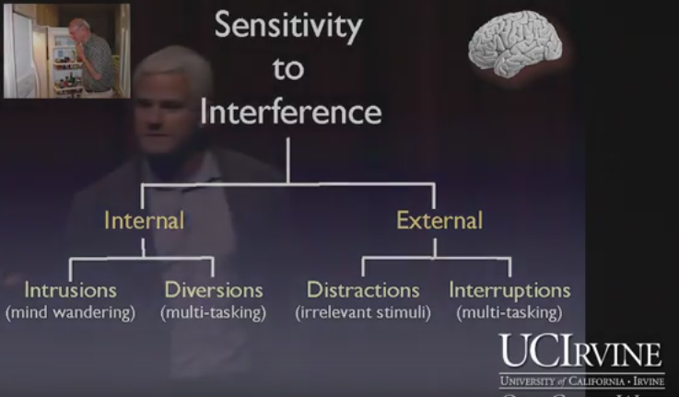
The Distracted Brain
Sensitivity to Interference (aka the “senior moment”)
Our brains, despite remarkable capabilities, have distinct limitations (Source: https://www.youtube.com/watch?v=7Wg0ho9UELY)
Click to return to prior slide
Selective Awareness Test: https://youtu.be/IGQmdoK_ZfY

Slide 65
Selective Attention
Selective attention refers to the learner's ability to select and process certain information while simultaneously ignoring other information. Several factors influence attention:
The meaning that the task or information holds for the individual
Similarity between competing tasks or sources of information
Task complexity or difficulty (influenced also by prior knowledge)
Ability to control attention (which differs with age, hyperactivity, intelligence, and learning disabilities)
Click to return to prior slide

Slide 66
Dual Coding Theory
Dual coding theory attempts to give equal weight to verbal and non-verbal processing in that cognition is unique and has become specialized for dealing simultaneously with language and with nonverbal objects and events.
The theory assumes there are two cognitive subsystems, one specialized for the representation and processing of nonverbal objects/events (i.e., imagery), and the other specialized for dealing with language.
Adds context to the written/spoken word.
Retention is improved through words and pictures (visual media) rather than through words alone.
Click to return to prior slide

