Slide 1


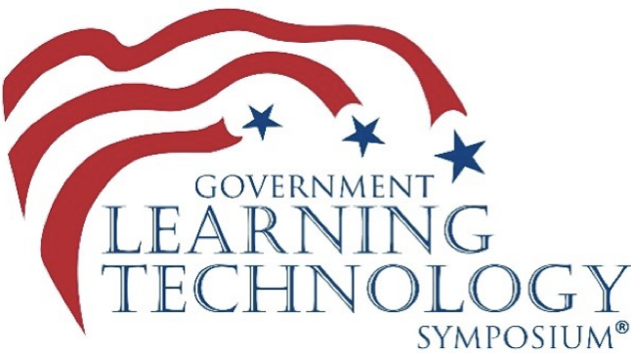
1
FGDLA Awards, December 4, 2024
FGDLA.US

Slide 2
Today’s Agenda
4
  Federal Government Distance
  Learning Association
  29th Annual Awards Presentation
  2024
  Dr. Carla Lane
  Russ Colbert
  Dr. Erika Jacobs

Slide 3
Upcoming Events
2
12/11/24 Enhancing Mission Quality Training:
  The Impact of Learn to Win’s Mobile-First Training Platform in the DoD
  1/15/25 VR: Instructional Design, Part 1
  2/19/25 VR: Production, Part 2
  3/19/25 FGDLA Annual Membership Meeting
  4/16/25 Instructional Design Using
  Direct Explicit Instruction

Slide 4

Sponsors
3

Slide 5



Welcome to the FGDLA
Federal Government Distance Learning Association
2024 Annual Awards
Virtual Ceremony
Celebrating the FGDLA’s 29th anniversary
recognizing excellence in distance learning

Slide 6
Welcome to the FGDLA
Federal Government Distance Learning Association
Please accept the award. Take yourself off mute by clicking on the microphone icon on the lower left side of the Zoom page.
Please, take photos and videos of awardees during their presentation and send to Kris Ptak.
kptak@FGDLA.us

Slide 7
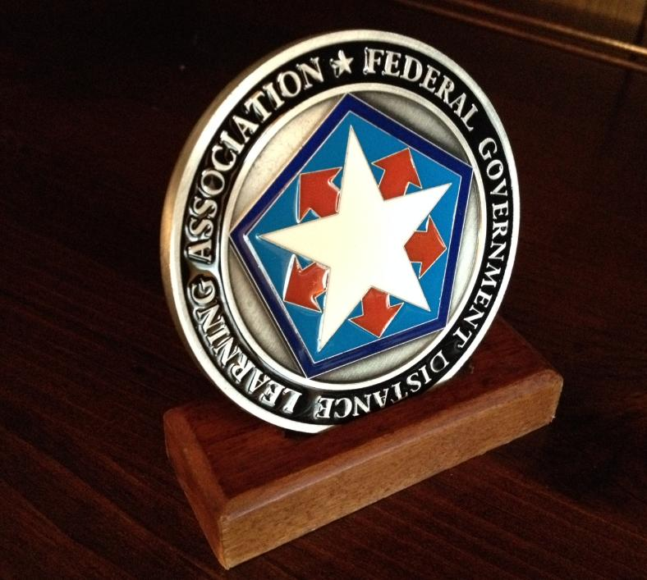
FGDLA 2024
Awards Ceremony
Organizational Awards

Slide 8

FGDLA 2024
Awards Ceremony
Innovation Award
The innovation award is in recognition of an organization for demonstrating excellence in the innovative use of technology in the development and delivery of distance learning in the Federal Government
Notes:
The innovation award is in recognition of an organization for demonstrating excellence in the innovative use of technology in the development and delivery of distance learning in the Federal Government

Slide 9

Innovation Award Winner
Defense Counterintelligence and Security Agency,
Center for the Development of Security Excellence
Notes:
The Federal Government Distance Learning Association is pleased to announce the presentation of the Innovation Award to the Center for Development of Security Excellence. The Innovation award recognizes an organization for their development and application of emerging distance learning technologies that support the Federal Government.
The Center for Development of Security Excellence (CDSE) within the Department of Defense (DoD) Defense Counterintelligence and Security Agency (DCSA) provides security training in support of 4 million DoD military and civilian workforce members to ensure consistent, standardized annual compliance training. However, there is no centralized mechanism within DOD for delivering mandatory compliance training and tracking and storing completion data. To that end, the CDSE has developed a solution that allows for centralized production and maintenance of courseware while providing decentralized administration of completion tracking at the level of the DoD enterprise through a unique Learning Management System.
On behalf of the membership and Board of Directors of the FGDLA, I would like to personally extend my heartfelt appreciation and congratulations on being chosen as the recipient of the Innovation Award.
This unwavering commitment to excellence, innovation, and collaborative effort deserves this recognition.

Slide 10



Innovation Award Winner
Training & Evaluation Branch
FAA Academy
Federal Aviation Administration
U.S. Department of Transportation
Notes:
The Federal Government Distance Learning Association is pleased to announce the presentation of the Innovation Award to the Homerun Team, Training & Evaluation Branch of the FAA Academy. The Innovation award recognizes an organization for their development and application of emerging distance learning technologies that support the Federal Government.
When the FAA Academy leadership recognized a recurring concern with its instructors showing a deficiency in their skill and ability to manage disruptive behaviors in the classroom, the Homerun Team, spearheaded by Instructional Systems Specialists’ Dawn Sprague and Kristy Fair, took the lead on this project and developed innovative multimedia techniques that supplemented the Train-the-Trainer courses delivered at the FAA Academy. Specifically, the Homerun Team developed a workflow, script, and ultimately microlearning videos used by the FAA Academy training staff at the branch, division, and off-station field training organization levels to supplement the Train-the-Trainer courses delivered at the FAA Academy.
Their enthusiastic support of distance learning in the federal government exemplifies the spirit of the Federal Government Distance Learning Association. This unwavering commitment to excellence, innovation, and collaborative effort deserves this recognition.
On behalf of the membership and Board of Directors of the FGDLA, I would like to personally extend my heartfelt appreciation and congratulations on being chosen as the recipient of the Innovation Award.

Slide 11


Innovation Award Winner
Pacific West Region Office of Fire and Aviation Management,
National Park Service
Notes:
The Federal Government Distance Learning Association is pleased to announce the presentation of the Innovation Award to the Pacific West Region Office of Fire and Aviation Management, National Park Service
The Innovation award recognizes an organization for their development and application of emerging distance learning technologies that support the Federal Government.
Due to budget and travel constraints, the number of available, trained Resource Advisors (READs) was severely limited. By integrating distance learning technologies, the Pacific West Region Office of Fire and Aviation Management increased the number of qualified READs through the deployment of this course. This was accomplished by twenty-four member team undertook that resulting in an entire course that included over 20 hours of asynchronous video created in less than three months.
The impact of this achievement extends beyond the confines of this project. This unwavering commitment to excellence, innovation, and collaborative effort deserves this recognition.
On behalf of the membership and Board of Directors of the FGDLA, I would like to personally extend my heartfelt appreciation and congratulations on being chosen as the recipient of the Innovation Award.

Slide 12

FGDLA 2024
Awards Ceremony
Five-Star Award
The five-star award is in recognition of an organization for demonstrating excellence in providing enterprise-wide distance learning solutions for the Federal Government
Notes:
The five-star award is in recognition of an organization for demonstrating excellence in providing enterprise-wide distance learning solutions for the Federal Government

Slide 13


Five-Star Award Winner
Interagency Security Committee
U.S. Department of Homeland Security
Notes:
The Federal Government Distance Learning Association is pleased to announce the presentation of the Five Star Award to the Interagency Security Committee, Cybersecurity and Infrastructure Security Agency, Department of Homeland Security.
The Five Star award recognizes a Federal Government organization for their leadership and best practices in the development and application of proven distance learning technologies supporting the Federal Government. This is evidenced by the Interagency Security Committee’s continued use of virtual instructor-led training in leveling technology to deliver a hybrid live, interactive session remotely. The virtual instructor-led training (VILT) option leverages technology to deliver a hybrid live, interactive session remotely. Participants can join from anywhere, eliminating geographical barriers. This delivery method enables real-time engagement, discussions, and collaborative exercises through a video conferencing platform. The demand for VILT increased by 34% from the previous fiscal year.
The Interagency Security Committee’s continued efforts and enthusiastic support of distance learning in the federal government exemplify the spirit of the Federal Government Distance Learning Association.
On behalf of the membership and Board of Directors of the FGDLA, I would like to personally extend my heartfelt appreciation and congratulations on being chosen as the recipient of the Five-Star Award.

Slide 14

Five-Star Award Winner
National Training Delivery Team
Workforce Development Training & Education
U.S Forest Service
Notes:
The Federal Government Distance Learning Association is pleased to announce the presentation of the Five Star Award to the National Training Delivery Team, Workforce Development Training and Education, U.S. Forest Service The Five Star award recognizes a Federal Government organization for their leadership and best practices in the development and application of proven distance learning technologies supporting the Federal Government.
National Incident Management System (NIMS) training is critical in preparing our nation’s wildland fire workforce to respond to wildland fire and all hazard incidents. In the past, organizations have relied on traditional “bricks and mortar” classroom instruction to deliver two key NIMS courses.
To that end, the National Training Delivery Team adapted the delivery method of these two courses to a combination of proven asynchronous and synchronous distance learning technologies. This effort resulted in 642 students taking this course that significantly reduced the existing training backlog. Their efforts directly contributed to additional personnel and teams being available to assigned to wildland fire incidents. It enabled hundreds of personnel to become qualified in preparation for what proved to be a year when national wildland fire resources were stretched and heavily committed across multiple geographic areas.
The National Training Delivery Team’s s continued and enthusiastic support of distance learning in the federal government exemplify the spirit of the Federal Government Distance Learning Association.
On behalf of the membership and Board of Directors of the FGDLA, I would like to personally extend my heartfelt appreciation and congratulations on being chosen as the recipient of the Five-Star Award.

Slide 15

FGDLA 2024
Awards Ceremony
Welcome to the FGDLA
Federal Government Distance Learning Association
Pillar Award
In recognition of an organization not affiliated with the Federal Government for their outstanding service and/or significant contribution to the Association
Notes:
In recognition of an organization not affiliated with the Federal Government for their outstanding service and/or significant contribution to the Association

Slide 16


Wyatt Scharf
Zoom for Government CSM Manager
Pillar Award Winner
Wyatt Scharf
ZOOM for Government Manager
Notes:
The Zoom Customer Success Team is assigned to US Federal Government Departments and Agencies to ensure efficient implementation, high utilization, best practice, increased security and return upon investment. The Team meets regularly with customers and individuals to provide training, guidance, encouragement and answer any questions. During 2024 the CSM Team has empowered customers to conduct hundreds of effective virtual and learning events. Consequently, this service and support to the Federal Government is of great value and exemplary leadership.
Congratulations to the Zoom Customer Success Team for their continued support of the FGDLA and their members.

Slide 17
FGDLA 2023
Awards Ceremony
Individual Awards

Slide 18

FGDLA 2024
Awards Ceremony
Pioneer Award
The pioneer award is in recognition of an individual for demonstrating initiative and leadership in the development and implementation of distance learning in the Federal Government
Notes:
The pioneer award is in recognition of an individual for demonstrating initiative and leadership in the development and implementation of distance learning in the Federal Government

Slide 19
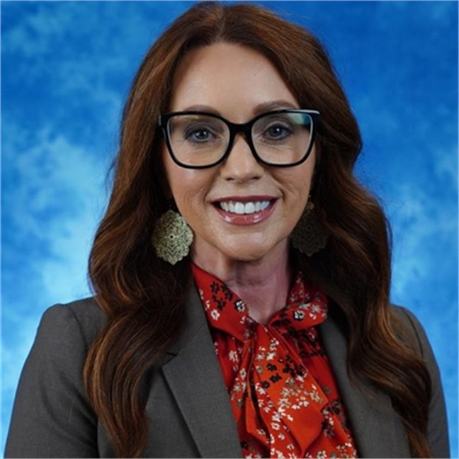

Pioneer Award Winner
Michelle Finney
Supervisor, Human Resources Development
Western States Network Consortium
U.S. Department of Veterans Affairs
Notes:
The VA Western States Network Consortium (WSNC) has demonstrated outstanding achievement in implementing an innovative Learning Management System (LMS). By transitioning numerous in-person courses to an online format, WSNC has significantly enhanced training accessibility and efficiency for its healthcare staff. This transformation not only streamlined the educational process but also ensured continuous professional development despite geographical and logistical challenges.
On behalf of the membership and Board of Directors of the FGDLA, congratulations on being presented with the Pioneer Award

Slide 20
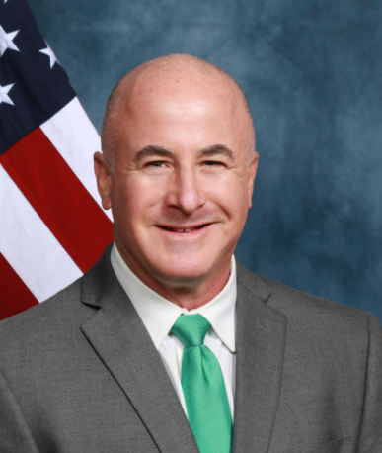
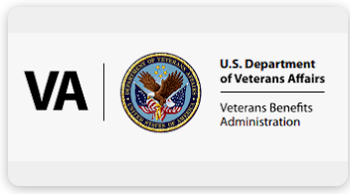
Pioneer Award Winner
Scott Tanner
Instructional Systems Specialist
Veterans Benefits Administration
U.S. Department of Veterans Affairs
Notes:
One of the most critical aspects of developing a training content is to correctly identify the instructional media delivery system. Using VBA’s Media Selection Model, curriculum developers and instructional system designers must include flexible design components to ensure the learning objectives were attained.
That said, while the Media Selection Model was originally built using MS Excel, Scott refined the Media Selection Model to include MS Forms, thereby allowing responses to be sent automatically to team members via power applications.
Through Scott’s innovative restructuring of the Media Selection Model, instructional systems designers and curriculum developers could selectively integrate the four different levels of interactive multimedia instruction. The result increased efficiency and effectiveness of the Media Selection Model in supporting the attainment of the learning outcomes.
On behalf of the membership and Board of Directors of the FGDLA, congratulations on being presented with the Pioneer Award

Slide 21


FGDLA 2024
Awards Ceremony
Hall of Fame Award
The Hall of Fame Award is in recognition of an individual who has made significant contributions in promoting and developing distance learning supporting the Federal Government
Notes:
In recognition of an individual who has, over several years, made significant
contributions in promoting and developing distance learning in the Federal
Government.

Slide 22

Hall of Fame Award Winner
John (Rick) Gividen
Program Manager
Federal Wildfire Workforce Development Program
Office of Wildfire Fire
U.S. Department of the Interior
Notes:
Rick’s career in distance learning began 29 years ago when, at meeting at the Pentagon’s Total Force Distance Learning Action Committee, he presented a strategic plan for implementing an academic component for distance learning in the Army National Guard. Then, U.S. Army Major Gividen, proposed a strategy to develop a regional distance learning network to serve as a prototype for the Army National Guard.
Throughout Rick’s career in the Federal Government, spanning over 25 years in the Department of the Interior, he developed an expertise in learning and knowledge management that lead to the development and implementation of numerous distance learning applications.
Some of his accomplishment were the implementation of an Instructional TV network supporting the National Indian Training Center’s Indian Country.
Rick also lead the development of Interior’s wildland fire distance learning programs supporting the National Park Service and the U.S. Fish and Wildlife Service, and the U.S. Forest Service.
Furthermore, Rick spearheaded the Center’s first web based training course, as well as developing a strategy to implement use of live interactive distance learning for delivery of mandated aviation safety training. Other agencies Rick supported with DL programs were the Bureau of Indian Education, Bureau of Indian Affairs, and Office of the Special Trustee for American Indians.
On behalf of the membership and Board of Directors of the FGDLA, congratulations on your induction into the FGDLA Hall of Fame

Slide 23

FGDLA 2024
Awards Ceremony
Congratulations Award Winners!
Send Photos & Videos
Kris Ptak
kptak@FGDLA.us

Slide 24
5
FGDLA.US

