Slide 1
Assistive technologies (AT) and Distance Learning Alex Koudry
November 29 2017

Slide 2
Alex Koudry, MS, ATP, RET, CPACC
Program Director of the OAS Center for IT Access (CITA) Program

Slide 3
3 Important Terms
Accessibility
Accommodation
Assistive Technology Each is related, yet unique!

Slide 4
Accessibility
“Accessibility to persons with disabilities refers to the design of products, devices, services, or environments for people with disabilities”
Accessibility of Electronic and Information Technology (E&IT) is our focus
There are two kinds of accessibility: Direct access – Built-in Indirect access – Works to with assistive technology to provide access

Slide 5
Assistive Technology
“Any item, piece of equipment, or product system, whether acquired commercially, modified or customized that is used to increase, maintain or improve functional capabilities of individuals with disabilities.”
Tech Act
Assistive Technology is often provided as an accommodation

Slide 6
(Reasonable) Accommodation
“Any change to a job, the work environment, or the way things are usually done that allows an individual with a disability to apply for a job, perform job functions, or enjoy equal access to benefits available to other individuals in the workplace.”
-U.S. Office of Personnel Management
Today we will focus on E&IT accommodations

Slide 7
Screen Readers - An Example Assistive Technology
Screen readers are used by persons who are blind or who have low vision
They intercept text output from the computer and speak that text to the user
I will show you some other examples of assistive technology later in the presentation

Slide 8
Accessibility
Focuses on ensuring the E&IT can be accessed by persons with disabilities
An example would be ensuring that the agency time and attendance system is designed so that persons accommodated with a screen reader can successfully use the system to get paid
Accessible design allows the use of assistive technology

Slide 9
Assistive Technology
An example is screen reading software
Assistive Technology fits between the user and the computer, addresses functional limitations
AT can be focused on: input, output, or Both
More on the technologies soon….

Slide 10
(Reasonable) Accommodation
Focuses on the person, on providing needed technology to allow people to do their jobs
An example would be providing a screen reader to a visually impaired person
Assistive Technology can be provided as an accommodation, but requires accessible E&IT to be useful – required by Section 508

Slide 11
Key Point
Persons accommodated with assistive technology can use accessible software and websites!

Slide 12
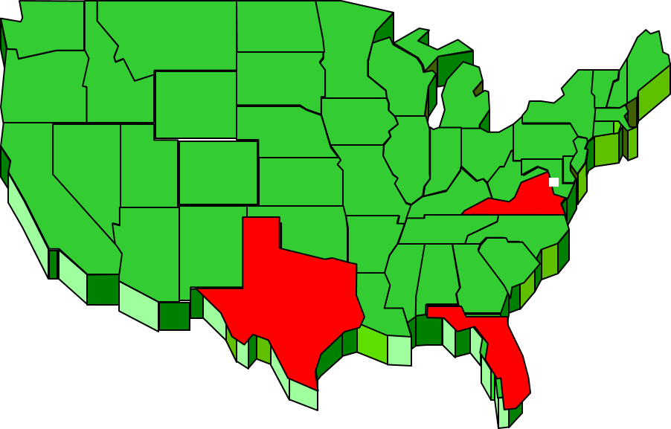
There are 56.7 Million Persons in the USA Who Have Disabilities*
DC 672,228
VA 8,282,993
FL 20,271,272
TX 27,469,114
Total 56,795,607
The Same Population
as All These States!
*https://www.census.gov 2012

Slide 13
Accessibility

Slide 14
The Rehabilitation Act of 1973

Slide 15
Section 504
Section 504 prohibits discrimination based on disability in federally funded and federally conducted programs or activities in the United States

Slide 16
Section 508
Section 508 of the Rehabilitation Act, as amended in 1998, requires that Federal agencies procure E&IT that is accessible to people with disabilities, including employees and members of the public.

Slide 17
508 Coordination
Ensure that all procurements containing EIT related deliverables include applicable Section 508 language
Incorporate Section 508 planning early into your project life cycle

Slide 18
Assistive Technology

Slide 19
Please Note:
The assistive technologies in this presentation are shown only as examples. The General Services Administration does not endorse or recommend products of any kind.

Slide 20
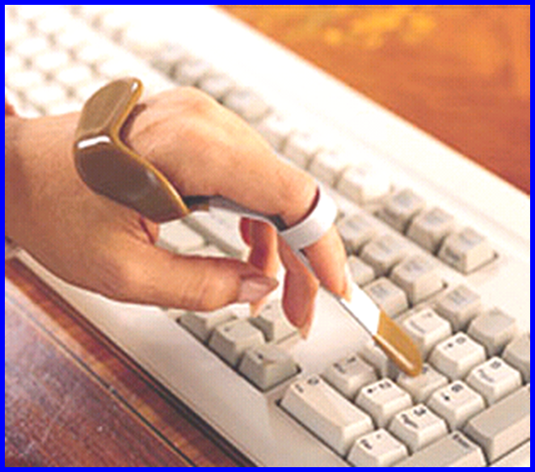
Pointing Stick

Slide 21
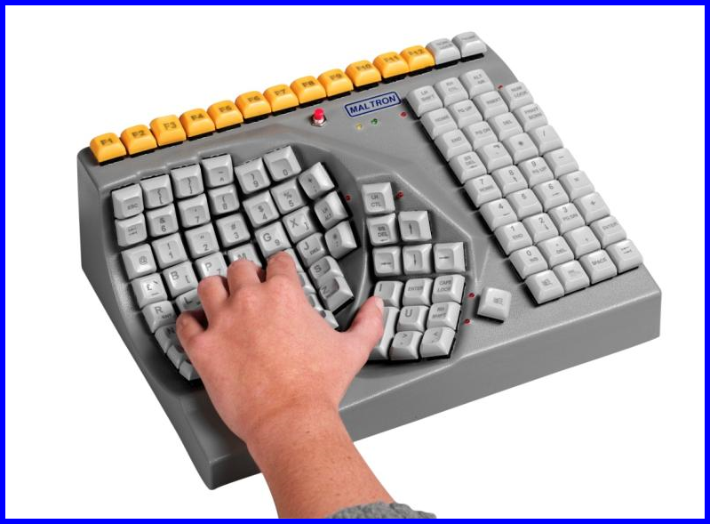
Left-handed keyboard

Slide 22
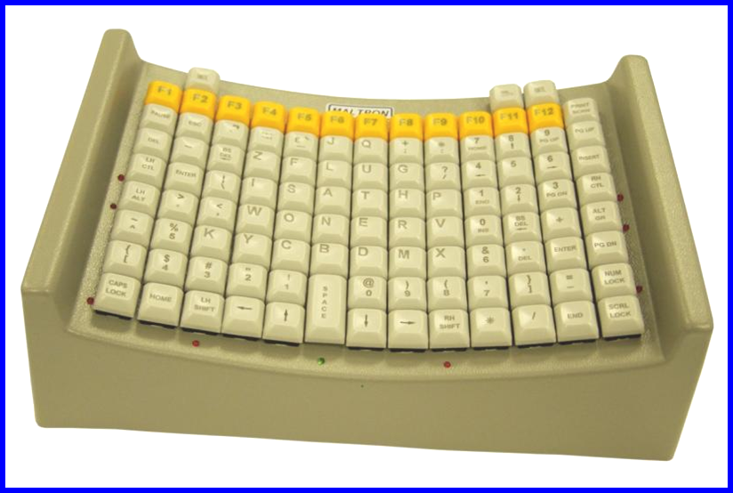
Mouth Stick Keyboard

Slide 23
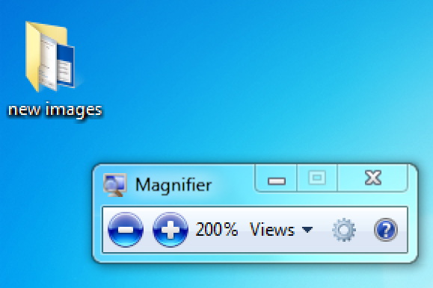
Screen Magnification

Slide 24
Screen Readers
Read the text to user
Also allow navigation
Considerations:
Focus
Content
Navigation
Links

Slide 25
On Screen Keyboard

Slide 26
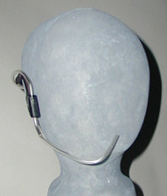
Sip/Puff Switch

Slide 27
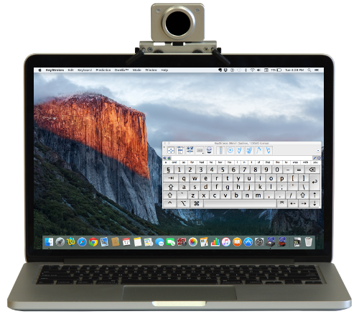
Eye Tracking Device

Slide 28
Voice Recognition
A computer equipped with a microphone and VR software that allows a user to train the computer to recognize words and input them into the computer

Slide 29
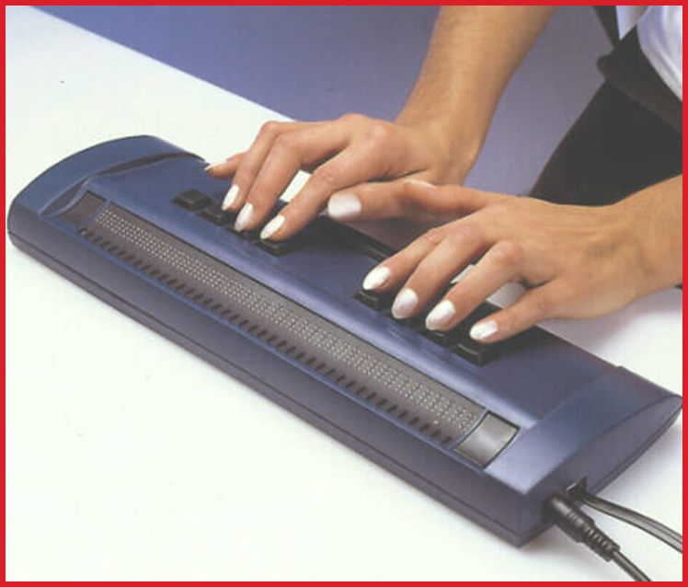
Braille Display

Slide 30
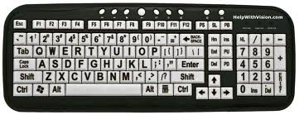
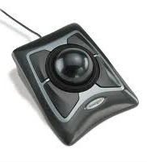
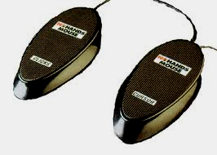
Alternative Input Devices

Slide 31
Other Example Assistive Technologies
Cueing/Memory Aids
Word Prediction Software
Speech Recognition Software

Slide 32
Accommodation

Slide 33
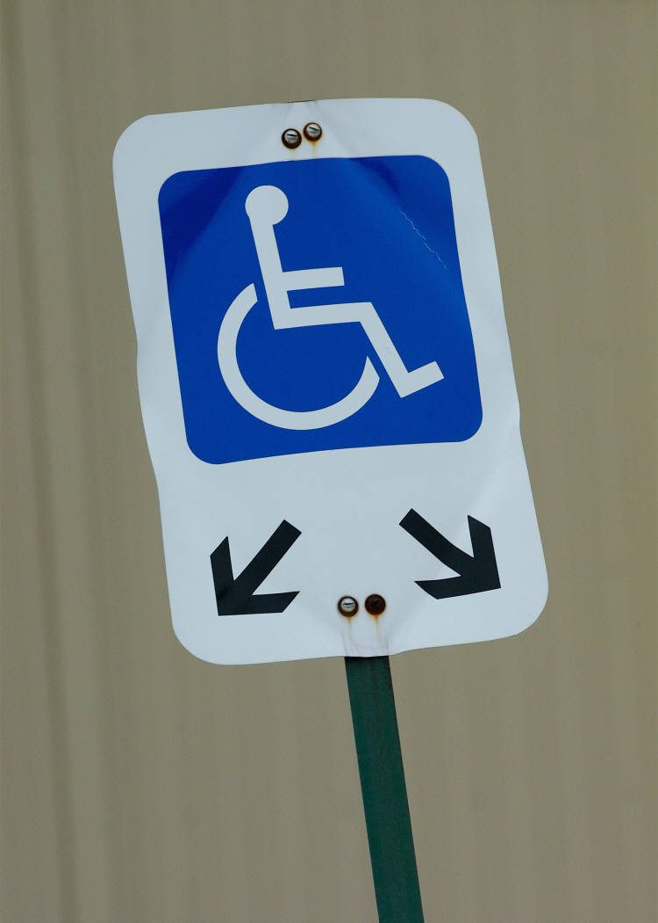
Reasonable Accommodation
What does the law require?
The Rehabilitation Act of 1973, as amended, and the American with Disabilities Act of 1990 (the “ADA”) as amended, requires employers to provide an effective accommodation to qualified individuals with disabilities unless to do so would cause undue hardship

Slide 34
Examples of Reasonable Accommodations
Adding accessibility devices to workplaces
Modifying work schedules, locations
Modifying equipment or devices
Adjusting examinations, training materials, or policies
Providing qualified readers or interpreters
Providing assistive technology

Slide 35
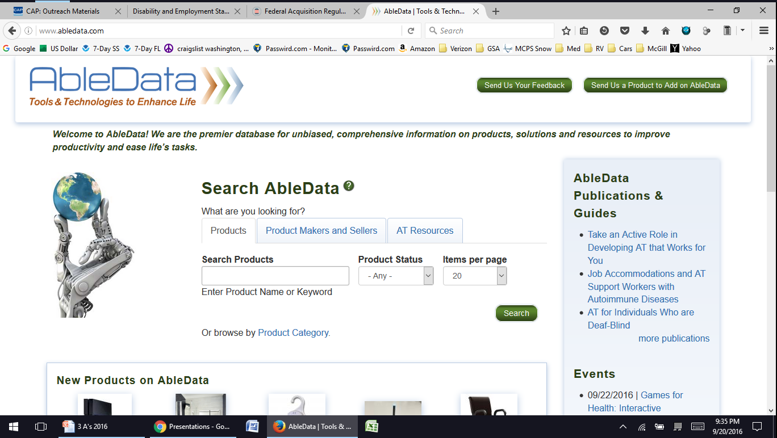
Assistive Technology Resources
www.abledata.com
A free database of tens of thousands of Assistive Technology items
57

Slide 36
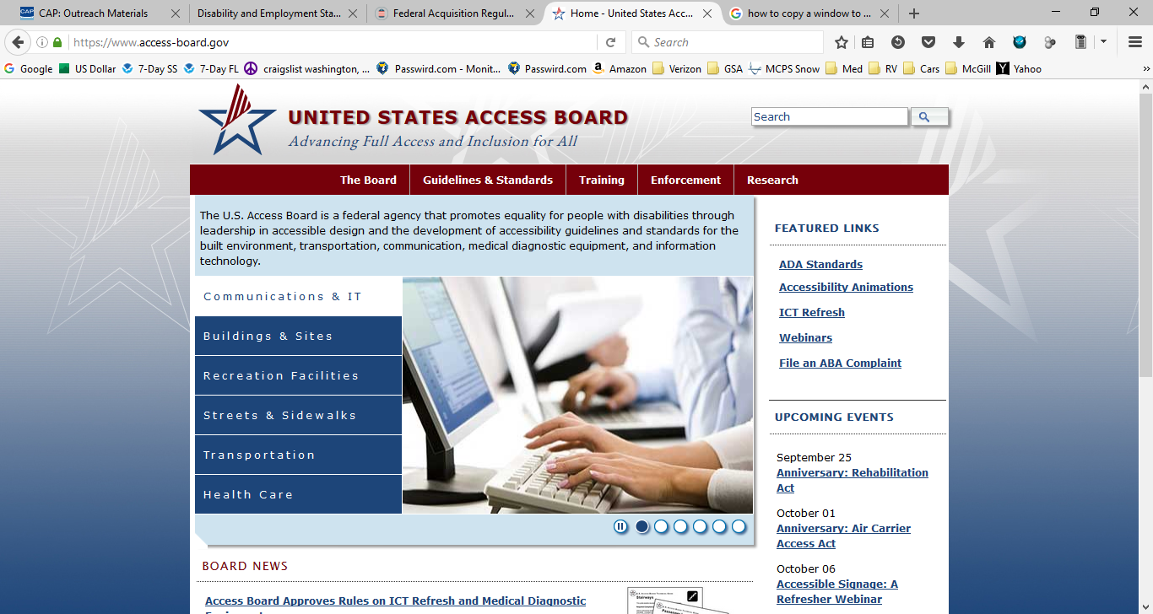
Accessibility Resources
http://www.access-board.gov
58

Slide 37
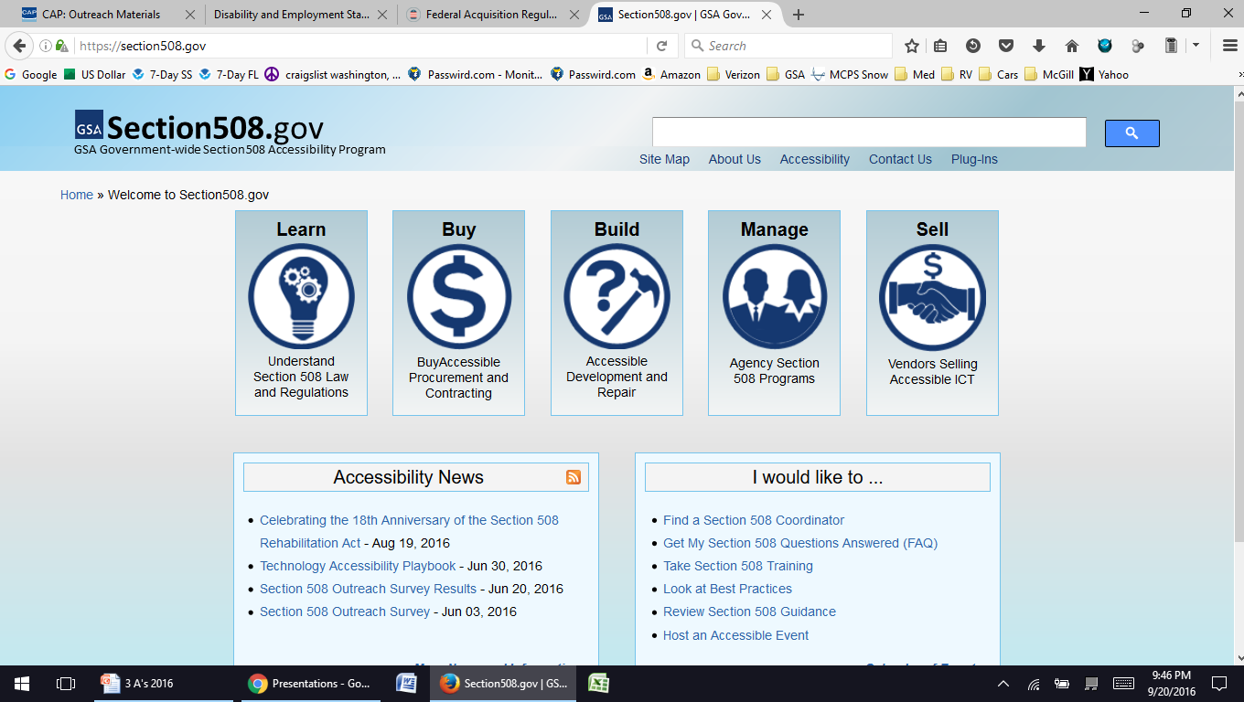
Accessibility Resources
http://www.Section508.gov/
59

Slide 38
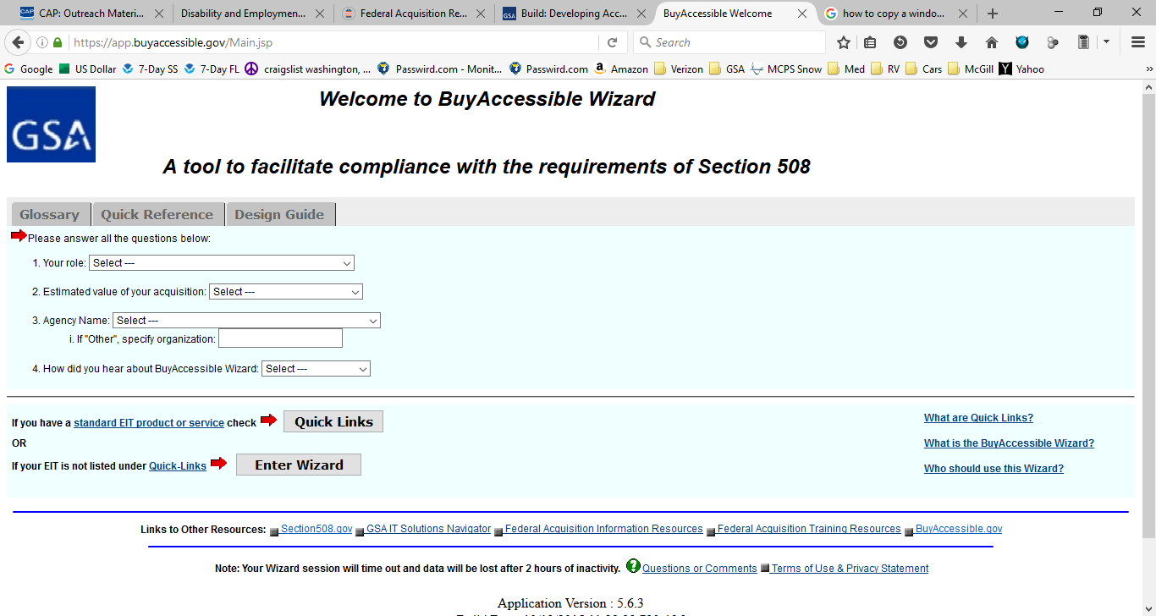
Accessibility Resources (www.508.gov)
https://app.buyaccessible.gov
60

Slide 39
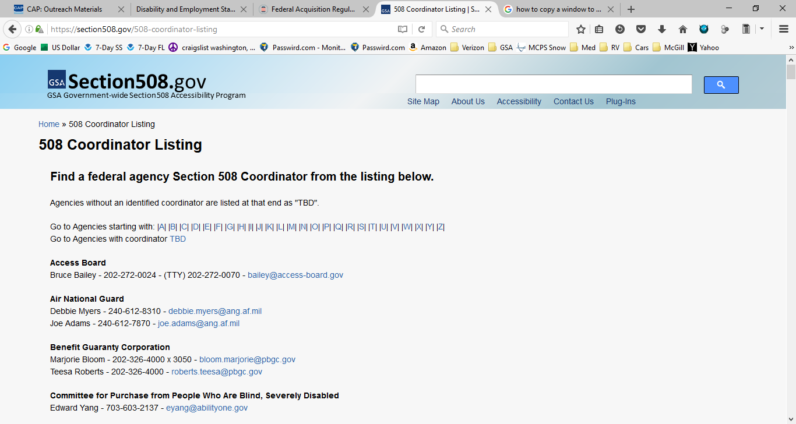
Accessibility Resources (www.508.gov)
https://section508.gov/508-coordinator-listing
61

Slide 40
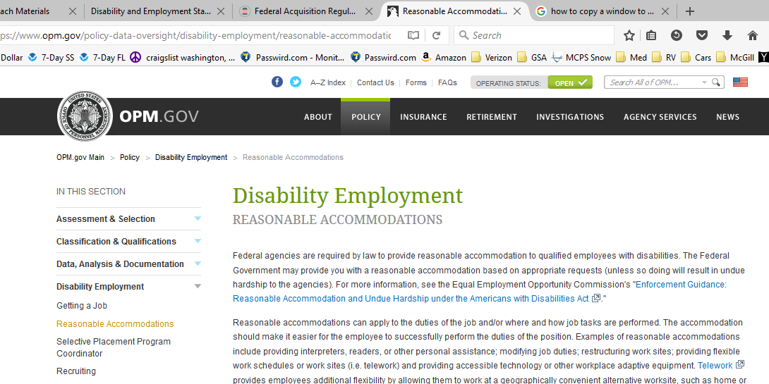
Accommodation Resources
https://www.opm.gov/policy-data-oversight/disability-employment/reasonable-accommodations/
62

Slide 41
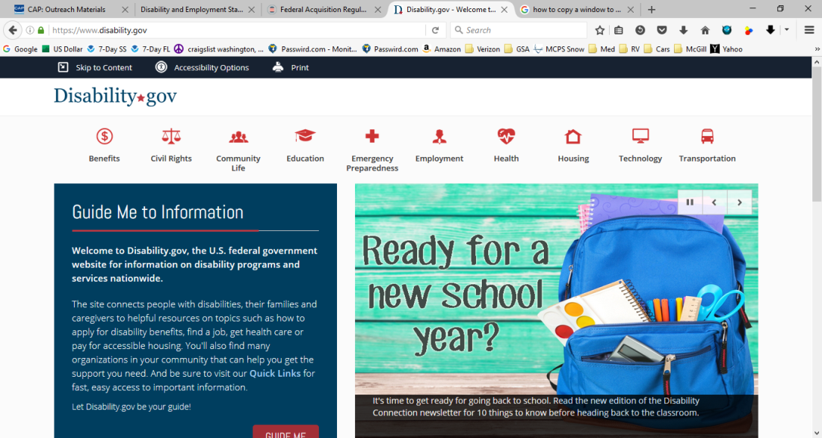
Accommoation Resources
https://www.disability.gov/
63

Slide 42
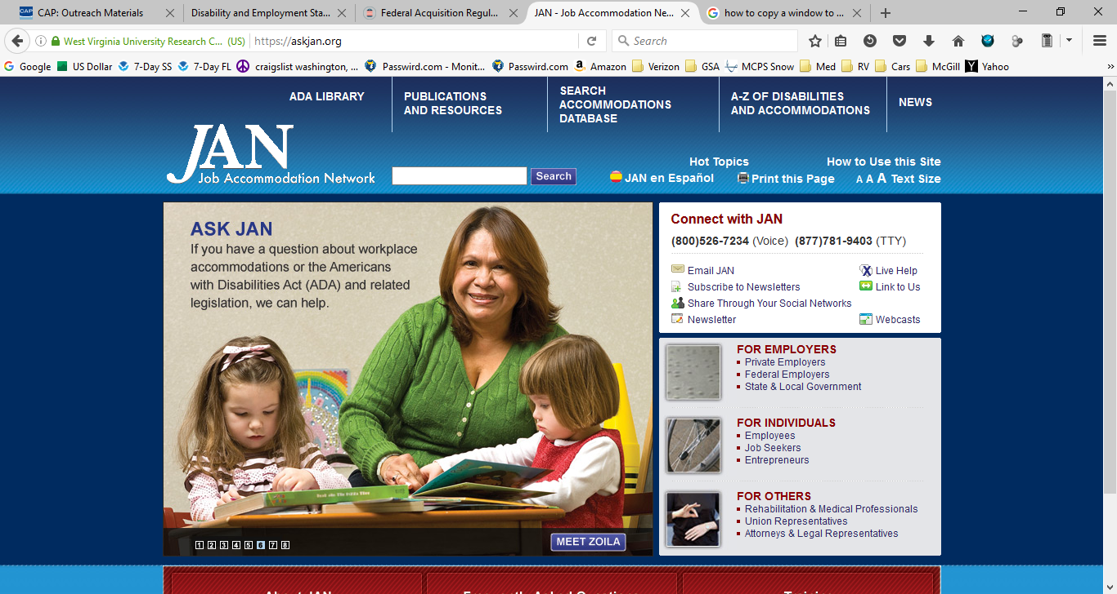
Accommodation Resources
https://askjan.org/
64

Slide 43
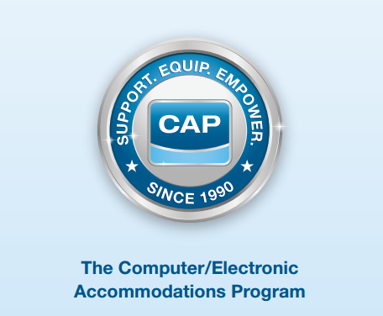
www.cap.mil
65

Slide 44
Computer/Electronic Accommodations Program
CAP was established in 1990 as the Department of Defense (DoD) centrally funded program to provide accommodations to DoD employees
Today, CAP provides assistive technology and support services to ensure federal employees with disabilities at 68 partnering organizations
66

Slide 45
CAP Services
Provide assistive technology and associated training
Conduct needs assessments and technology demonstrations
Provide training on disability program management and creating an accessible environment
Support the compliance of federal laws, regulations, and Executive Orders
67

Slide 46
QUESTIONS? alex.koudry@gsa.gov

