Slide 1



Welcome to the FGDLA
Federal Government Distance Learning Association
2023 Annual Awards
Virtual Ceremony
Celebrating the Association’s 27th anniversary
recognizing excellence in distance learning

Slide 2
Welcome to the FGDLA
Federal Government Distance Learning Association
Please accept the award. Take yourself off mute by clicking on the microphone icon on the lower left side of the Zoom page.
Take photos and videos of awardees during their presentation and send to ejacobs@fgdla.us.

Slide 3

FGDLA 2023
Awards Ceremony
Organizational Awards

Slide 4

FGDLA 2023
Awards Ceremony
Innovation Award
Notes:
The innovation award is in recognition of an organization for demonstrating excellence in the innovative use of technology in the development and delivery of distance learning in the Federal Government

Slide 5


Innovation Award Winner
Virtual Reality Development Team
Distance Learning Branch
Training Services Support Division
Federal Aviation Administration
Nabil Soulane, Ryan Mounts, Jeremy Reid, and David Garza
Notes:
The Distance Learning Branch’s Virtual Reality Development Team successfully converted a lesson from the instructor-led course on the use of the Mobile Video Surveillance System of Customs and Border Protection into a fully immersive experience. Their expertise, dedication, and visionary thinking have redefined how the FAA approaches training and showcases how an immersive learning environment can further engage our students through innovative, immersive, and richer user experiences.
The impact of this achievement extends beyond the confines of this project. The transformation of traditional instructor-led training into a fully immersive experience advances the FAA’s training delivery capabilities. It sets a new precedent for how we approach training within the FAA. This achievement showcases the potential of immersive technology to revolutionize how we engage with content and enhance the learning outcomes for our students.
Throughout this project, the entire Virtual Reality Development Team demonstrated exceptional teamwork and dedication, consistently pushing the boundaries of what is possible. Their ability to collaborate seamlessly and leverage each team member's strengths resulted in a seamless execution that surpassed our expectations. From conceptualization to implementation, their passion for innovation and meticulous attention to detail shone through, resulting in a proof of concept that is a testament to their exceptional abilities.
Furthermore, this initiative has garnered higher visibility and recognition within and beyond our organization. The success of this project has ignited a wave of enthusiasm and interest among stakeholders and peers continue to grow as the team explores new avenues to expand and enhance immersive training initiatives. This unwavering commitment to excellence, innovation, and collaborative effort deserves this recognition.

Slide 6

FGDLA 2023
Awards Ceremony
Five-Star Award
Notes:
The five-star award is in recognition of an organization for demonstrating excellence in providing enterprise-wide distance learning solutions for the Federal Government

Slide 7


Five-Star Award Winner
Air University
Global College of Professional Military Education
Notes:
Global College of Professional Military Education (GCPME), housed at Air University on Maxwell Air Force Base, virtually offers seven programs to 36,000 officer, enlisted, and government civilian equivalent students geographically located around the world. The programs include: Air War College (AWC), Air Command and Staff College (ACSC), Online Masters in Military Arts and Science Squadron Officer School (SOS), Senior Non-Commissioned Officer Academy (SNCOA), Non-Commissioned Officer Academic (NCOA) and Airmen Leadership School (ALS).
In addition, GCPME demonstrates leadership and best practices in the development and application of proven distance learning technologies by innovatively and effectively incorporating adult learning principles, instructional design, and educational technology. Professors who are subject-matter-experts work on teams with experts in design and development and adult learning principles and institutional effectiveness to create online curriculum that meets all the required needs of the Dept of Defense and is created in an engaging way that also meets best practices and assesses course and program outcomes. This incorporates self learning, peer-to-peer learning, and instructor to peer learning through reading, writing, discussing, and assessing. Part of how we meet best online practices includes incorporating various technology tools such as the Canvas LMS, Zoom, Microsoft Teams, Yellow Dig, Perusall, and various dashboards.
The GCPME uses Zoom or Microsoft Teams to host supplementary synchronous sessions, team meetings or webinars to meet best practices of incorporating visual and auditory teaching. The GCPME also hosts distinguished visitors (generals and senior executive service individuals or retired high level individuals) who offer to speak to our faculty and students who are located all around the world. The GCPME also has custom-made dashboards set up for faculty and leadership, so we may access various types of data to assess how students or instructors are performing and how they feel about our courses or to answer high level individuals questions or reports with data to support. The majority of the U.S. Air Force airmen earn their professional military education through Global College of Professional Military Education.

Slide 8
FGDLA 2023
Awards Ceremony
Individual Awards

Slide 9

FGDLA 2023
Awards Ceremony
Pioneer Award
Notes:
The pioneer award is in recognition of an individual for demonstrating initiative and leadership in the development and implementation of distance learning in the Federal Government

Slide 10
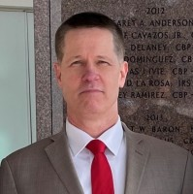
Pioneer Award Winner
Scott Tanchak
Special Agent in Charge
Office of Investigation, Office of Inspector General
U.S. Department of Housing and Urban Development
Notes:
Special Agent in Charge Scott Tanchak was assigned to the newly created Headquarters Unit of Policy, Strategy, and Training Division in August 2022 following a reorganization. SAC Tanchak was asked to lead the Division and increase and enhance the quality, credibility, and volume of training available to the 185 special agents and investigative staff. With a limited background in training, SAC Tanchak jumped in quickly and developed a strategy for delivering three major training components—all to be delivered in a virtual environment.
Special Agent in Charge Tanchak worked to develop the Leadership Development Strategy, which focused on building a succession planning and leadership training platform for all members of the organization. This included a supervisory training program with five live, virtual sessions that are now available on-demand, along with job aids to support new supervisors and conforms to the requirements of new supervisor training mandated by the Office of Personnel Management.
Working with a supervisory management Special Agent in Charge Tanchak’s leadership and support of the program has enabled it to become a stalwart of the organization’s leadership development initiatives supporting a virtual learning environment.
For this work, Special Agent in Charge Tanchak has become a pioneer in bringing a new method of distance learning to the organization.
On behalf of the membership and Board of Directors of the FGDLA, congratulations on being presented with the Pioneer Award

Slide 11

Pioneer Award Winner
Konstance N. Crownover
Instructional Systems Specialist
Training Services Support Division, Training and Evaluation Branch
FAA Academy
Notes:
Konstance developed a workflow, script, and ultimately microlearning videos used by the training staff to supplement the Train-the-Trainer courses at the FAA Academy. In only a few short weeks while juggling her training schedule and other course revision and development tasks, she led a small team of three and was able to successfully develop prototypes to present to management.
A few months later, Konstance volunteered to work on another microlearning video project focused on how to manage a difficult student. This five-minute video served a dual purpose as a just-in-time refresher for seasoned instructors, and it would also be incorporated into three train-the-trainer courses for newly hired instructors seeking their FAA Academy teaching certification.
All the videos are staged on a SharePoint site and are just one of the new technologies used to help transform the FAA into a predominant global learning institute.
On behalf of the membership and Board of Directors of the FGDLA, congratulations on being presented with the Pioneer Award

Slide 12

Carl P. Watts. Ph.D.
Air University
Pioneer Award Winner
Carl P. Watts, Ph.D.
Assistance Professor of National Security Studies
Global College of Professional Military Education
Air University
Notes:
Dr. Watts spearheaded the introduction of a social learning model in the Air Command and Staff College (ACSC) certificate program and accredited Online Master’s Program (OLMP) at the United States Air Force’s Global College of Professional Military Education. Approximately 3100 military officers and civilian equivalents complete these two programs each year. He synchronized best practices using ZOOM for structured seminars, Yellowdig for group discussion, and Perusall for collaborative reading assignments. These methods have greatly enhanced opportunities for student engagement and peer-to-peer learning, which are hallmarks of effective distance education. In total, his efforts led to the enhancement of three 135 student-hour master’s degree courses and two certificate level courses with these revolutionary tools.
Dr. Watts has demonstrated considerable initiative and leadership in the development and implementation of best practices and higher standards in distance learning. His distinctive accomplishments reflect great credit upon himself, the Global College of Professional Military Education, the United States Air Force, and the Department of Defense.

Slide 13
Pioneer Award Winner
Robert Wright
Development Technical Lead
Distance Learning Branch
FAA Academy
Notes:
Robert's outstanding effort and expertise in developing the FAA Academy's Student Services iOS app will significantly enhance our students' experience and engagement while advancing the Academy's technological capabilities. This app will be the first FAA in-house developed, externally available iOS app.
The new mobile application consolidates all essential resources into one platform, making it easy for FAA Academy students to access information on housing options and shuttle transportation routes. The app also gives Academy students access to information on essential services at the MMAC, including food, medical, banking, security, and childcare. This consolidation will greatly simplify students’ life and ensure a smoother experience in their learning journey.
On behalf of the membership and Board of Directors of the FGDLA, congratulations on being presented with the Pioneer Award.

Slide 14


FGDLA 2023
Awards Ceremony
Hall of Fame Award
Notes:
The Hall of Fame Award is in recognition of an individual who has made significant contributions in promoting and developing distance learning supporting the Federal Government

Slide 15
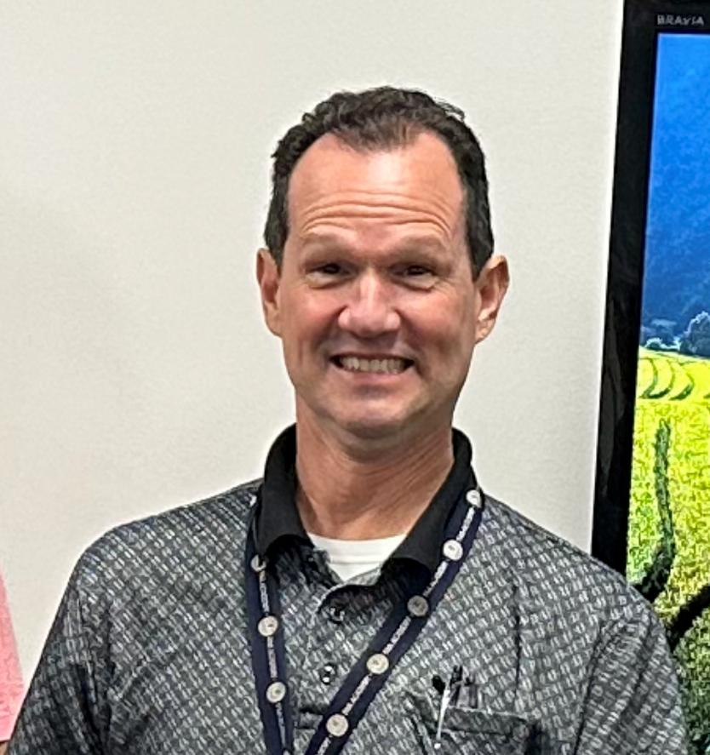
Hall of Fame Award Winner
Tony Decicco
Distance Learning Branch
FAA Academy
Notes:
Tony's unwavering dedication and effective management of this pivotal initiative have been instrumental in advancing training and professional development within the Federal Aviation Ad-ministration (FAA) over the past 15 years. His comprehensive oversight and technical expertise have significantly impacted the program's success and positive impact.
The Distance Learning Program (DLP) is a cornerstone of the FAA's training and developmental efforts, spanning 900 learning centers nationwide. Tony's journey with the DLP team began in April 1996, and his leadership culminated in him assuming the role of Program Manager in 2008. Tony's position speaks to his exceptional abilities and unwavering dedication. His responsibilities encompass a spectrum of tasks, including financial management, technical supervision, security compliance, collaboration with diverse agency stakeholders, and addressing troubleshooting challenges.
On behalf of the membership and Board of Directors of the FGDLA, congratulations on your induction into the FGDLA Hall of Fame

Slide 16

FGDLA 2023
Awards Ceremony
Welcome to the FGDLA
Federal Government Distance Learning Association
Special Recognition Award
Notes:
In recognition for outstanding service or significant contribution to the Association by an individual not affiliated with the Federal Government.

Slide 17



: In recognition for outstanding service or significant contribution to the Association by an individual not affiliated with the Federal Government.
John Defonzo
US Federal Government Market Director
Moodle
Dr. Lance Ford,
Education Advocate
Zoom
In recognition for outstanding service or significant contribution to the Association by an individual not affiliated with the Federal Government.
John Defonzo
US Federal Government Market Director
Moodle
Special Recognition Award Winner
John Defonzo
U.S. Federal Government Market Director
Notes:
John is Moodle US's Federal Lead and has been working within the Moodle community for nearly 8 years and in educational technology for over 15 years. As an open-source LMS platform, Moodle has been experiencing rapid adoption throughout the US Federal / DOD markets, including the US Army, US Air Force (ATO), US Coast Guard, FEMA, Department of Homeland Security, USMC, and Veterans Affairs. Moodle US has significant experience implementing Moodle or Moodle Workplace as a key component in a learning services ecosystem for federal and DoD clients, as envisioned in ADL's total learning architecture (TLA) project.

Slide 18


Special Recognition Award Winner
Dr. Lance Ford
Education Advocate
Notes:
Dr. Lance Ford is an educational advocate for Zoom. Lance has been a speaker for both state and national conferences on technology integration. He has presented for the Oklahoma Technology Association Conference, Missouri Distance Learning Association, Arkansas Distance Learning Association, Texas Distance Learning Association, EduComm, and US Secretary of Education’s Virtual School House.
Lance has been named Wal-Mart regional teacher of the year, Oklahoma Technology Administrator’s Technology Director of the Year, and the recipient of the Polaris Award for Excellence in Teaching. In 2007 Lance was recognized as an Apple Distinguished Educator, was awarded the 2008 Long Term Service Award from the Oklahoma Distance Learning Association, and received the Technology Facilitator of the Year award from the National Association for Educational Communications and Technology. Additionally, Lance received the Gold Leadership Award from the United States Distance Learning Association.
Lance is the past-president of the Oklahoma Distance Learning Association, and is a member of ASCD and ISTE. For two years, he served as an adjunct faculty member at the University of Maine, Farmington where he taught a graduate course in technology integration for teachers. He currently teaches as an adjunct online processor for Carl Albert College. Additionally, Lance conducts hundreds of educational demonstrations to and for the US Federal Government. At Zoom, he is directly responsible for new feature development in the Education and Training Communities.

Slide 19



FGDLA 2023
Awards Ceremony
Congratulations Award Winners!

